Slide 1
Listening – Portus project
https://www.youtube.com/watch?v=AIrQBu8bnOc – the project
What was the function of Portus?
What were the main roles of the port and when was the port in use?
What are the most exciting finds in Portus?
How was the oval building interpreted?
What are other disciplines used to understand the site?

Slide 2
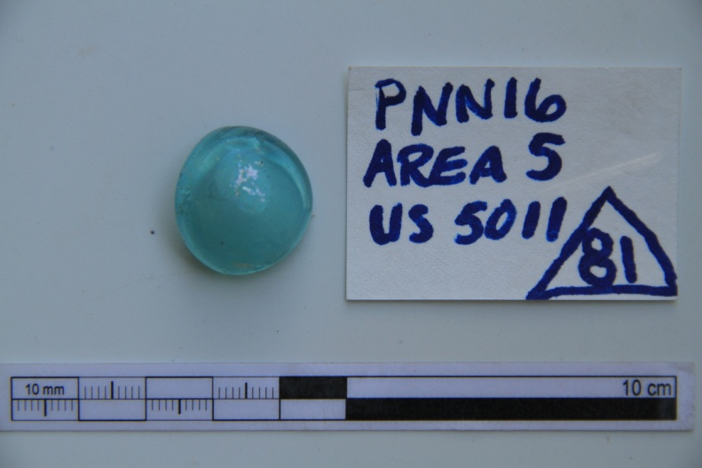
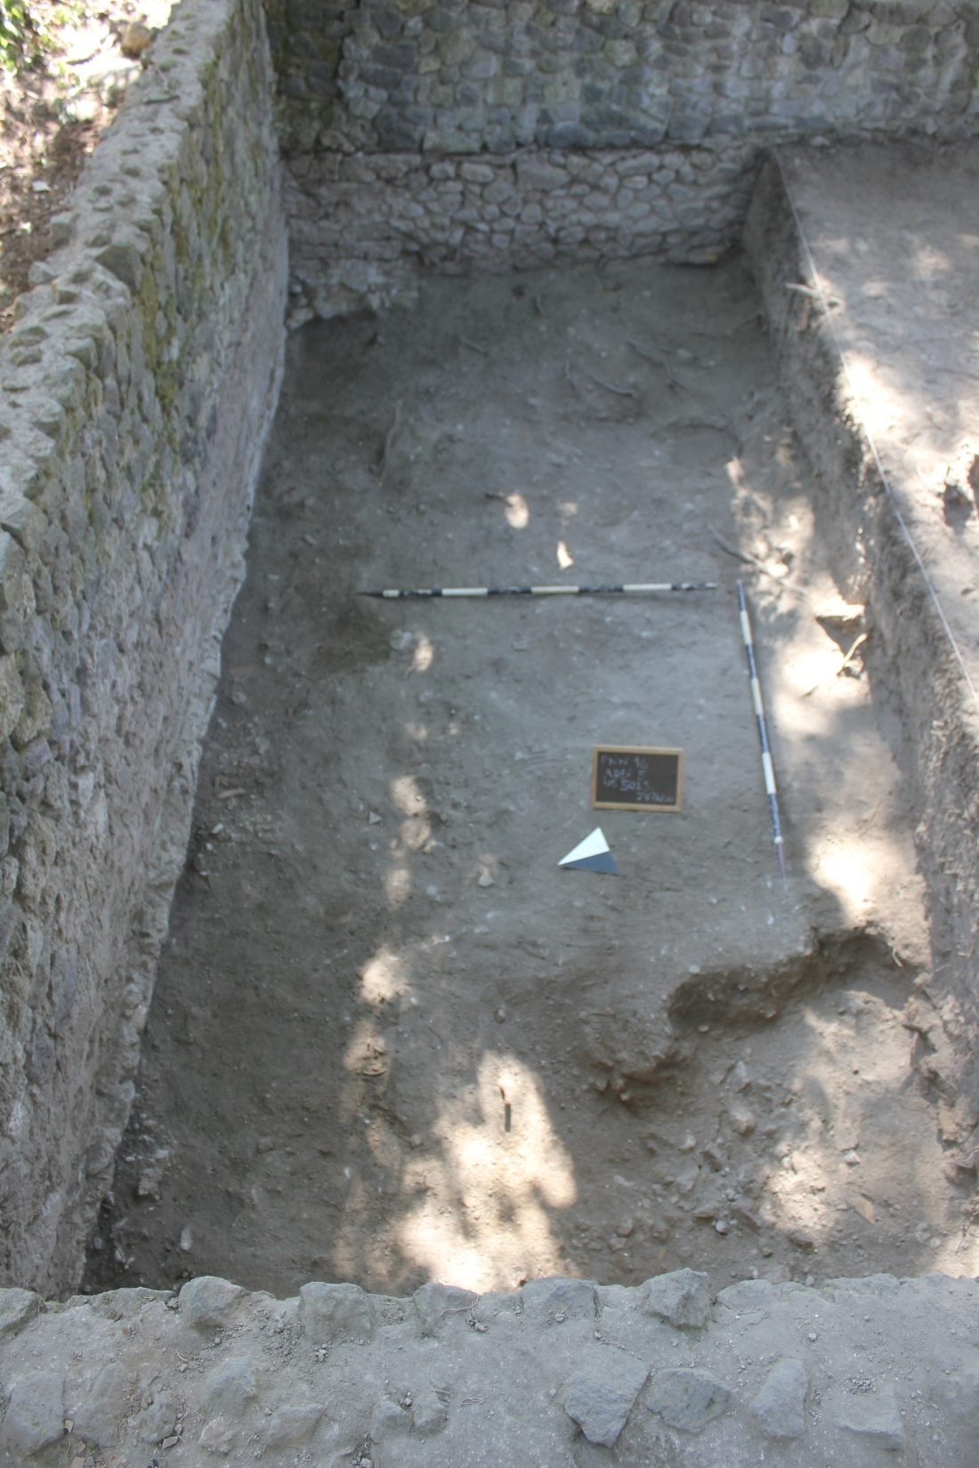
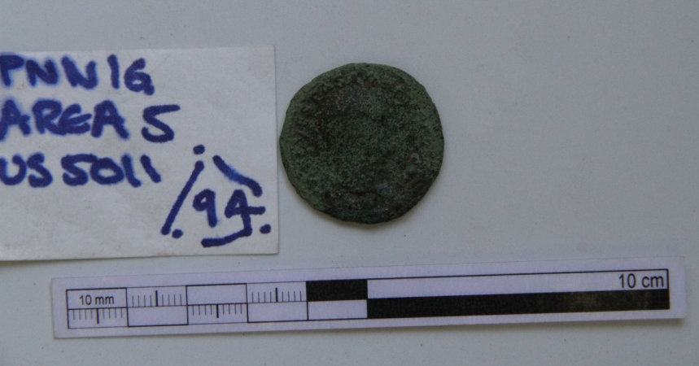
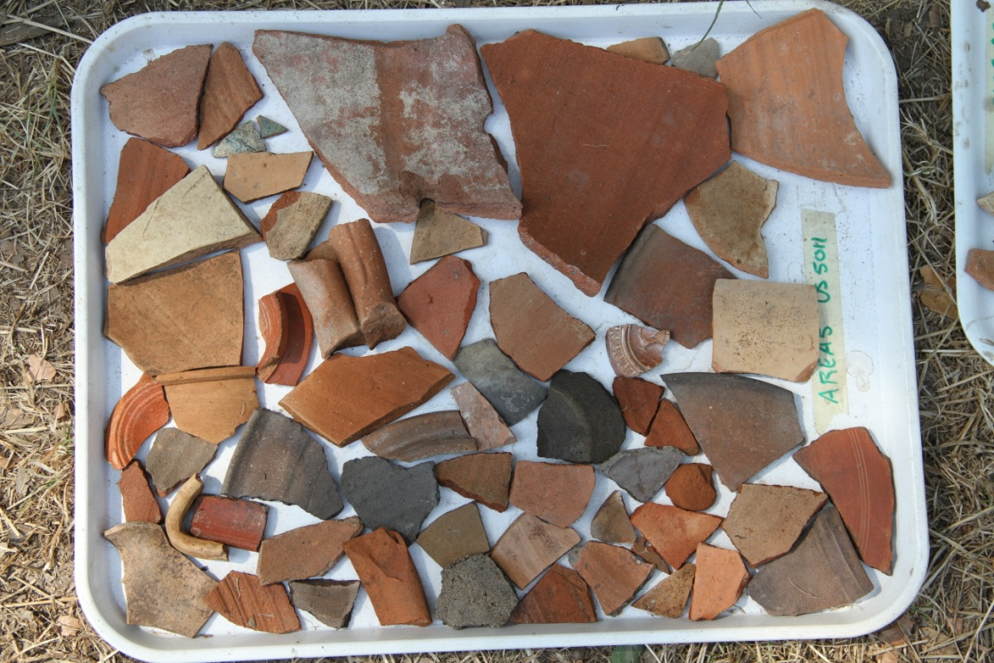

Slide 3
Example of a basic context sheet

