Slide 1

Čínská etiketa a společnost
Čínská etiketa a společnost
Mgr. Bc. Jan Hebnar MBA

Slide 2
Hlavní filosofické směry
  Čína vždy byla ateistická společnost.
  Bežný Číňan není věřící.
  Společnost a chování lidí nejvíce ovlivňují 3 filosofické směry:
    Daoism
    Legalism
    Confucianism
Notes:
POZN: Pokud někdy vidíte Číňana v kostele má to asi tak, jako moje babička, která chodila do kostela, že jí stál v cestě do obchodu.

Slide 3
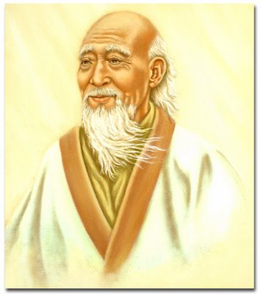
Taoismus
Taoismus – život v harmonii s Tao.
Tao - zdroj a hybatel všeho (odosobněný bůh, příroda, vesmír, osud).
Jakákoli lidská aktivita je vůči Tao zbytečná – být a nechat být.
Stability a harmonie je možno dosáhnout jen dosažením souladu s vesmírem (přirodou).
Co to znamená pro dnešek?
Notes:
POZN: China – everything is possible, nothing is easy.

Slide 4
Legalismus
Je politická filosofie (ne filosofie o smyslu bytí).
Vrchol za císaře Qin.
Nejdůležitější koncept je fa – právo:
  Vláda právem, nikoli vláda práva
  Právo jako systém kontroly a represe
  Právo odměňuje ty, kteří se podrobují, trestá ty, kteří se mu protiví
Co to znamená pro dnešek?
Notes:
POZN: Kojenecká voda kalibra – neexistence vyžadovaného nařízení.

Slide 5
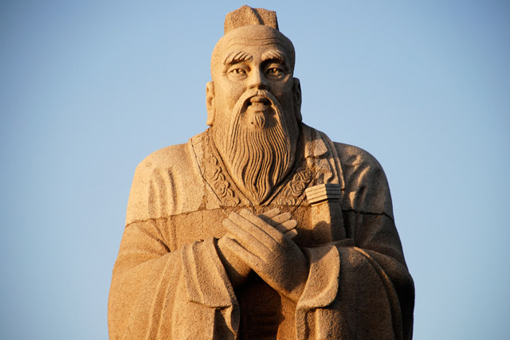
Konfucianismus
Kdo byl Konfucius?
Dvě hlavní témata Konfuciova učení:
  Hierarchické vztahy (4)
  Vzdělání a poučení z minulosti (kopírování?)
Co to znamená pro dnešek?
Jak to bylo a je s Konfuciem?
Notes:
Importance of two things:
Education - studying deeds of moral persons of past (past – i.e. golden era of Zhou state - was BETTER then now so that we should study it and learn from it)
Relationships - since responsibilities in society were clear and tis led to stable society
Emphasize importance of four relationships:
ruler and minister,
father and son,
elder brother and younger brother,
and husband and wife.
Superiors in relationships should behave toward those they governed the way that fathers should behave toward their children.
Still essential values of todays Chinese society!

Slide 6
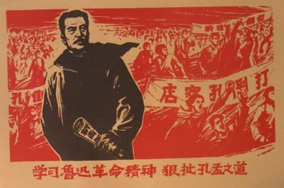

Slide 7
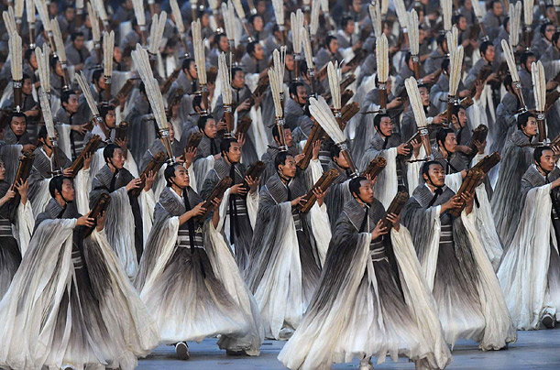
Notes:
Why is Confucius back in favor?
It fits in with a general tendency by the current regime to emphasize continuity with the past.
Good fit between the emphasis that he and his followers have always placed on social harmony, and the focus that Hu and other current Chinese leaders have placed on stability (Mao – progres is made via conflict and struggle – this ideology is now rejected).

Slide 8
Základní vzorce chování, kterými se řídí čínská společnost
Vztahy (guangxi)
Tvář (Mianzi)
Prostředníci
Hierarchie a sociální status
Vztah k cizincům
Svědomím vs trest
Relativní pravda

Slide 9

Guangxi 1

Slide 10
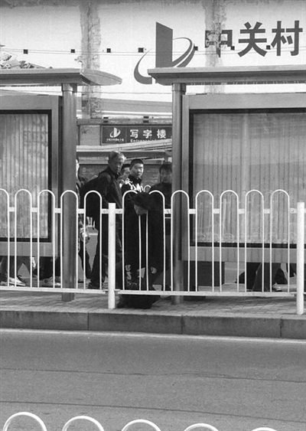

Slide 11


Slide 12
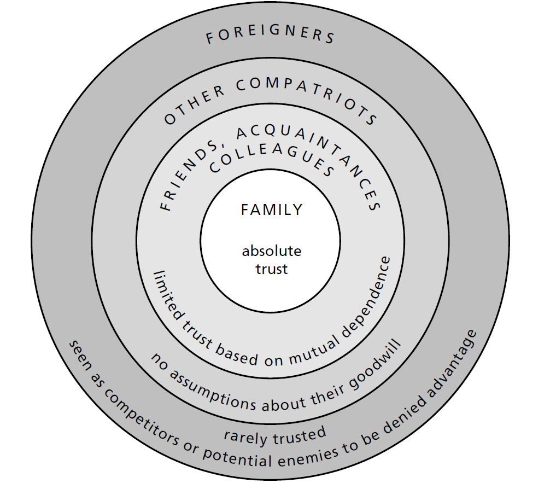
Guangxi 2(společnosti s nízkou důvěrou)
Notes:
1. The Chinese dislike doing business with strangers; it's helpful to be introduced properly by an intermediary known to both sides.
2. Alternatively, if you make an independent initial approach, you should provide as much information as possible about your company and what you hope to accomplish.
3. Business Relationships are institutional in nature and are not necessarily predicated on close personal ties. It's always a good idea to cultivate personal friends in the bureaucracy, however.

Slide 13
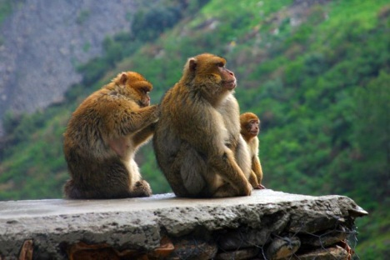
Guanxi 3
Jak získat Guanxi:
  Spřátelit se.
  Přiženit se.
  Studovat.
  Stát se členem „klubu“.
  Něco za něco mechanismus – lepidlo společnosti.
Konzultanti vám je (snad) prodají.
Notes:
Guanxi (connections) is a tit-for-tat arrangement between people or work units that makes the Chinese system go. It offers you access to goods and services otherwise difficult to acquire. The currency of guanxi is normally favors, not cash. Chinese generally expect foreigners to understand guanxi and behave according to its rules.
The balance sheet between two individuals or units is expected to remain in rough balance over a period of time. Beware of unsolicited favors, as they usually have a price. Try not to put a Chinese in the position of being unable to return a favor, and don't accept presents or favors unless you are prepared to reciprocate.
Local and foreign companies spend heavily to establish and maintain relationships with influential people. The payoff may be personal or organizational.
At its heart, guanxi is a tit-for-tat relationship between two people. Chinese naturally turn to their relationship networks for help, so they work hard to cultivate friends in high or strategic places. If a Chinese finds him- or herself without guanxi, the first order of business is to establish some.
One reason for the pervasiveness of the guanxi system on the mainland is the relative lack of a reliable legal system. But it is also important in areas outside China, where the legal system is more developed.
Good guanxi is a renewable resource and can be reestablished even after much time has passed. But it may also be an exhaustible resource if the ledger between two people does not remain in approximate balance.
Guanxi is well within the grasp of foreigners who wish to cultivate it. Often all it takes is an overture—a conversation, a meal, or a favor. Foreigners who live and work in China may become integrated into relationship networks, where they are expected to play by Chinese rules. Nonetheless, they are within their rights to draw their own lines as to what they are and are not prepared to deliver.
The Chinese assume the rest of the world works along a similar set of principles, and they sometimes view foreign friends as windows to benefits in the world outside China. They also often do not distinguish clearly between the world of the personal and the world of the organizational, which means that a personal friend may well ask for an organizational favor.
Chinese generally feel freer to ask for favors earlier in a relationship than Westerners do. Unlike foreigners, who may feel quite put upon when asked for favors —especially personal favors that involve the use of organizational resources—Chinese are often very eager to be of service if they have it in their power to assist. In recent years guanxi has even become a commodity for sale.
Chinese prefer to do business with, and even to hire, those with whom they have guanxi, as contrasted to an aversion to doing this among Westerners. They believe it diminishes the danger of problems, and makes solving them much easier when they do arise.

Slide 14

Mianzi (Tvář)
Tvář – našimi pojmy respekt, sociální postavení, úcta, prestiž….
Zdroje mianzi, poukázáním se Mianzi „dává“:
  Bohatství
  Inteligence
  Atraktivita
  Schopnosti
  Pracovní pozice
  Dobré guangxi
Může být ale i „vzata“ (jak?)
Notes:
Face, or mianzi—the regard in which one is held by others or the light in which one appears —is vitally important to the Chinese. Causing someone to lose face, through a public insult or dressing-down, or by failing to treat him or her with respect, results in a loss of cooperation and often in retaliation. If you do so you will also lose the respect of others aware of your transgression.
In China, face cannot only be lost and saved, it can also be given. Doing something to enhance someone's reputation or prestige, such as lauding a worker to his or her superior, is an example. Such actions carry a great deal of weight among Chinese when they come from foreigners.
Although it is an abstract concept, mianzi (face) is deadly serious business to the Chinese. Mianzi, money, and power are the three key motivators in China today.
A public insult, chastisement, or similar affront to personal dignity results in a loss of face. But in simply contradicting someone in front of another, or declining an invitation on a weak pretext, face may also be lost. Even the simple act of saying no to a request can be an assault on mianzi, which is why Chinese often label things “inconvenient” or “difficult” rather than rejecting them out of hand.
Losing control of yourself in any way—whether anger, grief, angst, or any other emotion gets the better of you—always constitutes serious damage to mianzi. This includes drinking alcohol to the point of losing self-control.
Rescinding an order can also be construed as a loss of face, which is why Chinese leaders may cling adamantly to policies, even when subsequent events prove them irrelevant or misguided. For a leader to change his or her mind is to appear to succumb to pressure or to admit error, both of which involve losing face.
Losing face is justification for retaliation. The price exacted may be as low as an apology or as high as a corresponding loss of face on the other side.
Organizations have face, too. Ministries, corporations, and bureaus all have reputations to worry about; so do entire countries. Jingoism in China today is strong enough to color the Chinese view of nearly any situation involving foreigners, whether justified or not, and assaults on face may be detected where they are not intended.
Chinese spend far more time thinking about face, and see its relevance in far more situations, than foreigners do. Chinese can be counted on to view their human interactions through the lens of face; each and every one represents an opportunity to give, receive, save, or lose mianzi.
Things that make others look up to you, or be envious of you, also confer face on you. Things that build the ego give face. Doing a favor for a stranger who is introduced to you by a close friend confers mianzi on the introducer. Praising someone to his or her boss is also face-enhancing.
Face is so important that it is justification for spending money even if a Chinese has little of it. Money that might be set aside for a rainy day or spent on something functional may instead be used to purchase designer clothing and accessories, or to entertain at expensive restaurants.
Chinese never forget or forgive.

Slide 15
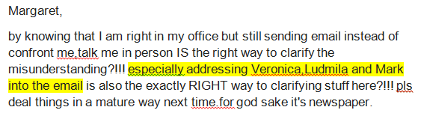
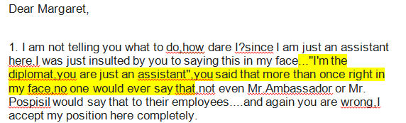
Margaret and Jenny

Slide 16

Prostředník
Dvojí význam prostředníků:
  1) Presumpce nedůvěry (vs. USA, EU).
    Číňané se neradi setkávají s někým, koho neznají.
    Důvěra musí být „transferována“ přes guangxi.
  2) Řadu věci nejde sdělit přímo (tvář).
  S prostředníkem se jedná příměji, než s partnerem (zvláště u cizinců, zvlášť špatné zprávy).
Notes:
Guanxi (connections) is a tit-for-tat arrangement between people or work units that makes the Chinese system go. It offers you access to goods and services otherwise difficult to acquire. The currency of guanxi is normally favors, not cash. Chinese generally expect foreigners to understand guanxi and behave according to its rules.
The balance sheet between two individuals or units is expected to remain in rough balance over a period of time. Beware of unsolicited favors, as they usually have a price. Try not to put a Chinese in the position of being unable to return a favor, and don't accept presents or favors unless you are prepared to reciprocate.
Local and foreign companies spend heavily to establish and maintain relationships with influential people. The payoff may be personal or organizational.
At its heart, guanxi is a tit-for-tat relationship between two people. Chinese naturally turn to their relationship networks for help, so they work hard to cultivate friends in high or strategic places. If a Chinese finds him- or herself without guanxi, the first order of business is to establish some.
One reason for the pervasiveness of the guanxi system on the mainland is the relative lack of a reliable legal system. But it is also important in areas outside China, where the legal system is more developed.
Good guanxi is a renewable resource and can be reestablished even after much time has passed. But it may also be an exhaustible resource if the ledger between two people does not remain in approximate balance.
Guanxi is well within the grasp of foreigners who wish to cultivate it. Often all it takes is an overture—a conversation, a meal, or a favor. Foreigners who live and work in China may become integrated into relationship networks, where they are expected to play by Chinese rules. Nonetheless, they are within their rights to draw their own lines as to what they are and are not prepared to deliver.
The Chinese assume the rest of the world works along a similar set of principles, and they sometimes view foreign friends as windows to benefits in the world outside China. They also often do not distinguish clearly between the world of the personal and the world of the organizational, which means that a personal friend may well ask for an organizational favor.
Chinese generally feel freer to ask for favors earlier in a relationship than Westerners do. Unlike foreigners, who may feel quite put upon when asked for favors —especially personal favors that involve the use of organizational resources—Chinese are often very eager to be of service if they have it in their power to assist. In recent years guanxi has even become a commodity for sale.
Chinese prefer to do business with, and even to hire, those with whom they have guanxi, as contrasted to an aversion to doing this among Westerners. They believe it diminishes the danger of problems, and makes solving them much easier when they do arise.

Slide 17
Hierarchie a sociální status
Číňané vždy ví, kde je hierarchicky jejich místo ve společnosti.
V rámci rodiny, podniku, společnosti obecně.
Chtějí znát i hierarchické postavení cizinců, jinak jsou zmatení.
Důležité v obchodních jednáních (vizitky).
Čím výš postavený Číňan, tím méně se skutečně vyjednává.
Notes:
Maintaining surface harmony at all times is of paramount importance to Chinese people. Regardless of one's true feelings, one should never do anything to cause a moment of public unpleasantness or embarrassment.
The need to preserve surface harmony and face often causes the Chinese to use intermediaries to carry unpleasant news. There is no premium on confrontation.
Intermediaries play an important role in business, where they are used to float trial balloons and communicate bad news, and serve as back channels for information.
Relatives, friends, neighbors, classmates, and co-workers are all people to whom one bears some form of obligation. No obligation is felt to others outside of one's circle, which explains the paucity of philanthropy in China and the tendency on the part of the Chinese to show little respect for public property or commonly held property.
Chinese society—communist and otherwise—has always had its class distinctions. Respect and deference are due to those in superior positions. Foreigners, whether they seek it or not, tend to be accorded fairly high status.
Maintain harmony or you might be harmonized ☺.

Slide 18
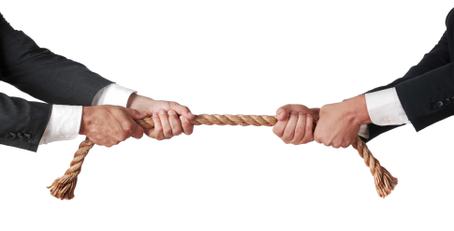
Vztahy k cizincům
Vztah k cizincům je někde mezi…
obdivem
odporem
Notes:
POZN: (Bílí) cizinci mají a priory vysoký společenský status.

Slide 19
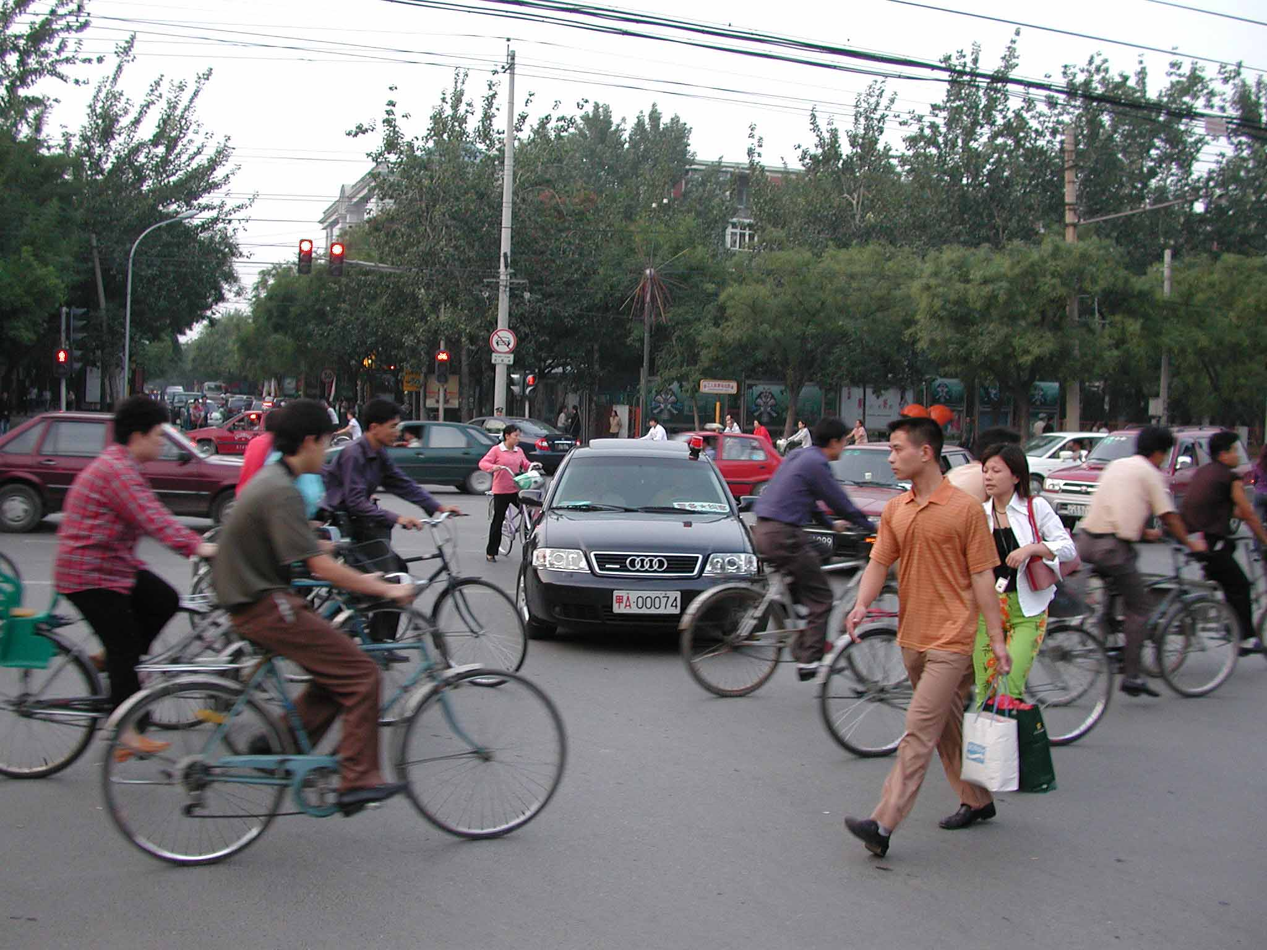
Svědomím vs trest
Notes:
V euro-americké společnosti jednání společnosti koriguje svědomí jednotlivců (křesťanský vliv).
Číňané nemají morální imperativy.
Společnost je korigována trestem a „osočením“.
POZN: Podvádění ve třídě MBA, osočení kolektivem.

Slide 20
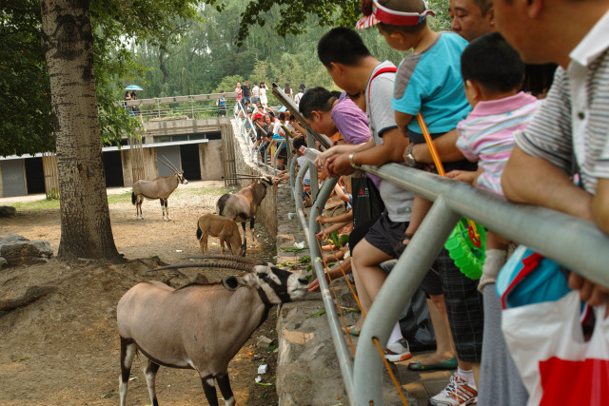
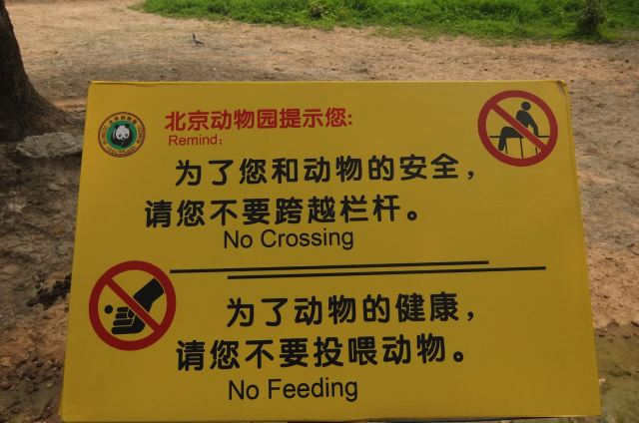

Slide 21
Relativní pravda
Pravda vs. jiný zájem v ČR
Pravda vs. jiný zájem v Číně

Slide 22
Úkol
Jste manažer v z zahraniční společnosti KBR l.t.d., registrované v Šanghaji. Jeden z Vašich podřízených, pan Wang, dlouhodobě:
  Chodí pozdě do práce
  Neplní pracovní úkoly v očekáváné kvalitě
  Snaží se nad ostatními kolegy vyvyšovat a uplatňovat (domnělou) autoritu
Uvažujete o tom, že pana Wanga na pozici prodejce nahradíte, ale obáváte se, že bez jeho konexí a kontaktů vám výrazně klesnou prodeje, alespoň v krátkodobém horizontu.
Připravte krátký email, který může být použit jako napomenutí (varování před výpovědí), ale současně je citlivý k tváři pana Wanga.

