Slide 1
Jak nalézt vhodného dodavatele
Mgr. Bc. Jan Hebnar, MBA

Slide 2
Má smysl importovat z Číny?
Pozor na skryté náklady:
Doprava
Prověření dodavatele
Návštěva techniků
Mezinárodní smlouva
Akreditiv
Náklady zásob
Náklady z odpovědnosti za vady
Fixní režijní náklady
A rizika (měnové, politické, podvod)
Notes:
I have no doubt that higher labor costs in China, coupled with more expensive freight, will drive reshoring. Not right now, but probably in a few years.
The truth is, many American and European companies would do better if they produced much closer to their market.
The authors of Lean Thinking propose to apply the following mathematical formula to determine the exact price of products made in Asia and sold in developed countries:
- Start with the piece part cost of making your product near your current customers in high-wage countries – that is: the US, Western Europe, Japan. Compare this number with the piece part cost of making the same item at the global point of lowest factor cost (probably dominated by wage cost). The low factor cost location will almost always have a much lower piece part cost.
- Add the cost of slow fright, to get the product to your customer.
You’ve now done all the math that purchasing departments seem to perform. Let’s call this “mass production math”. To get to “lean math”, you need to add additional costs to piece part + slow fright cost, in order to make the calculations more realistic.
- First, add the overhead costs allocated to production in the high-wage location — costs which usually don’t disappear when production is transferred. Instead, they are re-allocated to remaining products, raising their apparent cost.
- Then add the cost of the additional inventory of goods in transit over long distances, from the low-wage location to your customer. Then, add the cost of additional safety stocks, to ensure uninterrupted supply.
- Next, add the cost of expensive expedited shipments. You need to be careful here, because the plan for the product in question typically assumes that there aren’t any expediting costs, when a bit of casual empiricism will show that there almost always are.
- Then add the cost of warranty claims, if the new supplier has a long learning curve.
- Next, add the cost of engineer visits, or of a resident engineer at the supplier, to get the process right so the product is made at the correct specification with acceptable quality.
- Then add the cost of senior executive visits, to set up the operation, or to straighten up relationships with managers and suppliers operating in a very different business environment. Note that this may include all manner of payments and considerations, depending on local business practices.
- Then add the costs of out-of-stocks and lost sales, caused by the long lead times to obtain the correct specifications of the product, if demand changes.
- Now add the cost of remainder goods, or of scrapped stocks, ordered to a long range forecast and never actually needed.
- Then add the potential cost, if you are using a contract manufacturer in the low-cost location, of your supplier quickly becoming your competitor.
This is becoming quite a list! And note that these additional costs are hardly ever visible to the senior executives and purchasing managers who relocate production of an item to a low-wage location based solely on piece part price + slow freight.
However, “lean math” requires adding three more costs to be complete.
- First, currency risks. These can strike quite suddenly when the currency of either the supplying or the receiving country shifts.
- Second, country risk. These can also emerge very suddenly when the shipping country encounters political instability or when there is a political reaction in the receiving country, as trade deficits and unemployment emerge as political issues.
- Third, connectivity costs. These are the many costs in managing product hand-offs and information flows in highly complex supply chains across long distances, in countries with different business practices.
This formula seems pretty well thought out.

Slide 3
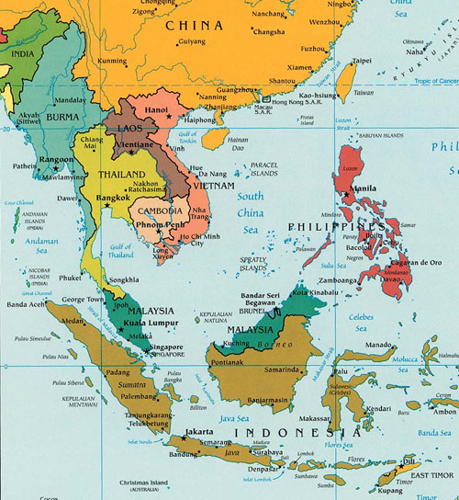
Alternativy?
Levnější – Vietnam, Bangladéš, Kambodža, Laos, Indonésie a Indie (a dokonce Severní Korea)
Dražší – HK, Evropa

Slide 4
Kdy se dovoz z Číny obecně vyplácí?
schopnost dosáhnout „ekonomie rozsahu“, nebo
vlastní brand, nebo
exklusivní importér.

Slide 5
Krok 9) Zařiďte dopravu
… ale jsou i malí čínští dopravci.

Slide 6
The process
Define the product
Find possible suppliers and narrow down
Request for quotation
Choose a few suppliers
Do the due dilligence
Sign a contract
Send the money (open L/C)
Arrange for transportation

Slide 7
Step 1) Define the product
Notes:
What kind of product do you really need?
Size and Dimension
Materials
Intended uses (If it is a new product/invention)
Order quantities (both initial order and intended annual orders)
Packaging requirements
Manufacturing technology requirements
Drawings, pictures, and blueprints- The more professional the designs you can provide, the more serious your supplier will take your product.
Without these details, a supplier could:
suspect you of not being the real buyer
provide you with an inaccurate or incomplete quote

Slide 8
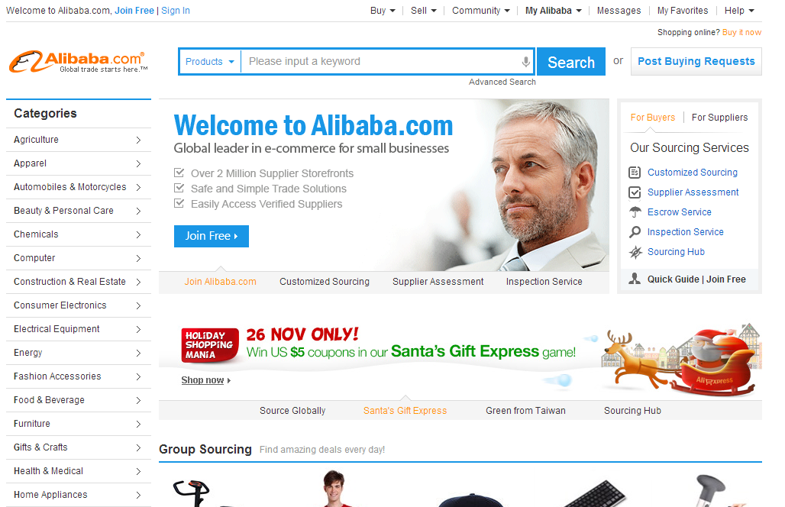
Step 2) Find possible suppliers
www.alibaba.com or
www.globalsources.com or
www.china.cn.
Notes:
www.alibaba.com (největší portál, obrovský výběr zboží, nejnižší ceny, ale také nejvíce podvodníků)
www.globalsources.com (relativně velký portál, rozumná nabídka zboží, většinou solidní výrobci)
www.china.cn (relativně malý portál, pod záštitou Ministerstva obchodu ČLR, většinou prověření dodavatelé, vyšší ceny)

Slide 9
Step 3) Request for quotation (RFQ)
Notes:
Dont accept the cheapest offer.
Make sure you state all the specifications in detail.

Slide 10
Step 4) Choose a few suppliers
Jak rychle reagují (max 3 dny)?
Angličtina?
Cena?
MOQ?
Výrobce/obchodník?

Slide 11
Step 5) Do the due dilligence
Notes:
registered business shipping account DHL?

Slide 12
Step 6) Sign a contract
Have a written contract,
Have that written contract be (preferably) in Chinese.
Have that written contract set out clearly how disputes are to be resolved and, even more importantly, pick the right forum for those disputes.
Have that written contract set out in excruciating detail what the Chinese company must do to be in compliance with the contract.
Set out the liquidated damages the Chinese company must pay if it fails to comply with the contract.
Make sure the Chinese company signs AND seals your contract.

Slide 13
Step 7) Send the money (open L/C)

Slide 14
Step 8) Arrange for transportation

