Slide 1
Use of Parallel Texts in Cultural-Cognitive Linguistic Research: Viewpoint in Translation
Wei-lun Lu (呂維倫)
Center for Chinese Studies
Masaryk University

Slide 2
Cognitive Linguistics
Cognitive linguistics: the study of natural language as a mental phenomenon.
How humans use language to create understanding.
How much universality and variation do we find cross-linguistically?
“No two languages are ever sufficiently similar to be considered as representing the same social reality” (Sapir 1929:162).

Slide 3
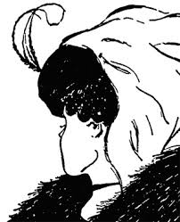
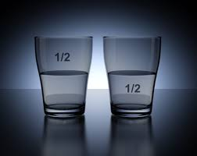
Understanding and Meaning
Various ways of understanding.
Meaning of the picture resides in the way we understand it.
Meaning of a situation resides in the way we verbalize it.

Slide 4
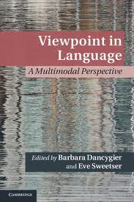
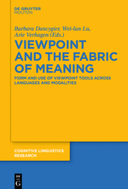
Viewpoint and Construal
The professors went to Brno for a conference.
The professors came to Brno for a conference.
How she [Alice] longed to get out of that dark hall!
How she [Alice] longed to get out of this dark hall!
Typical PoV markers:
Deictic verbs, demonstratives, tense...
Different linguistic manifestations, different construals.

Slide 5
What’s New?
Cognitive linguistics has taken advantage of various research methods.
Intuition-based.
Mono-lingual corpora.
Experimental (fMRI, EEG, eye-tracking).
No systematic use of parallel texts yet.
Rojo and Ibarretxe-Antuñano 2013; Muskat-Tabakowska 2014; Slobin 1996, 2003; Tabakowska 1993; Wu 2004.

Slide 6
What Are Parallel Texts?
Parallel texts as a collection of texts put alongside with their translations.
Benefit: Verbalization of highly similar (if not identical) social realities (Sapir 1929) or usage events (Langacker 1987).
Contextualized naturalistic data, with most variables controlled for.
Use of world masterpieces.
Translations in various languages
More than one version in a given language
Inter- and intra-language variation
Commercial translations are of high quality

Slide 7
Methodological Concern
What can use of parallel texts reveal that other methods cannot?
What does the finding tell us about how languages differ, in terms of “representing the same social reality”?

Slide 8
Case Studies
Simple TT: Deictic verbs across languages
Multiple TTs: Narrative schema across languages

Slide 9
COME in Mandarin:
Lai
qian-bian | huang-he | pai | zaizhong-kache |  | de | jiashi-yuan | cong
front-side | yellow-river | brand | big-rig-truck |  | DE | drive-man | from
jiashi-shi |  | li | tiao-xia-lai, |  | zhan | zai | lu-bian,
drive-room |  | in | jump-down-come |  | stand | LOC | road-side
naonu | de | kan-zhe | ta…
angry | DE | look-IMP | her
前边黄河牌载重卡车的驾驶员从驾驶室里跳下来，站在路边恼怒的看著她… (Lit.) “The driver of the Yellow River big-rig in front of them came down by means of jumping and stared daggers at her from the roadside.” (Published Translation) “The driver of the Yellow River big-rig in front of them jumped out of his cab and stared daggers at her from the roadside.”

Slide 10
Lai ‘Come’ vs. Qu ‘Go’
qian-bian | huang-he | pai | zaizhong-kache |  | de | jiashi-yuan | cong
front-side | yellow-river | brand | big-rig-truck |  | DE | drive-man | from
jiashi-shi |  | li | tiao-xia-qu, |  | zhan | zai | lu-bian,
drive-room |  | in | jump-down-go |  | stand | LOC | road-side
naonu | de | kan-zhe | ta…
angry | DE | look-IMP | her
前边黄河牌载重卡车的驾驶员从驾驶室里跳下去，站在路边恼怒的看著她… (Lit.) “The driver of the Yellow River big-rig in front of them went down by means of jumping from his cab and stared daggers at her from the roadside.” (constructed)

Slide 11
Specific Issues to Look at
How is a Mandarin passage with a typical deixis, such as 來 lai ‘come’, translated into English?
Is there any stylistic difference between the original and the translation, in terms of viewpoint management?
What kind of cognitive coordination does this deixis and its translated counterpart involve?

Slide 12
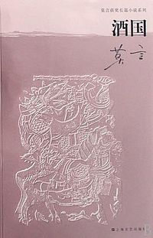
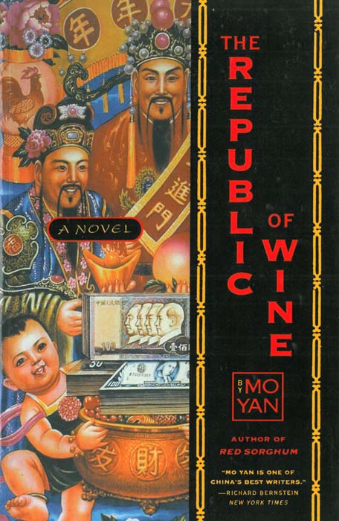
Material Choice
酒國/The Republic of Wine (Mo Yan).
Translation by Howard Goldblatt.
Only Chapter 1.

Slide 13
Frequency of COME in Mandarin
82 tokens of lai ‘come’ identified in the Mandarin version:
40 tokens in deictic expressions
42 tokens of lai in idiomatic expressions
Notes:
Comments Lily: What is not clear to me though is the methodology, Louis. Are you counting all tokens with LAI, regardless of whether they are 1) resultative verb compounds or 2) compounds with V-DIR-DEI (compounds composed of 3 characters) constructions only, as indicated in one of your slides? How about V-DEI (e.g. chu-lai) compounds then? Is qi-lai treated as an idiomatic expression, and is lAI a deictic here?
Response Louis: Yes, I realized I should have made this clear somewhere in the PPT, so I added something to this slide. As long as lai can be replaced with qu and still makes good sense, that occurrence counts in the first category. Qi-lai is obviously not in this category, but chu-lai is a different story, where pao-chu-lai ‘run-out-come’ and pao-chu-qu ‘run-out-go’ both make sense, while only wen-chu-lai ‘(lit) smell-out-come, find out by smelling’ makes sense but wen-chu-qu doesn’t. Therefore whether the occurrence is V-DIR-DEI or just V-DEI is not a criterion for my classification for the present purpose of PoV management, although they do exhibit a somehow skewed distribution (26/30:4/30), but that I believe is another story.
A look into the above mentioned semi-deictic usages will also be an interesting way to go, which was already in the slide on Further Issues (p.25).
Have I answered your question?

Slide 14
Frequency of COME in English
COME in the English version (incl. come(s), came, coming):
16 (!) tokens identified
10 tokens in deictic expressions
6 in idiomatic expressions (came up with the idea, he must come down to earth, etc.)

Slide 15
Distribution of Lai
In Mandarin, lai occurs predominantly as a resultative suffix in resultative constructions (cx).
They account for 75% (30/40) in the deictic category.
Constructional profile: lai as a viewpoint operator is attracted much more (3x more often) to the resultative cx than as a main verb.
The distribution and frequency of translation equivalents in both lg in the same usage event (representing the same conceptual content).

Slide 16
Resultative Constructions in Mandarin
Cx Schema: V(-DIRectional)(-DEIctic)
V-DIR-DEI:
qian-bian | huang-he | pai | zaizhong-kache |  | de | jiashi-yuan | cong
front-side | yellow-river | brand | big-rig-truck |  | DE | drive-man | from
jiashi-shi |  | li | tiao-xia-lai…
drive-room |  | in | jump-down-come
(Lit.) “The driver of the Yellow River big-rig in front of them came down from his cab by means of jumping…” (PT) “The driver of the Yellow River big-rig in front of them jumped out of his cab...”
Notes:
Comment Arie: I looked up the passage, and it is clear that lai is functional here: the viewpoint is with inspector Ding Gou’er and the (lady) driver if the truck they are in together. The next sentence is about Ding Gou’er’s feelings, so we-readers share HIS viewpoint: “Ding Gou’er could feel the anger radiating from the man’s eyes through the gleaming surface of his mirror-lens sunglasses.” So the Chinese text about the tax-driver contains an explicit marker that the viewpoint is Ding Gou’er’s! The English translation lacks this. This MIGHT perhaps have been expressed in English by “The driver … came jumping out of his cab”, or “jumped out and came towards them”, but the first is definitely not idiomatic (if it is grammatical ☺), and the second makes the text seriously less powerful (slows the pace of the story down), and (more importantly) it still does not express that the jumping is OBSERVED by Ding Gou’er, that this event is presented from INSIDE his viewpoint space (as Dancygier might say it). The viewpoint marking is thus sacrificed in the translation to the fact that English preferably marks the MANNER-of-Movement, not the path, in the main verb (cf. Talmy, Slobin).
I think one would be correct in claiming/objecting that the viewpoint configuration can well/easily be inferred pragmatically, so the translation need not necessarily be characterized as ‘wrong’ ☺ - but it still amounts to a significant difference in STYLE of the texts in the two languages, and the more so, if the difference is statistically more pronounced (as it is here!).
Response Louis: Arie, your suggestion of saying more on the PoV managing function of lai, and what it does to style, is a good idea. I’ve added a slide on this (p.15-16).
But I have one question re your foregoing comment. I had thought the viewpoint marking is sacrificed in the translation, not to the fact that English preferably marks the manner in the verb, but to the fact that English does not express the deictic center in the satellite, which Chinese does quite a lot. What do you think?
Re-response (☺) Arie: Partly, there may only be a terminological point here. What exactly is the grammatical analyis of lai and its relation to the verb? I infer from your use of “satellite” that you consider it a particle, as the directional particles (=satellites) in English “jump down/up/forward/…”). Is that correct? In that case, you are entirely right. For some reason I had assumed that lai can be used independently, i.e. as the main verb of a clause by itself (how do you say “He came with me” in Chinese?). If it can, then the present case might also be seen as a series of verbs (perhaps a serial verb construction?); English “He came out of the car, jumping” would then be a close equivalent, but not idiomatic – and the reason I gave for that is precisely that English is not a verb-framed, but a satellite-framed language, in Talmy’s terminology.
Louis: I think there’s something interesting behind the comments from both of you on this issue. For our case of deictic construction (let me just loosely call it a construction for our uncertainty), English incorporates it into the verb, and Chinese can use it either as a main verb that HAS TO STAND ALONE (lai and qu cannot be followed by a directional particle, in contrast to other motion verbs), or as a resultative suffix. And I think before we comfortably accept Talmy’s typology, we should figure out: Should the deictic center/PoV be considered a MANNER of motion? Or a part of the PATH of motion (either as source or goal)?
I totally agree that this is something extremely interesting to do, and we may have exciting things to say about the typology. But I kind of doubt whether this could fit into the current presentation. Perhaps a discussion of deictic verbs and verb-/satellite-framed lgs can be the basis of our next conf abstract?
Let me know what you think.

Slide 17
Instance of V-DEI
wo | shi | shi | li | pai-lai | de | xin
I | am | city | in | send-come | DE | new
kuang-zhang
mine-head
我是市里派来的新矿长。 (Lit.) “I am the new Mine Director, from the city (they) sent (me) and (I) came.” (PT) “I’m the new Mine Director, sent here by municipal authorities.”

Slide 18
Use of Come as a Dispreferred Option
qian-bian | huang-he | pai | zaizhong-kache |  | de | jiashi-yuan | cong
front-side | yellow-river | Brand | big-rig-truck |  | DE | drive-man | from
jiashi-shi |  | li | tiao-xia-lai, |  | zhan | zai | lu-bian,
drive-room |  | in | jump-down-come |  | stand | LOC | road-side
naonu | de | kan-zhe | ta, | (zui | li | dunang-zhe
angry | DE | look-IMP | her | mouth | in | murmur-IMP
“an | ni-ma | ge | qiu!”)
press | you-mother | CL | ball
(Lit.) “The driver of the Yellow River big-rig in front of them came down by means of jumping and stared daggers at her from the roadside, (murmuring “Stop pressing the fucking horn!”)” (PT) “The driver of the Yellow River big-rig in front of them jumped out of his cab and stared daggers at her from the roadside.”
Notes:
NEW SLIDE!
Comment Arie: Aha! I did not know, of course, that the clause following the jumping-sentence was like this. This does indeed make the English sentence at this position all the more interesting! In a sense, it shows the skill of the translator: He cannot mark viewpoint with the deictic element, the conventions of English grammar being what they are, but he finds another way, natural in English, which does give the reader of the English text a clue about the viewpoint, viz. the verb feel (with a non-finite complement). But there is still a difference, as you mention in the next slide. See also my comments there.

Slide 19
Translator’s Improvisation
An inserted passage: Ding Gou’er could feel the anger radiating from the man’s eyes through the gleaming surface of his mirror-lens sunglasses.
Use of cognition verb to access character’s thought (note the use of present participles) as an “approximation” of the viewpointing effect (narrator taking character viewpoint).
A difference in style and in construal remains.
Notes:
NEW SLIDE!
Comment Arie: I propose to avoid the term “implicit”, ans simply say ”in another manner”. Reason: in a specific sense, the Chinese text is MORE implitic! Consider: there is, indeed, an explicit deictic marker, but the reader has to INFER, from the context, what the identity of the ‘origo’, of the anchor of the viewpoint, is (viz. Din Gou’er). The English translation has “Ding Gou’er could feel” and this thus explicitly identifies whose viewpoint we are taking; moreover, feel as such is an explicit verb of cognition/emotion. Precisely these linguistic differences form the basis for the stylistic difference that you mention (with the deictic, Ding Gou’er is off-stage, thus construed more subjectively, in Langacker’s terms!).
Louis response: Totally agree! Done!
However I hesitate to include what you’ve mentioned re subjectivity, given the nature of the audience… Please advise, both.

Slide 20
The Importance of Being…
Constructionist
Disproportion accounted for by occurrences of a viewpoint marker in particular constructions.
Influence of grammar on stylistics.
And on constructional means to coordinate readers’ cognitive states.
Grammar: Speaker’s tendency to associate certain words (lai/qu) with given constructions.

Slide 21
Viewpoint Markers That Get Across?
Deictic COME: 10 (English), 40 (Mandarin)
It seems that only 10 tokens of deictic COME have “survived” the translation.
Only 5 tokens, out of 10, pair up with lai in the original.
The rest, 50%(!), is the translator’s own invention.

Slide 22
Radical Invention: Opposite Viewpoint
qing | ni-men | yansu-dian! |  | xianren | jiu-guo |  | shi | wei
please | you-PL | serious-DIM |  | current | wine-country |  | city | committee
xuanchuan | bu | fu-bu-zhang |  | Jin Gangzuan |  |  | shi | ci
promote | deputy | vice-deputy-head |  | Jin Gangzuan |  |  | BE | this
an | de | zhongyao | xianyiren, | ta |  | shi | cong | gui
case | DE | important | suspect | he |  | BE | from | you-HON
kuang | chu-qu | de.
mine | out-go | DE
请你们严肃点！现任酒国市委宣传部副部长金刚钻是此案的重要嫌疑人，他是从贵矿出去的。 (PT) “I must ask you to take this seriously. Liquorland’s Deputy Head of Propaganda, Diamond Jin, who is a prime suspect, comes from your esteemed mine.”
Notes:
Comment Arie:
Are you sure that the PoV in the translation is CONTRADICTORY to the original? You gloss “shi” as “BE”, where the translation has “come”. This suggests to me that we should say that Chinese lacks an indication of PoV, while the English translation explicitly marks the situation as embedded in the present (here-and-now) viewpoint.The balance between what is conventionally coded and what is pragmatically inferred would then be exactly the reverse of what I remarked on slide 13.
Response Louis: My bad! I should have highlighted the deictic marker (qu ‘go’) in the example! I hope the passage now makes sense to you.
Re-response Arie: It does! But do you have any idea what could motivate the English translation? Pure idiomaticity? (i.e. that the expression “comes from” is the coventional colloquial way of saying “originates from”). Or something deeper?
Louis: I think the degree of entrenchment of constructions and association between constructions are probably two important factors. I very quickly looked up come from and go from in the BNC, and it turns out that the former only has 1389 hits but the latter 11612 (almost 10x as much). Also the cx of go from is very often, at least roughly half of what I’ve gone through, used in a larger cx of go from A to B. So I think it is both the much higher frequency (i.e. higher degree of entrenchment) of come from and the close association between go from and go from A to B that dissuades the translator from choosing a cx that would have expressed the same PoV.
Make sense?
If so, we need to add another couple of slides. Let me know.

Slide 23
From Concept to Meaning and Form
In Mandarin version, only the SOURCE (cong ‘from’) and PATH (chu-qu ‘out-go’) of the motion are linguistically elaborated.
Direction: away from the speaker
Go (out) from would make THE ideal translation.

Slide 24
Cx Profile in the Way
Constructional profile: 70% (14/20) in go from involves a very specific pattern of go from X to Y (cf. come from: 0%).
Go from X prefers a construction with GOAL specified than without.
As a result go from X alone does not sound natural enough in that context (where the GOAL is not specified in the ST).
The entrenchment of the full pattern go from X to Y makes go from X a less ideal choice (though not impossible).

Slide 25
Summary
Differences and mismatches abound in the parallel texts.
Each lg has its own unique way of utilizing deictic elements as a PoV operator when “representing the same reality”.
Should be seen as the translator’s spontaneous response to the differences between the two systems.
Makes sense only when we view grammar as a system of cog routines with varying degrees of entrenchment.

Slide 26
What Parallel Texts Have Revealed
Difference in frequency and distribution of translation equivalents in the same usage event.
Translator’s improvisation and a consequent difference in construal.
The fact that the same reality may need to be presented from opposite viewpoints in different languages when grammar dictates.
Notes:
Comment Lily: Grammar plays a role, definitely. I however do not think it is the only deciding factor for the issue you raise or try to solve. What role does a translator play in terms of the stylistics (or poetics) of a written piece, esp a literary piece? Is it not true that linguistic choices (eg, when it come to the management of PoV) are also in the hands of the translators? Did you not at all hint at the possibility during your discussion?
Response Louis: Ah, yes, this explains why the translator strategically uses a PoV marker opposite to that in the original! I’ve added this valuable point here! It just occurred to me that here’s a way of looking into that at a larger scale: Compare different translations of the same literary text to see how PoV is managed across these translations. I’m pretty sure that different translators will come up with their own strategies of shifting PoV, or will make their own decision as to whether or not to shift (or show) PoV at all. We could possibly use Alice in Wonderland, which Arie and I have looked at a bit, and its various translations, as the materials for this possible direction of research. I’ve added this possibility to the slide of Further Issues (p.25).
Comment Arie: it would even be sensible to say that BECAUSE of the differences between grammars, translator’s decisions HAVE to play an important role (see comments on the other passages) – they are more closely interacting, as it were, than one being an “addition” to the other ☺.
Louis: Ahha! You’re right. I’ve put the original passage in a new way, a better way to construe the invention.

Slide 27
From Grammar to Stylistics
The stylistic/narrative convention is grammatically bound (use of deictic verbs as viewpointing devices).
Highly conventionalized.

Slide 28
Narrator and Character Viewpoint
You heard a sentence by John last week: “I will be on time tomorrow.” How would you report it now?
Direct Discourse
John said, “I will be on time tomorrow.”
Free Indirect Discourse (mixed verbal representations)
John promised that he would be on time tomorrow.
Indirect Discourse
John promised that he would be on time the next day.

Slide 29
Research Issues
How do different languages verbally package the same stylistic effect of mixing PoV (in different ways)?

Slide 30
Material Choice
Alice in Wonderland
Famous for its juxtaposition of different voices (Muskat-Tabakowska 2014)
Use in typological (Ververk 2014) and translation/poetic studies (M-T 2014)

Slide 31
Narrator’s voice in Alice in Wonderland
(2) Alice was beginning to get very tired of sitting by her sister on the bank, and of having nothing to do: once or twice she had peeped into the book her sister was reading, but it had no pictures or conversations in it…
Is there Alice’s fingerprint? Or the narrator takes the full responsibility?

Slide 32
Alice’s PoV?
(3) … but it had no pictures or conversations in it, 'and what is the use of a book,’ thought Alice 'without pictures or conversations?’
Structural features:
The presence of and.
and in lower case.
Comma.
Also Alice’s thought that precedes the direct thought.

Slide 33
What makes the mixture possible?
The flexible position of the reporting clause in English
(3) … but it had no pictures or conversations in it, 'and what is the use of a book,’ thought Alice 'without pictures or conversations?’
(3a)… but it had no pictures or conversations in it. Alice thought, 'and what is the use of a book without pictures or conversations?’ (constructed)

Slide 34
Recurrent Pattern (2)
(4) … but she could not even get her head through the doorway; 'and even if my head would go through,' thought poor Alice, 'it would be of very little use without my shoulders.
Structural features:
Conjunction and
and in lower case
Semi-colon before the quote
Interpolated reporting clause

Slide 35
Counterargument
In English we often use and as a discourse marker.
Alice’s thought and the narrator’s lg need not bear any connection.

Slide 36
Another Conjunction
(5) … she felt a little nervous about this; 'for it might end, you know,' said Alice to herself, 'in my going out altogether, like a candle.
Structural features:
Inferential conjunction for
for in lower case
Use of semi-colon
Interpolated reporting clause

Slide 37
Narrative Schema of Mixing PoV
In AiW in English:
[FULL CLAUSE] – [SECONDARY BOUNDARY MARK] – [“COORDINATING CONJ] – [FRAG 1,”] – [REPORTING CLAUSE,] – [“FRAG 2”]
Grammar:
Sequentiality of elements
Use of coordinating conjunctions
Typographic convention:
Use of letter case
Use of punctuation

Slide 38
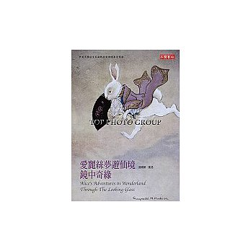
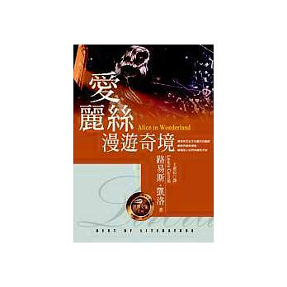
Alice in Mandarin
Why Mandarin?
Y.R. Chao
L.F. Chen
H.H. Wang
W.Y. Jia and W.H. Jia
Not only inter- but intra-lg comparison

Slide 39
How About Mandarin?
In the four translations of (3), none has the reporting clause interpolated.

Slide 40
Chao’s Translation of (3)
ta youshihou tou-tou di qiao ta jie-jie
she sometimes secret-RED DI see she sister-RED
kan de shi sheme shu, keshi shu li you
read LINK PRT what book but book in PRT
meiyou hua-er, you meiyou shuohua, ta jiu
NEG picture-DIM also NEG speech she PRT
xiang-dao, “yi-ben-shu li you meiyou hua-er,
think-COMP one-CL-book in PRT NEG picture-DIM
you meiyou shuohua, na-yang-shu yao ta
also NEG speech that-kind-book want it
gansheme ne?”
what for PRT

Slide 41
Wang’s Translation of (3)
suiran ta ye ceng zai yipang kuishi
although she also in the past LOC aside peek
jie-jie suo yuedu de shuji, que yin shu
sister-RED REL read DE book but because book
zhong wu tu ye wu duihua de neirong
in NEG picture also NEG conversation LINK content
er juede suoranwuwei. ailisi xin xiang: “meiyou
CONJ feel bored stiff Alice heart think NEG
tuan ye meiyou duihua de shu
picture also NEG conversation LINK book
you sheme yongchu ne?
have what usefulness PRT

Slide 42
Approximation of PoV effect in Mandarin
The narrative schema in English simply does not get through.
Viewpointing effect APPROXIMATED by different lexical means:
Use of yin ‘because’ (Wang)
Use of demonstrative na ‘that’ (Jia, nciku)
Use of emphatic constructions you… you…, ji… ye… (similar to neither… nor… in English)
Different construals introduced.

Slide 43
Translations of (4)
Three out of the four have the reporting clause interpolated (!?).
Such pattern is not found at all in the general corpus.
Local syntactic borrowing in the translations.
Recent and genre-specific phenomenon (how will that evolve?).

Slide 44
Chen’s Translation of (4)
danshi ta lian tou dou ji-bu-jin na-shan
but she even head PRT squeeze-NEG-in that-CL
men. “jiusuan wo de tou ji-de-jin,” kelian
door even if I LINK head squeeze-Pfv-in poor
de ailisi xin xiang, “jianbang ye ji-bu-jin-qu…
LINK Alice heart think shoulders PRT squeeze-NEG-in-go

Slide 45
PoV Effect in the Borrowed Structure?
NO.
Only 1 token of coordinating conjunction out of 12 (3 * 4 ver).
The Mandarin versions do not have intra-language consistency for the similar PoV operation at all.

Slide 46
Summary
In Carroll’s AiW, the stylistic effect of mixing PoV is achieved by a combination of gr and typo means.
Has a consistent structural pattern.
English-specific.
No inter-/intra-translator consistency in another lg.

Slide 47
Cultural Tools and Stylistics
Gr and typo of a lg encourages speakers to “represent same social reality” its own way.
Culture-specific tools that a text producer has available for stylistic purposes.
Highly conventional.

Slide 48
The CL Enterprise
Empiricism-based:
Evidence in parallel texts
Structural patterns beyond the lexical level
Outreach: A promising approach to poetics, narratology and translation studies
Use of translations as an innovative method in CL research

Slide 49
Take-home Messages
Use of parallel texts as a useful methodology in CLR.
Translation as a window to the interaction of grammar, stylistics and thinking.
The study of stylistics and translation cannot do without (constructional) grammar.

Slide 50
THANK YOU!
謝謝！
wllu@phil.muni.cz

