Slide 1
Basic Issues in Cognitive Linguistics: Course Overview
Wei-lun Lu
Masaryk University

Slide 2
History of CL
Started in the 70s.
Central figures: Wallace Chafe, Charles Fillmore, George Lakoff, Ronald Langacker, and Leonard Talmy.
Assumption: Meaning is central to language. Linguistic structures serve the function of expressing meanings and hence the mappings between meaning and form are a prime subject.
Opposed to: The prevalent idea that meaning was 'interpretive' and peripheral to the study of language. The central object of interest in language was syntax.

Slide 3
Milestones in the 80s
Took off in the 80s.
Milestones:
  Metaphors We Live By
  Foundations of Cognitive Grammar, 2 vol.
  Women, Fire and Dangerous Things
  Topics in Cognitive Linguistics, ed. by Brygida Rudzka-Ostyn

Slide 4
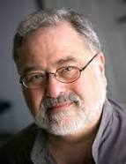
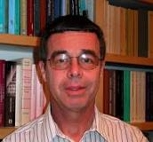
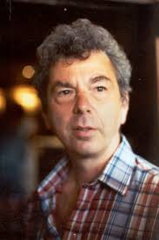
The Enterprise
Interprets lg in terms of concepts and bodily experience
George Lakoff
Ronald Langacker
Len Talmy

Slide 5
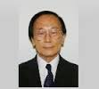
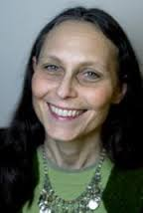
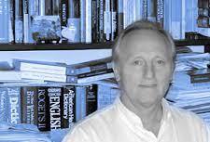
Visiting Scholars
Yoshihiko Ikegami
Laura Janda
Zoltan Kovecses

Slide 6


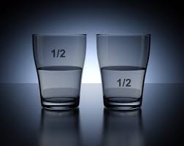
Meaning and understanding
Central concern of Cognitive Linguistics: meaning and ways of understanding.
What do you see?
Meaning of the picture resides in the way we understand it.
Meaning of a situation resides in the way we verbalize it.

Slide 7
Understanding Emotions
My love is a red, red rose.
Robert Burns.
O Ephraim, what am I to do to you? O Judah, what am I to do to you? For your love is like a morning cloud, and like the dew which goes early away.
Hosea 6:4.
Lakoff on LOVE (http://www.youtube.com/watch?v=Eu-9rpJITY8)

Slide 8
Applications of CL
Used in studying various sorts of real data:
  Specialized genres (literary/legal/tourism etc.)
  Translation (cross-linguistic)
  Second language acquisition/teaching

Slide 9
Assignment 4
Based on your research statement, write a 1-page assignment on the research methodology (choice of materials). Justify why such material choice is important. Stress methodological rigor (how your data is representative of the language/culture at issue).
For example, if you plan to compare languages, what are some possible ways?

Slide 10
Housekeeping
Show syllabus.

