Slide 1
Gender, sexuality and film audience and critics perspectives
Guest lecture Masaryk University Brno, November 2018
Prof. dr. Kevin Smets (Vrije Universiteit Brussel, Belgium)

Slide 2
Part 1: feminist media studies and gender perspectives
  Case study: audience study in Turkish and Moroccan communities
Part 2: queer studies and film
  Case study: “Zenne Dancer” and homonationalism

Slide 3


Margaret Mead: gender roles

Slide 4
Feminism: 4 waves
Late 19th – early 20th century: political rights (Suffragettes)
1960-70s: public role and participation of women: work and culture
1990s: violence, reproduction, sexual liberation
2010s: role of social media, harassment, #metoo
→ Media and cultural studies influenced since the second wave!

Slide 5
During the second wave: Laura Mulvey
Visual Pleasures and Narrative Cinema (1975)
  Combining Freud, Lacan and feminist theory
  Both men and women are represented in stereotypical roles
  Phallocentrism
  Cinema from a predominantly male – narcissistic point of view
  Scopophilia (voyeuristic gaze)

Slide 6
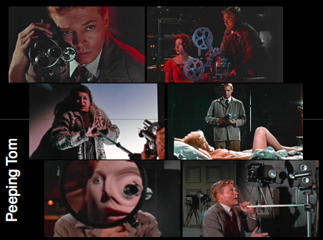
Peeping Tom (Michael Powell 1960)

Slide 7
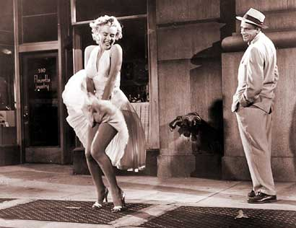
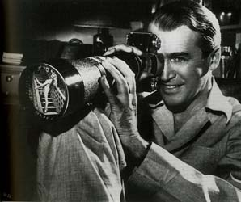
Laura Mulvey: Visual pleasures and narrative cinema (1975)
Viewing = identifying with the screen
“Male gaze”
Tension is resolved by giving man the role of spectator, and woman role of the spectacle
Spectator sees through eyes of male protagonist
Eroticization

Slide 8
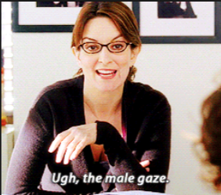
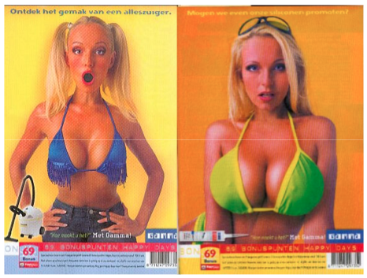

Slide 9
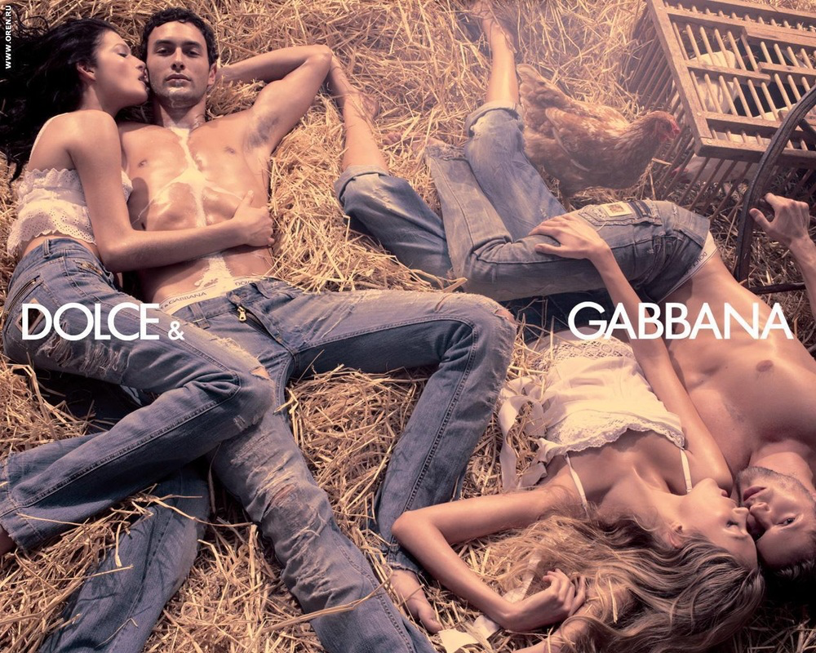
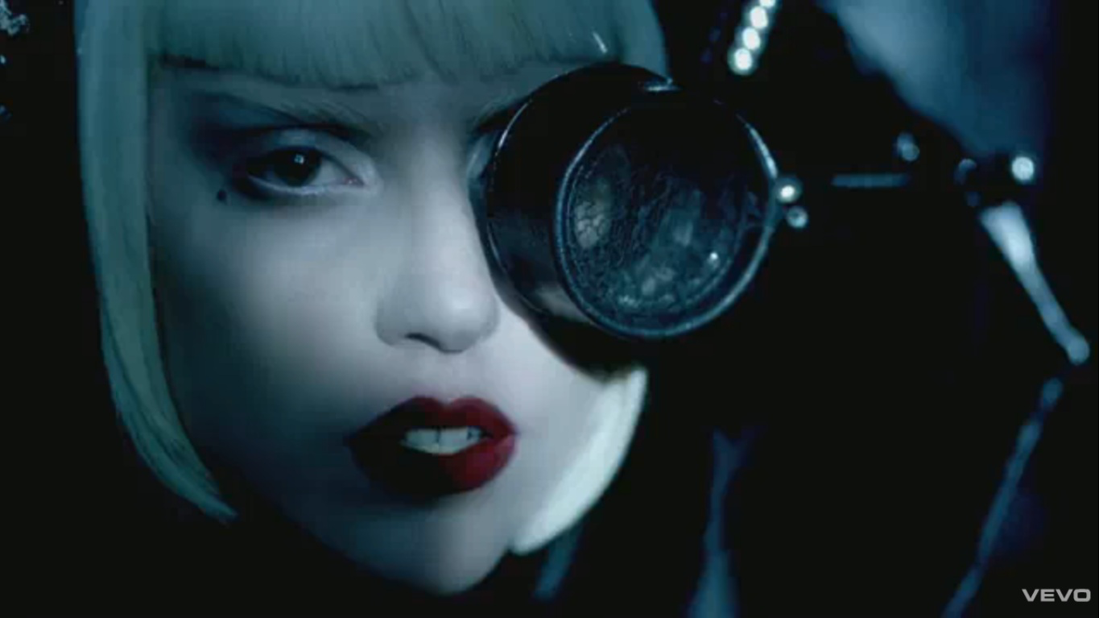
The male gaze: criticisms
Gay gaze, female gaze
Mulvey later nuances the theory

Slide 10
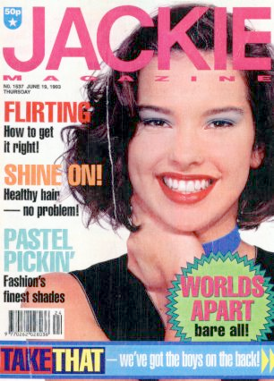

Feminism and cultural studies (1): Angela McRobbie

Slide 11
Angela McRobbie
Research on popular women’s magazines
--> Can be inspiring for film studies!
Gender and youth culture through perspective of Althusser’s “ideological state apparatus”
Power of publishers and media industry
Dominant reading: women’s lives revolve around beauty and men ; Meaning of love, beauty, sex... are determined by this industry
But: Attention for resistance, pleasure, disruption

Slide 12

Feminism and cultural studies (2): Janice Radway
Reading the Romance (1987)
Interpretative community of female readers of romance (clustered around a book shop)
Commercial and problematic aspects
But: the reading process can be empowering
  Romance can be idealized, but not the protagonists
  Readers create their own interpretative space
  Readers can resist the commercial reading
  Erotic pleasure of readers

Slide 13
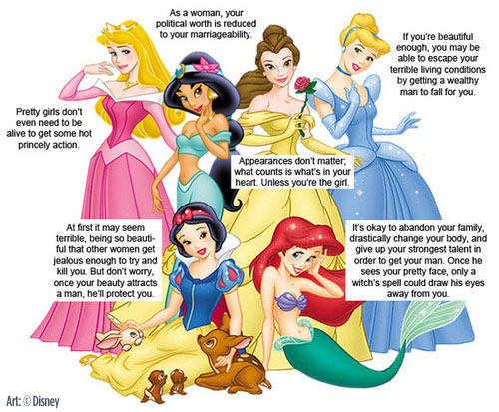
3th and 4th wave feminism and Disney

Slide 14
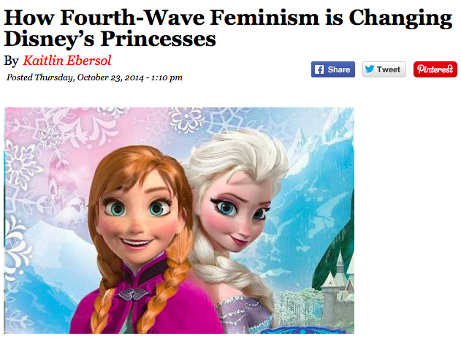
Highbrow Magazine 2014

Slide 15
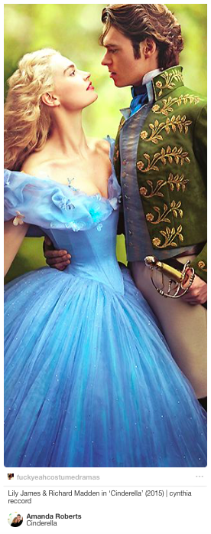

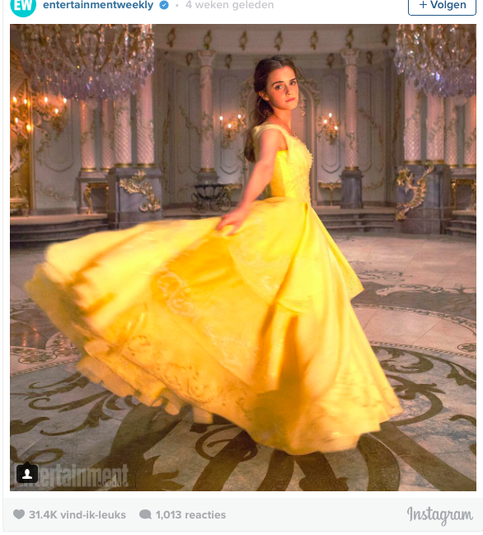

Slide 16
A case study: gendered viewing practices
Study on Turkish and Moroccan film cultures in Antwerp (Belgium)
Family environments, homes, and the film theatre

Slide 17
Family time: bridging divides in the multiplex
“[the head of the household] is willing to pay the price of a night out to the cinema. They have a drink, take a popcorn… The man feels good because he has done something with his family. For us, there are very few things to do with the whole family.”
man of Turkish origin (38yo, second generation)

Slide 18
Filmic safety zones among diasporic families
“[…] there is a lot of doubt about films from the West. One can always doubt and expect that something can happen and you should be careful to watch it with your family.”
girl of Moroccan origin (18yo, third generation)

Slide 19
Filmic safety zones among diasporic families
“[…] I wasn’t allowed to watch films like Dirty Dancing […]. I missed that, because it’s entertaining, especially as a teenager. I mean… your world opens through TV, because I wasn’t allowed to play outside very often either.
[…]
Years later, when I already had children, I finally watched Dirty Dancing and I was like: finally I can watch it [laughs]. Isn’t that silly?”
woman of Moroccan origin (32yo, second generation)

Slide 20
Filmic safety zones among diasporic families
Interviewer: And did you ever watch this films secretly?
“I guess so… When I heard somebody approaching in the background, I zapped quickly, or yeah… I realized that I shouldn’t watch be watching it. […] Or I heard they peeked at what I was watching. We had one TV, so there wasn’t much of a secret.”
woman of Moroccan origin (32yo, second generation)

Slide 21
Filmic safety zones among diasporic families
“For us, Indian films are accessible… I think that it is the main reason why Moroccan girls watch those films. It never crosses the limit, you know? I don’t know if you’ve ever seen such a film [laughs], but you notice that the limit is always precisely avoided. That is why many Moroccan girls watch those films, and Moroccans in general, I believe.”
girl of Moroccan origin (third generation)

Slide 22
Filmic safety zones among diasporic families
“[…] their culture is different, but the behavior is similar to ours, such as respect for the elderly, family values… It’s actually the same as in our culture.”
woman of Turkish origin (42yo, second generation)

Slide 23
Gendering genres, compromises and gendered guilt
women : romance
men : action
emotional
calm
sentimental
soft
wild
violent
to the point
“something for both”

Slide 24
Gendering genres, compromises and gendered guilt
“When I look at the women that I know [...], they are not interested in films. When a film starts, it is often like this: men on the couch, women in the kitchen. I have never seen them calmly, watching a film with us...”
Interviewer: Why do you think that is?
“My father’s wife and my father’s sister too... they seem to feel guilty when a film is turned on, they feel lazy when they are on the couch [...]. And they are constantly baking and making tea... because, when you watch a film you have to make tea. And it’s not just tea, there should be biscuits too, and so they keep going...”
woman of Moroccan origin (31yo, second generation)

Slide 25
Gendering genres, compromises and gendered guilt
“I think they take advantage of the little freedom they can get, they use it for that. […] I think they all secretly watch films when their husbands are absent.”
man of Moroccan origin (60yo, first generation)

Slide 26
Pleasure and resistance: (daytime) soaps and male stars
Kıvanç Tatlıtuğ

Slide 27
Male stars

Slide 28
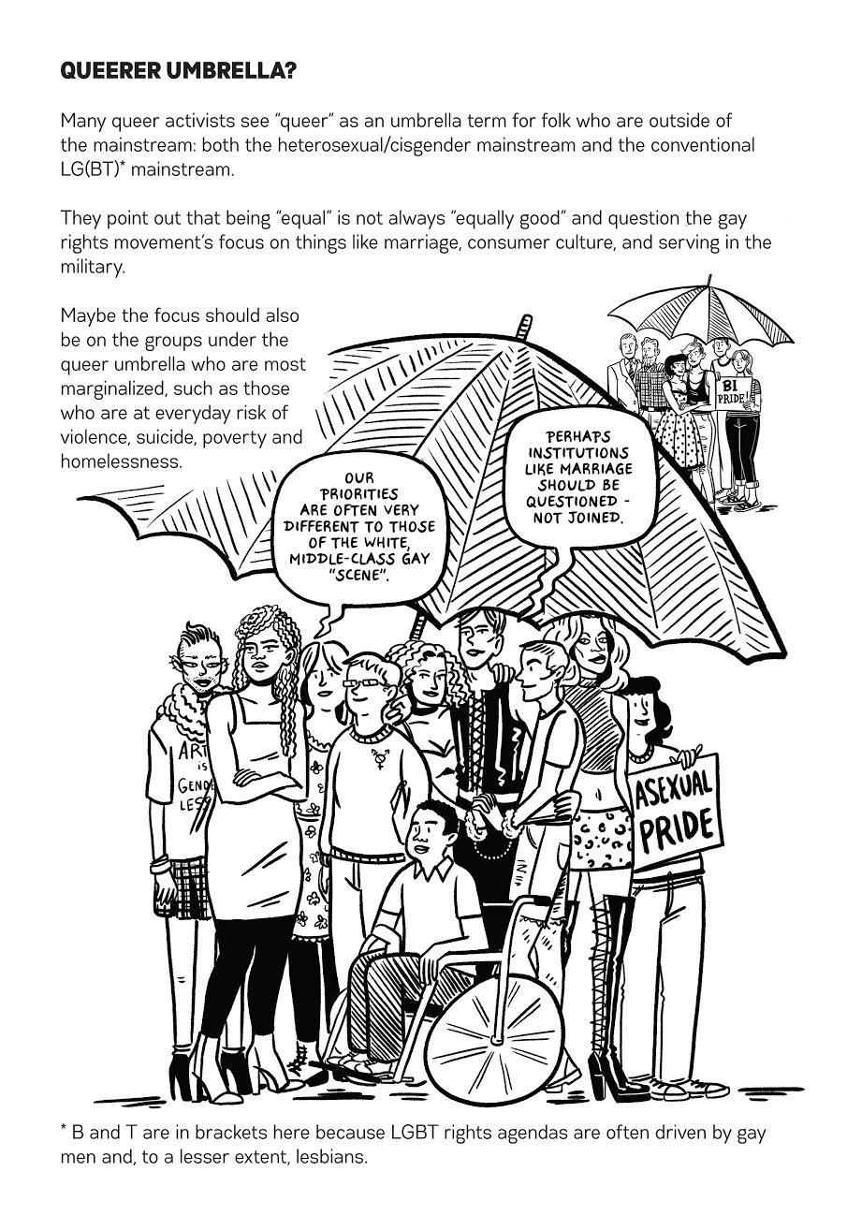
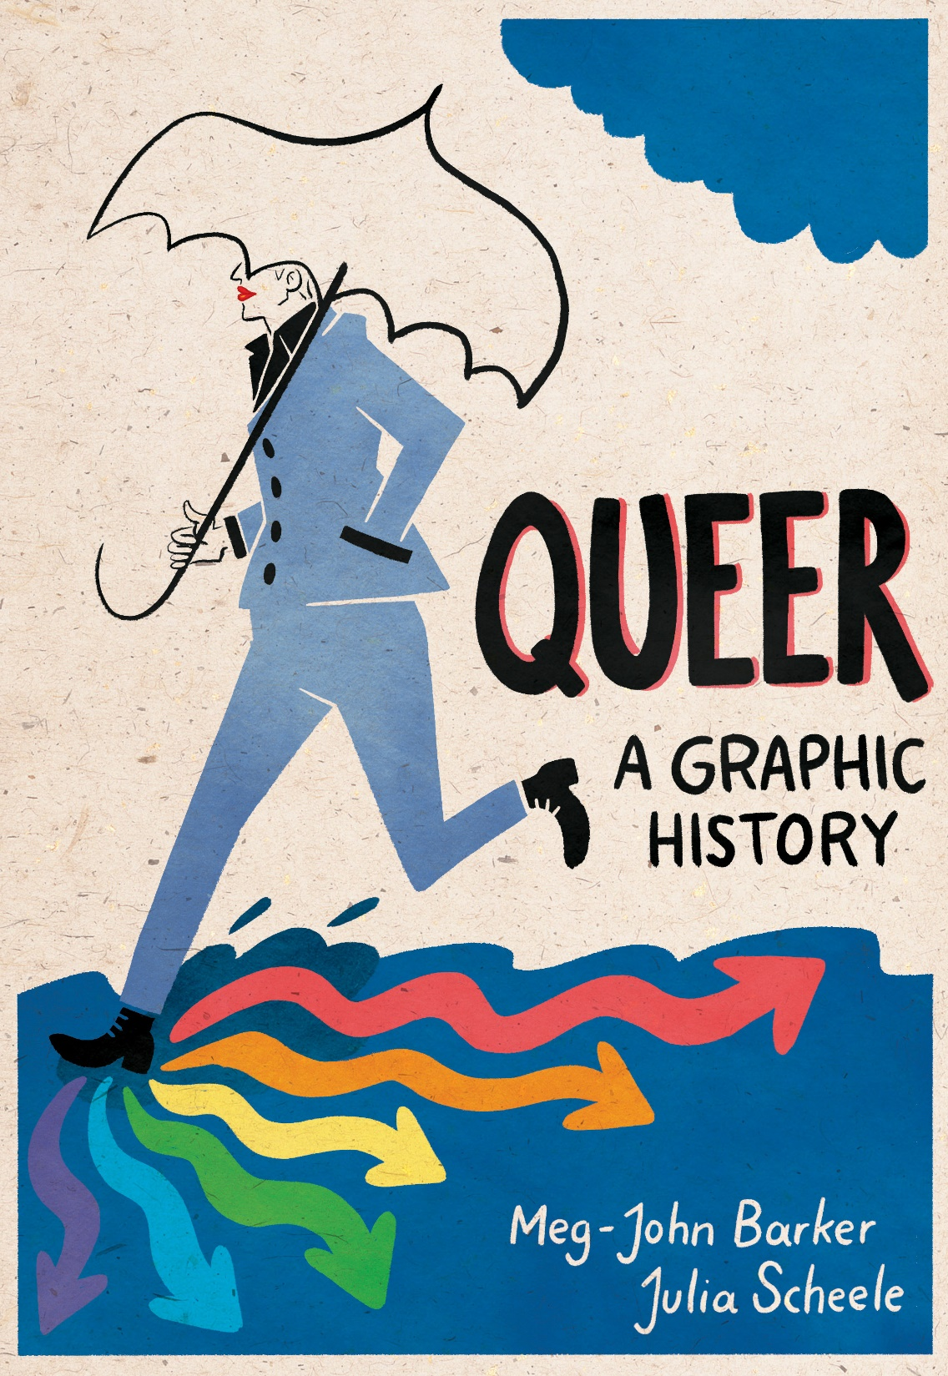
Part 2: queer films and homonationalism

Slide 29
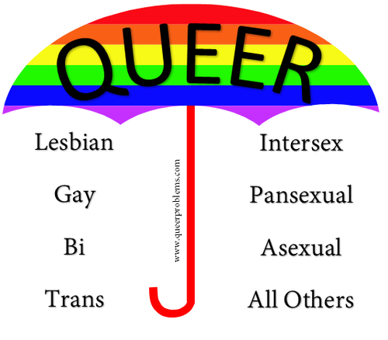
Queer?
“Homosexual”: 1869 (cf. Foucault)
Queer historical meaning: weird, strange
  German “quer”
Used as an insult during most of the 20th century
  Appropriated by activist community
Umbrella term / subversive

Slide 30
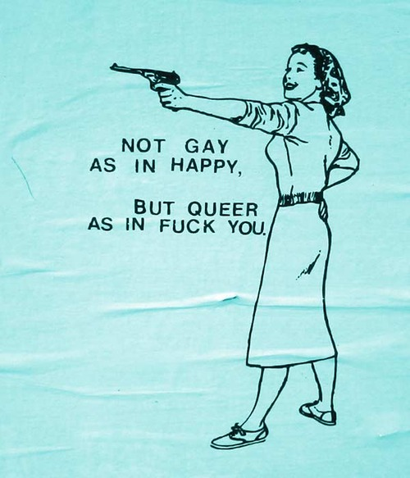
I use ‘queer’ in a narrower sense to note political investments that challenge not only heteronormativity and normative constructions of gender, but also homonormativity: the reproduction by GLBT of classed, raced, and gendered structures of privilege.
Sender (2012): 223

Slide 31
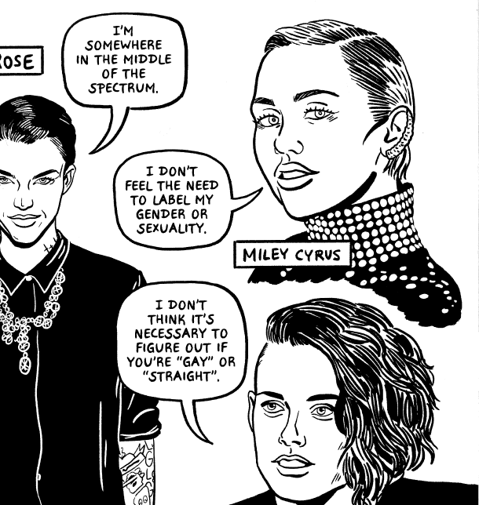

Slide 32
Queer theory: 1990s
Activism (aids activism, ...)
Artistic: cinema (see later)
Academic: from gender studies to gay & lesbian studies to queer studies : emphasis on performativity (most influential theorist: Judith Butler)
Notes:
New queer cinema: re-adding homosexual elements where they were ereased through ”straightwashing”
Or exposing limitations of sexual pleasure, seuxal preference and sexuality

Slide 33
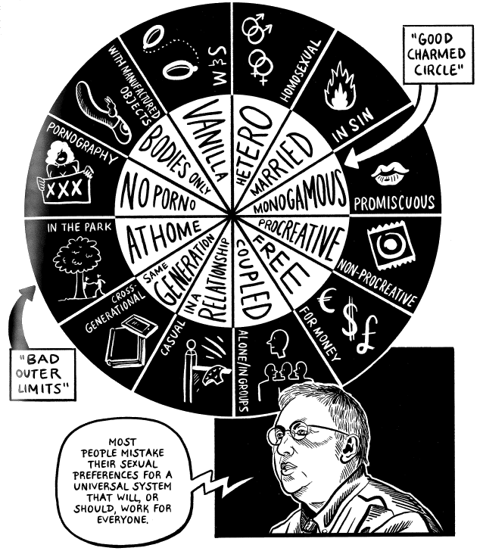
Gayle Rubin (1984)
Sexual peformativity
The “charmed circle”

Slide 34
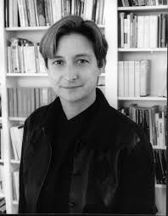
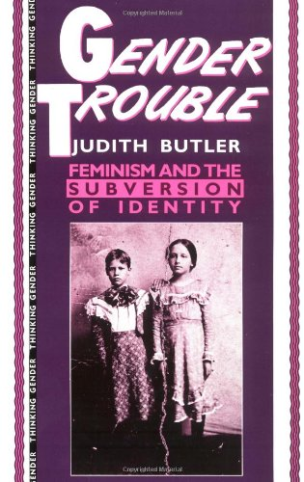
Judith Butler
Gender is a social construct; not what one is but what one does
Gender changes through time
Going outside the boundaries is punished
1990

Slide 35
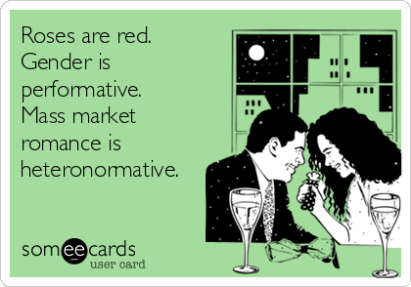

Slide 36
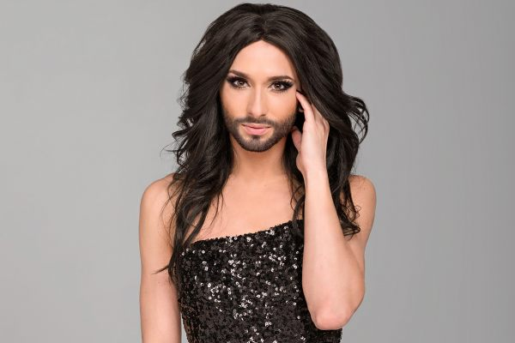
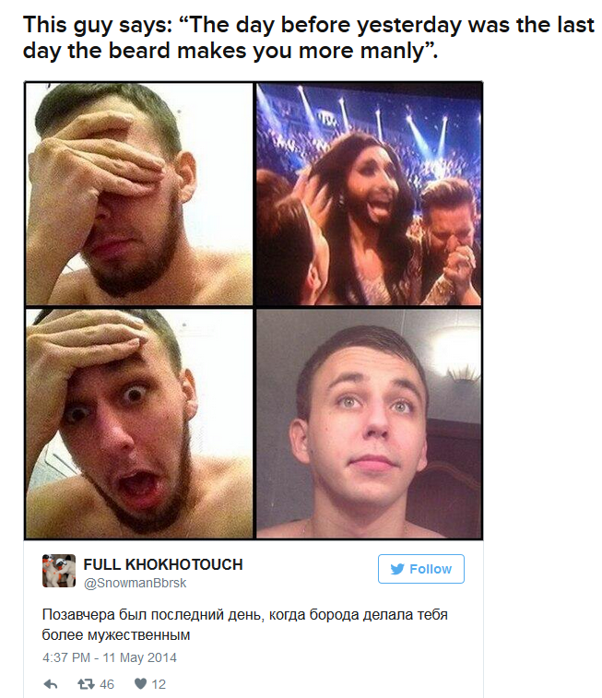
Queer and media studies?
Queer theory seeks to expose the false truths that have constructed boundaries of centrality and marginality, and have normalised the centre by revealing the performative nature of gender and sexuality and the fluidity of identity.
Jodie Taylor (2012): 30
Conchita Wurst

Slide 37
Queer cinema
New Queer Cinema
  E.g. Poison, Edward II, Swoon, The Living End...
  Later Brokeback Mountain, La vie d’Adelle, ...
-> queer-themed
independent film since 90s

Slide 38
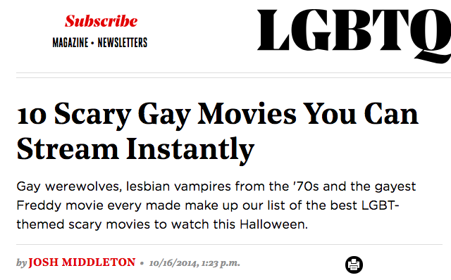

Slide 39
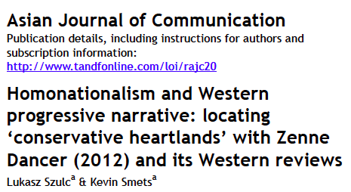
A case study: Zenne Dancer
Szulc & Smets (2015)

Slide 40

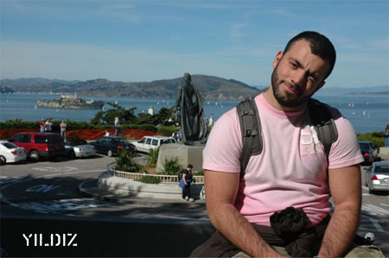
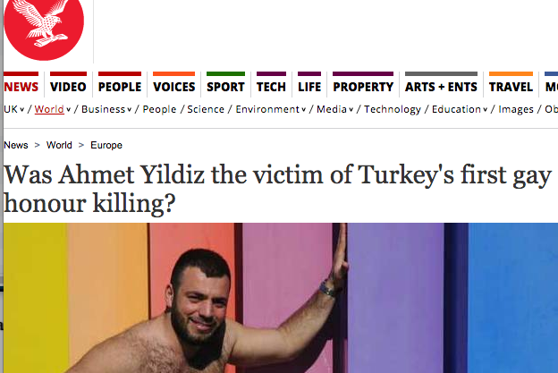
Murder on Ahmet Yıldız (2008)

Slide 41
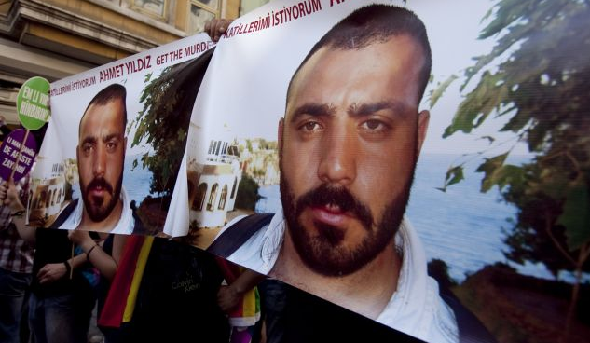
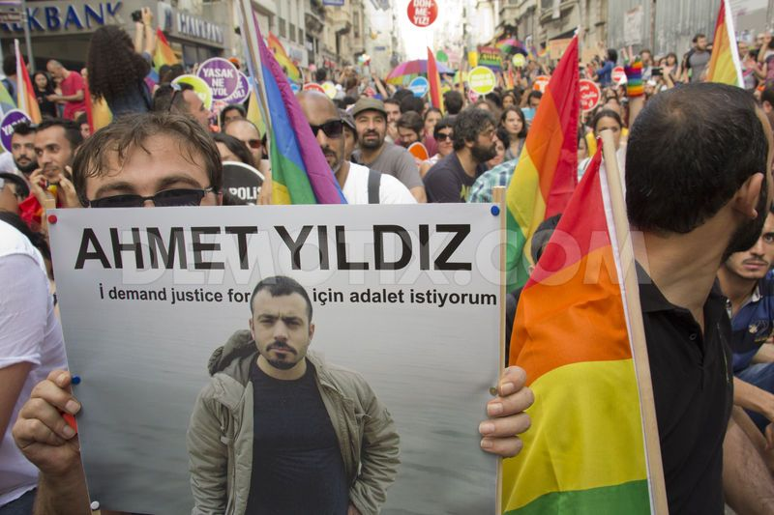
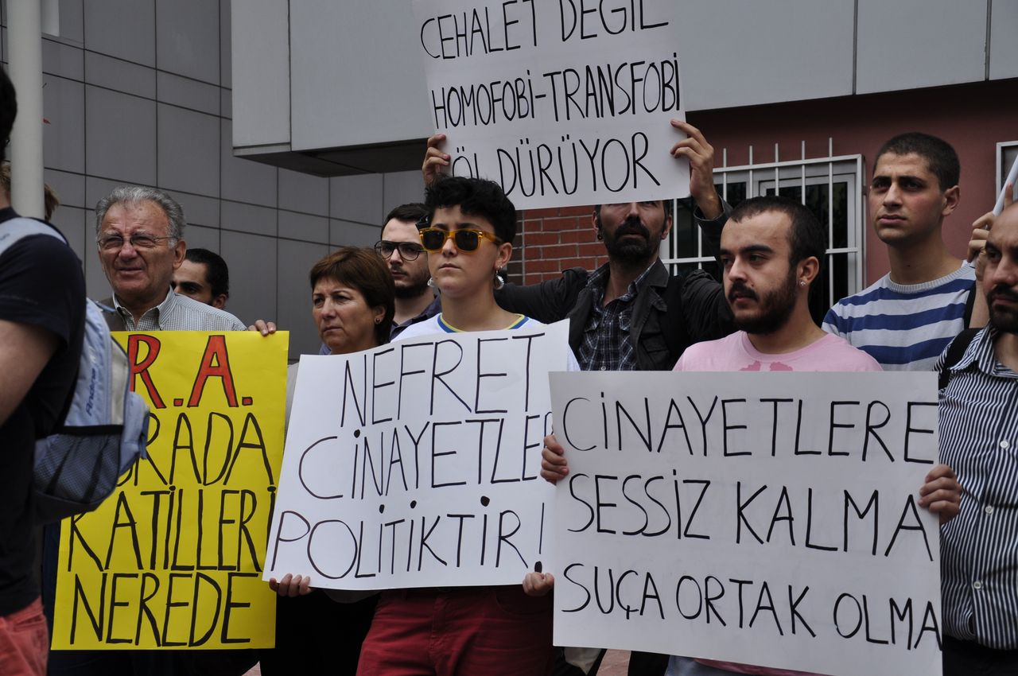
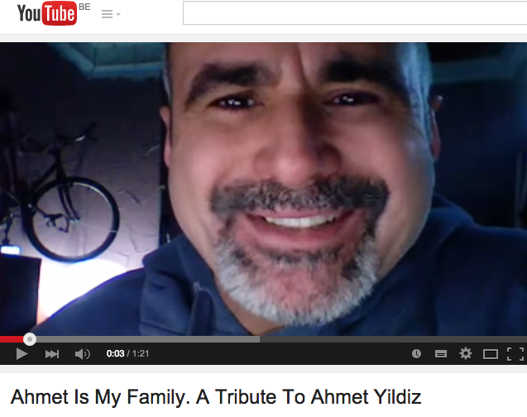

Slide 42

Zenne Dancer, 2011, dirs. Caner Alper and Mehmet Binay (CAM Films)

Slide 43
- Western progressive narrative
- Homonationalism: a rhetoric of sexual modernization that is simultaneously able to castigate the other as homophobic and perverse, and construct the imperialist center as “tolerant” but sexually, racially, and gendered normal (Jasbir Puar, 2005)

Slide 44
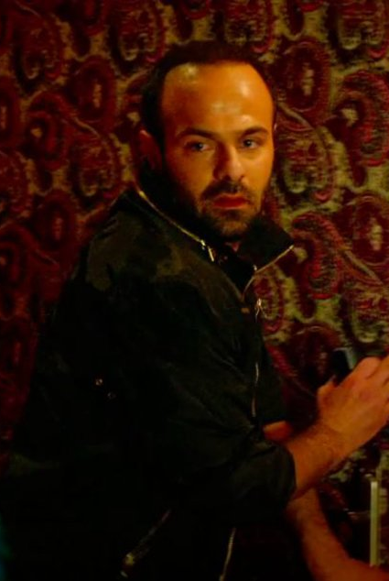
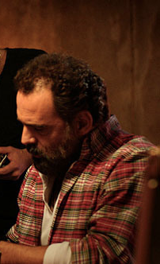
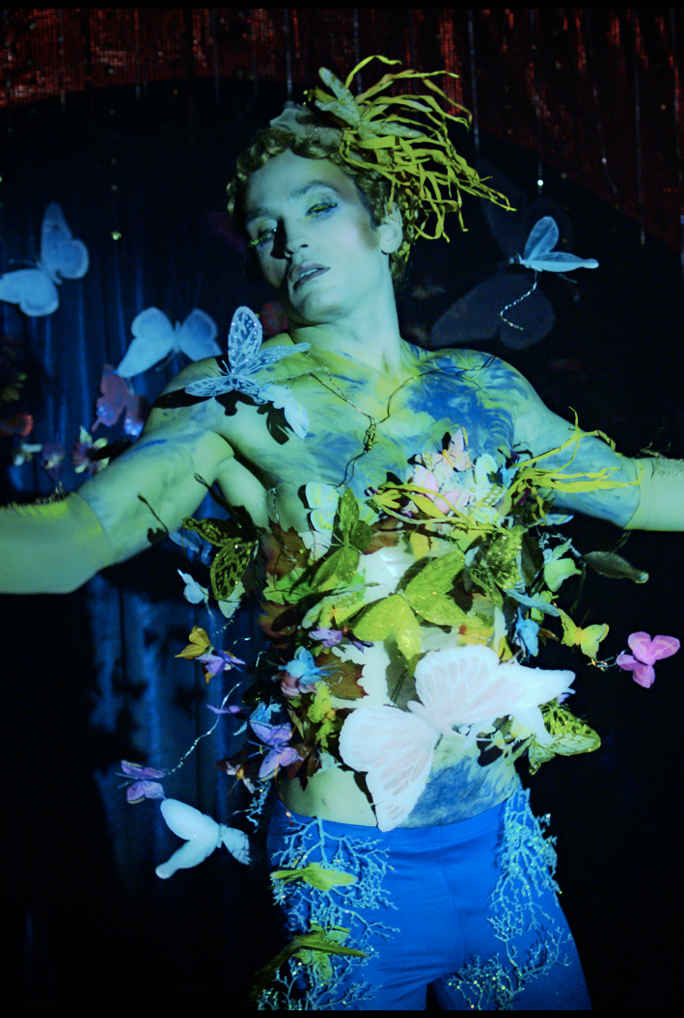
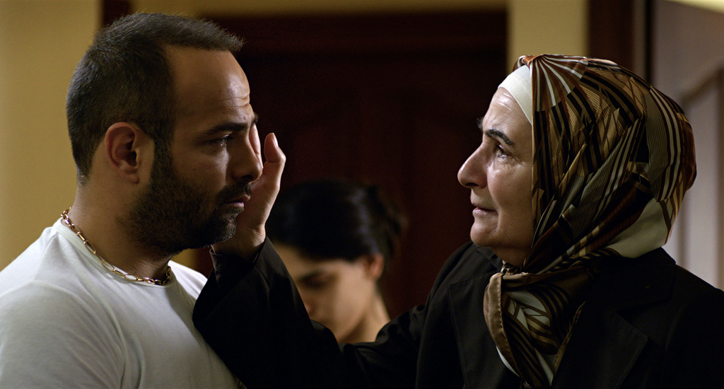
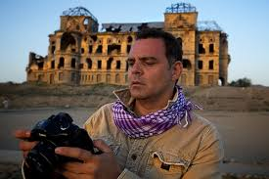
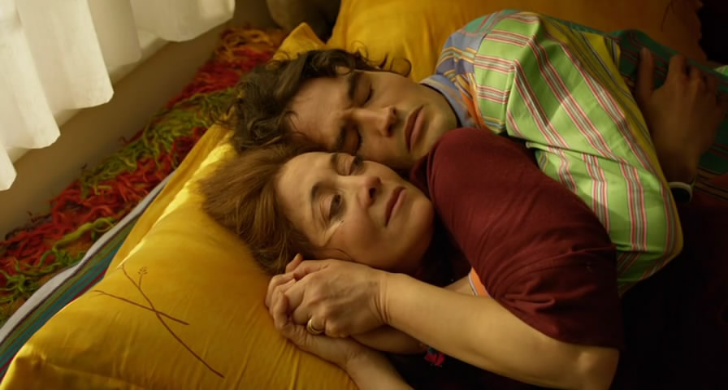
Ahmet
Daniel
Can

Slide 45
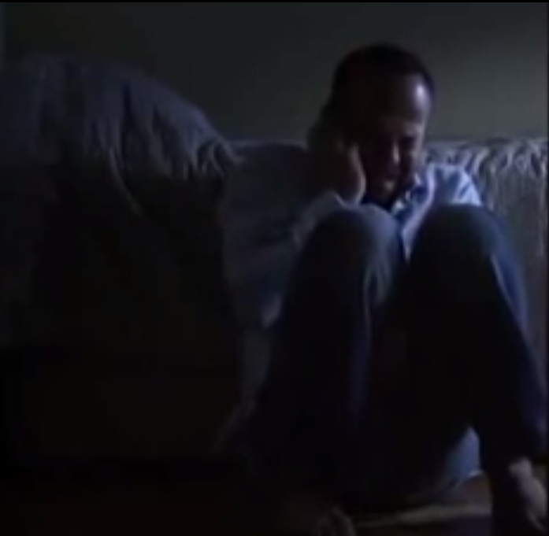
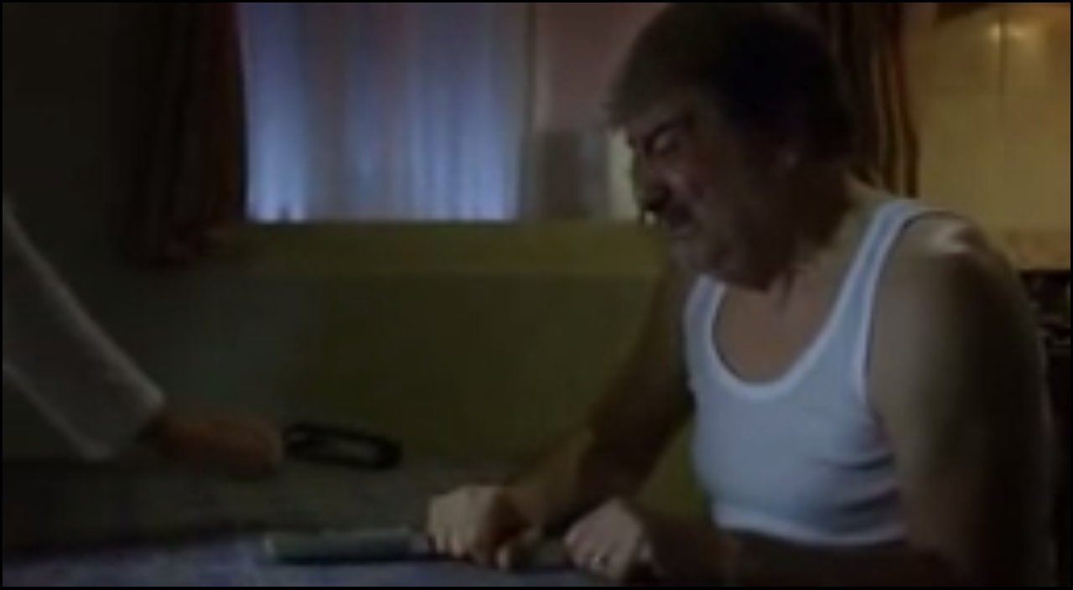
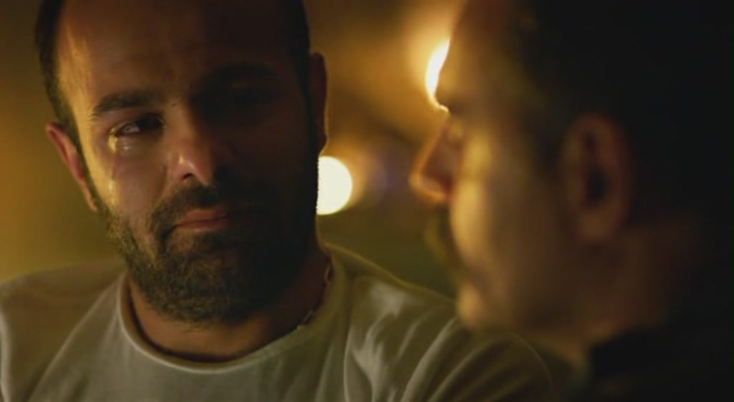

Slide 46

Daniel: Why can’t you be honest and tell the truth to your parents? Honesty is the easiest.
Ahmet: You don’t understand. Honesty will kill me.
Daniel (laughing): No, I can’t understand. What could possibly happen? They are your parents, they love you.

Slide 47
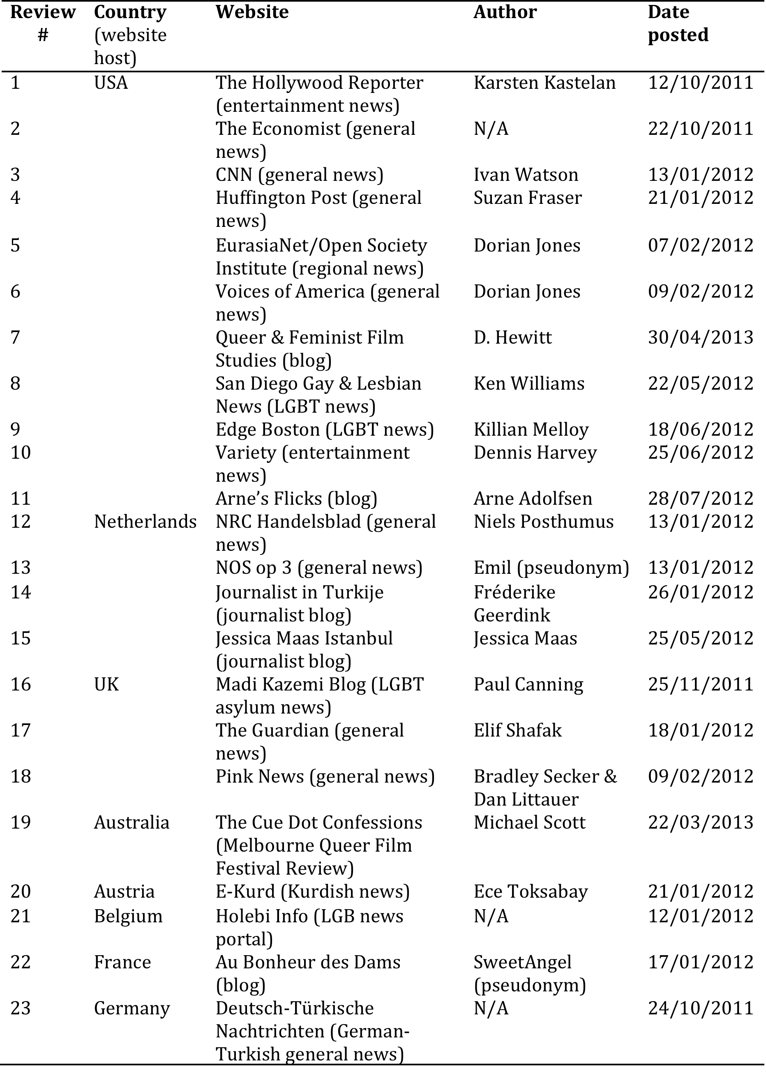

Slide 48
Turkey…
‘still has a long way to go before it overcomes deeply entrenched institutional homophobia’ (CNN)
‘has a long way to go when it comes to banning homophobia’ (NRC Handelsblad)
and that its society ‘still has a long way ahead’ (Holebi Info).

Slide 49
‘the hot-button issue of gay rights (or the lack thereof) in Muslim nations’ (Variety)
‘Islam disdains homosexuality as a sinful though curable disease’ (Deutsch-Türkische Nachrichten)
‘gays in a Muslim country that is seeking European Union membership’ (Huffington Post)

Slide 50
Locating conservatism
Turkey’s ‘conservative heartland’ (Huffington Post)
the ‘impoverished and conservative southeast’ (E-Kurd)
‘Middle Eastern values’ (San Diego Gay & Lesbian News)

Slide 51
Discussion
The imperative of coming out?
Superiority of the ”western” way of life?
Critiques on “feel good pride” and commodification of LGBT rights / pinkwashing

