Slide 1
Intro: https://www.youtube.com/watch?v=Ylow_1ytoiE
Woody Vasulka: Virtuální houbaření. Iluminace, 2006 DVD
Lenka Dolanová, Dialog s démony nástrojů - Steina a Woody Vasulkovi, Prague: Nakladatelství Akademie múzických umění / Mezinárodní festival dokumentárních filmů Jihlava, 2011. 208 pages.
Steina Vasulka ubu.com: http://www.ubu.com/film/vasulka_calligrams.html
http://www.vasulka.org/Videomasters/MA_index.html VIDEOARCHÍV
TRANSFORMATIONS 1978 https://www.youtube.com/watch?v=gHy3DCpZM6o

Slide 2
EXPANDED CINEMA

Slide 3
Stan VanDerBeek, Movie-Drome, 1963-65 https://vimeo.com/107947634
Lis Rhodes: Light Music 1975
https://www.youtube.com/watch?v=jlN6WF-3InA
Carolee schneemann:
DEVOUR http://www.galerielelong.com/artists/carolee-schneemann/videos?view=slider
SNOWS 1967 – kinetic theater https://www.youtube.com/watch?v=jgVpZnxrQJs

Slide 5
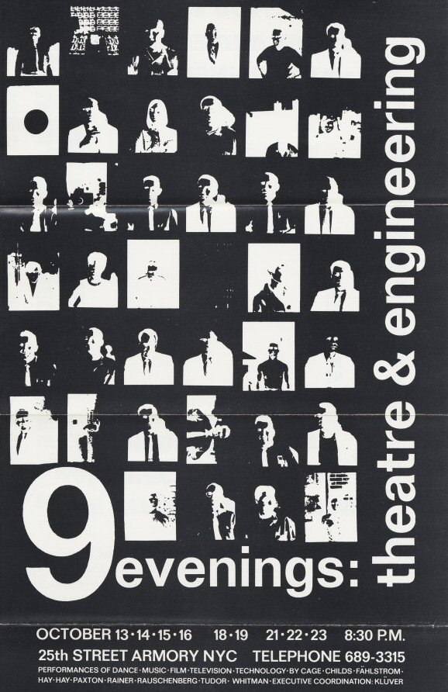
MULTIMÉDIÁ / MÉDIÁ A PERFORMANCE:
R.Rauschenberg: 9 Evenings: Theatre & Engineering (1966)
http://www.fondation-langlois.org/html/e/selection.php?Selection=9EVO

Slide 6
MULTIMÉDIÁ / MÉDIÁ A PERFORMANCE:
R.Rauschenberg: 9 Evenings: Theatre & Engineering (1966)
http://www.youtube.com/watch?v=DoxuzPPstXc
Open Score, 9 Evenings: Theater and Engineering, 1966
https://vimeo.com/107488380
http://www.youtube.com/watch?v=W-cgnK-kFoo
John Cage / VARIATIONS VII.
https://www.youtube.com/watch?v=JxeFhRZwU84

Slide 7
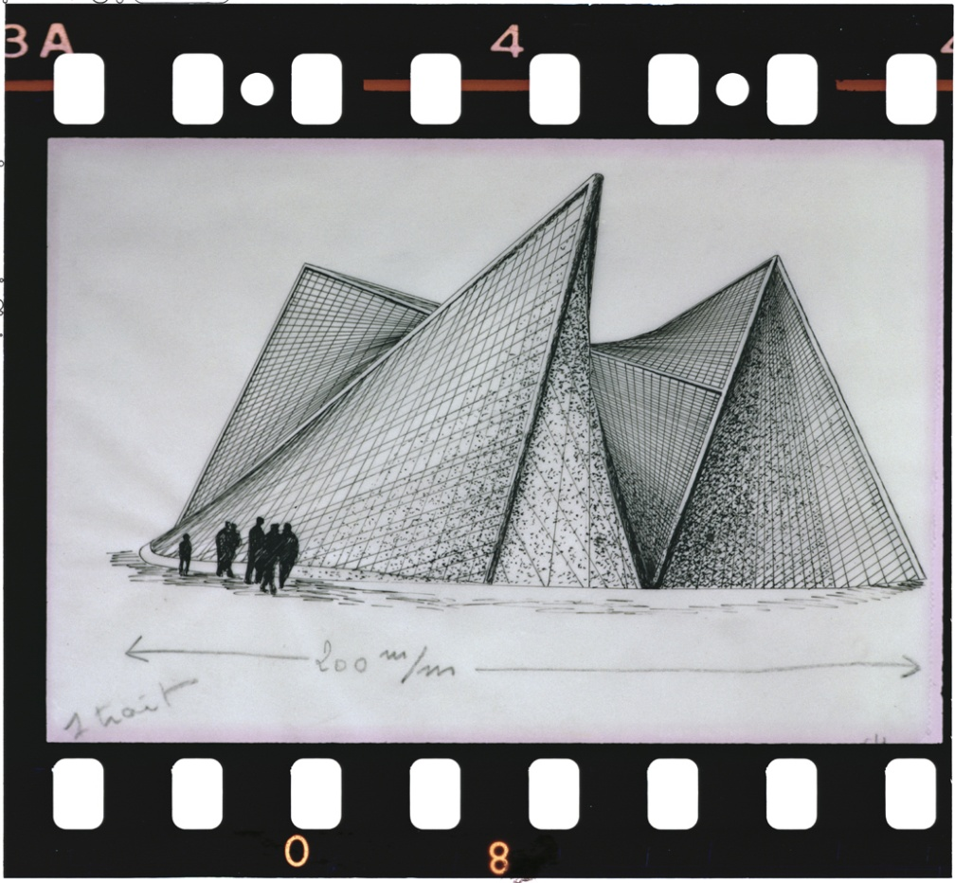
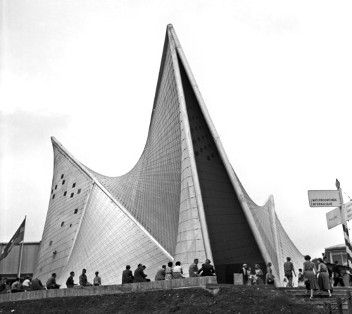
PHILIPS Pavillion 1958 EXPO Brusel
geste électronique total)

Slide 8
Iannis Xenakis: Electronic music /DIATOPES
Fenomén Expo: Edgard Varèse - Le Corbusier - Iannis Xenakis:
Poème électronique (Expo, 1958)
http://www.youtube.com/watch?v=0YlBmx3VulY
Virtualna rekonštrukcia pavilonu philips:
https://www.youtube.com/watch?v=YVJgOtZT-b8&index=7&list=PL-RzUsgEgwvdJombm7DsQJKg0CRRclXsz

Slide 9
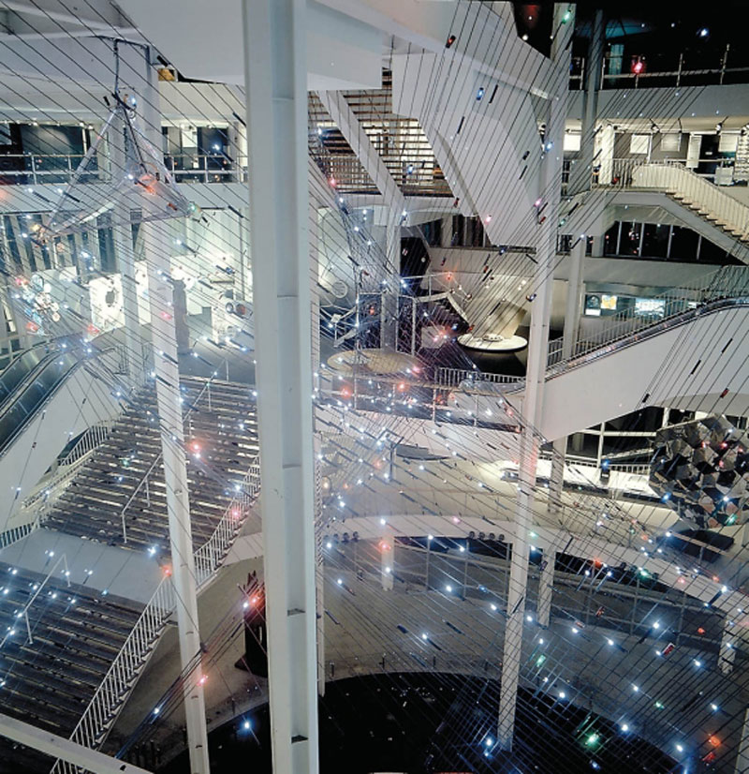
Montreal 1967 Polytope
https://www.youtube.com/watch?v=Af_JlAQQ7n8&t=129s
Xenakis Iannis Polytope de Cluny 1972 1974
https://www.youtube.com/watch?v=nVx0PvK9TnQ

Slide 10
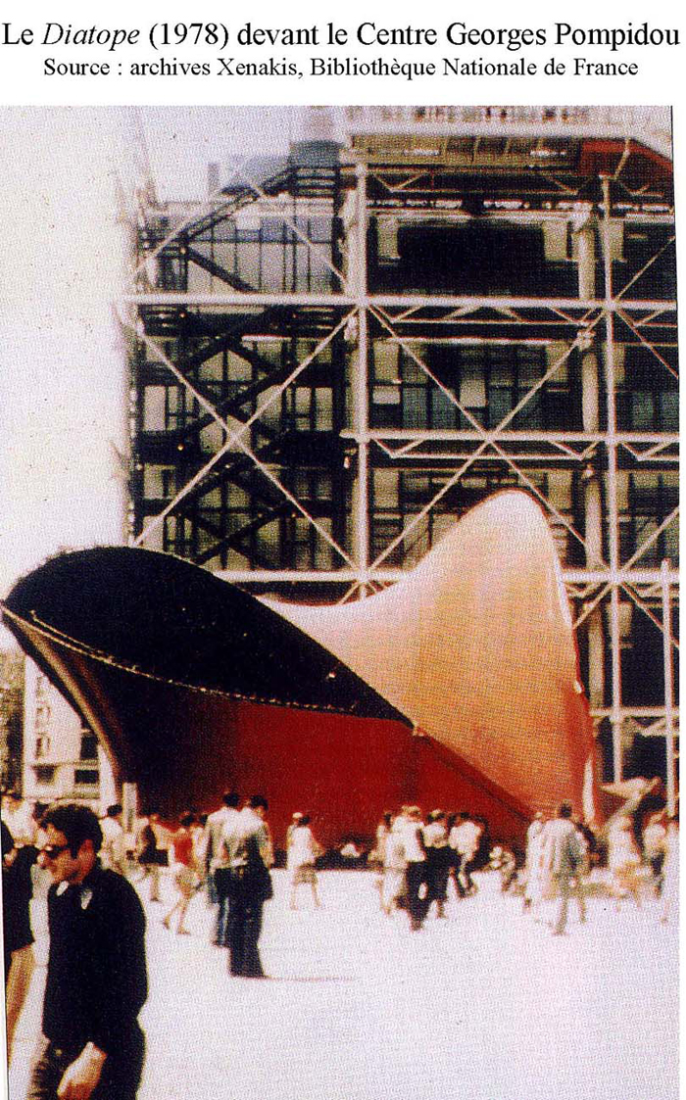
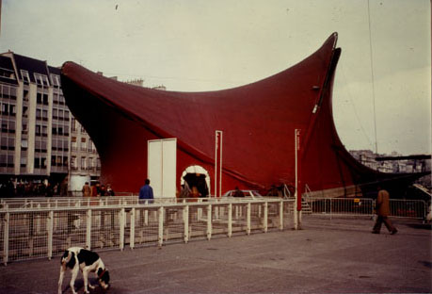
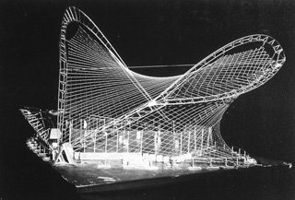
Diatope, 1978 Paris I.Xennakis: Xenakis: La Légende d'Eer (1977-78) https://www.youtube.com/watch?v=Nh7tVwcknb4

Slide 11
Three Tales
documentary digital video opera (1998-2002) Music: Steve Reich Video: Beryl Korot
Na novej úrovni spracováva dobové dokumenty, rozhovory
META-FILM a práca s readymade
OPERA alebo VIDEOKLIP?
1. Hindenburg, 2. Bikini, 3. Dolly
https://www.youtube.com/watch?v=AJ8nO5XOhRc

Slide 12
Karlheinz Stockhausen:
Gesang der Junglinge" (Song of the Youths) (1955-56)
the first masterpiece of electronic music
https://www.youtube.com/watch?v=Y1Psx24n3rM
Helicopter string quartet (1995)
http://www.youtube.com/watch?v=7ykQFrL0X74

