Slide 1
Taiwan: Island at the Crossroads
Evan Dawley
Goucher College
Baltimore, MD

Slide 2
Session 1: Taiwan’s History to 1945

Slide 3
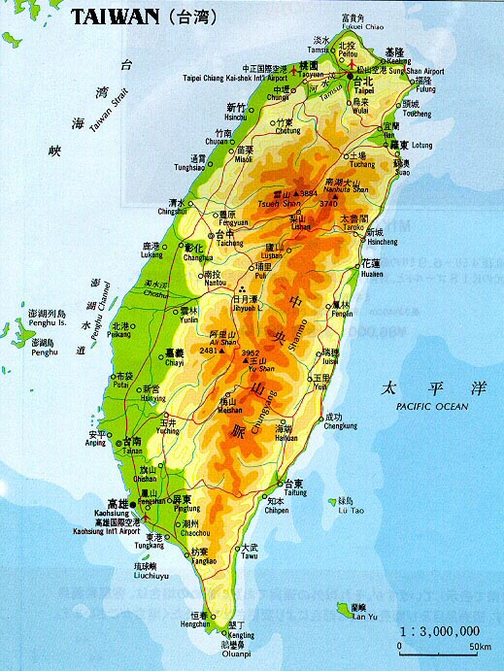

Slide 4
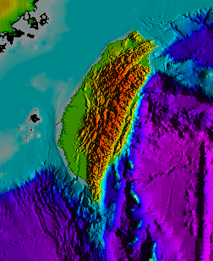

Slide 5
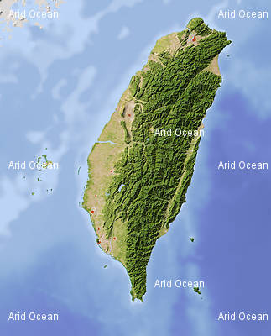

Slide 7
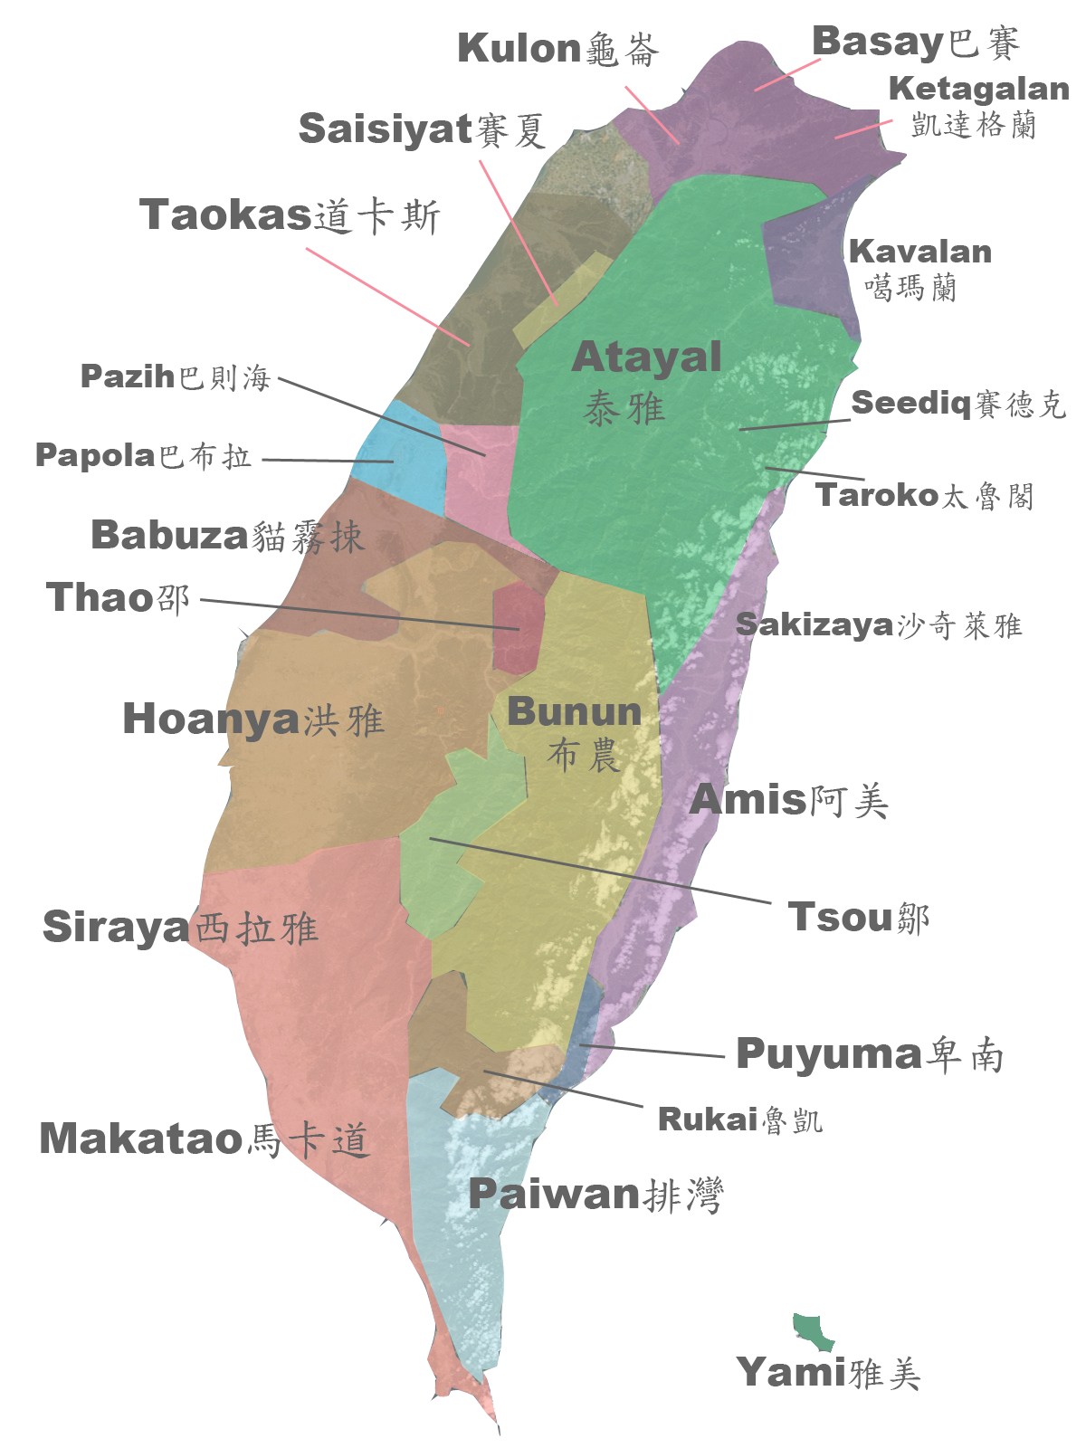

Slide 9
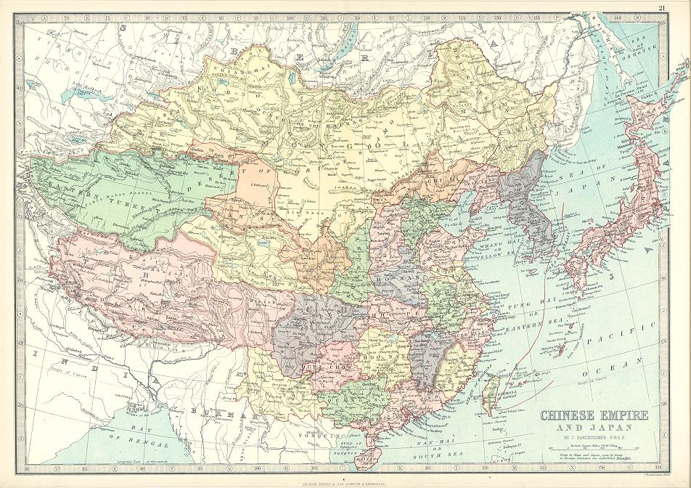

Slide 10
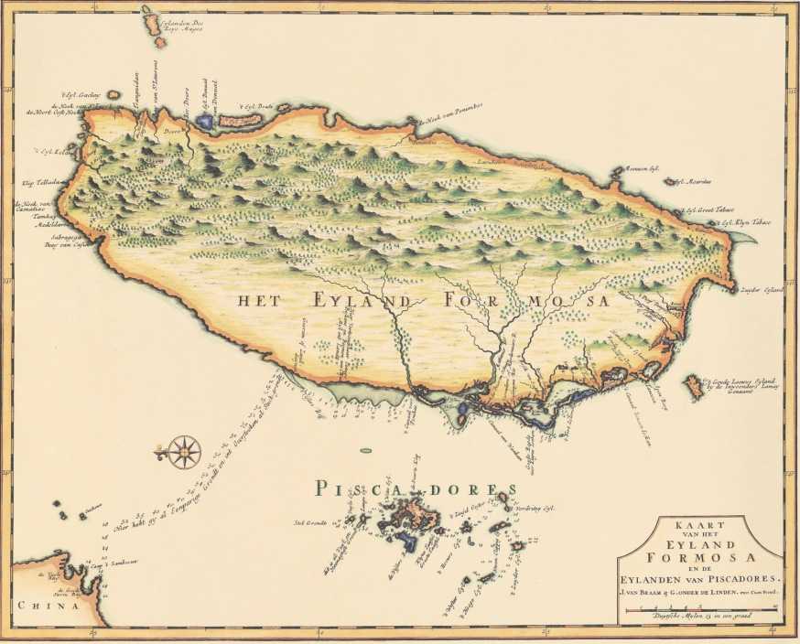

Slide 11
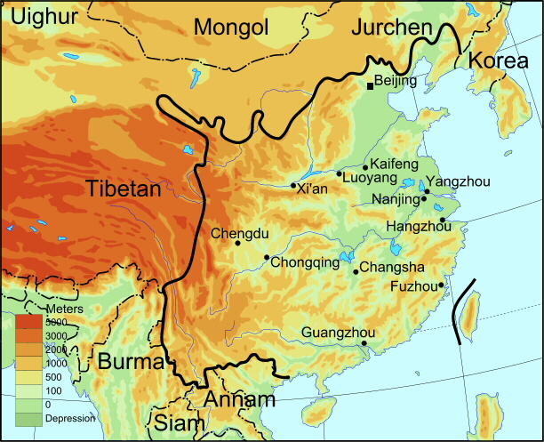

Slide 12
Questions about Accounts of Aborigines:
What aspects of aborigine life do the authors focus on?
How do they describe these characteristics? What words do they use?
What is their general opinion of aborigine life, culture, and society?
Why do the different authors hold their views of the aborigines?
How do the different accounts compare to each other? Are they similar or different? Why?

Slide 14
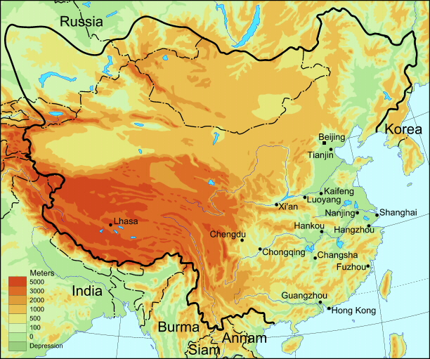

Slide 15
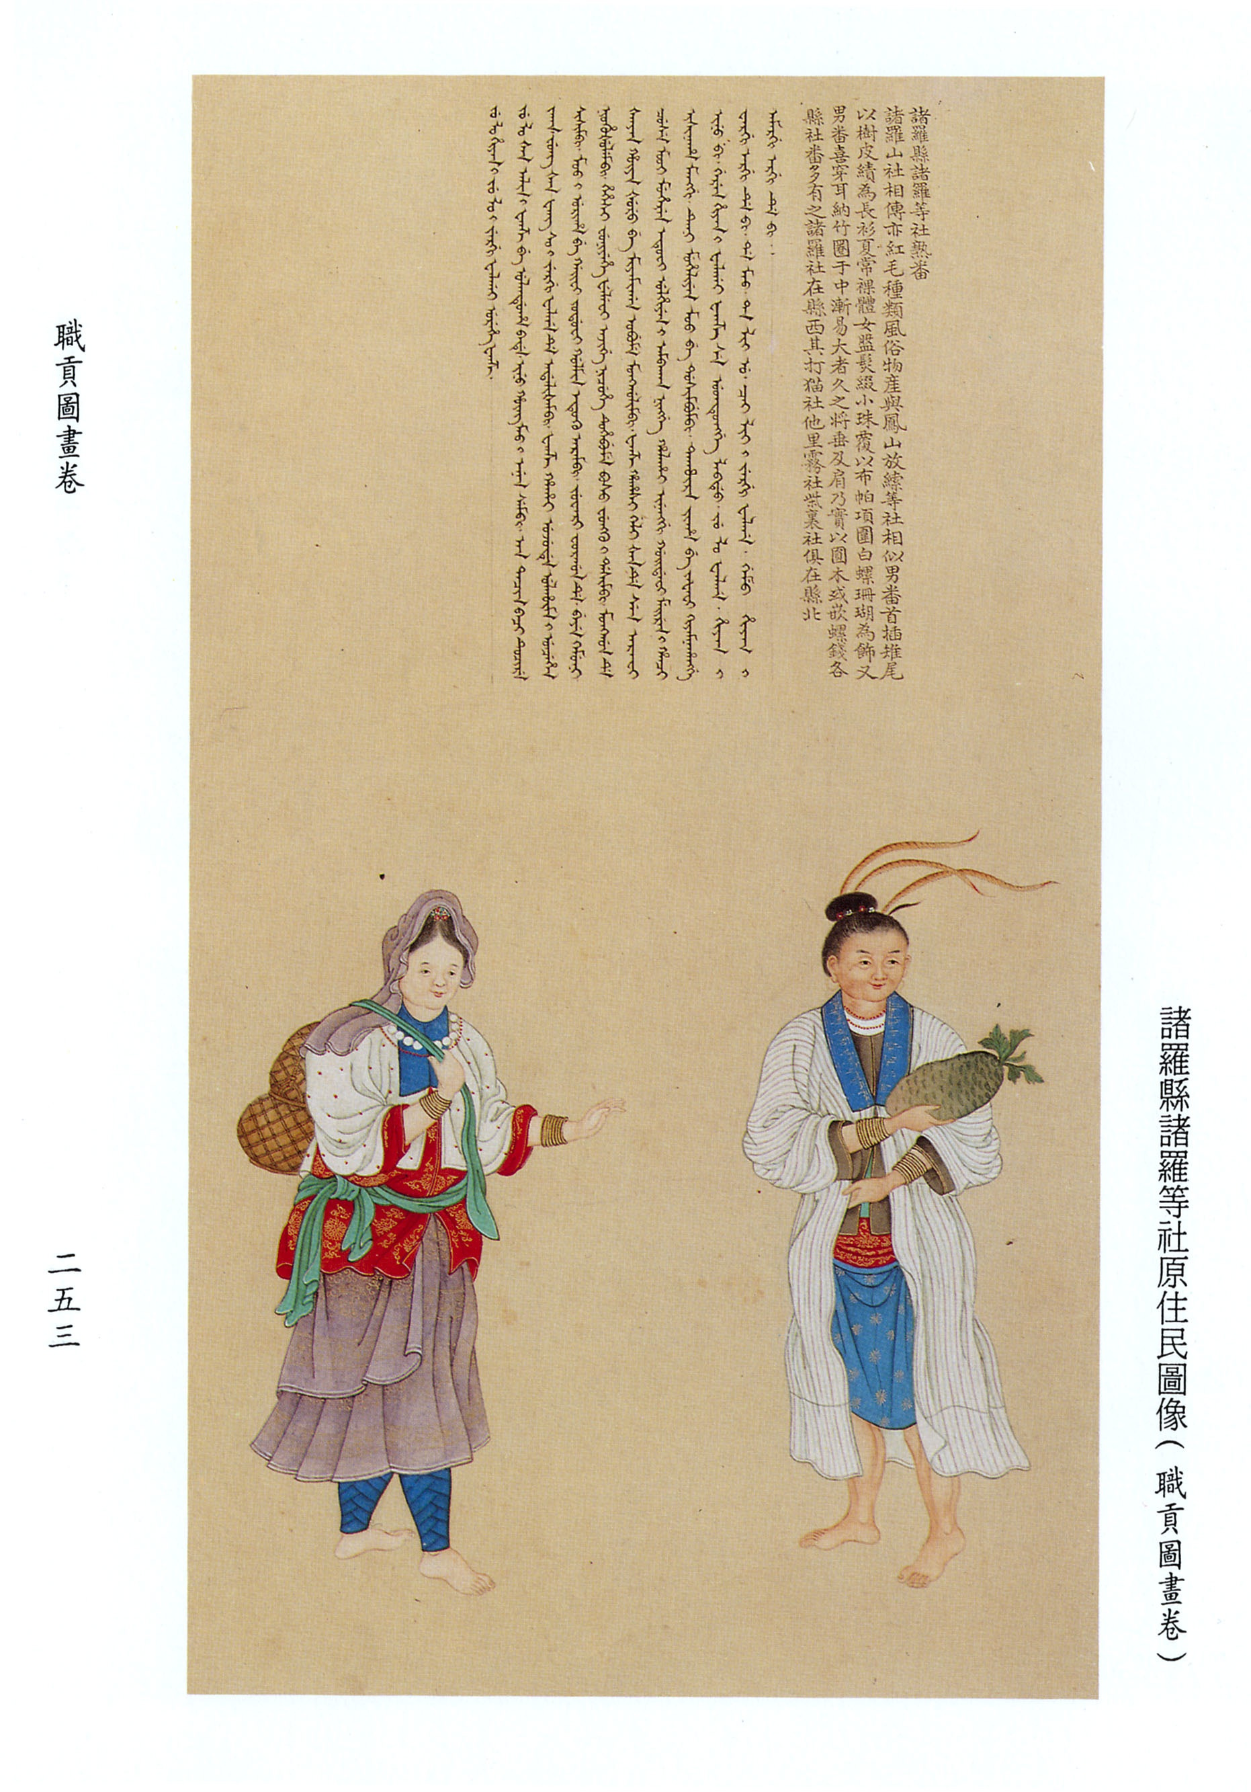
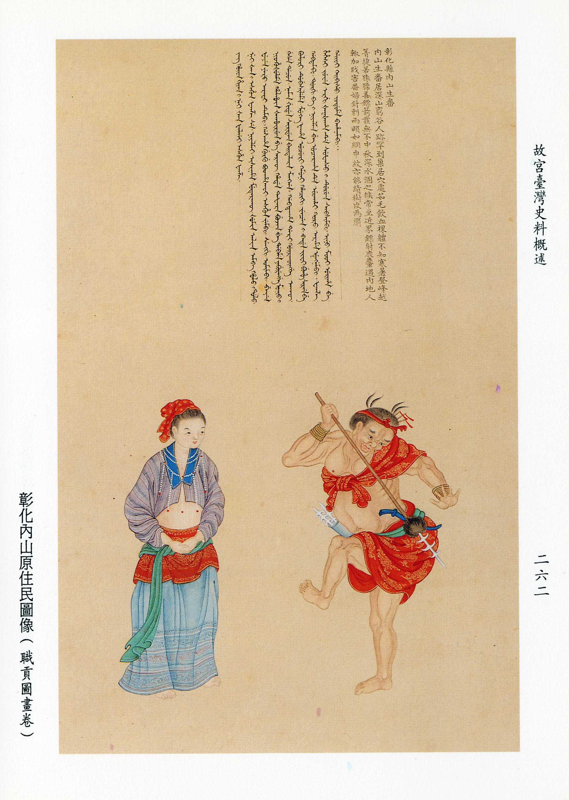
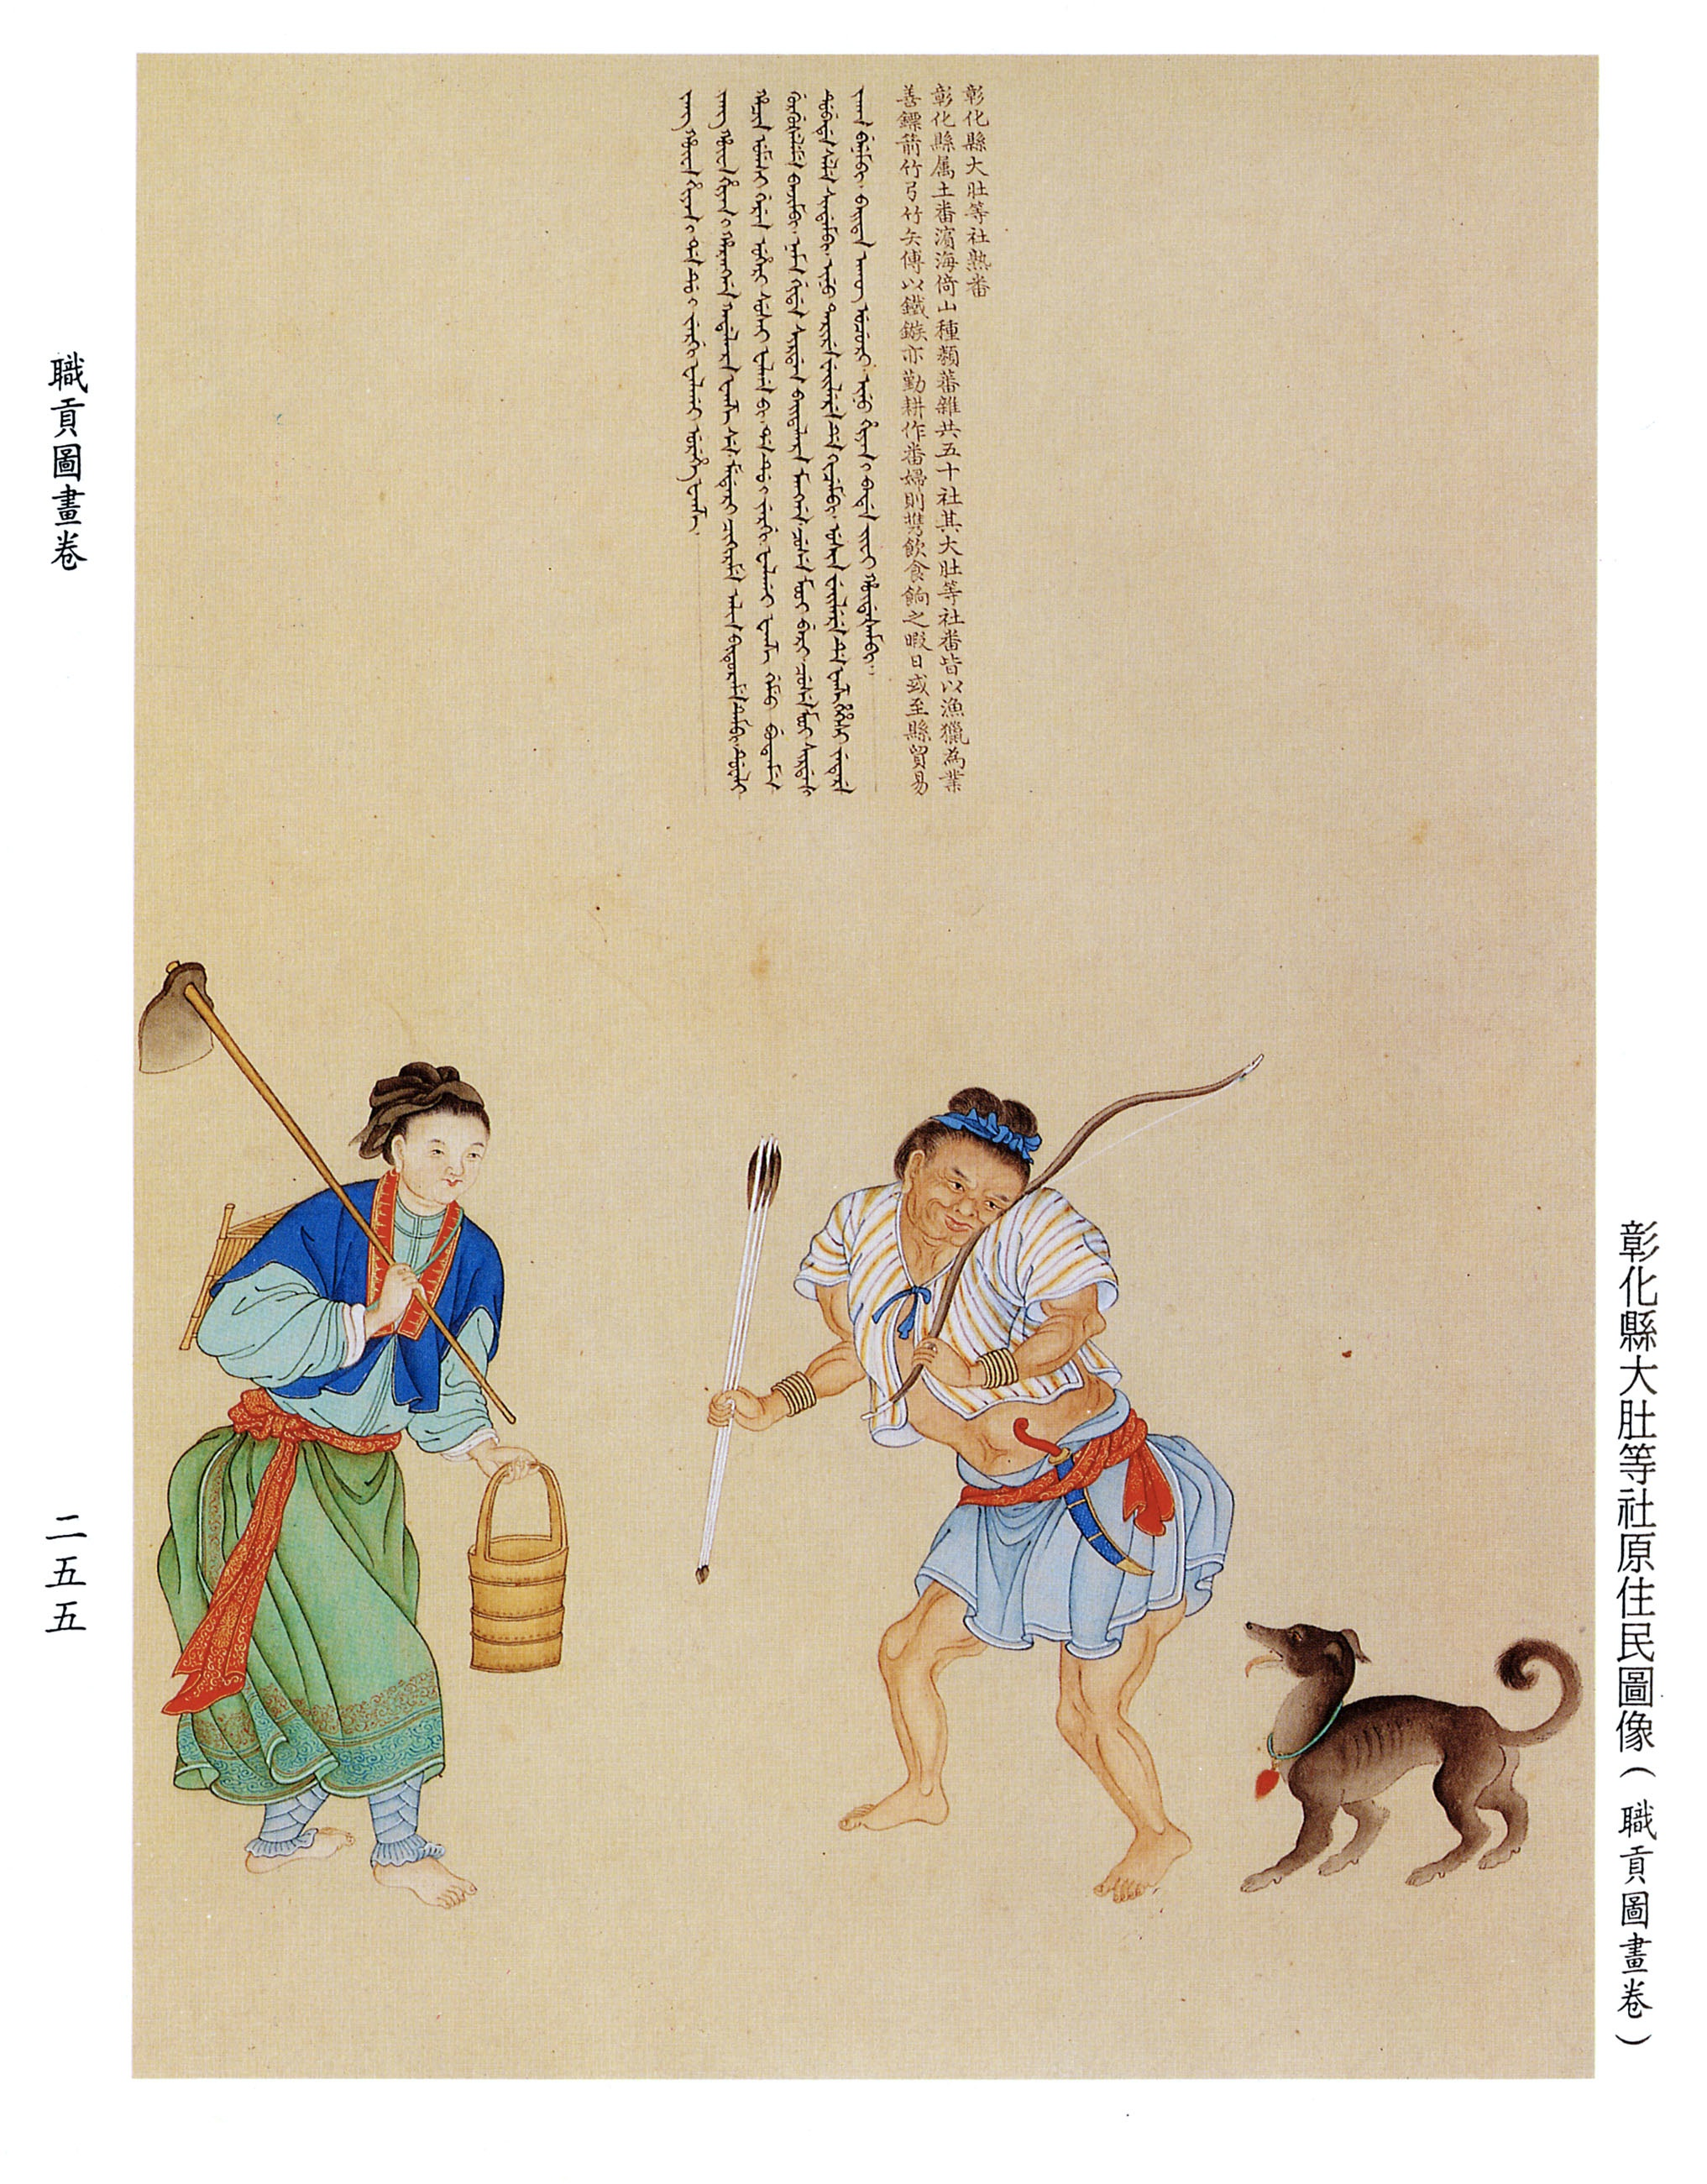
Images from Encyclopedia of China’s Peoples, presented to Qianlong Emperor, 1770s

Slide 17
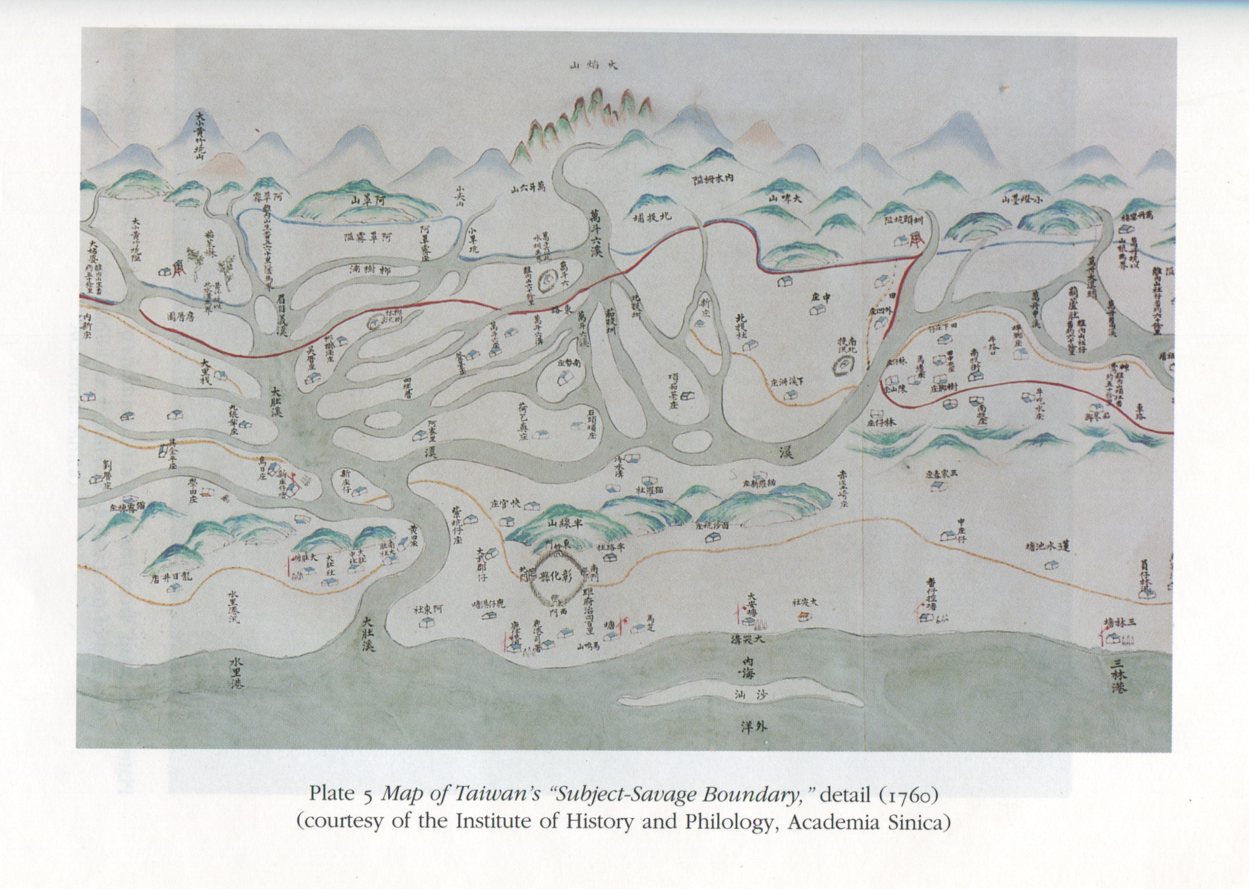

Slide 19
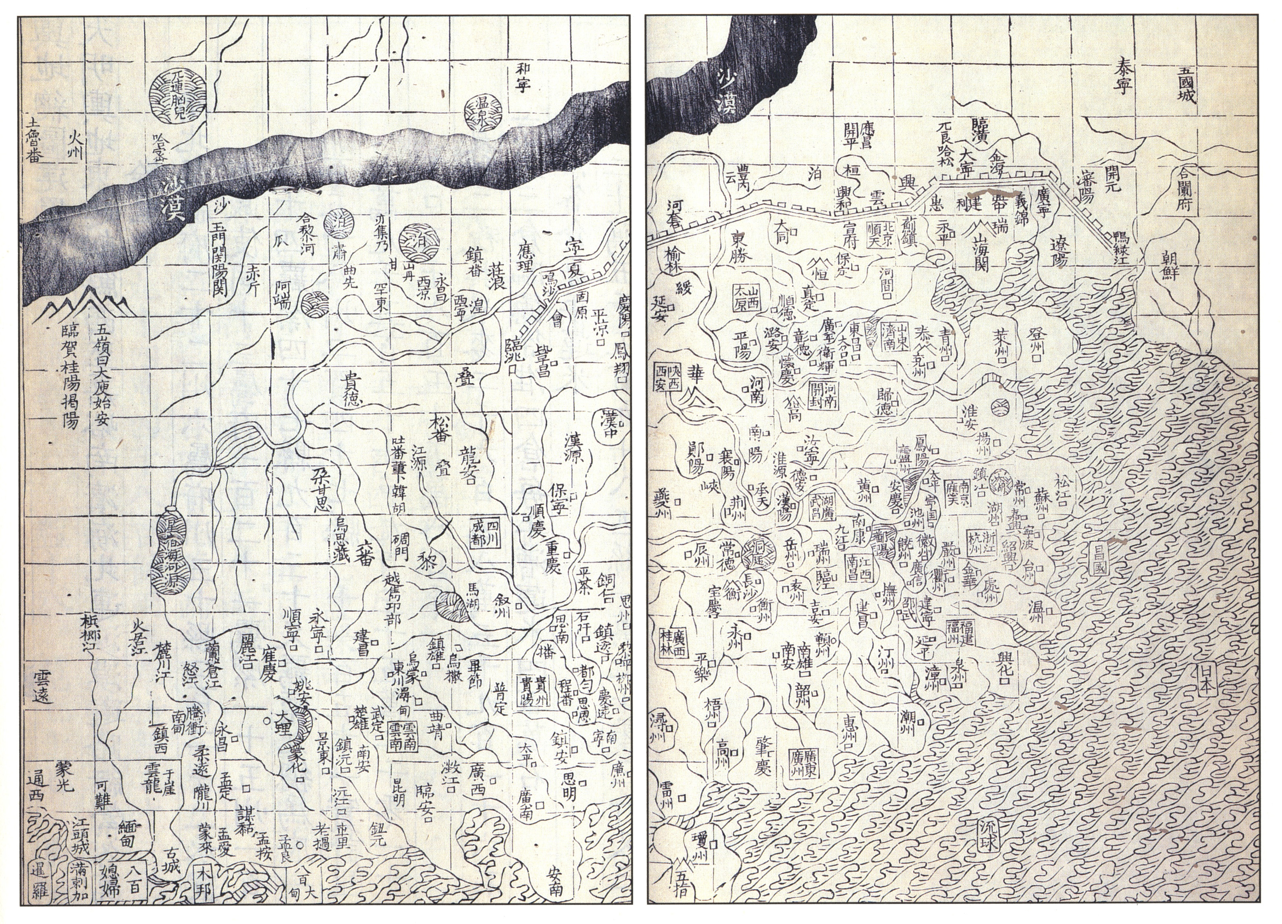
Map of China, Ming Dynasty

Slide 20
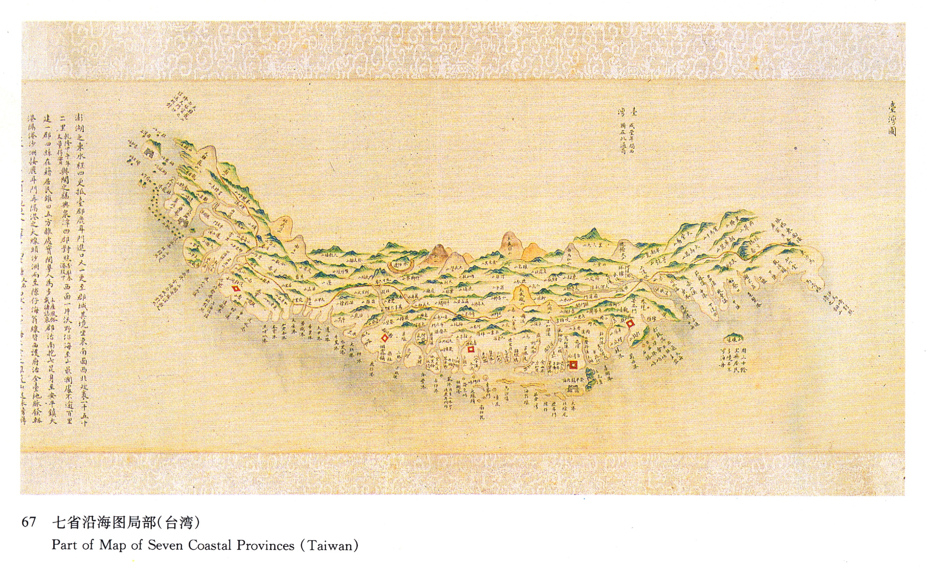
Map of Taiwan, 18th Century

Slide 21
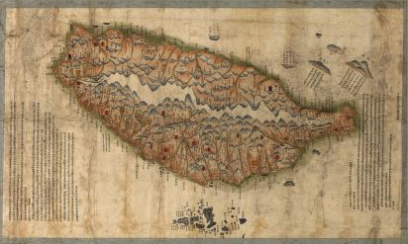
Map of Taiwan, Late 19th Century

Slide 22
Itō Hirobumi to Wu Tingfang, after first attempt at peace talks failed (February 1895):
“As soon as you return home, convey to Viceroy Li [Hongzhang] this message…that our refusal to continue negotiations with these particular Chinese envoys is not prompted by any love of war or distaste for peace…we are therefore fully prepared to resume negotiations whenever China becomes sincerely desirous of peace and appoints properly qualified plenipotentiaries. China remains the repository of many old customs and traditions, and the Peking government frequently seems unable to observe the universal practices of international intercourse. Nevertheless, on this particular issue we insist that China act in accordance with the prevailing rules of international law.”

Slide 23
Summary of Comments made by Li Hongzhang during Talks at Shimonoseki (March 1895):
“At least, he declared, the current war had had two beneficial consequences. First, Japan’s remarkable success in the utilization of European-style military organizations had given the world practical proof that the yellow races were in no way inferior to the white man. And second, the war had fortunately awakened China from her long slumber. By encouraging China to rouse herself, Japan made made a great contribution to China’s future progress. Hence, while many in China hated Japan bitterly, Li felt there was much for which Japan should be thanked. He reiterated that Japan and China were the two great powers of Asia; and as Japan was second to none of the powers in her knowledge and ability, while China possessed inexhaustible natural resources, he insisted that the two would find it easy to oppose the Western powers if only they joined hands together in common cause.”

Slide 24
Commentary on Li’s Remarks by Mutsu Munemitsu:
“These words were little more than the daily fare we have now come to expect from Asian statesmen, but it was still interesting to see how he attempted to win our sympathy by his long and fluent discourse, and to watch how he tried to conceal the humiliating position in which China’s defeat had placed him by offering amicable analyses of the world situation. It made the old rogue a bit lovable and showed that we was truly worthy of his rank as the greatest man of his era in China.”

Slide 26
