Slide 1
Session 2:
The Nationalist Regime on Taiwan

Slide 3
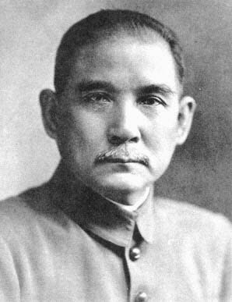
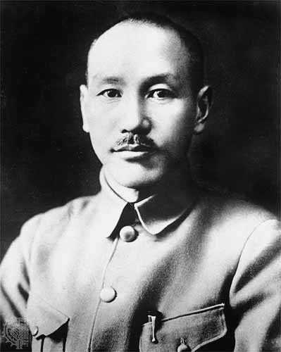
Sun Yat-sen
(Sun Zhongshan)
Chiang Kai-shek
(Jiang Jieshi)

Slide 4
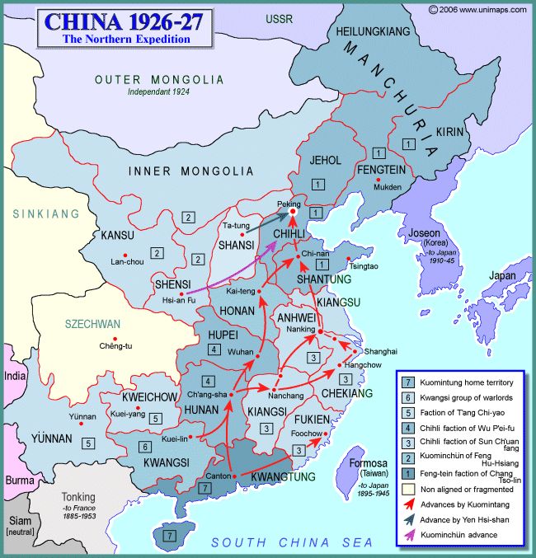

Slide 5
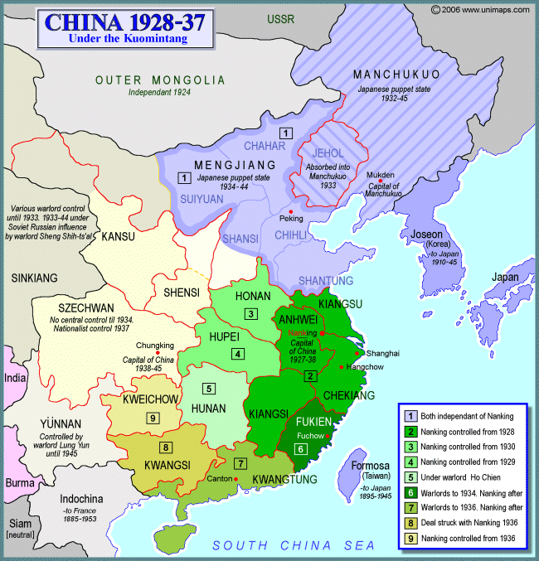

Slide 7
Questions on Documents:
What happened in Taiwan in February and March, 1947?
What motivated the Taiwanese?
What motivated the Chinese?
How do the events in these documents compare to what was in the film?

Slide 9
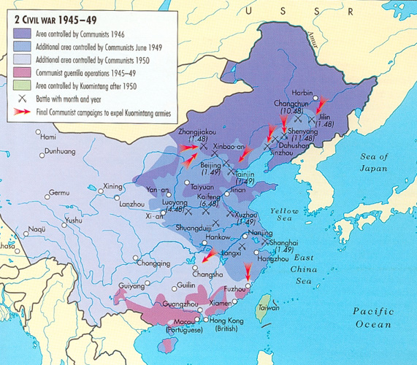

Slide 11
The Treaty of Peace between the Republic of China and Japan (aka, The Taipei Treaty), 1952

Slide 12
Mutual Defense Treaty between the United States of America and the Republic of China, 1954

Slide 14
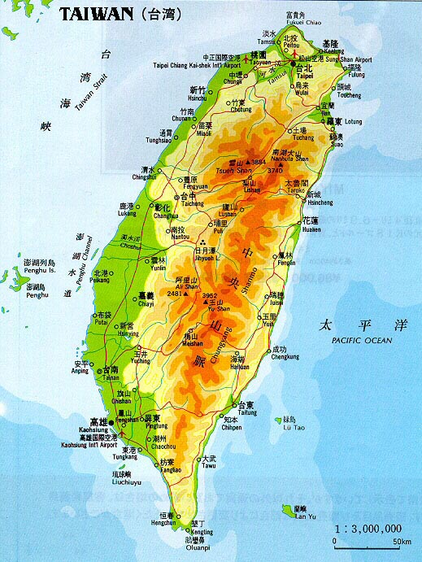

Slide 16
The Shanghai Communique, 1972
11. The two sides reviewed the long-standing serious disputes between China and the United States. The Chinese side reaffirmed its position: the Taiwan question is the crucial question obstructing the normalization of relations between China and the United States; the Government of the People's Republic of China is the sole legal government of China; Taiwan is a province of China which has long been returned to the motherland; the liberation of Taiwan is China's internal affair in which no other country has the right to interfere; and all U.S. forces and military installations must be withdrawn from Taiwan. The Chinese Government firmly opposes any activities which aim at the creation of "one China, one Taiwan", "one China, two governments", "two Chinas", an "independent Taiwan" or advocate that "the status of Taiwan remains to be determined".
12. The U.S. side declared: The United States acknowledges that all Chinese on either side of the Taiwan Strait maintain there is but one China and that Taiwan is a part of China. The United States Government does not challenge that position. It reaffirms its interest in a peaceful settlement of the Taiwan question by the Chinese themselves. With this prospect in mind, it affirms the ultimate objective of the withdrawal of all U.S. forces and military installations from Taiwan. In the meantime, it will progressively reduce its forces and military installations on Taiwan as the tension in the area diminishes. The two sides agreed that it is desirable to broaden the understanding between the two peoples. To this end, they discussed specific areas in such fields as science, technology, culture, sports and journalism, in which people-to-people contacts and exchanges would be mutually beneficial. Each side undertakes to facilitate the further development of such contacts and exchanges.

Slide 18
The Second Communiqué, January 1, 1972

Slide 19
The Taiwan Relations Act
(enacted by U.S. Congress, April 1979)

