Slide 1
Session 3:
The Taiwan Independence Movement in Global Context

Slide 2
The Shanghai Communique, 1972
11. The two sides reviewed the long-standing serious disputes between China and the United States. The Chinese side reaffirmed its position: the Taiwan question is the crucial question obstructing the normalization of relations between China and the United States; the Government of the People's Republic of China is the sole legal government of China; Taiwan is a province of China which has long been returned to the motherland; the liberation of Taiwan is China's internal affair in which no other country has the right to interfere; and all U.S. forces and military installations must be withdrawn from Taiwan. The Chinese Government firmly opposes any activities which aim at the creation of "one China, one Taiwan", "one China, two governments", "two Chinas", an "independent Taiwan" or advocate that "the status of Taiwan remains to be determined".
12. The U.S. side declared: The United States acknowledges that all Chinese on either side of the Taiwan Strait maintain there is but one China and that Taiwan is a part of China. The United States Government does not challenge that position. It reaffirms its interest in a peaceful settlement of the Taiwan question by the Chinese themselves. With this prospect in mind, it affirms the ultimate objective of the withdrawal of all U.S. forces and military installations from Taiwan. In the meantime, it will progressively reduce its forces and military installations on Taiwan as the tension in the area diminishes. The two sides agreed that it is desirable to broaden the understanding between the two peoples. To this end, they discussed specific areas in such fields as science, technology, culture, sports and journalism, in which people-to-people contacts and exchanges would be mutually beneficial. Each side undertakes to facilitate the further development of such contacts and exchanges.

Slide 4
The Second Communiqué, January 1, 1972

Slide 5
The Taiwan Relations Act
(enacted by U.S. Congress, April 1979)

Slide 7
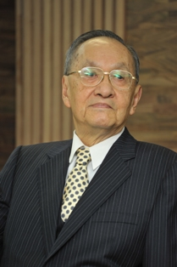
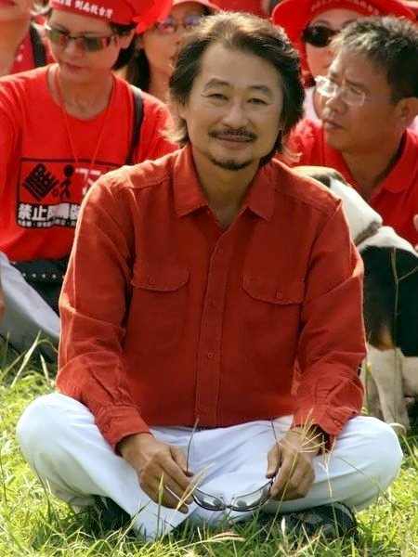
Peng Ming-min
Shih Ming-te

Slide 9
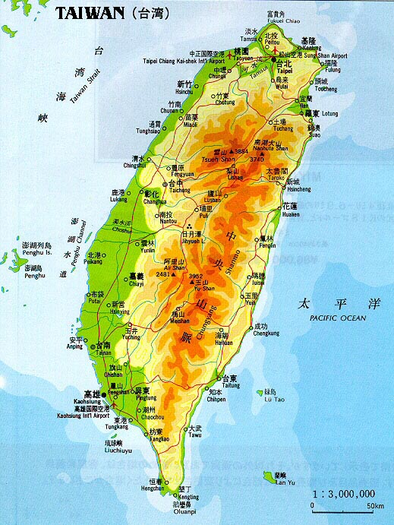

Slide 10
Mao Zedong on Taiwan, 1936
Edgar Snow: “Is it the immediate task of the Chinese people to regain all the territories lost to Japanese imperialism, or to only drive Japan from North China, and all Chinese territory beyond the Great Wall?”
      Mao: “It is the immediate task of China to regain all our lost territories, not merely to defend our sovereignty south of the Great Wall. This means that Manchuria must be regained. We do not, however, include Korea, formerly a Chinese colony, but when we have reestablished the independence of the lost territories of China, and if the Koreans wish to break away from the chains of Japanese imperialism, we will extend them our enthusiastic help in their struggle for independence. The same thing applies for Taiwan.”

Slide 12
Deng Xiaoping on Taiwan, 1979
“Our great motherland belongs to us and to you. The reunification of the motherland is the sacred mission history has handed to our generation. Times are moving ahead and the situation is developing. The earlier we fulfill this mission, the sooner we can jointly write an unprecedented, brilliant page in the history for our country, catch up with advanced powers and work together with them for world peace, prosperity and progress. Let us join hands and work together for this glorious goal!”

Slide 13
Jiang Zemin’s Eight Points on Taiwan, 1995

Slide 14
Hu Jintao’s Six Points on Taiwan, 2008
firm adherence to the 'one China' principle
strengthening commercial ties, including negotiating an economic cooperation agreement
promoting personnel exchanges
stressing common cultural links between the two sides
allowing Taiwan's 'reasonable' participation in global organizations
negotiating a peace agreement

Slide 16
The Third Communiqué, 1982
The Six Assurances to Taiwan, 1982

Slide 18
The PRC-Japan Joint Communiqué, 1972

