Slide 1
Session 4:
Taiwan in the Age of Democracy

Slide 2
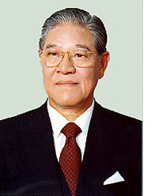
Lee Teng-hui

Slide 3
Both sides of the Taiwan Strait agree that there is only one China. However, the two sides of the Strait have different opinions as to the meaning of "one China." To Peking, "one China" means the "People's Republic of China (PRC)," with Taiwan to become a "Special Administration Region" after unification. Taipei, on the other hand, considers "one China" to mean the Republic of China (ROC), founded in 1911 and with de jure sovereignty over all of China. The ROC, however, currently has jurisdiction only over Taiwan, Penghu, Kinmen, and Matsu. Taiwan is part of China, and the Chinese mainland is part of China as well.
- Taiwan’s Mainland Affairs Commission (MAC), 1992

Slide 4
The “1992 Consensus”
ARATS: At this working-level consultation in Hong Kong, SEF representatives suggested that each side use respective verbal announcements to state the one China principle. On November 3rd, SEF sent a letter to ARATS, formally notifying that "each side will make respective statements through verbal announcements." ARATS fully respects and accepts SEF's suggestion.
SEF: Peking has agreed to a Taipei proposal that both sides "orally state" their respective "one China" positions. ... Though both sides of the Taiwan Strait insist on the "one China" principle in the process of joining efforts to pursue national unification, they have different understandings about the substance of "one China."

Slide 6
Lee Teng-hui’s Speech to Cornell, June 1995
When a president carefully listens to his people, the hardest things to bear are the unfulfilled yearnings he hears. Taiwan has peacefully transformed itself into a democracy. At the same time, its international economic activities have exerted a significant influence on its relations with nations with which it has no diplomatic ties. These are no minor accomplishments for any nation, yet, the Republic of China on Taiwan does not enjoy the diplomatic recognition that is due from the international community. This has caused many to underestimate the international dimension of the Taiwan Experience.
Frankly, our people are not happy with the status accorded our nation by the international community. We believe that international relations should not be solely seen in terms of formal operations regulated by international law and international organizations. We say so because there are semi-official and unofficial rules that bind the international activities of nations. This being so, we submit that a nation's substantive contribution to the international community has to be appreciated in light of such non-official activities as well.

Slide 8
DPP Party Platform, March 1995
A. The Establishing of a Sovereign and Independent Republic of Taiwan: Territorial Sovereignty and nationality are the preconditions for modern sovereign nations to establish the rule of law and to develop international relations. The fact that Taiwan is sovereign and independent, that it does not belong to the People's Republic of China, and that the sovereignty of Taiwan does not extend to mainland China, reflect historical realities as well as the present situation, and at the same time they form part of the consensus of the international community. In accordance with the reality of Taiwan’s sovereignty, an independent country should be established and a new constitution drawn up in order to make the legal system conform to the social reality in Taiwan and in order to return to the international community according to the principles of international law.

Slide 9
Lee Teng-hui’s Speech to Cornell, June 1995
When a president carefully listens to his people, the hardest things to bear are the unfulfilled yearnings he hears. Taiwan has peacefully transformed itself into a democracy. At the same time, its international economic activities have exerted a significant influence on its relations with nations with which it has no diplomatic ties. These are no minor accomplishments for any nation, yet, the Republic of China on Taiwan does not enjoy the diplomatic recognition that is due from the international community. This has caused many to underestimate the international dimension of the Taiwan Experience.
Frankly, our people are not happy with the status accorded our nation by the international community. We believe that international relations should not be solely seen in terms of formal operations regulated by international law and international organizations. We say so because there are semi-official and unofficial rules that bind the international activities of nations. This being so, we submit that a nation's substantive contribution to the international community has to be appreciated in light of such non-official activities as well.

Slide 11
Lee Teng-hui’s Inaugural Address, 1996
In an attempt to influence the outcome of the first popular presidential election in March, the Chinese Communists conducted a series of military exercises against Taiwan, but unrivaled restraint prevailed in this country. We know that it is imperative that peace and stability be maintained in the Asia-Pacific region. More important, we would not like to see the sudden disappearance of the economic growth in mainland China that has been made possible with great difficulty by its openness policy over the years. Patience on the part of the 21.3 million people is not tantamount to cowardice. Because we believe quiet tolerance is the only way to dispel enmity bred by confrontation. We will never negotiate under threat of attack, but we do not fear to negotiate. Our position is that dialogue will lead to the resolution of any issues between the two sides of the Taiwan Straits… My fellow countrymen: We in Taiwan have realized the Chinese dream. The Chinese of the 20th century have been striving for the realization of a happy, wealthy China and of Dr. Sun Yat-sen's "popular sovereignty" ideal. For 50 years, we have created in the Taiwan, Penghu, Kinmen and Matsu area an eye-catching "economic miracle" and achieved a world-acclaimed democratic reform.

Slide 13
National Chengchi University Election Study Center

Slide 15
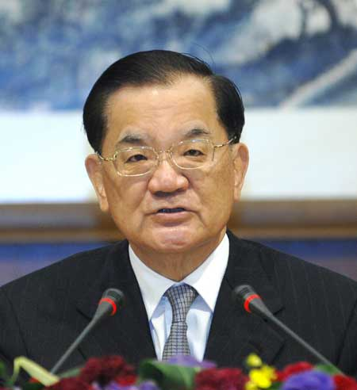
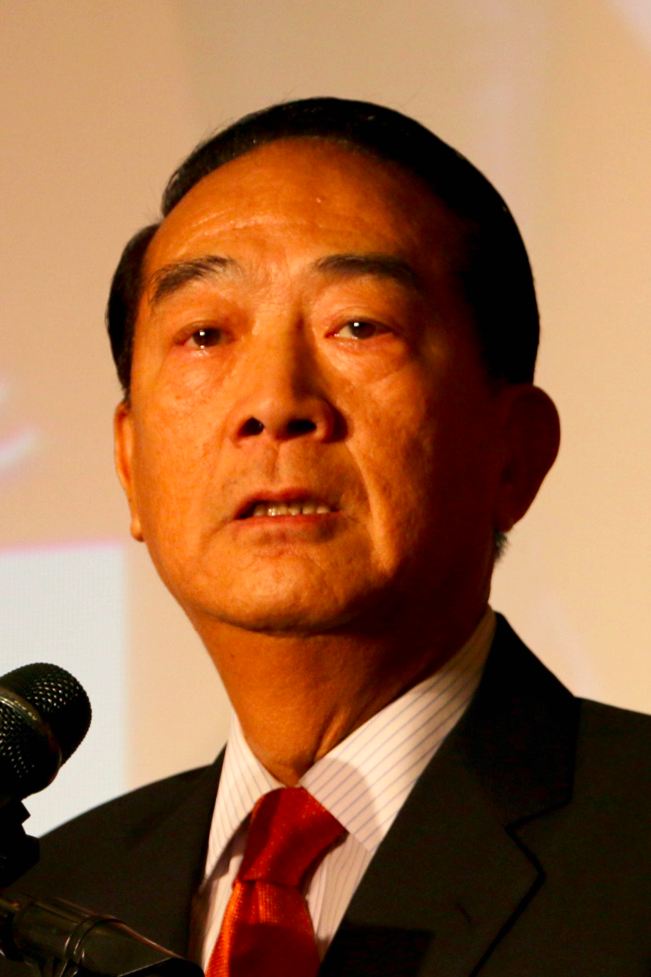
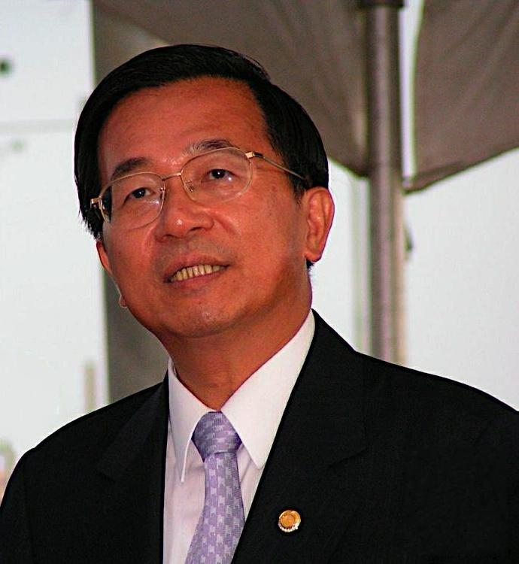
Major Presidential Candidates, 2000 Election
Lien Chan
Nationalist Party (KMT)
James Soong
People’s First Party (PFP)
Chen Shui-bian
Democratic Progressive Party (DPP)

Slide 16
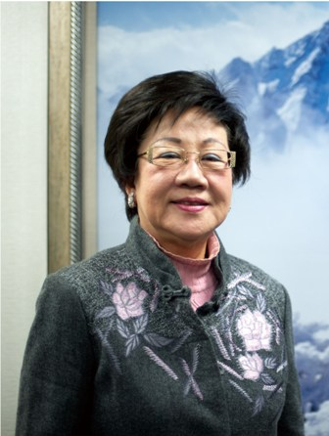
The DPP in Power
Chen Shui-bian
Annette Lu Hsiu-lien

Slide 18
PRC Anti-Secession Law, Promulgated 14 March 2005:
Article 8: In the event that the "Taiwan independence" secessionist forces should act under any name or by any means to cause the fact of Taiwan's secession from China, or that major incidents entailing Taiwan's secession from China should occur, or that possibilities for a peaceful re-unification should be completely exhausted, the state shall employ non-peaceful means and other necessary measures to protect China's sovereignty and territorial integrity.
The State Council and the Central Military Commission shall decide on and execute the non-peaceful means and other necessary measures as provided for in the preceding paragraph and shall promptly report to the Standing Committee of the National People's Congress.

