Slide 1
CEE investments in China (activities of Skoda company in China)
František Milan
Veronika sokolíková
Elvina Kurtasanov
Zuzana dulovcová

Slide 2


Since 2007
SAIC Volkswagen Automotive Company
FABIA, OCTAVIA, YETI, RAPID, RAPID SPACEBACK, SUPERB, KAROQ, KODIAQ, KAMIQ
2017 – Vision E electromobile

Slide 3
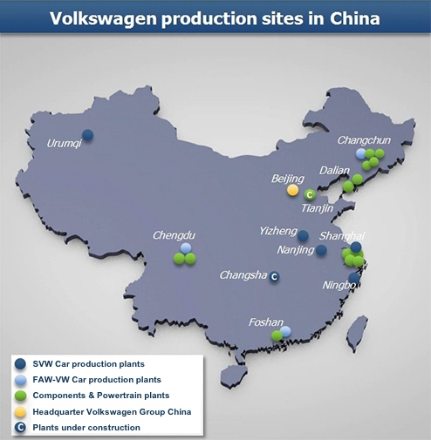
Production plants :
Anting
Yizheng
Nanjing
Ningbo
Changsha
more than 2 million ŠKODA cars produced in China by 2017

Slide 4
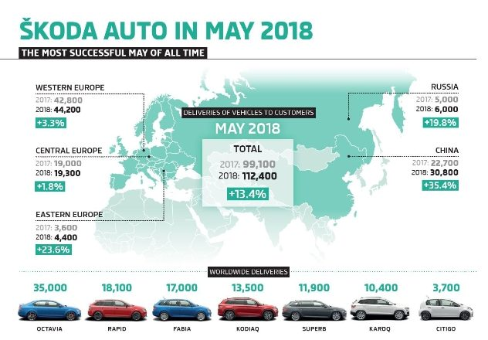
China became the largest single market for ŠKODA.
The bestseller = Skoda Octavia (1,2 mil.)

Slide 5
BUSINESS MODELS FOR SKODA
SWOT-analysis (Strengths,Weaknesses – (of the company )
opportunities, Threats (of the market)
4Ps ( product, place, price, promotion )
Five-forces model ( Bariers to entry. barging power of supliers, The threat of potential entrants, the threat of alternatives, competitions among comapnies

Slide 6
THE BACKGROUND OF CHINESE AUTO MARKETING
The Introduction of Main Brands In Chinese Auto Market
(Volkswagen, Hongguang (domestic), Toyota, Saic GM (domestic)
Five Forces Model to Analyze Chinese Auto Market (restrictions, joint ventur, supliers power of buyers )
Five major tremds in China´s auto industry for future (electrification,car sharing, car inteligence,)

Slide 7
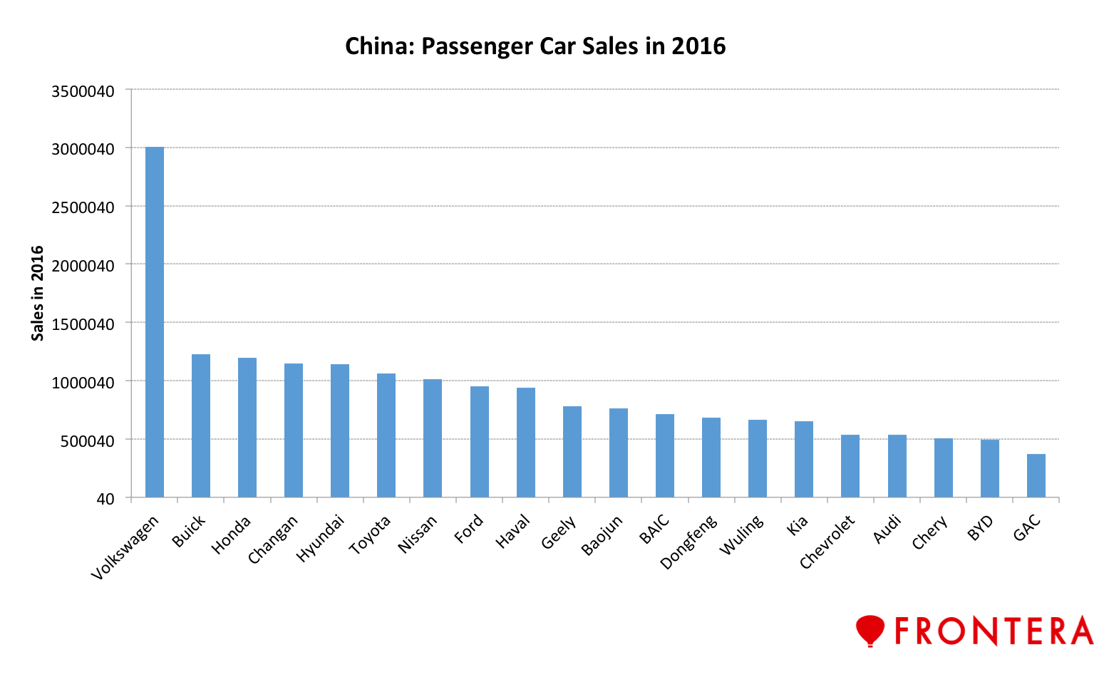

Slide 8
ANALYZE CASE OF VOLKSWAGEN IN CHINA
The Background of Volkswagen (the largest group of auto industry in Europe )
The brand Strategy of Volkswagen (folk car )
The Ability of Competition In Volkswagen (can offer different brands: (Porsche, Audi, Bentley,... )

Slide 9
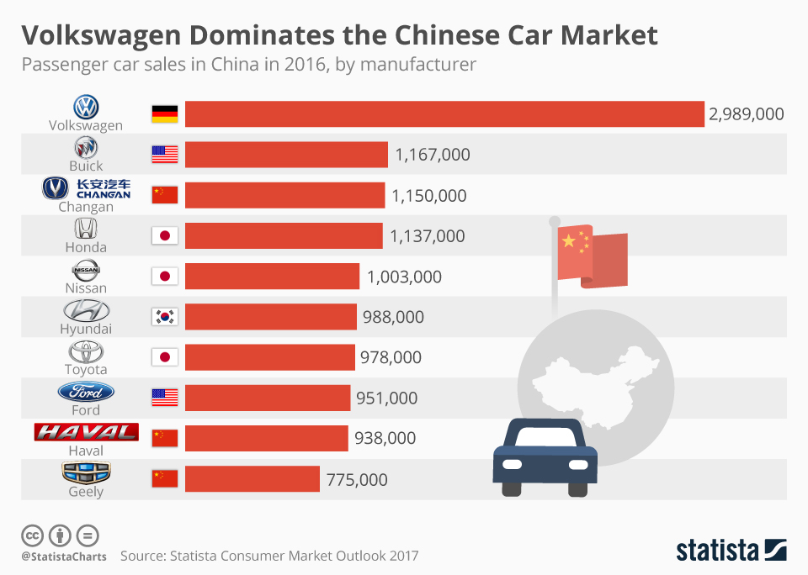

Slide 10
The ten most successful markets for ŠKODA in 2017
(Country - Deliveries to customers in 2017):
1. China - 325,000 7. France - 27,300
2. Germany - 173,300
3. Czech Republic - 95,000 8. Turkey - 25,000
4. Great Britain - 80,100 9. Italy - 24,700
5. Poland - 66,600 10. Austria - 24,300
6. Russia - 62,300

Slide 11
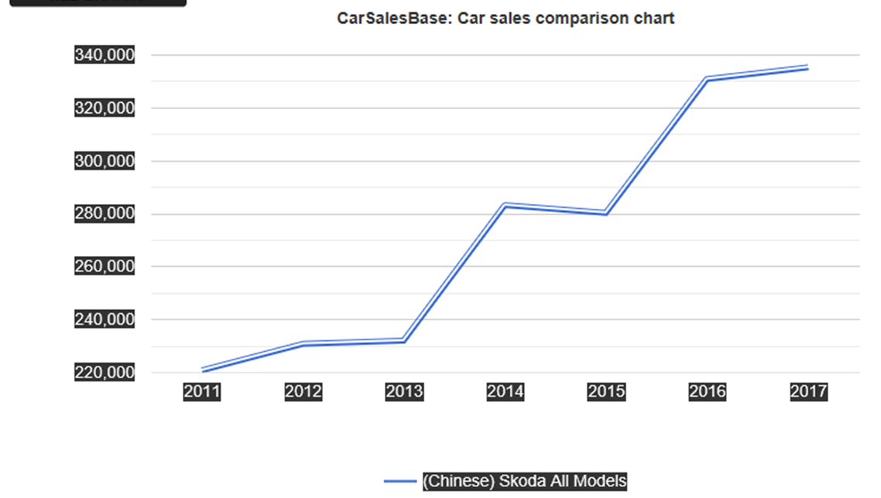

Slide 12
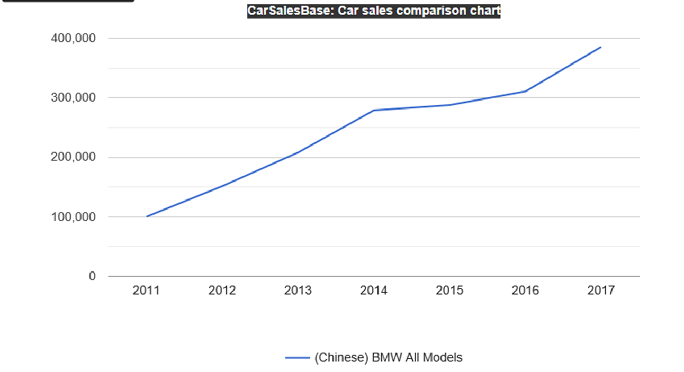

Slide 13


Slide 14
Sources
- http://archive.skoda-auto.com/en/company/production-plants/china
- https://www.autocar.co.uk/opinion/motor-shows-shanghai-auto-show/how-skoda-cracked-chinese-market
https://www.skoda-storyboard.com/en/press-releases/skoda-continues-market-
campaign-china/
http://www.volkswagengroupchina.com.cn/content/vgc/content/en/partnership/shanghai_volkswagen.html

