Slide 1
Elizabethan Drama
Introduction to Literature
(Autumn 2019)

Slide 2
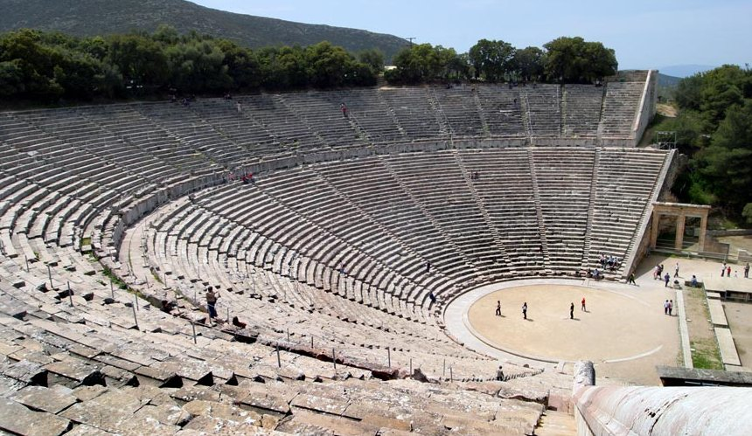
Birth of Drama in Europe
Ancient Greece (6th cent. BC)

Slide 3
Greek Drama
Tragedy
Aeschilus, Sophocles, Eurepides
Comedy
Aristophanes
Satyric play
Sophocles, Eurepides
Aristotle’s Poetics (Περὶ ποιητικῆς, 335 BC)
– first treatise on dramatic (and literary) theory

Slide 4
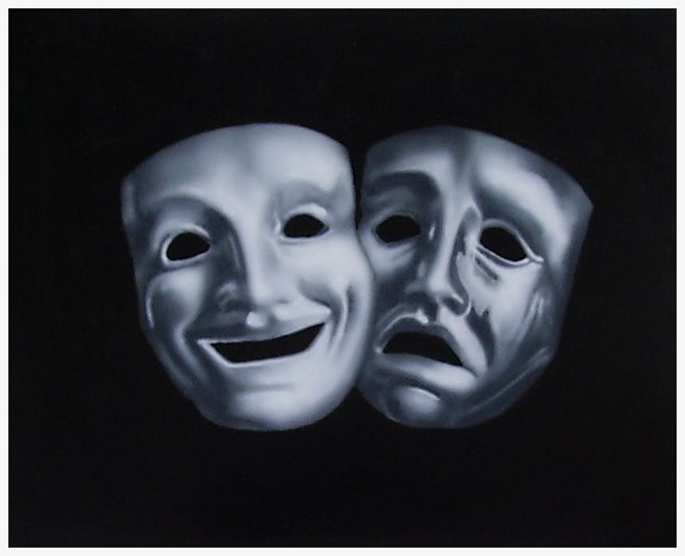
Roman Drama (3rd cent. BC)
Tragedy
Seneca (4 BC-AD 65)
Comedy
Plautus (254-184 BC)

Slide 5
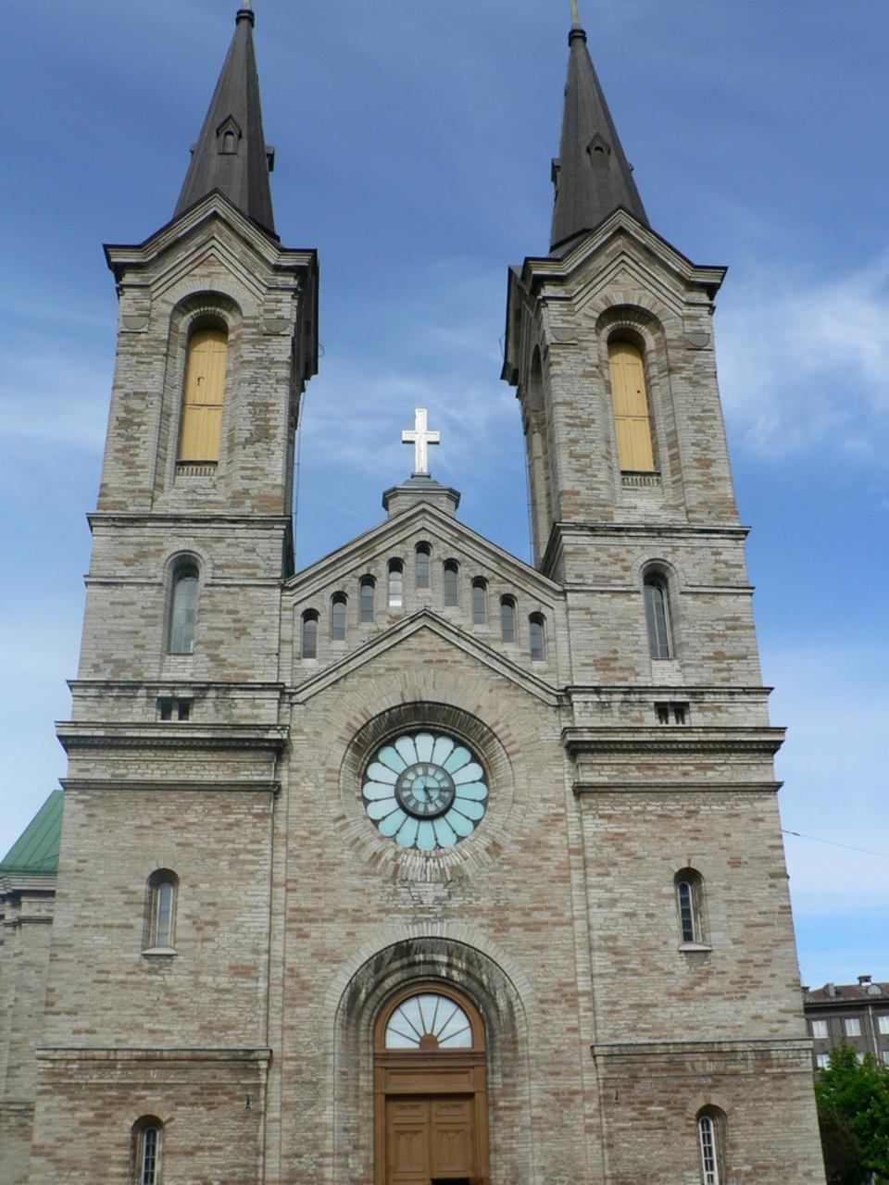
Mediaeval Drama (9th cent. AD)
Celebration of principal Christian feasts
Biblical material – re-enacting popular stories of Christian myth

Slide 6
Mediaeval Drama
Innocent III (1198–1216)

Slide 7
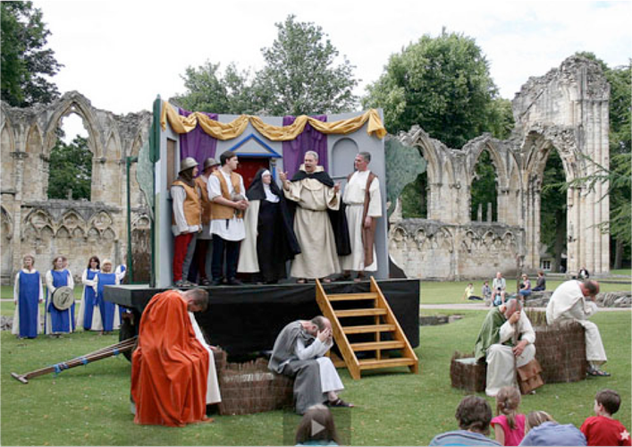
A mistery play from the York cycle (mid-14th century, recontruction)

Slide 8
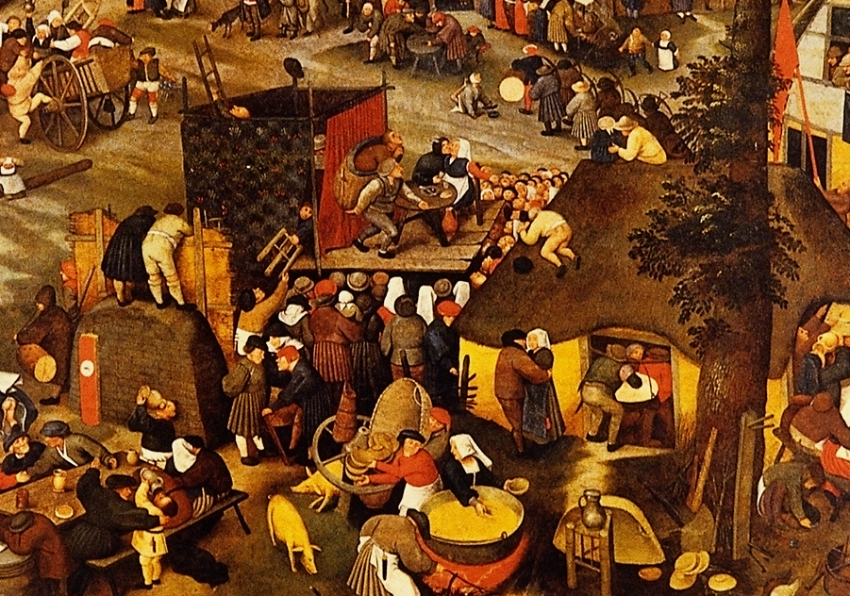
Village Fair by Pieter Breughel the Younger (1632)

Slide 9
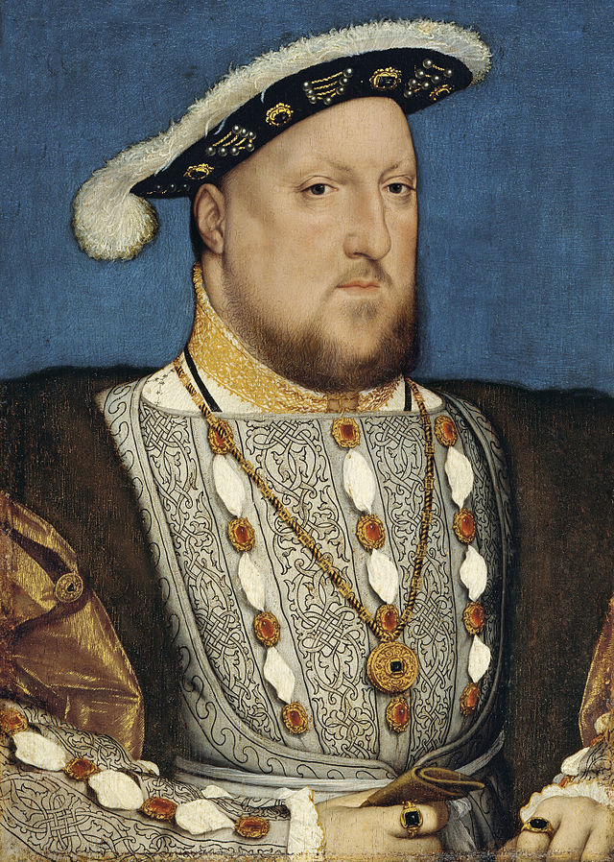
Early-modern English Drama
Henry VIII (1509–1547)

Slide 10
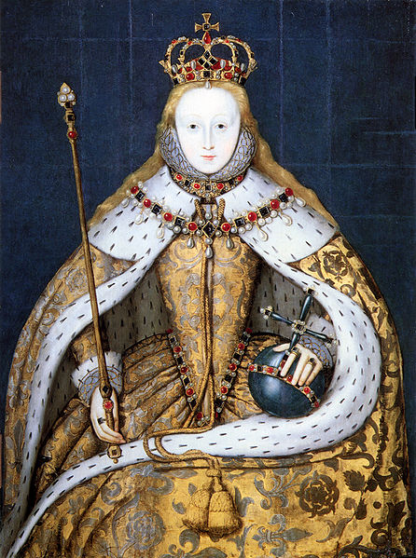
Elizabethan Drama
Elizabeth I (1558–1603)

Slide 11
Elizabethan Drama
The Vagabonds Act of 1572:
…all fencers, bear-wards, common players of interludes, and minstrels wandering abroad (other than players of interludes belonging to any baron of this realm, or any other honourable personage of greater degree to be authorised to play, under the hand or seal of arms of such baron or personage) shall be taken, adjudged, and deemed as rogues-vagabonds…

Slide 12
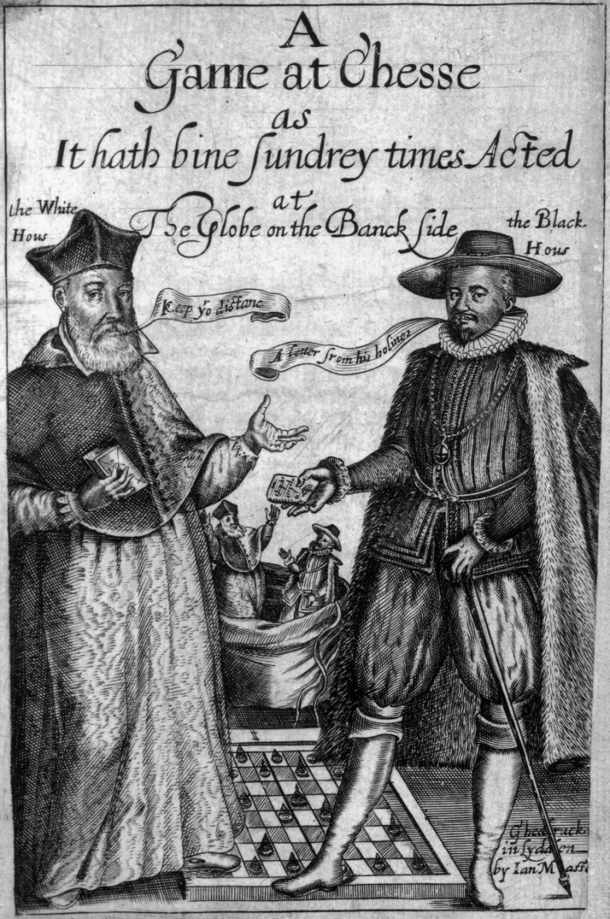
Elizabethan Drama
Thomas Middleton: A Game at Chess (1624)

Slide 13
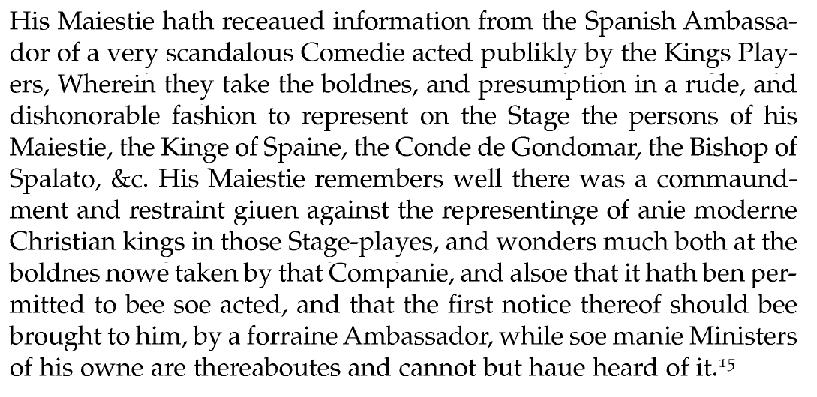
Elizabethan Drama
From the letter of Sir Eward Conway, 12/8/1624:

Slide 14
Elizabethan Drama
1576–77:
The Theatre was built – the first permanent theatre house built in England for the sole purpose of theatrical productions.
Later followed by the Curtain (1577), the Newington Butts (1577), the Rose (1587), the Swan (1596), the Fortune (1600), the Hope (1614), and others.

Slide 15
Elizabethan Drama
1598–99:
The first Globe theatre was built – the first early-modern English theatre co-owned by an acting company.
The original share-holders were: Richard Burbage (25%), Cuthbert Burbage (25%), William Shakespeare (12.5%), John Heminges (12.5%), Augustine Philips (12.5%), and Thomas Pope (12.5%).

Slide 16
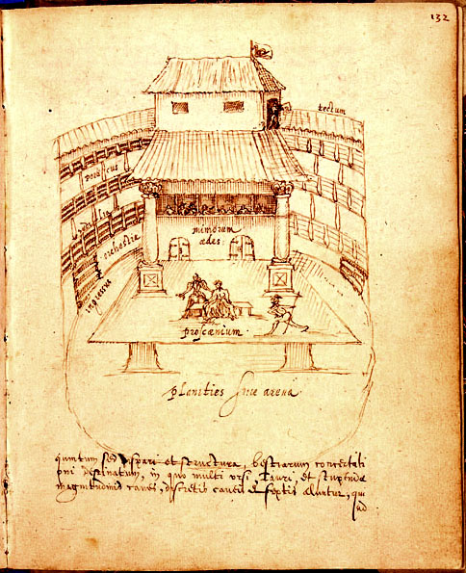
Johannes de Witt: The Swan Theatre

Slide 17
Elizabethan Drama
From A Midsummer Night’s Dream:
Quince. Pat, pat; and here's a marvellous convenient place for our rehearsal. This green plot shall be our stage, this hawthorn-brake our tiring-house; and we will do it in action as we will do it before the duke.
(Act 3, Scene 1)

Slide 18
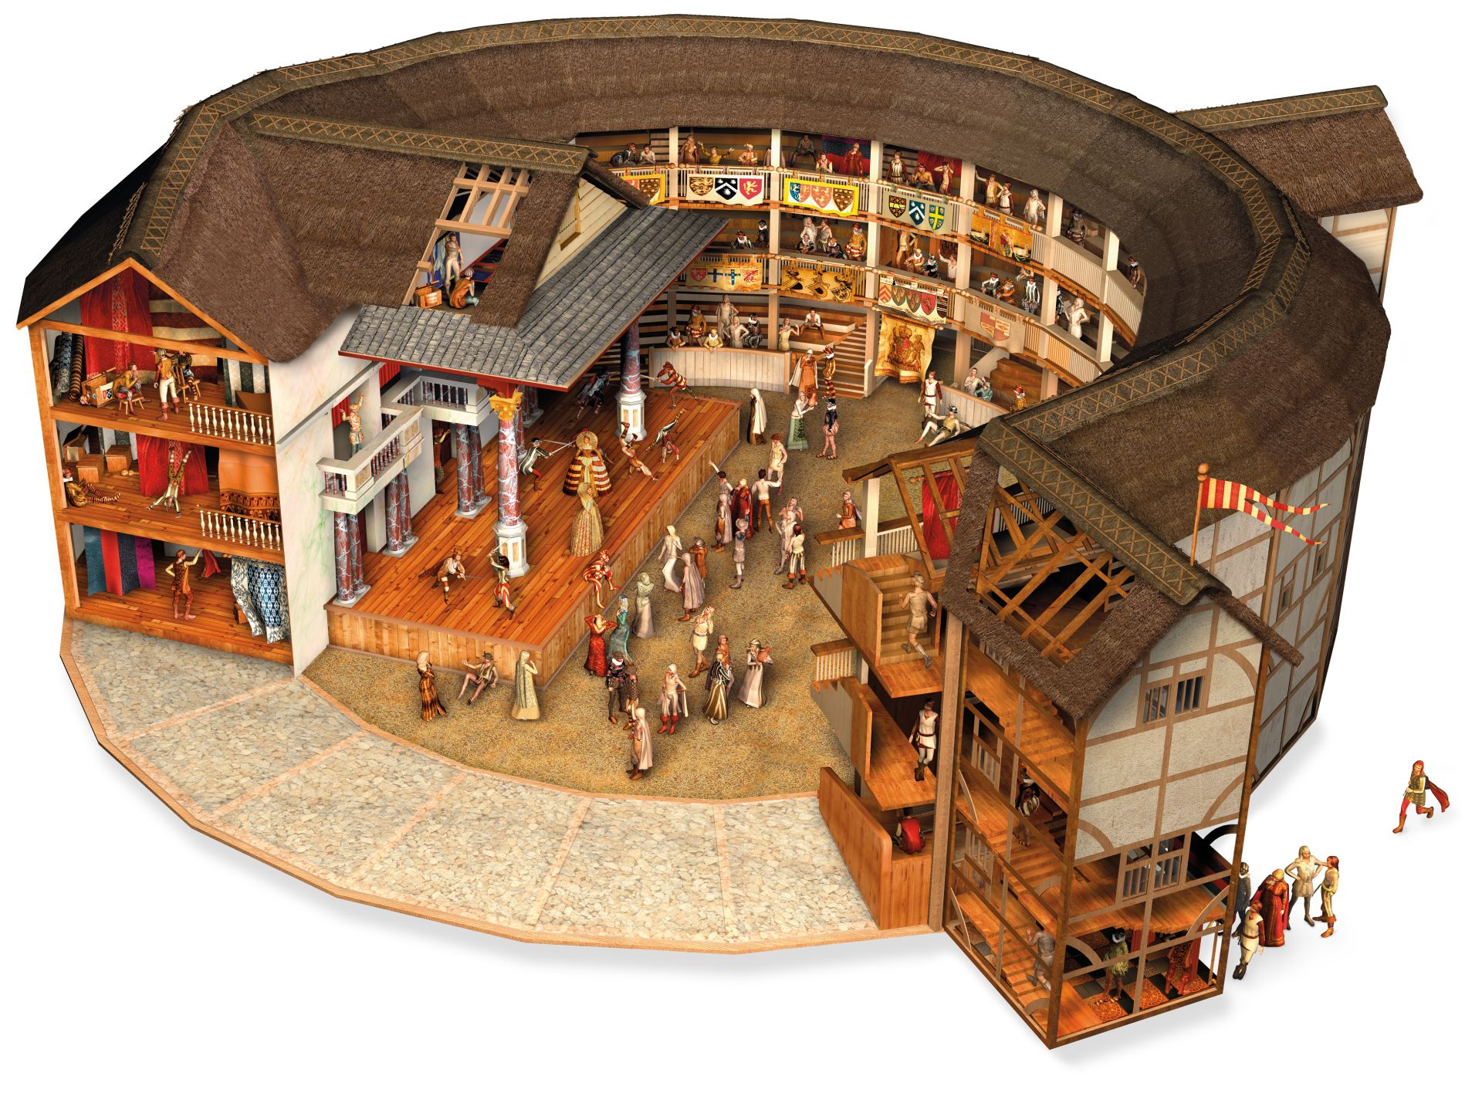
The Globe Theatre (1599): A Reconstruction

Slide 19
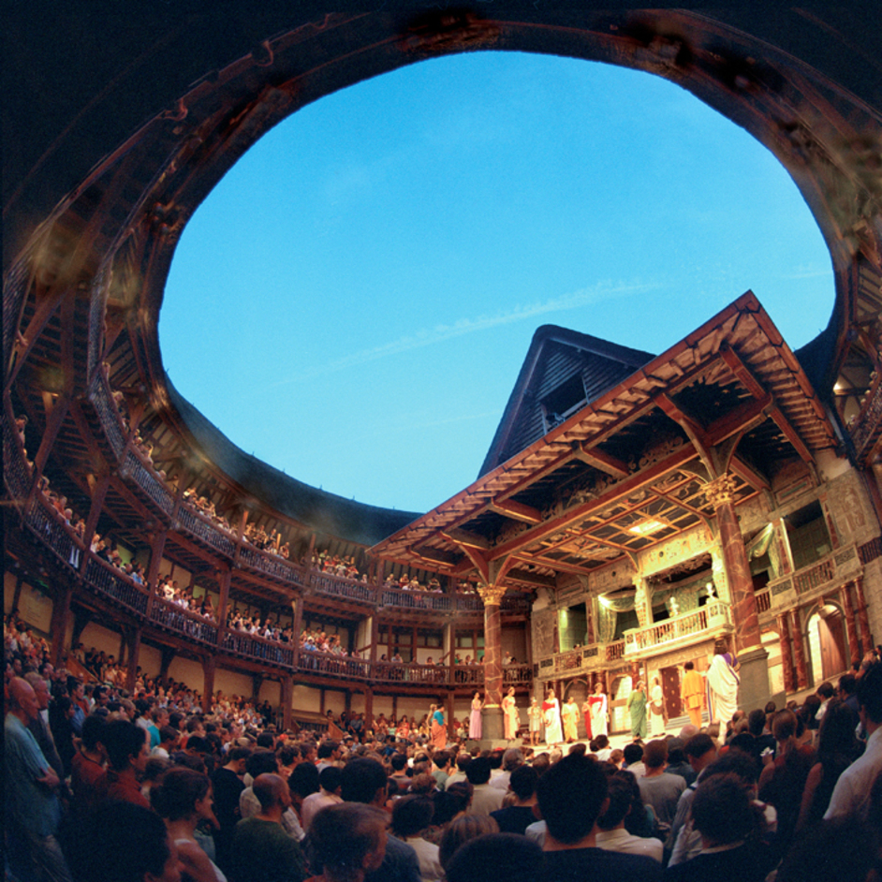
Shakespeare‘s Globe Theatre, London (1997)

Slide 20
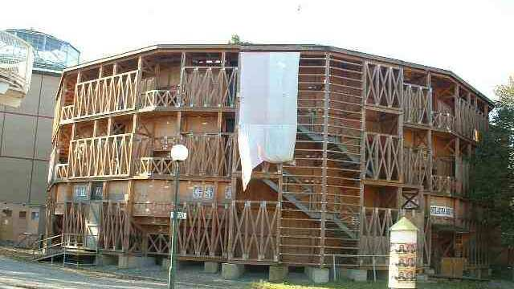
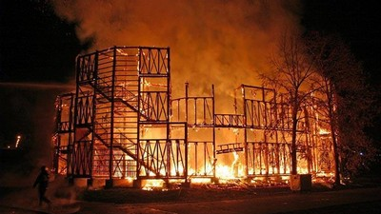
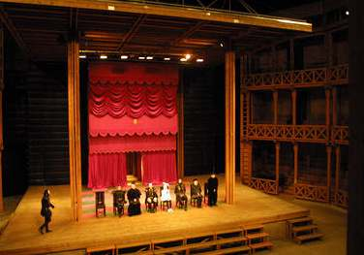
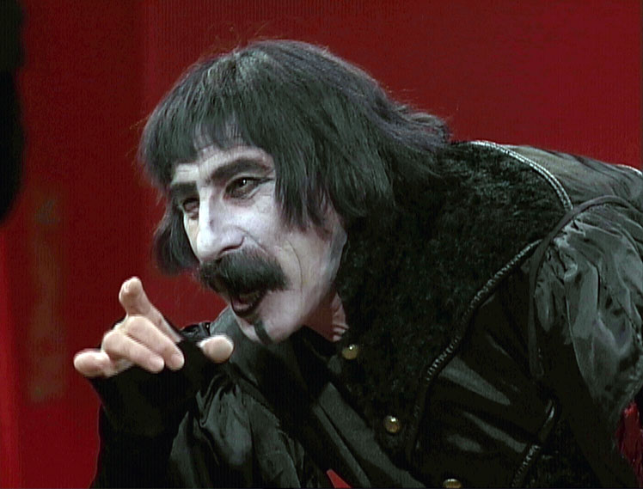
The Globe Theatre, Prague (1999-2005)

Slide 21
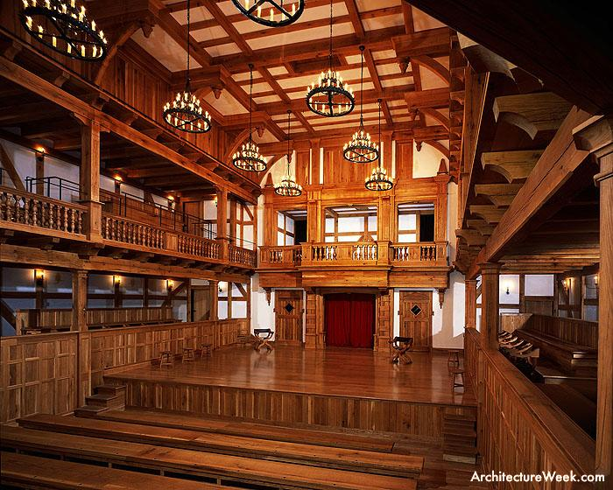
The Blackfriars Theatre (1608): A Reconstruction

Slide 22
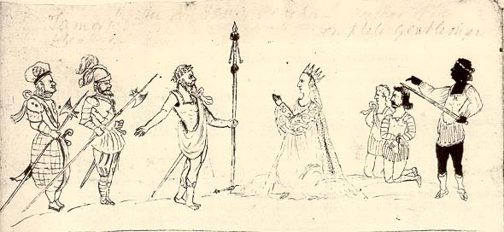
Titus Andronicus in the Longleat MS (c. 1594)

Slide 23
Elizabethan Drama
1603:
Queen Elizabeth dies. The Elizabethan period becomes Jacobean (after King James I) until 1625 and, later on, Caroline (after King Charles I) until 1642.
2 September 1642:
The play-houses in London are closed, marking the end of the Elizabethan drama. Since 1660, we speak of the Restoration drama.

Slide 24
Elizabethan Drama
Number of plays staged between the 1560s and 1642:
Circa 3,000.
Number of surviving plays of the period:
Circa 230 (=7.5%).

Slide 25
Elizabethan Drama
From Hamlet:
Polonius. The best actors in the world, either for tragedy, comedy, history, pastoral, pastoral-comical, historical-pastoral, tragical-historical, tragical-comical-historical-pastoral, scene individable, or poem unlimited: Seneca cannot be too heavy, nor Plautus too light. For the law of writ and the liberty, these are the only men.
(Act 2, Scene 2)

Slide 26
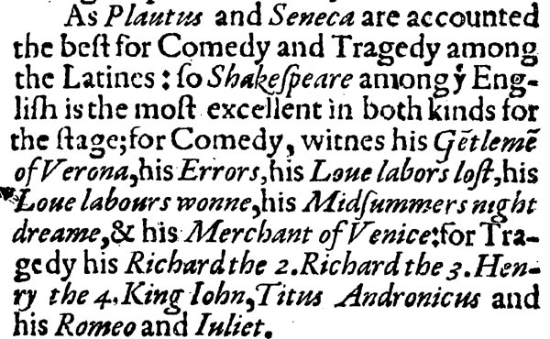
From Palladis Tamia (by Francis Meres, 1598):

Slide 27
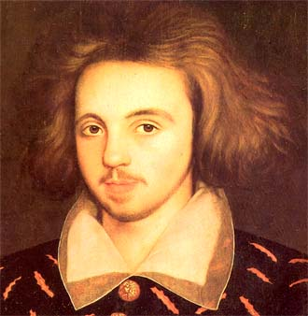
Early Modern Dramatists
Christopher Marlowe (1564–1593)

Slide 28
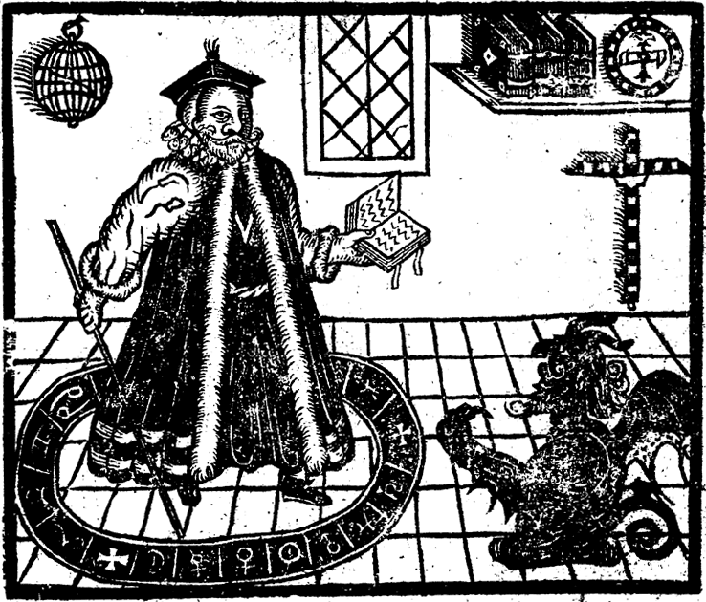
Early Modern Dramatists
Dr. Faustus in his study

Slide 29
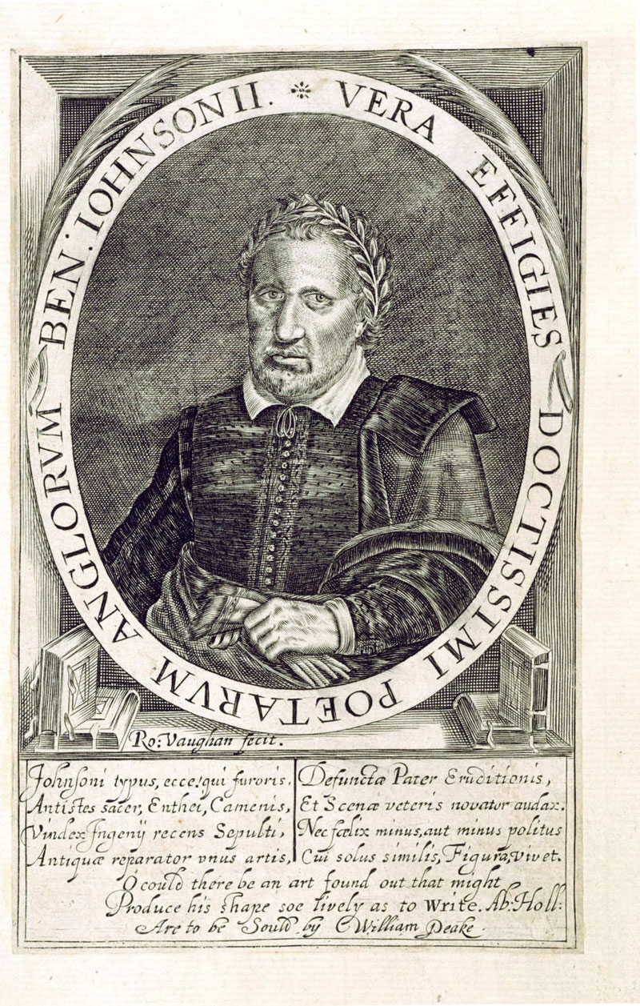
Early Modern Dramatists
Ben Jonson (1572–1637)

Slide 30
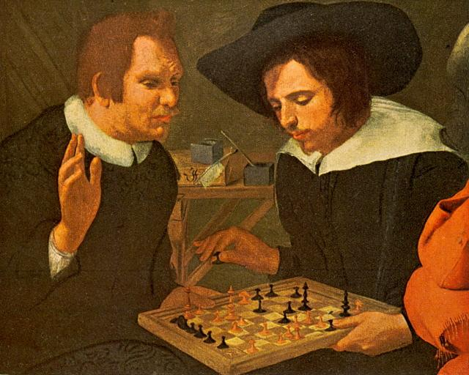
Early Modern Dramatists
Ben Jonson and William Shakespeare Playing Chess by Karel van Mander (1604)

Slide 31
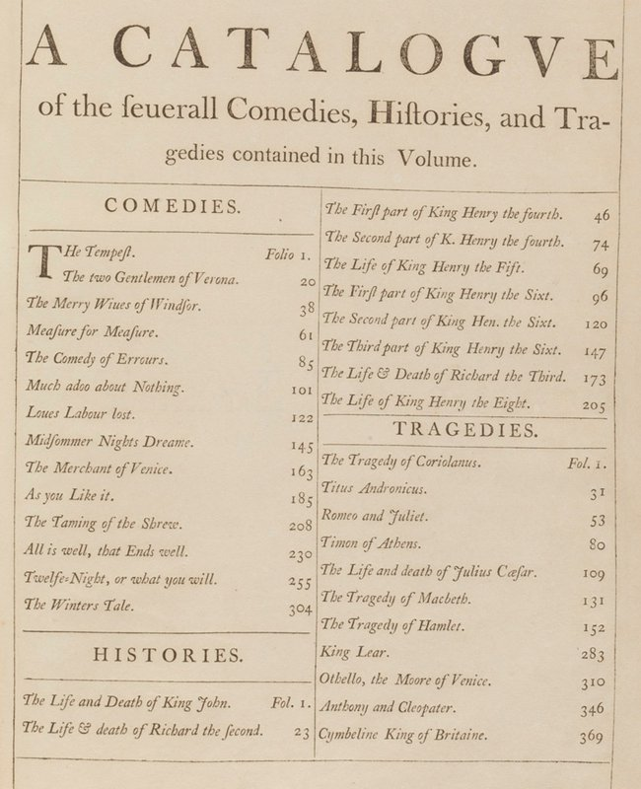

Slide 32
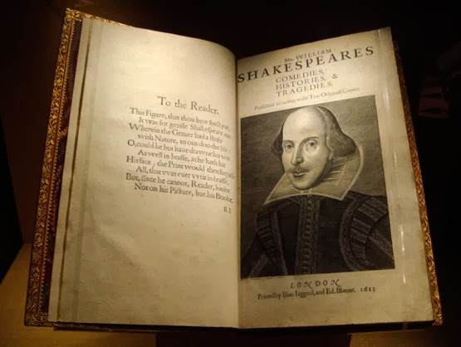
The so-called First Folio
of Shakespeare‘s Works (1623)

Slide 33
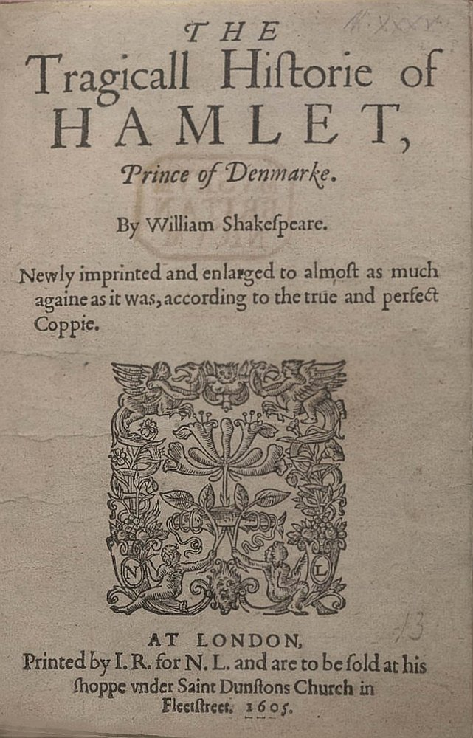
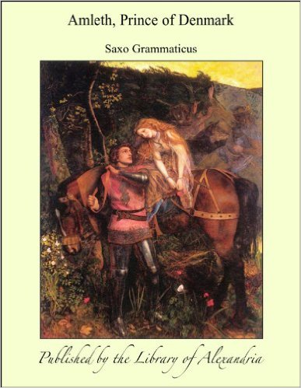
Shakespearovy zdroje
Shakespeare‘s Sources

Slide 34
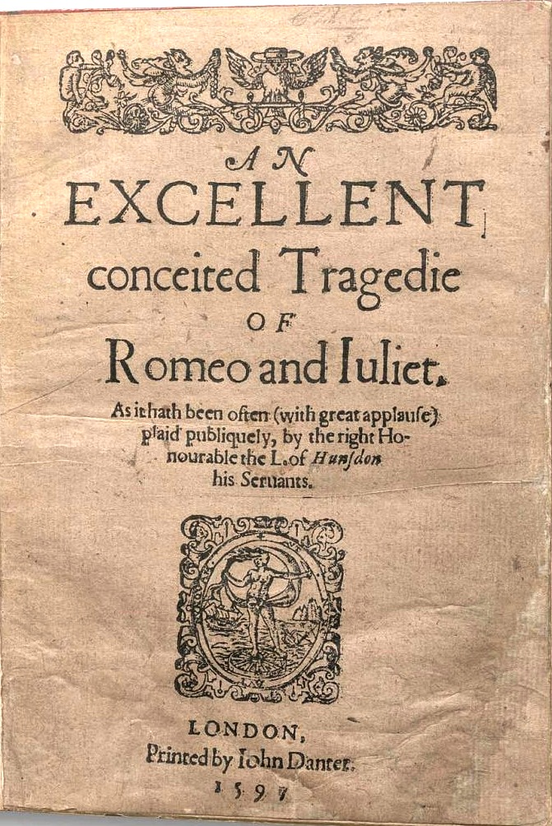
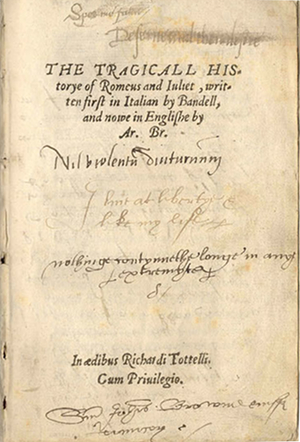
Shakespearovy zdroje
Shakespeare‘s Sources

Slide 35
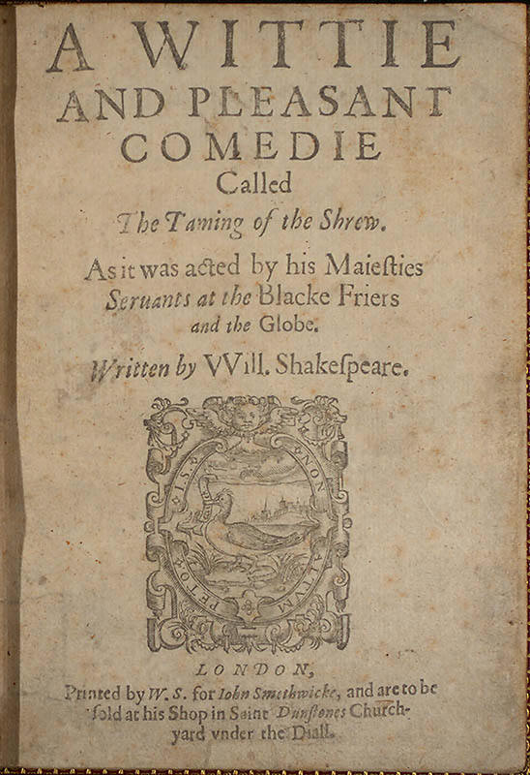
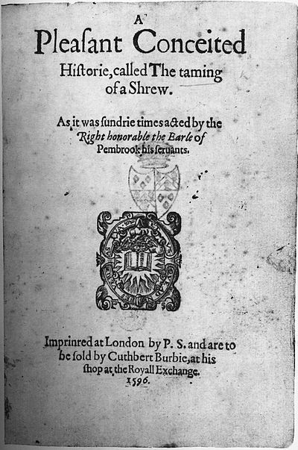
Shakespearovy zdroje
Shakespeare‘s Sources

Slide 36
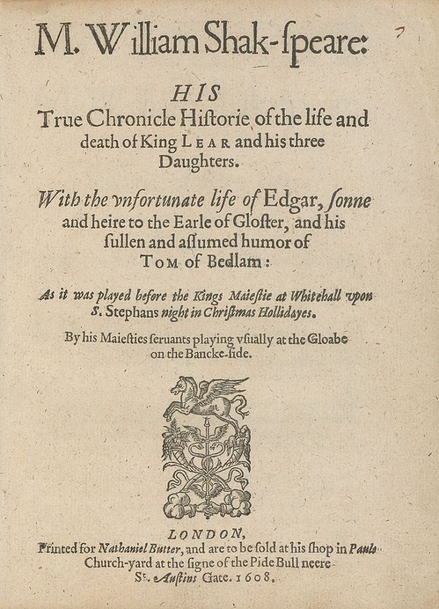
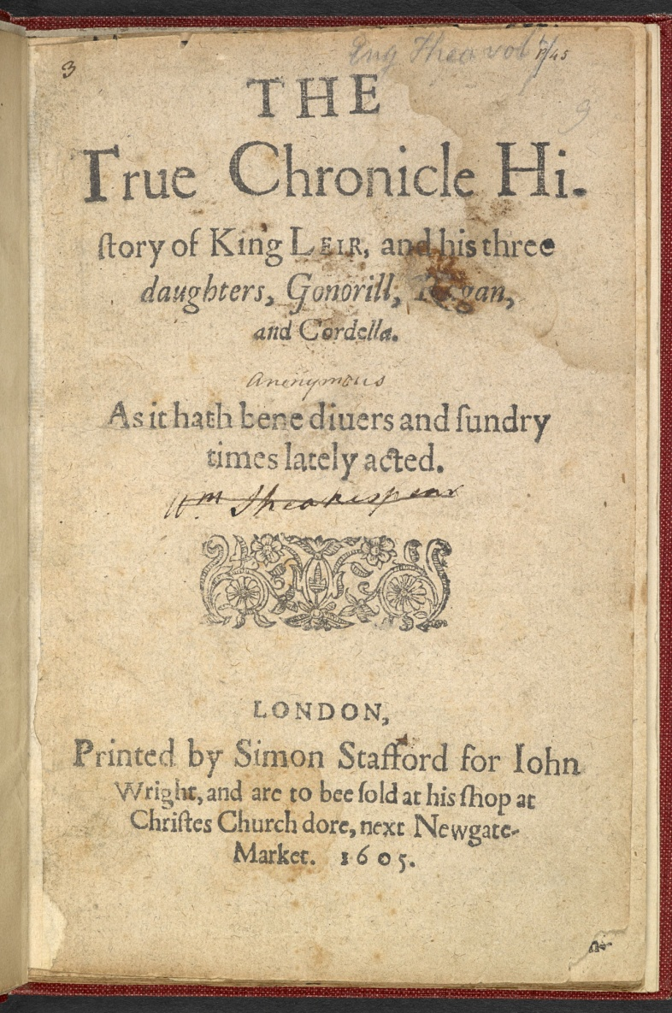
Shakespearovy zdroje
Shakespeare‘s Sources

Slide 37
Shakespeare “Upstart Crow”
Robert Greene on William Shakespeare:
[T]rust them not: for there is an vpstart Crow, beautified with our feathers, that with his Tygers hart wrapt in a Players hyde, supposes he is as well able to bombast out a blanke verse as the best of you: and being an absolute Iohannes fac totum, is in his owne conceit the onely Shake-scene in a countrey.
(Groats-worth of Wit, 1592)

Slide 38
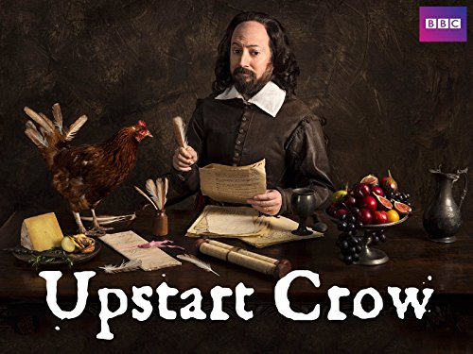
Shakespeare “Upstart Crow”

Slide 39
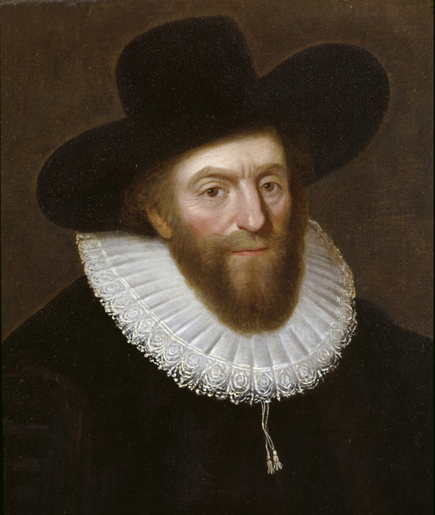
Early-modern English Actors
Edward Alleyn (1566–1626)

Slide 40
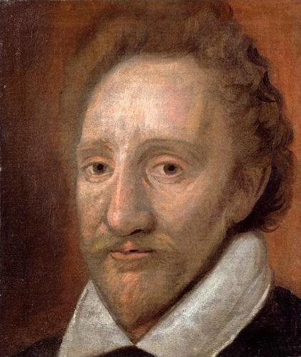
Early-modern English Actors
Richard Burbage (1567–1619)

Slide 41
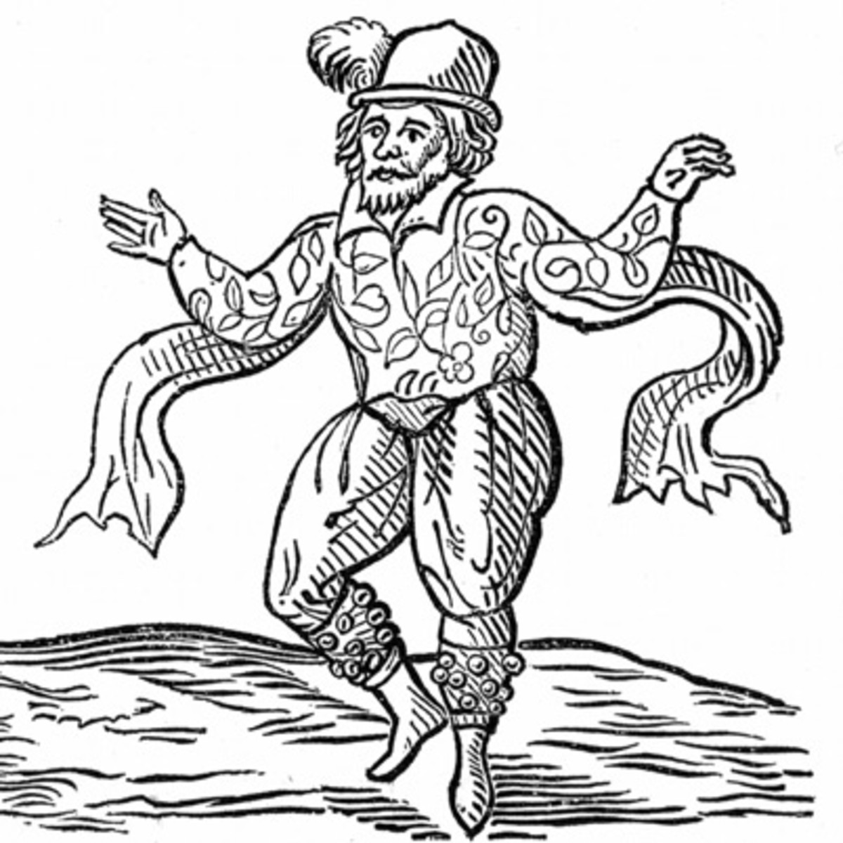
Early-modern English Actors
Will Kempe (died 1603)

Slide 42
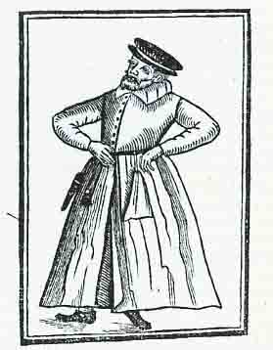
Early-modern English Actors
Robert Armin (c. 1563-1615)

Slide 43
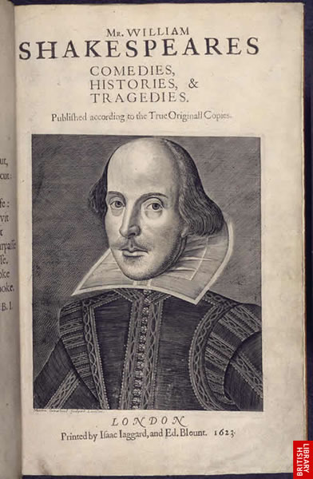
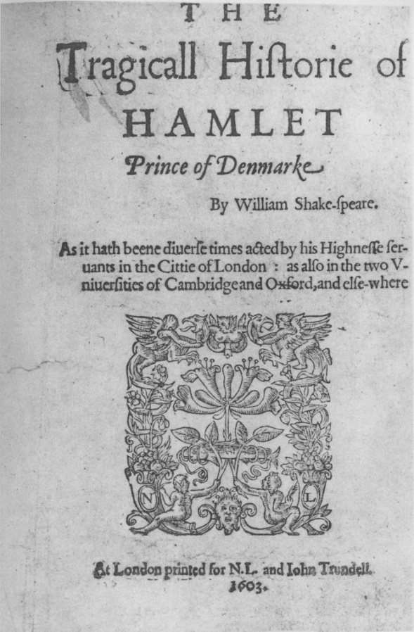
Shakespeare’s F1 (c. 30x38 cm) Q1 of Hamlet (c. 24x30 cm)

Slide 44
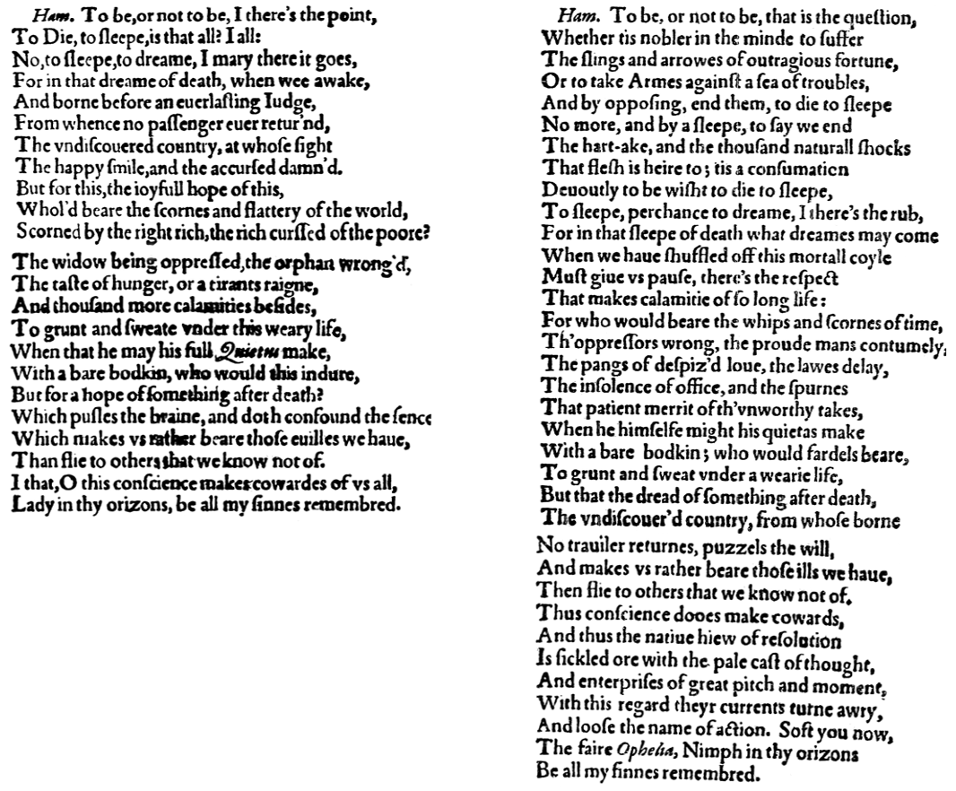

Slide 45
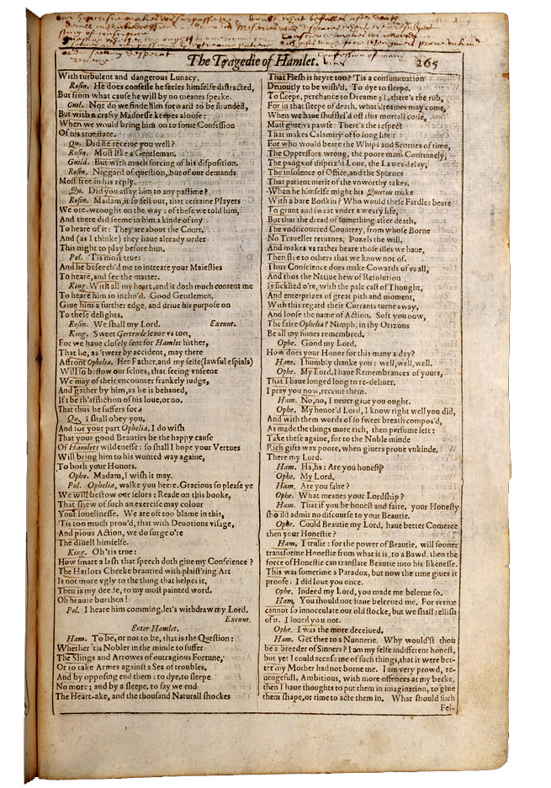
[Q]uestion whether we ought to ouercome our selues and our passions by extreame patience or die seeking desperat reuenge.
(The Meisei First Folio)

Slide 46
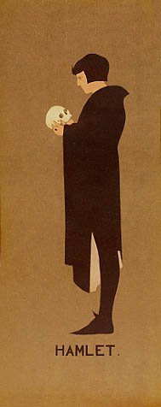
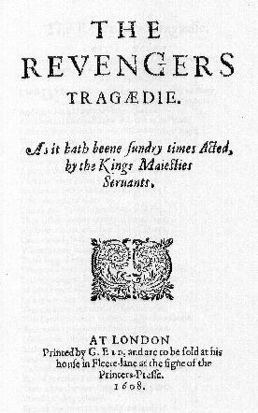
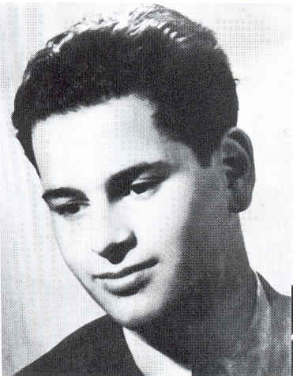
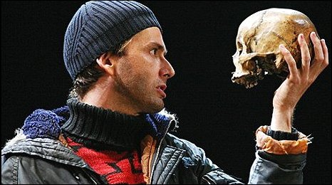
Hamlet‘s Skull

Slide 47
Shakespeare’s Language
Words:
Abstemious, antipathy, critical, frugal, dwindle, extract, horrid, vast, hereditary, excellent, eventful, barefaced, assassination, lonely, leapfrog, indistinguishable, well-read, zany…
Phrases:
Vanish into thin air, play fast and loose, the milk of human kindness, remembrance of things past, cold comfort, salad days, flesh and blood, the wish is father to the thought, be cruel to be kind, blinking idiot, it’s Greek to me…

Slide 48
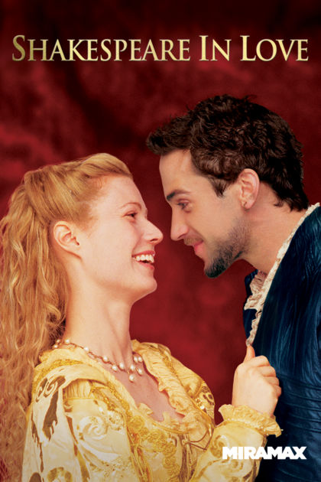
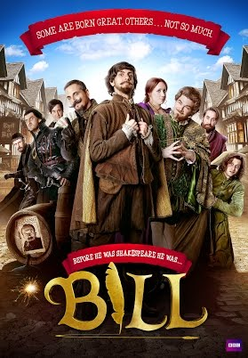
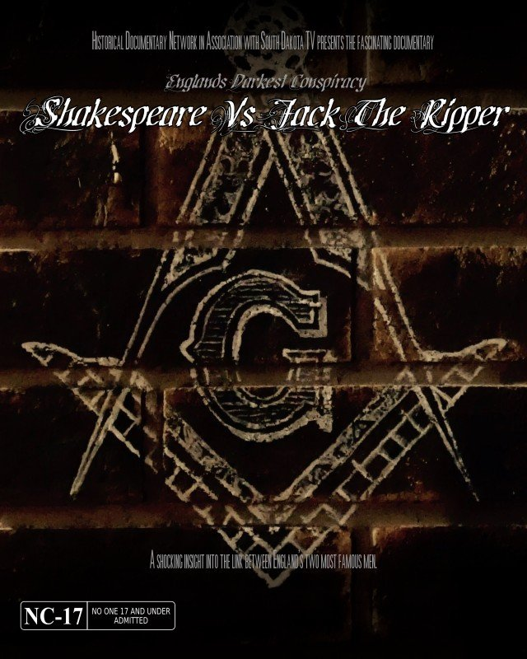
Shakespeare on Screen

