Slide 1
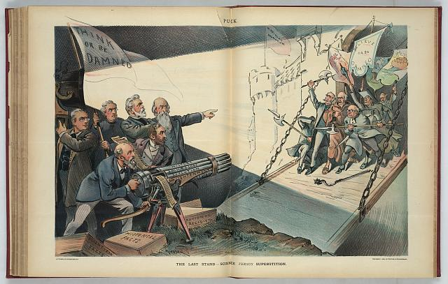
Náboženství a věda ARTS 011

Slide 2
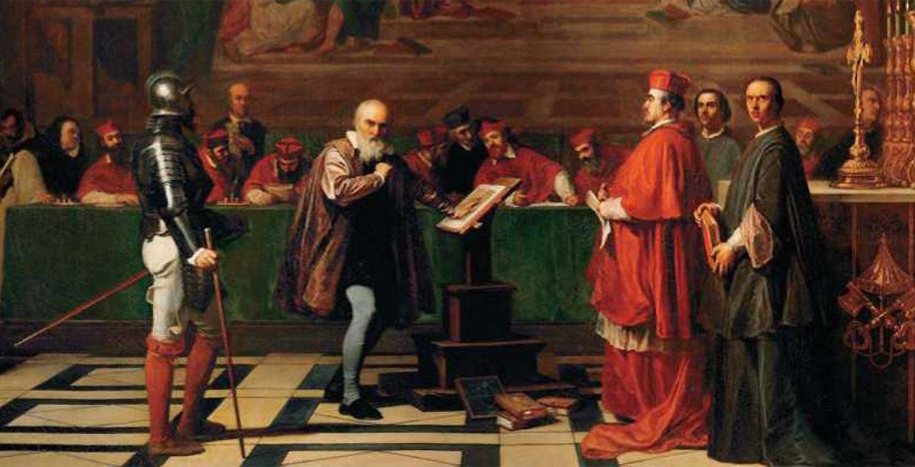
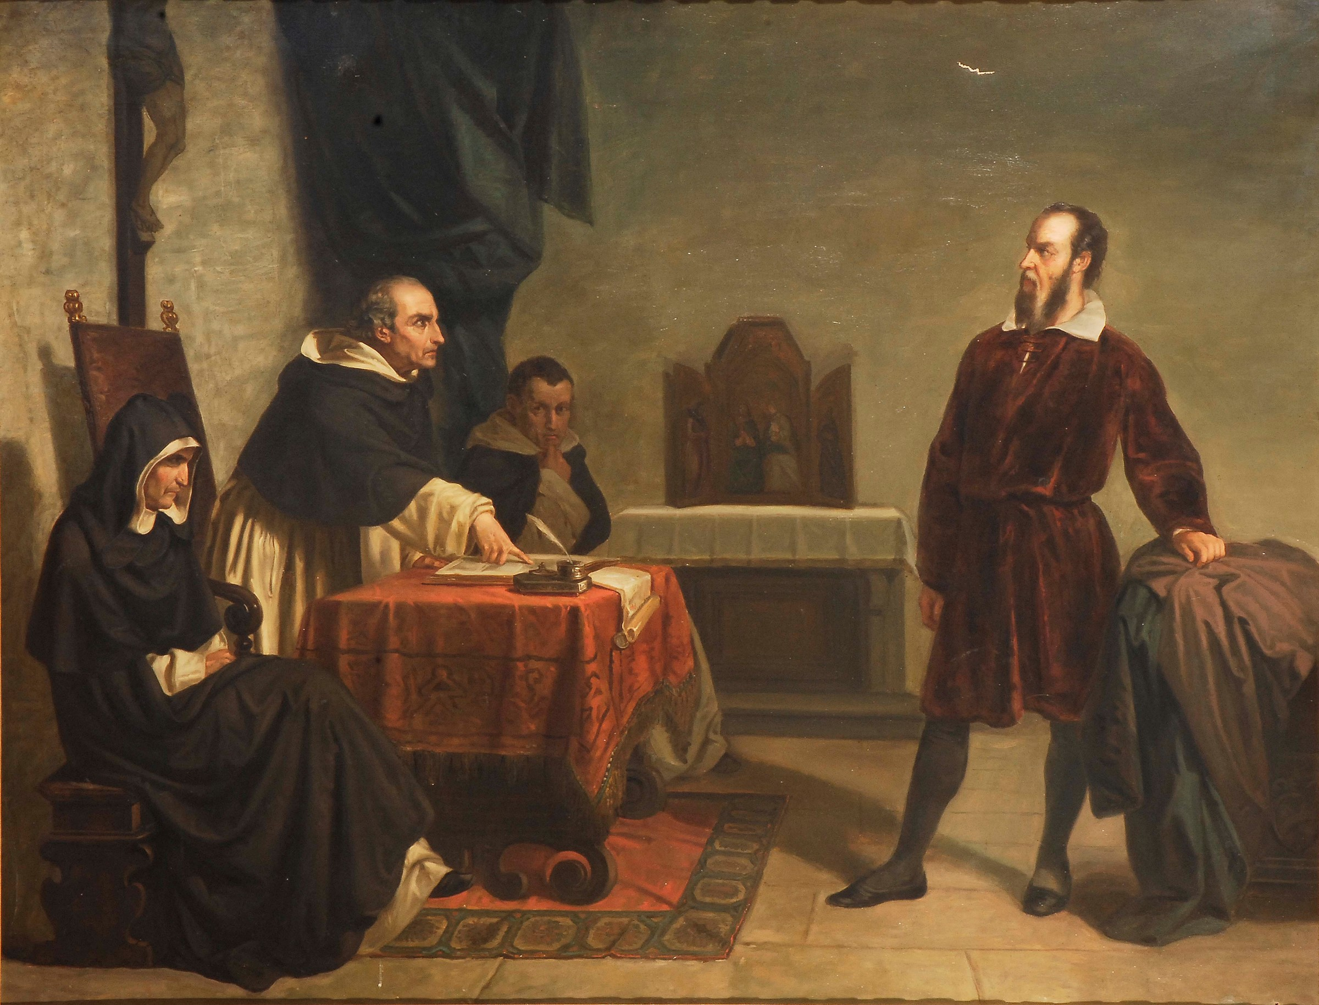
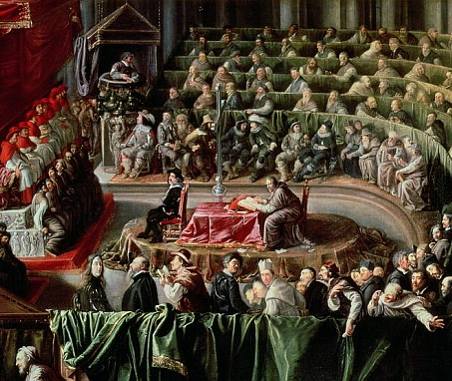

Slide 3
(….) What is there in places almost empty of Matter, and whence is it that the Sun and Planets gravitate towards one another, without dense Matter between them? Whence is it that Nature does nothing in vain; and whence arises all that Order and Beauty which we see in the World? . . . How came the Bodies of Animals to be contrived with so much Art and for what ends were their several Parts? Was the eye conceived without Skill in Opticks, and the Ear without Knowledge of Sounds? How do the Motions of the Body follow from the Will, and whence is the Instinct in Animals? . . . And these things being rightly dispatch’d, does it not appear from Phaenomena that there is a Being incorporeal, living, intelligent, omnipresent, who in infinite Space, as it were in his Sensory, sees the things themselves intimately, and thoroughly perceives them, and comprehends them wholly by their immediate presence to himself . . . And though every true Step made in this Philosophy brings us not immediately to the Knowledge of the first Cause, yet it brings us nearer to it.

Slide 4
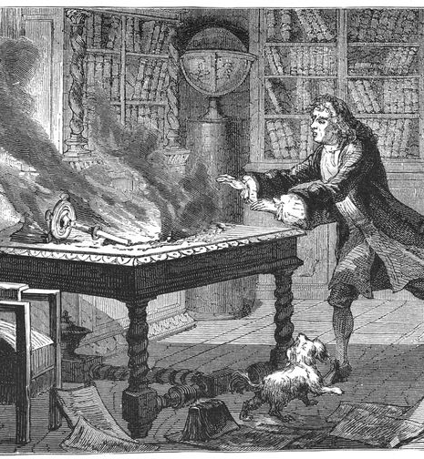
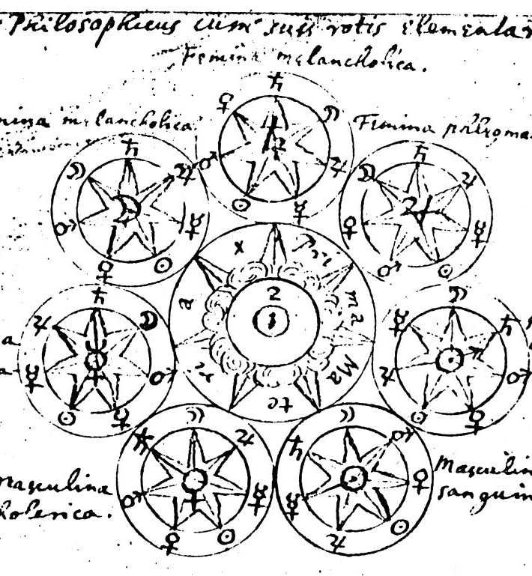

Slide 5
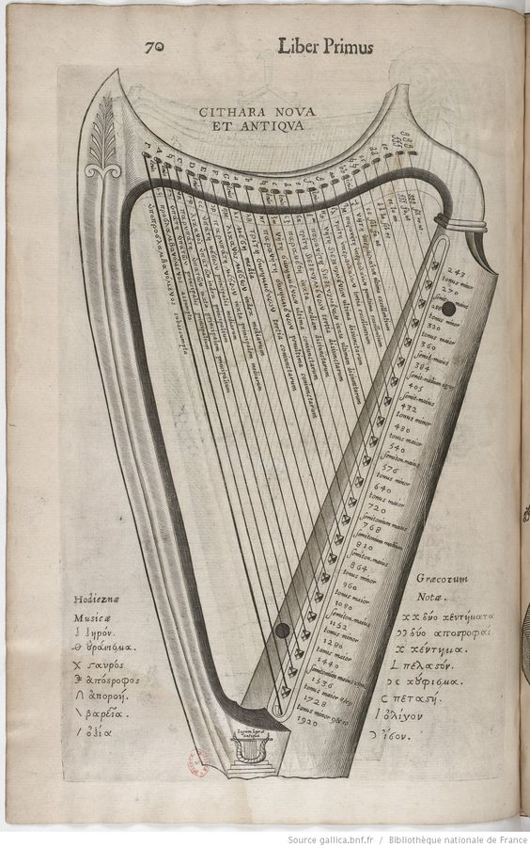
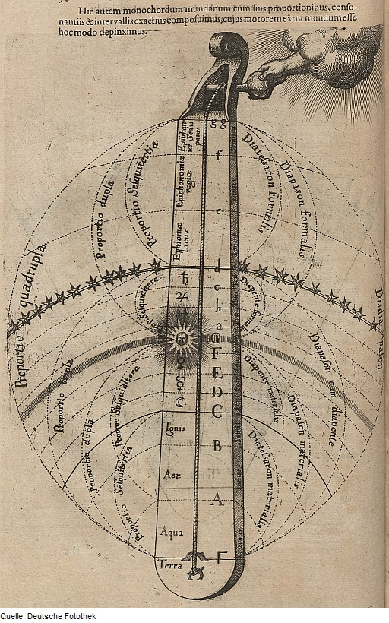

Slide 6
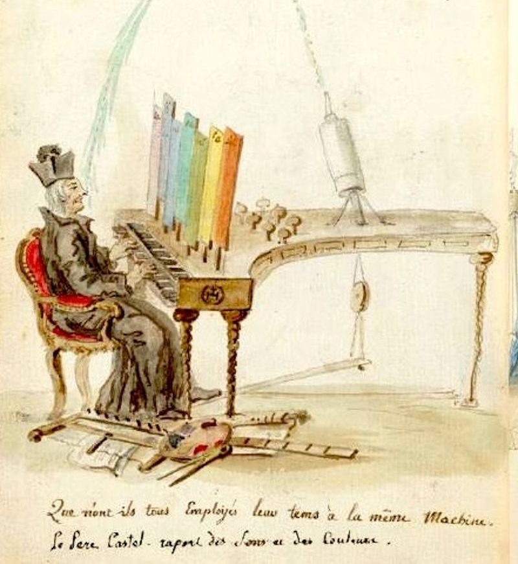
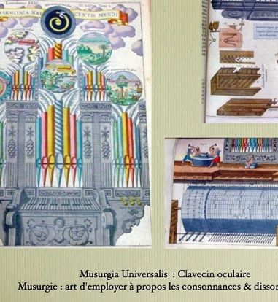

Slide 7
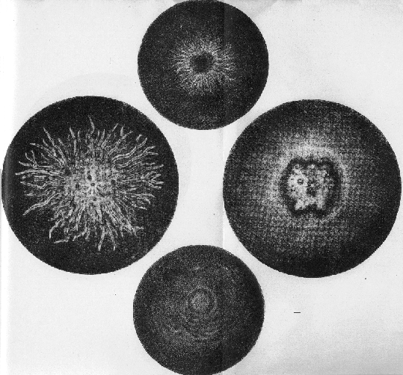
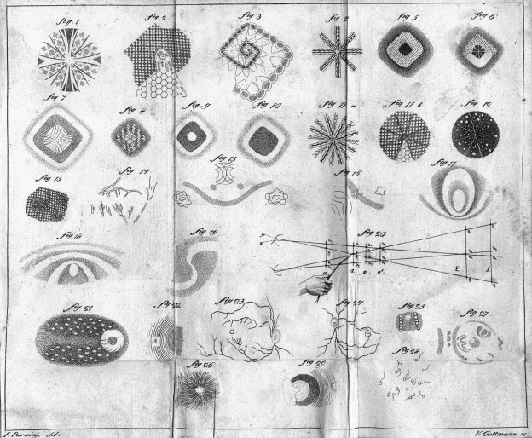

Slide 8
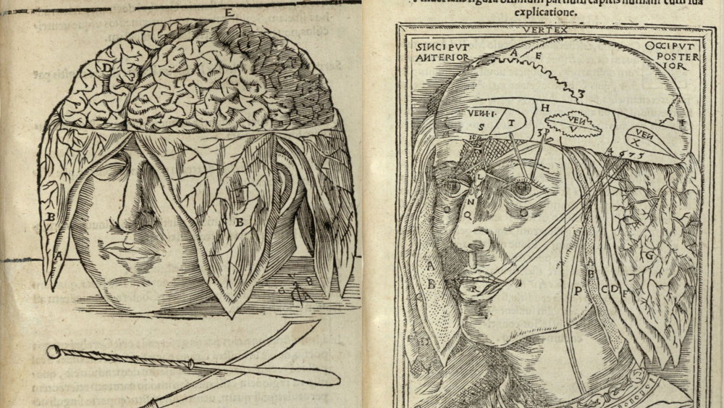

Slide 9
Poškození (nervů, mozku, smysl. orgánů)
démonické působení
metaforická hluchota

