Slide 1





第一课
Greetings
Are you ready……

Slide 2

Q&A
How do people greet each other when meeting for the first time?

Slide 3
Q&A
nǐ hǎo
你 好

Slide 4

wèn hǎo
问 好
Greetings

Slide 5


Vocabulary
nǐ
你
(you)

Slide 6


wǒ
tā
我
他 (he)
她 (she)
它 (it)
(I;me)

Slide 7

Vocabulary
hǎo
好
(fine)

Slide 8

Attention!!!
你好≠You are fine(good)
你好 is not you are fine(good)
你好 is just a greeting, like hi, hello

Slide 9
Vocabulary
qǐng
请
(please)

Slide 10
qǐng
请
polite form of request
to treat or to invite(somebody)

Slide 11
Vocabulary
wèn
问
(to ask)

Slide 12



qǐng wèn
请 问
a polite formula to be used to get someone's attention，like"excuse me, may I please ask..."

Slide 13
Vocabulary
xiǎo jiě
小 姐
(Miss
young lady)

Slide 14
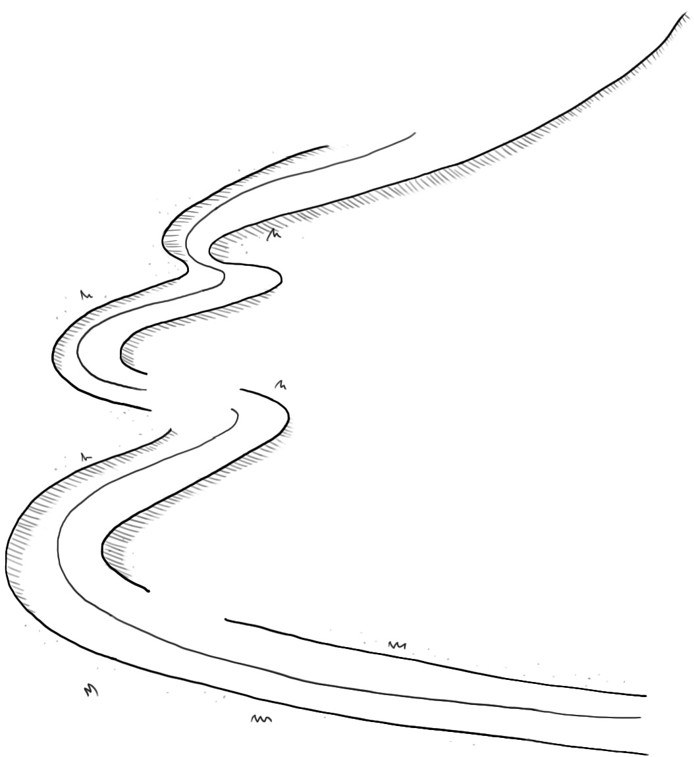
Attention!!!
xiǎo jiě
小 姐
xiǎo jiě xiáo jiě
When we find a word with two third tone syllables. making the first third tone”小“ a second tone. The second syllable ”姐“ can also be pronounced in the neutral tone

Slide 15
Vocabulary
jiào
叫
(to call
to be called)

Slide 16
Vocabulary
shén me
什 么
(what)

Slide 17
Vocabulary
míng zi
名 字
(name)

Slide 18

A:你叫什么名字？(nǐ jiào shén me míng zi ？)
What is your name?
B:我叫......（wǒ jiào .... ）
My name is ....

Slide 19
Vocabulary
xiān sheng
先 生
(Mr.
husband
teacher)

Slide 20
Vocabulary
guì
贵
(honorable
expensive)

Slide 21

€500
€10
guì
pián yí
贵
便宜(cheap)

Slide 22
Vocabulary
xìng
姓
(surname)

Slide 23
Grammar 1 姓（n/v)
姓 is both a noun and a transitive verb. When it is used as a verb, it must be followed by an object
The Verb 姓（xìng ）
A：你姓什么？(nǐ xìng shén me ？)
What is your surname?
B: 我姓李。（wǒ xìng lǐ ）
My surname is Li.

Slide 24


Practice
In groups of three
practice this conversation

Slide 25
Grammar 1 姓（n/v)
姓 is usually negated with “不“（bù ）
The Verb 姓（xìng ）
A：你姓李吗？(nǐ xìng lǐ ma ？)
Is your family name Li?
B: 我不姓李。（wǒ bú xìng lǐ ） 我不姓(X)
My surname is not Li.

Slide 26
Attention!!!
bù
不
bù xìng bú xìng
不姓
When followed by a 4th tone, 不 (bù) changes to 2nd tone (bú).

Slide 27
Practice
In groups of three
practice this conversation

Slide 28
Grammar 1 姓（n/v)
贵姓（guì xìng ）is a respectful or polite expression to ask for someone`s surname
The Verb 姓（xìng ）
A：你贵姓？(nǐ guì xìng？)
What is your surname?
B: 我姓王。（wǒ xìng wáng ） 我贵姓王(X)
免贵姓王。（miǎn guì xìng wáng ）
My surname is not Wang.

Slide 29
Practice
In groups of three
practice this conversation

Slide 30
Grammar 2 呢
You can use "呢"（ne ） at the end of a question to form a question
A：请问，你贵姓？(qǐng wèn ，nǐ guì xìng ？)
What is your family name,please?
B: 我姓李,你呢？（wǒ xìng lǐ，nǐ ne ？ ）
My family name is Li.How about you?

Slide 31
Practice
In groups of three
practice this conversation

Slide 32
Grammar 2 呢
When 呢（ne) is used in this way, there must be some context. In each of the two examples about, the context is provided by the preceding sentence
A：你叫什么名字？(nǐ jiào shén me míng zi ？)
What is your name?
B: 我叫王朋,你呢？（wǒ jiào wáng péng ，nǐ ne ？ ）
My name is Wang Peng .How about you?

Slide 33
Practice
In groups of three
practice this conversation

Slide 34
Grammar 3 叫
The verb 叫(jiào) has several meanings. It means "to be called" in this lesson. Like 姓(xìng), it must be followed by an object
A：你叫什么名字？(nǐ jiào shén me míng zi ？)
What is your name?
B: 我叫王朋。（wǒ jiào wáng péng ？ ）
My name is Wang Peng .

Slide 35
Practice
In groups of three
practice this conversation

Slide 36
Grammar 3 叫
叫(jiào) is usually negated with “不“（bù ）
A：你叫李生吗？(nǐ jiào lǐ shēng ma ？)
Is your name Li Sheng?
B: 我不叫李生。（wǒ bù jiào lǐ shēng.）
My name is not Li Sheng.

Slide 37
Practice
In groups of three
practice this conversation

Slide 38
Basic word order of Chinese sentences
Subject+Verb+Object
statements and questions are the same

Slide 39
Text
Man： 你好！
Woman：你好！
Man： 请问，你贵姓？
Woman：我姓李。你呢？
Man： 我姓王。李小姐，你叫什么名字？
Woman：我叫李友。王先生，你叫什么名字？
Man： 我叫王朋。

Slide 40
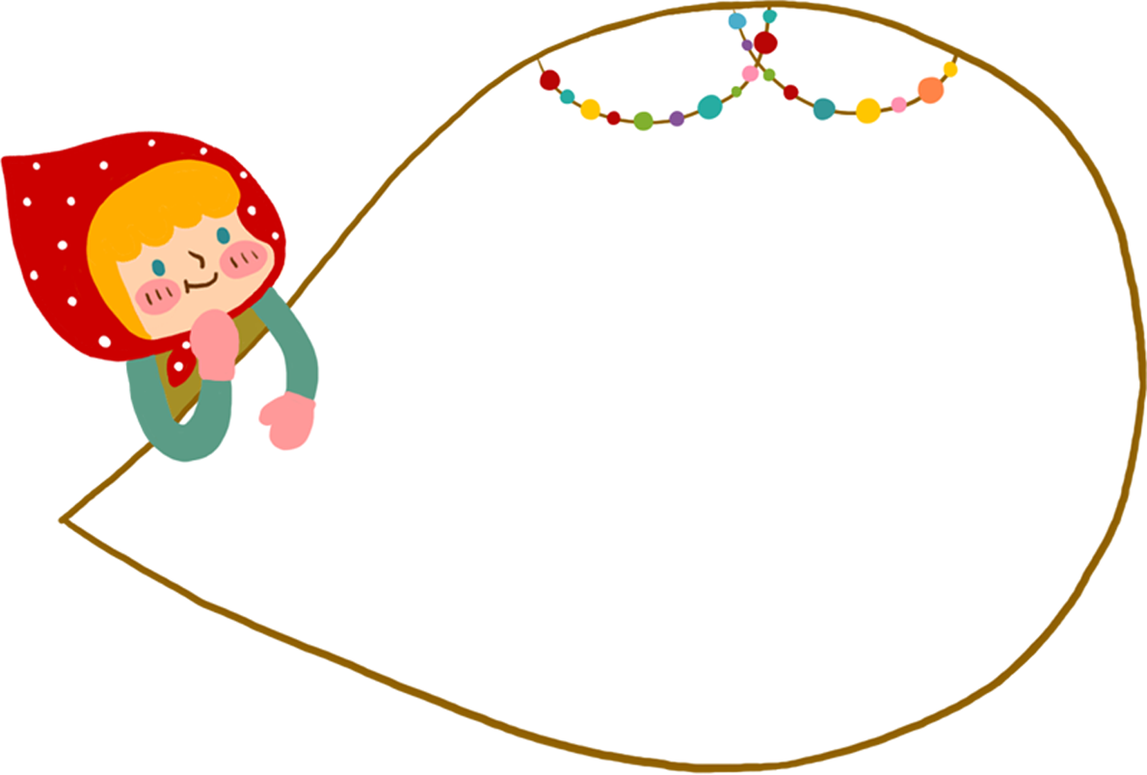
Question
You can discuss it with your group members
1、What did the man say first to the woman?
2、What is the woman`s family name?
3、What is the man`s full name?
Please read the text to answer the following questions

Slide 41
Language
practice

Slide 42
Don`t forget your homework
and Class quizzes!!!
Attention!!!

Slide 43
Class is over
BYE BYE

