Slide 1
Hobbies
爱好
ài hào
LI XINYU

Slide 2
On October 29, we will review 1-5 lessons. On October 30, we will have a paper-based examination, which includes listening, reading pinyin to write Chinese characters, reorganizing sentences, translating English into Chinese, and reading comprehension. 20% of the final exam questions will be the same as those in this paper. Please don't be absent!!!

Slide 3
zhōu mò
周末
weekend

Slide 4
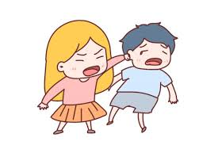
dǎ
打
dǎ qiú
to hit
打球
qiú
to play ball
球
ball

Slide 5
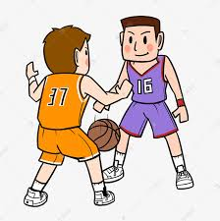
A：我喜欢打球，你呢？
wǒ xǐ huan dǎ qiú,nǐ ne ？
I like to play ball, How about you?
B：我也喜欢打球。
wǒ yě xǐ huan dǎ qiú.
I like to play ball, too.

Slide 6
tiào
跳
tiào wǔ
to jump
跳舞
wǔ
to dance
舞
to dance

Slide 7
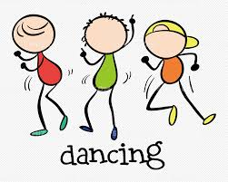
他们喜欢跳舞。
tā men xǐ huan tiào wǔ.
They like to dance

Slide 8
chàng
唱
chàng gē(r)
to sleep
唱歌(儿)
gē
to sing (a song)
歌
song

Slide 9
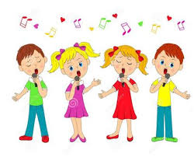
A：你喜欢不喜欢唱歌(儿)？
nǐ xǐ huan bù xǐ huan chàng gē(ér)？
Do you like to sing?
B：我不喜欢唱歌(儿)。
wǒ bù xǐ huan chàng gē(ér).
I don`t like to sing.

Slide 10
tīng
听
to listen

Slide 11
yīn yuè
音乐
music

Slide 12
tīng yīn yuè
听音乐listen to music

Slide 13
kàn
看
to watch;
to look;
to read

Slide 14
diàn shì
电视
television

Slide 15
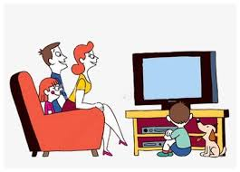
kàn diàn shì
看电视
watch TV

Slide 16
A：你喜欢看电视吗？
nǐ xǐ huan kàn diàn shì ma？
Do you like to watch TV?
B：我喜欢看电视。
wǒ xǐ huan kàn diàn shì.
I like to watch TV.

Slide 17
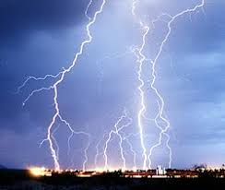
diàn
电
electricity

Slide 18
shì
视
vision

Slide 19
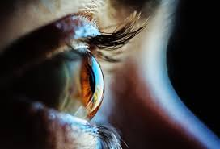
他的视觉很敏锐。
tā de shì jué hěn mǐn ruì 。
His vision is very sharp

Slide 20
diàn yǐng
电影
movie

Slide 21
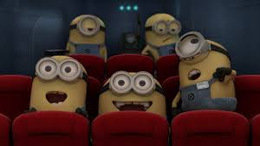
kàn diàn yǐng
看电影
watch movie

Slide 22
yǐng
影
shadow

Slide 23
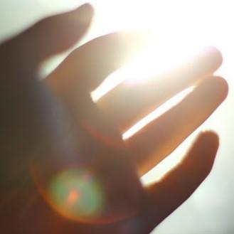
guāng
光
light

Slide 24
shū
书
book

Slide 25
duì
对
right;correct

Slide 26
cuò
错
wrong

Slide 27
yǒu de
有的
some

Slide 28
shí hou
时候
(a point in)time;
moment;
(a duration of)time

Slide 29
yǒu de shí hou
有的时候
sometimes

Slide 30
nà
那
in that case;then

Slide 31
cháng cháng
常常
often

Slide 32
A：你周末常常做什么？
nǐ zhōu mò cháng cháng zuò shén me ？
What do you often do on weekends?
B：我周末常常看电影。
wǒ zhōu mò cháng cháng kàn diàn yǐng.
I often watch movies on weekends.

Slide 33
wài guó
外国
foreign country

Slide 34
qǐng kè
请客
to invite someone
(to dinner,coffee,etc.);
to play the host

Slide 35
zuó tiān
昨天
yesterday

Slide 36
suǒ yǐ
所以
so

Slide 37
The basic word order in a Chinese sentence is as follow.
Subject (agent of the action) | Adverbial (time,place,manner,ect) | Verb | object (receiver of the action)
Subj. | Adverbial | Verb | Obj.
王朋 | 周末/常常 | 听 | 音乐
wáng péng | zhōu mò / cháng cháng | tīng | yīn yuè
Wang Peng often listens to music on weekends.

Slide 38
The basic word order in a Chinese sentence is as follow.
Subject (agent of the action) | Adverbial (time,place,manner,ect) | Verb | object (receiver of the action)
Subj. | Adverbial | Verb | Obj.
李友 | 明天 | 吃 | 中国菜
lǐ yǒu | míng tiān | chī | zhōng guó cài
Li You will have Chinese food tomorrow.

Slide 39
The basic word order in a Chinese sentence is as follow.
Subject (agent of the action) | Adverbial (time,place,manner,ect) | Verb | object (receiver of the action)
Subj. | Adverbial | Verb | Obj.
高文中 | 昨天下午五点半 | 去看 | 外国电影
gāo wén zhōng | zuó tiān xià wǔ wǔ diǎn bàn | qù kàn | wài guó diàn yǐng
Gao Wenzhong went to see a foreign movie at 5:30 yesterday aftenoon.

Slide 40
Affirmative+Negative(A-not-A) Questions
In this type of question there can be no adverbials before the verb other than time words as in (1) and (2). If there is an adverbial--such as 很(hěn,very), 都(dōu,all), or 常常(cháng cháng,often)--before the verb, the 吗 type question must be used instead, as in (3),(4), and (5). If there is more than one verb, the question form applies to the first verb, as seen in (6) and (7).

Slide 41
1、你明天去不去？
nǐ míng tiān qù bu qù ？
Are you going tomorrow?
2、她今天晚上看不看电视？
tā jīn tiān wǎn shang kàn bu kàn diàn shì ？
Is she going to watch TV tonight?

Slide 42
3、他们都是学生吗？ 他们都是不是学生？(X)
tā men dōu shì xué sheng ma ？
Are they all students?
4、你常常看电影吗？ 你常常看不看电影？(X)
nǐ cháng cháng kàn diàn yǐng ma ？
Do you often go to the movies?
5、王医生很忙吗？ 王医生很忙不忙？(X)
wáng yī shēng hěn máng ma ？
Is Dr. Wang very busy?

Slide 43
6、你想不想跳舞？ 你想跳不跳舞?(X)
nǐ xiǎng bu xiǎng tiào wǔ ？
Do you want to dance?
7、你的同学去不去打球？ 你的同学去打不打球?(X)
nǐ de tóng xué qù bu qù dǎ qiú ？
Does your classmate go to play ball?

Slide 44
The Conjunction 那(么)(nà me,then; in that case)
In a dialogue, immediately following a statement by speaker A, speaker B can often start with 那(么), which links up the sentences by the two speakers.

Slide 45
A:今天晚上没事儿。
jīn tiān wǎn shang méi shìr .
We have nothing to do tonight.
B:那我们去看电影，怎么样？
nà wǒ men qù kàn diàn yǐng ，zěn me yàng ?
In that cases, let`s go to see a movie. How`s that?
A:好，我请客。
hǎo,wǒ qǐng kè.
Okay,my treat!
B:是吗？太好了！
shì ma ？tài hǎo le ！
Really? Great!

Slide 46
A:我今天很忙，不想去吃晚饭。
wǒ jīn tiān hěn máng,bù xiǎng qù chī wǎn fàn 。
I`m very busy today.I don`t want to go to dinner.
B:那明天呢？
nà míng tiān ne ？
Then how about tomorrow?

Slide 47
A:你喜欢不喜欢吃美国菜？
nǐ xǐ huan bu xǐ huan chī měi guó cài ？
Do you like to eat American food or not?
B:不喜欢。
bù xǐ huān.
No,I don`t
A:那我们吃中国菜，怎么样？
nà wǒ men chī zhōng guó cài,zěn me yàng ？
Then let`s cat Chinese food. How`s that?
B:我也不喜欢。
wǒ yě bù xǐ huan.
I don`t like that either.

Slide 48
去(qù , to go)+Action
1、明天晚上我们去看电影。
míng tiān wǎn shang wǒ men qù kàn diàn yǐng.
We are going to see a movie tomorrow night.
2、晚上我不去跳舞。
wǎn shang wǒ bú qù tiào wǔ 。
I will not go dancing tonight.
3、周末我去跳舞，你去不去？
zhōu mò wǒ qù tiào wǔ ，nǐ qù bu qù ？
I`ll go dancing this weekend. Are you going?

Slide 49
Questions with 好吗
(hǎo ma)
To solicit someone`s opinion, we can ask 好吗(hǎo ma) after stating an idea or suggestion.
You will also hear people say 好不好(hǎo bu hǎo), instead of 好吗(hǎo ma)

Slide 50
1、我们去看电影，好吗？
wǒ men qù kàn diàn yǐng ，hǎo ma ？
We`ll go see a movie, all right?
2、我们今天晚上吃中国菜，好吗？
wǒ men jīn tiān wǎn shang chī zhōng
guó cài，hǎo ma ？
We`ll eat Chinese food tonight, all right?

Slide 51
高文中：白英爱，你周末喜欢做什么？
白英爱：我喜欢打球、看电视。你呢？
高文中：我喜欢唱歌、跳舞，还喜欢听音乐。
你也喜欢看书，对不对？
白英爱：对，有的时候也喜欢看书。
高文中：你喜欢不喜欢看电影？
白英爱：喜欢。我周末常常看电影。
高文中：那我们今天晚上去看一个外国电影，
怎么样？我请客。

Slide 52
白英爱：为什么你请客？
高文中：因为昨天你请我吃饭，所以今天我
请你看电影。
白英爱：那你也请王朋、李友，好吗？
高文中：...好。

Slide 53
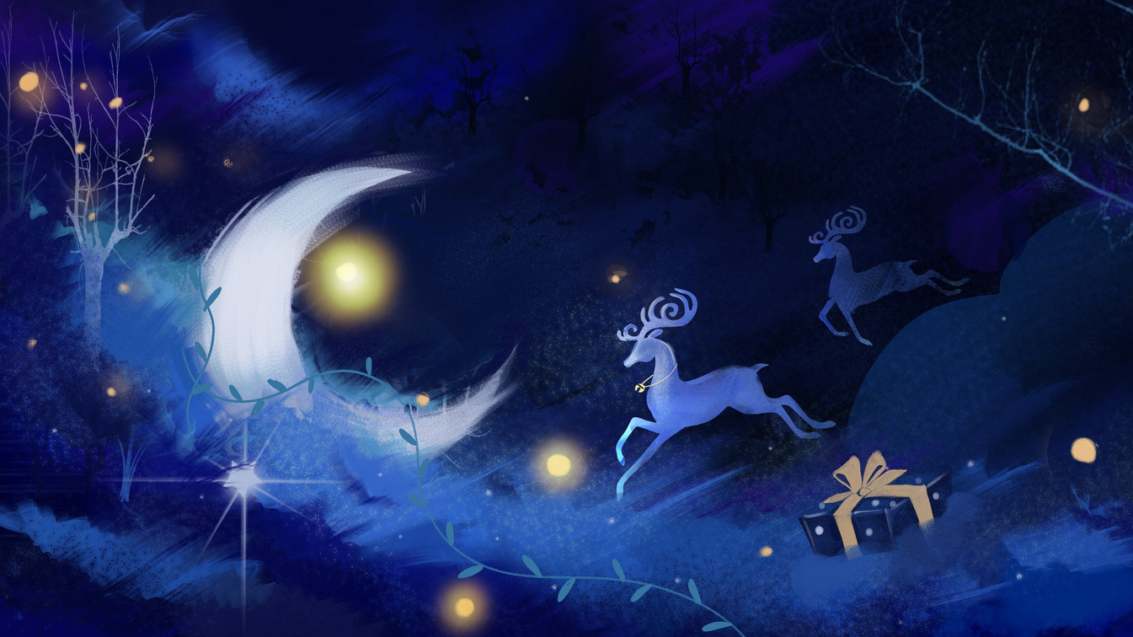
Question
1、What does Gao Wenzhong like to do on weekends?
2、What does Bai Ying ai like to do on weekends?
3、Who is treating this evening?

Slide 54
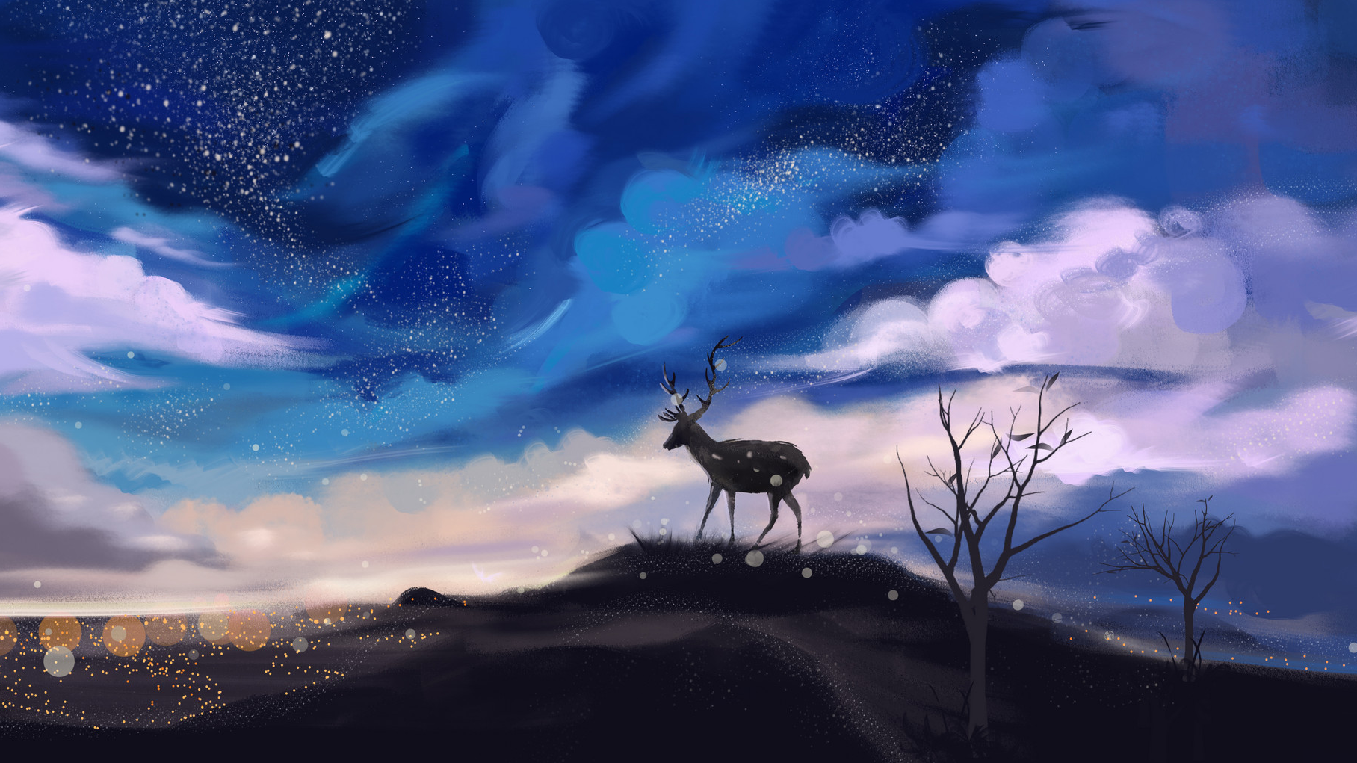
Language Practice

