Slide 1
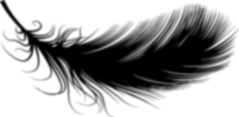
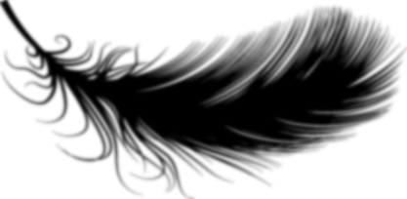
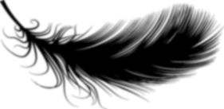
Hobbies
爱好
ài hào
LI XINYU

Slide 2
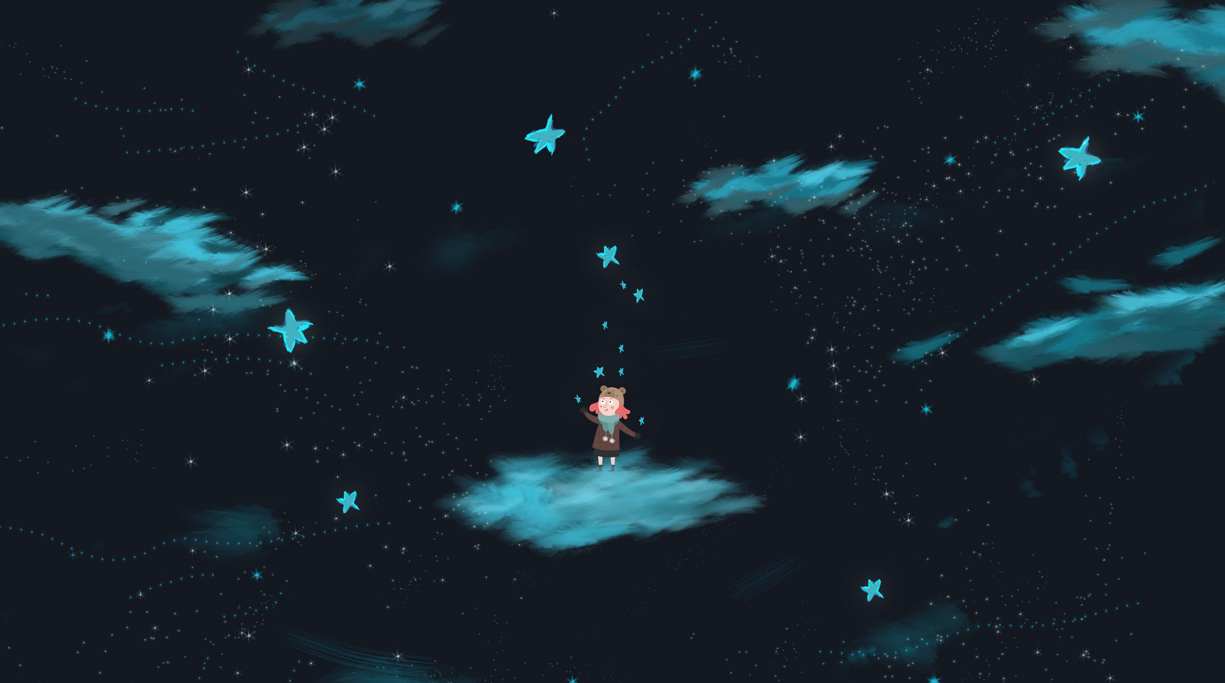
On October 29, we will review 1-5 lessons. On October 30, we will have a paper-based examination, which includes listening, reading pinyin to write Chinese characters, reorganizing sentences, translating English into Chinese, and reading comprehension. 20% of the final exam questions will be the same as those in this paper. Please don't be absent!!!

Slide 3
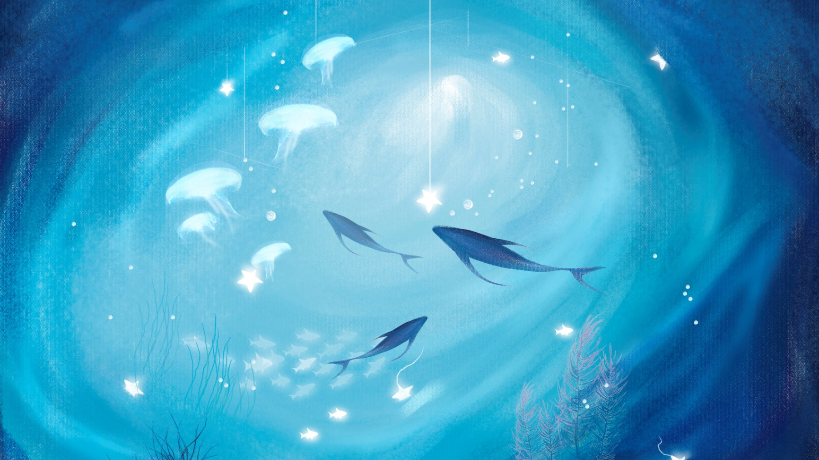
xiǎo
小
small;little

Slide 4
A familiar and affection way of addressing a young person is to add 小 (xiǎo,little;small) to the family name.,小王(xiǎo wáng,Little Wang). Similarly, to address an older acquaintance, 老(lǎo,old) can be used with the surname, e,g.,老王(lǎo wáng,Old Wang). However, such terms are rarely used to address a relative, or a superior

Slide 5
hǎo
好
hǎo jiǔ
very
好久
a long time
jiǔ
久
long(of time)

Slide 6
你好吗？(nǐ hǎo ma? How are you？) is a question typically asked of people that you already know. The answer is "我很好"(wǒ hěn hǎo, I am fine.)
typically

Slide 7
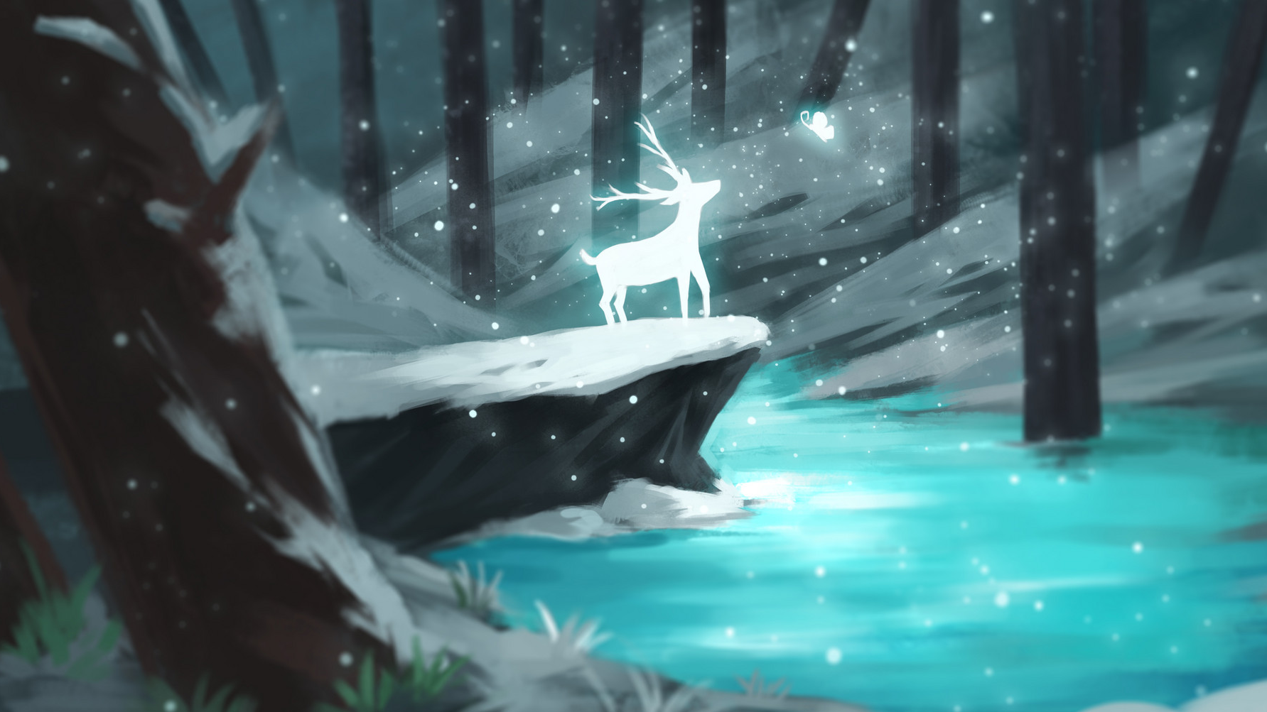
好久不见
hǎo jiǔ bú jiàn
Long time no see

Slide 8
bú cuò
不错
pretty good

Slide 9
xiǎng
想
to want to;
would like to;
to think

Slide 10
jué de
觉得
to feel;to think

Slide 11
yì si
意思
meaning

Slide 12
yǒu yì si
有意思
interesting

Slide 13
The position of negatives in Chinese is not always the same as their counterparts in English. An English speaker would say: "I don`t think going to the movies is a lot of fun," but a Chinese speaker would say 我觉得看电影没有意思(wǒ jué de kàn diàn yǐng méi you yì si ), which literally means, "I think going to the movies is not a lot of fun."

Slide 14
zhǐ
只
only

Slide 15
shuì
睡
shuì jiào
to sleep
睡觉
jiào
to sleep
觉
sleep

Slide 16
The character 觉 is pronounced in two different ways and has two different meanings: jué as in 觉得(jué de, to feel) and jiào as in 睡觉(shuì jiào, to sleep).
jué de
shuì jiào
觉得
睡觉
to feel
to sleep

Slide 17
suàn le
算了
forget it;
never mind

Slide 18
zhǎo
找
to look for

Slide 19
bié rén
别人
other people;
another person

Slide 20
bié (de)
别(的)
other

Slide 21
A：你想听音乐吗？
nǐ xiǎng tīng yīn yuè ma ？
Would you like to listen to some music?
B：我想听音乐。
wǒ xiǎng tīng yīn yuè 。
I would like to listen to music.

Slide 22
白老师想打球，可是王老师不想打。
bái lǎo shī xiǎng dǎ qiú ，kě shì wáng lǎo shī bù xiǎng dǎ.
Teacher Bai felt like playing ball, but Teacher Wang didn`t.

Slide 23
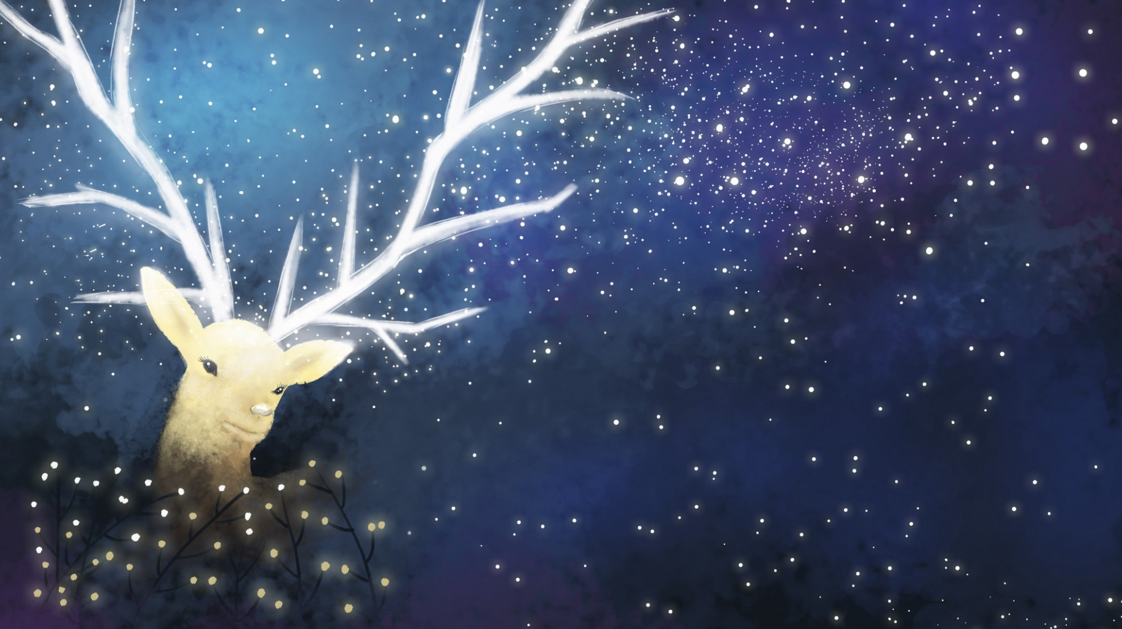
A：你想不想看中国电影？
nǐ xiǎng bu xiǎng kàn zhōng guó diàn yǐng ？
Do you feel like going to see a Chinese movie?
B：我想看中国电影。
wǒ xiǎng kàn zhōng guó diàn yǐng.
I feel like going to see a Chinese movie.

Slide 24
A：你想不想听外国音乐？
nǐ xiǎng bu xiǎng tīng wài guó yīn yuè ？
Do you feel like listening to some foreign music?
B：我想听外国音乐。
wǒ xiǎng tīng wài guó yīn yuè.
I feel like listening to some foreign music.

Slide 25
想(xiǎng) VS 喜欢(xǐ huan)
想(xiǎng) can be translated as "would like to," "to have a desire to." 喜欢(xǐ huan) is "to like" meaning "be fond of." 想(xiǎng) and 喜欢(xǐ huan) are different, and are not interchangeable.

Slide 26
想(xiǎng) VS 觉得(jué de)
Both想(xiǎng) and 觉得(jué de) can be translated as "to think," but the former means "to desire," whereas the latter means "to feel," "to have the opinion," or "to give a comment."

Slide 27
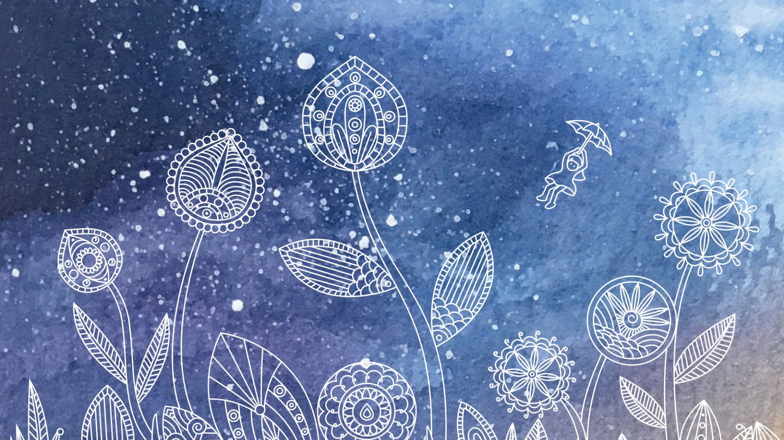
Verb+Object as a Detachable Compound
Even though 睡觉(shuì jiào, to sleep), 唱歌(chàng gē, to sing), and 跳舞(tiào wǔ, to dance) are treated each as a word, grammatically speaking, they are all verb-object compounds. When there is an attributive element to modify the object, such as an adjective or a number-measure word combination, it must be inserted between the verb and the noun.

Slide 28
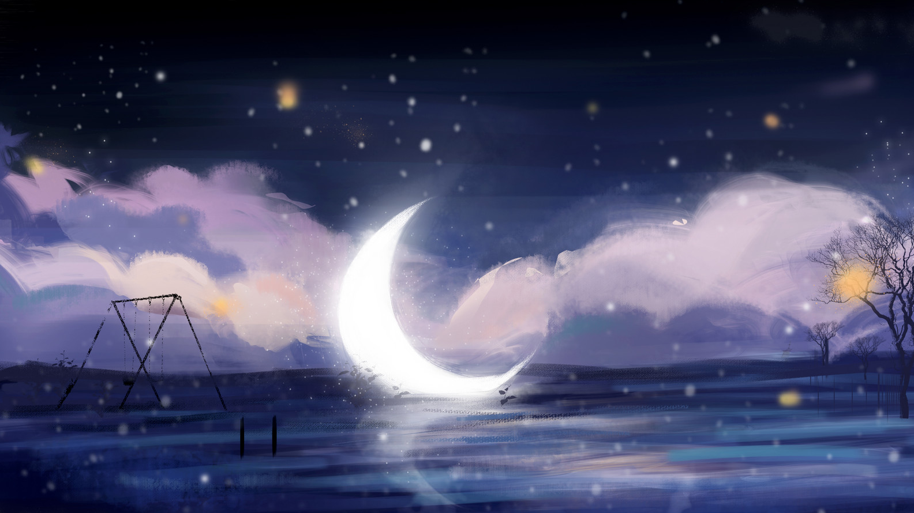
Verb+adjective/number-measure word+noun
睡一个好觉
shuì yí ge hǎo jiào
have a good sleep
唱英文歌
chàng yīng wén gē
sing an English song
跳中国舞
tiào zhōng guó wǔ
do a Chinese dance
睡觉 shuì jiào
to sleep
唱歌 chàng gē
to sing
跳舞 tiào wǔ
to dance

Slide 29
王 朋：小高，好久不见，你好吗？
高文中：我很好。你怎么样？
王 朋：我也不错。这个周末你想做什么？
想不想去打球？
高文中：打球？我不喜欢打球。
王 朋：那我们去看球，怎么样？
高文中：看球？我觉得看球也没有意思。
王 朋：那你这个周末想做什么？
高文中：我只想吃饭、睡觉。
王 朋：算了，我去找别人。

Slide 30
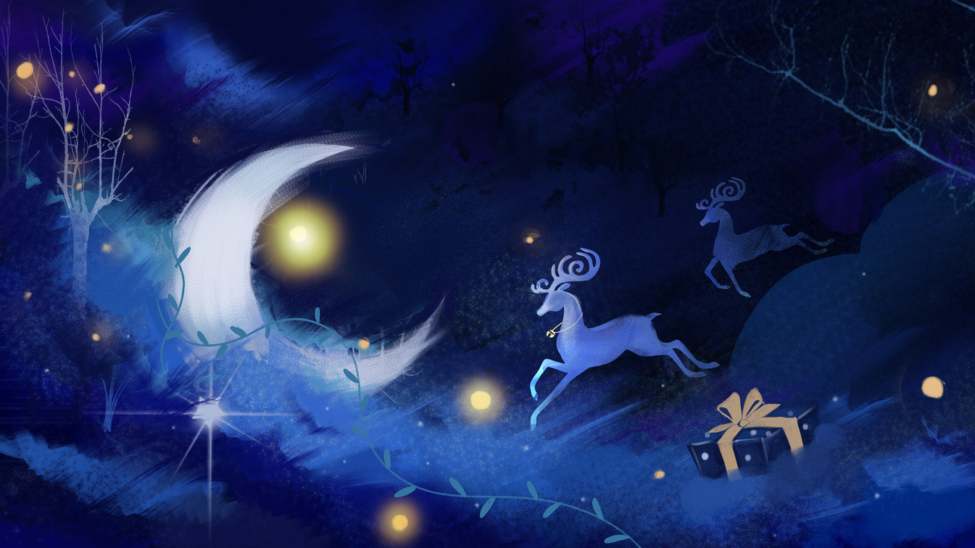
Question
1、How does Wang Peng greet Gao Wenzhong? 2、Does Gao Wenzhong want to play ball? Why?
3、What does Gao Wenzhong like to do ?

Slide 31
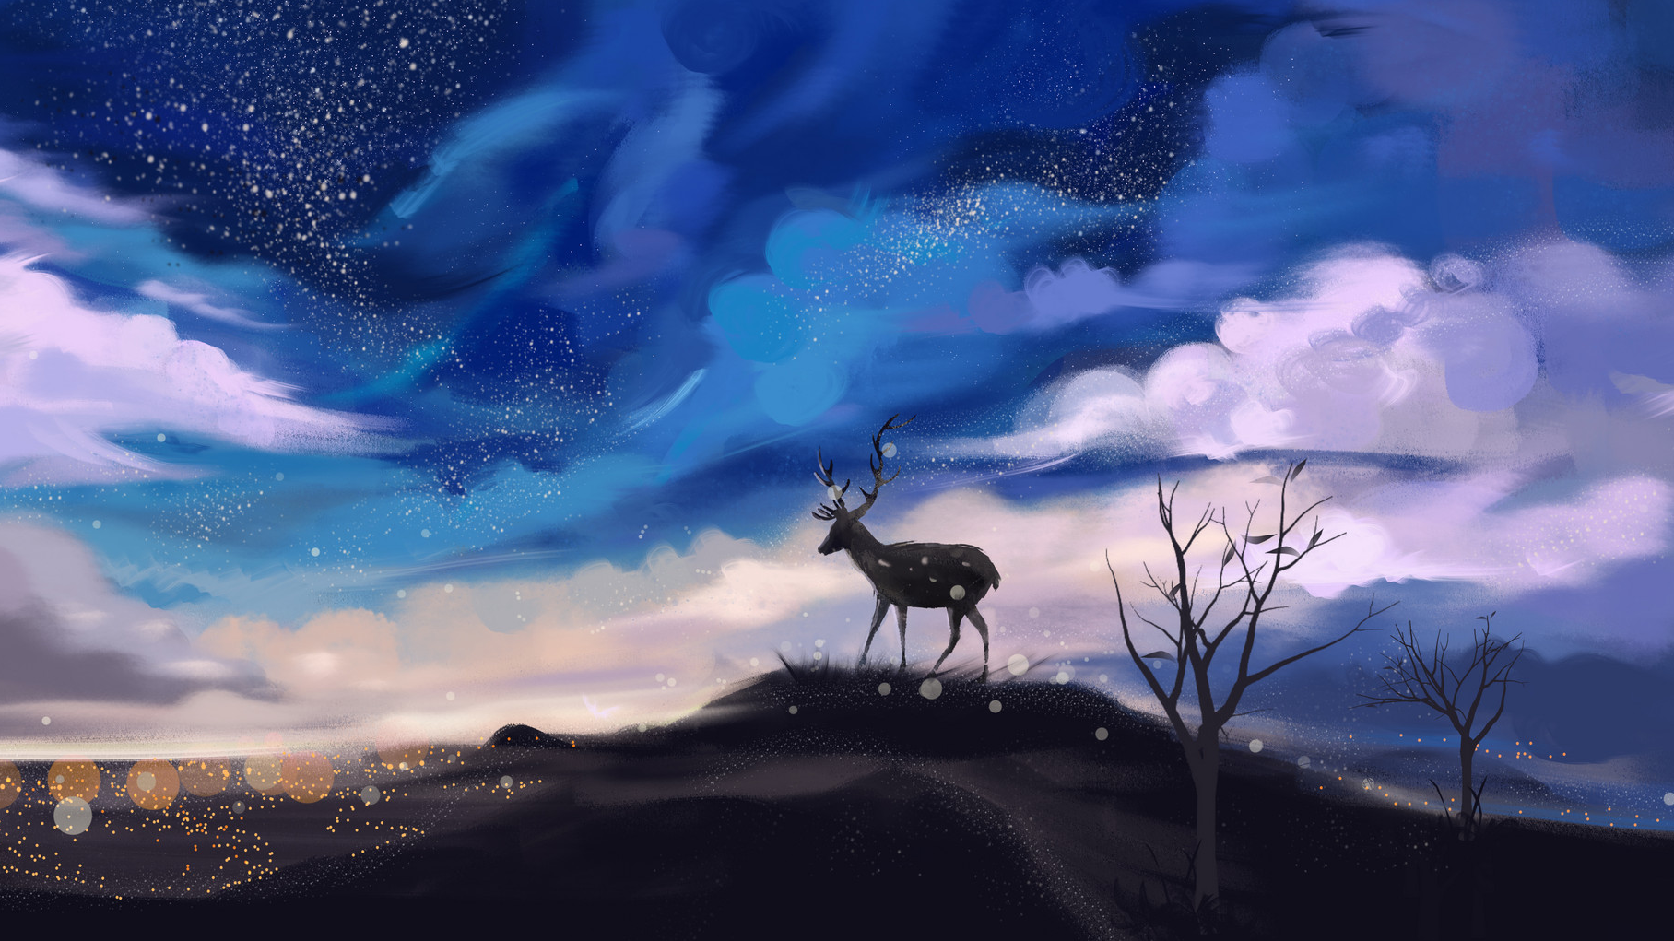
Language Practice

