Slide 1
第七课 电脑和网络

Slide 2
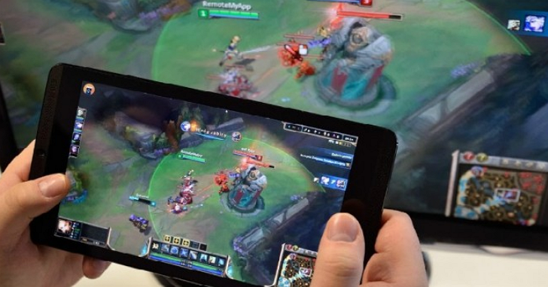
网路
wǎnglù
网络
wǎngluò
看
新闻
xīnwén
查
chá
资料
zīliào
玩
游戏
yóuxì

Slide 3
追剧
zhūijù
看电影
追
zhūi
剧
jù
To chase
serial
A：你周末在做什么？
B：我周末在追剧。
A：你在追什么剧？
B：我在追Why Women Kill。

Slide 4
网络购物
听音乐

Slide 5
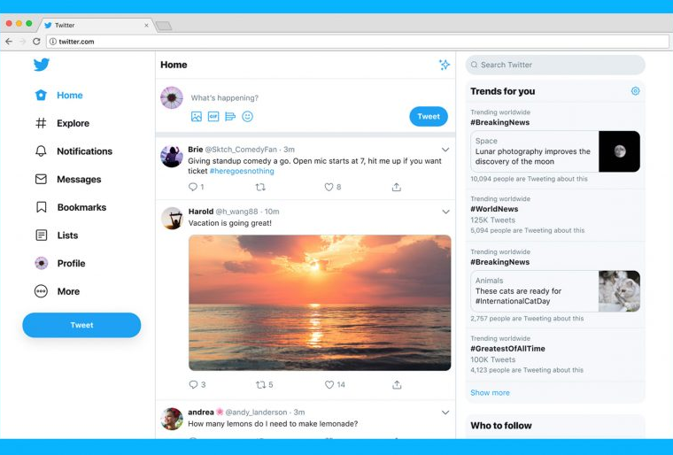
写博客
bókè
部落格
bùluògé
网站
wǎngzhàn
wēibó

Slide 6
To download
软件
ruǎnjiàn
下载
xiàzài
你用软件学中文吗？
你用什么软件学中文？
Anki

Slide 7
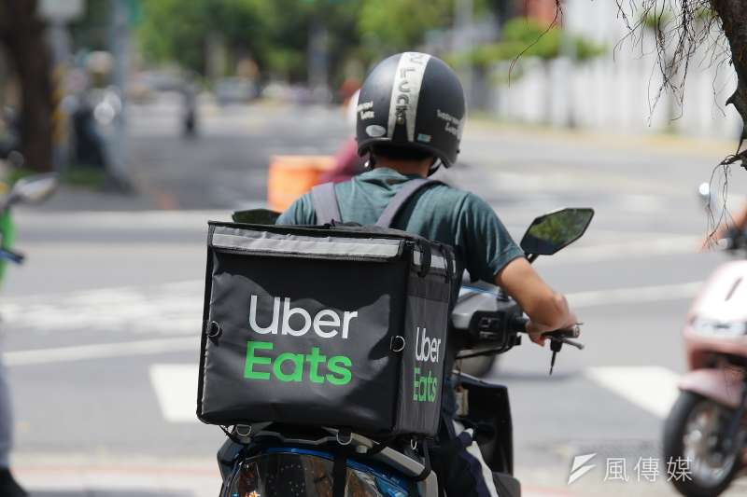
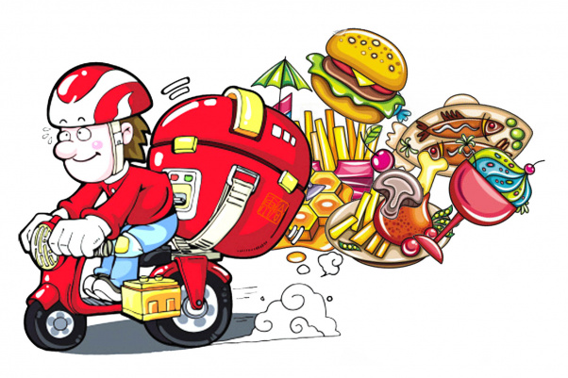
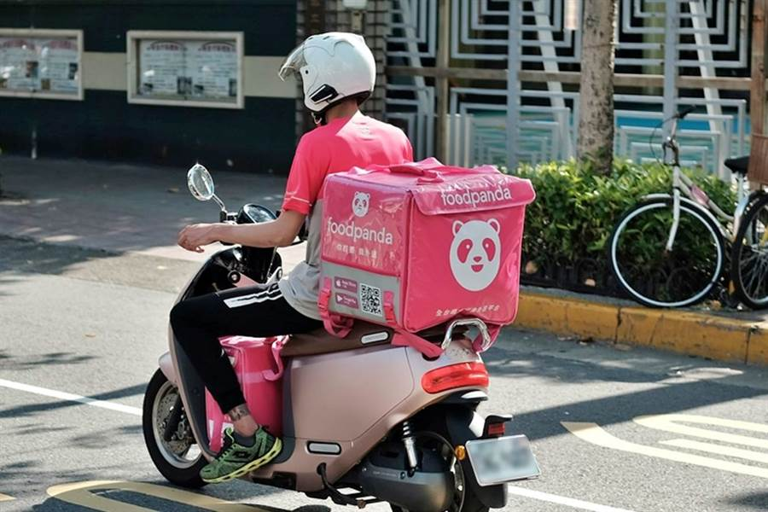
叫外卖
jiào wàimài
翻译
fānyì
交朋友

Slide 8
你常常上网做什么事？你不上网做什么事？
我常常上网…
我不上网…
看新闻
查资料
玩游戏
追剧
看电影
购物
听音乐
写博客
学中文
叫外卖
翻译
交朋友

Slide 9
Era
时代
shídài
Nowadays is internet’s era.
现在是网络的时代。
To lag behind
落伍
luòwǔ

Slide 10
Grammar
语法

Slide 11
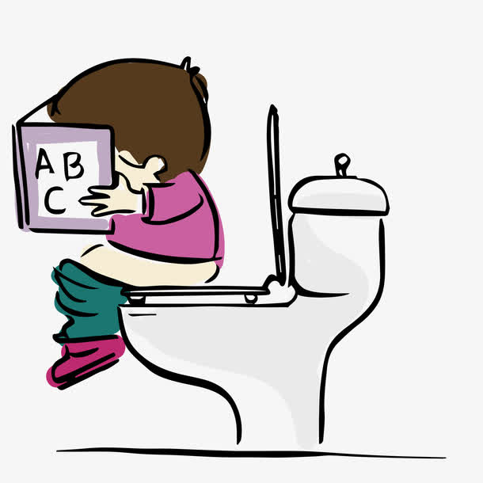
Conjunction 甚至
Even
+Something too over
(from speaker’s view point)
Is used to single out an item for emphasis in order to stress the speaker’s point of view.
他非常喜欢看书，甚至上厕所的时候也在看。
Emphasizing how much he likes to read book
上厕所

Slide 12
Conjunction 甚至
Even
+Something too over
(from speaker’s view point)
他很喜欢哈利波特
把哈利波特的书看了十次
我看了十次。
他很喜欢看哈利波特，甚至把哈利波特的书看了十次。

Slide 13
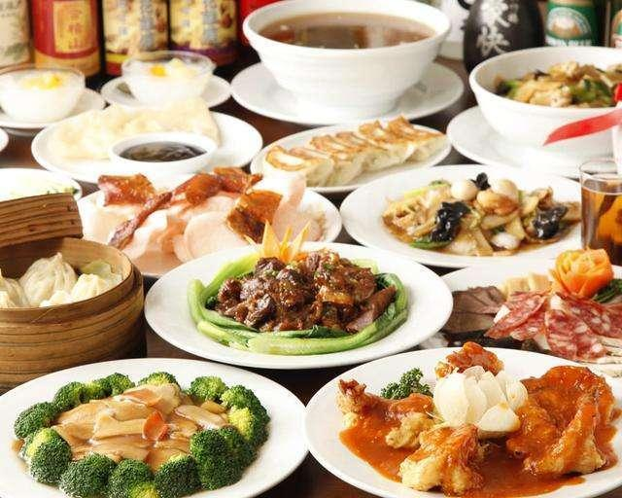
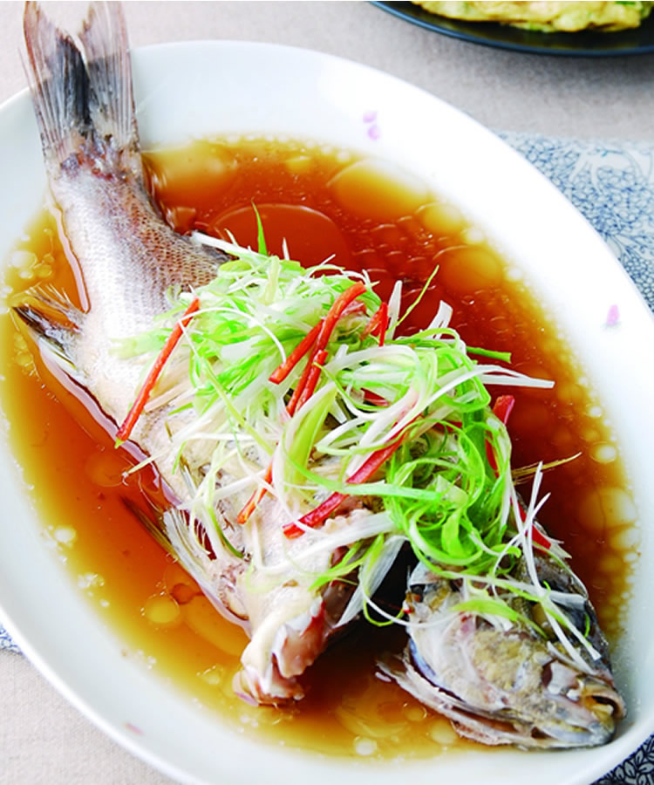
Conjunction 甚至
+连…都/也
Even
+Something too over
(from speaker’s view point)
弟弟很会做中国菜
清蒸鱼都会做
弟弟很会做中国菜，甚至连清蒸鱼都会做。

Slide 14
Conjunction 甚至
+连…都/也
Even
+Something too over
(from speaker’s view point)
姐姐会说很多语言
印度语她也会说
姐姐会说很多语言，甚至连印度语她也会说。

Slide 15
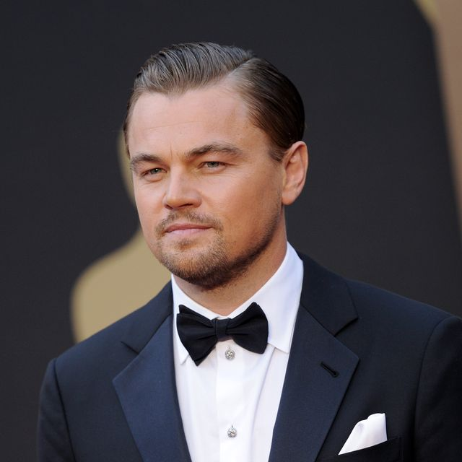
Conjunction 甚至
+连…都/也
Even
+Something too over
(from speaker’s view point)
他的朋友很多
Leonardo DiCaprio也是他的朋友
我朋友很多。
他的朋友很多，甚至连Leonardo DiCaprio也是他的朋友。

Slide 16
Conjunction 甚至
+连…都/也
Even
+Something too over
(from speaker’s view point)
请造句

Slide 17
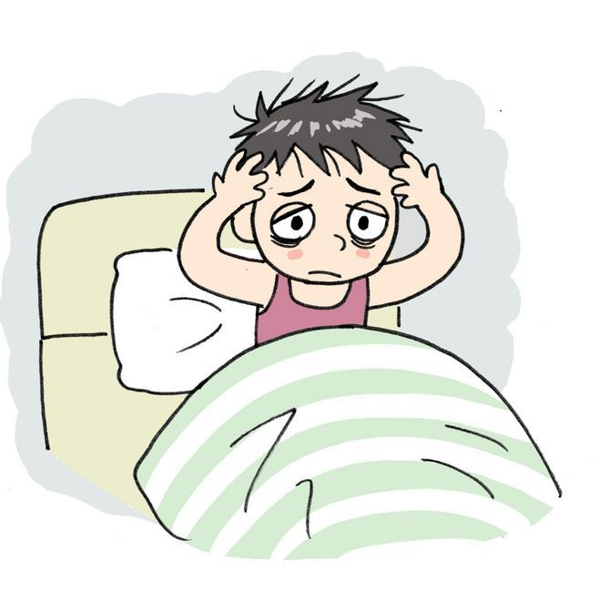
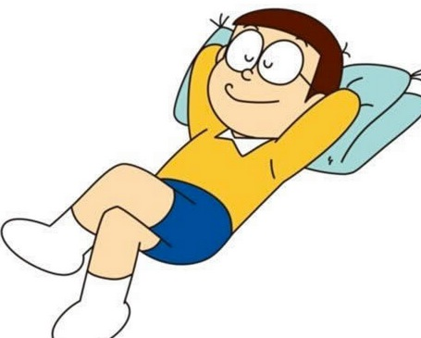
Potential Complements
1
V+得/不+resultative complement/ directional complement
x
He can’t fall a sleep.
他不能睡着。
他 睡
他睡着了
他睡不着

Slide 18
Potential Complements
1
V+得/不+resultative complement
Can you finish your homework?
(write)
你写得完你的作业吗？
I can’t finish.
I can finish.
我写不完。
我写得完。

Slide 19
Potential Complements
1
V+得/不+resultative complement
(看懂)
看不懂
我的中文水平不高，_________中文电影。

Slide 20
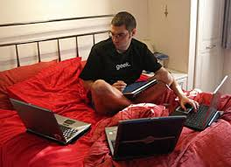
Potential Complements
1
V+得/不+resultative complement
Can’t leave apart from the computer
(离开)
离不开
哥哥是个电脑迷，经常__________电脑。

Slide 21
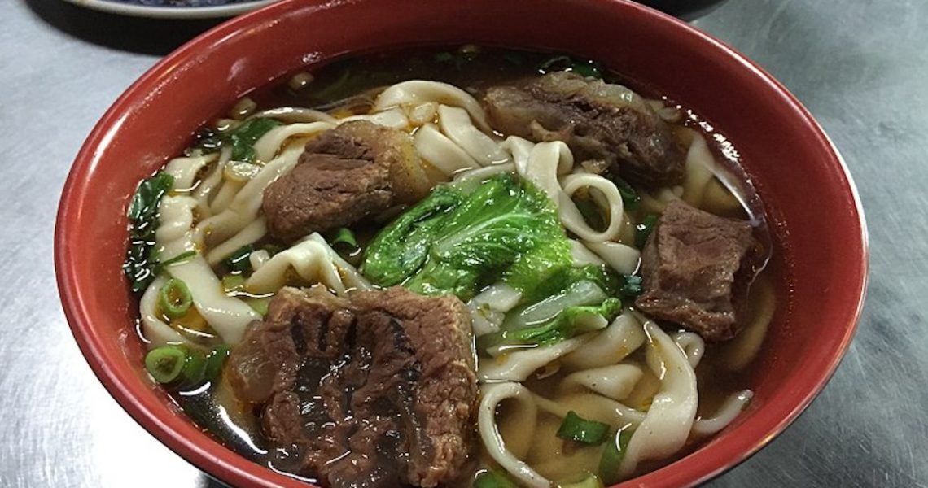
Potential Complements
1
V+得/不+resultative complement
(吃完)
吃得完
这碗牛肉面的面不多，我________。

Slide 22
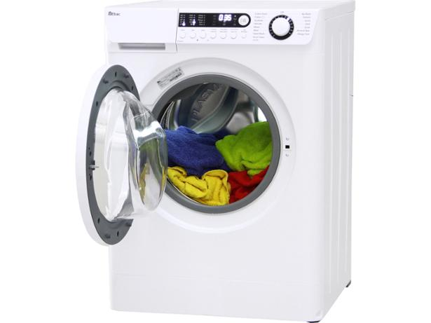
Potential Complements
1
V+得/不+resultative complement
dong dong………
(听见)
听不见
洗衣机的声音太吵了，我________你在说什么。

Slide 23
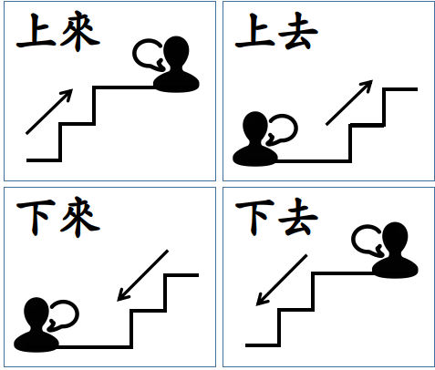
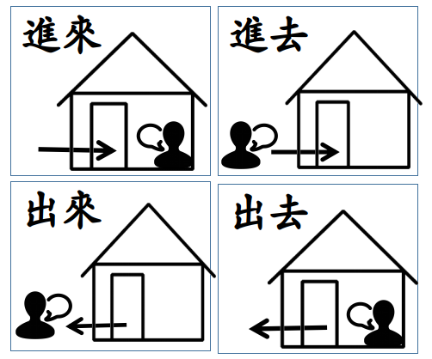
Potential Complements
1
V+得/不+directional complement
Directional complement
into
进
out
出
+ 来/去
上
up
down
下

Slide 24
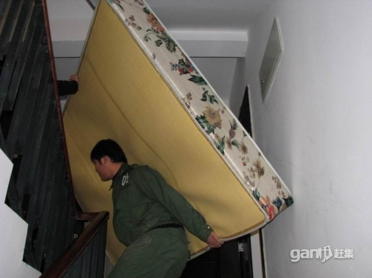
Potential Complements
1
V+得/不+directional complement
(搬)
bān
(上去)
搬不上去
这张床太重了，我_________。

Slide 25
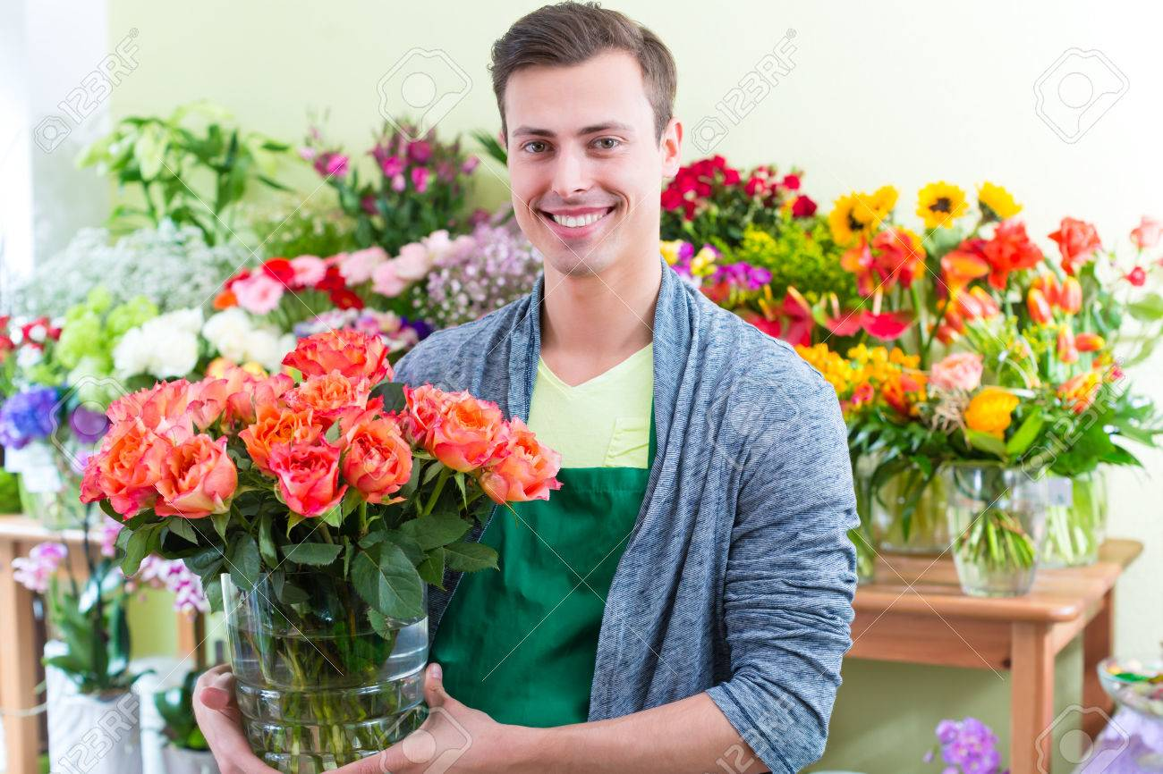
Potential Complements
1
V+得/不+directional complement
你的朋友在卖花，你觉得一定会有很多人买。
你说：These flowers are beautiful, they will be sold out.
卖得出去
A：这些花很漂亮，一定__________。

Slide 26
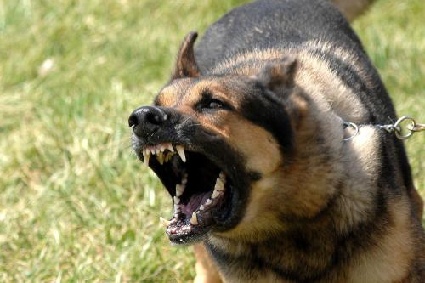
Potential Complements
1
V+得/不+directional complement
你的朋友在房子里。
你在房子外。
房子外有一只很凶的狗。
Can you come in?
进得来
朋友：你__________吗?
进不去
你：我__________。

Slide 27
The negative form of potential complements cannot be replaced by 不能。Otherwise meaning will be changed.
x
这张床太重了，我不能搬上去。
这张床太重了，我搬不上去。
Unable to move up
这张床我不能搬上去，因为这张床不是我的。
I can’t move the bed, because the bed is not mine.

Slide 28
The affirmative form of potential complements can be replaced with
“能+verb+directional complement/resultative complement”
I can finish today’s homework.
我写得完今天的作业。
我能写完今天的作业。

Slide 29
Potential Complements
Use in question sentences
Can you finish this 牛肉面？
吃得完
1
这碗牛肉面你_______吗？
吃得完吃不完
2
这碗牛肉面你_____________？

Slide 30
Potential Complements
Use in question sentences
这张床你搬得上去吗？
这张床你搬得上去搬不上去？

Slide 31
Potential Complements
Use in question sentences
你的作业写得完吗？
你的作业写得完写不完？

Slide 32
Potential Complements
1
V+得/不+resultative complement/ directional complement
请造句

Slide 33
Formal
To publish
正式
zhèngshì
出版
chūbǎn
journals; magazine
We have to use
formally published journals.
我们得用正式出版的杂志。
杂志
zázhì

Slide 34
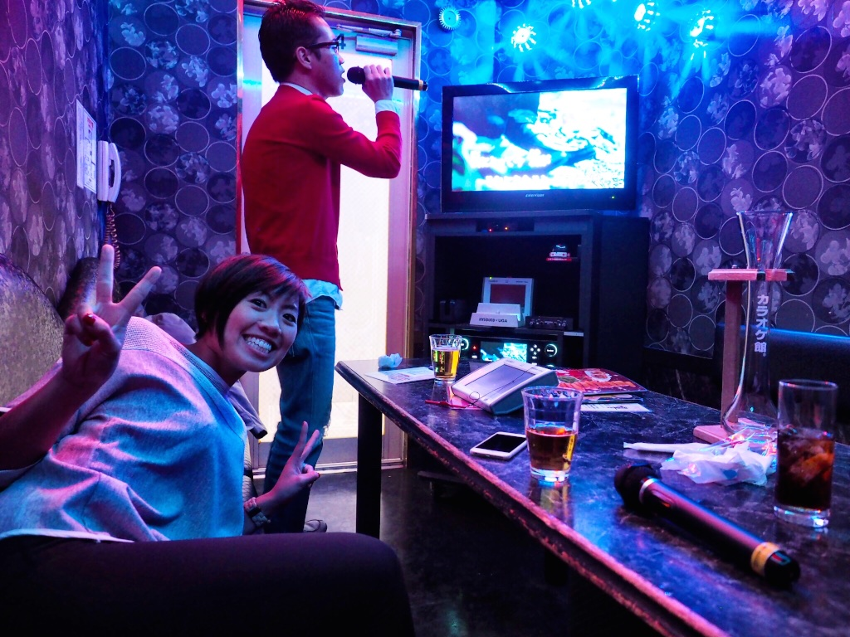
hastily; in a hurry
急忙
jímáng
唱
chàng
卡拉OK
kǎlā
She hastily called her professor.
她急忙地叫了她的教授。

Slide 35
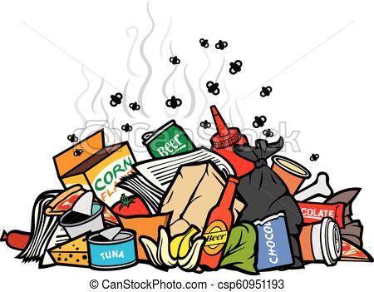
你相信所有网络上的资料吗？
garbage; trash
I don’t believe, because there are too many trash
from the internet.
我不相信，因为网路上有太多垃圾。
垃圾
lājī(lèsè)
网路上的资料很可靠、很有用。
dependable
useful
可靠
kěkào
有用
yǒuyòng

Slide 36
In short; in brief; anyway
总之
zǒngzhī
总之，只要有网络，
衣食住行都很方便。
basic necessities of life
衣食住行
yī shí zhù xíng

Slide 37
Always
To arrive late
老是
lǎoshì
迟到
chídào
Who always be late in our class?
我们班谁老是迟到？

Slide 38
Grammar
语法

Slide 39
Potential Complements
2
V+得/不+了(liǎo)
This pattern is used to talk about whether or not you are able to do something.
Unable to eat
这碗牛肉面太咸，我________。
吃不了
我吃不了这碗牛肉面，因为它太咸了。

Slide 40
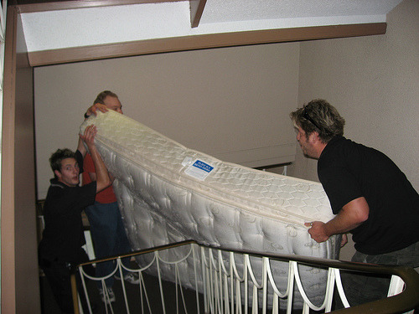
Potential Complements
2
V+得/不+了(liǎo)
This pattern is used to talk about whether or not you are able to do something.
Unable to move
搬不了
这张床太重，我__________。
我搬不了这张床，因为它太重。

Slide 41
Potential Complements
2
V+得/不+了(liǎo)
This pattern is used to talk about whether or not you are able to do something.
thick
厚
hòu
Unable to read
看不了
这本书太厚，我_________。

Slide 42
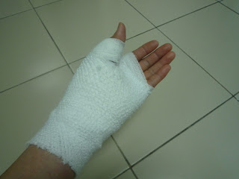
Potential Complements
2
V+得/不+了(liǎo)
This pattern is used to talk about whether or not you are able to do something.
Ａ：Are you able to write words?
你写得了字吗？
B：Sorry, I can’t write.
对不起，我写不了。

Slide 43
Potential Complements
2
V得了V不了
Use in question sentences
今天的派对你去得了吗？
今天的派对你去得了去不了？
这碗酸辣汤你喝得了吗？
这碗酸辣汤你喝得了喝不了？

Slide 44
好 as a resultative complement
V好
V好O
Indicates bringing an action to completion and being ready for the next action
I have already chosen lessons.
我已经选好课了！
(occur)
Let’s have a dinner after we choosing lessons.
我们选好课后就去吃饭吧！
(doesn’t occur)

Slide 45
好 as a resultative complement
(doesn’t occur)
V好O后就do sth
Indicates bringing an action to completion and being ready for the next action
After we move the bed
go to sleep
我们搬好床后就去睡觉。

Slide 46
好 as a resultative complement
(doesn’t occur)
V好O后就do sth
Indicates bringing an action to completion and being ready for the next action
After I finish my homework
We go shopping
我写好我的作业后我们就去购物。

Slide 47
好 as a resultative complement
S+V好了....
(occur)
Indicates bringing an action to completion and being ready for the next action
My homework has done
We can go shopping
(write)
我的作业写好了，
我们可以去购物了。

Slide 48
好 as a resultative complement
S+V好了....
(occur)
Indicates bringing an action to completion and being ready for the next action
(done)
I’ve searched information
We can go to karaoke
我资料查好了，
我们可以去唱卡拉OK了。

Slide 49
好 as a resultative complement
S+V好了....
(occur)
V好can use with these verbs
讨论
去哪里你们已经讨论好了吗？
想
这个问题你想好了吗？
找
资料找好了吗？
买
东西你买好了吗？
准备
考试准备好了吗？

Slide 50
好 as a resultative complement
*Some verb can’t use with 好
X
饭吃好了。
完
书看好了。
完
完
音乐听好了。
东西卖好了。
完
茶喝好了。
完
游戏玩好了
完

Slide 51
好 as a resultative complement
造句
S+V好了....
V好O后就do sth
选
搬
写
查
找
想
讨论
买
准备

Slide 52
从…到…
From…to (till)…
From childhood to adulthood
I live in Brno
小
大
从小到大我都住在布尔诺。

Slide 53
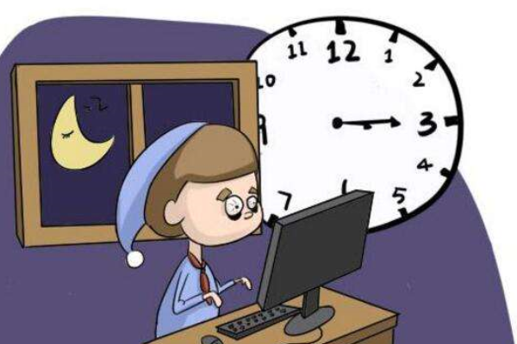
从…到…
From…to (till)…
From morning to night
He didn’t sleep
从早到晚，他都没睡觉。

Slide 54
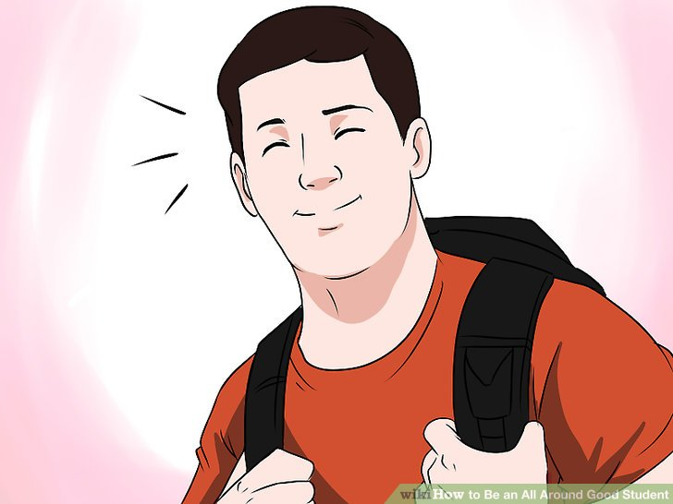
从…到…
From…to (till)…
From past till now
He is a good student
以前
现在
从以前到现在，他都是一位好学生。

Slide 55
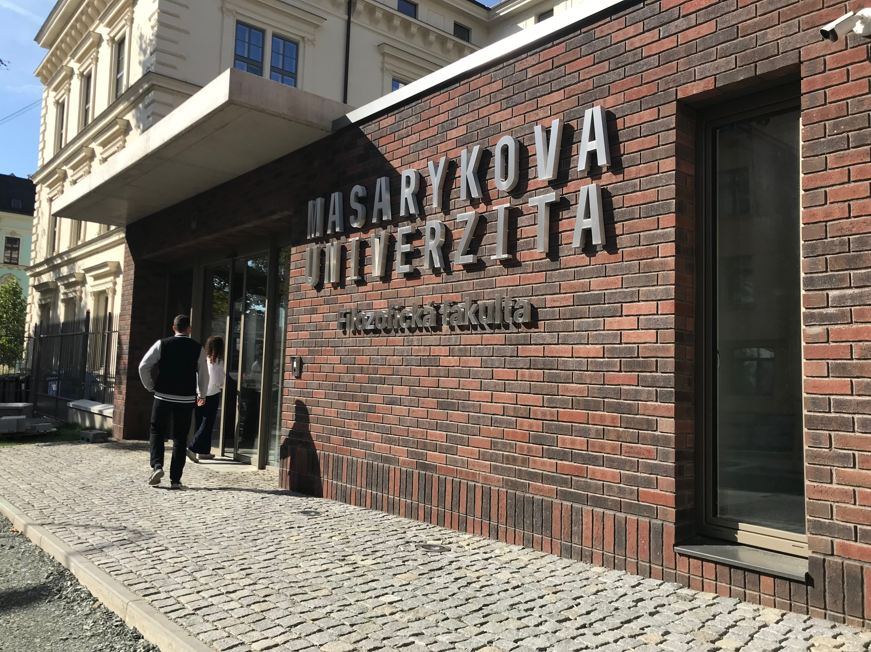
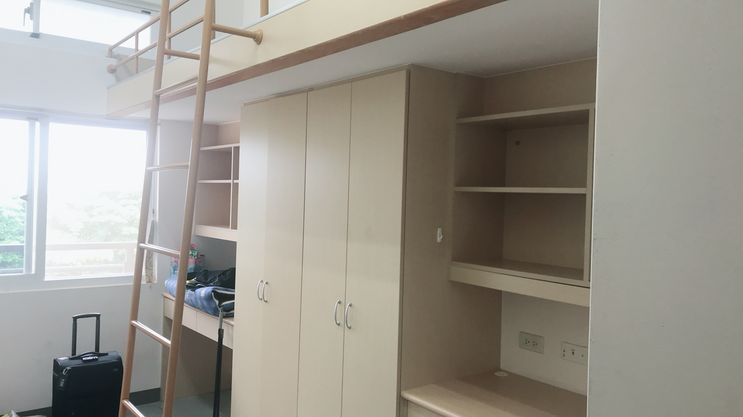
从…到…
From…to (till)…
(Distance)
From my dormitory to school
走路只要五分钟
从我的宿舍到学校走路只要五分钟。

Slide 56
从…到…
From…to (till)…
请造句

Slide 57
或者
“or”
Is used in non-interrogative sentences
A：你平常周末做什么？
Or
B：听音乐或者写博客。

Slide 58
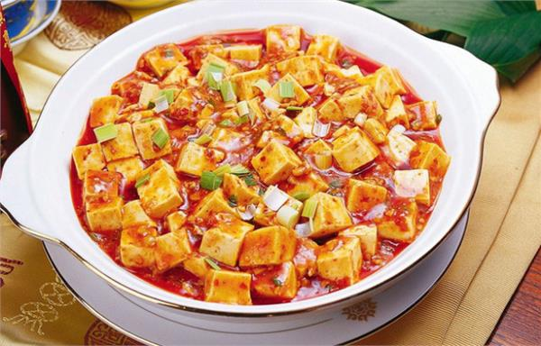
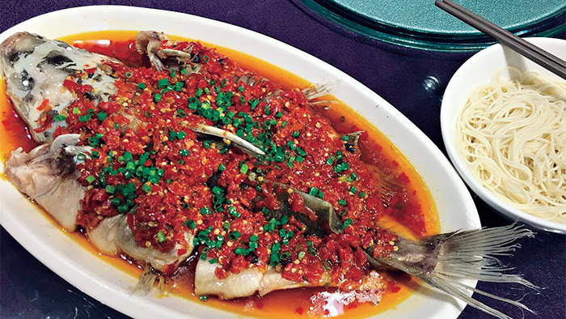
或者
“or”
Is used in non-interrogative sentences
你一般都做什么中国菜？
四川菜
湖南菜
Or
我一般都做四川菜或者湖南菜。

Slide 59
或者
“or”
Is used in non-interrogative sentences
你都上网做什么事？
Or
追剧
zhūijù
我都上网查资料或者追剧。

Slide 60
“or” in questions, use 还是
What kind of tea do you like? Black tea or green tea?
你喜欢哪种茶？红茶还是绿茶？
Which lessons do you like? Chinese lesson or economic lesson?
你喜欢哪门课？中文课还是经济课？
What kind of sport do you like?Playing tennis or basketball?
你喜欢哪种运动？打网球还是打篮球？

Slide 61
To dare
敢
gǎn
How dare you are!
你怎么敢这样对我！
(spoken Chinese)
To stay
你朋友看到你在教室外面，她问：
待
dāi
How long have you stayed here.
你在这儿待多久了？

Slide 62
House; room
Please stay at house.
请待在屋子里。
屋子
wūzi
To become addicted
Are you in addicted to drinking alcohol?
上瘾
shàngyǐn
你喝酒喝上瘾了吗？
(negative)

Slide 63
serious
Important
严重
yánzhòng
重要
zhòngyào
To help
Price
帮助
bāngzhù
价格
jiàgé

Slide 64
免费
miǎnfèi
This app is free to download.
这个APP免费下载。
To crack a joke
开玩笑
kāi wánxiào
feeling
感觉
gǎnjué
I’m just kidding
我只是在开玩笑。

Slide 65
Grammar
语法

Slide 66
结果(as a result)
Conjunction
Express a result of the condition indicated in the first clause
他对老师开玩笑
老师就生气了
他对老师开玩笑，结果老师就生气了。

Slide 67
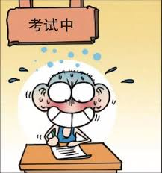
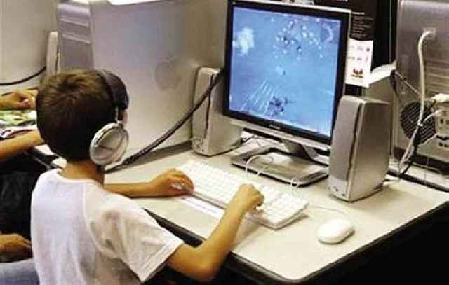
结果(as a result)
Conjunction
Express a result of the condition indicated in the first clause
考试的时候，
他一个字也写不出来
他考试的前一天
一直玩电脑游戏
他考试的前一天一直玩电脑游戏，结果考试的时候，
他一个字也写不出来。

Slide 68
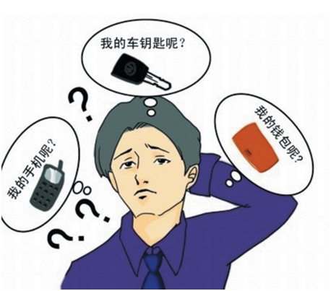
结果(as a result)
Conjunction
Express a result of the condition indicated in the first clause
他老是丢三拉四的，
钱包、手机都乱丢
他的钱包就不见了
他老是丢三拉四的，钱包、手机都乱丢，结果他的钱包就不见了。

Slide 69
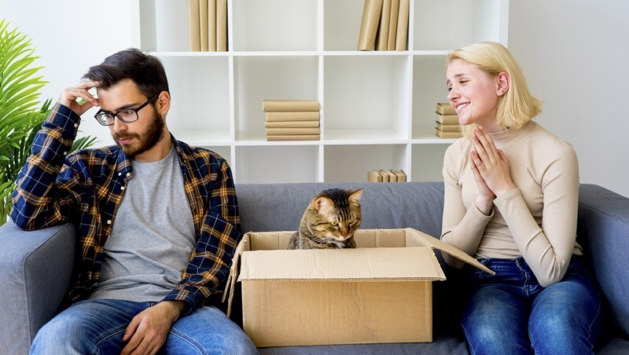
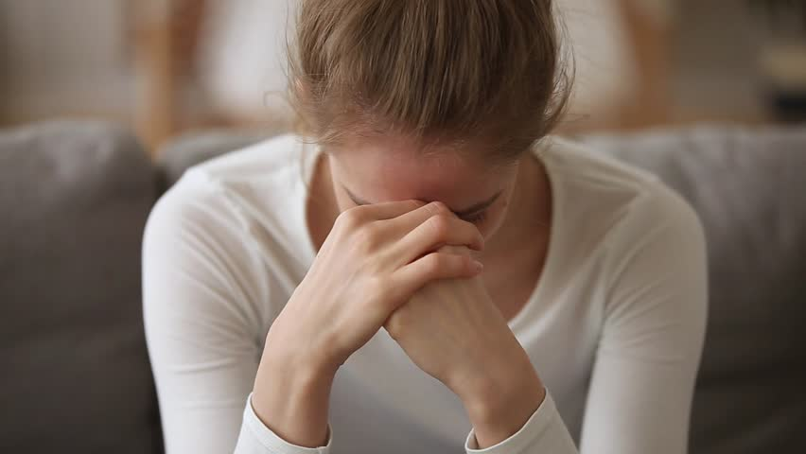
结果(as a result)
Conjunction
Express a result of the condition indicated in the first clause
She often asks people for favors,
but never say thank you
She doesn’t have a single friend.
她经常麻烦别人，可是从不说谢谢，结果一个朋友也没有。

Slide 70
Conjunction
结果(as a result)
Express a result of the condition indicated in the first clause
请造句

Slide 71
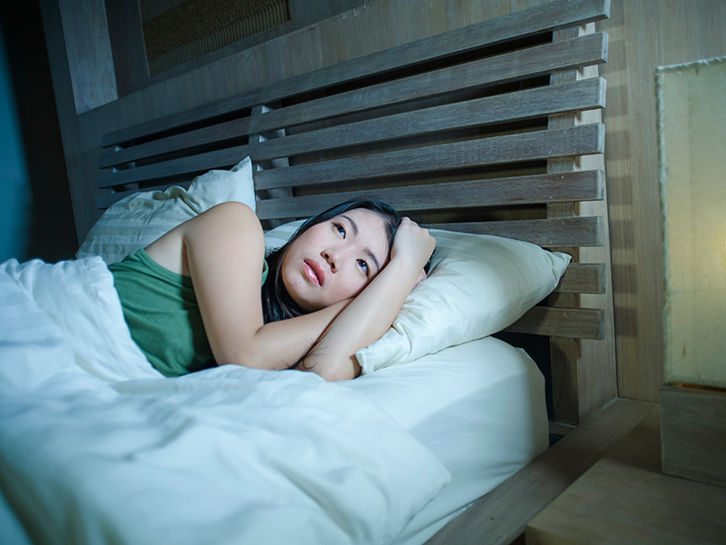
害(得)
To do harm(so that)
This verb means to make someone suffer or adversely affect someone
Usage:something happened+害(得)+something make someone suffer
You didn’t come back last night
Mom can’t fall a sleep
你昨天晚上没回来，害(得)妈妈睡不着。

Slide 72
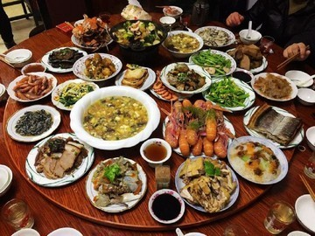
害(得)
To do harm(so that)
This verb means to make someone suffer or adversely affect someone
Usage:something happened+害(得)+something make someone suffer
他做的菜太多了
我吃不完
他做的菜太多了，害(得)我吃不完。

Slide 73
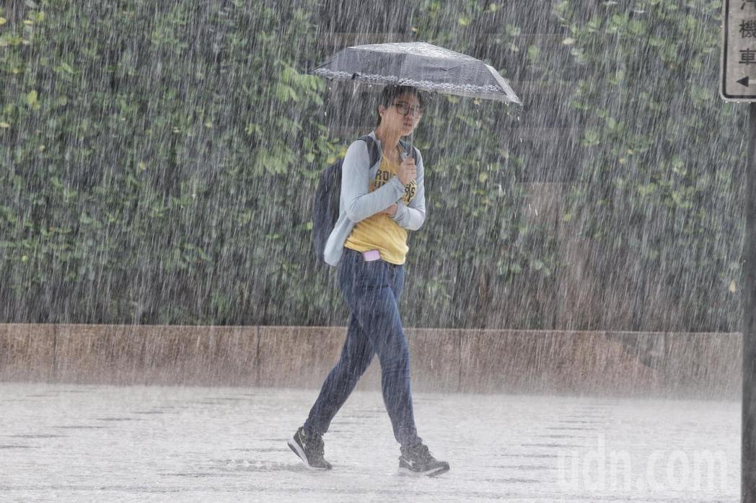
害(得)
To do harm(so that)
This verb means to make someone suffer or adversely affect someone
Usage:something happened+害(得)+something make someone suffer
今天下大雨
我去不了派对
今天下大雨，害(得)我去不了派对。

Slide 74
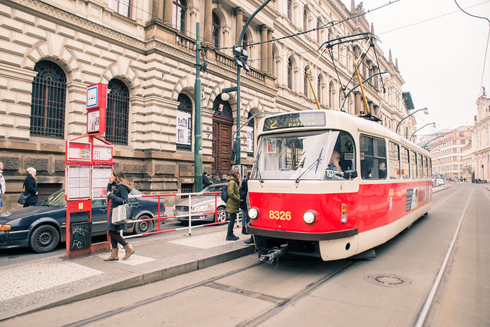
害(得)
To do harm(so that)
This verb means to make someone suffer or adversely affect someone
Usage:something happened+害(得)+something make someone suffer
电车耽误了时间
我今天迟到
Delay
耽误
dānwù
电车耽误了时间，害(得)我今天迟到。

Slide 75
To do harm(so that)
害(得)
Usage:something happened+害(得)+something make someone suffer
请造句

Slide 76
几乎
almost
(written Chinese)
It can be interchanged with the adverbial 差不多，but is more formal than 差不多
He is very busy recently
Almost one moth haven’t called his girlfriend
他最近非常忙，几乎一个月没打给他女友了。

Slide 77
几乎
almost
(written Chinese)
It can be interchanged with the adverbial 差不多，but is more formal than 差不多
I like playing phone’s games
I play phone’s games almost everyday
手机游戏
我喜欢玩手游，几乎每天都在玩。

Slide 78
几乎
almost
(written Chinese)
It can be interchanged with the adverbial 差不多，but is more formal than 差不多
I don’t like recent weather, because raining almost everyday.
我不喜欢最近的天气，因为几乎每天都在下雨。

Slide 79
almost
几乎
It can be interchanged with the adverbial 差不多，but is more formal than 差不多
请造句

Slide 80
2
It seems that
It sounds that
看起来
听起来

Slide 81
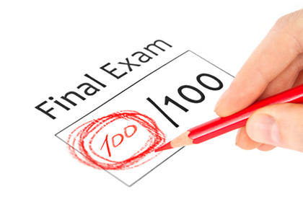
看起来
It seems that
She look at her grade and smile,
it seems like she got a good grade.
她笑着看她的成绩，看起来她成绩不错。

Slide 82
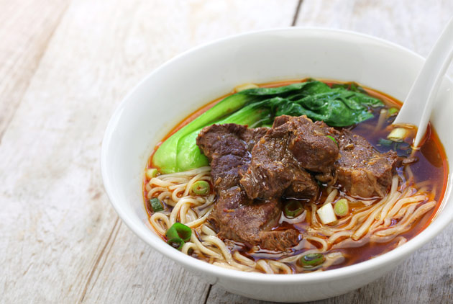
看起来
It seems that
He throw 牛肉面 to the garbage can,
it seems that he doesn’t like that 牛肉面。
把
他把牛肉面丢进垃圾桶里，看起来他不喜欢那碗牛肉面。

Slide 83
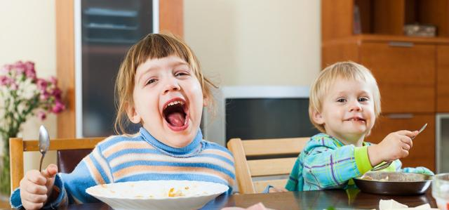
看起来
It seems that
她把所有的菜吃完了
这家饭馆儿的菜不错
她把所有的菜吃完了，看起来这家饭馆儿的菜不错。

Slide 84
It seems that
看起来
请造句

Slide 85
听起来
It sounds (that)
What follows is the speaker’s interpretation or conclusion based on what he or she has heard.
A: 今天要吃什么？
B：今天我们吃清蒸鱼和饺子吧！
A：这个主意听起来不错！

Slide 86
听起来
It sounds (that)
What follows is the speaker’s interpretation or conclusion based on what he or she has heard.
A：明天要不要跟我去演唱会？
B：我想去，但是我作业有一点儿多,我明天还有考试……
A：听起来你不太想去。

Slide 87
Connecting sentences
In narrative sentences time words can not only express the time of an action
but can also serve as linking devices.
老师一开门，我就走进教室。十分钟后，老师就开始上课。
老师一开门，我就走进教室。老师十分钟后就开始上课。
Without time expressions the sentence would not be cohesive.

Slide 88
Connecting sentences
In narrative sentences time words can not only express the time of an action
but can also serve as linking devices.
张天明后天要去见他的指导教授，讨论选课的事，他想先找别的同学聊聊。这一天下午，他在篮球场上正好碰见大四的李哲，就一边和李哲打球，一边聊了起来。
张天明后天要去见他的指导教授，讨论选课的事，他想先找别的同学聊聊。他这一天下午，在篮球场上正好碰见大四的李哲，就一边和李哲打球，一边聊了起来。

Slide 89
Connecting sentences
Place expressions can also be cohesive devices
上星期我去购物中心买东西，在那儿看见了好久不见的朋友。
上星期我去购物中心买东西。我在那儿看见了好久不见的朋友。

Slide 90
Textbook课文
1. 张天明是什么迷？他在网上做什么？
2. 天明、丽莎、科林、雪梅约好今天做什么？
3. 雪梅的教授让他们用网上的东西吗？为什么？
4. 天明几乎整天在屋子里做什么？
5. 为什么天明喜欢发电邮？
6. 雪梅喜欢做什么？

