Slide 1
第八课 打工

Slide 2
Income
This job has good income.
这份工作有好的收入。
收入
shōurù
To provide; to support financially
pressure
供
gōng
压力
yālì

Slide 3
压力
Pressure
有压力
1
When I feel pressure, I’ll go jogging.
当我觉得有压力的时候，我会去跑步。

Slide 4
压力
Pressure
压力很大
2
A lot of pressure
There are too many exams and homework, I feel a lot of pressure.
考试和作业太多，我觉得压力很大。

Slide 5
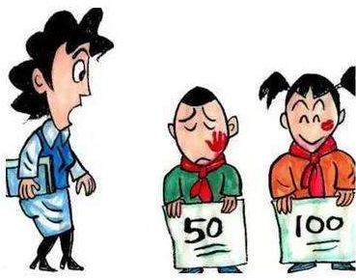
压力
Pressure
给…压力
3
has given…pressure
My mom has given me a lot of pressure.
我妈妈给我很大的压力。

Slide 6
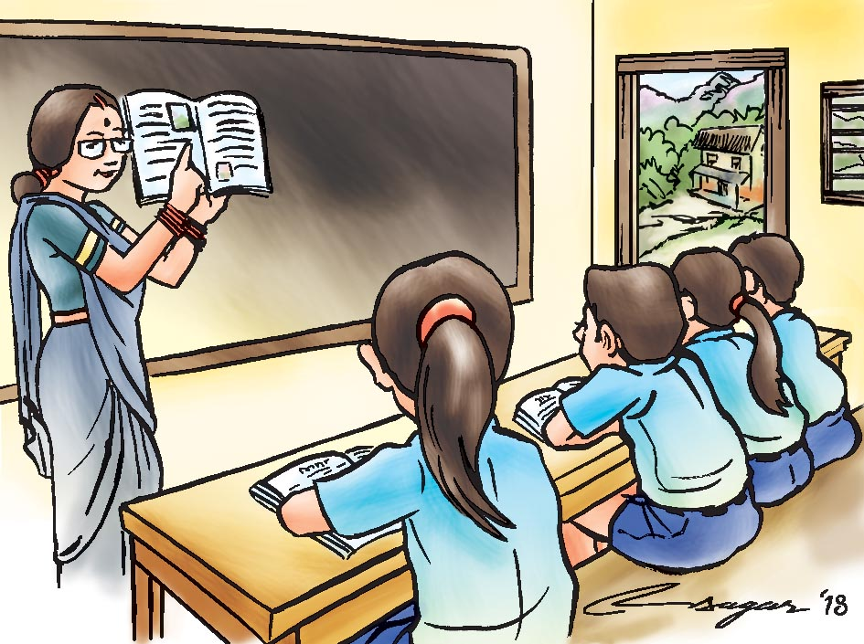
education
good (written Chinese)
良好
liánghǎo
教育
jiàoyù
To receive
influence; to influence
受到
shòu dào
影响
yǐngxiǎng

Slide 7
受到
To receive
To suffer
Is often followed by abstract nouns
S+受到+N/Adj.+abstract noun
My older sister and I have received a good education.
abstract noun
我和我姐姐受到良好的教育。
He has received teacher’s influence.
他受到老师的影响。

Slide 8
受到
To receive
To suffer
Is often followed by abstract nouns
S+受到+N/Adj.+abstract noun
treatment
She has suffered a bad treatment.
对待
duìdài
她受到不好的对待。

Slide 9
To give birth to; to be born
To save up
生
shēng
存
cún
continuously
adult
不断
búduàn
大人
dàrén

Slide 10
Grammar
语法

Slide 11
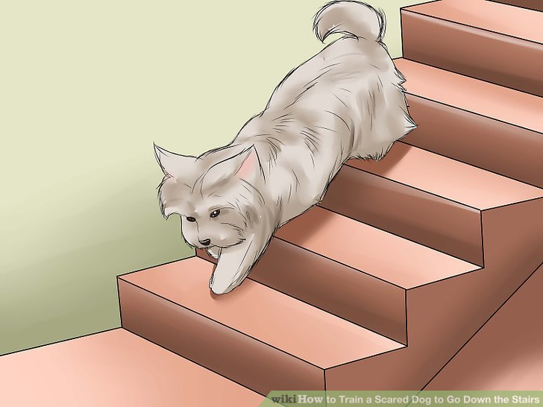
Directional complements suggesting result
direction
V
下来
1
Go down
Please go down
请走下来。
V
下来
Implies detachment or
separation of one thing from another
2
Parents started to payed money as soon as children were born.
孩子一生下来，父母就开始付钱。

Slide 12
Directional complements suggesting result
2
V
下来
Please turn out your sweater.
毛衣/脱/把/请/你的/下来。
请把你的毛衣脱下来。
2
下来
The paper has been tear out.
V
被/这张/撕/纸/下来。
这张纸被撕下来。

Slide 13
Directional complements suggesting result
2
V
下来
下and 来can be separated
下….来
V
numeral+measure word+noun
Please tear out a paper from your book.
书上/从/请/下/你的/纸/撕/来/张/一
请从你的书上撕下一张纸来。

Slide 14
Directional complements suggesting result
direction
V
出来
1
Go out
Please go out
请走出来。
V
出来
2
Signifies the emergence of something from a hidden place into the open
or a change from having nothing to having something

Slide 15
Directional complements suggesting result
Signifies the emergence of something from a hidden place into the open
or a change from having nothing to having something
V
出来
2
Please take out your notebook.
把
请把你的笔记本拿出来。
笔记本
bǐjìběn
Have you came up with this question?
(topic sentence)
你/问题/出来/吗/这个/了/想？
这个问题你想出来了吗？

Slide 16
Directional complements suggesting result
Signifies the emergence of something from a hidden place into the open
or a change from having nothing to having something
V
出来
2
出and 来can be separated
V
出…来
numeral+measure word+noun
Please write a sentence.
一/请/出/句子/写/来/个。
请写出一个句子来。

Slide 17
Practice练习
想出来
省下来
说出来
看出来
看出来
A：我_________你心情不好。怎么了？有什么事儿，__________听听。说不定我能帮忙。
说出来
B：最近经济不好，我父母都没有工作。为了减轻父母的经济负担，我从学校宿舍搬回家住，把饭钱、住宿费都_________了，但家里的生活费还是有问题。
省下来
想出来
A：别着急。办法是人________的。…对了，我们出版社正好在找英文翻译，你可以试试。
B：是吗？那我明天就去申请。

Slide 18
To earn money
挣钱
zhèng qián
In order to pay tuition fee, I need to earn money.
为了付学费，我需要挣钱。
To lessen
burden
减轻
jiǎnqīng
负担
fùdān

Slide 19
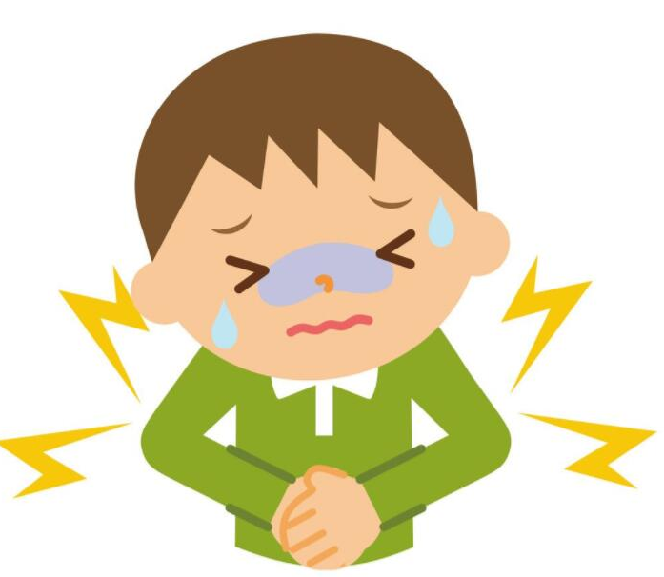
减轻
To lessen
is generally followed by an abstract noun
cut
light
burden
减轻
+
…负担
如果我也去挣钱就能减轻父母的经济负担。
pain
减轻
+
...疼痛
药
yào
téngtòng
吃这些药就能减轻你的疼痛。

Slide 20
减轻
To lessen
is generally followed by an abstract noun
cut
light
(很多、不少、一点儿)
Abstract
noun
+
减轻
+
Adverb of degree
不少/减轻/压力/她的/了。
她的压力减轻了不少。
她的压力减轻不少了。
After found the job, her pressure has been lessen a lot.
找到工作后，她的压力减轻了不少。

Slide 21
来
Connecting two verb phrases
When 来connects two verb phrases with the second phrase indicating a purpose.
来 “to” “in order to”
I should get a job to ease(lessen) my parents’ burden.
我应该找一份工作来减轻父母的负担。

Slide 22
来
Connecting two verb phrases
来 “to” “in order to”
A：你是怎么提高中文水平的？
看中国剧
提高汉语水平的
purpose
我是看中国剧来提高汉语水平的。

Slide 23
来
Connecting two verb phrases
来 “to” “in order to”
给他过生日
我决定办一个派对
purpose
我决定办一个派对来给他过生日。

Slide 24
来
Connecting two verb phrases
来 “to” “in order to”
我们应该找一间餐厅
庆祝这学期结束
purpose
To celebrate
庆祝
qìngzhù
我们应该找一间餐厅来庆祝这学期结束。

Slide 25
To suit
suitable
适合
合适
(V)
(Adj.)
S+适合+O
合适+的+N
S1+适合+S2+V
Adverb of degree+合适
S+适合+V phrase

Slide 26
适合
This T-shirt suit to you.
合适
这件T恤衫适合你。
The size, length and width of the jeans are all suitable.
这条牛仔裤的大小、长短、宽窄都很合适。
This jeans don’t suit you.
(S1+适合+S2+V)
这条裤子不适合你穿。
Today’s weather is good to sleep.
今天的天气适合睡觉。

Slide 27
适合
合适
or
适合
1. 小王喜欢查资料，这份研究工作_______他。
适合
2. 你不爱跟小孩打交道，不________当老师。
适合
不合适
3. 这种家具_______家里用，放在办公室________。
合适
适合
4. 这条牛仔裤长短_______,样子、颜色也不错，很_______你。

Slide 28
To suit
适合
(V)
S1+适合+S2+V
S+适合+V phrase
造句

Slide 29
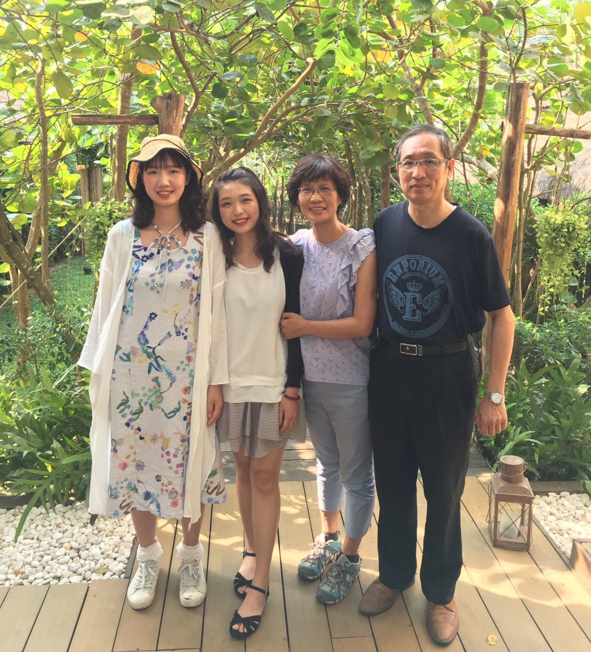
family (unit)
To obtain; to gain
取得
qǔdé
家庭
jiātíng
We can gain some working experiences.
我们可以取得一些工作经验。
allowance
My mom give me allowance today.
零用钱
língyòngqián
我妈妈今天给我零用钱。

Slide 30
scholarship money
To hand over
交
jiāo
奖学金
jiǎngxuéjīn
把
Hand over your scholarship！
(V出来)
把你的奖学金交出来！
政府
zhèngfǔ
government

Slide 31
village
贷款
dàikuǎn
农村
nóngcun
wages
The wages of this restaurant
is very low.
工资
gōngzī
这间餐厅的工资很低。

Slide 32
Grammar
语法

Slide 33
N
V
influence; to influence
影响
Don’t influence she to make decision.
决定/她/别/做/影响
别影响她做决定。
The teacher affect his study.
这位老师影响他的学习

Slide 34
N
V
influence; to influence
影响
A对B有影响
N
喝太多咖啡
身体健康
喝太多咖啡对身体健康有影响。

Slide 35
N
V
influence; to influence
影响
A对B有影响
不写作业
你的成绩
x
不写作业对你的成绩有影响。

Slide 36
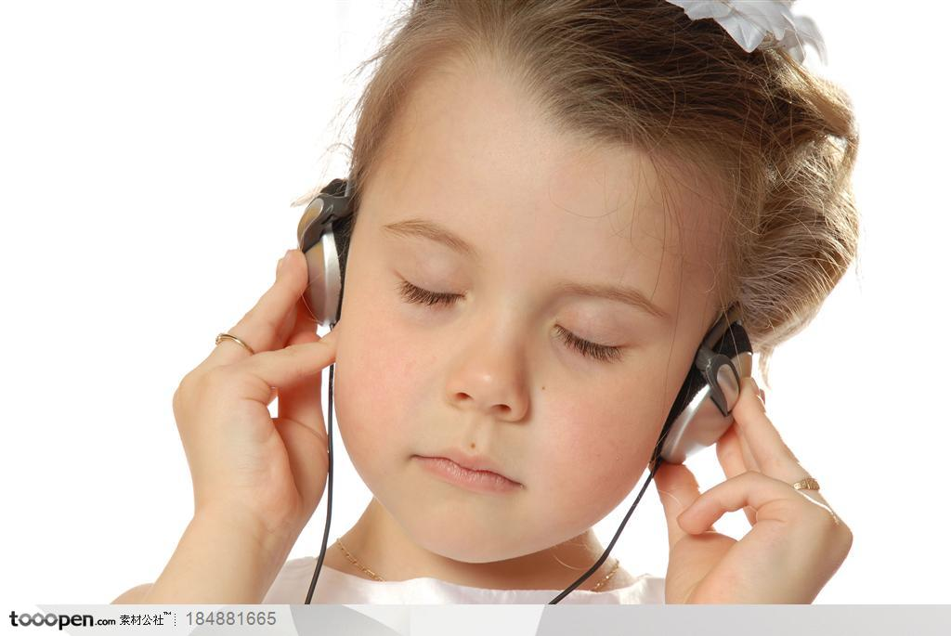
N
V
influence; to influence
影响
A对B有…影响
(很好的、不好的、很大的)
听录音
学中文
听录音对学中文有很好的影响。

Slide 37
N
V
A对B有…影响
influence; to influence
影响
(很好的、不好的、很大的)
熬夜追剧
眼睛
熬夜
áoyè
stayed up late
熬夜追剧对眼睛有不好的影响。

Slide 38
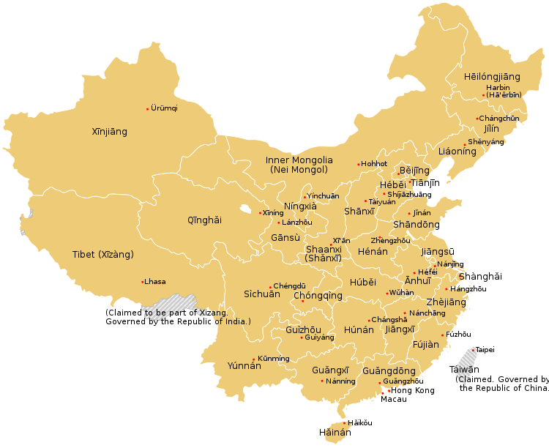
N
V
A对B有…影响
influence; to influence
影响
(很好的、不好的、很大的)
去中国留学一年
找工作
去中国留学一年对将来找工作会有很大的影响。

Slide 39
影响
A对B有…影响
(很好的、不好的、很大的)
请造句

Slide 40
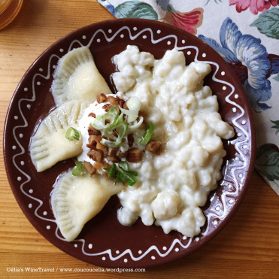
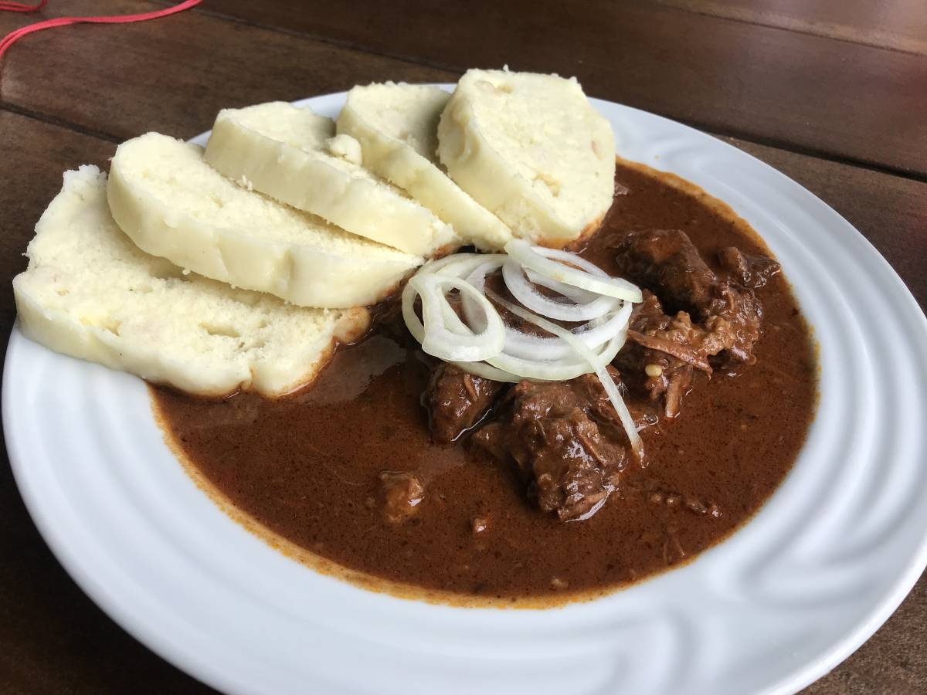
不是A就是B
if it’s not A, it’s B
either A or B
used to enumerate two predictable scenarios
A：你一般在家都做什么菜？
B：不一定，不是做捷克菜就是做斯洛伐克菜。

Slide 41
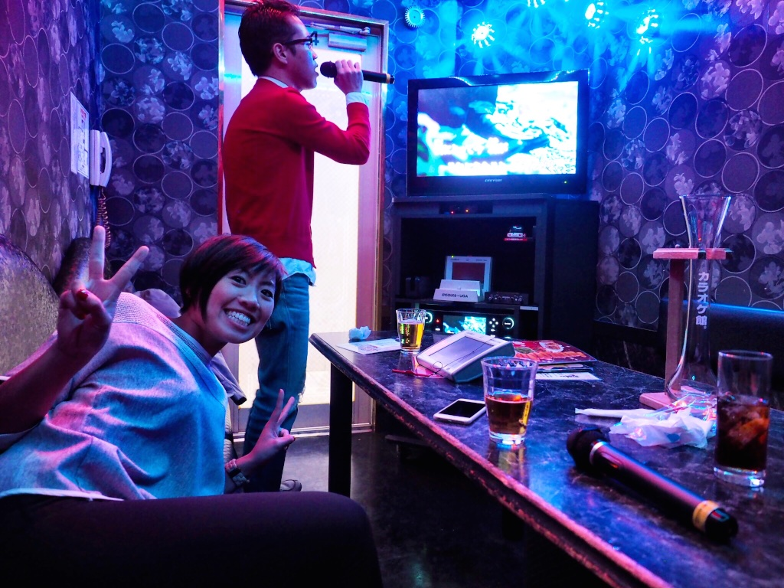
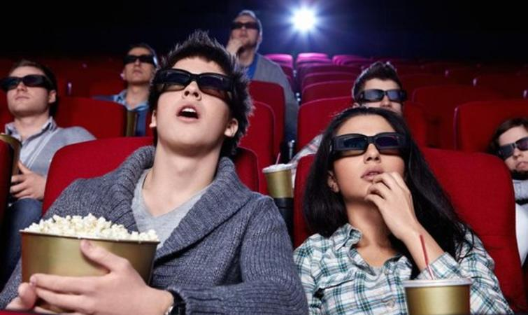
不是A就是B
if it’s not A, it’s B
either A or B
used to enumerate two predictable scenarios
He either goes to karaoke or watches movie on Sunday.
星期天他不是去唱卡拉OK就是去看电影。

Slide 42
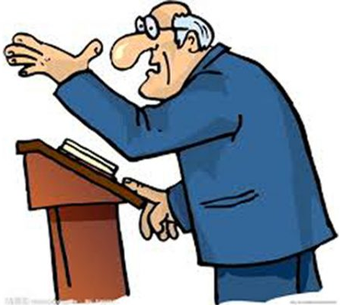
不是A就是B
if it’s not A, it’s B
either A or B
used to enumerate two predictable scenarios
Those who came here were either teachers or professor, none of the students.
昨天晚上来这里的不是老师就是教授，一个学生都没有。
N
N

Slide 43
不是A就是B
if it’s not A, it’s B
either A or B
used to enumerate two predictable scenarios
The students in our class either smart or hard working.
smart
hard working
我们班的同学不是很聪明就是很努力。
Adj.
Adj.

Slide 44
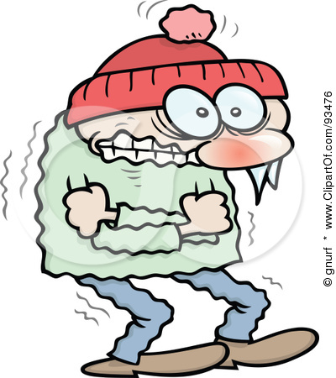
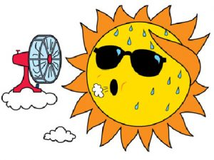
不是A就是B
if it’s not A, it’s B
either A or B
used to enumerate two predictable scenarios
The recent weather is very strange, either too cold or too hot.
最近的天气很奇怪，不是很冷就是很热。

Slide 45
不是A就是B
if it’s not A, it’s B
either A or B
请造句

Slide 46
Rhetorical Questions
The speaker is really emphasizing a point rather than asking a real question.
难道….吗？
Don’t you think…..?
张天明住在台湾一年了
科林：天明，你知不知道台湾的捷运站里不能吃东西？
张天明：拜托！我都住在这里一年了，难道我会不知道这点儿小事吗？
我知道这点儿小事

Slide 47
Rhetorical Questions
The speaker is really emphasizing a point rather than asking a real question.
难道….吗？
Don’t you think…..?
你觉得会有人买这幅画吗？
declarative sentence
This picture is beautiful and chip someone must buy it.
这幅画又漂亮又便宜肯定会有人买。
positive
rhetorical questions
This picture is beautiful and chip, don’t you think no one buy it?
这幅画又漂亮又便宜难道不会有人买吗？
negative

Slide 48
Rhetorical Questions
The speaker is really emphasizing a point rather than asking a real question.
难道….吗？
Don’t you think…..?
declarative sentence
This dish is oily and salty, everyone don’t like it.
这道菜又油又咸，大家都不喜欢。
rhetorical questions
This dish is oily and salty, don’t you think everyone like it?
这道菜又油又咸，难到大家都喜欢吗？

Slide 49
Rhetorical Questions
The speaker is really emphasizing a point rather than asking a real question.
难道….吗？
Don’t you think…..?
declarative sentence
你又哭又叫，妈妈不会开心。
rhetorical questions
你又哭又叫，难道妈妈会开心吗？

Slide 50
Rhetorical Questions
The speaker is really emphasizing a point rather than asking a real question.
难道….吗？
Don’t you think…..?
请造句

Slide 51
讨论 discuss
你有打工吗？做什么打工？为什么你想(或不想)打工？
2. 你挣钱是为了什么？
3. 请谈谈一边上学一边打工对学习有什么影响？

Slide 52
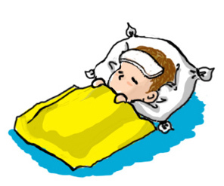
Rhetorical Questions
The speaker is really emphasizing a point rather than asking a real question.
怎么…呢？
How could…?
Will he come to the lesson?
他今天会来上课吗？
declarative sentence
He is sick, he won’t come to the lesson.
他生病了不会来上课。
rhetorical questions
He is sick, how can he come to the lesson?
(a little bit emotion)
他生病了怎么会来上课呢？

Slide 53
Rhetorical Questions
The speaker is really emphasizing a point rather than asking a real question.
怎么…呢？
How could…?
declarative sentence
他上课都在睡觉，不可能考一百分。
(change to opposite)
rhetorical questions
He always sleep in the lesson, how could he get 100.
他上课都在睡觉，怎么可能考一百分呢？

Slide 54
Rhetorical Questions
The speaker is really emphasizing a point rather than asking a real question.
怎么…呢？
How could…?
他喜欢学中文，
会来上中文课
(change to opposite)
他喜欢学中文，怎么不会来上中文课呢？

Slide 55
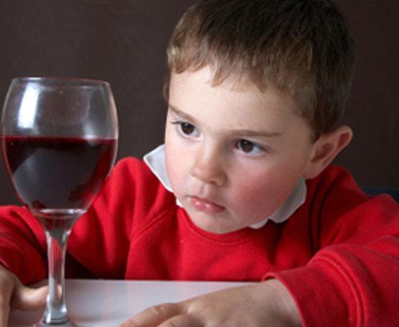
Rhetorical Questions
The speaker is really emphasizing a point rather than asking a real question.
怎么…呢？
How could…?
He is too young, how could he drink alcohol?
他还那么小，怎么能喝酒呢？

Slide 56
Rhetorical Questions
怎么…呢？
How could…?
请造句

Slide 57
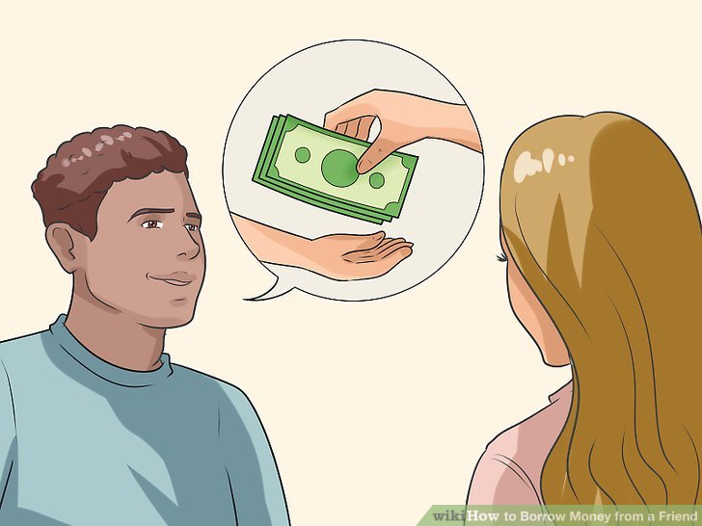
Tutor
To study
家教
jiājiào
读书
dúshū
borrow
To dislike; to complain of
嫌
xián
借
jiè

Slide 58
not tasty
owe
欠
qiàn
难吃
nánchī
He owes the bank a lot of money.
银行
yínháng
他欠银行很多钱。

Slide 59
thing; matter
Well-behave(talk to children)
乖
guāi
事情
shìqing

Slide 60
Adverb 可
In spoken Chinese
可 (kě) can be used to intensify an adjective, or to add emphasis to a verb. It is stronger than other modifiers, as 可 compares the speaker‘s expectations with the actual situation. The meaning of 可 is very reliant on context.
Add 可 doesn’t change meaning of the sentence
S+可+Ｖ/Adj.
(usually with不/没/别)

Slide 61
Adverb 可
S+可+Ｖ/Adj.
(with不or 没)
Not me! I would never be able to do a thing like that.
我/不/出/可/的/做/事情/这样/我/不是！
不是我！我可做不出这样的事情。

Slide 62
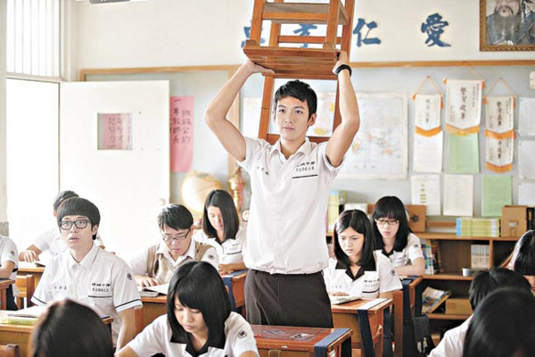
Adverb 可
S+可+Ｖ/Adj.
(with不or 没)
情境：你做错事，老师要你站起来，但是你坐下来了。
老师：I didn’t say you can sit down!
我可没说你可以坐下！

Slide 63
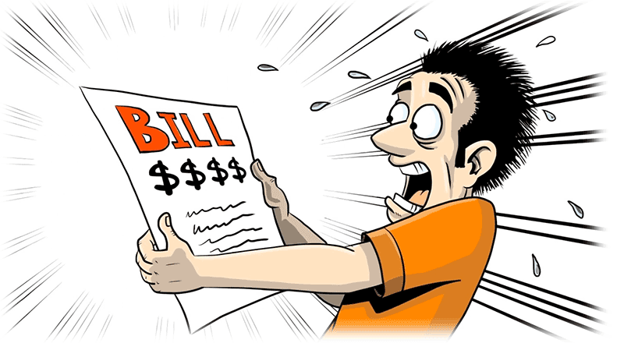
Adverb 可
S+可+Ｖ/Adj.
(with不or 没)
The price is too high, I’m not able to pay。
价钱这么高！我可付不起。

Slide 64
Adverb 可
S+可+Ｖ/Adj.
Sometimes without negative words
A：听说你交女朋友了。她漂亮吗？
Of course! She is pretty,
and also very smart!
B：当然！她可漂亮了,而且还很聪明。

Slide 65
Adverb 可
S+可+Ｖ/Adj.
Sometimes without negative words
你家的猫聪明吗？
My cat is smart!
He can sing and dance.
我家的猫可聪明了！牠会唱歌还会跳舞。

Slide 66
Adverb 可
In spoken Chinese
S+可+Ｖ/Adj.
(usually with不/没/别)
请造句

Slide 67
说到
speaking of
To expand on a topic already mentioned, we can say 说到
A：昨天晚上我借我男朋友两百块钱。
B：说到钱，上次我欠你多少钱？

Slide 68
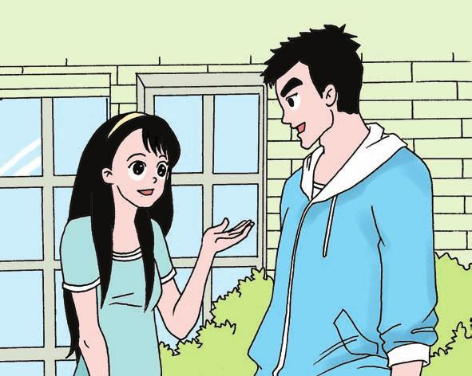
说到
speaking of
To expand on a topic already mentioned, we can say 说到
A：昨天我在派对上遇到王朋了。
听说他交新女友了
B：speaking of 王朋_________________________

Slide 69
说到
speaking of
To expand on a topic already mentioned, we can say 说到
A：我在instagram上看到我同学去了台湾。
B：speaking of 台湾_______________________

Slide 70
说到
speaking of
To expand on a topic already mentioned, we can say 说到
A：我昨天都在写作业，结果一整晚没睡。
B：speaking of 写作业_______________________

Slide 71
说到
speaking of
To expand on a topic already mentioned, we can say 说到
A：圣诞节我要和我的朋友去喝啤酒。
B：speaking of圣诞节_________________________

Slide 72
嫌
To dislike
V
S+嫌+something bad
他嫌昨天的晚餐太难吃了。

Slide 73
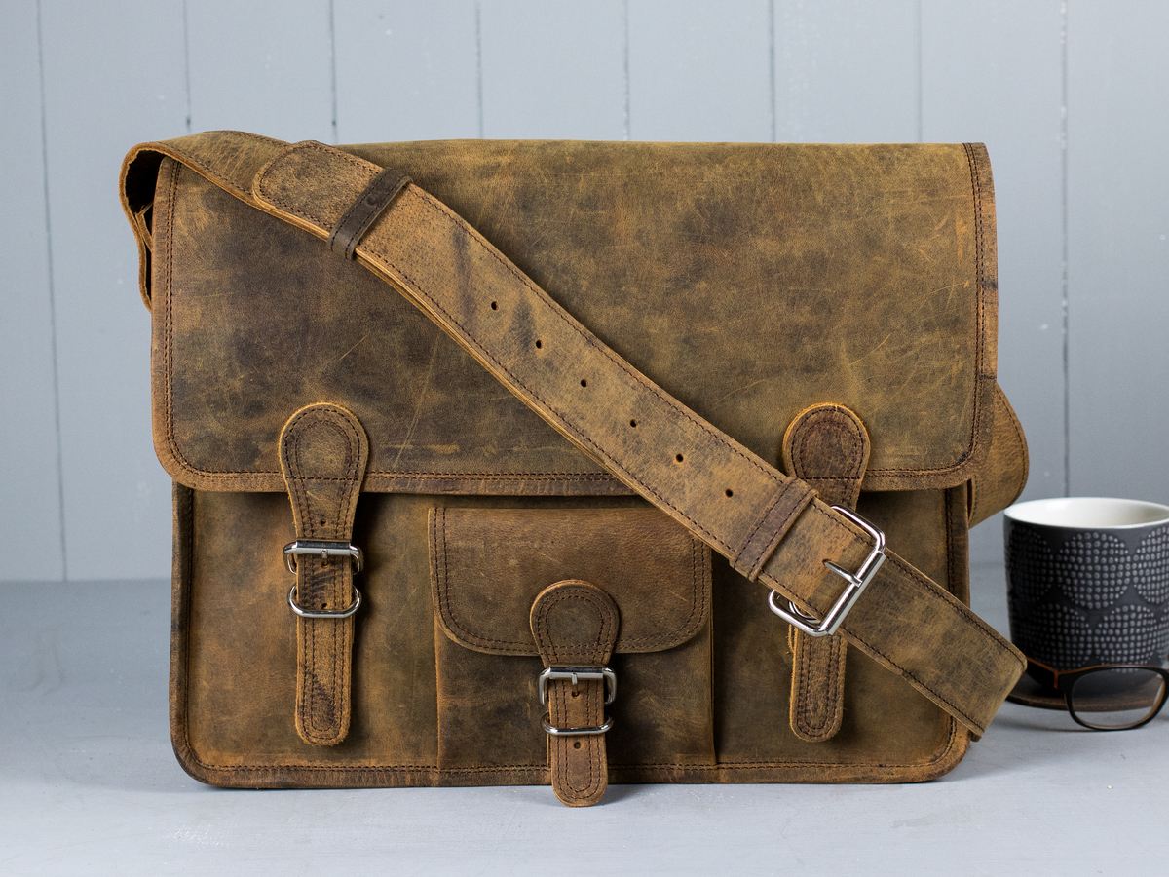
嫌
To dislike
V
S+嫌+something bad
I dislike the bag
Too old
So I don’t want to buy
我嫌这个包包太旧了，所以我不想买。

Slide 74
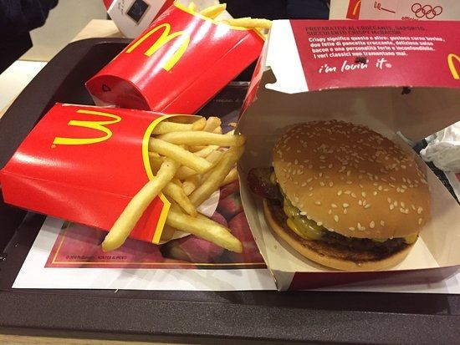
嫌
To dislike
V
S+嫌+something bad
She dislike food of Macdonald
Too oil
So she’s not often to eat
她嫌麦当劳的食物太油了，所以她不常吃。

Slide 75
嫌
To dislike
V
S+嫌+something bad
He dislike dormitory
Too noisy
So he plan to move out
他嫌宿舍太吵了，所以他打算搬出去。

Slide 76
嫌
To dislike
V
S+嫌+something bad
造句

Slide 77
多
How…it is
(spoken Chinese)
Adverb
多 expresses a high level of intensity, an exaggeration, or charged emotion.
This type of sentence often ends with the particle 呀or 啊
父母挣钱不容易。
父母挣钱多不容易啊！

Slide 78
多
How…it is
(spoken Chinese)
Adverb
多 expresses a high level of intensity, an exaggeration, or charged emotion.
How easy the grammar is!
这个语法多容易啊！

Slide 79
多
How…it is
(spoken Chinese)
Adverb
多 expresses a high level of intensity, an exaggeration, or charged emotion.
Every day my brother takes a taxi to school. How extravagant!
弟弟
弟弟每天坐出租车去学校。多浪费啊！

Slide 80
多
How…it is
(spoken Chinese)
Adverb
多 expresses a high level of intensity, an exaggeration, or charged emotion.
Look! How beautiful the dress is! I wanna but it.
你看！那件裙子多漂亮呀！我想买一件。

Slide 81
(spoken Chinese)
Adverb
多
How…it is
多 expresses a high level of intensity, an exaggeration, or charged emotion.
造句

