Slide 1
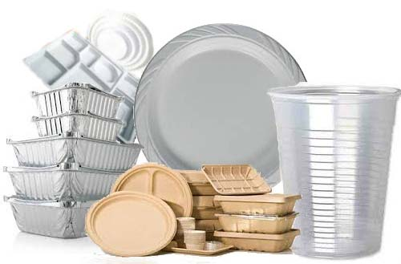
第五课 一次性产品

Slide 2
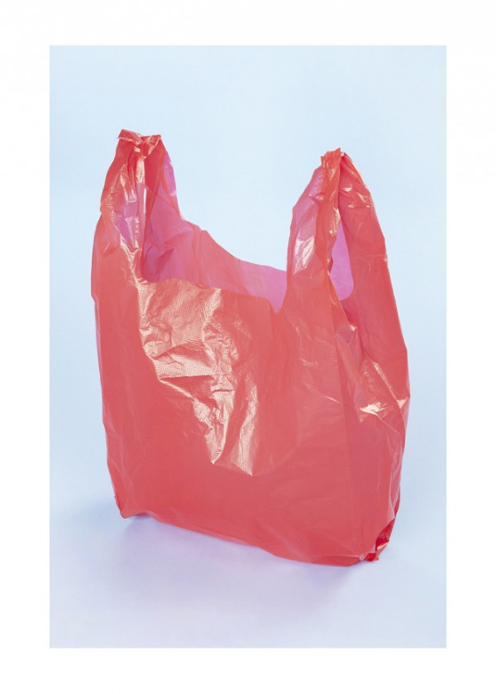
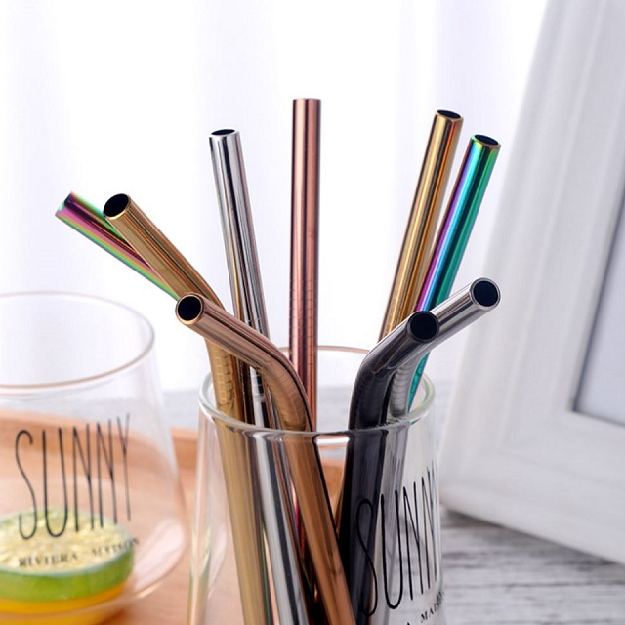
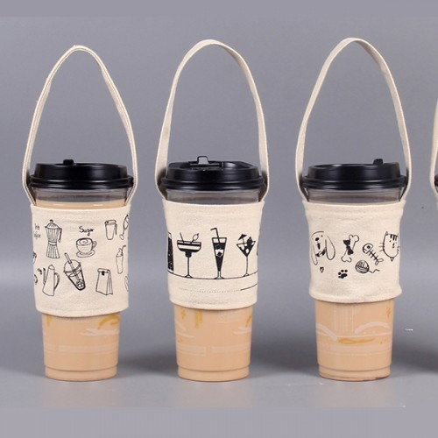
讨论discuss
你喜欢用一次性产品吗？说说你对一次性产品的看法。
你的国家提倡环保吗？

Slide 3
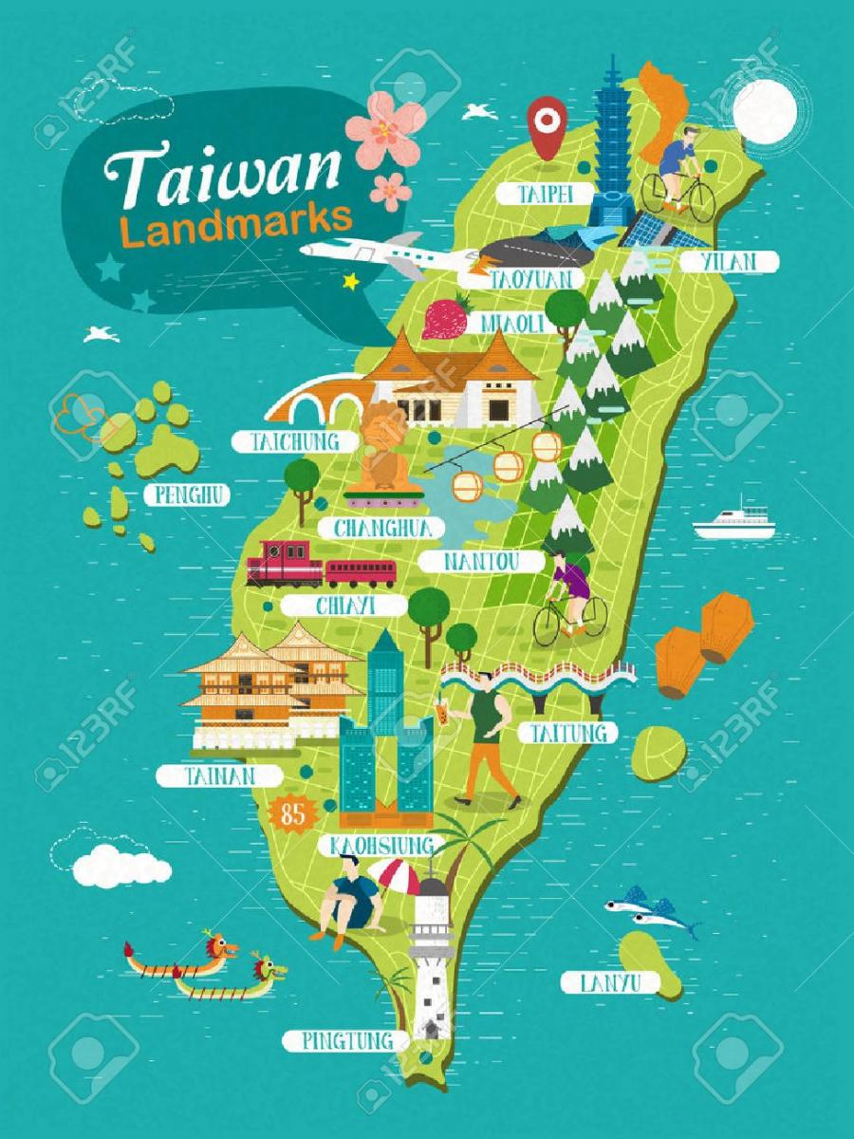
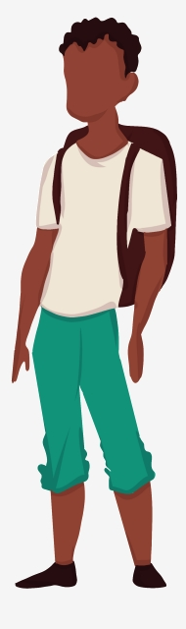
不见得
Not necessarily！
不一定
不会说中文的人住在台湾十年，就会说中文。
不见得会说中文。
住在台湾十年

Slide 4

不见得
Not necessarily!
不一定
每个捷克人都喜欢喝啤酒。
每个捷克人不见得都喜欢喝啤酒。
🤔
Not necessarily

Slide 5
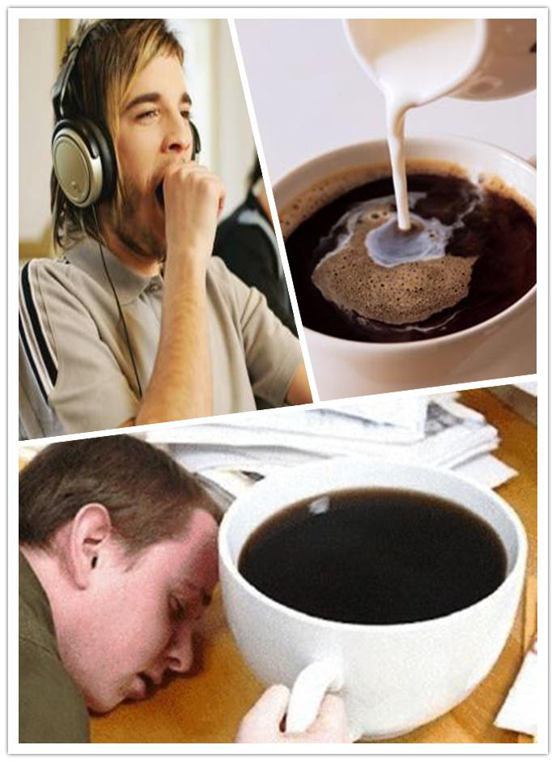
不见得
Not necessarily!
不一定
喝咖啡可以提神。
喝咖啡不见得可以提神。
🤔
Not necessarily

Slide 6
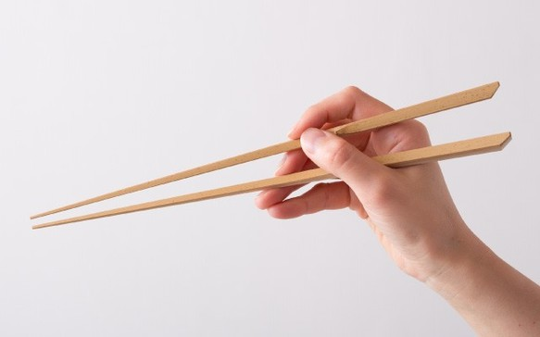
不见得
Not necessarily!
不一定
中国人一定会用筷子。
中国人不见得会用筷子。

Slide 7
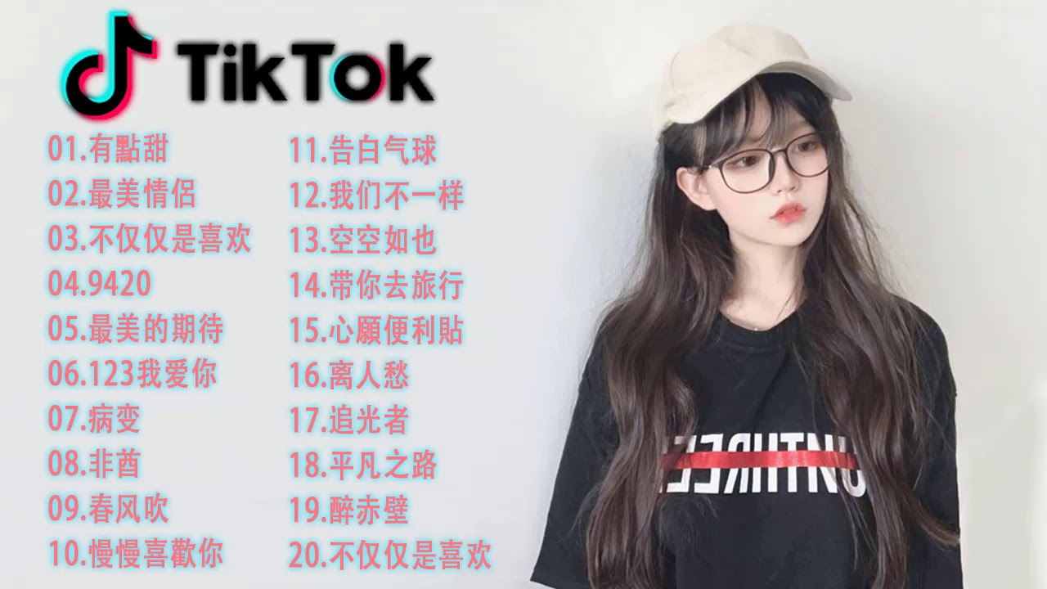
不见得
Not necessarily!
不一定
听中文歌中文一定会变好。
听中文歌中文不见得会变好。

Slide 8
Not necessarily!
不见得
请造句

Slide 9

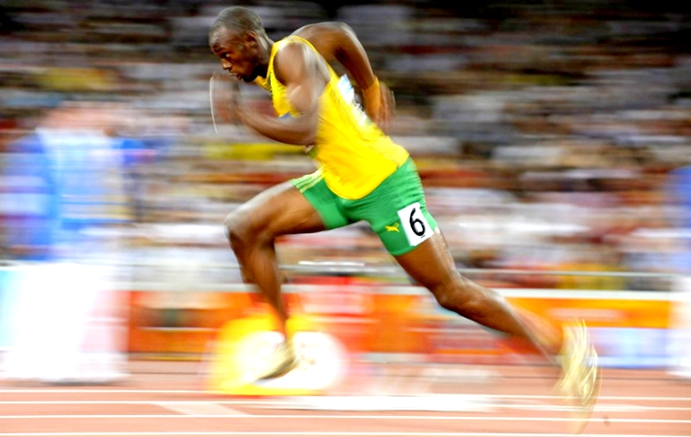
A不如B
Use tip:不如 means more or less the
same thing as 没有 in comparative sentence.
A+不如 +B(+adj, etc.)
我跑得很快
弟弟跑得更快
I’m not faster than 弟弟
我跑得没有弟弟快。
我跑得不如弟弟(跑得)快。

Slide 10

A不如B
Use tip:不如 means more or less the
same thing as 没有 in comparative sentence.
A+不如 +B(+adj, etc.)
上次的考试比较难。
这次的考试
这次的考试不如上次的(考试)难。

Slide 11
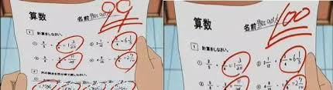
A不如B
Use tip:不如 means more or less the
same thing as 没有 in comparative sentence.
A+不如 +B(+adj, etc.)
Unlike 没有，不如does not always need to be followed by an adj
A不如B(好)
我考的分数
姐姐
好
我考的分数不如姐姐。

Slide 12
A不如B
A+不如 +B(+adj, etc.)
Unlike 没有，不如does not always need to be followed by an adj
A不如B(好)
我的中文
他的中文
已经会写文章了
一个句子都造不出来
他的中文不如我，我已经会写文章了，但是他一个句子都造不出来。

Slide 13
A+不如 +B(+adj, etc.)
A不如B
请造句

Slide 14

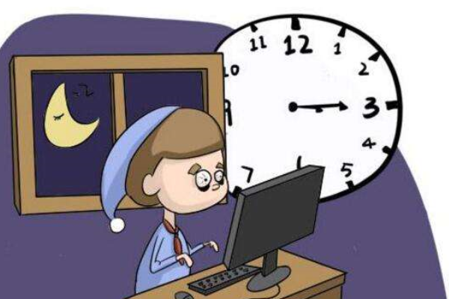
尽管
even though; despite
Even though he has a lesson at 8am, he still sleep very lately.
尽管他明天早上八点有课，他还是很晚睡。

Slide 15


尽管
even though; despite
He is already 22
still like a child
尽管他已经二十二岁了，还是像个孩子一样。

Slide 16

尽管
even though; despite
She has a new boyfriend.
She still likes her ex-boyfriend.
尽管她有了新的男朋友，她还是喜欢她的前男友。

Slide 17
尽管
even though; despite
I still went to drill lesson.
I feel very tired.
我还是来上drill课，尽管我很累。

Slide 18
尽管
even though; despite
请造句

Slide 19
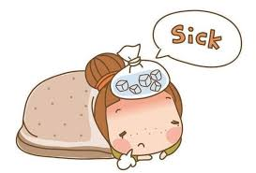
难道…吗？
Could it be possible that…
Is used in rhetorical questions.
Adverb
The speaker guess the reason
你昨天没来上课
是生病了吗？
你昨天没来上课，难道是生病了吗？

Slide 20
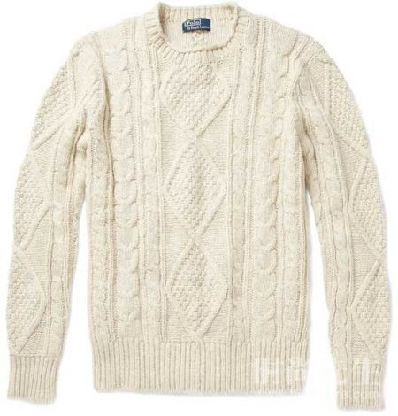
难道…吗？
Could it be possible that…
Is used in rhetorical questions.
Adverb
The speaker guess the reason
质量不好
你没买那件毛衣
你没买那件毛衣，难道是觉得毛衣的质量不好吗？

Slide 21

难道…吗？
Could it be possible that…
Is used in rhetorical questions.
Adverb
The speaker guess the reason
Why you brought an umbrella?
Is it going to rain today?
你为什么要带雨伞？难道今天会下雨吗？

Slide 22

难道…吗？
Could it be possible that…
Is used in rhetorical questions.
Adverb
the speaker expresses his doubt that something he considers
你的功课这么多
你不觉得累
你的课这么多，难道你不觉得累吗？

Slide 23
难道…吗？
Could it be possible that…
Is used in rhetorical questions.
Adverb
the speaker expresses his doubt that something he considers
你这么反对用一次性产品
他们一点好处都没有？
against
No Benefit?
反对
fǎndùi
你这么反对用一次性产品，难道他们一点好处都没有吗？

Slide 24
Could it be possible that…
Is used in rhetorical questions.
难道…吗？
～+难道(guess the reason)吗？
～+难道(expresses your doubt that something you consider)吗？
请造句

Slide 25
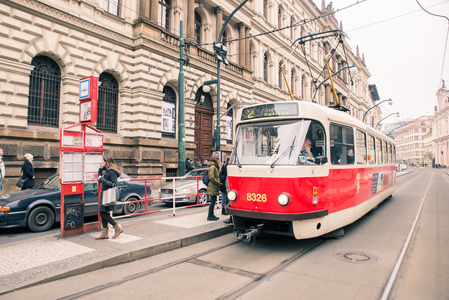
以…来说
based on…;as far as…concerned
Based on traffic
N. (big range)
Prague is more convenient than Brno
以交通来说，布拉格比布尔诺还方便。

Slide 26
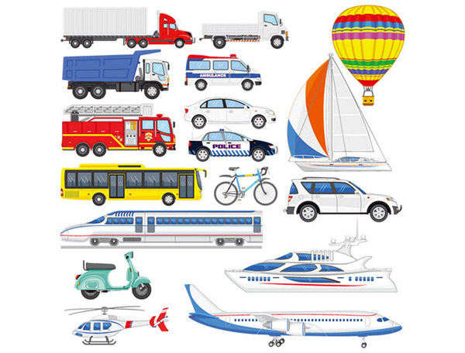
以…来说
based on…;as far as…concerned
Based on transport
N. (big range)
Airplane is the fastest.
公交
gōngjiāo
交通工具
jiāotōnggōngjù
以公交来说，飞机是最快的。

Slide 27
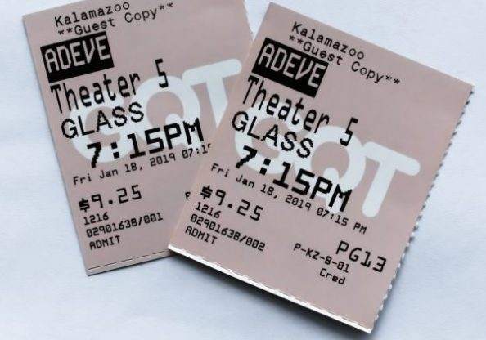
以…来说
based on…;as far as…concerned
Based on price
N. (big range)
Taiwan’s movie tickets are more expensive than the Czech
以价钱来说，台湾的电影票比捷克的还贵。

Slide 28
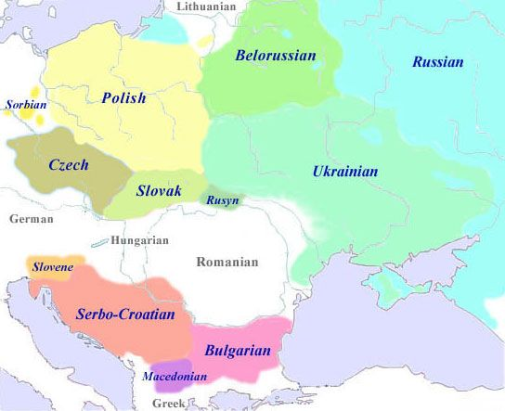
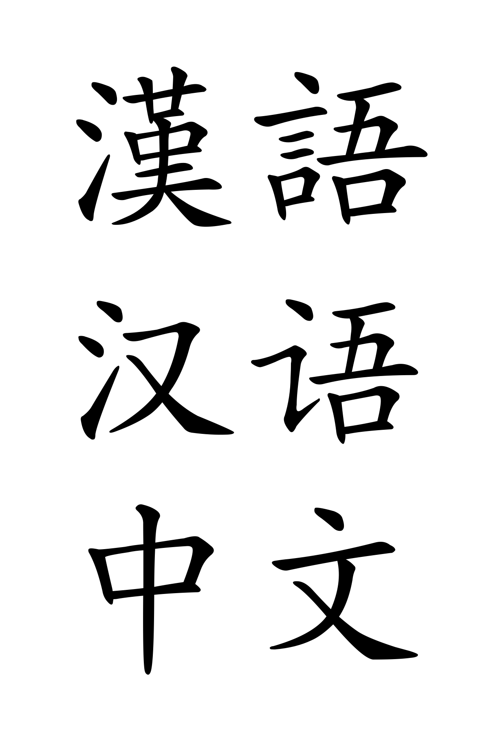
以…来说
based on…;as far as…concerned
Based on language
N. (big range)
Slavic language is more difficult than Chinese
以语言来说，斯拉夫语比中文更难学。

Slide 29
based on…; as far as…concerned
以…来说
N. (big range)
请造句

Slide 30

甚至(于)
Even to the point that
Father likes Harry Potter very much
把所有哈利波特的书都买下了
爸爸很喜欢哈利波特，甚至把所有哈利波特的书都买下了。

Slide 31
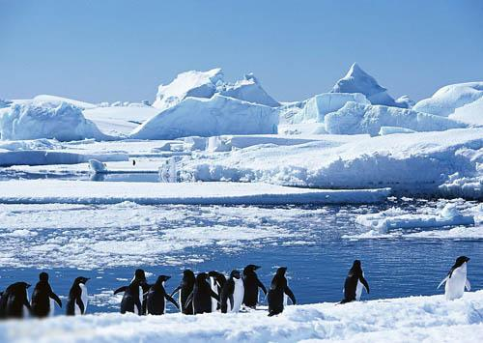
Even to the point that
甚至(于)
+连
She like to travel very much
南极她都去过了。
Antarctic
她很喜欢去旅游，甚至连南极她都去过了。

Slide 32
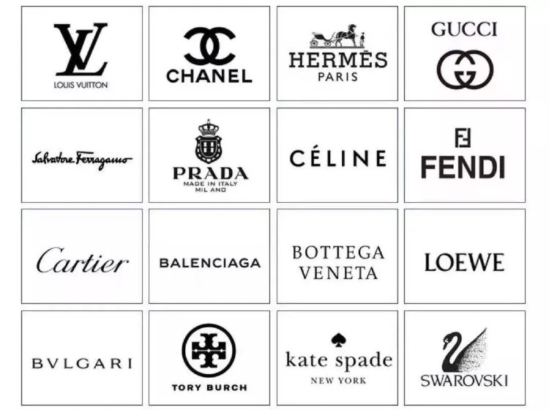
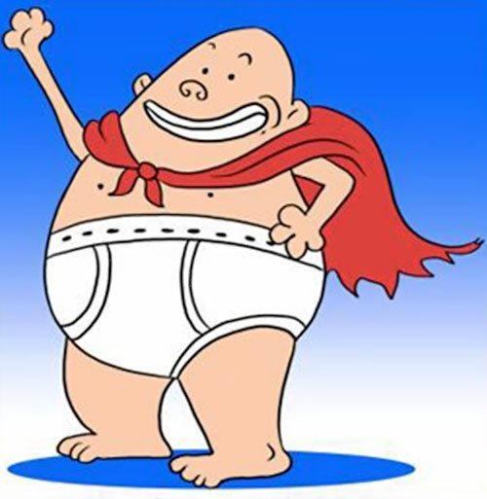
Even to the point that
甚至(于)
+连
All of his stuff are famous brand
Underpants are also famous brand
他什么东西都是名牌的，甚至连内裤也是名牌的。

Slide 33
Even to the point that
甚至(于)
+连
请造句

Slide 34
“in terms of…”
(在)…上
abstract noun
(character; interest; studies; work; life, etc.)
性格
兴趣爱好
学习
工作
生活

Slide 35

(在)…上
“in terms of…”
In terms of Chinese grammar
I have a lot of questions
在中文语法上，
我有很多问题。

Slide 36
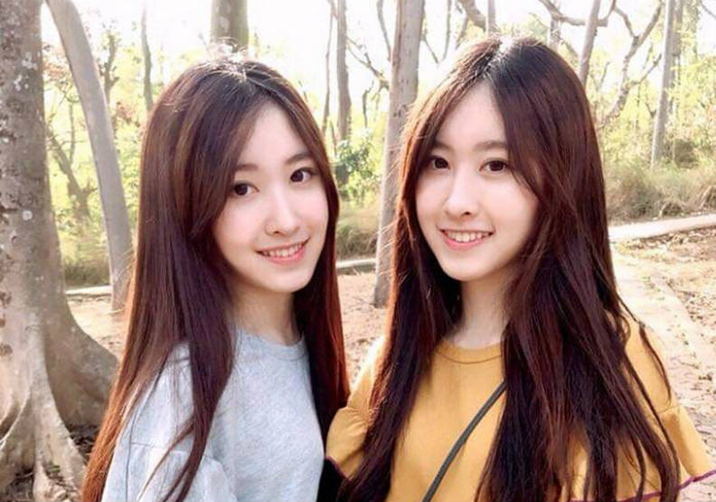
(在)…上
“in terms of…”
In terms of character,
older sister is more extroverted than younger sister.
在性格上，
姐姐比妹妹还开朗。

Slide 37
(在)…上
“in terms of…”
In terms of shopping,
the standard of my mom and I are totally different.
在购物上，
我和妈妈的标准完全不同。

Slide 38
(在)…上
S+
My father has had a lot of problems with his job.
我爸爸在工作上有很多问题。

Slide 39
“in terms of…”
(在)…上
abstract noun
(character; interest; studies; work; life, etc.)
性格
兴趣爱好
学习
工作
生活
请造句

Slide 40
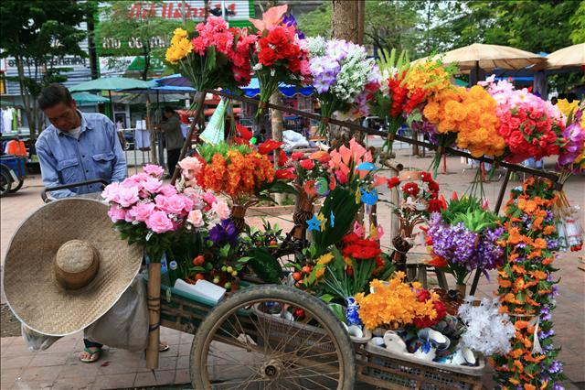
靠…为生
make a living by…
She make a living by selling flower
她是靠卖花为生的，所以她每天不得不在街上卖花。

Slide 41

靠…为生
make a living by…
She made a living by singing before
Verb phrase
but now she has retired
她以前是靠唱歌为生的，但现在她退休了。

Slide 42
make a living by…
靠…为生
Verb phrase
请造句

