Slide 1
Doing Research in Humanities in Taiwan
Christianity in Taiwan

Slide 2
My own journey

Slide 3
HOW SHOULD I START DOING THE RESEARCH?
HOW?

Slide 4
EFFECT

Slide 5


Slide 6
The most important factors when selecting a research topic?

Slide 7
Interest
Access
一口吃个胖子
Help

Slide 8
How to select the sources?

Slide 9
Terminology

Slide 10
本土化
VS
中国化

Slide 11
How to select the “correct” methodology?

Slide 12
Conflict of interests?

Slide 14
My research on Christianity in Taiwan (and the PRC)

Slide 15
Presbyterian Church in Taiwan as “a catalyst of discourse on civic Taiwanese nationalism” (Yoshihisa Amae, 2007) (?)

Slide 16
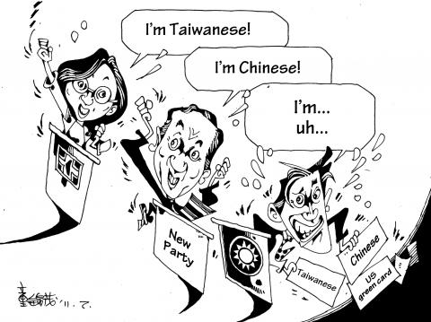

Slide 17


Slide 18
Under Japanese rule
1895-1945
During martial law
1949-1987
First years: Good status - the PCT represented over 80% of all Christians
After 1930: Shinto ceremonies before every service Forced to use Japanese language Bibles burned Romanized transcript banned - spies Foreign missionaries expelled
Forced to use Mandarin language 1975 – Bibles confiscated PCT members persecuted
Translations to foreign language only for foreigners Romanized transcript banned
The PCT realized, that for Taiwan was necessary to reach human rights, democracy and self-government

Slide 19
Why does one Christian group decide to oppose the totalitarian rule while other does not?

Slide 20
“One of the primary goals of most religious organisations is maximisation (or retention) of parishioners.”
(Anthony Gill, 1998)

Slide 22
Social media VS traditional media VS Internet websites

Slide 24
Read Participation as user involvement by Daniela Landert (pp. 31-33; 33-35; 38-40)
Group 1: What is interaction and participation? How would you study this? (pp. 31-33)
Group 2: What is involvement? What is involving content, involving language? How would you study this? (pp. 31-33)
Group 3: What is potential of interaction? How might this influence research? (pp. 33-35)
Group 4: What is horizontal and vertical communication? How might this indluence research? (38-40)

Slide 25
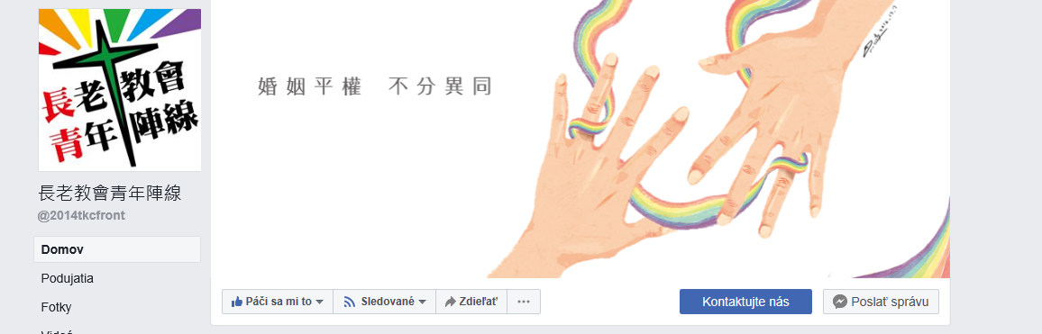

Slide 26
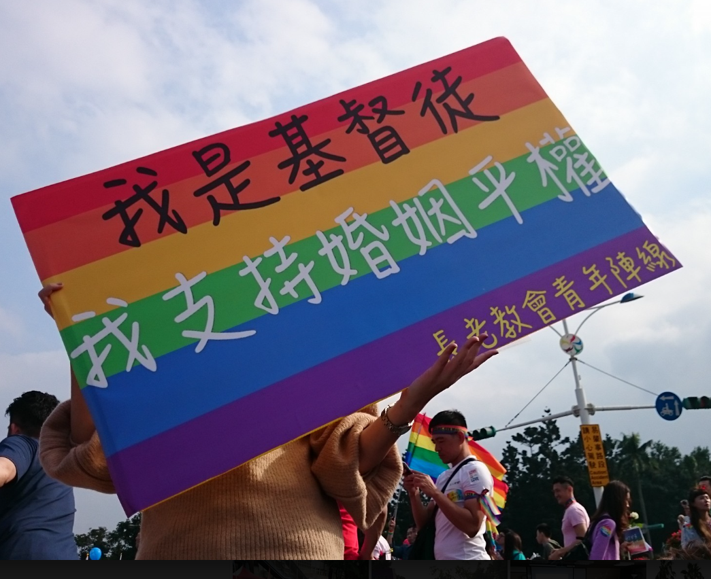

Slide 27
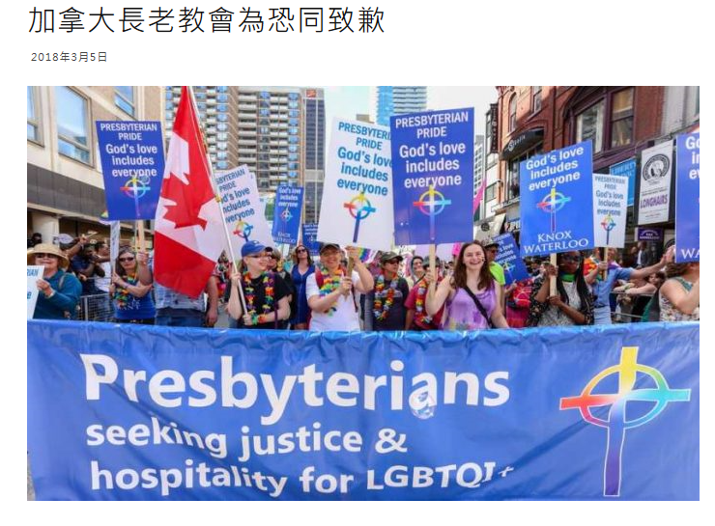

Slide 28

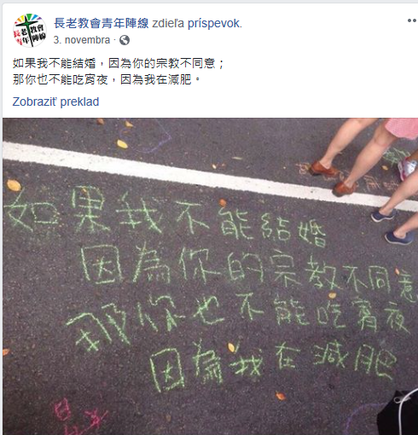
https://www.youtube.com/watch?v=z4_ALYJ3Juo
https://www.youtube.com/watch?v=S96dLpkDWCo

Slide 29
Try to think about a different purpose of each material
Give at least three distinctive point of each material (focusing on differences between the materials)
In which situation would you use each material?
What do you think the FB group tried express

