Slide 1
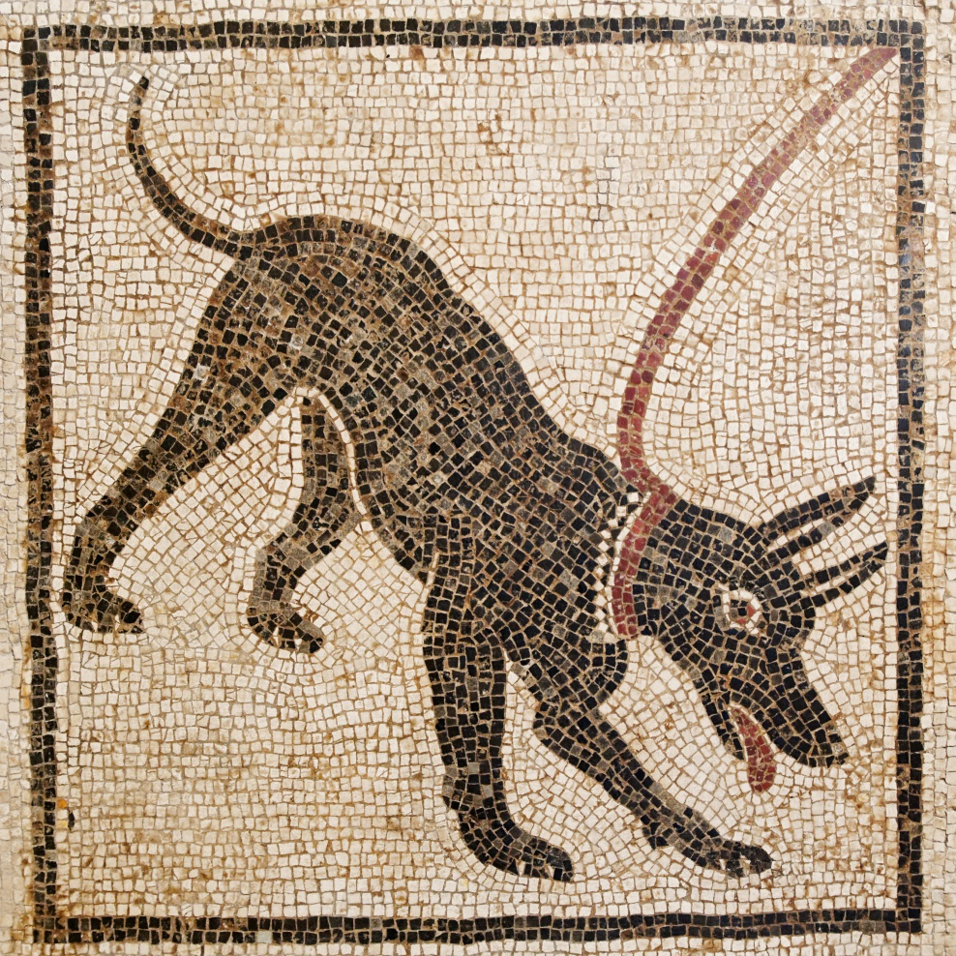
Ancient Fauna
Animals in Antiquity, 26.9.2019

Slide 2
Sources of information
Written sources – mainly encyclopedic accounts
Aristotle – History of Animals (4.ce.BC)
Strabo – Geography (1.ce.AD)
Pliny the Elder – Natural History (1.ce.AD)
Aelian – Characteristics of Animals (3.ce.AD)

Slide 3
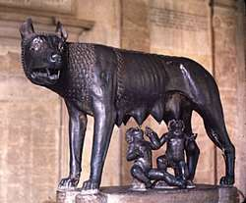
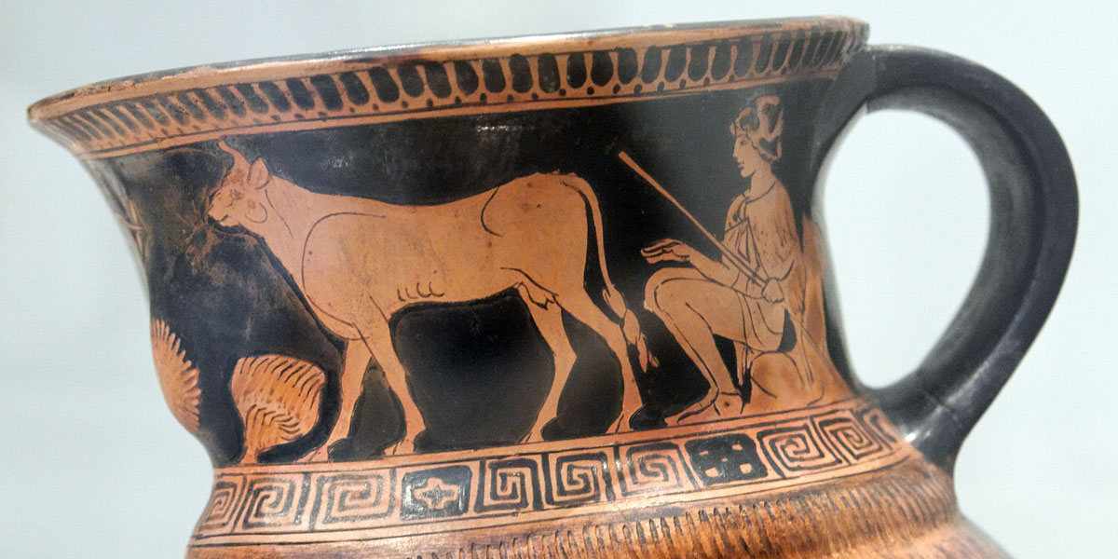
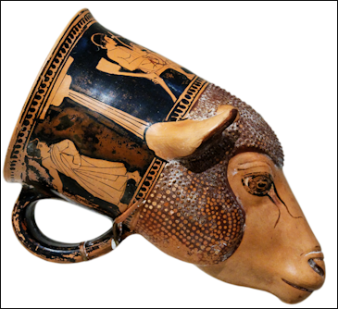
Images of Animals
Paintings, sculptures, ...

Slide 5
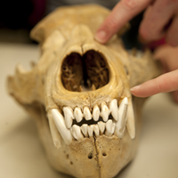
Zooarchaeology
The most reliablie – bones (origins, extinctions, distributions, movements, uses, roles)
Verifies if existence, placement and use of animal corresponds to written sources and iconography
New directions (DNA)

Slide 6
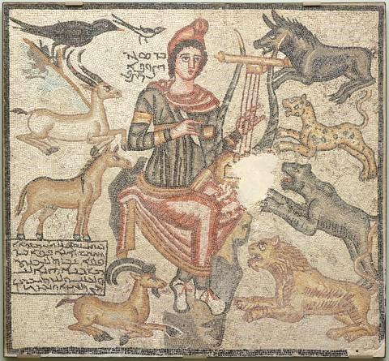
Ancient Fauna
Common domesticated species (major and minor taxa)
Wild fauna

Slide 7
Wild progenitors of domesticated animals
Progenitors of domestic cattle:
Aurochs (Bos primigenius) - exctinct, Bison (Bison bonasus), Buffalo (Bubalus bubalis)
Wild sheep and goats – domesticated since Neolithic times, mouflon
Wild boar (Sus scrofa) – hunt, vivaria

Slide 8
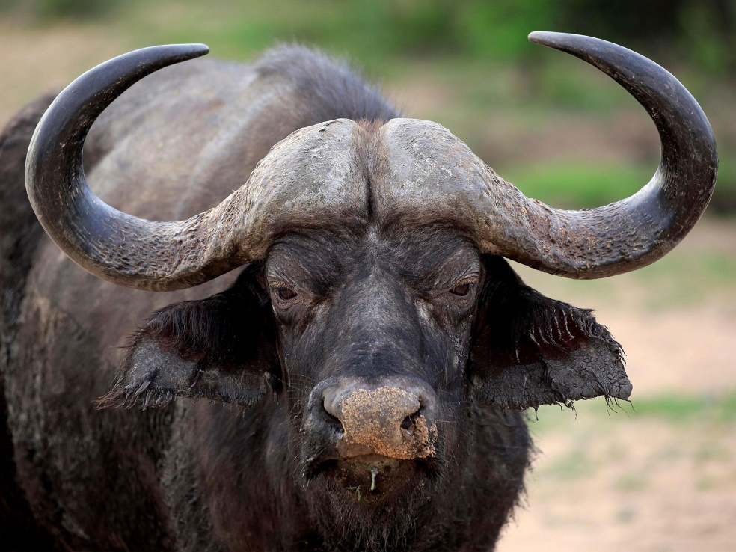
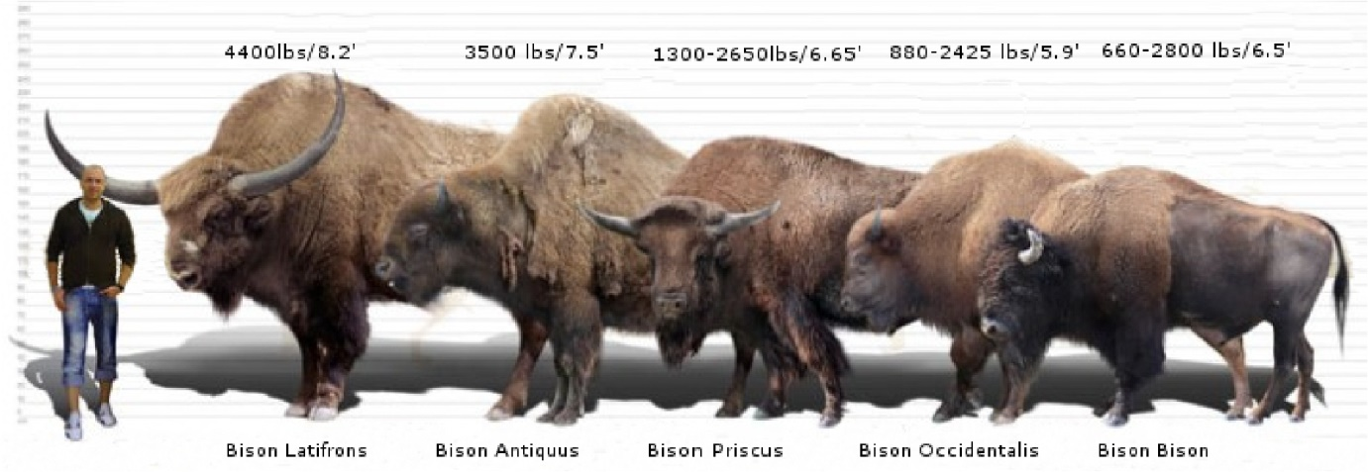

Slide 9
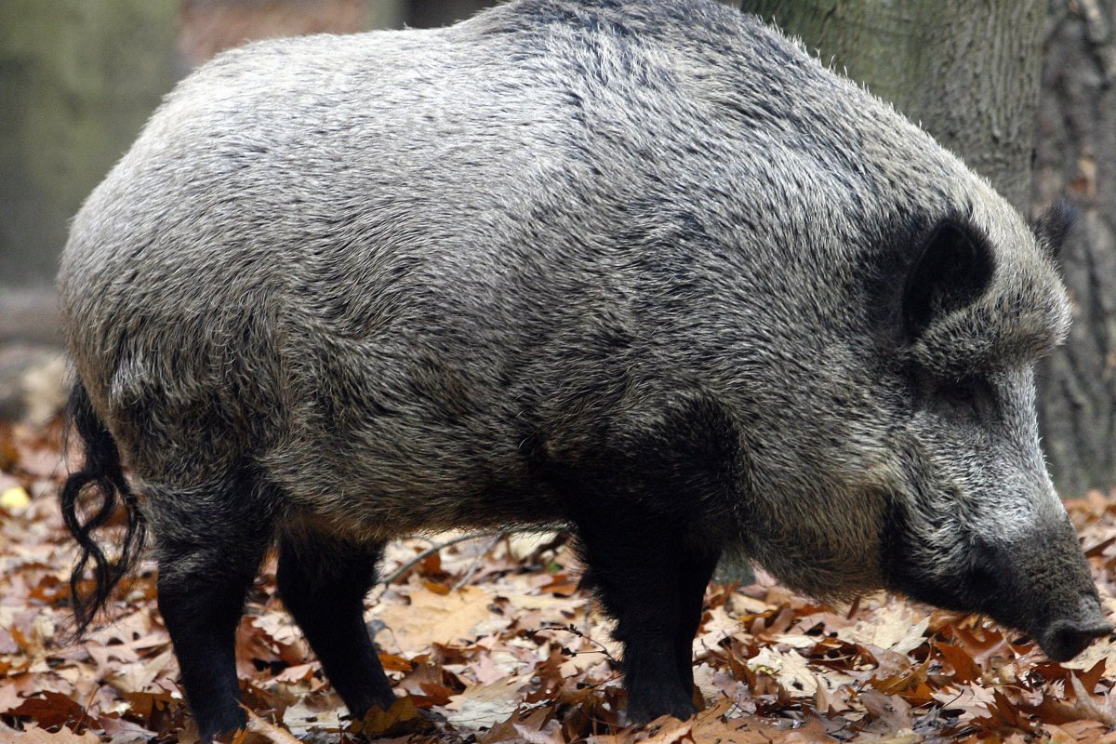

Slide 10
Marble sarcophagus with boar hunt scene (2.ce.AD, Rome)

Slide 11
Major mammalian taxa
Deer (Red deer – Cervus Elaphus, Roe deer – Capreolus capreolus, Fallow deer – Dama dama)
Hare (Brown hare – Lepus europaeus, African hare – Lepus capensis, Mountain hare – Lepus timidus)
European rabbit (Oryctolagus cuniculus)

Slide 12
Eros chasing deer, 4.ce.BC

Slide 13
Hare and Birds (4.ce.AD, Antioch)

Slide 14
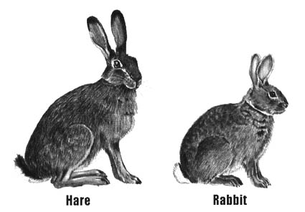
What is the difference between rabbit and hare?

Slide 15
Minor wild animals
Brown Bear (Ursus arctos)
Wolf (Canis lupus)
Red fox (Vulpes vulpes)
Wild cat (Felis sylvestris), Lynx (Lynx lynx)
Hedgehog, Porcupine, Badger, Marten, Stoat Weasel, Polecat
Beaver (Castor fiber)
Bats

Slide 16
Bear hunt (3.-4.ce.AD, Baiae)

Slide 17
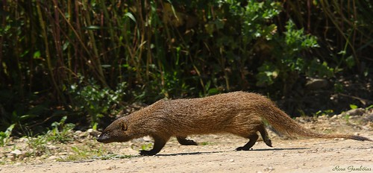
African and Asian Minor Wild Animals
African Wild Ass (Equus africanus)
Egyptian Moongoose (Herpestes ichneumon)
Gazelle

Slide 18
Moongoose on a leash at Beni Hassan tomb of Baqet I. (11th Dynasty)
Notes:
https://www.livescience.com/59022-egypt-tomb-with-leashed-mongoose-drawing.html

Slide 19
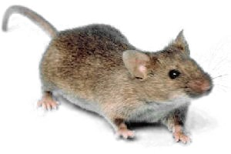
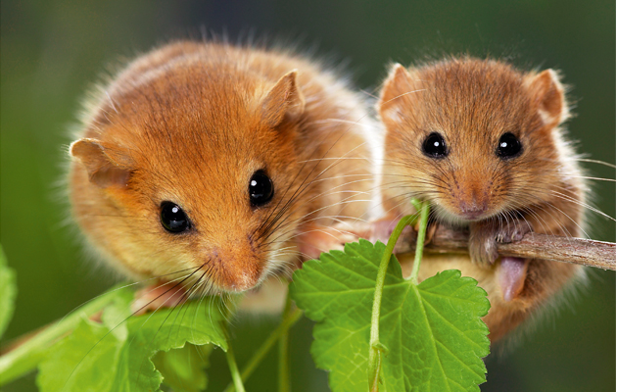
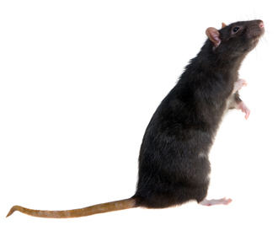
Rats, Mice and other Microfauna
Edible dormice
House mice (Mus musculus)
Black rat (Rattus rattus)

Slide 20
Glirarium – fattening jar for dormice
Notes:
https://www.atlasobscura.com/articles/dormouse-jars-glirarium-rome // recipe - https://www.romanobritain.org/2-arl_food/arl_roman_recipes-dormouse.php // more about the practice - https://sarahemilybond.com/2017/06/06/pass-the-dormice-breeding-selling-and-eating-honeyed-dormice-in-antiquity/

Slide 22
Mouse depicted on „Unswept floor mosaic“ from Rome, 2.ce.AD
Notes:
https://slicesofbluesky.com/unswept-floor-mosaic-from-ancient-rome/

Slide 23
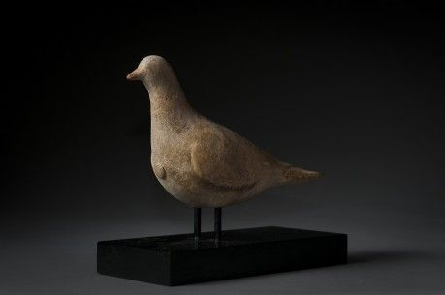
Birds
Diet, hunting, sport, pets, ritual and cult, augury, magic, medicine, folklore...
The most common taxa: fowl (pheasants, partridges, etc.), waterfowl (ducks, geese), pigeons, doves, songbirds

Slide 24
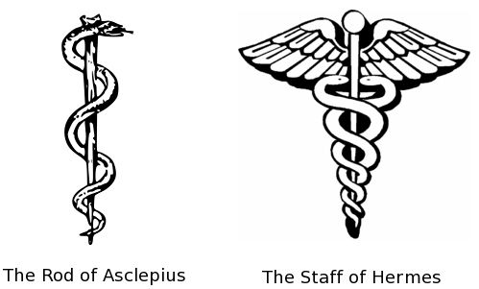
Reptiles and amphibians
Infrequently represented in ancient art and texts
Mainly used in medicine and cult practices
Tortoise – shell, meat

Slide 25
Lararium from House Vetti, Pompeii
Notes:
http://www.bbc.co.uk/history/ancient/romans/pompeii_art_gallery_08.shtml

Slide 26
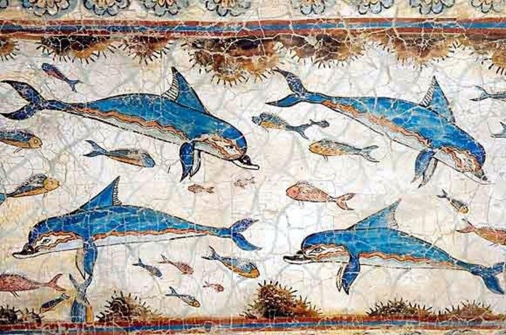
Fish and Aquatic Animals
Whales
Dolphins

Slide 27
Pets
Dogs
Cats
Birds
Snakes
Tamed wild animals
https://www.youtube.com/watch?v=Vxlci1d2rOg
Notes:
Dog epitaphs - https://www.thedodo.com/9-touching-epitaphs-ancient-gr-589550486.html

