Slide 1
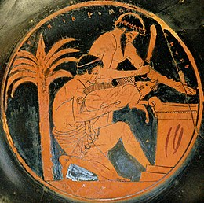
Animal Sacrifice
https://www.youtube.com/watch?v=mw8JD972M78

Slide 2
Animal sacrifice vs. Human sacrifice
Holocaustum (Hebrews)
Animal sacrifice vs. Ritual slaughter (continuation of ancient hunting rituals?)

Slide 3
Ancient Egypt
Origins of animal sacrifice? (4400-4000 BC)
Goats, sheep, but also hippos and baboons – later restrited to livestock

Slide 4
Ancient Greece
Sacrifice of domestic animals at altars + hymns and prayers
https://www.youtube.com/watch?v=CuzOezP5ifI
https://www.youtube.com/watch?v=Y8H1iZq73k0

Slide 5
Ancient Rome
Similar to Greek sacrifice
Dii superi – daylight and public – white infertile victims of their own sex: Juno – white heifer, Jupiter – white castrated ox
Di superi with connection to earth (Mars, Janus, Neptune) – fertile victims
Banquet after the sacrifice

Slide 6
Chtonic gods – dii inferi – nightime + dark fertile victims, holocaustum and no banquet, since „living can´t share meals with dead“
Goddesses of fertility (Ceres) – pregnant victims
Demi-gods and heroes – black and white victims (dual nature)

