Slide 1
Aristophanes – Frogs
Jana Malínková, Natálie Tvrdá, Žaneta Tondrová

Slide 2
The plot
Dionysus (with his servant Xanthias) goes to the Underworld to get the great poet Euripides back
He asks Heracles for a way and is dressed like him (as a parody of the story how Heracles went to the Underworld for Cerberos)
He rows the boat with Charon while being accompanied by the chorus of frogs
In the Underworld Euripides and Aeschylus are arguing over the throne for the best poet
A poetry competition takes place – Dionysus decides the winner is Aeschylus and takes him on the Ground instead of Euripides
550
530
500
450
400
380
350
Aeschylus
Sophocles
Euripides
Aristophanes

Slide 3
Vulgarisms
Xanthias Can I say the really funny one?
Dionysus Of course, Go right ahead—but don't let me catch you saying this.
Xanthias What's that?
Dionysus That you must shift your pack to ease yourself.
Aeacus By Zeus our Saviour, a real gentleman is your master.
Xanthias Of course he's a real gentleman, he only knows how to drink and screw.

Slide 4
Humour
before they went to the Underworld, Dionysus wanted a dead man to take their heavy bags.
Dionysus And sure enough, they're bringing out a corpse right here. Hallo you there ! —you, the dead man, I mean; Will you take this baggage down to Hell?
Corpse Will you pay two drachmas?
Dionysus God no, less than that.
[…]
Corpse If you don't put down two drachmas, no deal.
Dionysus Come, take nine obols.
Corpse I'd rather be alive again.

Slide 5
Interaction with the audience
Dionysus Have you met here with any parricides [murder of one’s father] Or perjurers [similar to a liar], as he told us?
Xanthias Haven't you?
Dionysus By Poseidon, yes. l think I see some now. Looking to the audience.
(when they see Empusa)
Dionysus Where can I escape?
Xanthias And where can I?
Dionysus (begs a priest sitting in the first row) Oh priest, preserve me now, to be your drinking buddy.
(after Empusa’s gone)
Dionysus Good grief, how I grew pale at the sight of her.
Xanthias (points at the priest) But this thing of yours got stained reddish brown with fear.

Slide 6
Criticizing other poets at the time
Heracles
And where's Xenocles?
Dionysus Oh, God! May he drop dead!
Heracles What of Pythangelus?
Xanthias No word of me, long suffering with this shoulder ache of mine!

Slide 7
Empusa
Xanthias And now, by Zeus, l see a monstrous beast.
Dionysus What kind?
Xanthias O horrible! it takes all kinds of shapes, Now it's an ox, and now a mule, and now A lovely woman.
Dionysus Where is she? I'll go meet her.
Xanthias Wait, now it's not a woman, but a bitch.
Dionysus Why, this must be Empusa.
Xanthias Ah! her whole face burns like fire.
Dionysus Does she have a leg of bronze?
Xanthias By Poseidon, yes,
and the other is cow dung.
Be sure of it.
Dionysus Where can I escape?

Slide 8
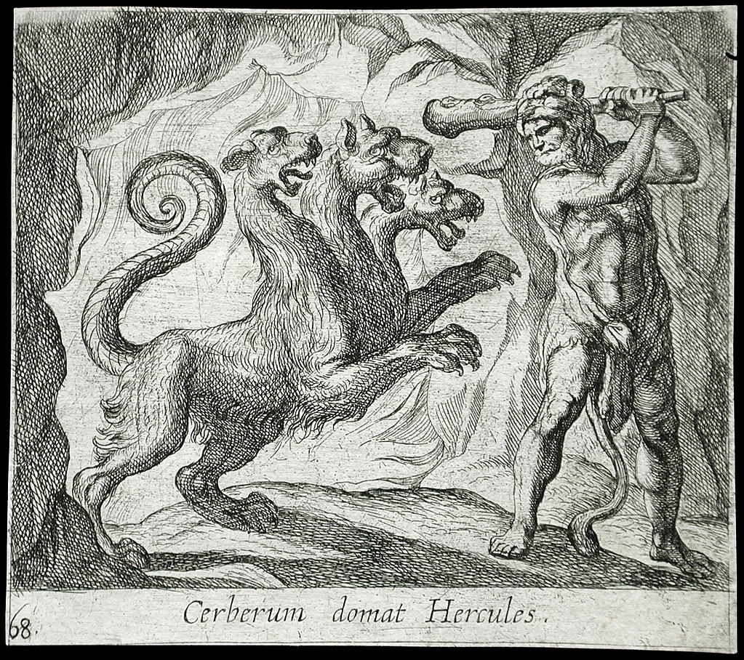
Mythological creatures
Aeacus
O you abominable, you shameless reckless wretch— villain, villain, damned smiling villain— the man who made off with Cerberus my dog! You grabbed him by the throat and throttled him, then took off on the run, while I stood guard. Now you’re caught—black-hearted Stygian rocks, and blood-dripping peaks of Acheron will hold you down. Roaming hounds of Cocytus will gnaw your guts to bits—Echnida, too, and she’s a hundred heads. The Tartesian eel will chew your lungs, your kidneys bleed from entrails Tithrasian Gorgons rip apart.
Cerberus

Slide 9
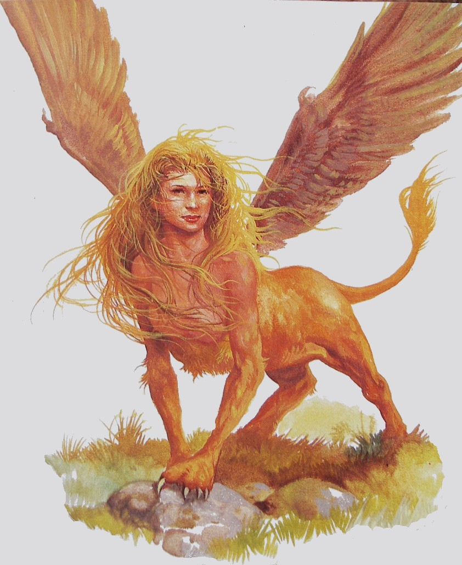
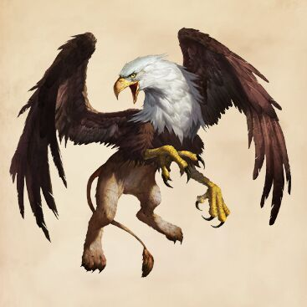
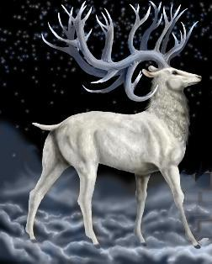
Griffin
Tragelaphos
Sfinx

Slide 10
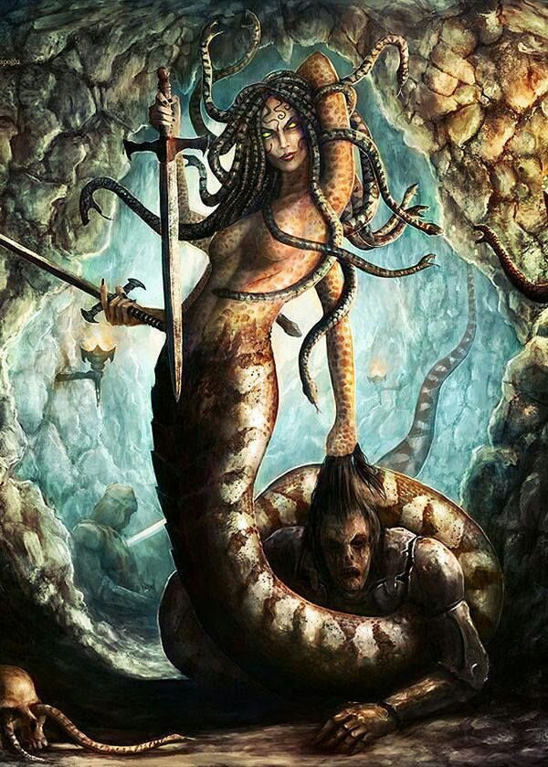
Echidna

Slide 11
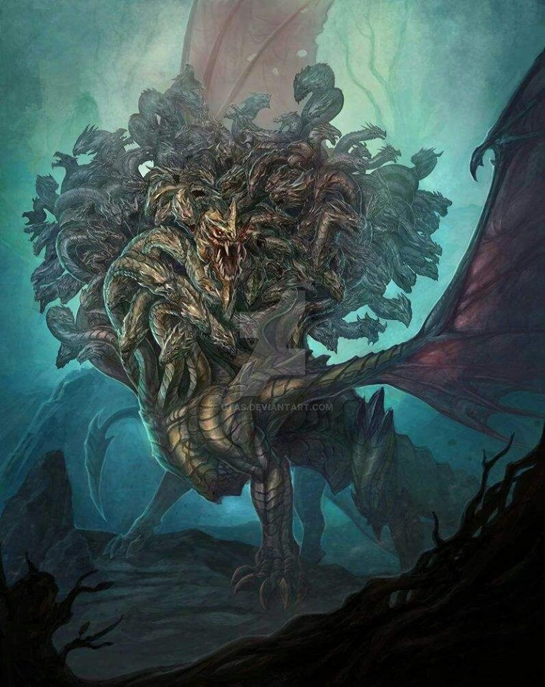
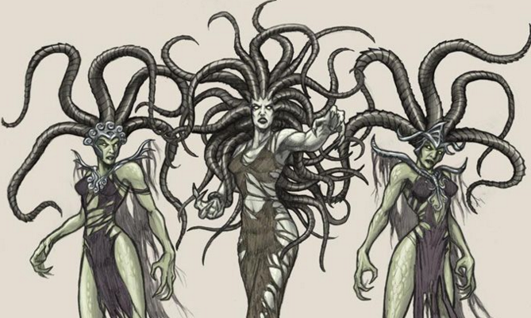
Typhon
The Gorgons

Slide 12
Frogs
Charon tells Dionysus:
You’ll hear lovely melodies once you make the effort.
The amazing music of the swan frogs.
[…] [As the small boat begins to move, the Chorus of Frogs is heard from off stage.]
CHORUS OF FROGS
Brekekekex koax koax Brekekekex koax koax. Children of the marsh and lake harmonious song now sweetly make, our own enchanting melodies koax koax. […] Brekekekex koax koax.

Slide 13
DIONYSUS [still rowing]
I’m starting to get a pain in the ass from all your koax koax.
CHORUS OF FROGS
Brekekekex koax koax.
[…]
DIONYSUS
Piss off—and take that koax koax with you. Nothing but koax koax.
[…]
DIONYSUS
Stop it, you music-loving tribe!
CHORUS OF FROGS
No, no. We’ll sing on all the more— if we’ve ever hopped on shore
on sunny days through weeds and rushes rejoicing in our lovely songs as we dive and dive once more, or as from Zeus’ rain we flee to sing our varied harmonies at the bottom of the marsh, our bubble-splashing melodies.
[…]
DIONYSUS
Go on. Keep croaking. I don’t care.
CHORUS OF FROGS
We’ll croak on ’til our throats wear out. We’ll croak all day.
DIONYSUS
Brekekekex koax koax You never beat me in this play!
CHORUS OF FROGS
And you’ve no chance to win your way, not matched with us.
DIONYSUS
And you’ve no hope outdoing me. No, no. If I must I’ll yell all day, koaxing you to get my way— Brekekekex koax koax
[Dionysus listens for a response from the Chorus, but there is none.]
You see. Sooner or later I was going to win— and make you stop your harsh koaxing din.

Slide 14
Sources
English translation by Matthew Dillon: http://www.perseus.tufts.edu/hopper/text?doc=Perseus:text:1999.01.0032
English translation by Ian Johnston: http://johnstoniatexts.x10host.com/aristophanes/frogshtml.html
Images:
https://data.whicdn.com/images/233280303/original.jpg
http://www.cambridgeblog.org/wp-content/uploads/2013/10/the-frogs-615x290.jpg
https://mythology.wikia.org/wiki/Empusa
https://en.wikipedia.org/wiki/Cerberus
https://aminoapps.com/c/mythology/page/blog/griffin/evjQ_vbi3udLGe7X8LNwLXpMKVBPdZxMlX?fbclid=IwAR3Ec_iy_eYmgGK_H-cG1RzjbiXoeQ-nBUKPZlSeFxwRkErDLzed5D25ozg
https://warriorsofmyth.fandom.com/wiki/Hircocervus
http://magical-angels.blog.cz/en/1202/sfinx
https://aminoapps.com/c/pagans-witches/page/blog/echidna-mother-of-all-monsters/D851_aW6sPum2JnP4b1EGVoePJ53MEx1gB1?fbclid=IwAR2wOIUPHGDeNGzZYzB3VZ47zwPGQKXVOkRlUfSKqtOmB-7HqVMYih5LWuo
https://imgur.com/gallery/zFZnP?fbclid=IwAR1WVf77t47hjEE-qNo2oxcrI8HS8Ic96SUhG9yvftdAOqbiHt5aKhkrMj0

Slide 15
THE END

