Slide 1
Animals as magical ingredients in the Epigraphical Sources in the Area of Roman Empire
Andrea Salayová, Masaryk University, Brno
24.7.2019 Kommission für Alte Geschichte und Epigraphik, Munich

Slide 2
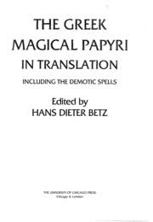
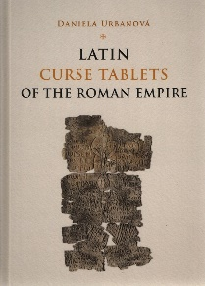
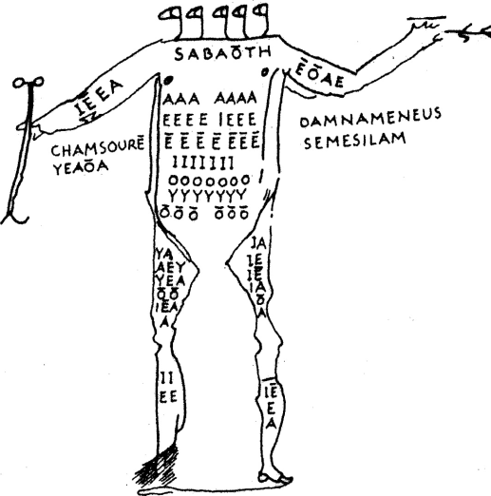
Written sources on magic in antiquity
Classical authors
Greek magical papyri
Curse tablets

Slide 3
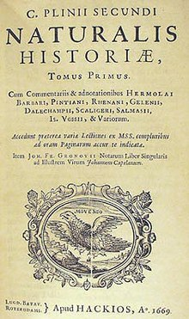
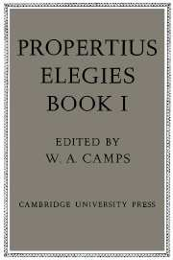
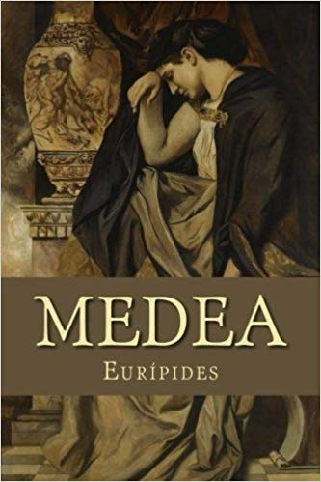
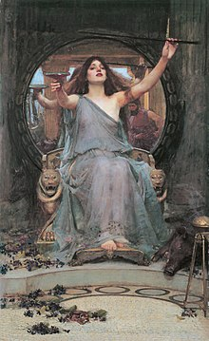
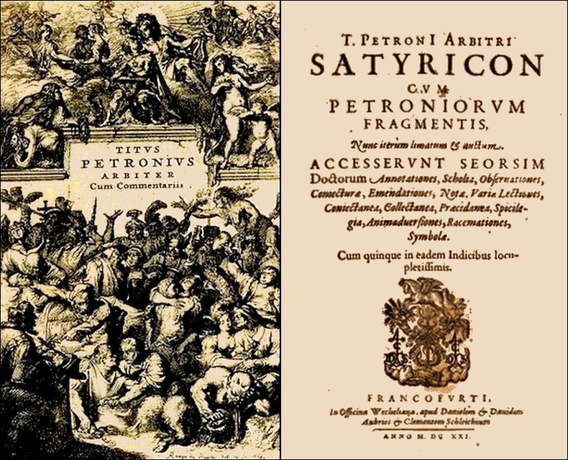
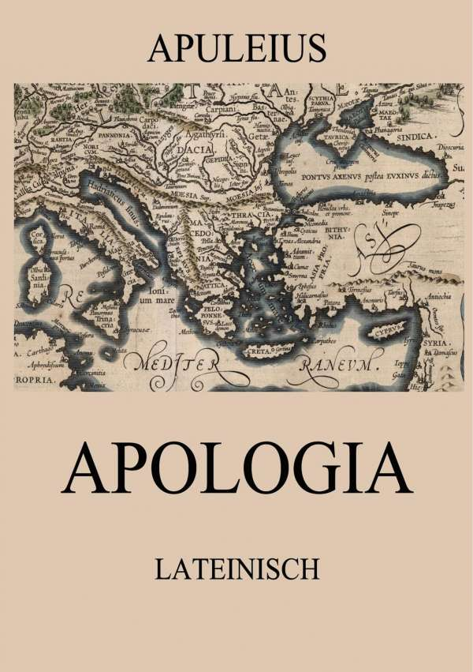
Classical authors on magic

Slide 4
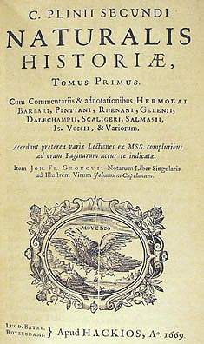
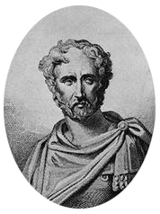
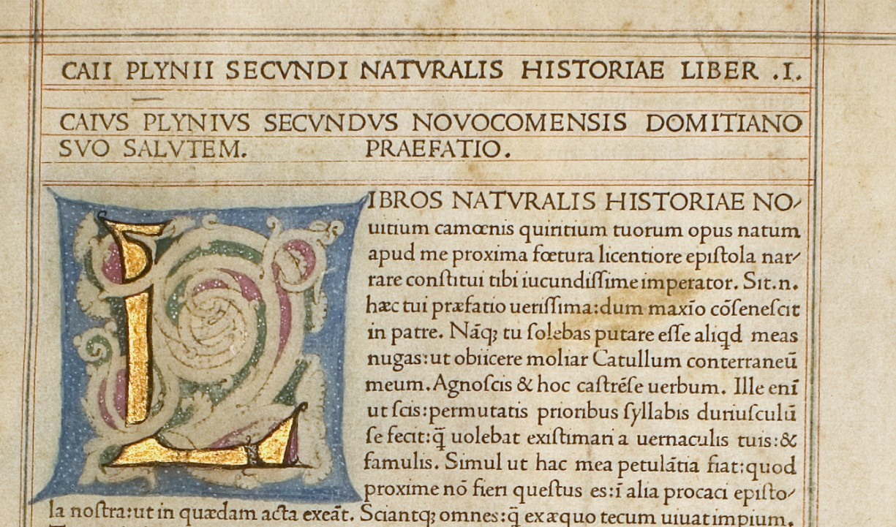
Pliny the Elder – Natural History
“The Natural History of Pliny the Elder is a voluminous survey of science, pseudoscience, art, and technology. Reflecting the state of knowledge of the late Hellenistic era, it is based on a hundred or so earlier authorities.” (Arcana mundi, p. 68.)

Slide 5
Pliny vs. magicians
„Magorum vanitas perunctis adipe eo faciliorem gratiam apud populos regesve promittit, praecipue tamen eo pingui, quod sit inter supercilia, ubi esse nullum potest.“ (PLIN. Nat. 28. 25)

Slide 6
Magical ingredients within Natural history
human ingredients
animal ingredients
ingredients against certain illnesses
Foreign animal species

Slide 7
Animals as magical ingredients in Greek magical papyri
"The Greek magical papyri" is a name given by scholars to a body of papyri from Greco-Roman Egypt containing a variety of magical spells and formulae, hymns and rituals. The extant texts are mainly from the second century B.C. to the fifth century A.D.“ (Betz, 1986, p.41)
„The Greek magical papyri are, however, original documents and primary sources. Their discovery is as important for Greco-Roman religions as is the discovery of the Qumran texts for Judaism or the Nag Hammadi library for Gnosticism.“ (Betz, 1986, p.42)

Slide 8
PGM I. 247-62 - Invisibility spell
Ἀμαύρωσι<ς> δοκίμη. μέγα ἔργον· λαβὼν πιθήκου ὀφθαλμὸν ἢ νέκυος βιοθανάτου καὶ βοτάνην ἀγλαοφωτίδος (τὸ ῥόδον λέγει) ταῦτα τρίψας σὺν ἐλαίῳ σουσίνῳ, τρίβων δὲ αὐτὰ ἐκ τῶν δεξιῶν εἰς τὰ εὐώνυμα λέγε τὸν λόγον, ὡς ὑπόκειται· “ΑΝΟΚ ΑΝΟΥΠ ΑΝΟΚ ΟΥΣΙΡΦΡΗ ΑΝΟΚ ΣΟΣΩΤ ΣΩΡΩΝ ΟΥΙΕΡ ΑΝΟΚ ΠΕ ΟΥΣΙΡΕ ΠΕΝΤΑ ΣΗΤ ΤΑΚΟ· ἀνάστηθι, δαίμων καταχθόνιε ιω Ἐρβηθ ιω Φορβηθ ιω Πακερβηθ ιω Ἀπομψ, ὃ ἐὰν ἐπιτάξω ὑμῖν ἐγὼ ὁ δεῖνα, ὅπως ἐπήκοοί μοι γένησθε.” ἐὰν δὲ θελήσῃς ἄφαντος γενέσθαι, χρῖσόν σου τὸ μέτωπον μόνον ἐκ τοῦ συνθέματος, καὶ ἄφαντος ἔσῃ, ἐφ’ὅσον χρόνον θέλεις. ἐὰν δὲ θελήσῃς ἐμφαίνεσθαι, ἀπὸ δύσεως ἐρχόμενος εἰς ἀνατολὴν λέγε το ὄνομα τοῦτο, καὶ ἔσει δηλωτικὸς καὶ ἔποπτος πᾶσιν ἀνθρώποις. ἔστιν δὲ τὸ ὄνομα· “Μαρμαριαωθ μαρμα ριφεγγη, ποιήσατέ με, τὸν δεῖνα, ἔποπτον πᾶσιν ἄνθρώποις ἐν τῇ σήμερον ἡμέρᾳ, ἤδη, ἤδη, ταχύ, ταχύ.” ἔχε<ι> λίαν καλῶς.

Slide 11
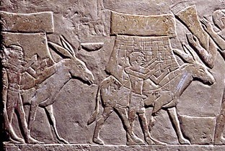
Why donkey?

Slide 13
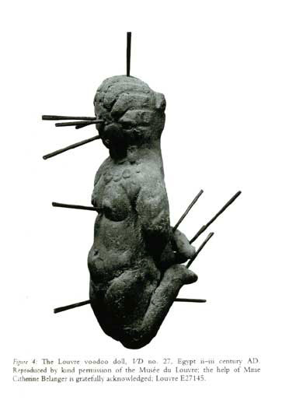
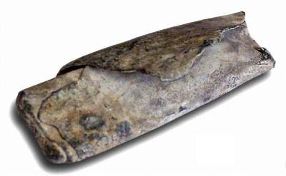
Curse Tablets

Slide 14
CIL 8.12511, Carthago, 1st.-3rd. cent. CE
„Ὡς οὗτος ὁ ἀλέκτωρ καταδέδεται τοῖς ποσὶ καὶ ταῖς χερσὶ καὶ τῆ κεφαλῆ, οὕτως καταδήσατε τὰ σκέλη καὶ τὰς χῖρας καὶ τὴν κεφαλὴν καὶ τὴν καρδίαν Βικτωρικοῦ τοῦ ἡνιόχου τοῦ βενέτου ἐν τῆ αὖριν ἡμέρα καὶ τοὺς Ἵππους ...“

Slide 16
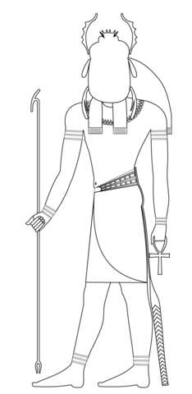
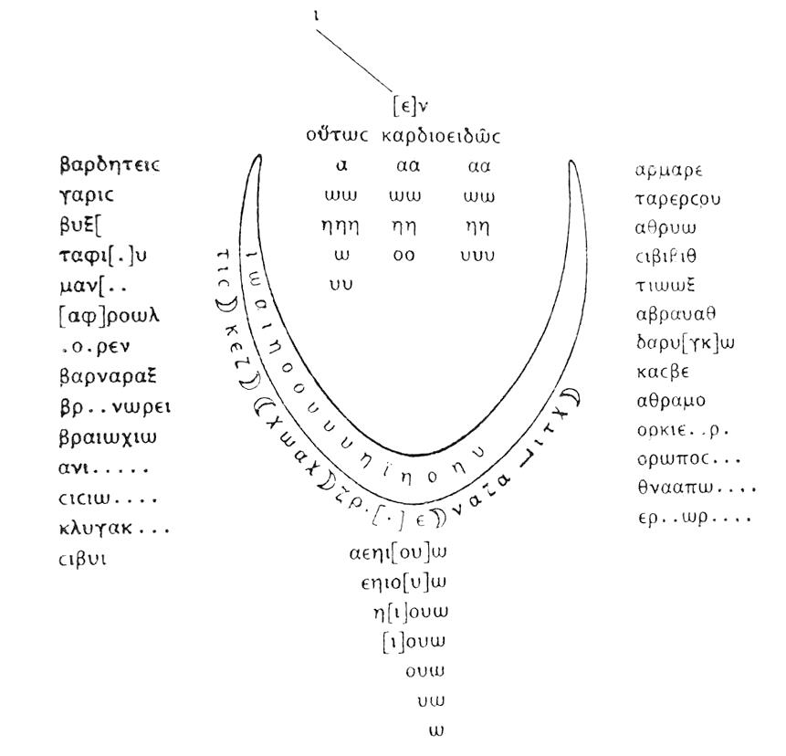
Conclusion

Slide 17
Thank you for your attention!
asalayova@gmail.com

Slide 18
Sources:
BETZ, H.D.: Greek magical papyri in translation, 1986
FARAONE, Ch.A., ORBINK, D.: Magika hiera, 1991
JOHNSTON, S. I.: Ancient religions, 2007
KITCHELL Jr., K.F.: Animals in the ancient world from A to Z, 2014
LUCK, G.: Arcana Mundi, 1985
PLINY The Elder: Natural History, John Bostock ed.
ROSSEL, S., MARSHALL, F. et al.: Domestication of the donkey: Timing, processes, and indicators, 2008
SCHWARTZ, M.D.: The aesthetics of blessing and cursing: literary and iconographic dimensions of hebrew and aramaic blessing and curse texts

