Slide 1

K-POP

Slide 2

V Live

Slide 3
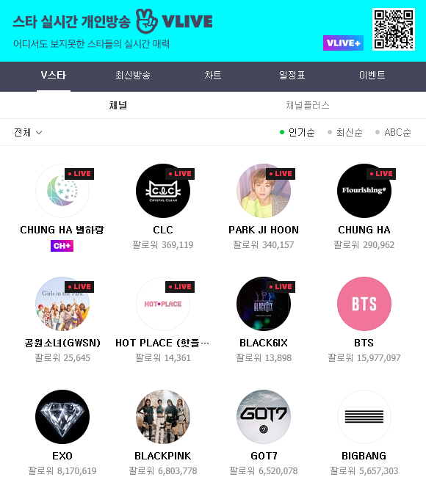
https://www.vlive.tv/home/

Slide 4
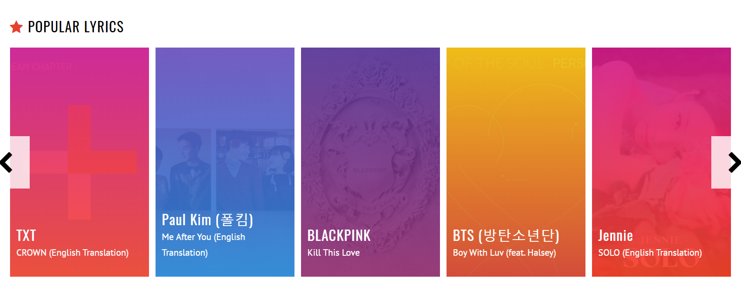
https://lyricskpop.net/

Slide 5

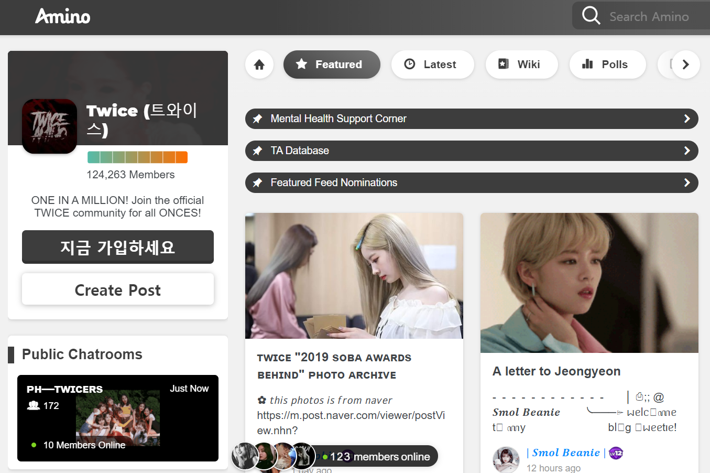
https://aminoapps.com/c/once/home/

Slide 6
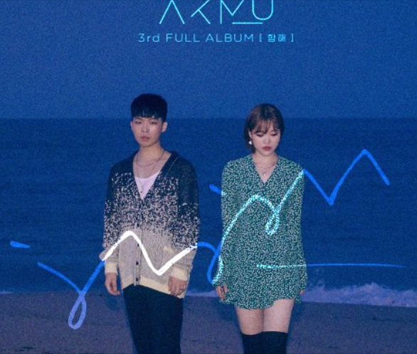
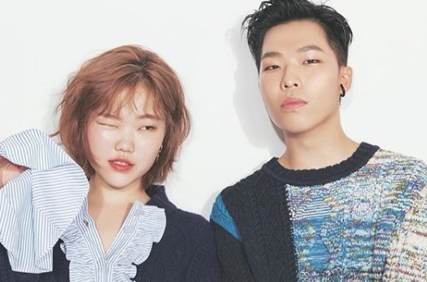
AKMU

Slide 7
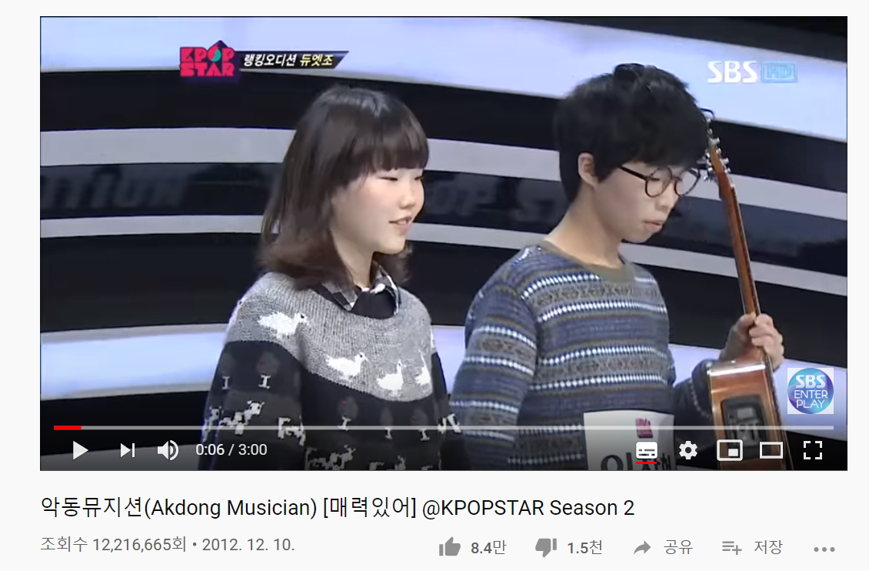
https://www.youtube.com/watch?v=tgkVdxi-D0Y

Slide 8
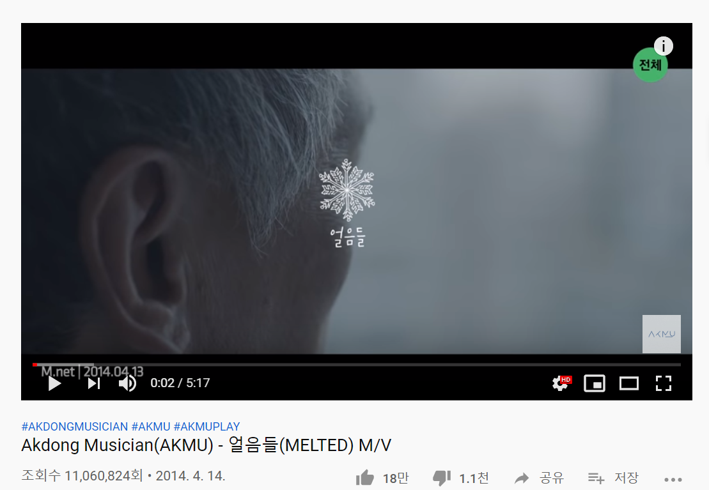
https://www.youtube.com/watch?v=Oya7nVq1FHM
https://www.youtube.com/watch?v=Oya7nVq1FHM

Slide 9
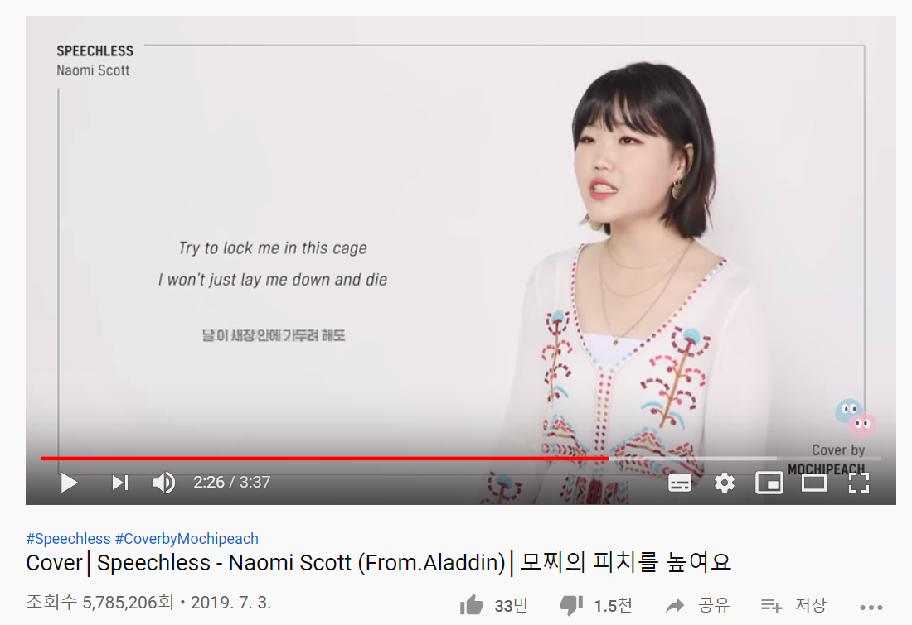
https://www.youtube.com/watch?v=N2gqSg8sXns&t=29s

Slide 10
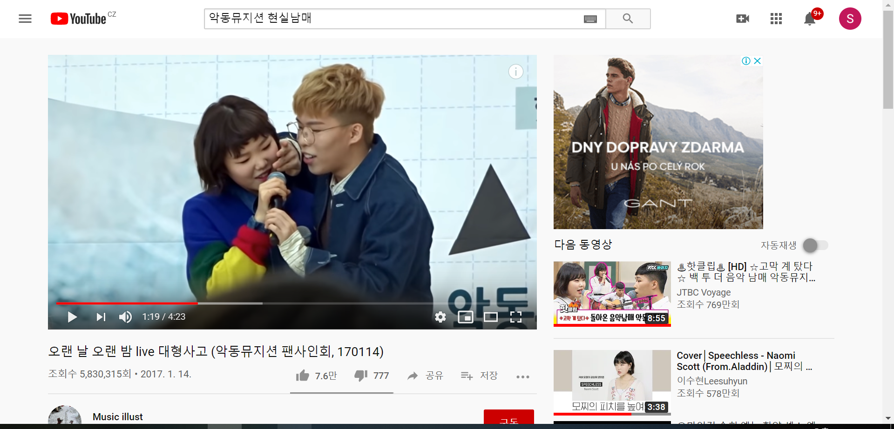
https://www.youtube.com/watch?v=RqV-7bpIxx0&t=63s

Slide 11
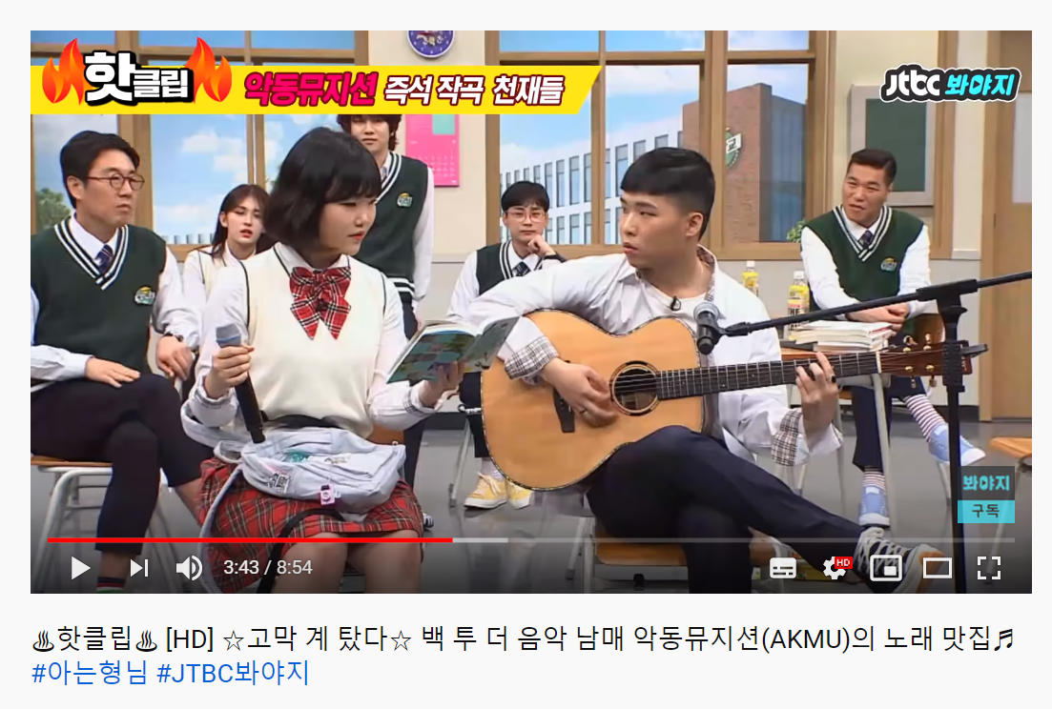
https://www.youtube.com/watch?v=MejPSVZdaVA&t=78s

Slide 12
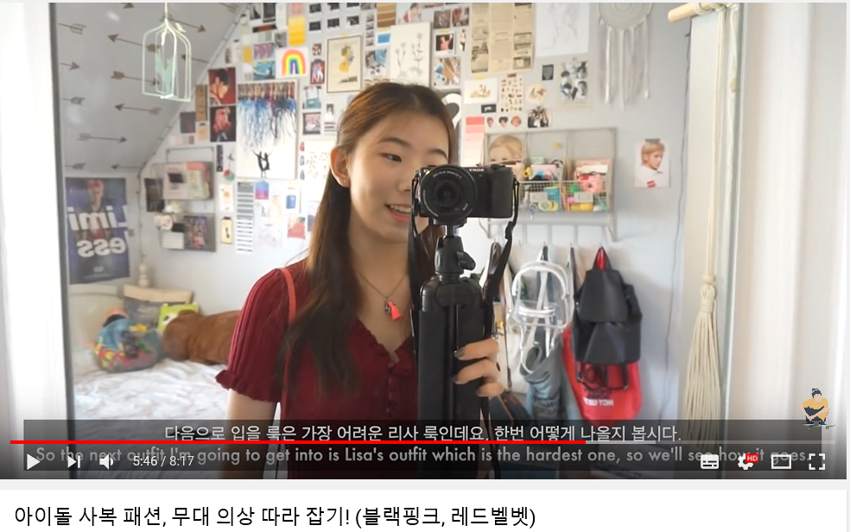
https://www.youtube.com/watch?v=4XKk9gwWmjg

Slide 13
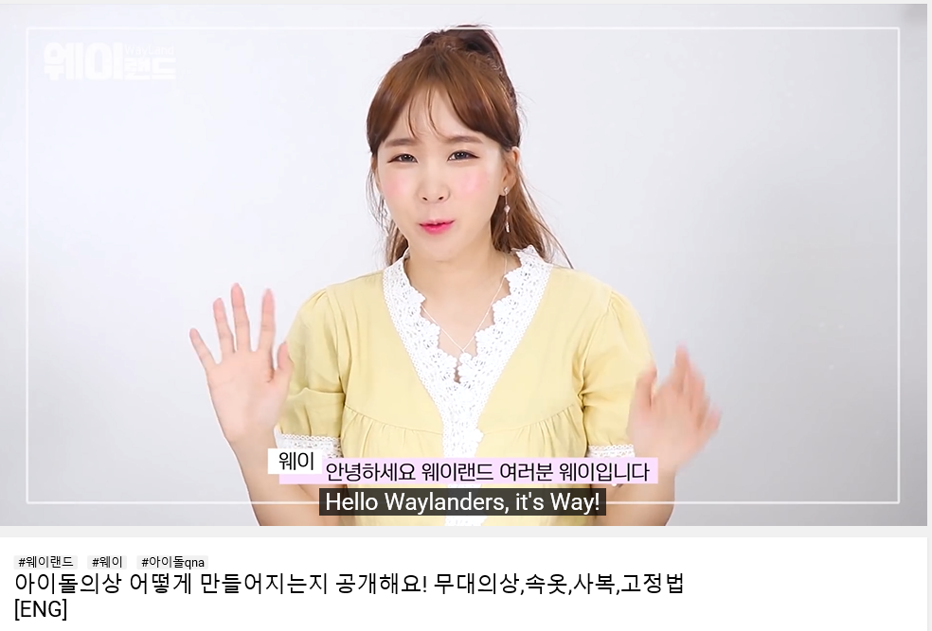
https://www.youtube.com/watch?v=wdT2iNNro1w
How clothes of idols are made!

Slide 14
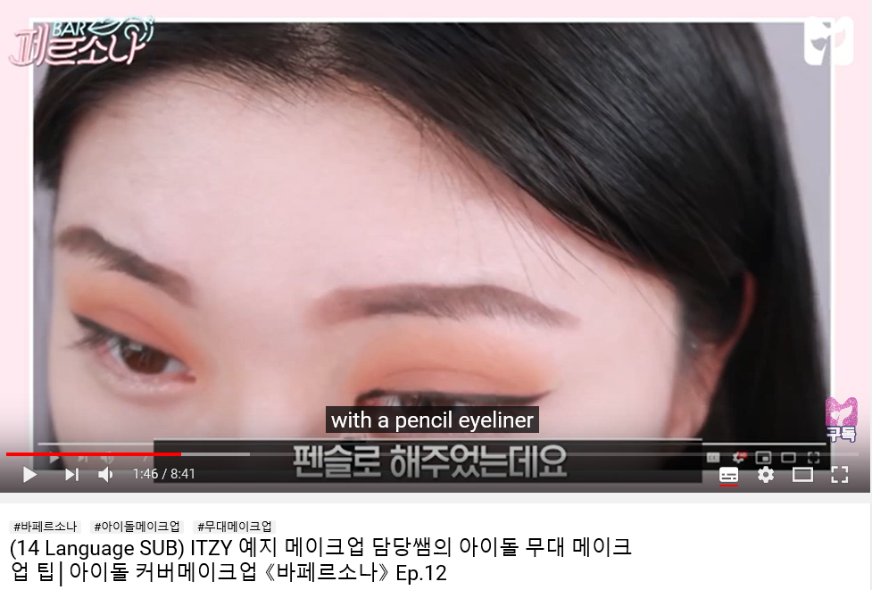
https://www.youtube.com/watch?v=jbtUD4QfahM
How idols get their makeup?

Slide 15
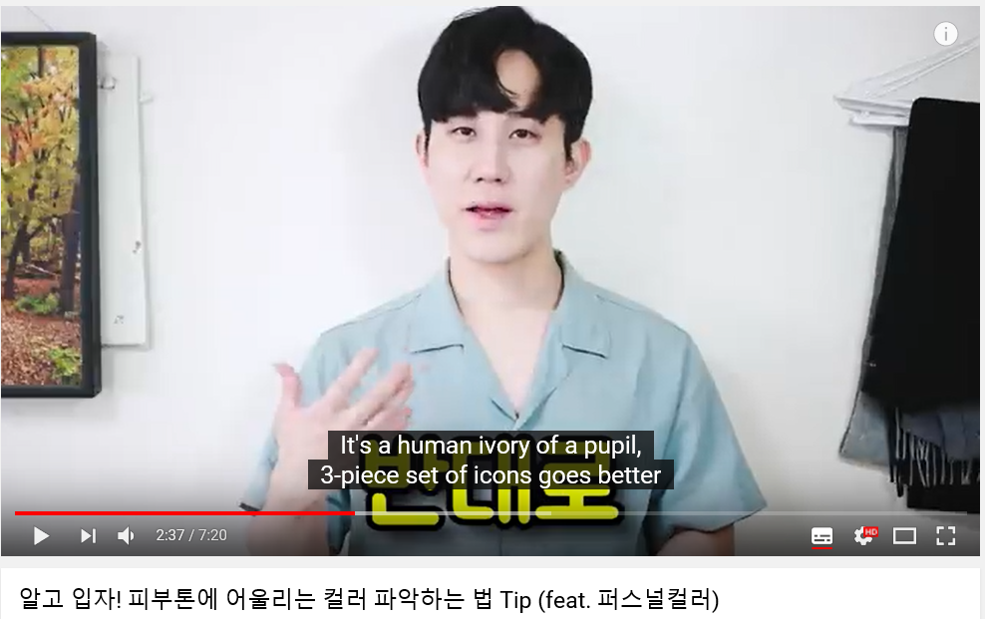
https://www.youtube.com/watch?v=Hjrmc9m1OmA

Slide 16

Many boys who want to be idols apply for this program.
Production crews select 101 boys among them.
The boys do contest programs and people vote for them after they watched broadcast.
Boys who have many valid number of votes are selected to be members of an idol group.

Slide 17

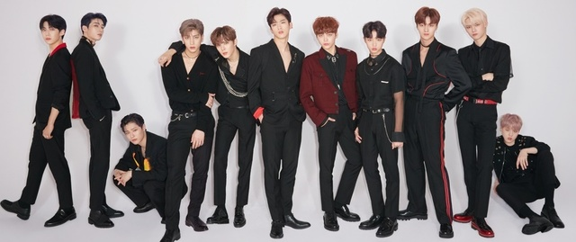
The idol groups of this program
National Producer Representative
The mentor of members

Slide 18
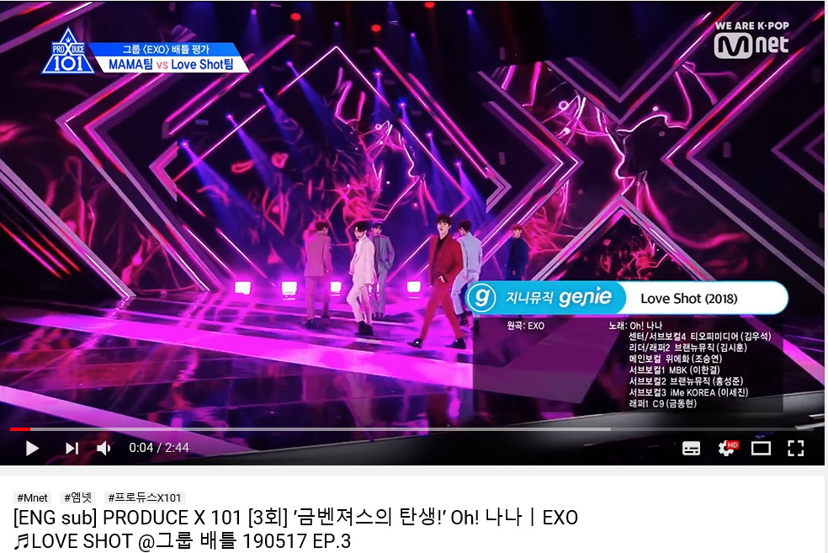
Group Battle
:Boys select a song they want among prepared songs by broadcast crews.
Songs are by EXO, BTS, GOT7 who are famous in Korea.
People vote for better group and members.
Group Battle 1 Mama vs Love Shot [EXO]
https://www.youtube.com/watch?v=43b2wQ6Nll4

Slide 19
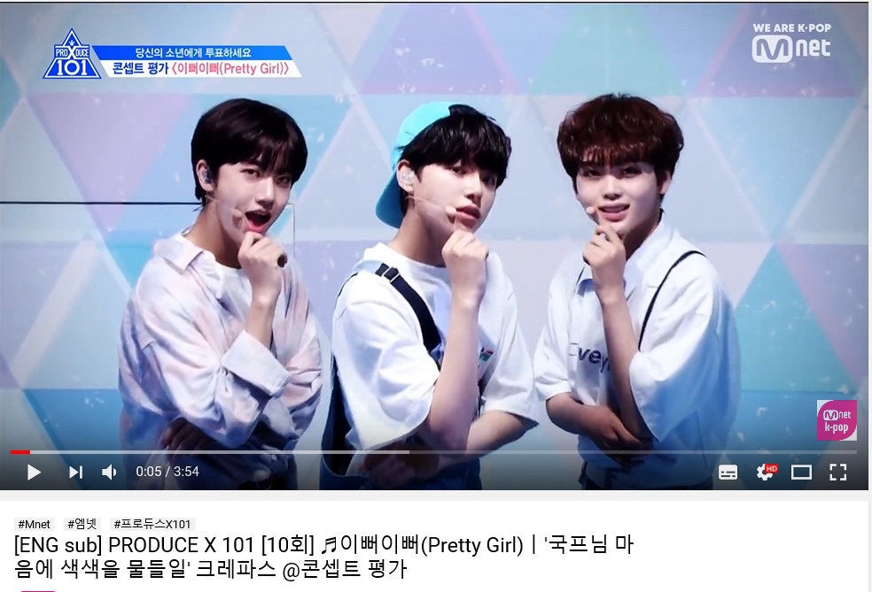
Concept Evaluation
: Boys are evaluated how much they express themselves well
https://www.youtube.com/watch?v=TTOloFDxZZg

Slide 20
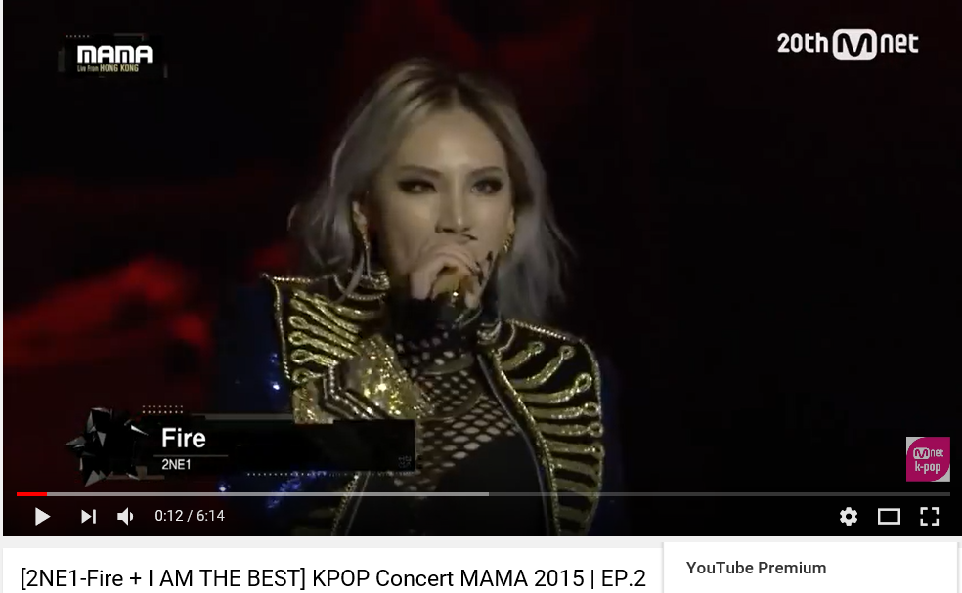
https://www.youtube.com/watch?v=_Sm_BIkbJkw

Slide 21
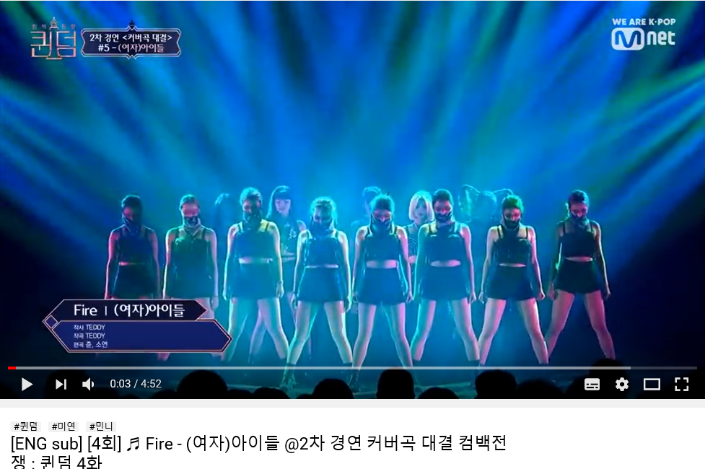
https://www.youtube.com/watch?v=Og_X5gTXTF0

