Slide 1

BTS

Slide 2

Name: RM (Kim namjoon)
Birth: 1994.09.12
Position: leader, main rapper
직캠
https://www.youtube.com/watch?v=qlg3kTRAUrM
문제적남자
https://www.youtube.com/watch?v=K72LYDmeWYY
찌찌몬스터
https://www.youtube.com/watch?v=geoQPA3Tcw4
https://www.youtube.com/watch?v=VzKn8YjZ9VY
https://www.youtube.com/watch?v=emcbP1M5fa0

Slide 3

Name: Jin (Kim seokjin)
Birth: 1992.12.04
Position: vocal
아재개그
https://www.youtube.com/watch?v=nkGNiZEPp6g
직캠
https://www.youtube.com/watch?v=MilKNyALZ6w
https://www.youtube.com/watch?v=wc2ZMcO2dts

Slide 4
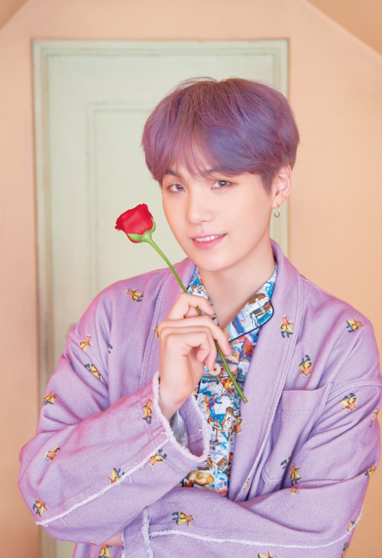
Name: Suga (Min yoongi)
Birth: 1993.03.09
Position: lead rapper
직캠
https://www.youtube.com/watch?v=BZ7N161noT8
싸이퍼
https://www.youtube.com/watch?v=D_GzE2XeRzw
https://www.youtube.com/watch?v=lfatrffyt5g
https://www.youtube.com/watch?v=JyHaRCMbx6A

Slide 5
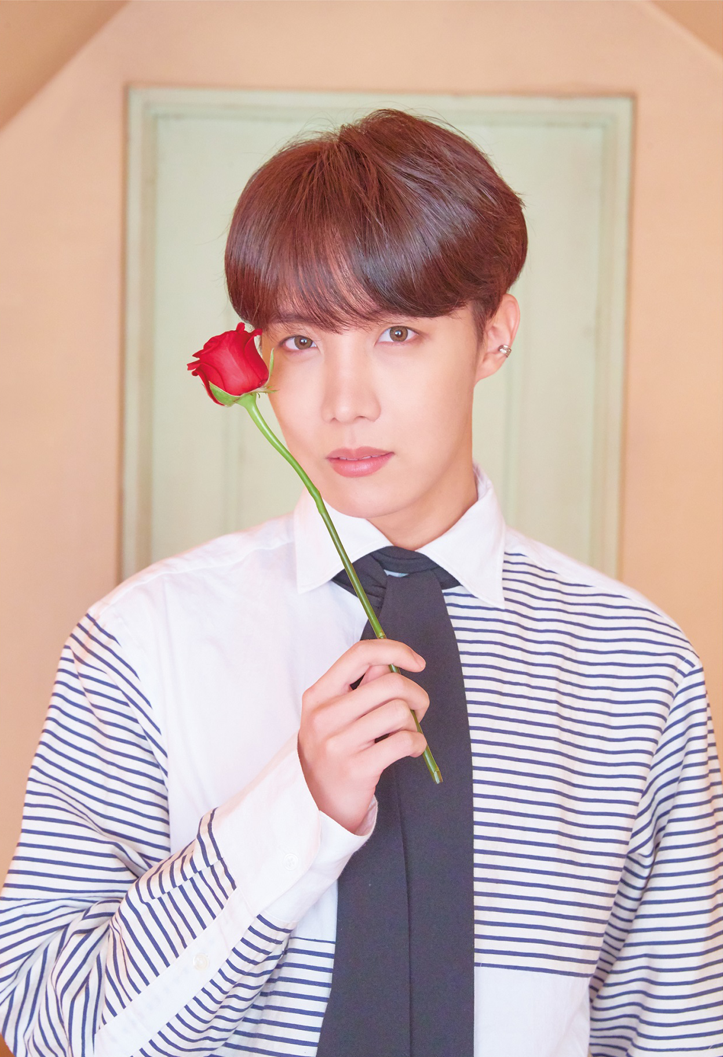
Name: J-hope(Jung hoseok)
Birth: 1994.09.12
Position: main dancer, rapper
직캠
https://www.youtube.com/watch?v=dSIMAD61hNY
독무
https://www.youtube.com/watch?v=Hngm4rc50UM
https://www.youtube.com/watch?v=rRs_Y8i2-3Q
https://www.youtube.com/watch?v=MzKEd6j7eDk
https://www.youtube.com/watch?v=EmAjPVW7koA

Slide 6
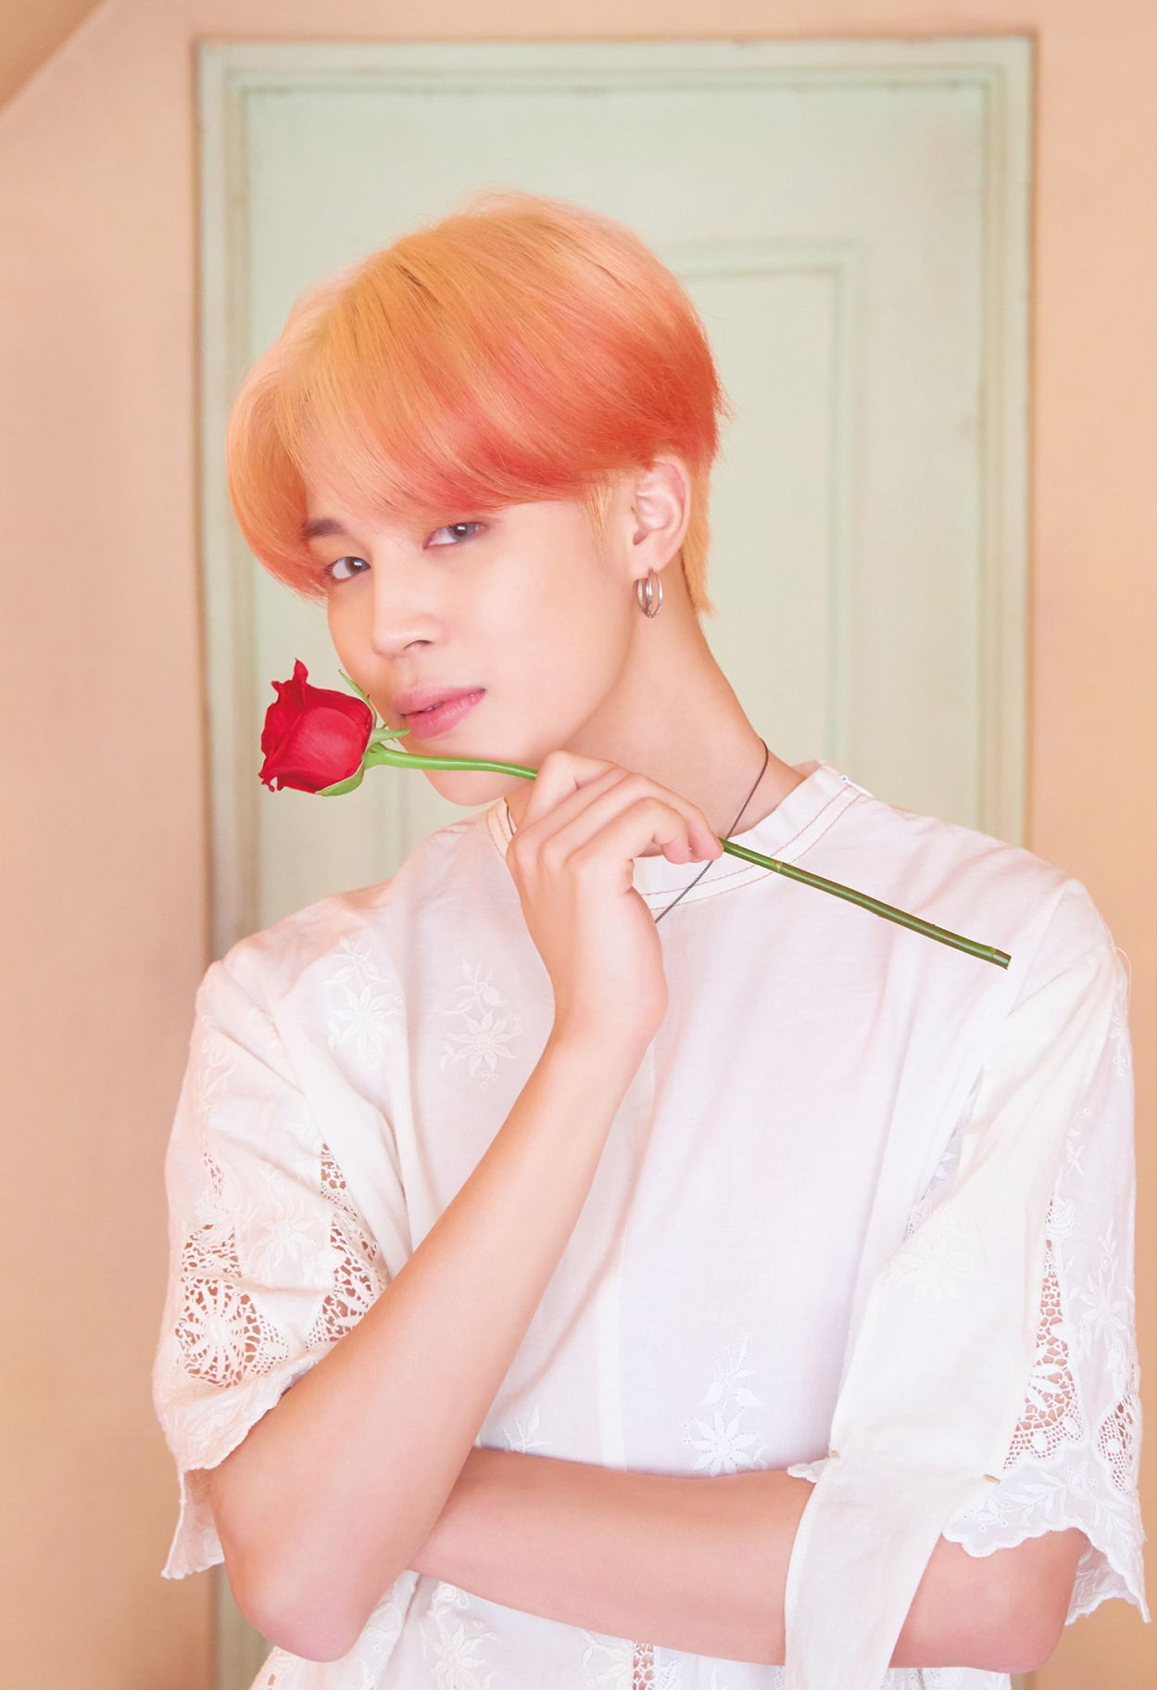
Name: Jimin (Park Jimin)
Birth: 1995.10.13
Position: main dancer, lead vocal
페잌럽
https://www.youtube.com/watch?v=GfX62fI1NyA
보조개
https://www.youtube.com/watch?v=BTkOOsaiVI4
현대무용
https://www.youtube.com/watch?v=HTxuftPGlFY

Slide 7

Name: V (Kim taehyung)
Birth: 1995.12.30
Position: vocal
직캠
https://www.youtube.com/watch?v=i0G7z_LG0mc
예능
https://www.youtube.com/watch?v=s5gSvq8b72U
https://www.youtube.com/watch?v=ETwxaPAygXE

Slide 8

Name: Jungkook (Jeon Jungkook)
Birth: 1997.09.01
Position: lead dancer, main vocal
묘기
https://www.youtube.com/watch?v=Dhr_MtrDwp0
직캠
https://www.youtube.com/watch?v=w5XxXWJrARU
팬싸
https://www.youtube.com/watch?v=kDJj3KRZRRI

Slide 9
Cover stage
말하자면
https://www.youtube.com/watch?v=fHNWVKJ2YC8
퍼팩트맨
https://www.youtube.com/watch?v=AMMx1hOwH-4
레이니즘
https://www.youtube.com/watch?v=8WOxFTrFw70&t=45s
레이니즘 리액션
https://www.youtube.com/watch?v=G1lQ-7Axbqw

Slide 10
Korean traditional things
피땀눈물
https://www.youtube.com/watch?v=v8z1TtlY1no
https://www.youtube.com/watch?v=m1H13i-24UQ
https://www.youtube.com/watch?v=e3g68C5xCcw
태권도
https://www.youtube.com/watch?v=CR3_UG8tWkQ
아리랑
https://www.youtube.com/watch?v=vwc5zTayVJw
씨름
https://www.youtube.com/watch?v=D1O69wKToPg

Slide 11





Slide 12


BTOB
Born TO Beat
Debut: 21.03.2012
Fandom: Melody
Famous songs:
I can’t live without you
Miss you
Beautiful but sick
MOVIE

Slide 13
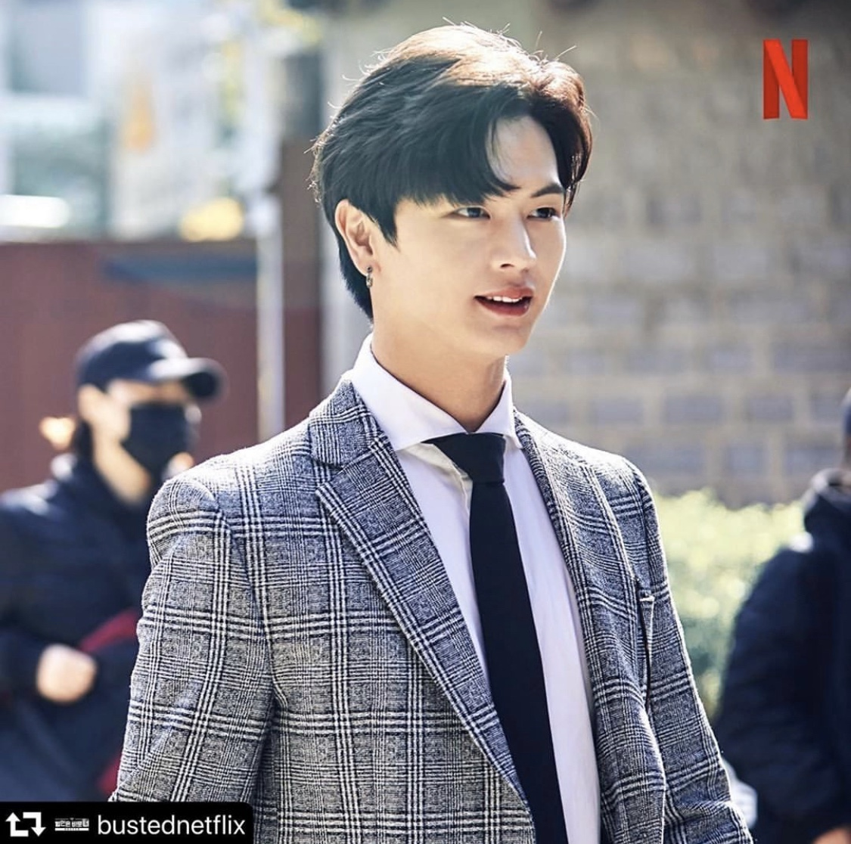
Yook Sungjae
Birth: 02.05.1995
Position: serve vocal
Profession: Idol, actor
Famous appearance work as an actor: Goblin
InstagramID: yook_can_do_it
https://www.youtube.com/watch?v=rDQrq4PofnA

Slide 14
Movie stage
https://www.youtube.com/watch?v=42A-rFdralM
연예가 중계 06:06~
https://www.youtube.com/watch?v=U4c0Un8SAYI
육성재 아는형님 민경훈 모창
https://www.youtube.com/watch?v=XLFUK5hEads

Slide 15



Slide 16

Seo Eungwang
Birth: 22.11.1990
Leader of BTOB
Position: Main Vocal
Nickname: Silverlight, Seoeunga
https://www.youtube.com/watch?v=nQzwi3wxOmw

Slide 17
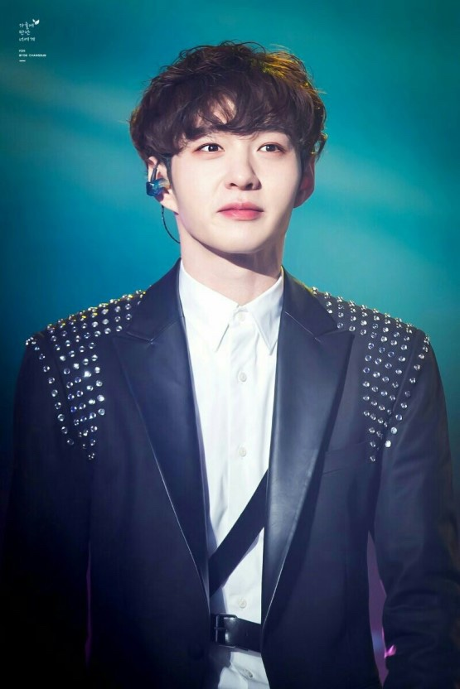
Lee Changsub
Birth: 26.02.1991
Position: Serve /Lead Vocal

Slide 18
배틀 트립
https://www.youtube.com/watch?v=v4eAs7mScNM
비투비 ask
https://www.youtube.com/watch?v=mKP-4YqI34c
예능
https://www.youtube.com/watch?v=nkyLuP7eiM4

Slide 19

Lim Hyeonsik
Birth: 07.03.1992
Position: Serve/Lead vocal
https://www.youtube.com/watch?v=4oHmzNF42m8

Slide 20

Lee Minhyuk
Birth: 29.11.1990
Position: Lead Rapper
Nickname: Leesain bolt, redhyeong
https://www.youtube.com/watch?v=DbxMH2sy3U8
https://www.youtube.com/watch?v=BKBZEudZ9xk

Slide 21
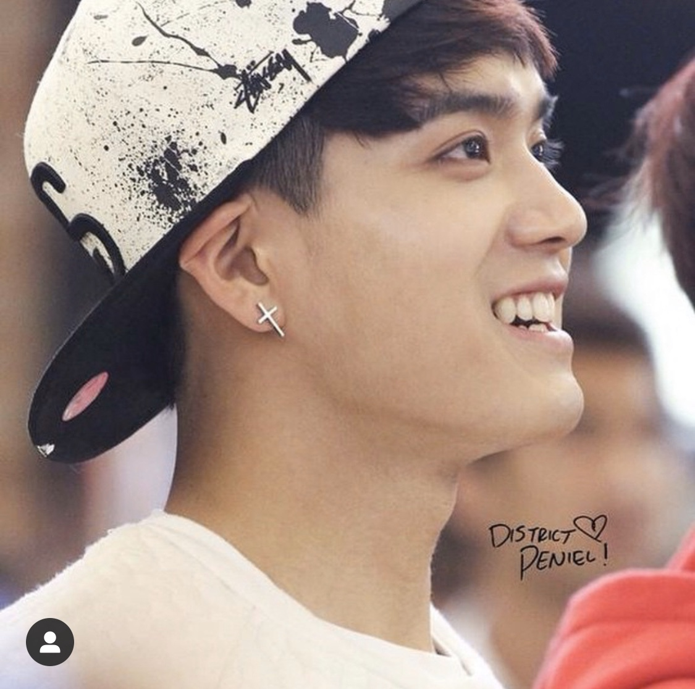
Peniel
Birth: 10.03.1993
Position: Serve Rapper

Slide 22
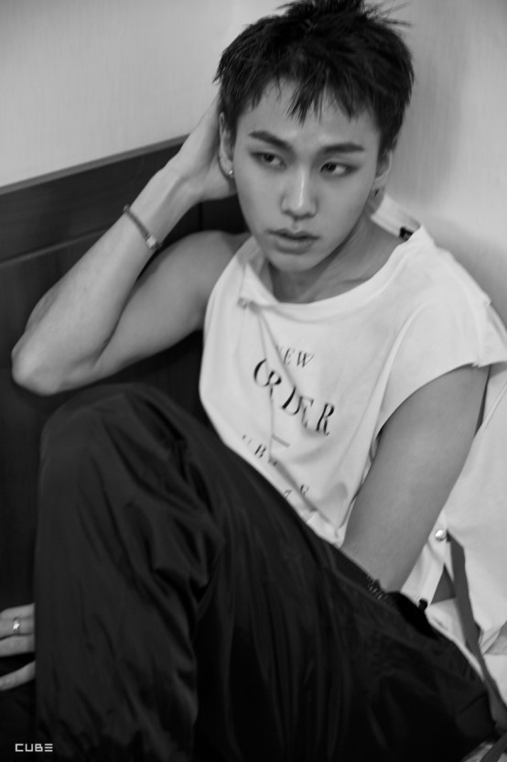
Jung Ilhoon
Birth: 04.10.1994
Position: Main Rapper
https://www.youtube.com/watch?v=mF9cpV2ev0Q

