Slide 1
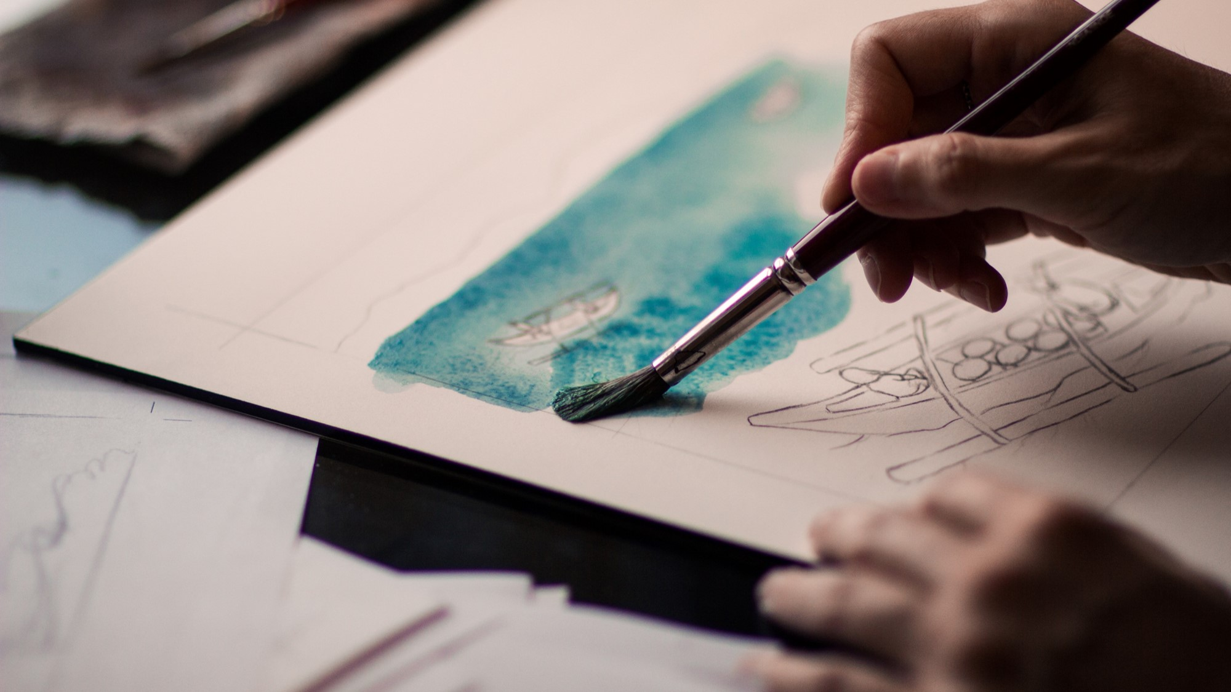
KPOP CLASS
2019.11.12
Copyrightⓒ. Saebyeol Yu. All Rights Reserved.

Slide 2
KPOP HISTORY

Slide 3
H.O.T
01
Best songs
We hate all kind of violence
The Warrior’s Descendants
Candy
Resurrection
Light
Light
https://www.youtube.com/watch?v=6U4IEgYmXRk
Comedy program
https://www.youtube.com/watch?v=fgbG-zPpt7w

Slide 4
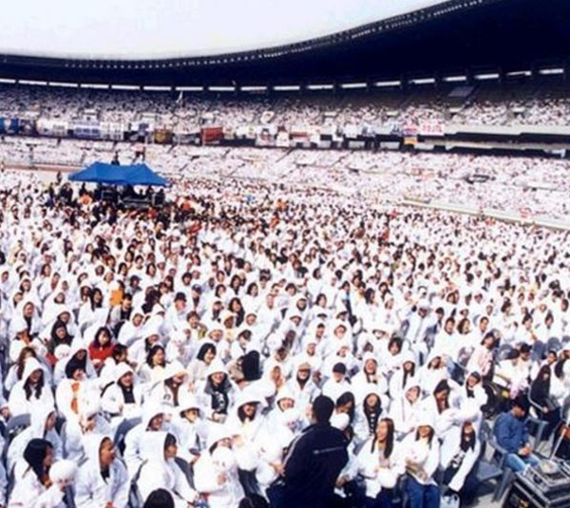
H.O.T
02
Popularity
Awards
Fandom

Slide 5
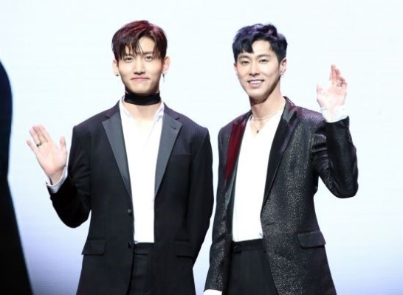
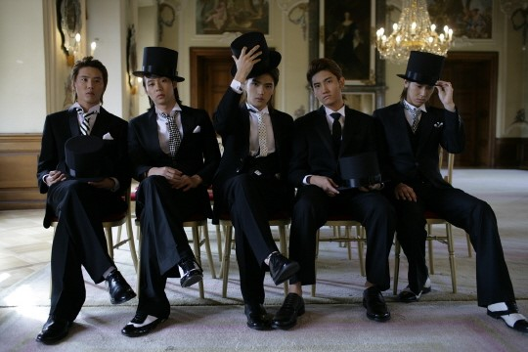
Saebyeol’s PowerPoint
PART 1
Second GENERATION OF KOREAN IDOLS
Why
https://www.youtube.com/watch?v=Jd9yMbsiY_w
TVXQ 일본 콘서트
https://www.youtube.com/watch?v=ai5X8neP_6Y
TVXQ
Members
You know Yunho
Cheogang Changmin
Debut: 2003.12.26
Entertainment: SM
Fandom: Cassiopeia[Korea], Bigeast[japan]
Official color: Pearl Red
Members
You-know Yunho
Cheogang Changmin
Yeongung Jaejung
Xia Junsu
Micky Yucheon
hug 2004
https://www.youtube.com/watch?v=ItwTg3Cm7oU

Slide 6
https://www.youtube.com/watch?v=KpTEBV5iMNg
유노윤호
https://www.youtube.com/watch?v=fSiaoZ-GzBU
Copyrightⓒ. Saebyeol Yu. All Rights Reserved.

Slide 7
Saebyeol’s PowerPoint
PART 1
Second GENERATION OF KOREAN IDOLS
Girl’s Generation
Wonder Girls
Entertainment: SM
Debut: 2007.08.05
Official color: Pastel Rose
Members: Taeyeon Sunny Tiffany Hyoyeon Yuri Sooyeong Yuna Seohyeon
Entertainment: JYP
Debut: 2007
Members: Yubin Yeeun Sunmi Hyerim
Gee 2009
https://www.youtube.com/watch?v=U7mPqycQ0tQ
Nobody 2008
https://www.youtube.com/watch?v=QZBn1e9pr2Q

Slide 8
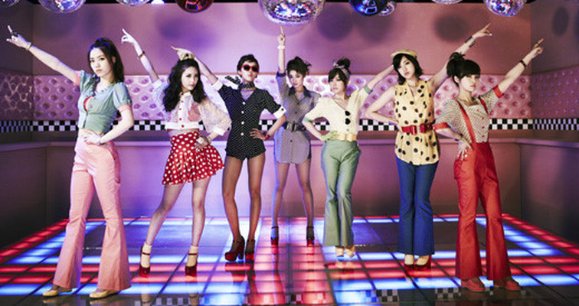
I don’t care 2009
https://www.youtube.com/watch?v=9wJs6dByMJI
2NE1
Entertainment: YG
Debut: 2009
Members: Park Sandara CL Park Bom Gong Minji
T-ARA
Entertainment: MBK
Debut: 2009
Members Jiyeon Hyomin Eunjung quri Boram Soyeon
Roly Poly 2009
https://www.youtube.com/watch?v=08uYAi9wkXI

Slide 9
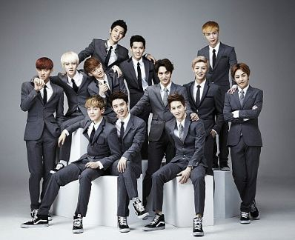
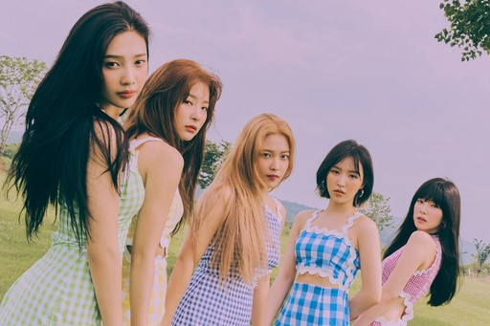
growl 2013
https://www.youtube.com/watch?v=kHwFJRFCq-8
EXO
Entertainment: SM
Debut: 2012.04.08
Members: Suho Chanyeol Kai DO BeakHyun Sehun Xiumin Chen Lay
2015
https://www.youtube.com/watch?v=-aFPo-RN00I
Red Velvet
Entertainment: SM
Debut: 2014
Members: Wendy Irene Seulgi Joy Yeari

Slide 10
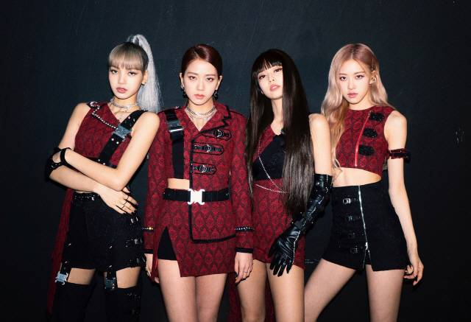
BLACKPINK
Debut: 2016
Entertainment: YG
Members: Jisu Jenny Rose Lisa
https://www.youtube.com/watch?v=IHNzOHi8sJs
TWICE
Debut: 2015.10.20
Entertainment :JYP
Memebers: Nayeon Jungyeon Momo Sana
Jihyo Mina Dahyeon Chaeyeong Zzeuwi
https://www.youtube.com/watch?v=ePpPVE-GGJw

Slide 11
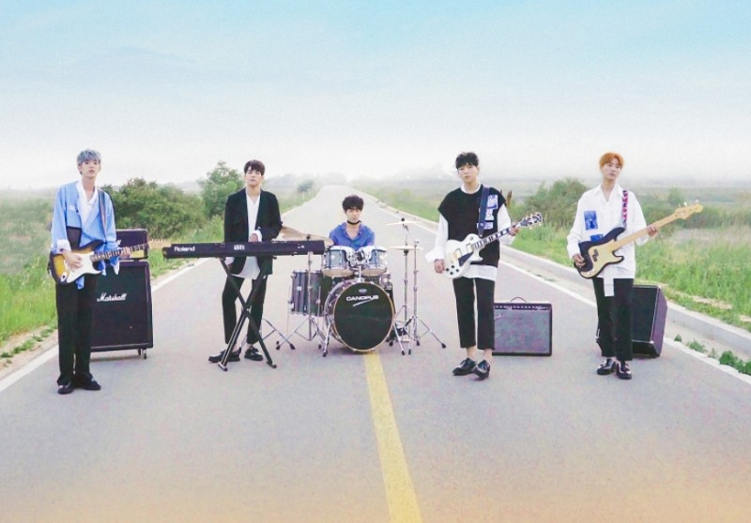
DAY6

Slide 12
Debut: 07-09-2015
Debut Song : Congratulations
Meaning of the Team name:
6 days + 1day = 1week
Fandom: My day

Slide 13
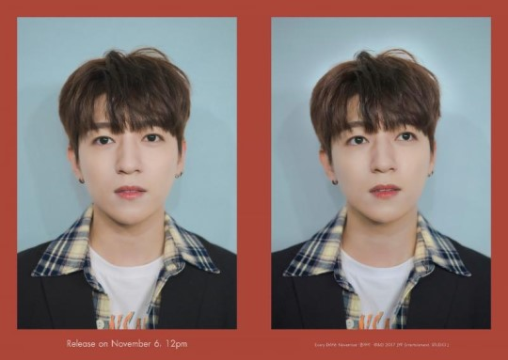
Name: SungJin
Position: Leader, Vocal, Guitar
Birth: 16-01-1993
Physical: 177cm, 70kg
https://www.youtube.com/watch?v=kSMNmyjsuxs

Slide 14
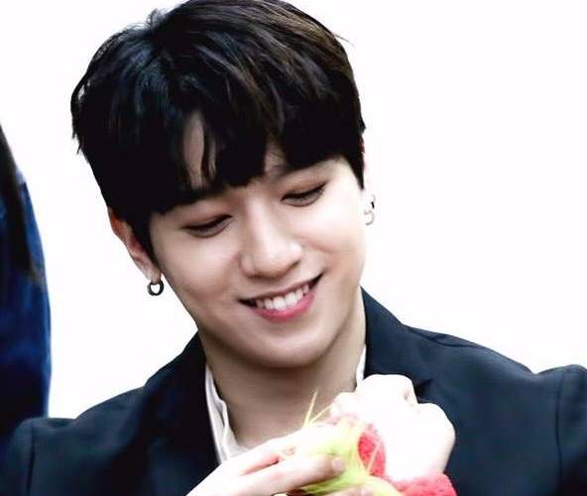
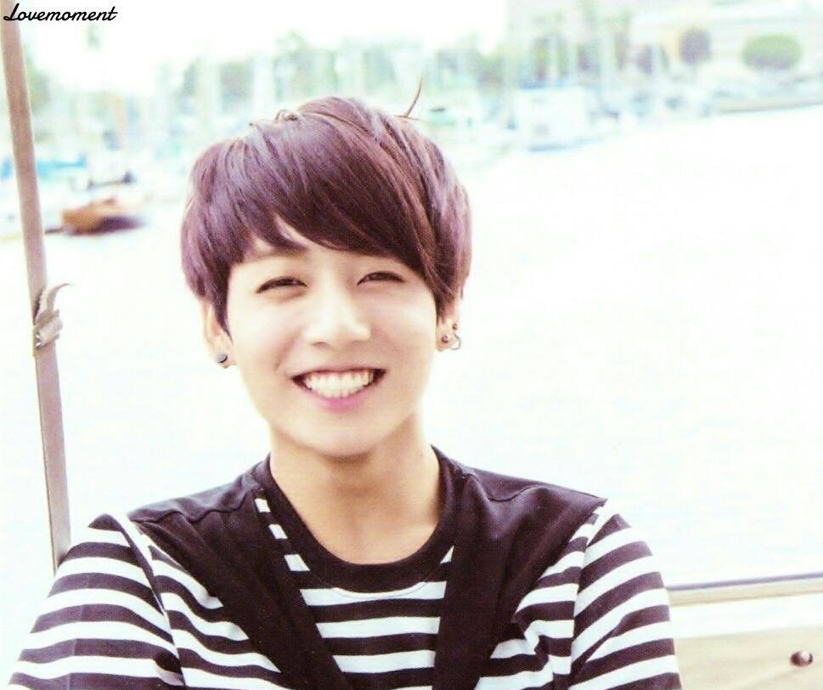
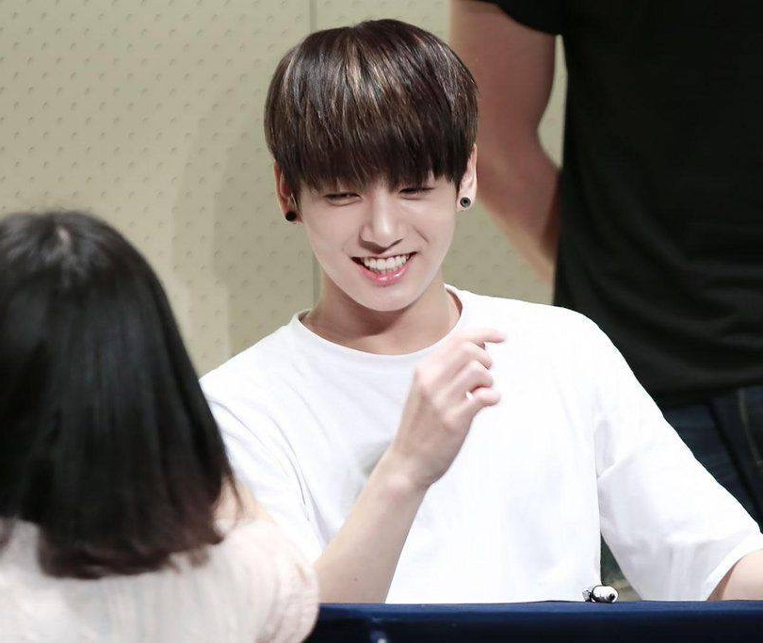
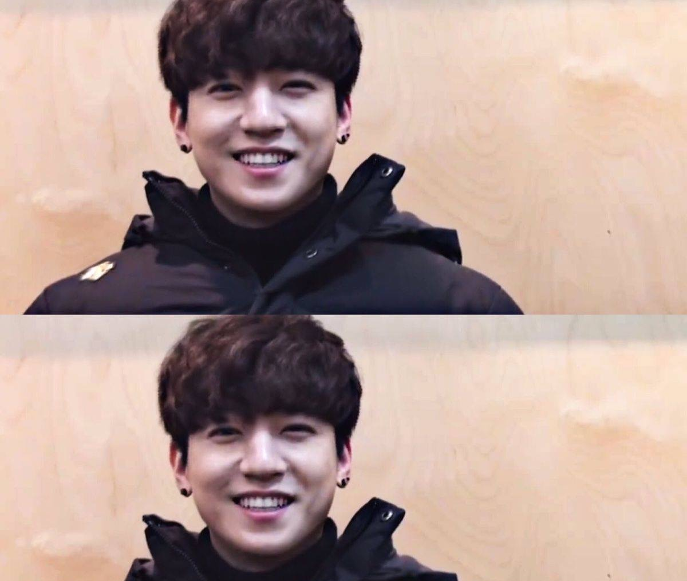

Slide 15
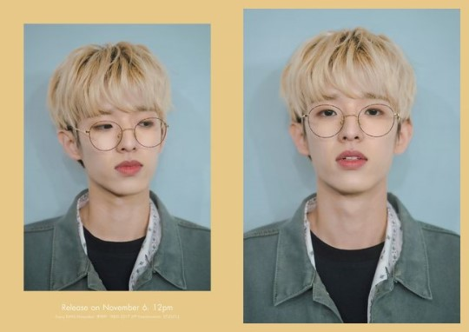
Name: Jae
Position: Vocal, Rap, Guitar
Birth: 15-09-1992
Physical: 182cm, 65kg
https://www.youtube.com/watch?v=vikaA-Oun3M
https://www.youtube.com/watch?v=8CUlKW4MWN8

Slide 16
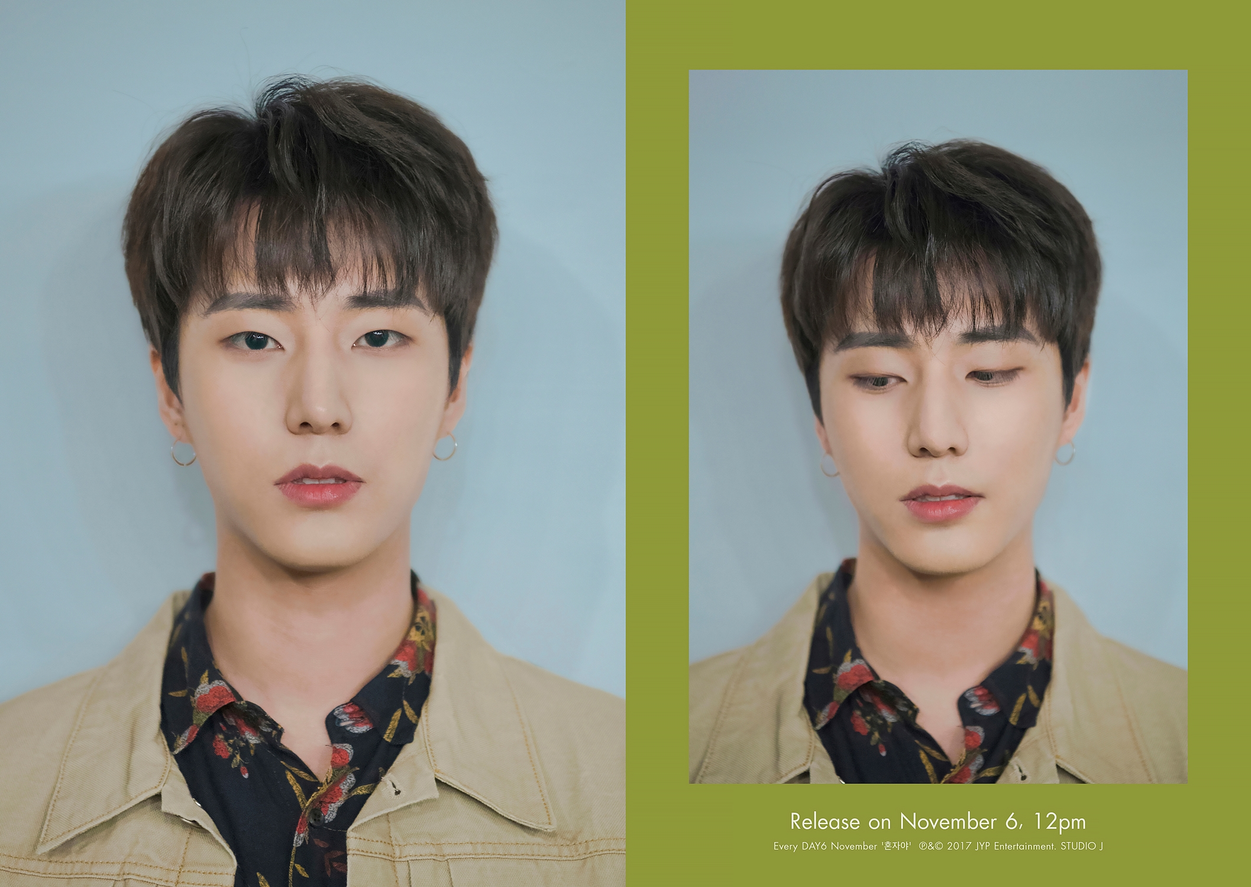
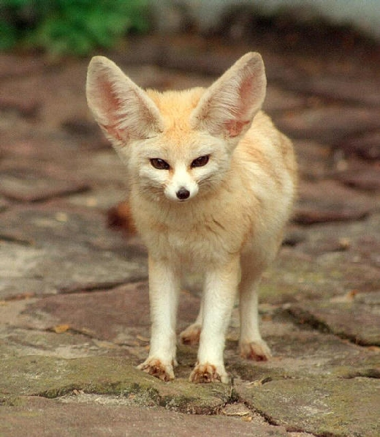
Name: Young K
Position: Vocal, Rap, Base Guitar
Birth: 19-12-1993
Physical: 180.2cm, 68kg
https://www.youtube.com/watch?v=J1ZpmxpHApQ

Slide 17
Name: Wonpil
Position: Vocal, Keyboard, synthesizer
Birth: 28-04-1994
Physical: 176cm, 60kg
https://www.youtube.com/watch?v=g74D8h-_quA

Slide 18
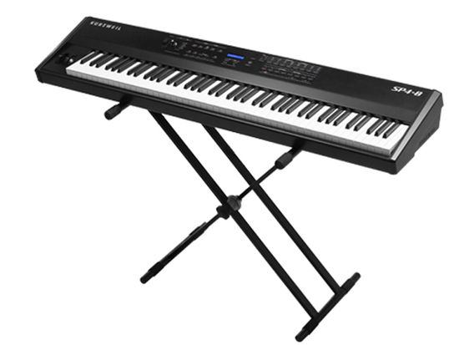
https://www.youtube.com/watch?v=whs7gl4Yeks

Slide 19
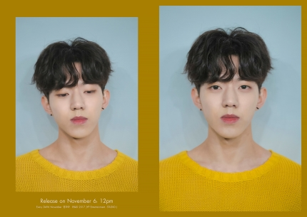
Name: Dowoon
Position: Vocal, Drum
Birth: 25-08-1995
Physical: 177cm, 60kg
https://www.youtube.com/watch?v=zXEU9W2GLyQ

Slide 20
https://www.youtube.com/watch?v=CWUGikRxGQs

Slide 21
https://www.youtube.com/watch?v=sGBlO8Qd9-Q

Slide 22
https://www.youtube.com/watch?v=clj74ZNdJu0

Slide 23
https://www.youtube.com/watch?v=ZwcJlLjGg08

Slide 24
https://www.youtube.com/watch?v=G6nSf0uB4g8

Slide 25
IU

Slide 26
Debut: 18-09-2008
Debut Song : missing child
Meaning of the name:
The music connect I &You
Fandom: U&I
Name: IU (Lee Jieun)
Position: Sing a song writer, Actress
Birth: 16-05-1993
Physical: 160cm, 44kg

Slide 27
https://www.youtube.com/watch?v=AblLHjtRkUw

Slide 28
https://www.youtube.com/watch?v=U_KH7Tw97HU

Slide 29
https://www.youtube.com/watch?v=9_dfn02K8b0&t=212s

Slide 30
https://www.youtube.com/watch?v=d9IxdwEFk1c

Slide 31
https://www.youtube.com/watch?v=2OQFQGC-jmo

