Slide 1
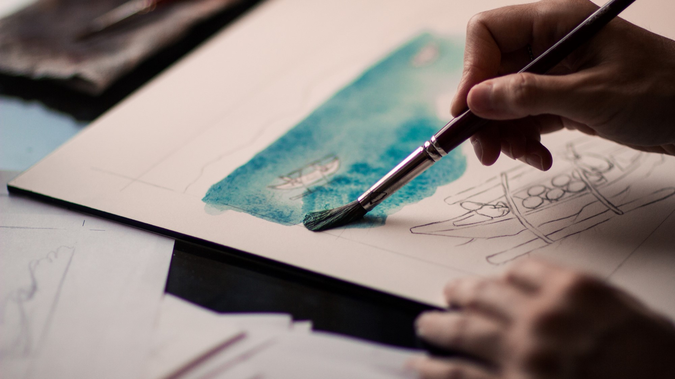
KPOP CLASS
2019.11.19
Copyrightⓒ. Saebyeol Yu. All Rights Reserved.

Slide 2
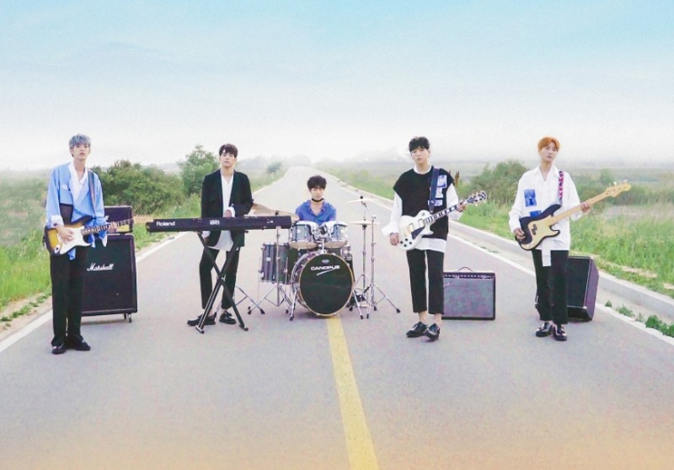

DAY6

Slide 3
Debut: 07-09-2015
Debut Song : Congratulations
Meaning of the Team name:
6 days + 1day = 1week
Fandom: My day

Slide 4
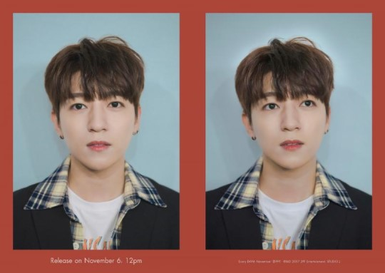
Name: SungJin
Position: Leader, Vocal, Guitar
Birth: 16-01-1993
Physical: 177cm, 70kg
https://www.youtube.com/watch?v=kSMNmyjsuxs

Slide 5
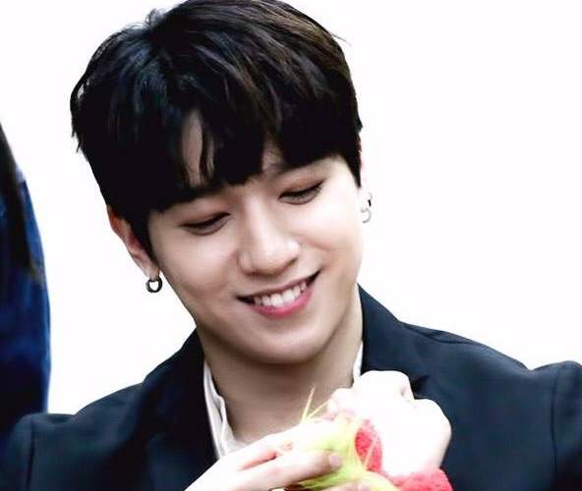
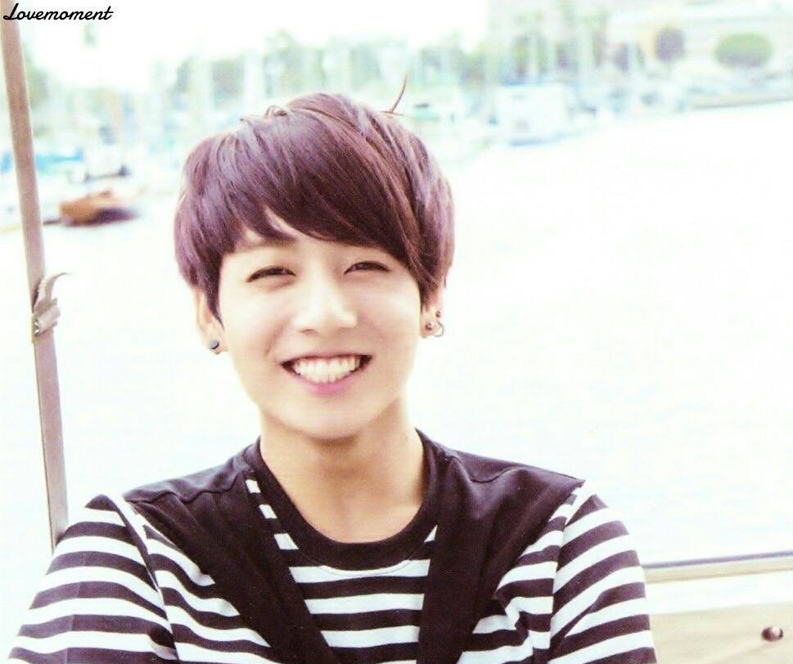
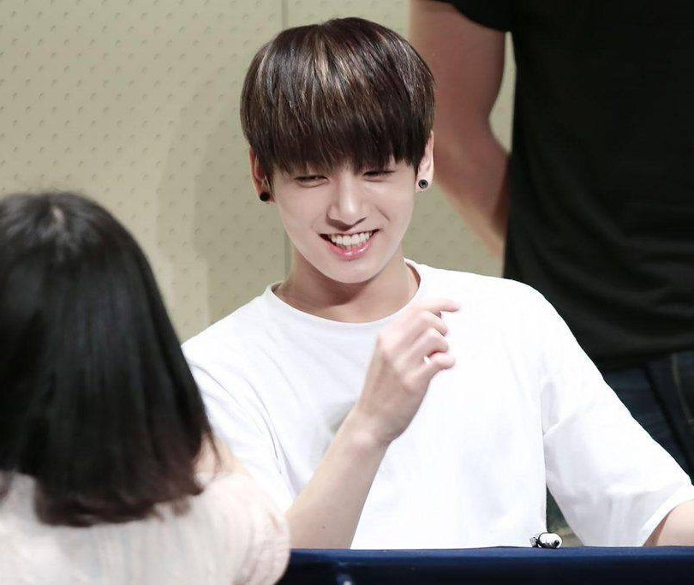
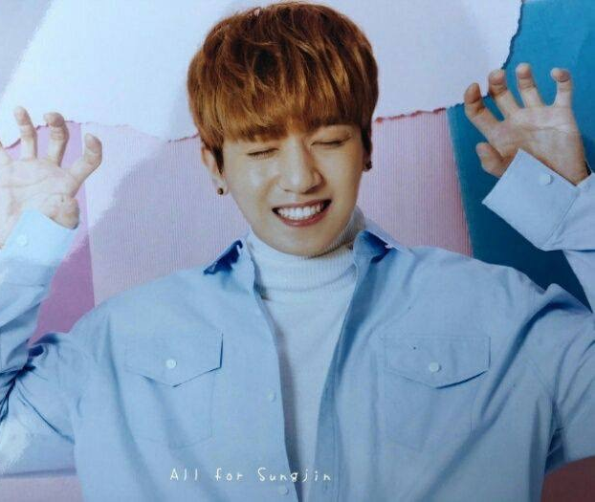

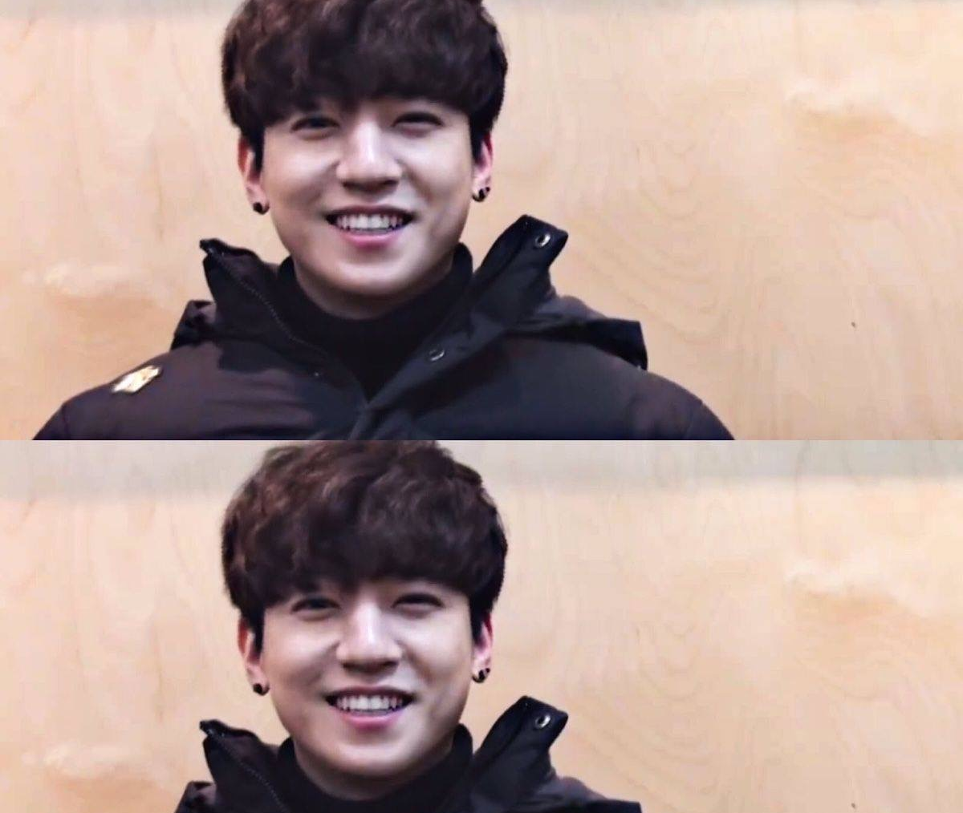

Slide 6
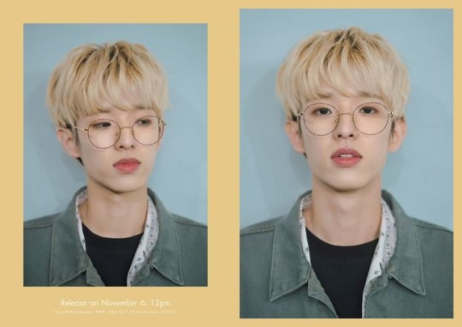
Name: Jae
Position: Vocal, Rap, Guitar
Birth: 15-09-1992
Physical: 182cm, 65kg
https://www.youtube.com/watch?v=8CUlKW4MWN8

Slide 7
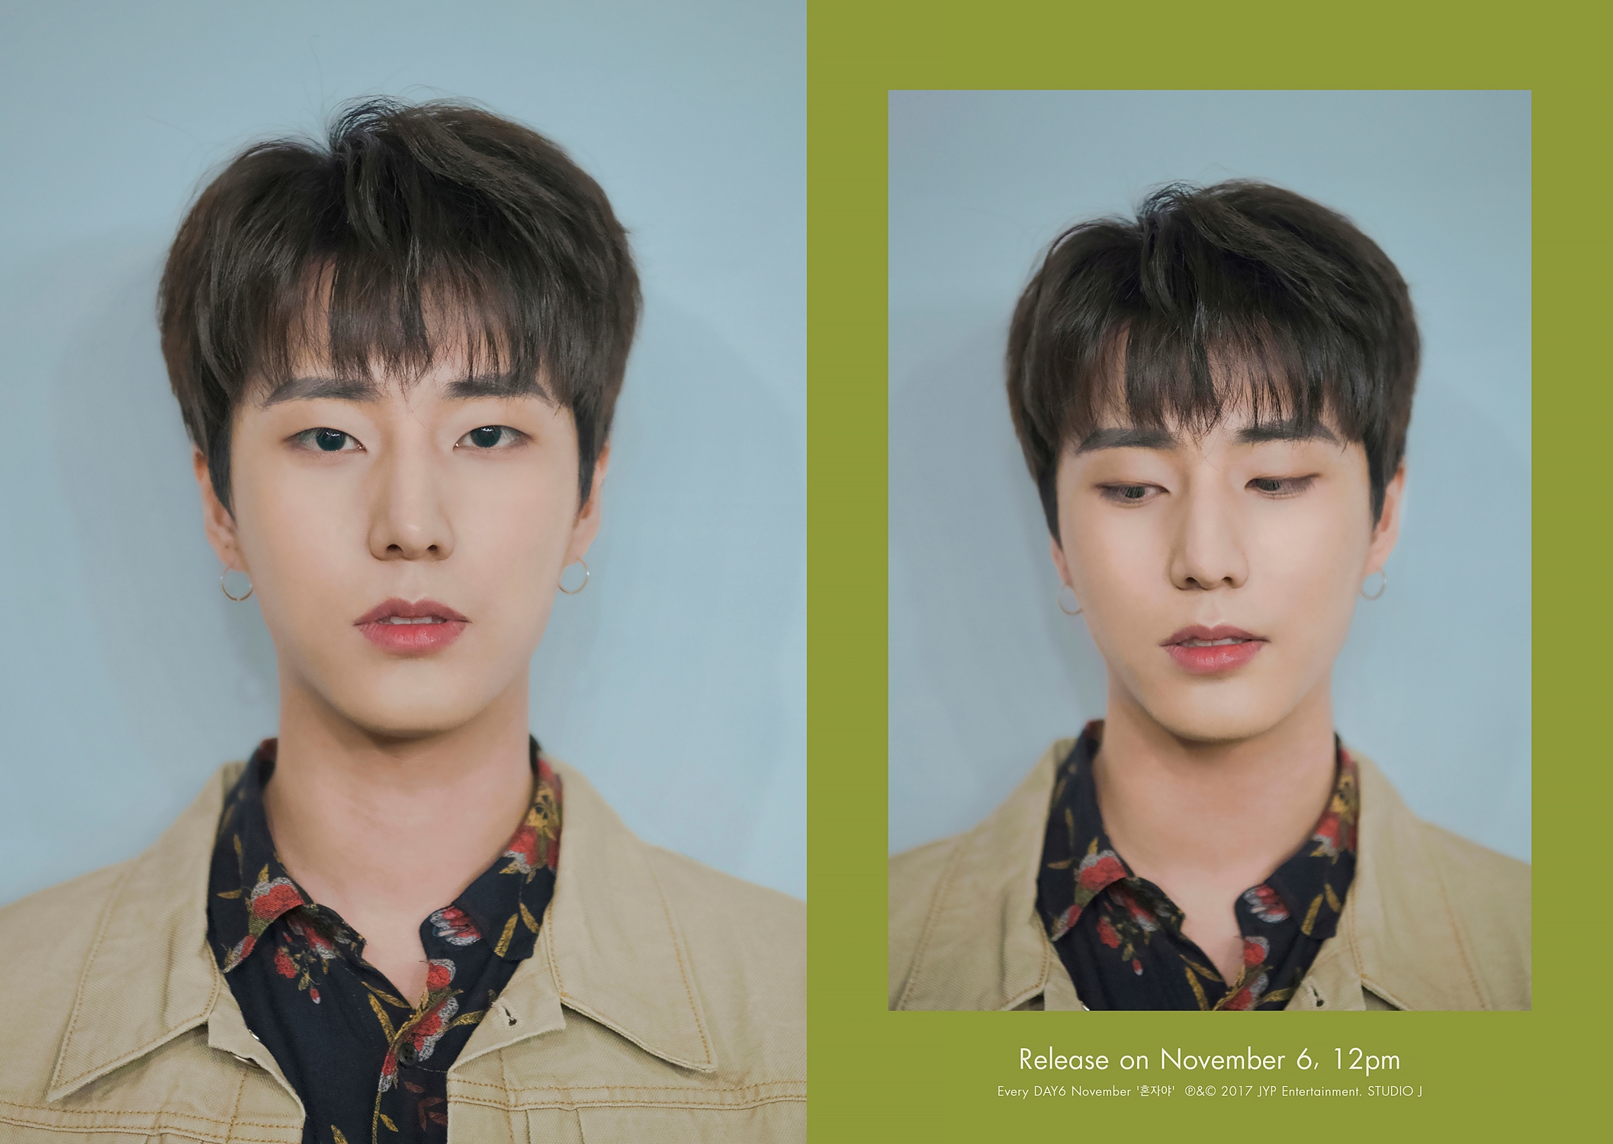
Name: Young K
Position: Vocal, Rap, Base Guitar
Birth: 19-12-1993
Physical: 180.2cm, 68kg
https://www.youtube.com/watch?v=J1ZpmxpHApQ

Slide 8
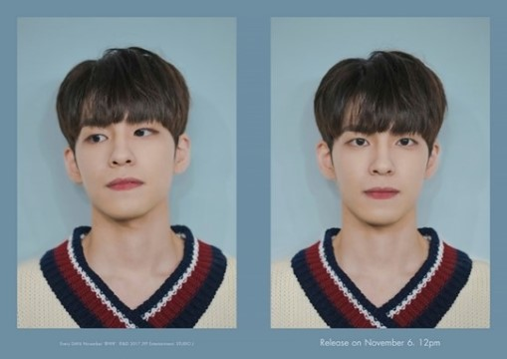
Name: Wonpil
Position: Vocal, Keyboard, synthesizer
Birth: 28-04-1994
Physical: 176cm, 60kg
https://www.youtube.com/watch?v=g74D8h-_quA
https://www.youtube.com/watch?v=whs7gl4Yeks

Slide 9
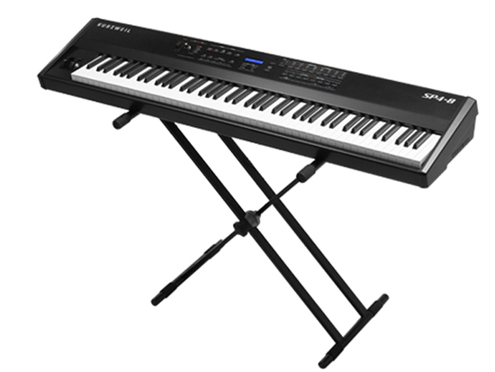
https://www.youtube.com/watch?v=whs7gl4Yeks

Slide 10
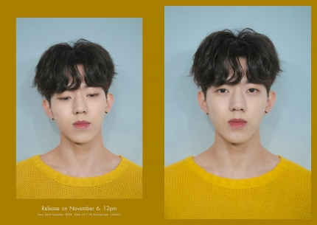
Name: Dowoon
Position: Vocal, Drum
Birth: 25-08-1995
Physical: 177cm, 60kg
https://www.youtube.com/watch?v=zXEU9W2GLyQ

Slide 11
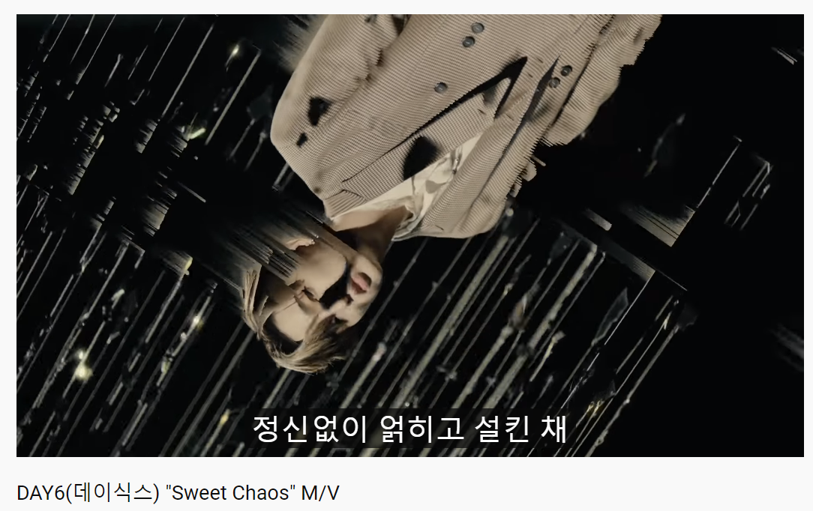
https://www.youtube.com/watch?v=CWUGikRxGQs

Slide 12
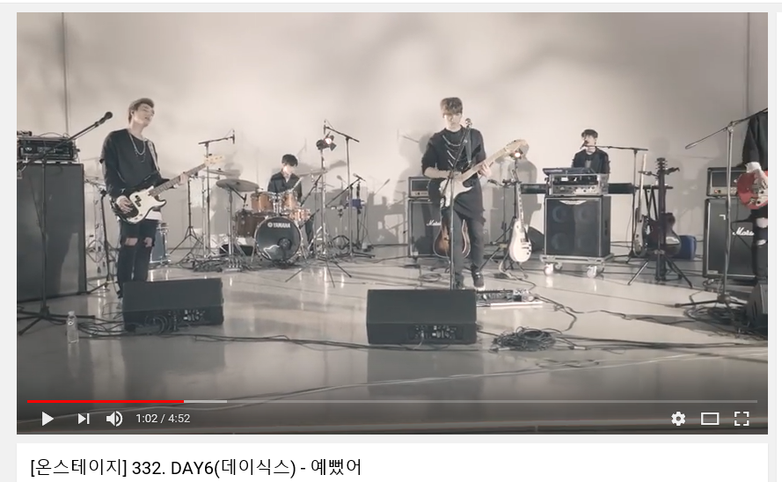
https://www.youtube.com/watch?v=sGBlO8Qd9-Q

Slide 13
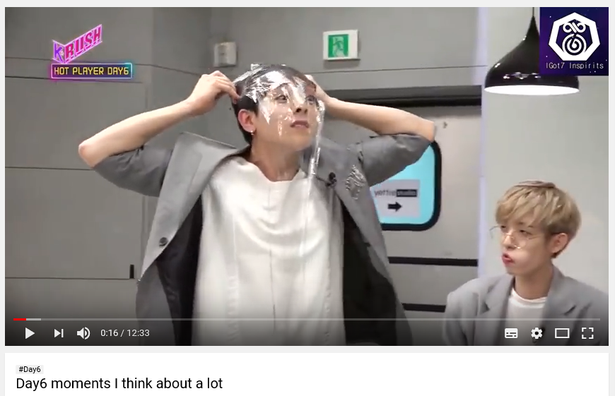
https://www.youtube.com/watch?v=clj74ZNdJu0

Slide 14
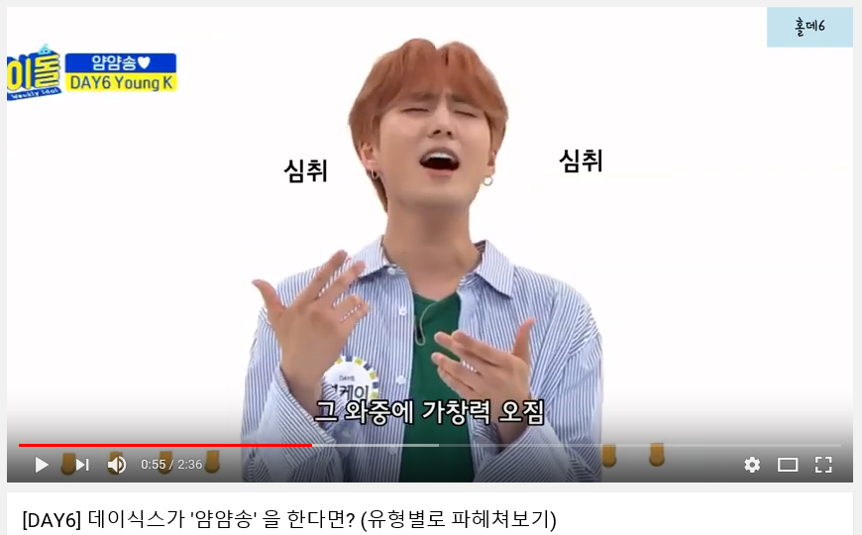
https://www.youtube.com/watch?v=ZwcJlLjGg08

Slide 15
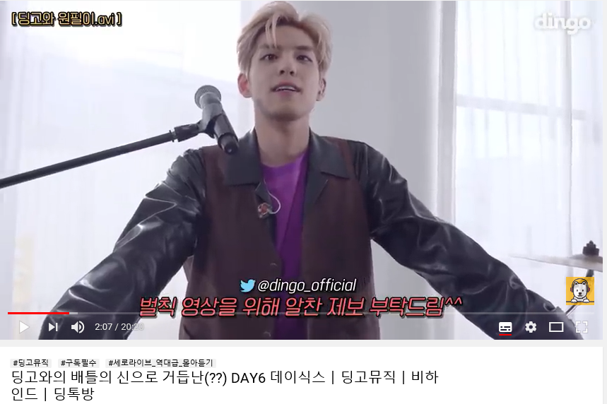
https://www.youtube.com/watch?v=G6nSf0uB4g8

Slide 16

IU

Slide 17
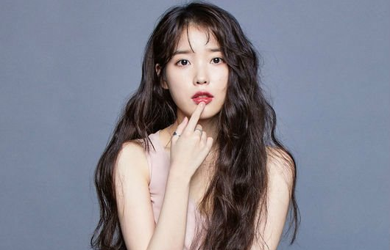
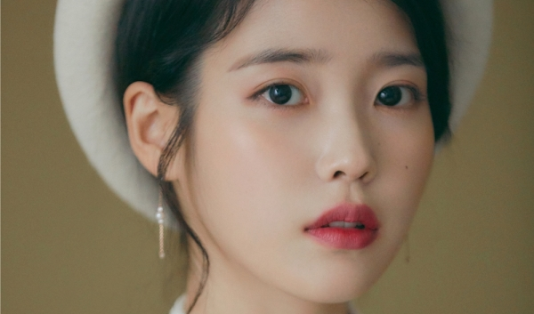
Debut: 18-09-2008
Debut Song : missing child
Meaning of the name:
The music connect I &You
Fandom: U&I
Name: IU (Lee Jieun)
Position: Sing a song writer, Actress
Birth: 16-05-1993
Physical: 160cm, 44kg

Slide 18
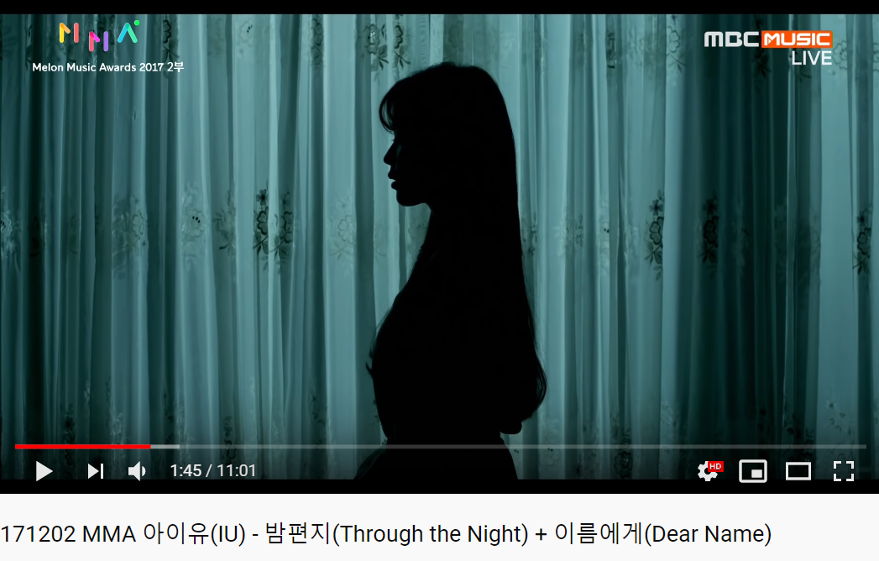
https://www.youtube.com/watch?v=AblLHjtRkUw

Slide 19
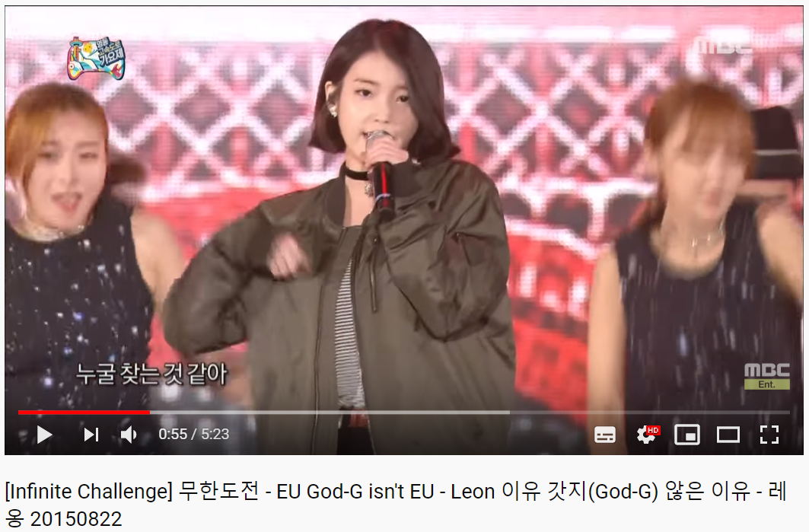
https://www.youtube.com/watch?v=U_KH7Tw97HU

Slide 20
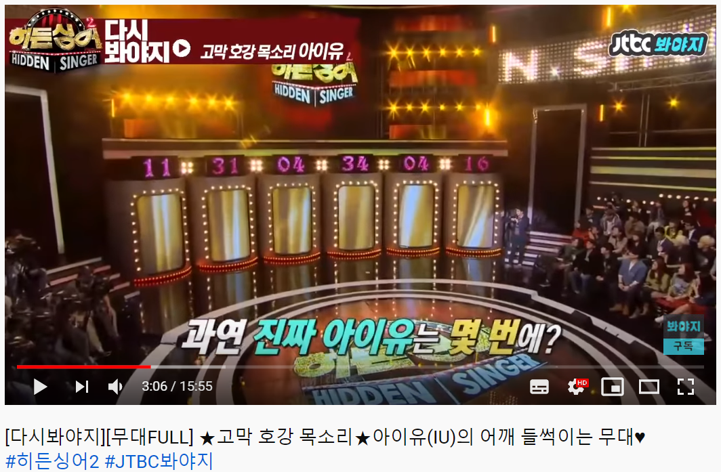
https://www.youtube.com/watch?v=9_dfn02K8b0&t=212s

Slide 21
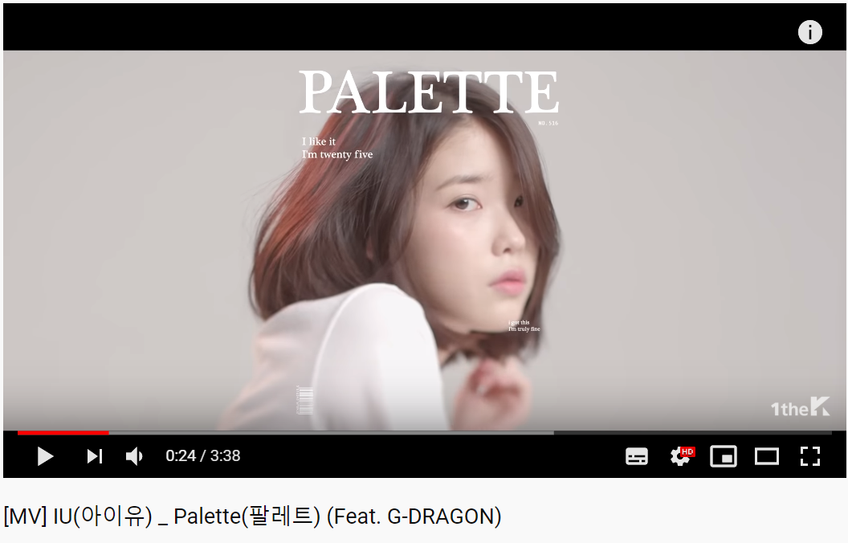
https://www.youtube.com/watch?v=d9IxdwEFk1c

Slide 22
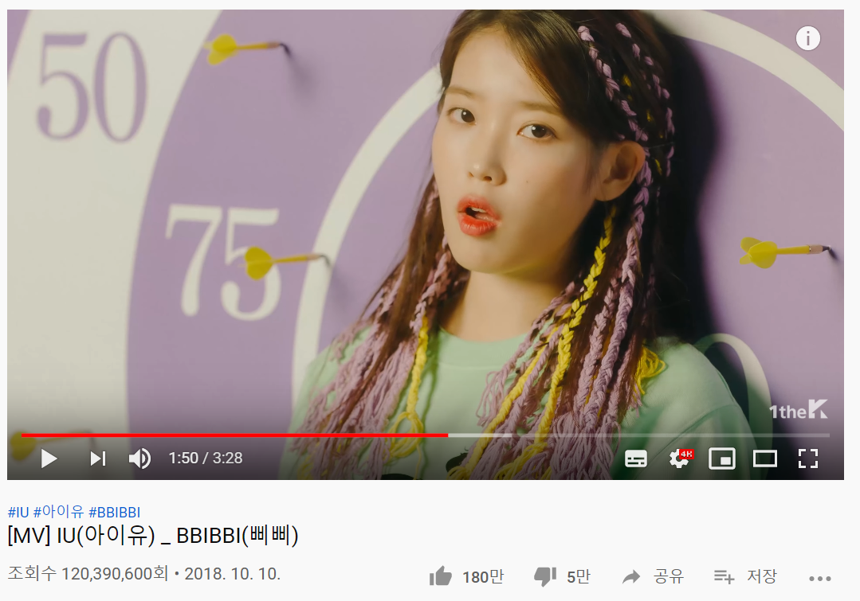
https://www.youtube.com/watch?v=nM0xDI5R50E

Slide 23
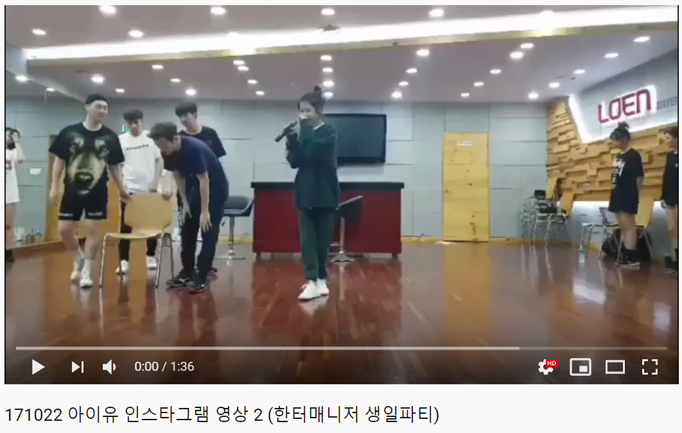
https://www.youtube.com/watch?v=2OQFQGC-jmo

Slide 24
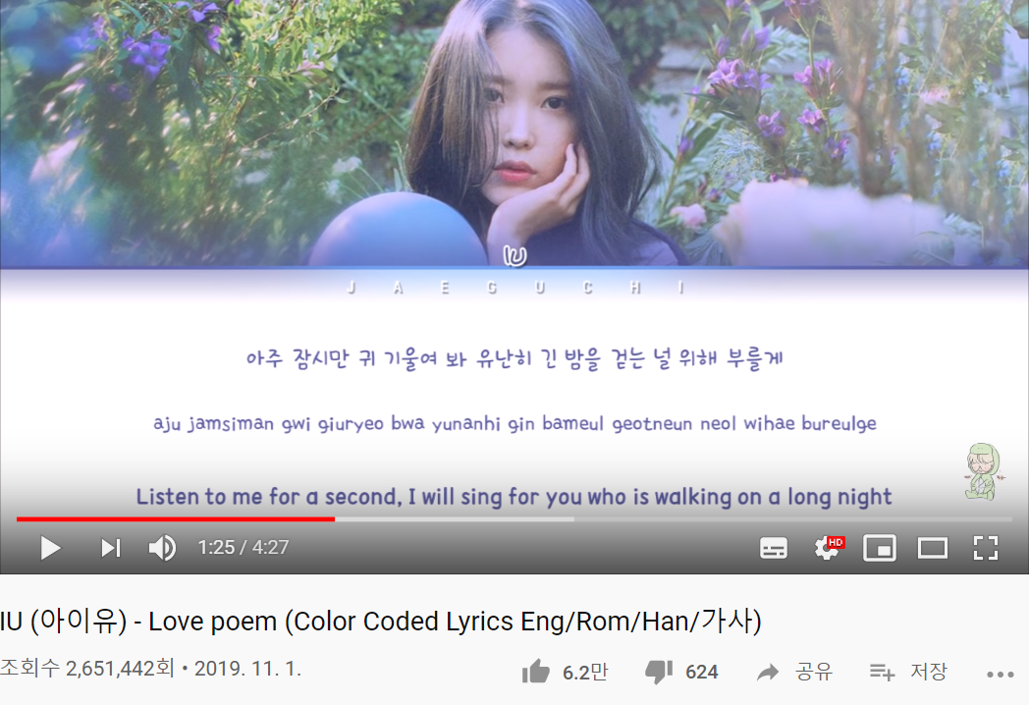
https://www.youtube.com/watch?v=qch5tdUQvYk

Slide 25
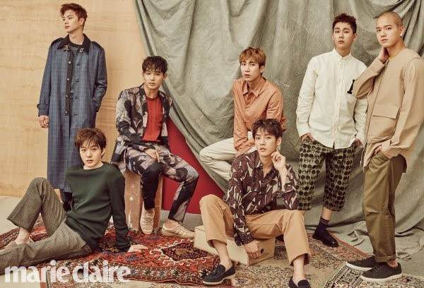
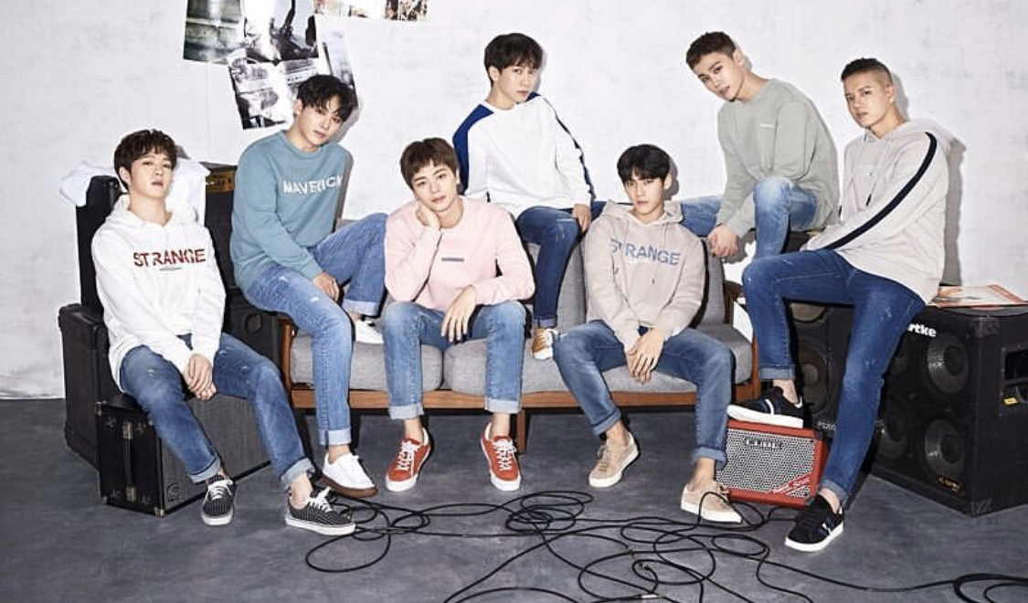
BTOB
Born TO Beat
Debut: 21.03.2012
Fandom: Melody
Famous songs:
I can’t live without you
Miss you
Beautiful but sick
MOVIE

Slide 26
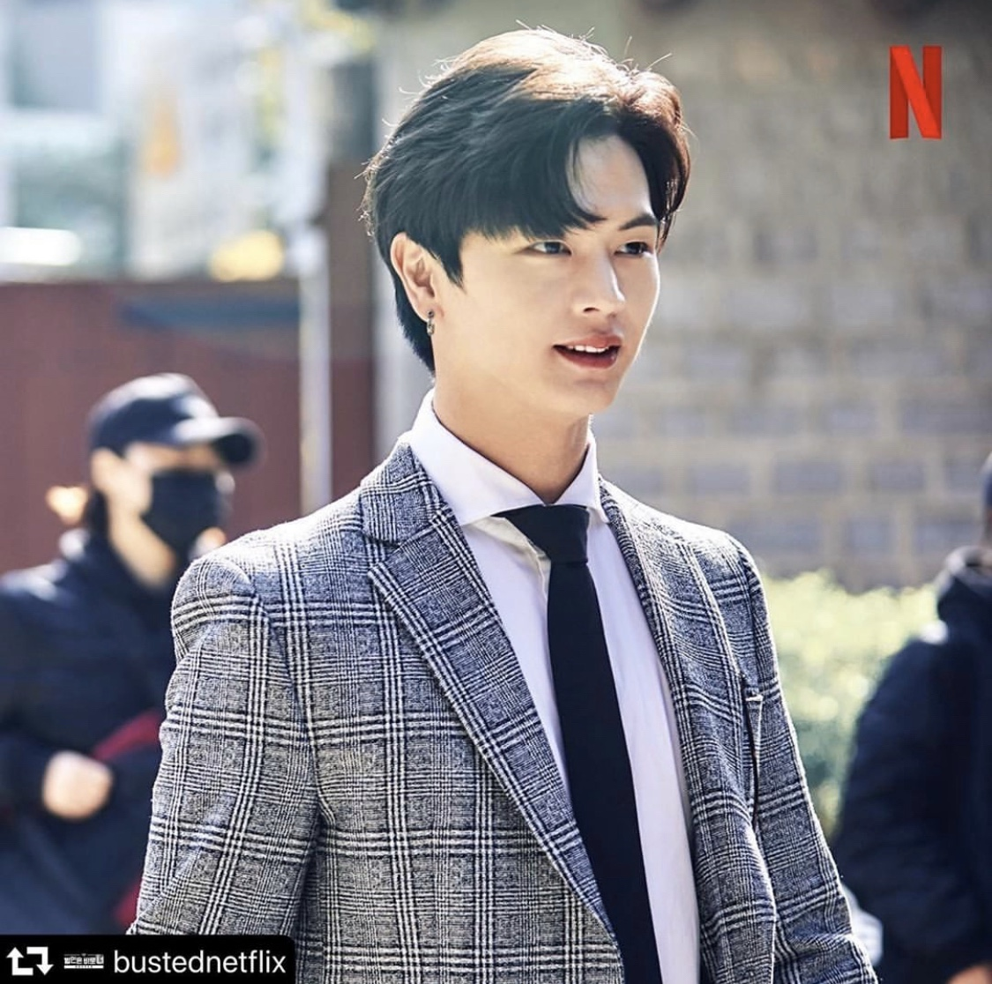
Yook Sungjae
Birth: 02.05.1995
Position: serve vocal
Profession: Idol, actor
Famous appearance work as an actor: Goblin
InstagramID: yook_can_do_it
https://www.youtube.com/watch?v=rDQrq4PofnA

Slide 27
Movie stage
https://www.youtube.com/watch?v=42A-rFdralM
연예가 중계 06:06~
https://www.youtube.com/watch?v=U4c0Un8SAYI
육성재 아는형님 민경훈 모창
https://www.youtube.com/watch?v=XLFUK5hEads

Slide 28



Slide 29
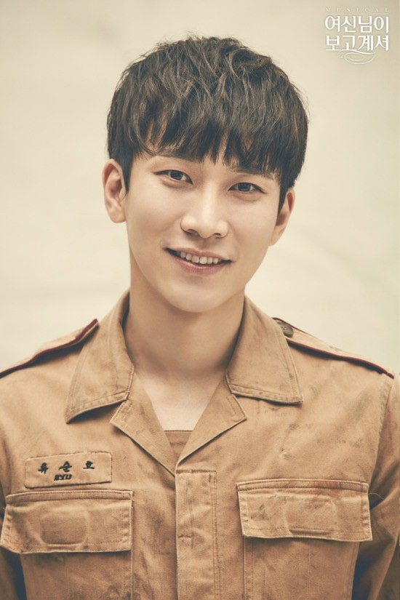
Seo Eungwang
Birth: 22.11.1990
Leader of BTOB
Position: Main Vocal
Nickname: Silverlight, Seoeunga
https://www.youtube.com/watch?v=nQzwi3wxOmw

Slide 30
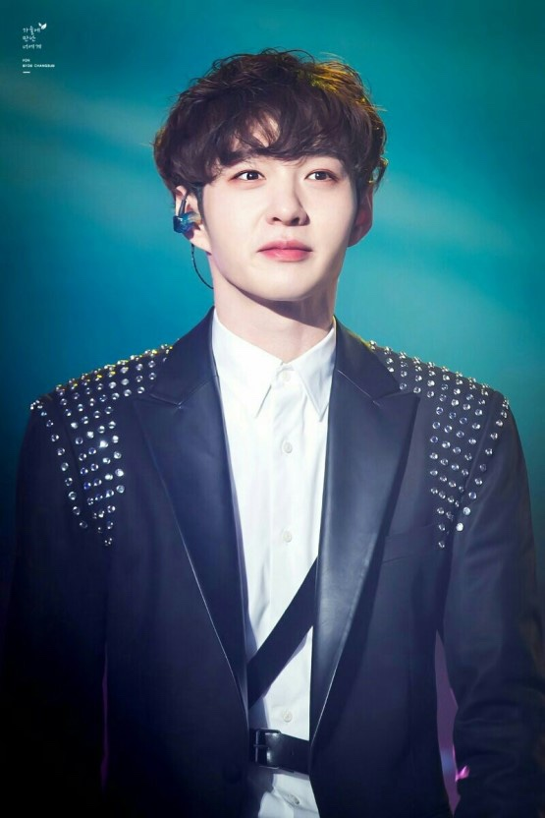
Lee Changsub
Birth: 26.02.1991
Position: Serve /Lead Vocal

Slide 31
배틀 트립
https://www.youtube.com/watch?v=v4eAs7mScNM
비투비 ask
https://www.youtube.com/watch?v=mKP-4YqI34c
예능
https://www.youtube.com/watch?v=nkyLuP7eiM4

Slide 32
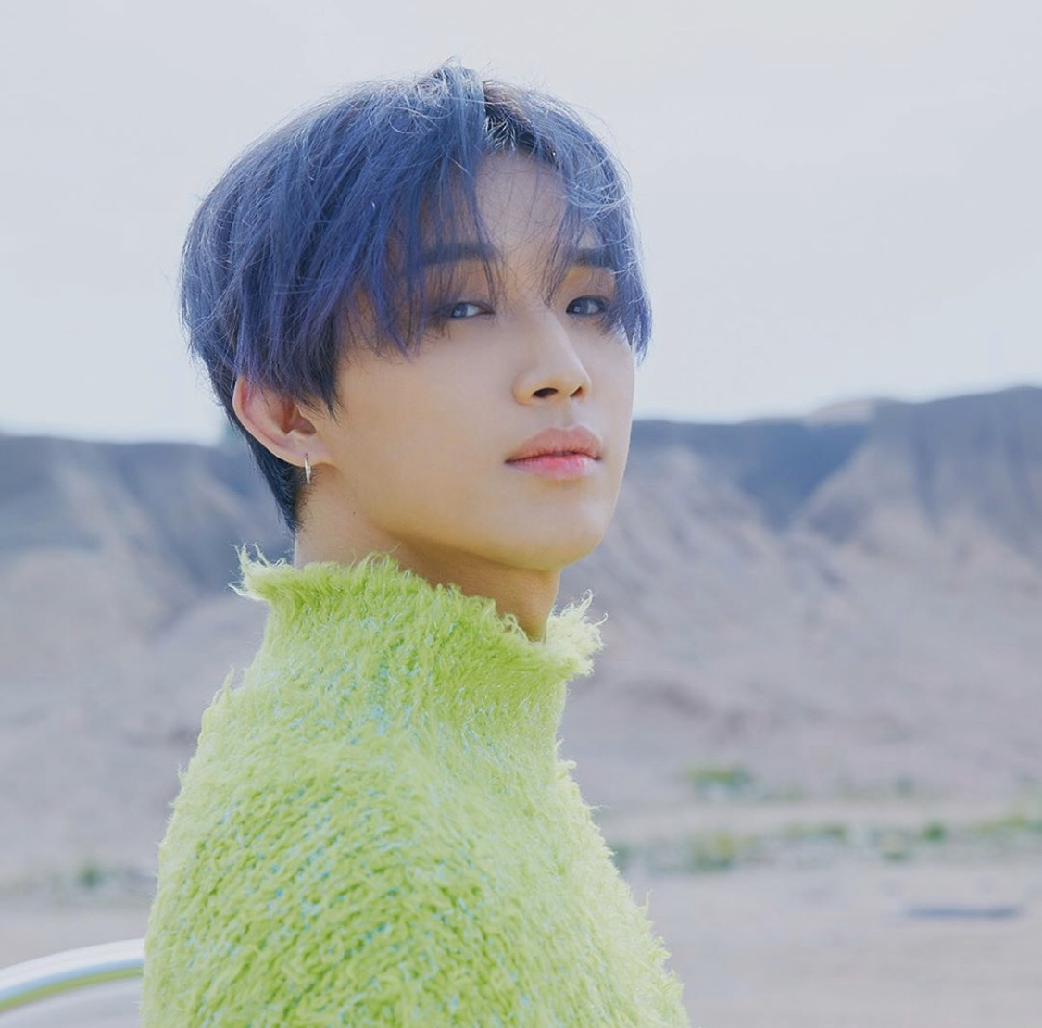
Lim Hyeonsik
Birth: 07.03.1992
Position: Serve/Lead vocal
https://www.youtube.com/watch?v=4oHmzNF42m8

Slide 33
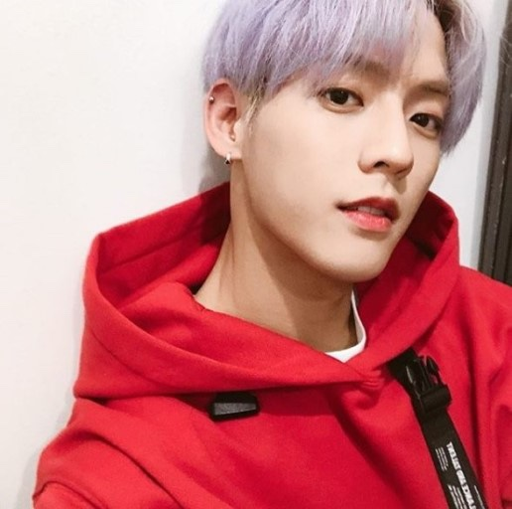
Lee Minhyuk
Birth: 29.11.1990
Position: Lead Rapper
Nickname: Leesain bolt, redhyeong
https://www.youtube.com/watch?v=DbxMH2sy3U8
https://www.youtube.com/watch?v=BKBZEudZ9xk

Slide 34
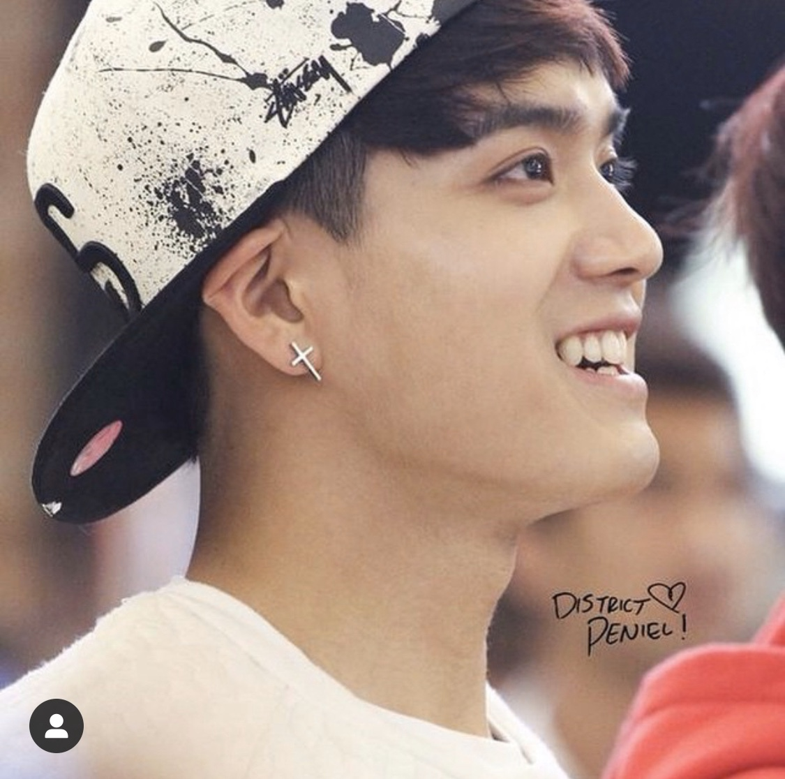
Peniel
Birth: 10.03.1993
Position: Serve Rapper

Slide 35
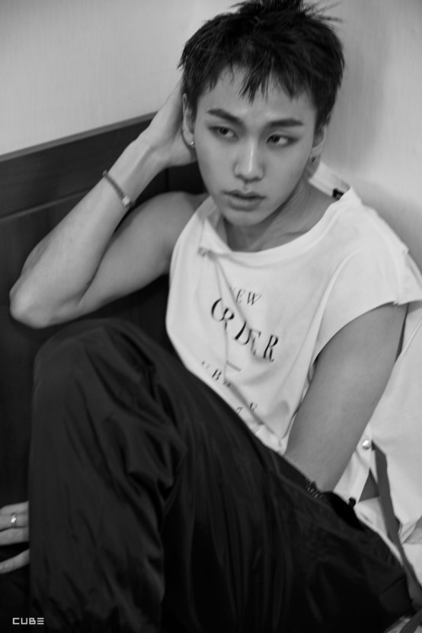
Jung Ilhoon
Birth: 04.10.1994
Position: Main Rapper
https://www.youtube.com/watch?v=mF9cpV2ev0Q

Slide 36
Boy with luv
https://www.youtube.com/watch?v=OEnvXsyGZmU

