Slide 1
KPOP CLASS
2019.11.25
Copyrightⓒ. Saebyeol Yu. All Rights Reserved.

Slide 2
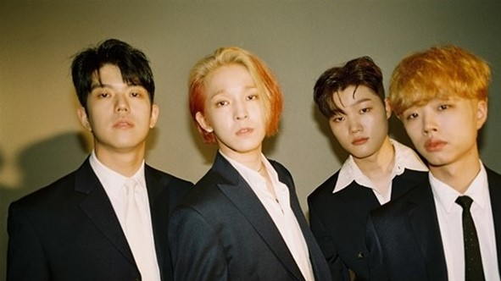
SOUTHCLUB
Debut: 05.26.2017
Members: Nam Taehyun / Kang Minjun
Jeong Hoemin / Lee donggeun
https://www.youtube.com/watch?v=351ntdB-Fto

Slide 3
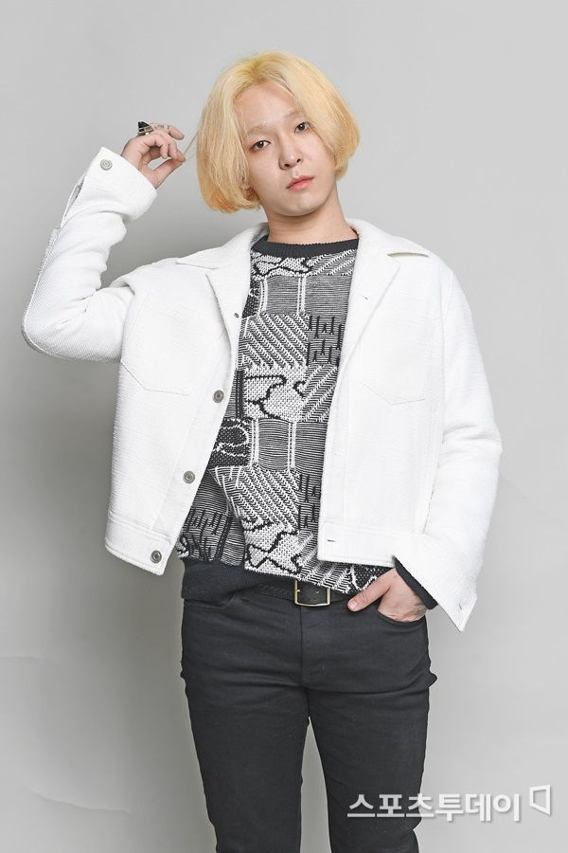
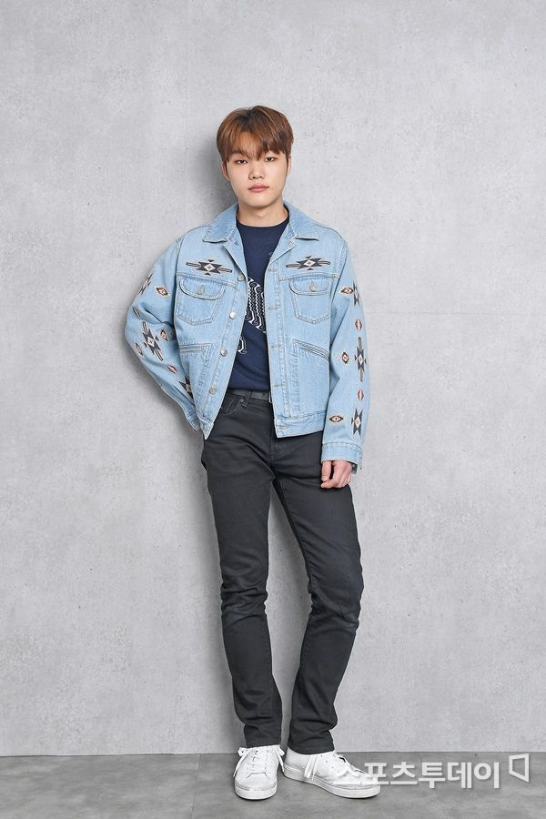
Kang Minjun
Nam Tae Hyun
Group: Southclub
Position: Vocalist, composer, lyricist, guitarist
Birth: 05.10.1994
Physical: 180cm, 63kg
Position: Guitarist
Birth: 178cm, 65kg
복면가왕
https://www.youtube.com/watch?v=2axWpcz399I
셀프 영상
https://www.youtube.com/watch?v=-87JOFZPP14

Slide 4
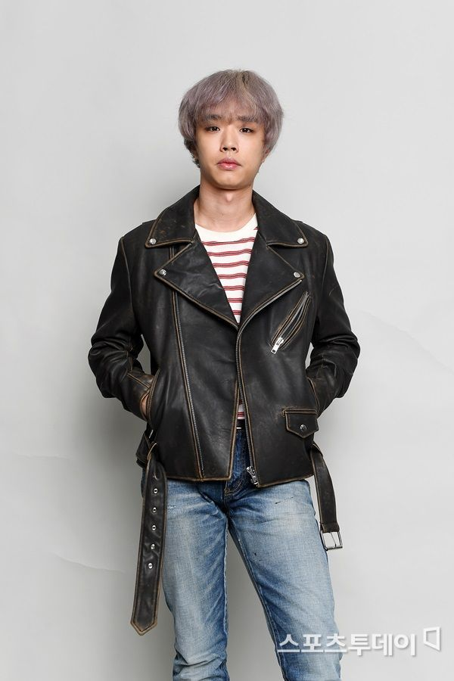
Jung hoe min
Lee dong geun
Position: Base
Birth: 12.21.1993
Position: drummer
Birth: 02.12.1997
Physical: 183cm,
70kg

Slide 5
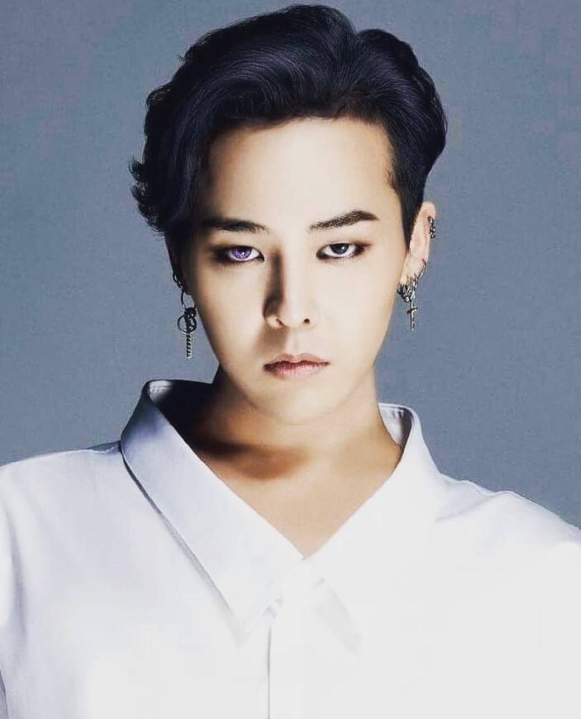
G-Dragon
Original name: Kwon Jiyong
Group: BIGBANG
Debut: 08.19.2006
Position: Leader, Main Rapper, Composer, Lyricist
Entertainment:YG
Birth: 08.18.1988

Slide 6
G-DRAGON
Compose,
write the lyrics
Most of BIGBANG best songs
: Lie, Last Farewell, Everday, BANGBANGBANG, Loser, Fantastic baby, BLUE, I don’t know
SOLO:
Heartbreaker,
High High
Oh Yeah
Crayon
COUP D’ETAT
Untitled

Slide 7
무제 Untitled
https://www.youtube.com/watch?v=IQ8Cmsd4c8E

Slide 8
맨정신 sober
https://www.youtube.com/watch?v=AvJ40aW0-zM

Slide 9
Awards
Prime Minister's Award at the 7th Korea Popular Culture and Arts Award
Mnet Asian Music Awards-Singer of the Year
Mnet Asian Music Awards NISSAN JUKE Best Music Video
Mnet Asian Music Awards Best Dance Performance Male Solo
Mnet Asian Music Awards-Male Singer Award

Slide 10
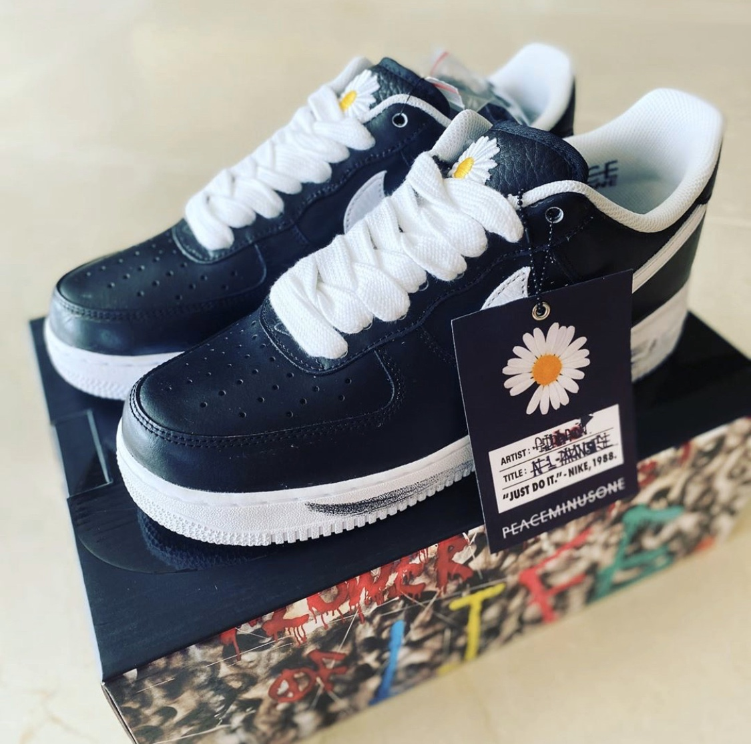
Fashion show 조세호
https://www.youtube.com/watch?v=Wo0Fvyy-POU

Slide 11
슈퍼맨이 돌아왔다 사랑이 29:41
https://www.youtube.com/watch?v=urcP504U5wk

Slide 12
무한도전
https://www.youtube.com/watch?v=ywJpttrQdA8

Slide 13
주간아이돌
https://www.youtube.com/watch?v=Zl9GvQ0qrT0

Slide 14
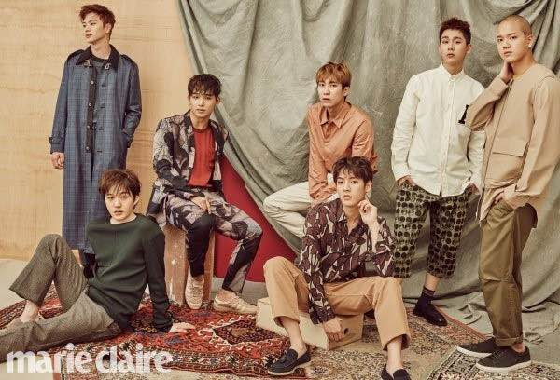
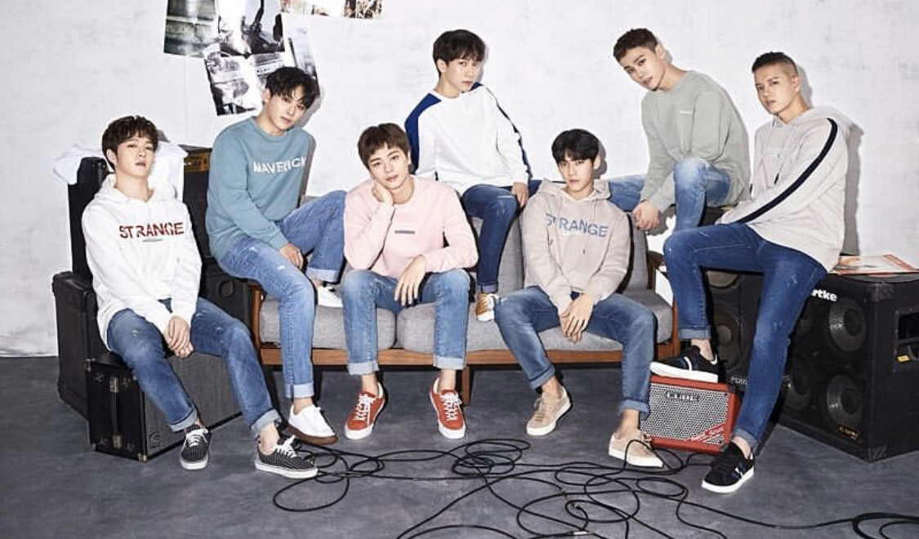
BTOB
Born TO Beat
Debut: 21.03.2012
Fandom: Melody
Famous songs:
I can’t live without you
Miss you
Beautiful but sick
MOVIE

Slide 15
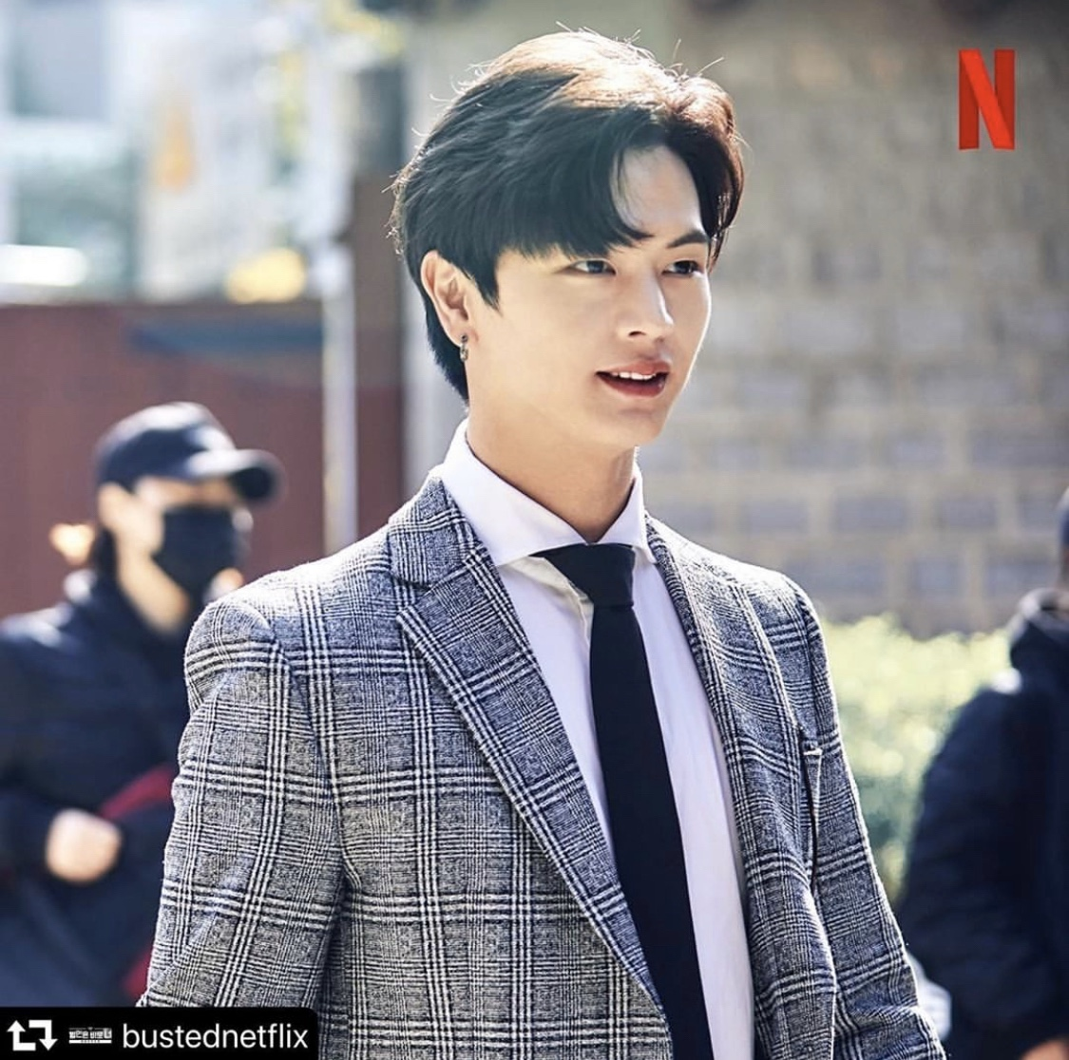
Yook Sungjae
Birth: 02.05.1995
Position: serve vocal
Profession: Idol, actor
Famous appearance work as an actor: Goblin
InstagramID: yook_can_do_it
https://www.youtube.com/watch?v=rDQrq4PofnA

Slide 16
Movie stage
https://www.youtube.com/watch?v=42A-rFdralM
연예가 중계 06:06~
https://www.youtube.com/watch?v=U4c0Un8SAYI
육성재 아는형님 민경훈 모창
https://www.youtube.com/watch?v=XLFUK5hEads

Slide 18
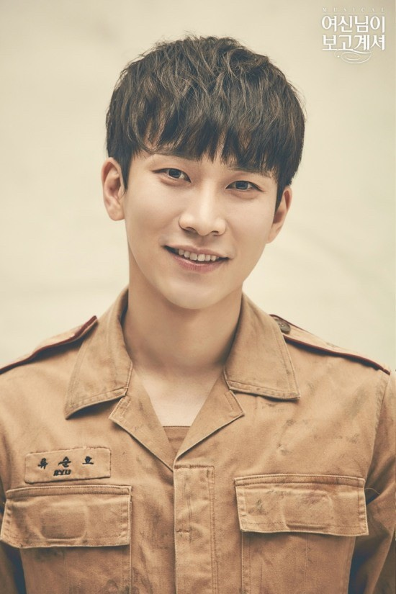
Seo Eungwang
Birth: 22.11.1990
Leader of BTOB
Position: Main Vocal
Nickname: Silverlight, Seoeunga
https://www.youtube.com/watch?v=nQzwi3wxOmw

Slide 19
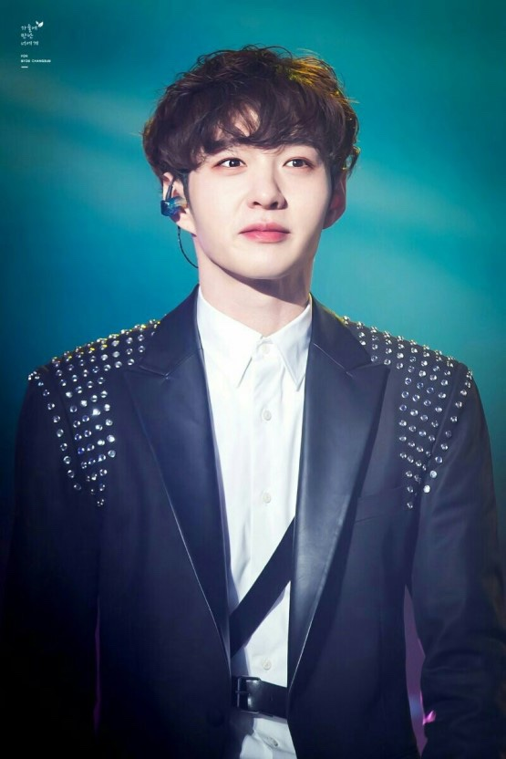
Lee Changsub
Birth: 26.02.1991
Position: Serve /Lead Vocal

Slide 20
배틀 트립
https://www.youtube.com/watch?v=v4eAs7mScNM
비투비 ask
https://www.youtube.com/watch?v=mKP-4YqI34c
예능
https://www.youtube.com/watch?v=nkyLuP7eiM4

Slide 21
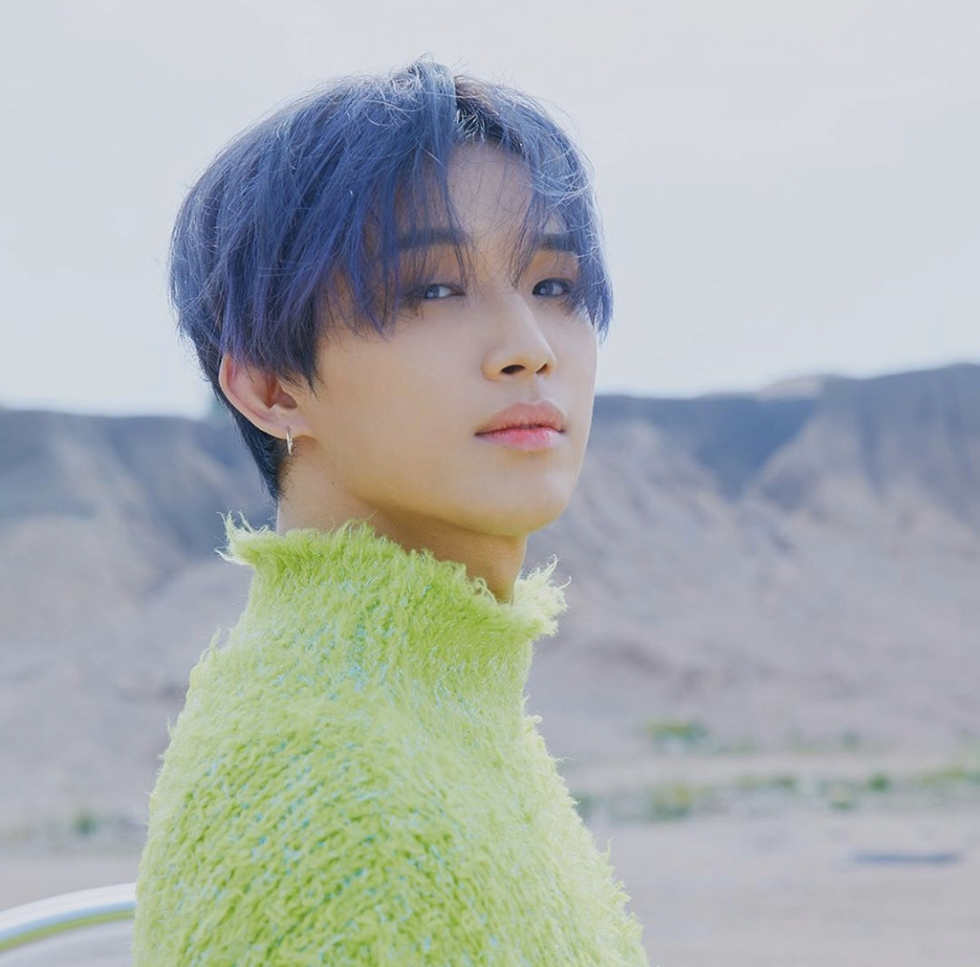
Lim Hyeonsik
Birth: 07.03.1992
Position: Serve/Lead vocal
https://www.youtube.com/watch?v=4oHmzNF42m8

Slide 22
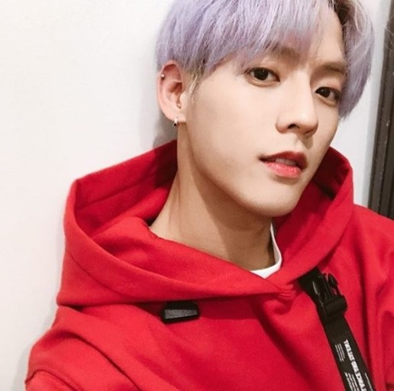
Lee Minhyuk
Birth: 29.11.1990
Position: Lead Rapper
Nickname: Leesain bolt, redhyeong
https://www.youtube.com/watch?v=DbxMH2sy3U8
https://www.youtube.com/watch?v=BKBZEudZ9xk

Slide 23
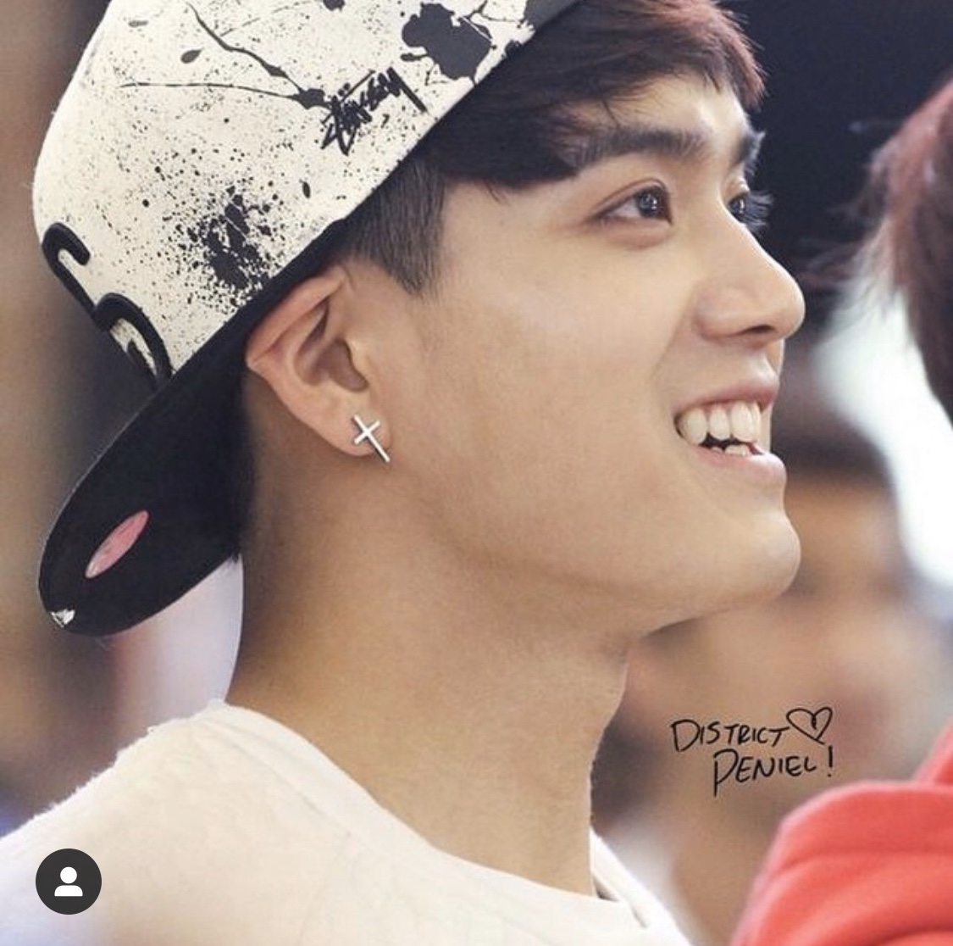
Peniel
Birth: 10.03.1993
Position: Serve Rapper

Slide 24
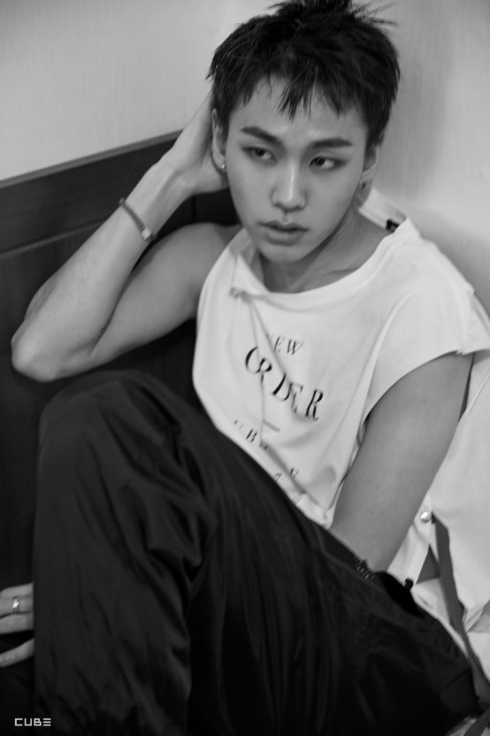
Jung Ilhoon
Birth: 04.10.1994
Position: Main Rapper
https://www.youtube.com/watch?v=mF9cpV2ev0Q

Slide 25
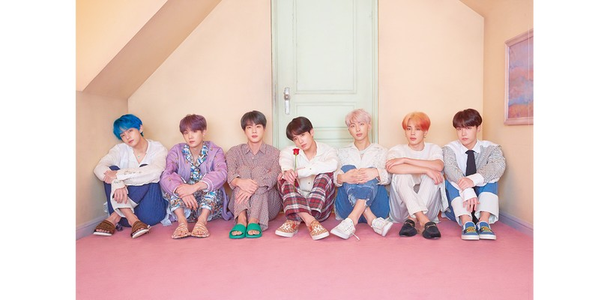
BTS

Slide 26
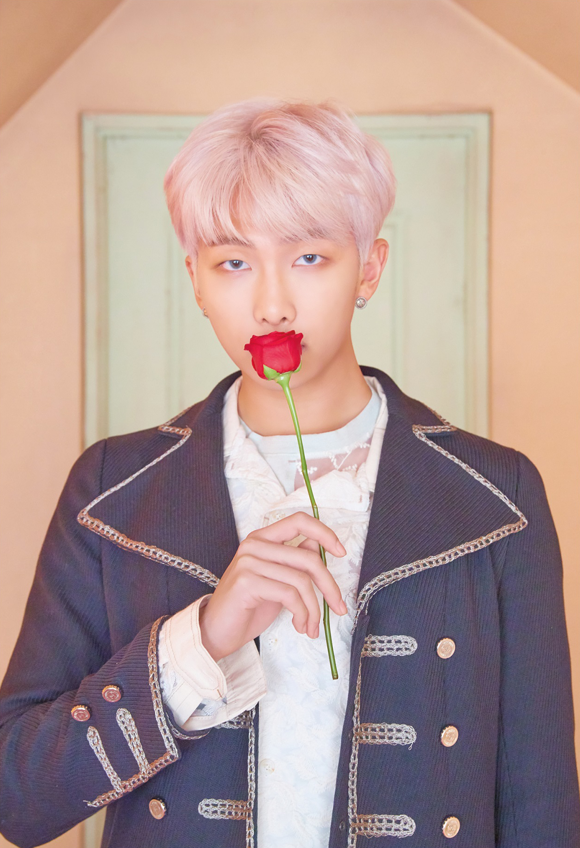
Name: RM (Kim namjoon)
Birth: 1994.09.12
Position: leader, main rapper
직캠
https://www.youtube.com/watch?v=qlg3kTRAUrM
문제적남자
https://www.youtube.com/watch?v=K72LYDmeWYY
찌찌몬스터
https://www.youtube.com/watch?v=geoQPA3Tcw4
https://www.youtube.com/watch?v=VzKn8YjZ9VY

Slide 27
Name: Jin (Kim seokjin)
Birth: 1992.12.04
Position: vocal
아재개그
https://www.youtube.com/watch?v=nkGNiZEPp6g
직캠
https://www.youtube.com/watch?v=MilKNyALZ6w
https://www.youtube.com/watch?v=wc2ZMcO2dts

Slide 28
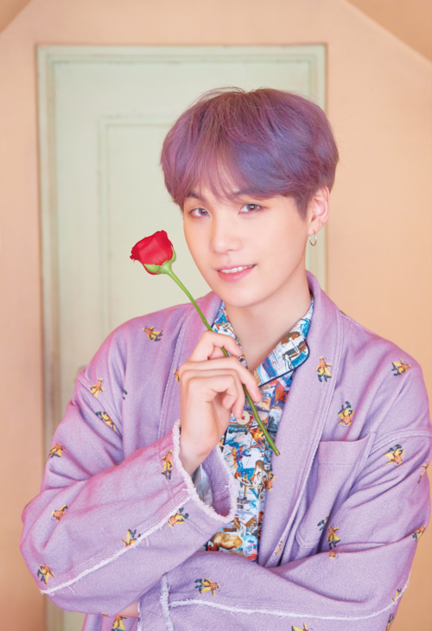
Name: Suga (Min yoongi)
Birth: 1993.03.09
Position: lead rapper
직캠
https://www.youtube.com/watch?v=BZ7N161noT8
싸이퍼
https://www.youtube.com/watch?v=D_GzE2XeRzw
https://www.youtube.com/watch?v=lfatrffyt5g

Slide 29
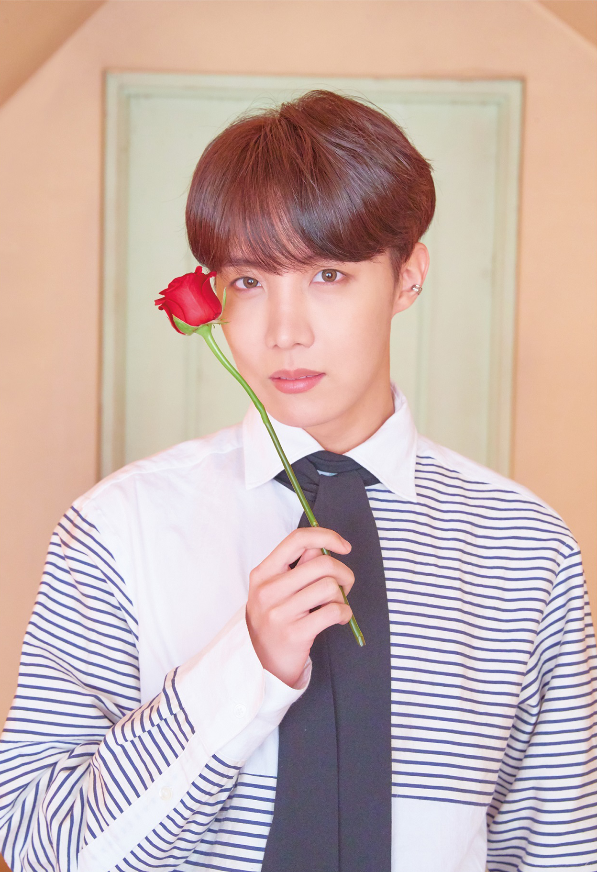
Name: J-hope(Jung hoseok)
Birth: 1994.09.12
Position: main dancer, rapper
직캠
https://www.youtube.com/watch?v=dSIMAD61hNY
독무
https://www.youtube.com/watch?v=Hngm4rc50UM
https://www.youtube.com/watch?v=MzKEd6j7eDk
https://www.youtube.com/watch?v=EmAjPVW7koA

Slide 30
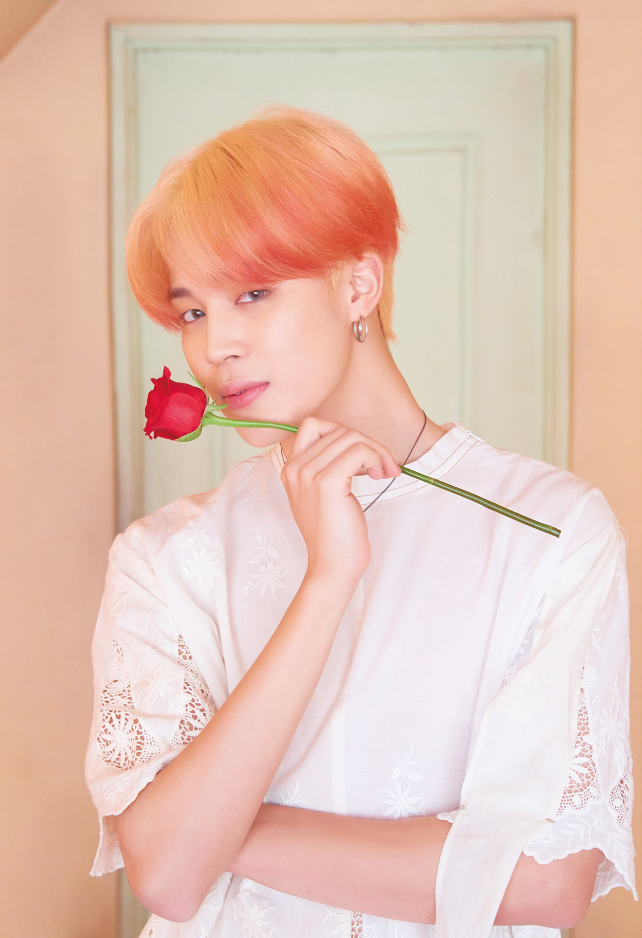
Name: Jimin (Park Jimin)
Birth: 1995.10.13
Position: main dancer, lead vocal
페잌럽
https://www.youtube.com/watch?v=GfX62fI1NyA
보조개
https://www.youtube.com/watch?v=BTkOOsaiVI4
현대무용
https://www.youtube.com/watch?v=HTxuftPGlFY

Slide 31
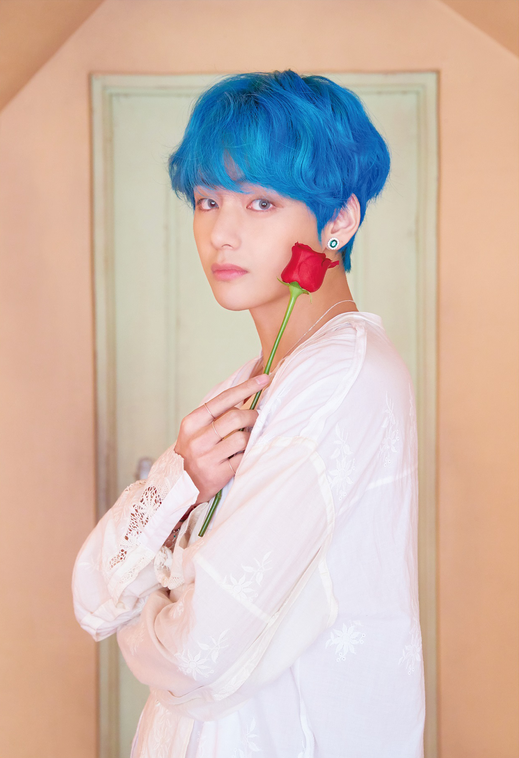
Name: V (Kim taehyung)
Birth: 1995.12.30
Position: vocal
직캠
https://www.youtube.com/watch?v=i0G7z_LG0mc
예능
https://www.youtube.com/watch?v=s5gSvq8b72U
https://www.youtube.com/watch?v=ETwxaPAygXE

Slide 32
Name: Jungkook (Jeon Jungkook)
Birth: 1997.09.01
Position: lead dancer, main vocal
묘기
https://www.youtube.com/watch?v=Dhr_MtrDwp0
직캠
https://www.youtube.com/watch?v=w5XxXWJrARU
팬싸
https://www.youtube.com/watch?v=kDJj3KRZRRI

Slide 33
Cover stage
말하자면
https://www.youtube.com/watch?v=fHNWVKJ2YC8
퍼팩트맨
https://www.youtube.com/watch?v=AMMx1hOwH-4
레이니즘
https://www.youtube.com/watch?v=8WOxFTrFw70&t=45s
레이니즘 리액션
https://www.youtube.com/watch?v=G1lQ-7Axbqw

Slide 34
Korean traditional things
피땀눈물
https://www.youtube.com/watch?v=v8z1TtlY1no
https://www.youtube.com/watch?v=e3g68C5xCcw
태권도
https://www.youtube.com/watch?v=CR3_UG8tWkQ
아리랑
https://www.youtube.com/watch?v=vwc5zTayVJw
씨름
https://www.youtube.com/watch?v=D1O69wKToPg

