Slide 1
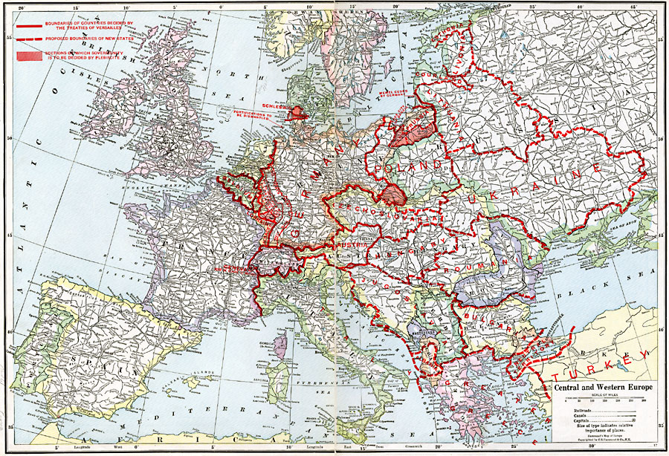
After 1918: The New Central Europe of National States

Slide 2
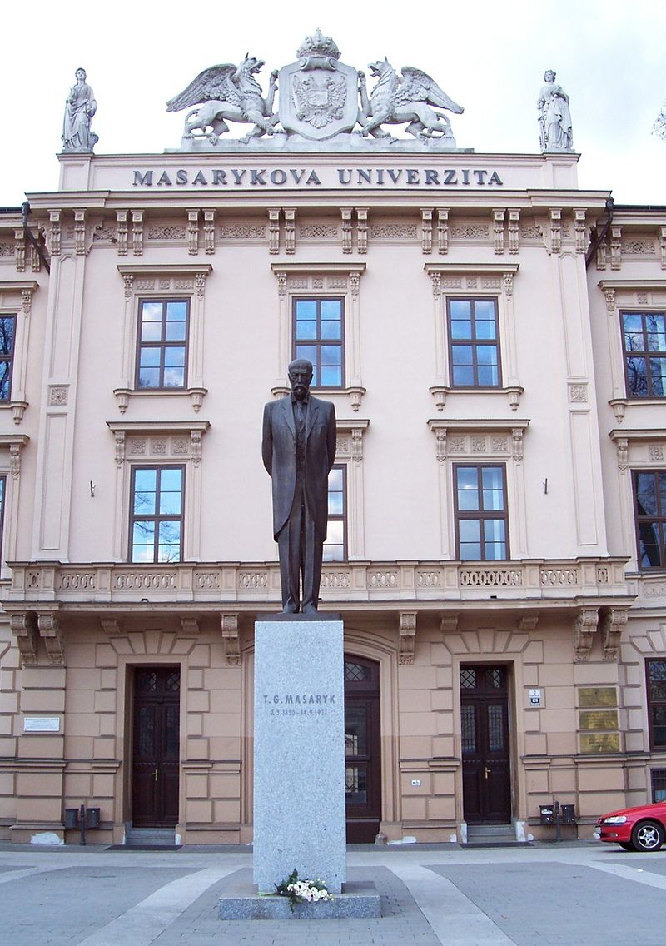
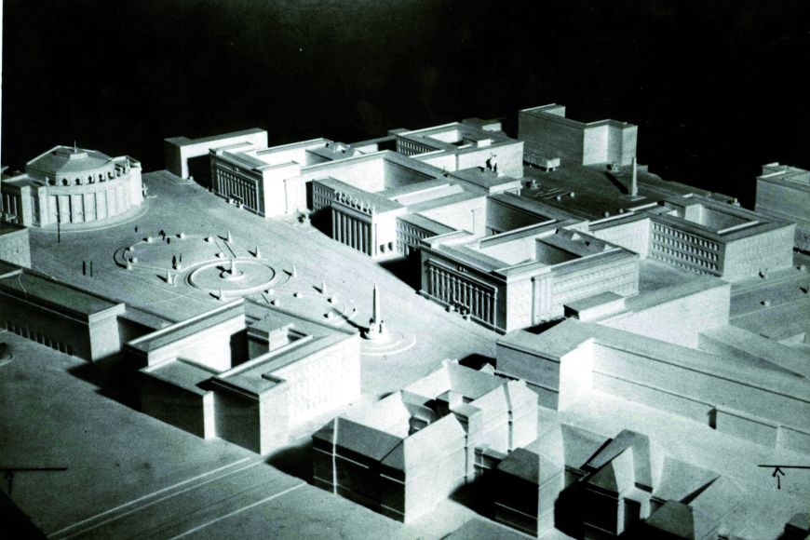
Tomáš Garrigue Masaryk in Brno
The Masaryk University campus as planned in 1932
Vincenc Makovský, TGM, cast 2000

Slide 3
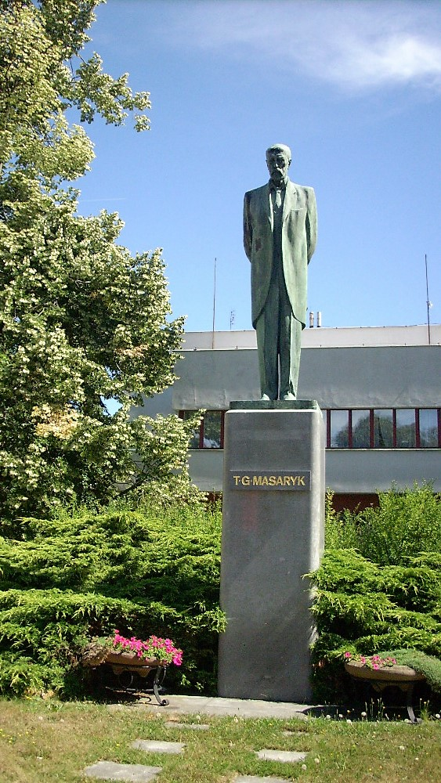
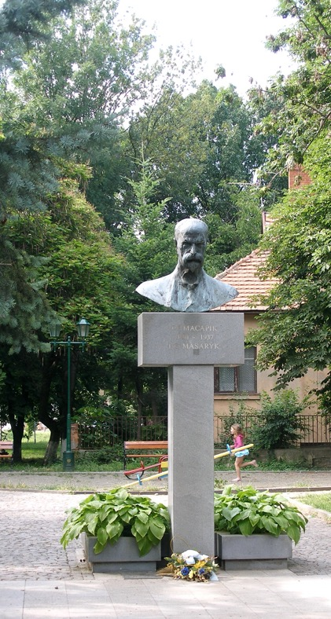
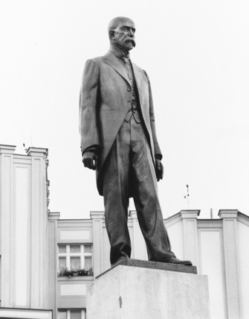
Otto Gutfreund, TGM, Hradec Králové, 1926
Olena Mondičová, Uzzhorod
Vincenc Makovský, TGM, Humpolec, 1937

Slide 4
http://tg-masaryk.cz/mapa/

Slide 5
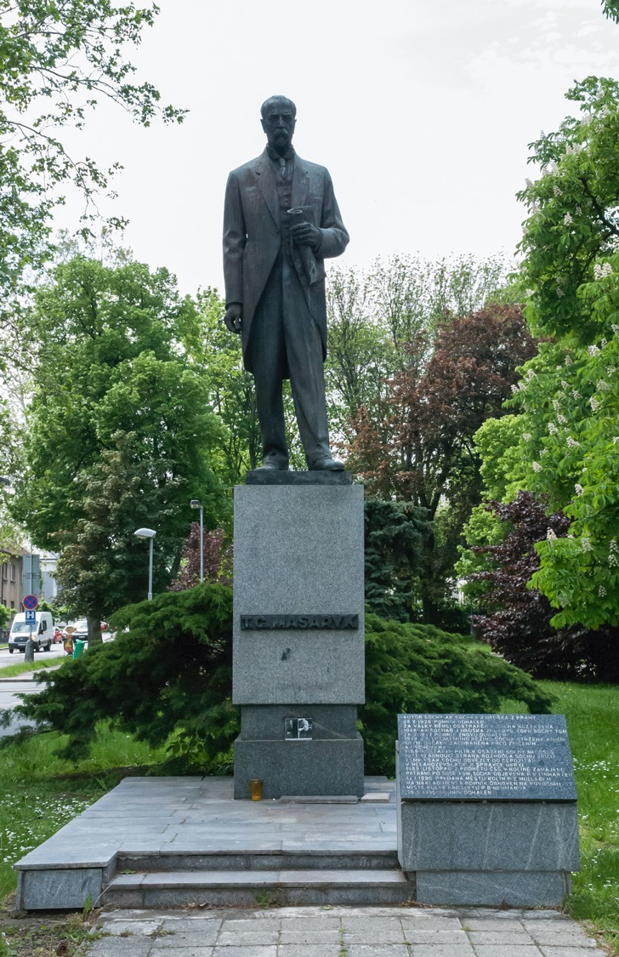
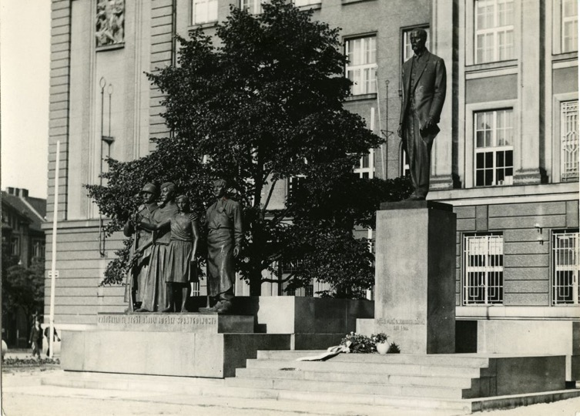
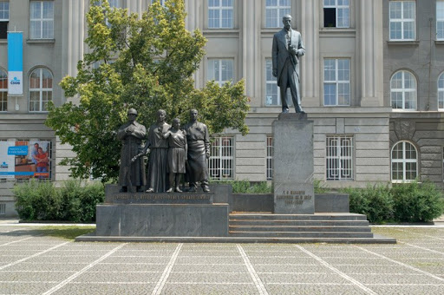
Karel Kotrba - Jaroslav Hruška - Bohumil Pícha, TGM, Plzeň, 1928
New sculpture, Plzeň, 1990
Jaroslav Hruška, Kolín, 1929

Slide 6
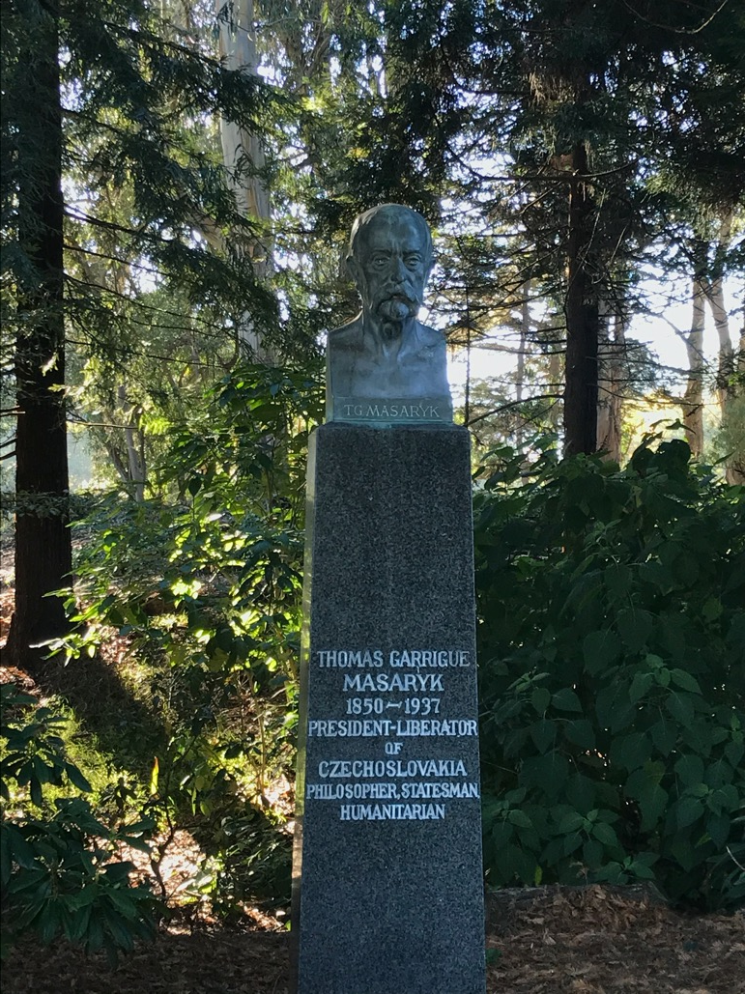
Albín Polášek (1879–1965) , TGM as a Blaník knight, Chicago, 1940-49
Josef Mařatka, TGM, Golden Gate Park, San Francisco (1874-1937)

Slide 7
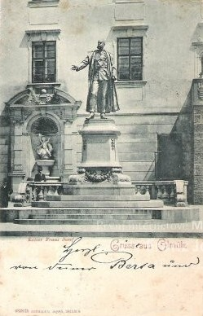
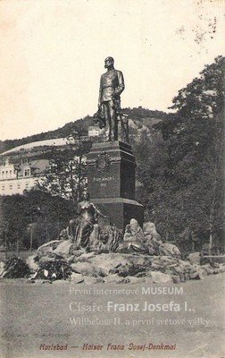
Franz Joseph I.
Karlovy Vary, 1910
Olomouc, installed 1898, removed 1919

Slide 8
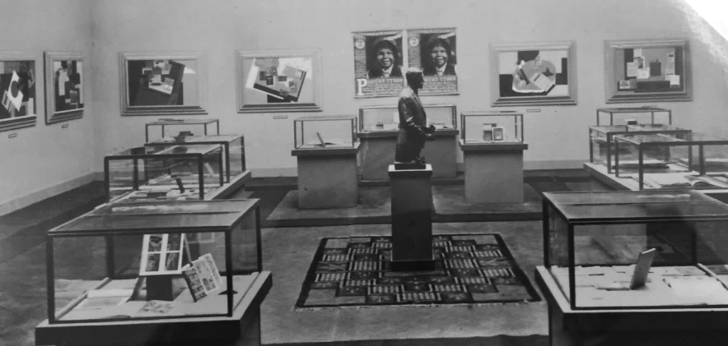
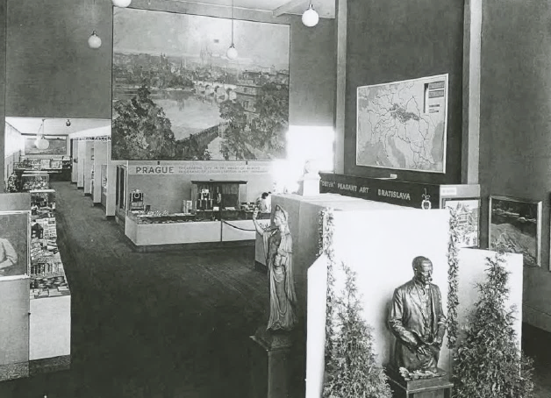
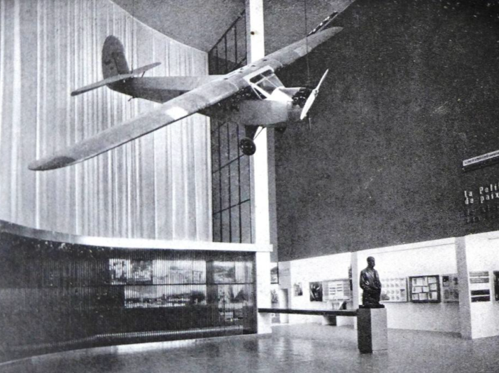
Czechoslovak section, 2nd international book fair, Florence, 1932
Masaryk’s busts at international exhibitions
Czechoslovak pavilion, Chicago, 1933/34
Czechoslovak pavilion, Brussels, 1935

Slide 9
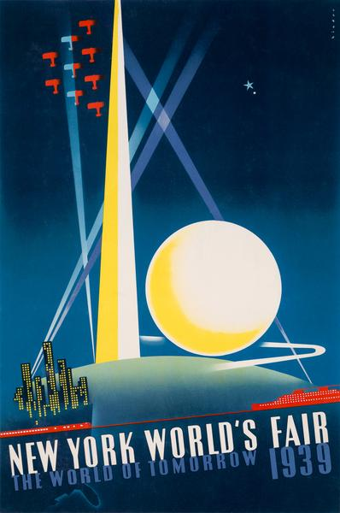
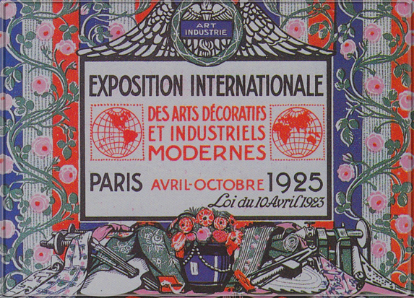
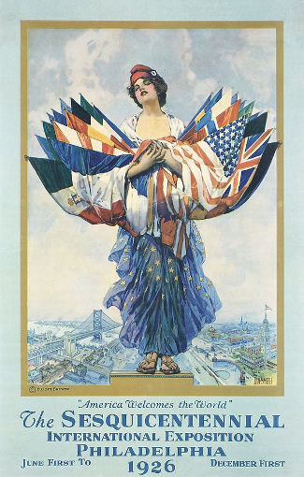
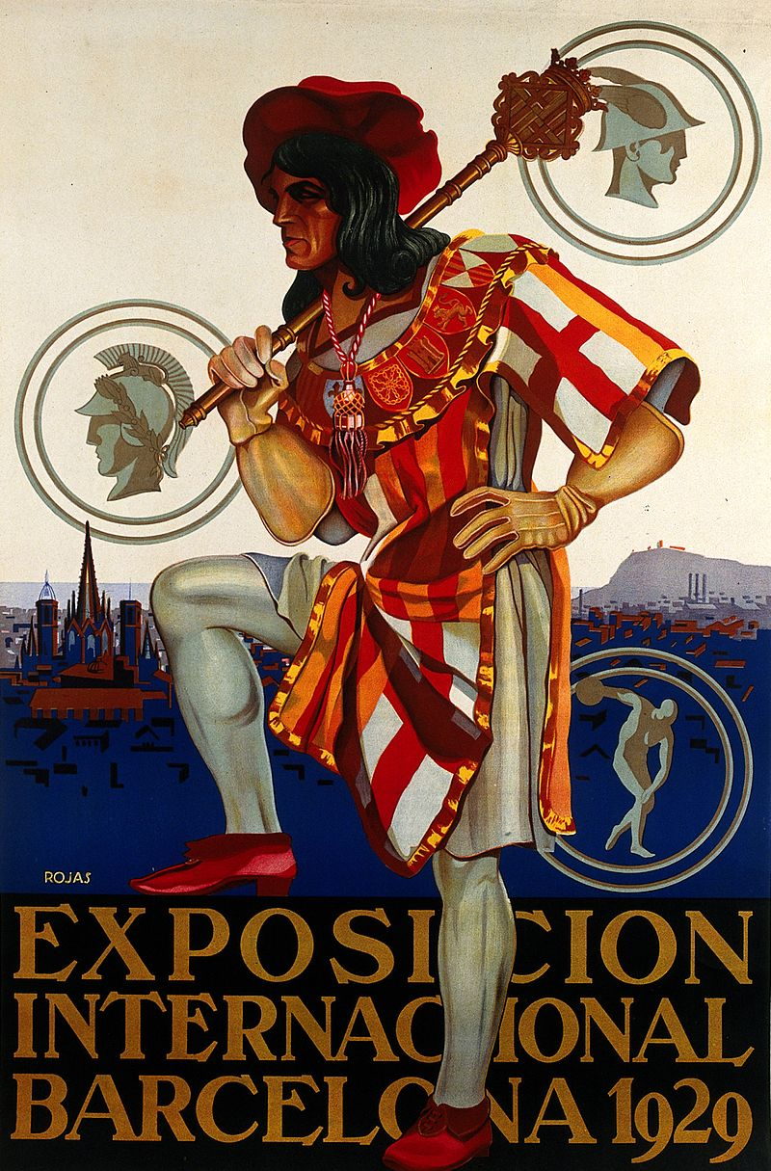
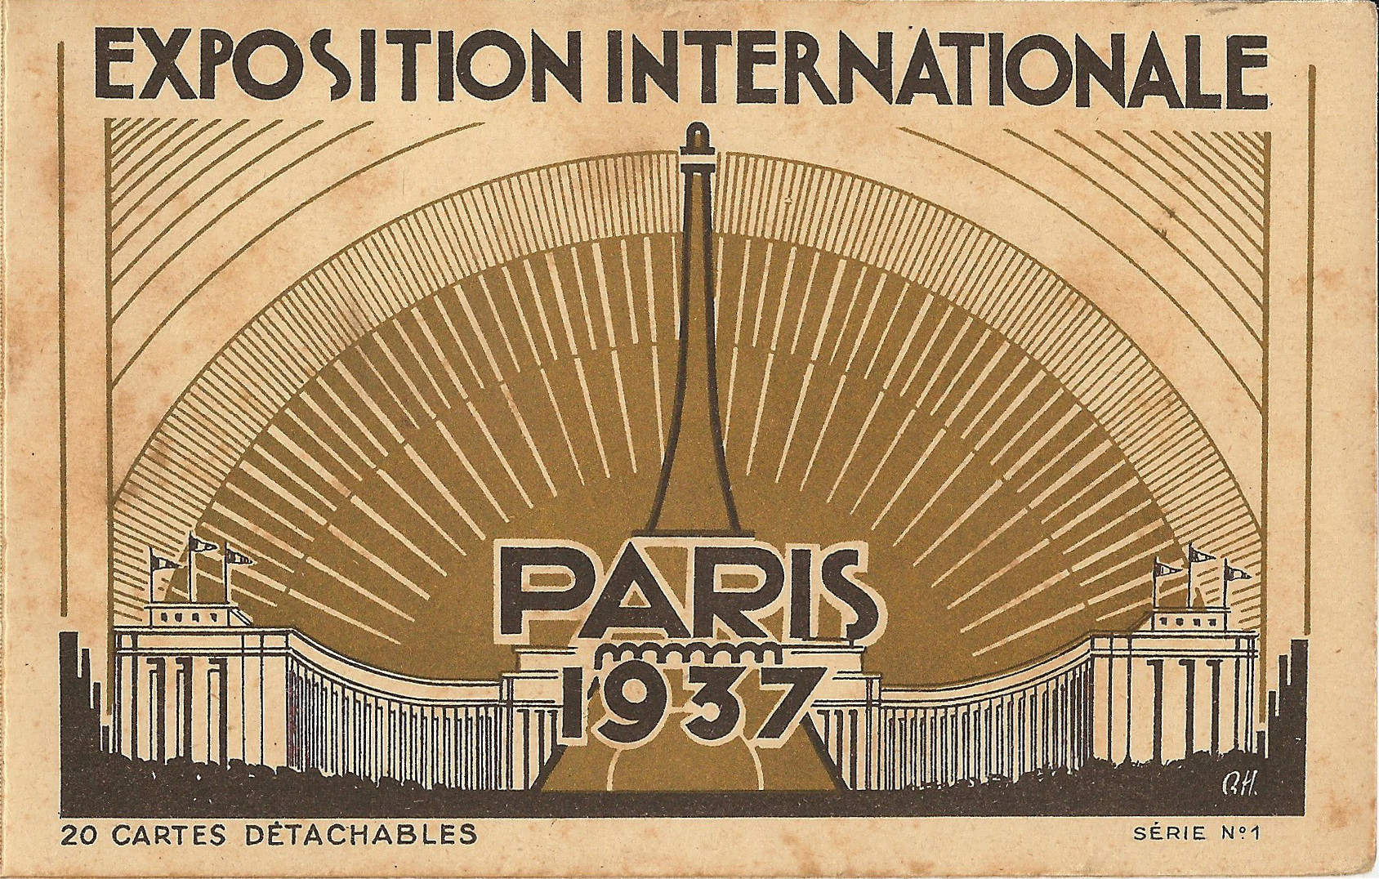

Slide 10
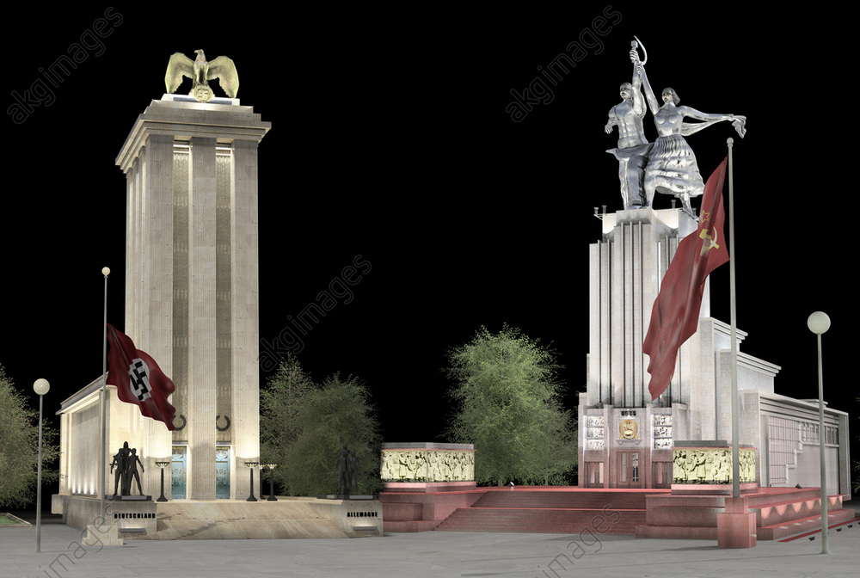
German and Soviet pavilions. Exposition Internationale des Arts et Techniques dans la Vie Moderne, Paris 1937.

Slide 11
Czechoslovak pavilions at world’s fairs
Paris, 1937
New York, 1939/40
San Francisco, 1939/40
Notes:
Exhibition design influenced by El Lissitzky’s USSR pavilion,

Slide 12
Modern art and design
Ladislav Sutnar, ceramics
School of Art and Design
Association of the Czechoslovak Works
Notes:
Personal links, schools,
Stech,
Detva as a Slovak company manufacturing folk art

Slide 13
Presentations of companies:
Baťa
Detva
Pilsner

Slide 14
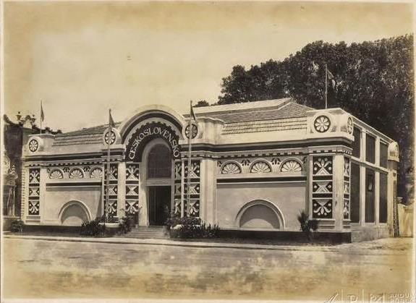
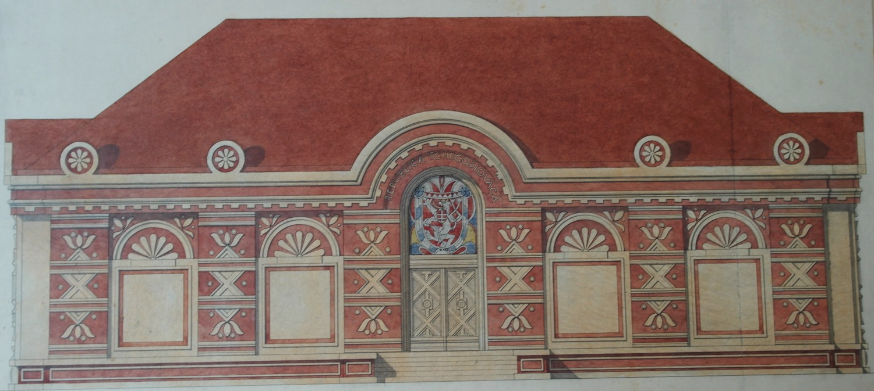
Pavel Janák – Josef Pytlík, Czechoslovak pavilion, Centennial exhibition, Rio de Janeiro, 1922

Slide 15
Pavel Janák (1882-1956): national style
Plan for the hydroelectric power station in Háj, 1921
Pavel Janák, crematorium, Pardubice, 1921

Slide 16
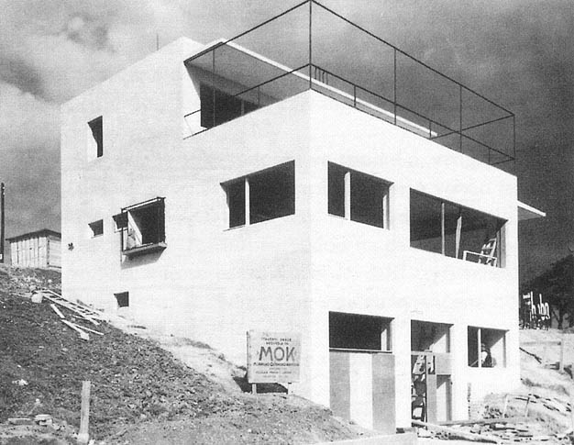
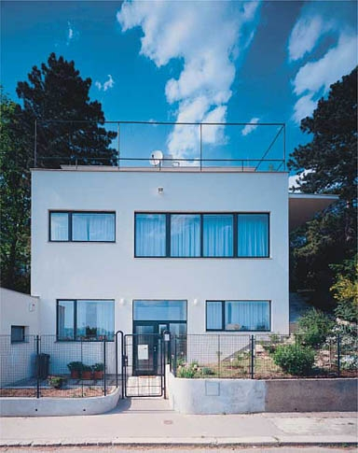
Janák’s own house, Baba estate, Prague, 1932

Slide 17
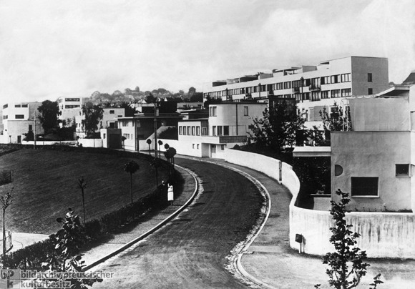
Weissenhofsiedlung, Stuttgart, 1927 built at the occasion of the Wohnung (The Dwelling) exhibition
Buildings by:
Mies van der Rohe, Lily Reich, Peter Behrens, Walter Gropius, Le Corbusier, Bruno Taut…

Slide 18
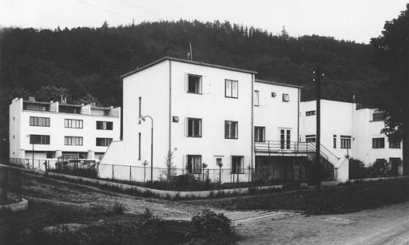
Bohuslav Fuchs and Jaroslav Grunt, New House colony, Brno, 1928-29

Slide 19
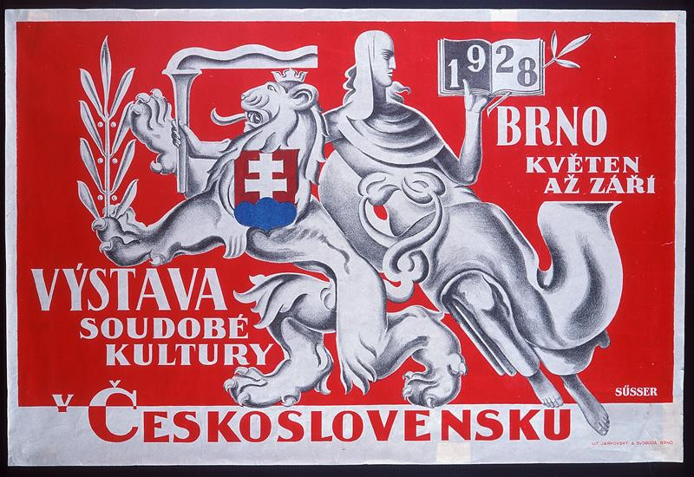
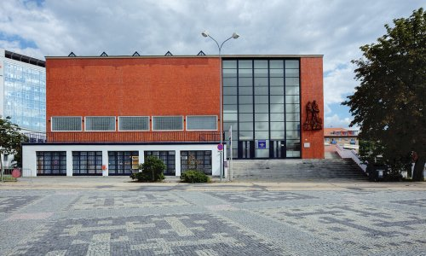
The Exhibition of Czechoslovak Contemporary Culture, 1928, Brno
B. Fuchs (1895-1972), The City of Brno pavilion

Slide 20
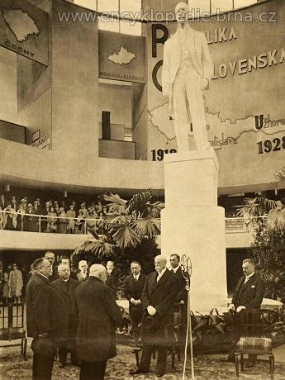
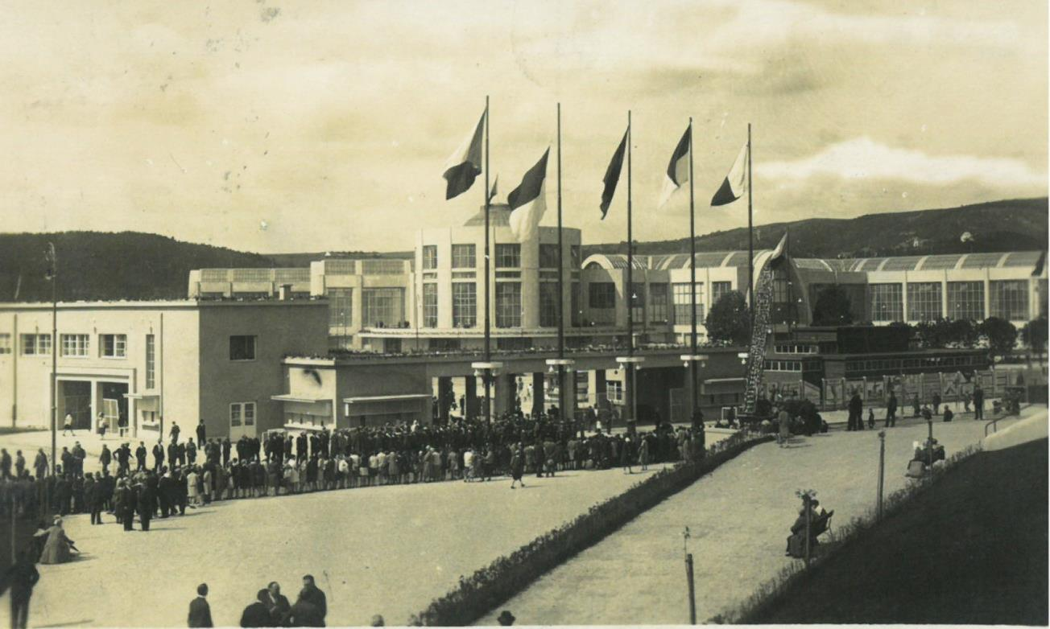
Exhibition of Czechoslovak Contemporary Culture
TGM at the exhibition

Slide 21
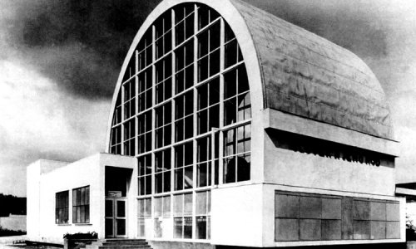
Jiří Kroha, The Pavilion of Humanity
Masaryk inspects the reconstituted mammoth

Slide 22
Kamil Roškot, Czechoslovak pavilion in Chicago, 1933

Slide 23
Jaromír Krejcar, Zdeněk Kejř, Bohumil Soumar, Ladislav Sutnar – Czechoslovak pavilion in Paris, 1937

Slide 24
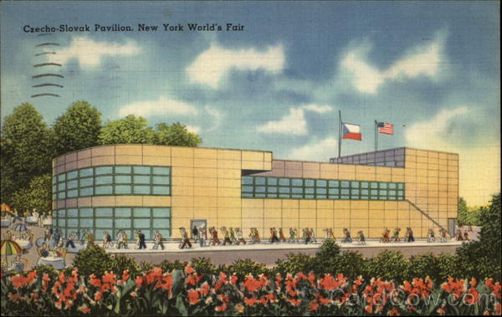
Kamil Roškot, Czechoslovak pavilion at the New York world’s fair, 1939

Slide 25
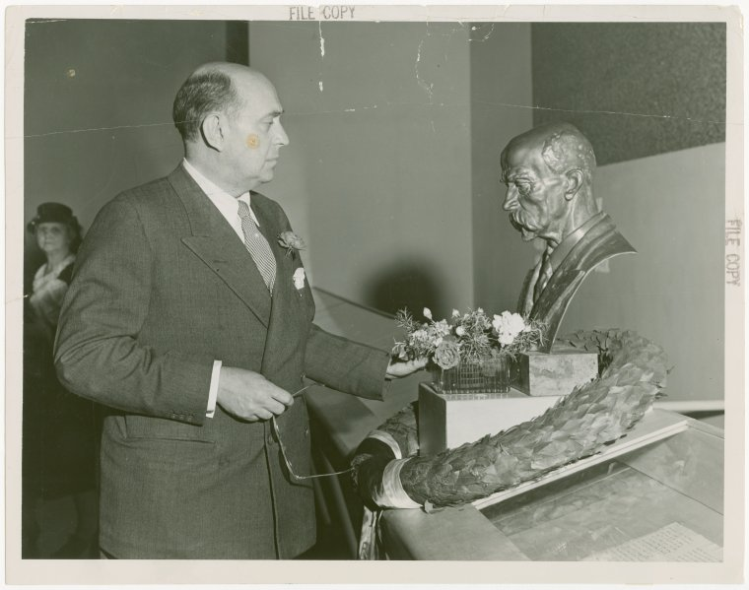
Jan Masaryk looks at the bust of his father at the Czechoslovak pavilion, New York, 1939

Slide 26
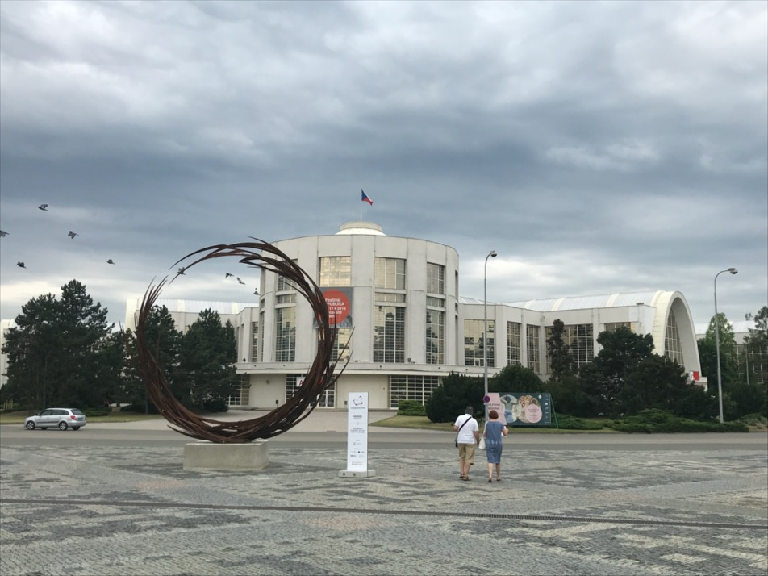
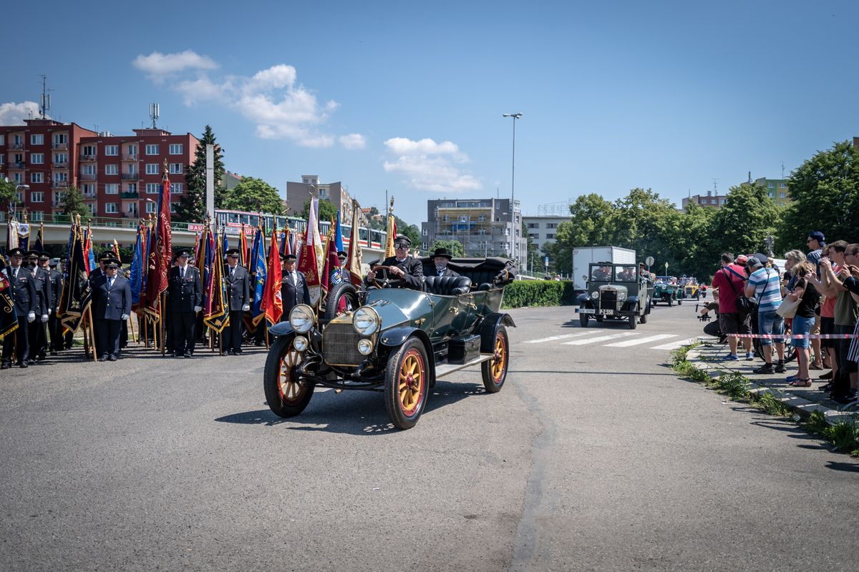
Re:public Festival, Brno, 2018

Slide 27
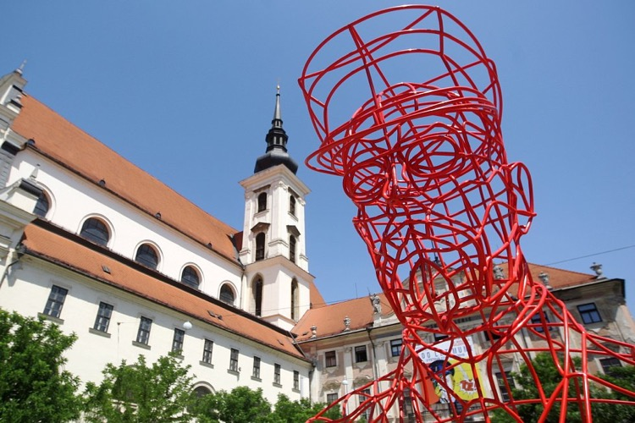
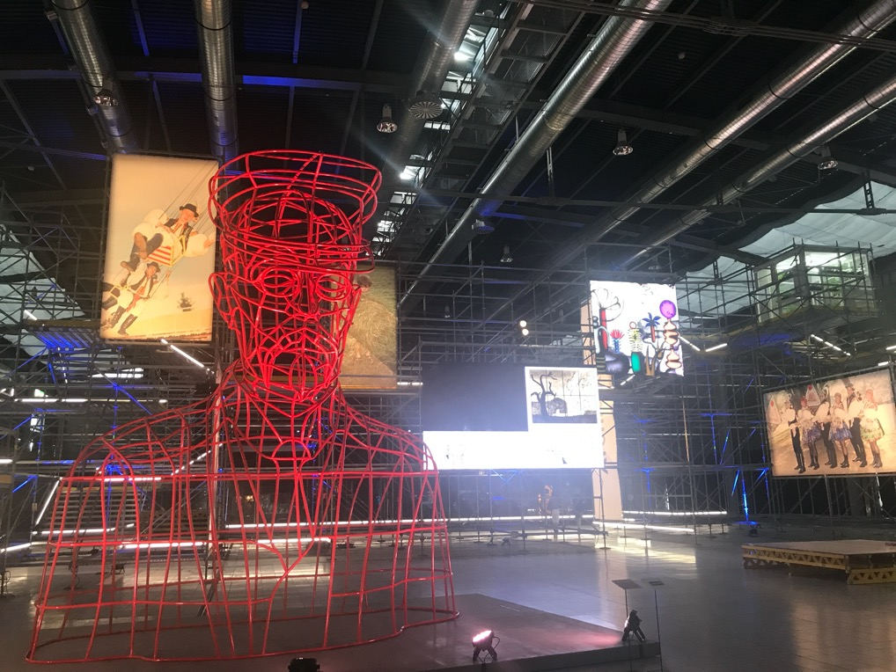
Maxim Velčovský, Masaryk climbing frame, 2018

Slide 28
https://socharske.brno.cz/mapa/

