Slide 1
Holy Roman Empire Of German Nation before 1806
The Central European World of the 19th century
and the Idea of the Austrian State
Jiří Němec (Institut of history)

Slide 2
Central Europe and Napoleon Bonaparte (1799-1815)

Slide 3
Europe 1790

Slide 4
Europe 1810

Slide 5
Dissolution of the Holy Roman Empire of German Nation August 1806 Abdication by the Emperor Francis II
1806
Francis II (Franz II) (1768-1835)
Emperor (1792-1806)
1804 Emperor od Austria
(as Francis I)

Slide 6
1815 Battle of Waterloo

Slide 7
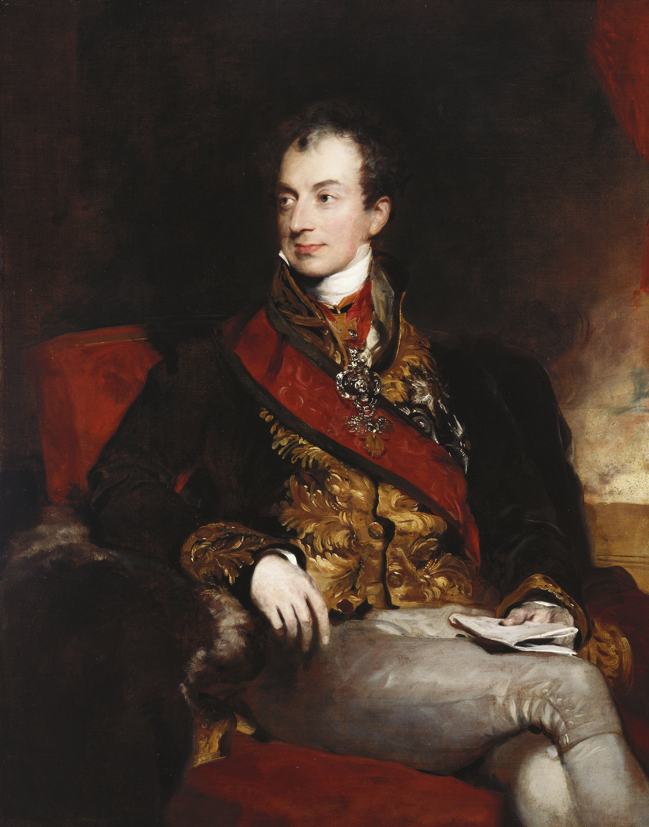
1814-1815 Congress of Vienna
Meternich (1773-1859)
Austrian Minister
and Diplomat

Slide 8
Europe 1810

Slide 9
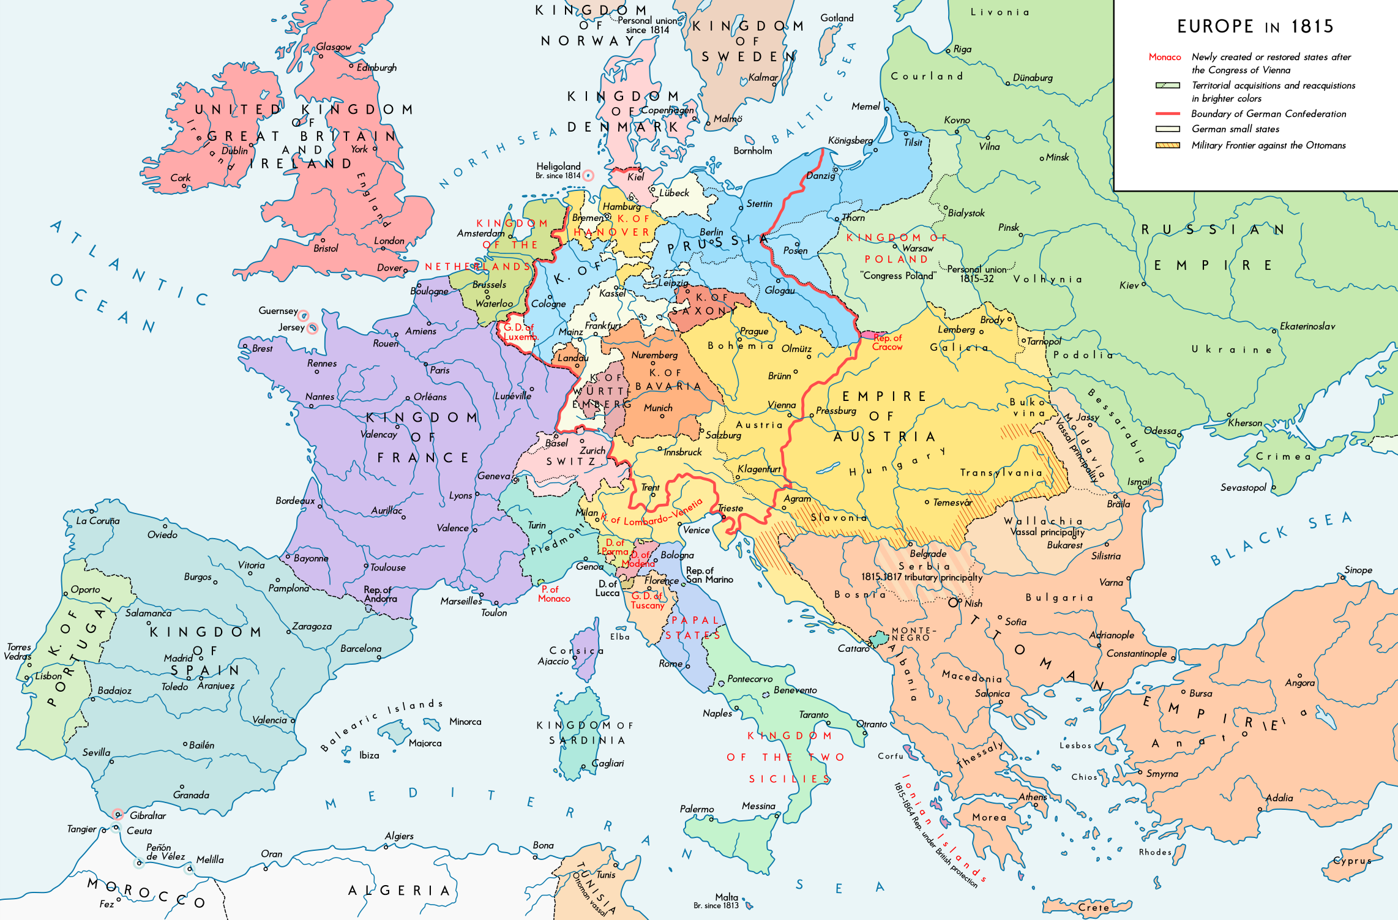
Europe 1815

Slide 10
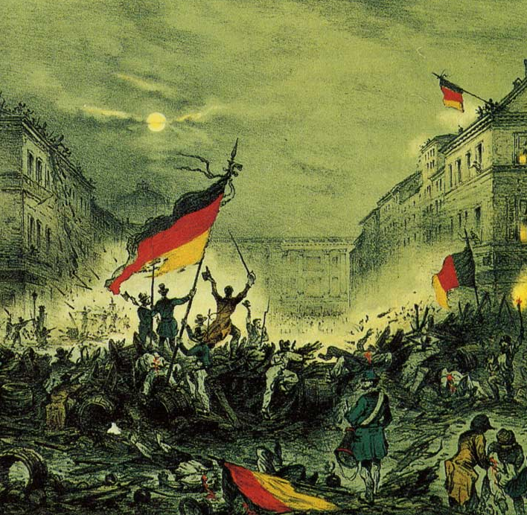
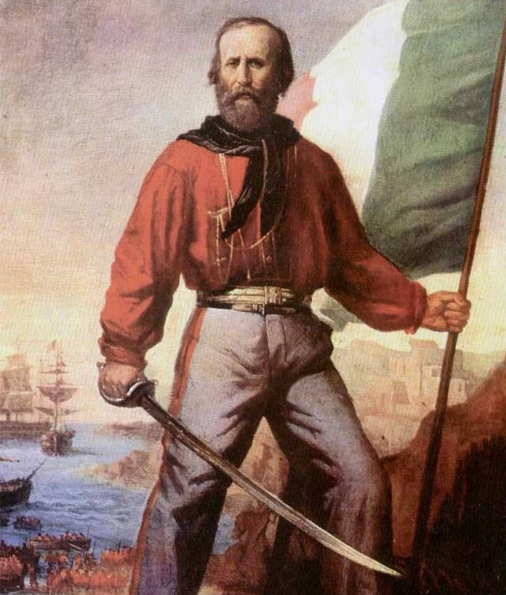
1815
1871
1848

Slide 11
Empire of Austria 1815-1866

Slide 12
1910 languages in Empire of Austria
A 1910 census found that 23% of the empire’s citizens spoke German as a mother-tongue, 20% Hungarian, 13% Czech, 10% Polish, 8% Ruthenian (Ukrainian), 6% Romanian, 5% Croat, 4% Slovak, 4% Serbian, 2% Slovene, 2% Italian, and 5% another of the languages which the survey asked about, including Bulgarian, Bunjevac (a Štokavian dialect of Croatian), and Romani (N.B. the percentages do not add up to 100% due to rounding).
This sample of languages contains representatives from many different language groups: Germanic (German), Uralic (Hungarian), Slavic (Bulgarian, Bunjevac, Czech, Slovak, Slovene, Ruthenian, Polish, Serbo-Croatian), Romance (Romanian, Italian) and Indo-Aryan (Romani).

Slide 13
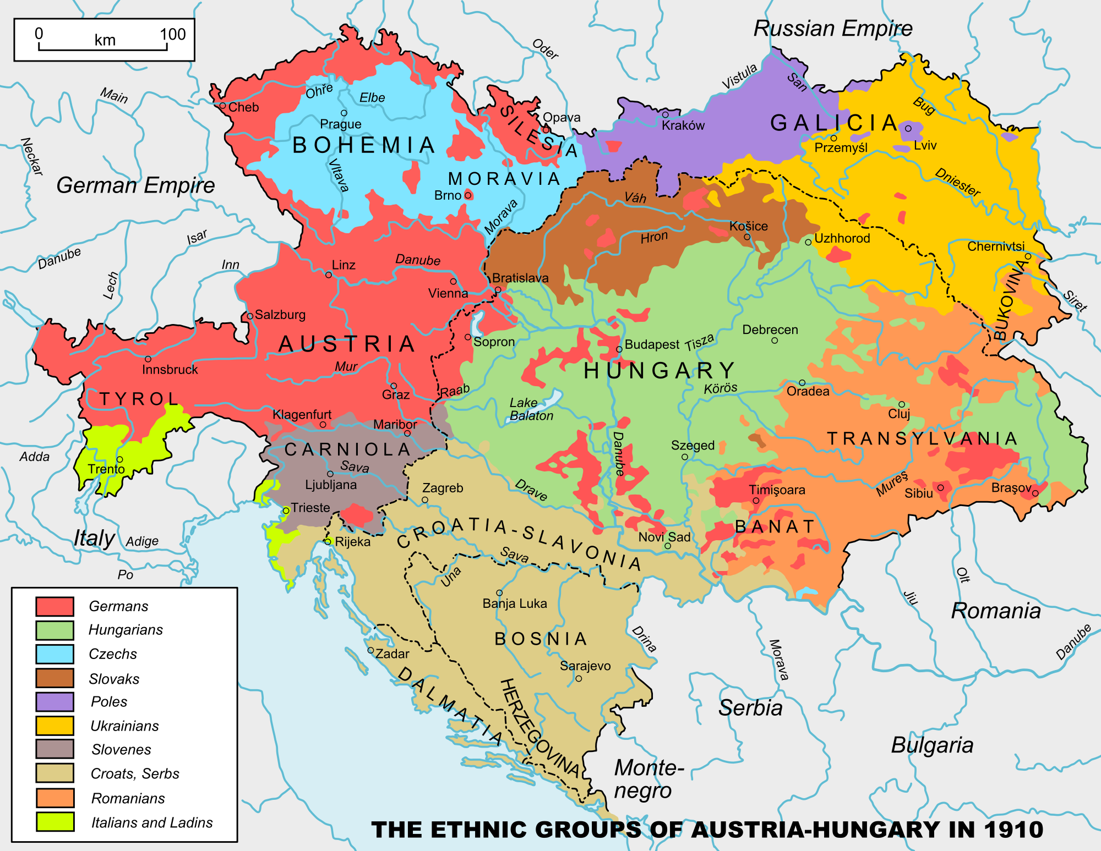
19th Century Ethnolingvistic strukture of population in Austria
German 12 mil.
Hugaryan 10 mil.
Czech 6,4 mil.
Croat-Serb 5,6 mil.
Polish 5 mil.
Ruthenian 4 mil.
Romanian 3,2 mil.
Slovak 2 mil.
Slovene 1,2 mil.
Italian 0,8 mil.
Other 1 mil.
Total 51,4 mil.

Slide 14
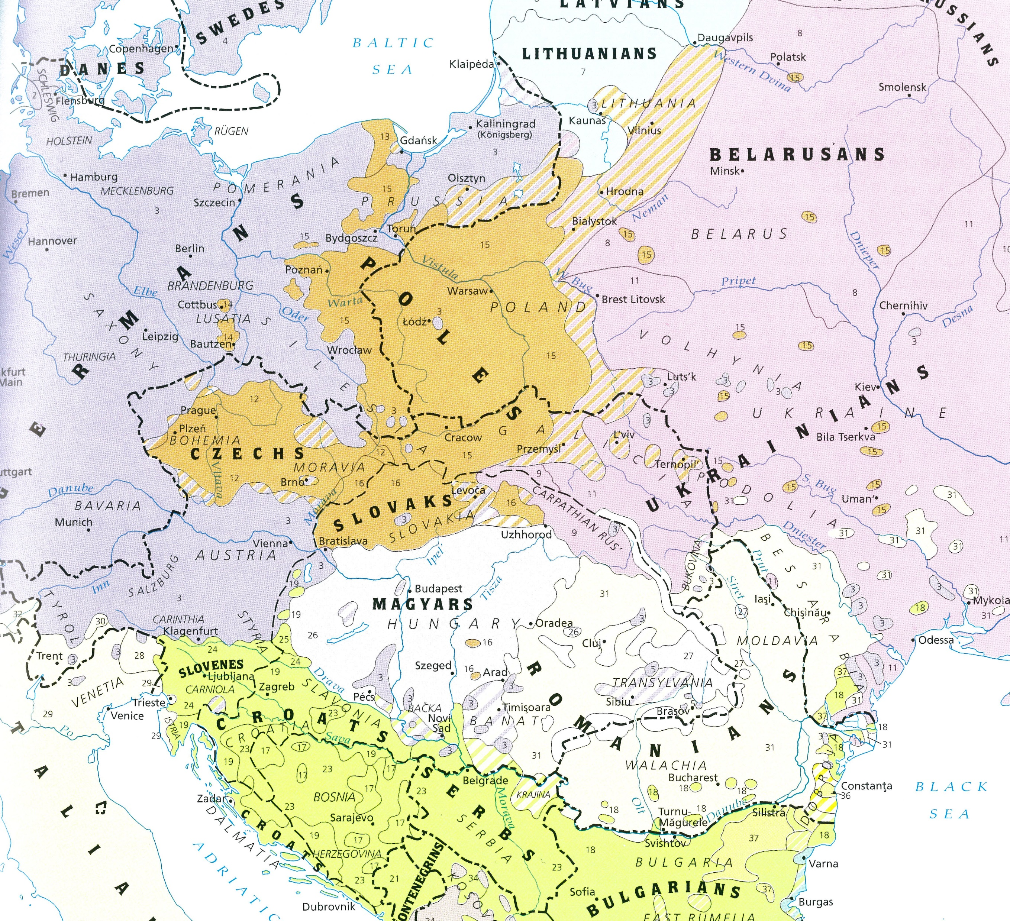
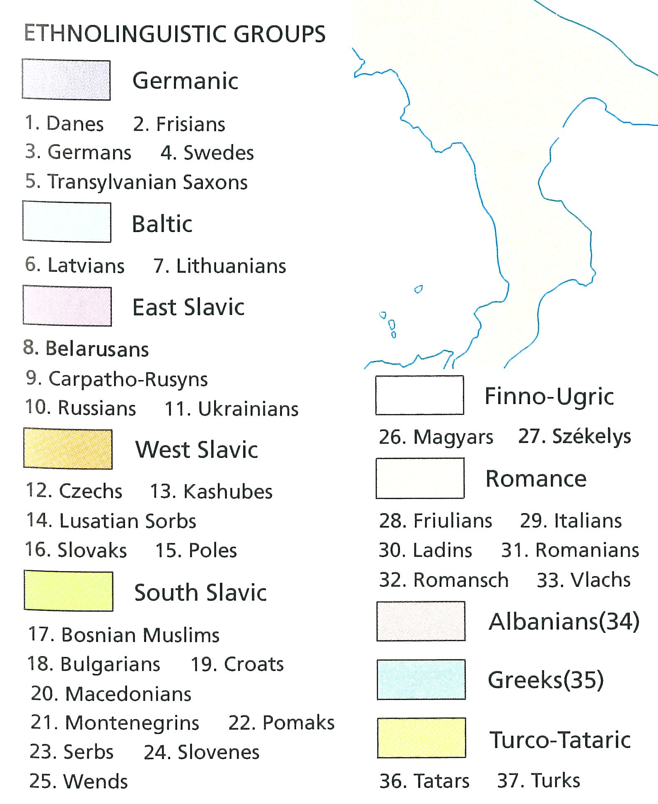
19th Century Ethnolingvistic strukture of population in Central Europe

Slide 15
Revolution 1848 in Austria
1. attempts at unifying Germans and the territories of the German Confederation into one large Germany,
2. attempts to gain recognition for the unity of the territories of the crown of St Wenceslas and recognizing the equality of the Czech nation and the German nation,
3. endeavours on the part of the Hungarian aristocracy to acquire an independent constitution and an independent Hungarian kingdom in Austria.

Slide 16
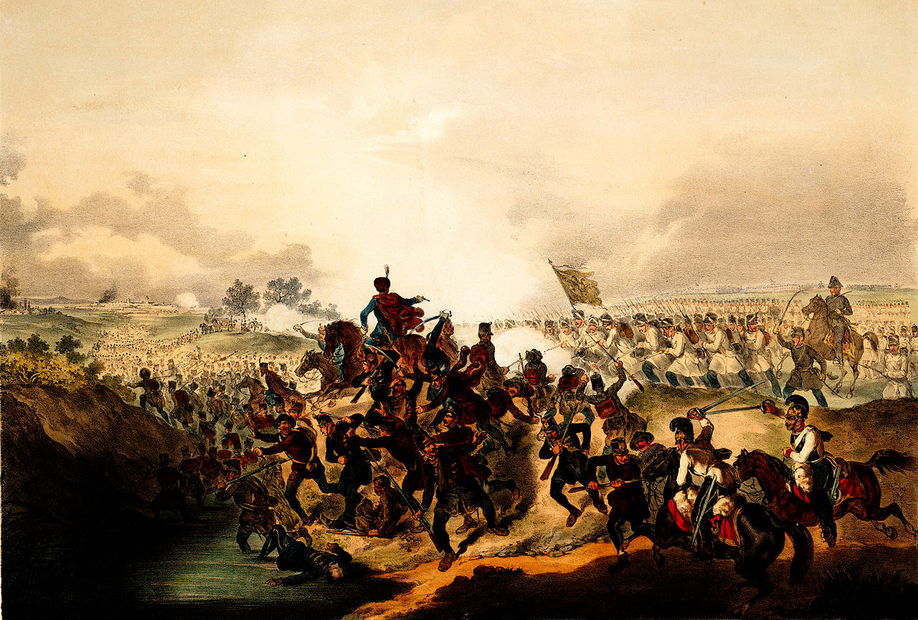
1848 – 1849 Hungarian Uprising defeated by Austrian military forces
13. August 1849
Capitulation of Hungarian Army at Világos

Slide 17
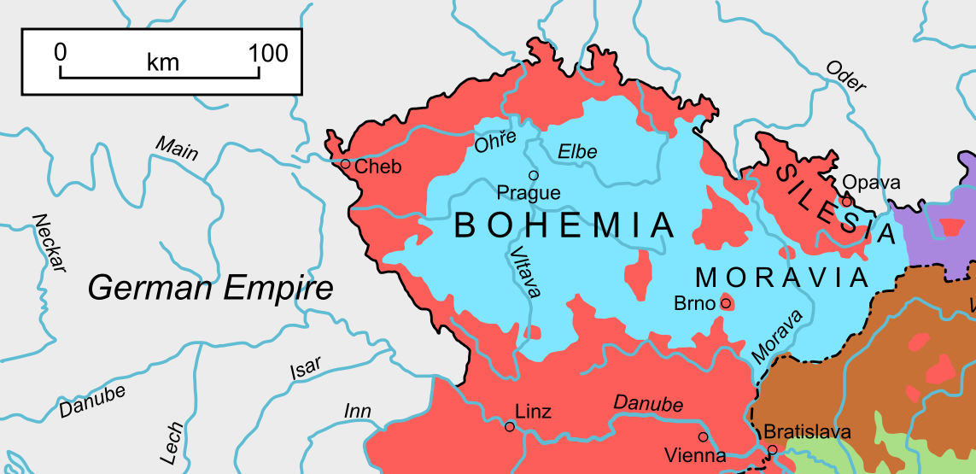
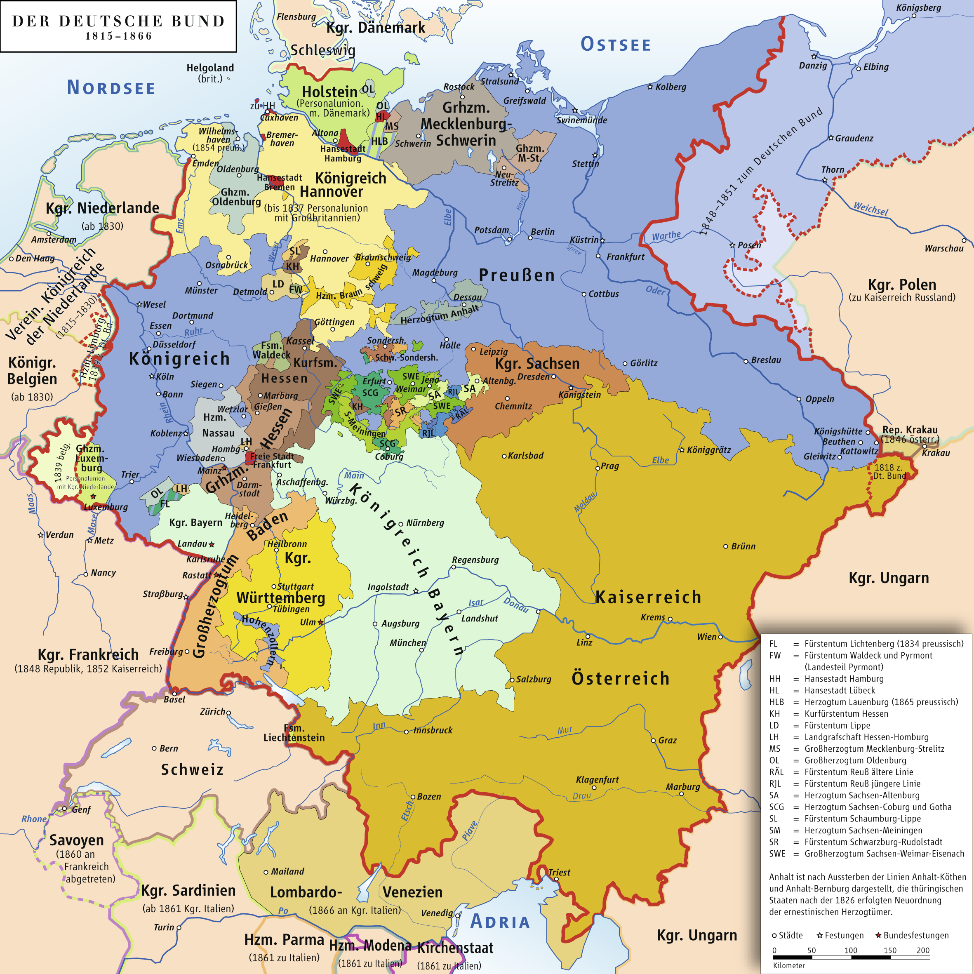
Bohemia, Moravia, Silesia (Czech lands)
German Confederation
S
B
M
red .... German language
blue …. Czech language
Bohemia ….B
Moravia ….M
Silesia ….S

Slide 18
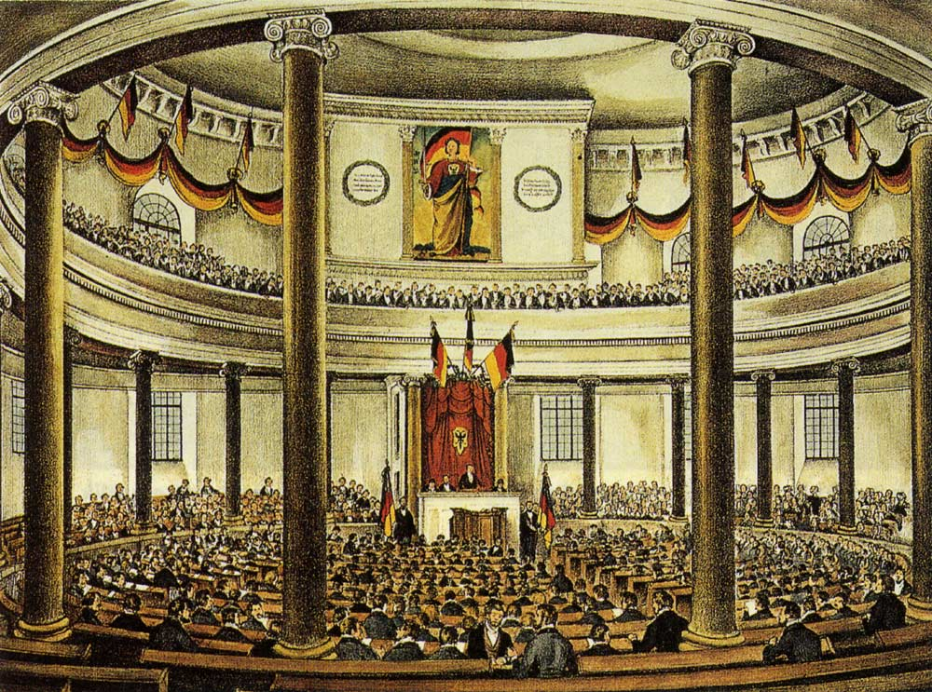
Spring 1848 Preliminary Parlament in Frankfurt
Aim … to prepare
for the unification of
all German territories
on basis of
German Confederation

Slide 19
František Palacký (1798-1876)
Czech historian
and liberal-conservative politician
April 1848 he was invited to taka part on the preliminary parliament in Frankfurt.
„Letter to Frankfurt“ from 11 April 1848
(the most important political statement of the Czech national movement in 1848)

Slide 20
Franz Joseph I. Emperor (1848-1916)

Slide 21
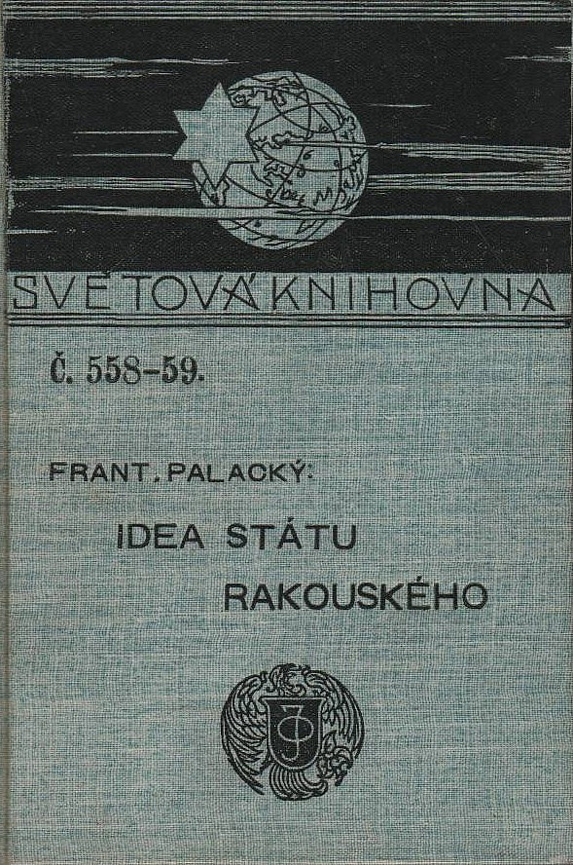
„Idea of the Austria State“ (1865) (in Czech) František Palacký
German translation
„Österreichs Staatsidee“ (1866)

Slide 22
1866 Austro-Prussian war

Slide 23
Austro-Hungarian Empire 1867-1914

