Slide 1
Bibliometrie
Igor Hlaváč – Ústřední knihovna FF MU

Slide 2
Bibliometrie
Bibliometrie měří, sleduje a analyzuje vědeckou literaturu (ROEMER a BORCHARDT 2015)
  Pritchard (1969) explained the term bibliometrics as “the application of mathematical and statistical methods to books and other media of communication”.
  Nalimov and Mulchenko (1969) defined scientometrics as “the application of those quantitative methods which are dealing with the analysis of science viewed as an information process”.
Cíl bibliometrie:
  Dříve spíše pro knihovny (rozvoj fondu), nyní pro hodnocení/financování vědy a strategické rozhodování (mimo kontext vzniku).

Slide 3
Citační databáze
Web of Science
Scopus
Impact factor
AIS (Article Influence Score)
H-Index
Citovanost
ResearcherID (WoS)
ORCID ID
CiteScore
SJR (SCImago journal rank)
SNIP (Source-Normalized Impact per Paper)
H-Index
Citovanost
ORCID ID

Slide 4
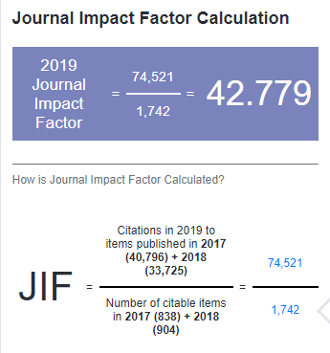
(Journal) Impact Factor

Slide 5
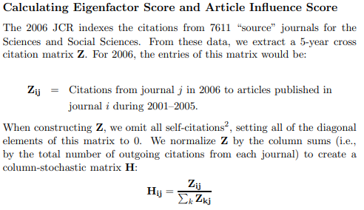

Article Influence Score/EigenFactor Score

Slide 6
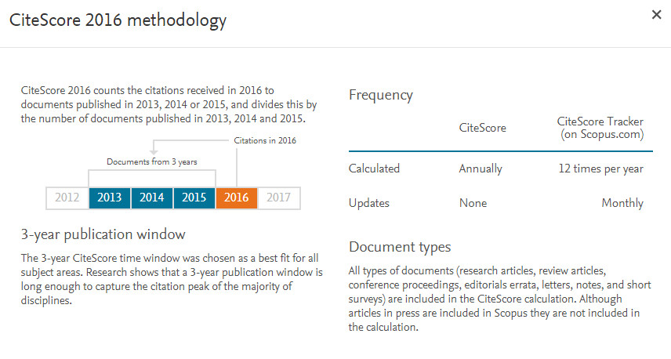
CiteScore

Slide 7
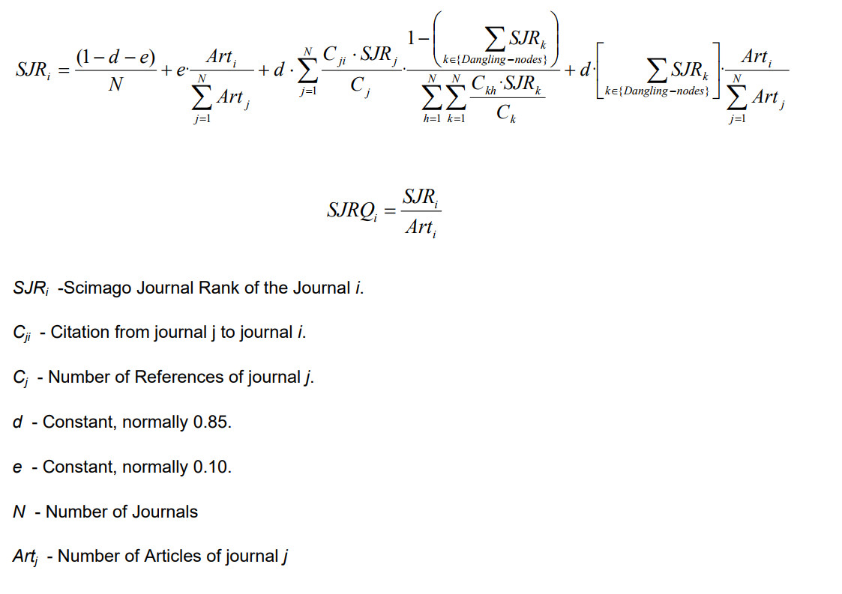
SCImago Journal Rank (SJR)

Slide 8
Seznam časopisů Journal Data Filtered By: Selected JCR Year: 2019 Selected Editions: SCIE,SSCI Selected Categories: 'ETHICS','HISTORY & PHILOSOPHY OF SCIENCE','MULTIDISCIPLINARY SCIENCES' Selected Category Scheme: WoS
NATURE
SCIENCE
National Science Review
Science Advances
Nature Human Behaviour
Nature Communications
Science Bulletin
PROCEEDINGS OF THE NATIONAL ACADEMY OF SCIENCES OF THE UNITED STATES OF AMERICA
AMERICAN JOURNAL OF BIOETHICS
Journal of Advanced Research
GigaScience
Scientific Data
Research Synthesis Methods
ANNALS OF THE NEW YORK ACADEMY OF SCIENCES
FRACTALS-COMPLEX GEOMETRY PATTERNS AND SCALING IN NATURE AND SOCIETY
iScience
GLOBAL CHALLENGES
JOURNAL OF BUSINESS ETHICS
SOCIAL STUDIES OF SCIENCE
SOCIAL STUDIES OF SCIENCE
Scientific Reports
JOURNAL OF KING SAUD UNIVERSITY SCIENCE
Journal of the Royal Society Interface
Frontiers in Bioengineering and Biotechnology
NPJ Microgravity
PHILOSOPHICAL TRANSACTIONS OF THE ROYAL SOCIETY A-MATHEMATICAL PHYSICAL AND ENGINEERING SCIENCES
Journal of Responsible Innovation
PROCEEDINGS OF THE JAPAN ACADEMY SERIES B-PHYSICAL AND BIOLOGICAL SCIENCES
Advanced Theory and Simulations
SCIENCE AND ENGINEERING ETHICS
SCIENCE AND ENGINEERING ETHICS
PROCEEDINGS OF THE ROYAL SOCIETY A-MATHEMATICAL PHYSICAL AND ENGINEERING SCIENCES
PLoS One
Royal Society Open Science
Symmetry-Basel
BUSINESS ETHICS QUARTERLY
BRITISH JOURNAL FOR THE PHILOSOPHY OF SCIENCE
BRITISH JOURNAL FOR THE PHILOSOPHY OF SCIENCE
NURSING ETHICS
INTERNATIONAL JOURNAL OF BIFURCATION AND CHAOS
COMPLEXITY
BMC Medical Ethics
AGRICULTURE AND HUMAN VALUES
AGRICULTURE AND HUMAN VALUES
PeerJ
MIT Technology Review
PUBLIC UNDERSTANDING OF SCIENCE
Journal of Law and the Biosciences
ENVIRONMENTAL VALUES
Science of Nature
MINERVA
Ethics and Information Technology
JOURNAL OF MEDICAL ETHICS
NanoEthics
NanoEthics
SCIENCE PROGRESS
ETHICS
SOUTH AFRICAN JOURNAL OF SCIENCE
Journal of Taibah University for Science
Journal of Radiation Research and Applied Sciences
BIOETHICS
ARABIAN JOURNAL FOR SCIENCE AND ENGINEERING
Medicine Health Care and Philosophy
SCIENCE AS CULTURE
SCIENTIFIC AMERICAN
HASTINGS CENTER REPORT
RENDICONTI LINCEI-SCIENZE FISICHE E NATURALI
HEALTH CARE ANALYSIS
Philosophy Ethics and Humanities in Medicine
Philosophy Ethics and Humanities in Medicine
European Physical Journal H
JOURNAL OF AGRICULTURAL & ENVIRONMENTAL ETHICS
JOURNAL OF AGRICULTURAL & ENVIRONMENTAL ETHICS
SYNTHESE
SYNTHESE
Developing World Bioethics
MEDICAL HISTORY
MEDICAL HISTORY
Journal of Bioethical Inquiry
HEC Forum
PHILOSOPHY OF SCIENCE
PHILOSOPHY OF SCIENCE
Proceedings of the Romanian Academy Series A-Mathematics Physics Technical Sciences Information Science
ANAIS DA ACADEMIA BRASILEIRA DE CIENCIAS
Frontiers in Life Science
Science & Education
JOURNAL OF POLITICAL PHILOSOPHY
NEW GENETICS AND SOCIETY
Journal of Empirical Research on Human Research Ethics
STUDIES IN HISTORY AND PHILOSOPHY OF SCIENCE
STUDIES IN HISTORY AND PHILOSOPHY OF SCIENCE
Journal of Applied Philosophy
OSIRIS
OSIRIS
Public Health Ethics
Neuroethics
Engineering Studies
Engineering Studies
Jove-Journal of Visualized Experiments
Science and Technology Studies
JOURNAL OF MEDICINE AND PHILOSOPHY
BIOLOGY & PHILOSOPHY
BIOLOGY & PHILOSOPHY
ETHICS & BEHAVIOR
PHILOSOPHY & PUBLIC AFFAIRS
JOURNAL OF LAW MEDICINE & ETHICS
STUDIES IN HISTORY AND PHILOSOPHY OF MODERN PHYSICS
Biosemiotics
Biosemiotics
HISTORY OF SCIENCE
HISTORY OF SCIENCE
ISSUES IN SCIENCE AND TECHNOLOGY
Social Epistemology
ADVANCES IN COMPLEX SYSTEMS
PERSPECTIVES IN BIOLOGY AND MEDICINE
THEORETICAL MEDICINE AND BIOETHICS
ECONOMICS AND PHILOSOPHY
SCIENTIST
INQUIRY-AN INTERDISCIPLINARY JOURNAL OF PHILOSOPHY
PROCEEDINGS OF THE NATIONAL ACADEMY OF SCIENCES INDIA SECTION A-PHYSICAL SCIENCES
Ethics & International Affairs
KENNEDY INSTITUTE OF ETHICS JOURNAL
BRITISH JOURNAL FOR THE HISTORY OF SCIENCE
East Asian Science Technology and Society-An International Journal
Proceedings of the Estonian Academy of Sciences
Iranian Journal of Science and Technology Transaction A-Science
HISTORY AND PHILOSOPHY OF THE LIFE SCIENCES
HISTORY AND PHILOSOPHY OF THE LIFE SCIENCES
DISCRETE DYNAMICS IN NATURE AND SOCIETY
JOURNAL OF THE PHILOSOPHY OF SPORT
Journal of Media Ethics
JOURNAL OF THE HISTORY OF BIOLOGY
JOURNAL OF THE HISTORY OF BIOLOGY
RADICAL PHILOSOPHY
JOURNAL OF THE ROYAL SOCIETY OF NEW ZEALAND
European Journal for Philosophy of Science
LAW AND PHILOSOPHY
JOURNAL OF THE HISTORY OF MEDICINE AND ALLIED SCIENCES
JOURNAL OF THE HISTORY OF MEDICINE AND ALLIED SCIENCES
TECHNOLOGY AND CULTURE
TECHNOLOGY AND CULTURE
PHILOSOPHICAL PSYCHOLOGY
SOCIAL HISTORY OF MEDICINE
SOCIAL HISTORY OF MEDICINE
BULLETIN OF THE HISTORY OF MEDICINE
BULLETIN OF THE HISTORY OF MEDICINE
JOURNAL OF THE INDIAN INSTITUTE OF SCIENCE
IEEE ANNALS OF THE HISTORY OF COMPUTING
Philosophia Mathematica
TRANSACTIONS OF THE ROYAL SOCIETY OF SOUTH AUSTRALIA
DEFENCE SCIENCE JOURNAL
CURRENT SCIENCE
PHILOSOPHY OF THE SOCIAL SCIENCES
AMERICAN SCIENTIST
Studies in History and Philosophy of Science Part C-Studies in History and Philosophy of Biological and Biomedical Sciences
Studies in History and Philosophy of Science Part C-Studies in History and Philosophy of Biological and Biomedical Sciences
HISTORY OF THE HUMAN SCIENCES
HISTORY OF THE HUMAN SCIENCES
Foundations of Chemistry
Politics Philosophy & Economics
Foundations of Science
ISIS
ISIS
Sains Malaysiana
Journal of Moral Philosophy
PHYSICS IN PERSPECTIVE
PHYSICS IN PERSPECTIVE
Dynamis
Dynamis
SCIENCE IN CONTEXT
SCIENCE IN CONTEXT
ARCHIVE FOR HISTORY OF EXACT SCIENCES
HUMAN STUDIES
Kuwait Journal of Science
International Journal of Feminist Approaches To Bioethics
JOURNAL FOR THE HISTORY OF ASTRONOMY
Early Science and Medicine
Historical Studies in the Natural Sciences
Historical Studies in the Natural Sciences
Theology and Science
HERALD OF THE RUSSIAN ACADEMY OF SCIENCES
SOCIAL PHILOSOPHY & POLICY
AGRICULTURAL HISTORY
AGRICULTURAL HISTORY
CRYPTOLOGIA
JOURNAL OF VALUE INQUIRY
SCIENCEASIA
ACTA SCIENTIARUM-TECHNOLOGY
NATIONAL ACADEMY SCIENCE LETTERS-INDIA
JOURNAL OF THE NATIONAL SCIENCE FOUNDATION OF SRI LANKA
Ambix
HYLE
HYLE
Notes and Records-The Royal Society Journal of the History of Science
Journal of the History of the Neurosciences
COMPTES RENDUS DE L ACADEMIE BULGARE DES SCIENCES
ANNALS OF SCIENCE
ANNALS OF SCIENCE
HISTORY AND PHILOSOPHY OF LOGIC
Historical Records of Australian Science
History of Geo- and Space Sciences
History of Geo- and Space Sciences
Nexus Network Journal
Journal of Social Philosophy
Maejo International Journal of Science and Technology
Chiang Mai Journal of Science
Etikk i Praksis
ENDEAVOUR
Revue d Histoire des Mathematiques
HISTORIA MATHEMATICA
HISTORIA MATHEMATICA
Berichte zur Wissenschaftsgeschichte
Berichte zur Wissenschaftsgeschichte
ENVIRONMENTAL ETHICS
NEW SCIENTIST
Ethics & Global Politics
STUDIES IN EAST EUROPEAN THOUGHT
Nuncius-Journal of the History of Science
Nuncius-Journal of the History of Science
CENTAURUS
CENTAURUS
Imago Mundi-The International Journal for the History of Cartography
EARTH SCIENCES HISTORY
EARTH SCIENCES HISTORY
INTERDISCIPLINARY SCIENCE REVIEWS
ARCHIVES OF NATURAL HISTORY
ARCHIVES OF NATURAL HISTORY
Ethical Perspectives
Acta Bioethica
Bollettino di Storia delle Scienze Matematiche

Slide 9
Seznam časopisů Journal Data Filtered By: Selected JCR Year: 2019 Selected Editions: SCIE,SSCI Selected Categories: 'COMMUNICATION' Selected Category Scheme: WoS
JOURNAL OF ADVERTISING
POLITICAL COMMUNICATION
Journal of Computer-Mediated Communication
Communication Methods and Measures
JOURNAL OF COMMUNICATION
NEW MEDIA & SOCIETY
Information Communication & Society
Digital Journalism
COMMUNICATION MONOGRAPHS
COMMUNICATION RESEARCH
International Journal of Advertising
HUMAN COMMUNICATION RESEARCH
Comunicar
Journalism
Social Media + Society
Policy and Internet
International Journal of Press-Politics
Mobile Media & Communication
EUROPEAN JOURNAL OF COMMUNICATION
PUBLIC OPINION QUARTERLY
MEDIA PSYCHOLOGY
INFORMATION SOCIETY
JOURNAL OF SOCIAL AND PERSONAL RELATIONSHIPS
Journalism Studies
PUBLIC UNDERSTANDING OF SCIENCE
SCIENCE COMMUNICATION
PUBLIC RELATIONS REVIEW
TELECOMMUNICATIONS POLICY
JOURNAL OF ADVERTISING RESEARCH
JOURNALISM & MASS COMMUNICATION QUARTERLY
MEDIA CULTURE & SOCIETY
HEALTH COMMUNICATION
COMMUNICATION THEORY
Journal of Public Relations Research
International Communication Gazette
INTERNATIONAL JOURNAL OF CONFLICT MANAGEMENT
Mass Communication and Society
Environmental Communication-A Journal of Nature and Culture
INTERNATIONAL JOURNAL OF PUBLIC OPINION RESEARCH
Journal of Information Technology & Politics
WRITTEN COMMUNICATION
Convergence-The International Journal of Research into New Media Technologies
CRITICAL STUDIES IN MEDIA COMMUNICATION
JOURNAL OF BROADCASTING & ELECTRONIC MEDIA
Feminist Media Studies
JOURNAL OF HEALTH COMMUNICATION
RESEARCH ON LANGUAGE AND SOCIAL INTERACTION
Profesional de la Informacion
Journalism Practice
PERSONAL RELATIONSHIPS
DISCOURSE STUDIES
Discourse & Communication
Management Communication Quarterly
Media and Communication
DISCOURSE & SOCIETY
Games and Culture
Discourse Context & Media
Chinese Journal of Communication
Cyberpsychology-Journal of Psychosocial Research on Cyberspace
Journal of Media Psychology-Theories Methods and Applications
International Journal of Mobile Communications
International Journal of Business Communication
Communications-European Journal of Communication Research
Communication & Sport
Critical Discourse Studies
Communication Culture & Critique
Journal of Children and Media
LANGUAGE & COMMUNICATION
JOURNAL OF BUSINESS AND TECHNICAL COMMUNICATION
International Journal of Communication
QUARTERLY JOURNAL OF SPEECH
JOURNAL OF LANGUAGE AND SOCIAL PSYCHOLOGY
Social Semiotics
Communication and Critical-Cultural Studies
JAVNOST-THE PUBLIC
IEEE TRANSACTIONS ON PROFESSIONAL COMMUNICATION
Interaction Studies
Rhetoric Society Quarterly
JOURNAL OF APPLIED COMMUNICATION RESEARCH
Argumentation
Journal of Media Ethics
Television & New Media
NARRATIVE INQUIRY
Asian Journal of Communication
Media International Australia
Translator
Visual Communication
African Journalism Studies
Continuum-Journal of Media & Cultural Studies
Text & Talk
Journal of African Media Studies
Tijdschrift voor Communicatiewetenschap

Slide 10
Literatura
ROEMER, Robin Chin a Rachel BORCHARDT. Meaningful metrics: a 21st century librarian's guide to bibliometrics, altmetrics, and research impact. Chicago: Association of College and Research Libraries, A division of the American Library Association, 2015. ISBN 9780838987551.
Pritchard, A. (1969): Statistical Bibliography or Bibliometrics? In: Journal of Documentation 25 (4): 348-349.
Nalimov, V.V. /Mulchenko, Z.M. (1969): Scientometrics. The study of science as an information process, Nauka, Moscow, 1969. [In English-Measurement of Science. Study of the Development of Science as Information Process, Washington, DC: Translation Division, Foreign Technology Division, United States Air Force Systems Command, 13 October, 1971.]
https://scientometrics.muni.cz/
https://knihovna.phil.muni.cz/podpora-studia-a-vedy/vedecke-publikovani-riv

