Slide 1
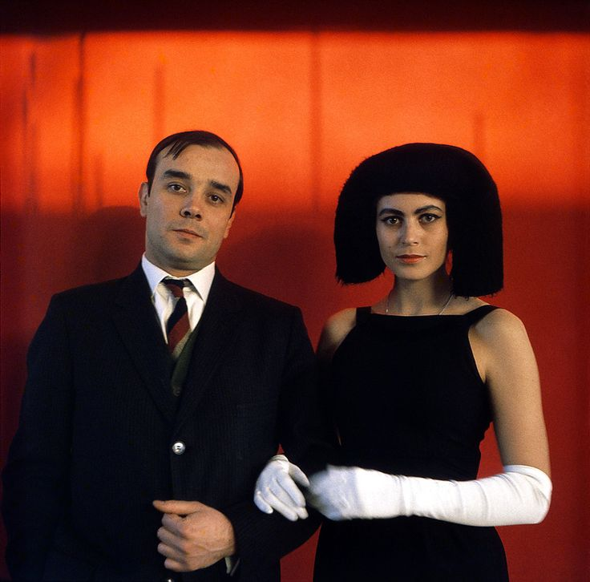
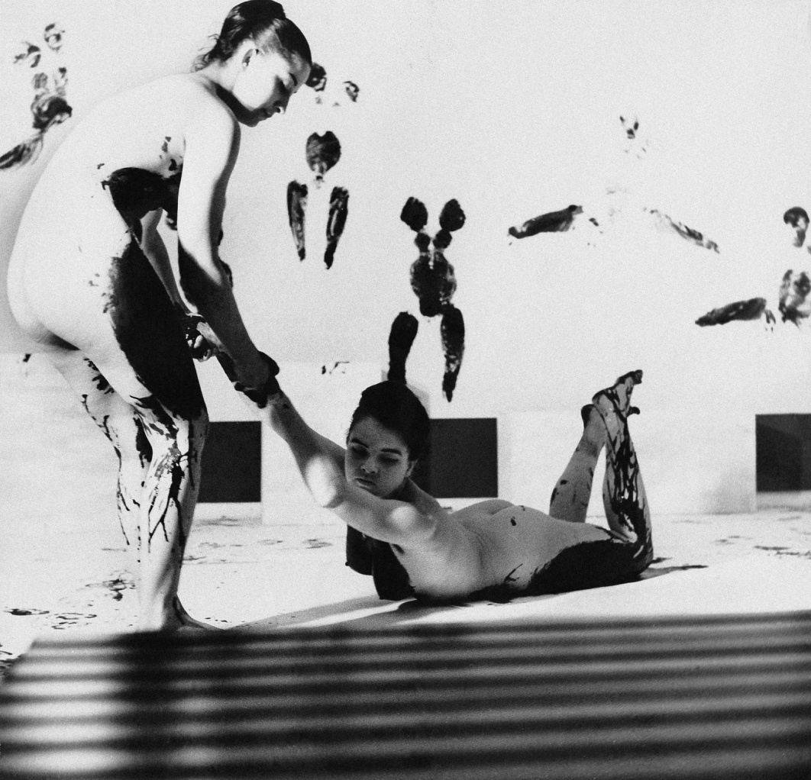
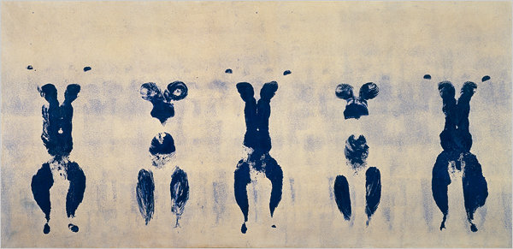
Yves Klein 1928-1962

Slide 2
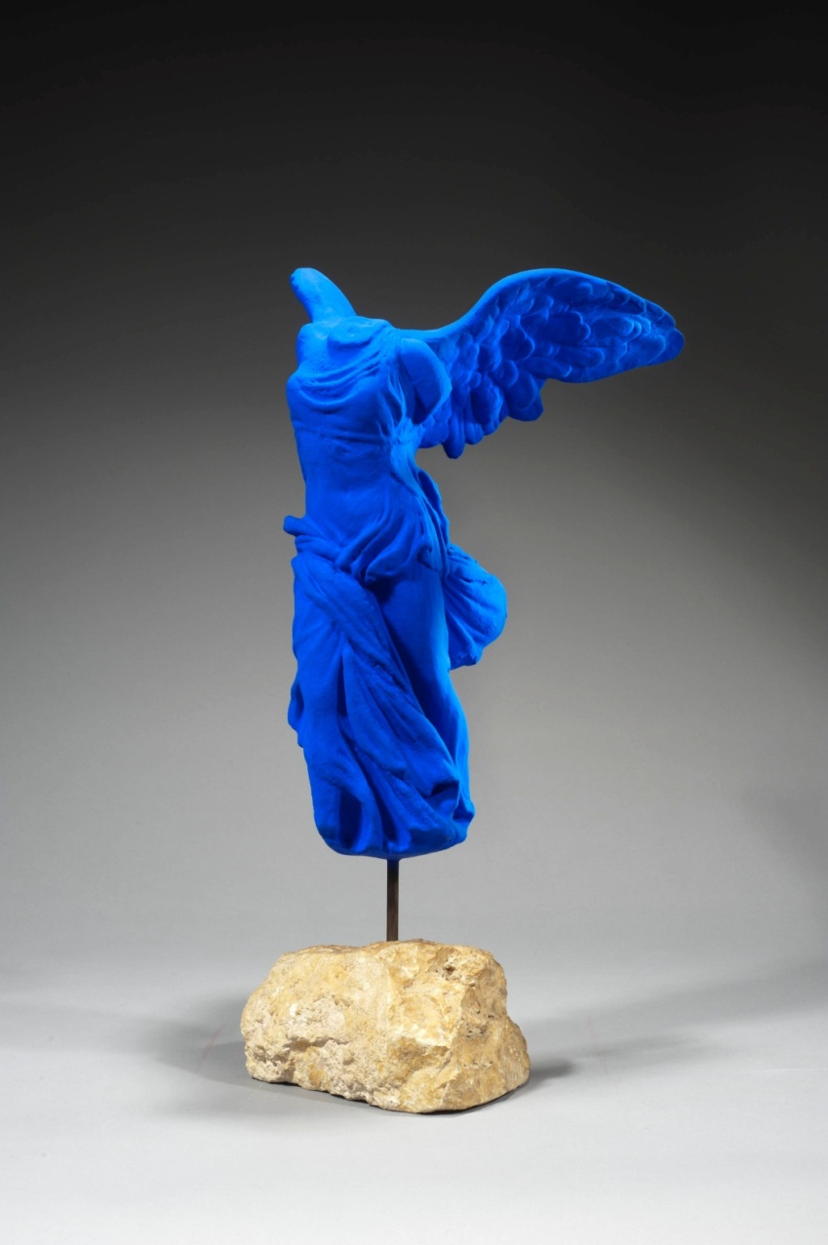
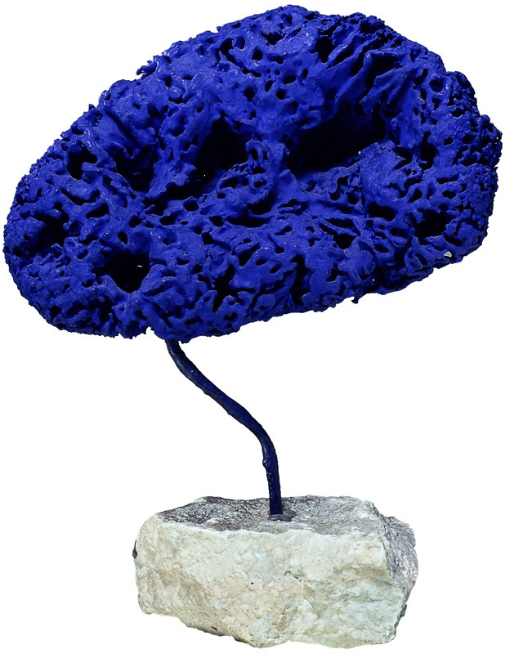
Vítězství Samothrace 1962

Slide 3
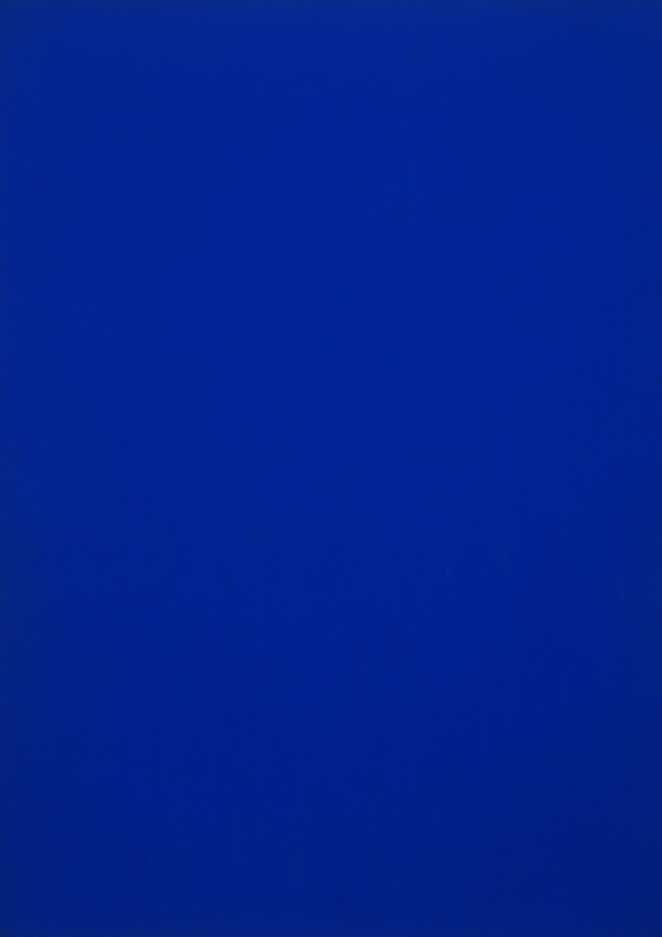
Blue monochrome 1961

Slide 4
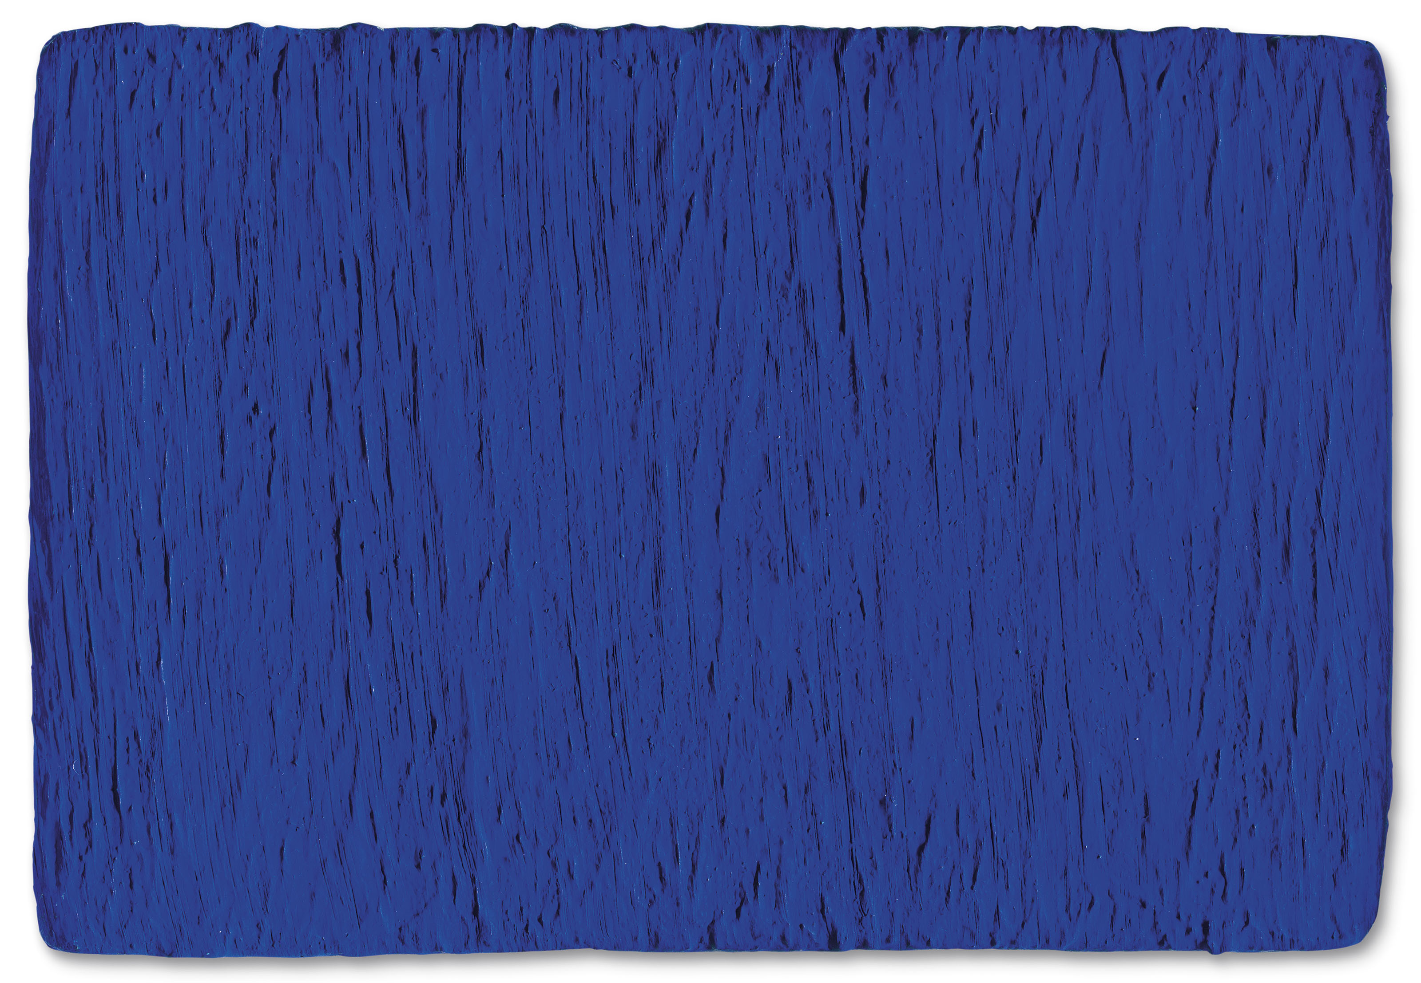
Untitled, Blue monochrome 62

Slide 5
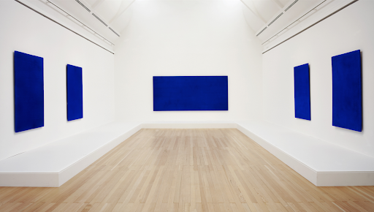

Slide 6
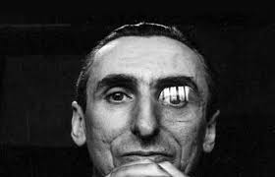
Art informel
Tašismus
Lyrická abstrakce
Michel Tapié Un art autre 1952

Slide 7
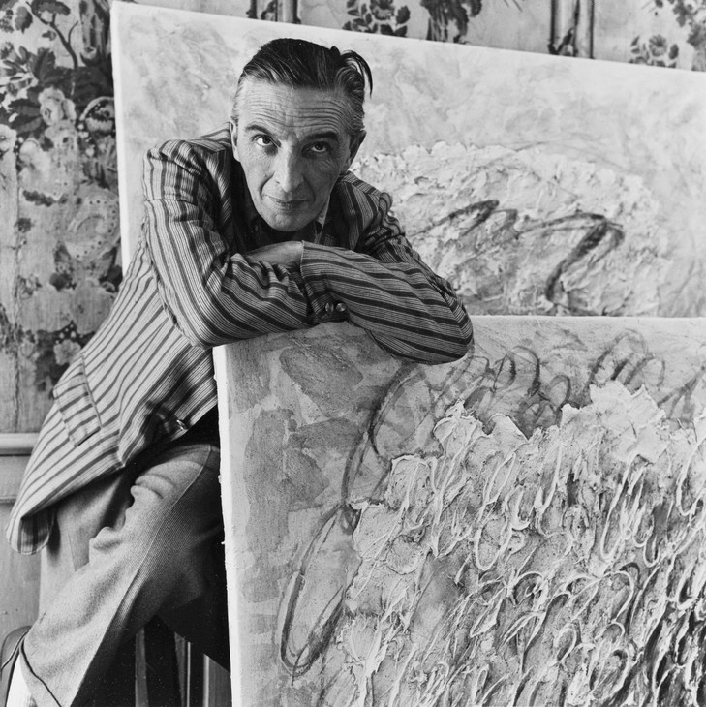
Jean Fautrier 1898-1964

Slide 8
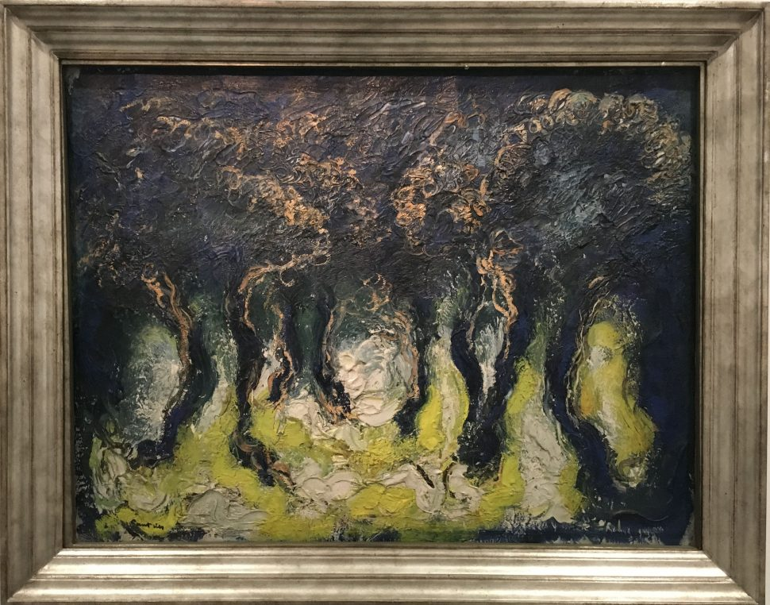
Les 1928

Slide 9
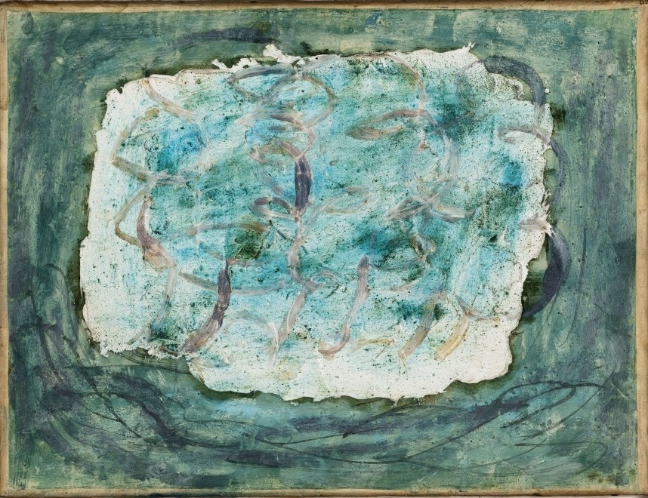
Les 1943

Slide 10
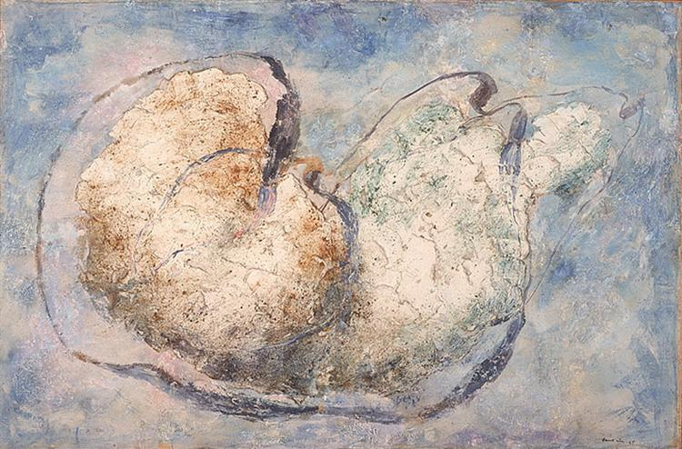
Holý 1945

Slide 11
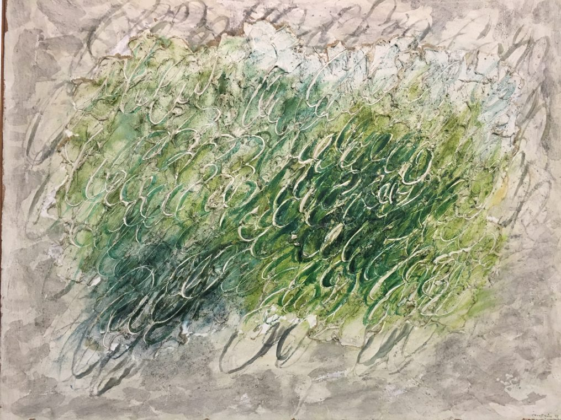
Zelené stromy 1958

Slide 12
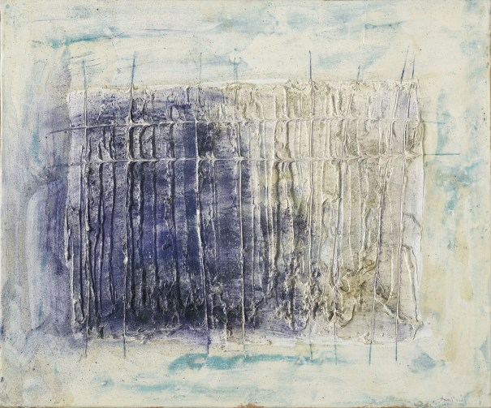
Pravoúhlá konstrukce 1958

Slide 13
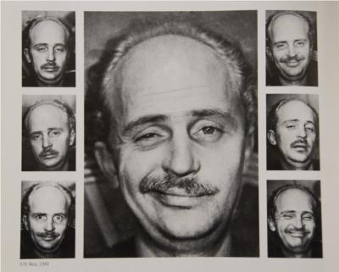
Wols (Alfred Otto Wolfgang Schulze) 1913-1951

Slide 14
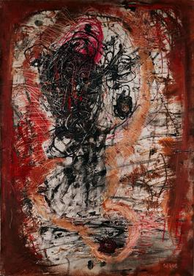
Bez názvu 1946-47

Slide 15
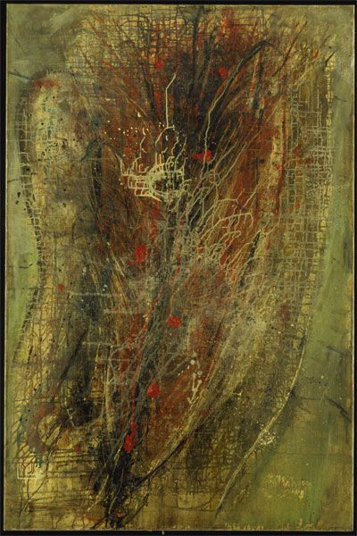
Manhattan 1948-49

Slide 16
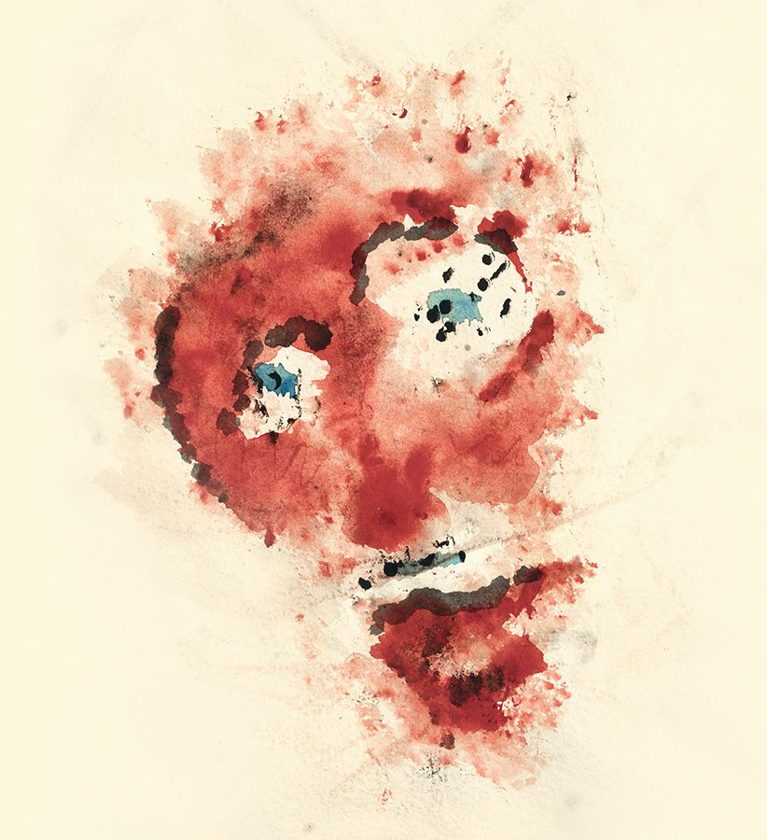
Henri Michaux 1899-1984

Slide 17
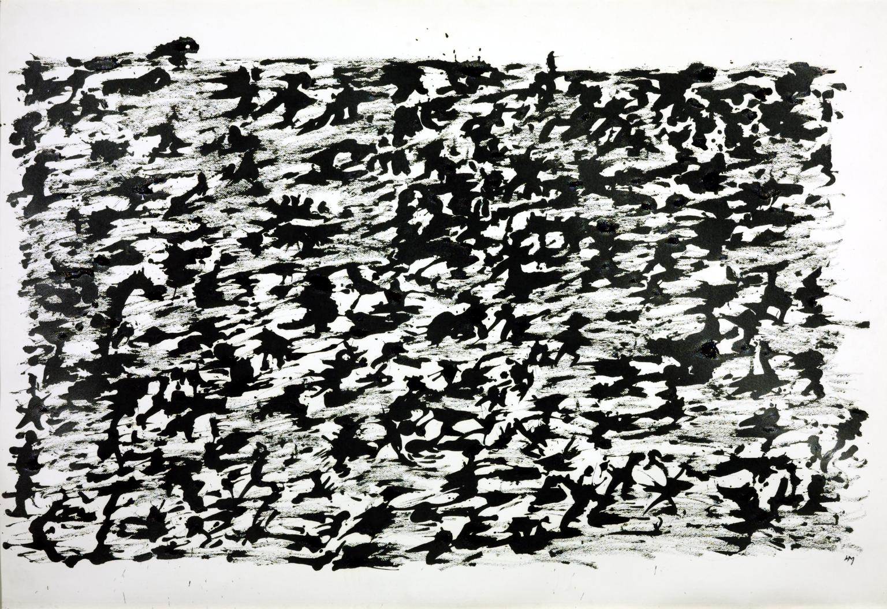
Bez názvu 1961

Slide 18
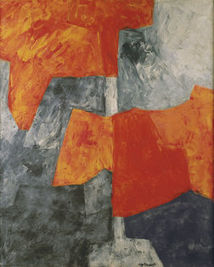
Serge Poliakoff 1900-1969
Composition grise et rouge 1964

Slide 19
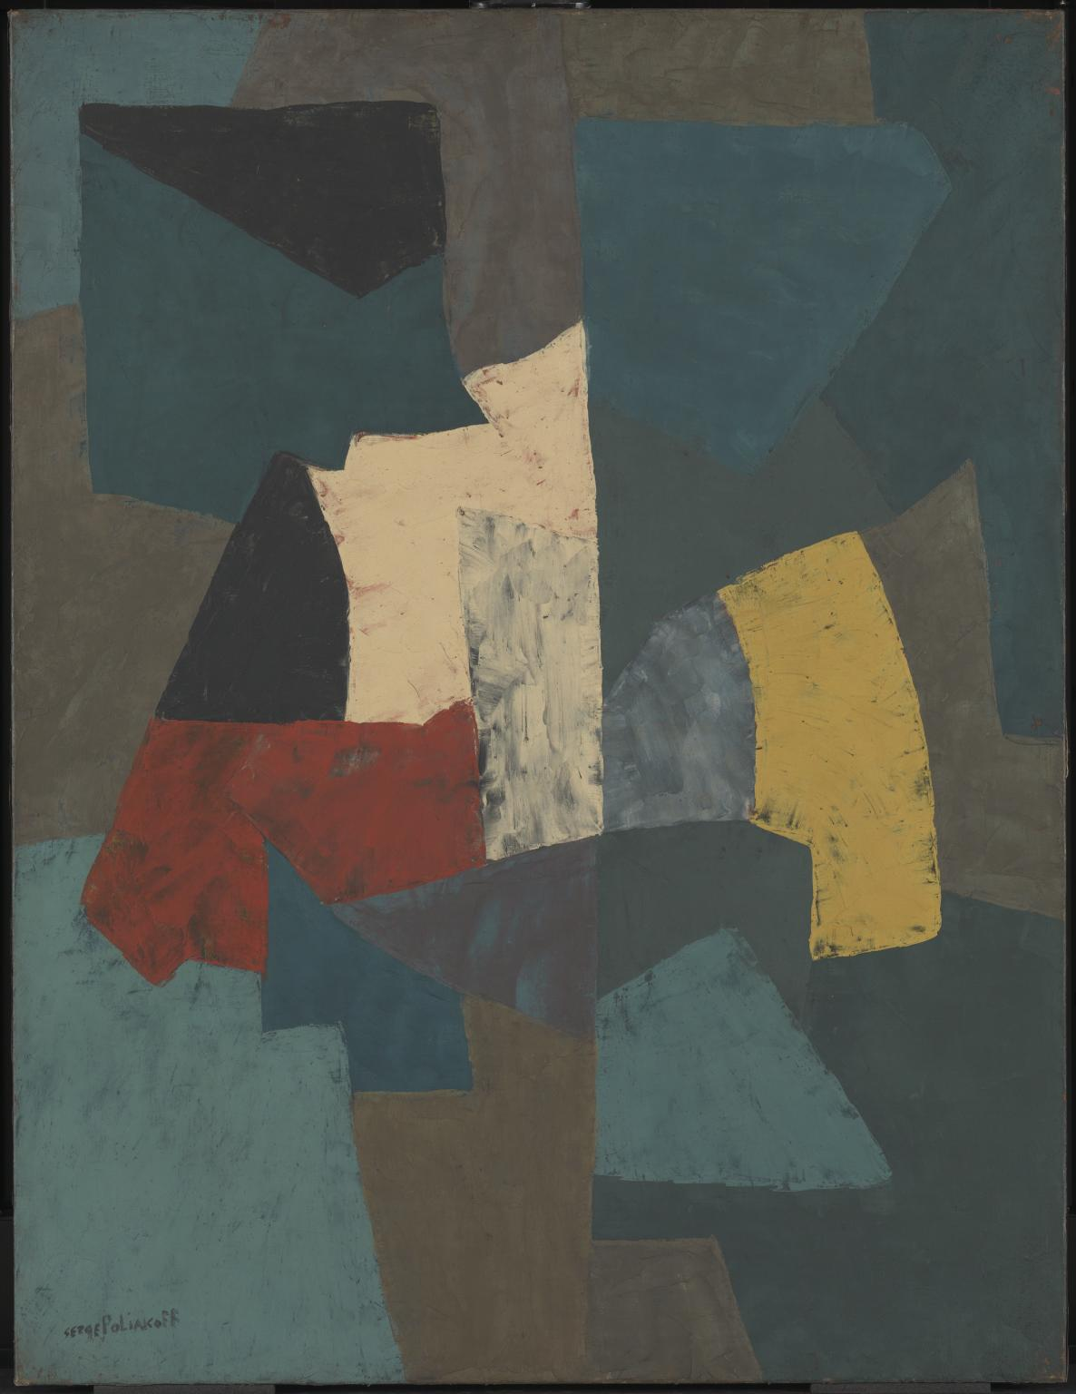
Abstraktní kompozice tate 1954

Slide 20
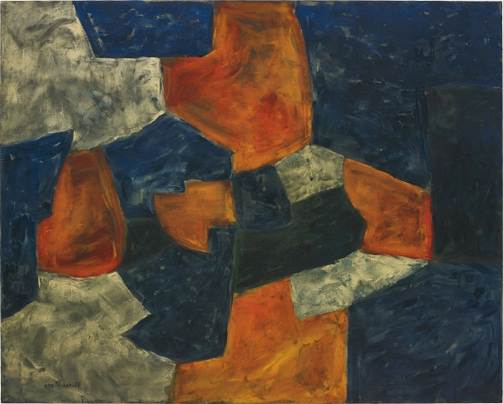
Abstraktní kompozice 1959

Slide 21
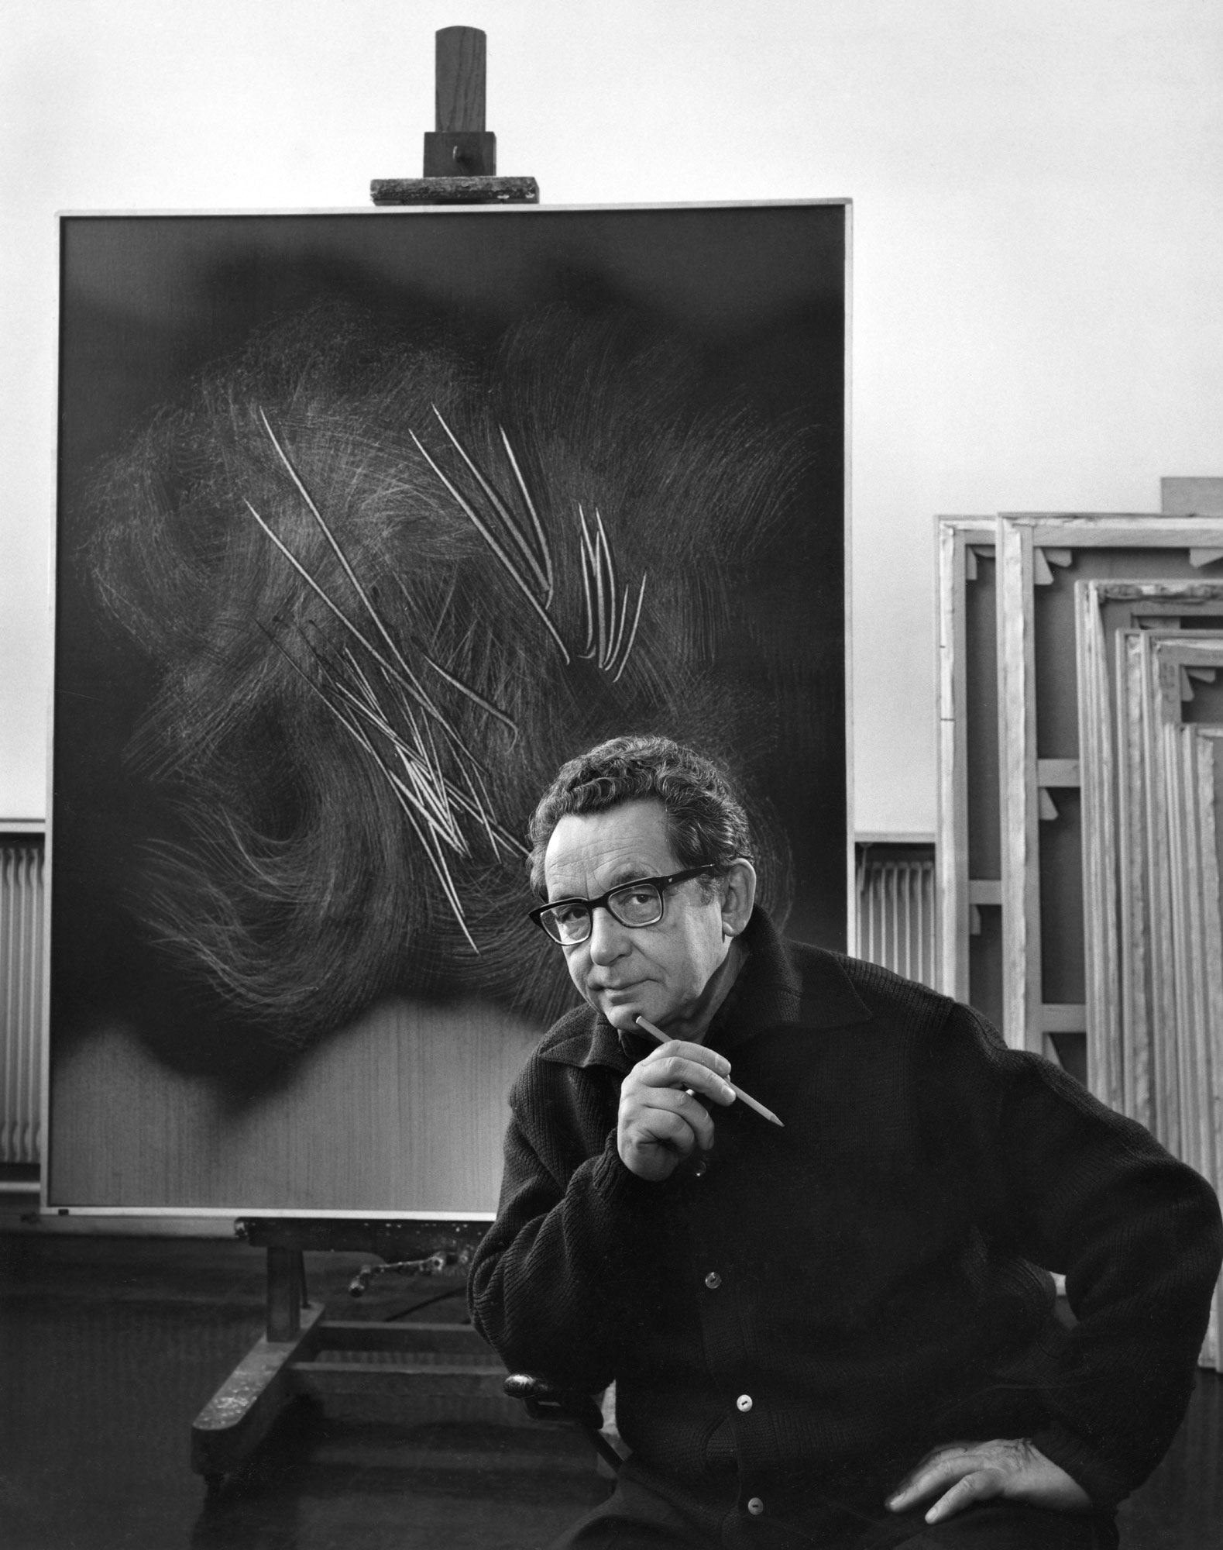
Hans Hartung 1904-1989

Slide 22
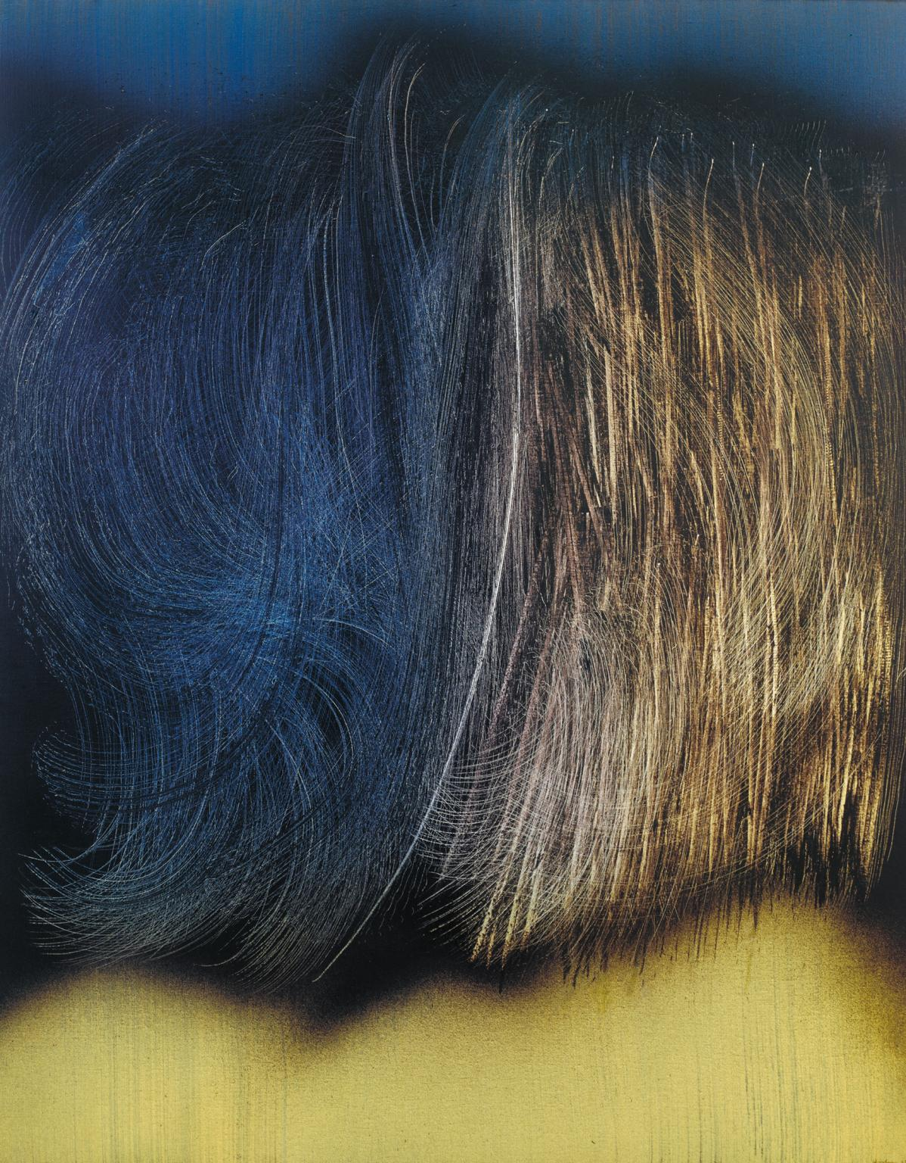
T1963-R6', Hans Hartung, 1963 | Tate

Slide 23
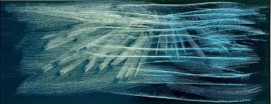

Slide 24
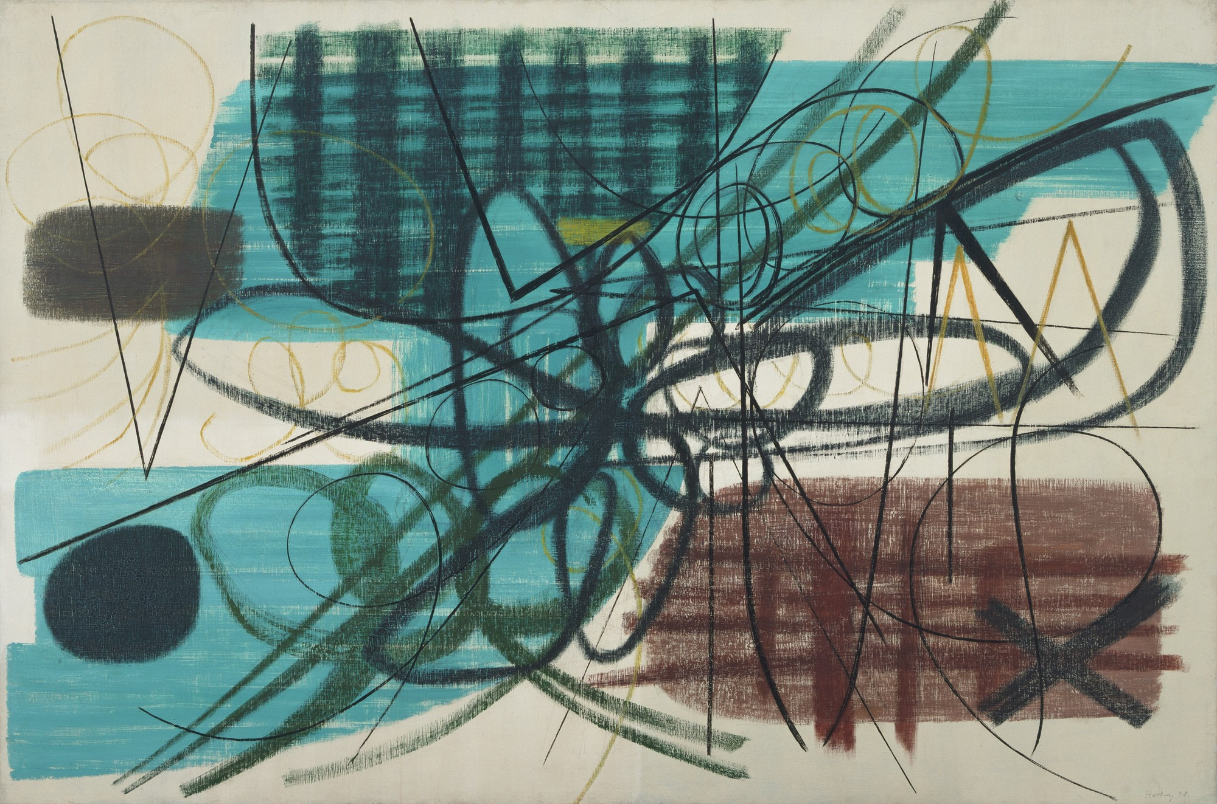
Obraz 1948

Slide 25
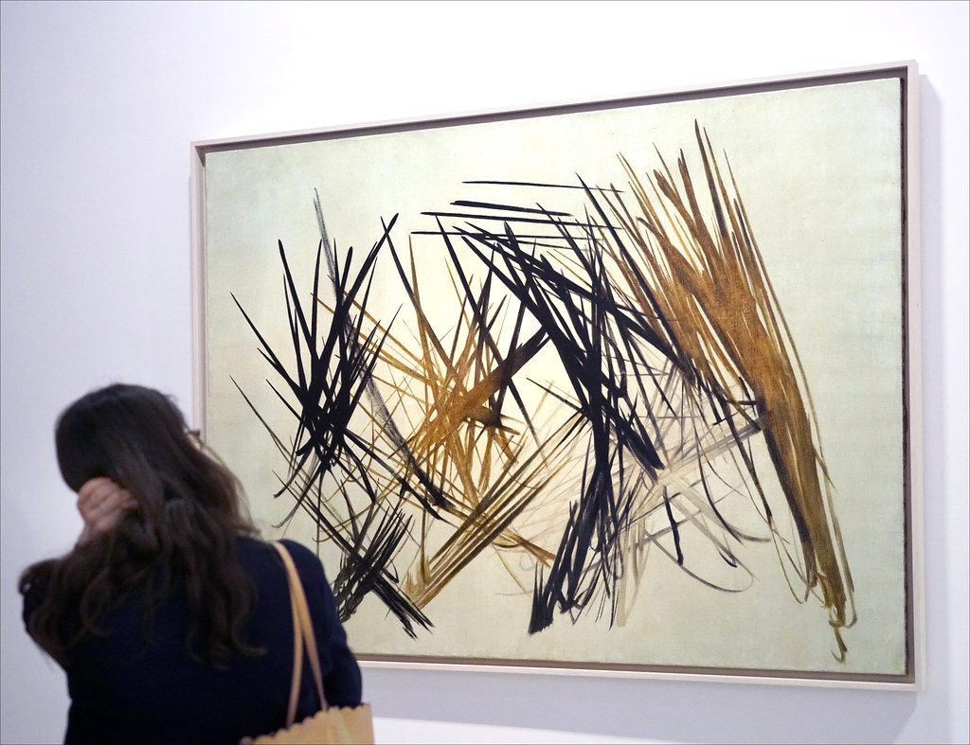

Slide 26
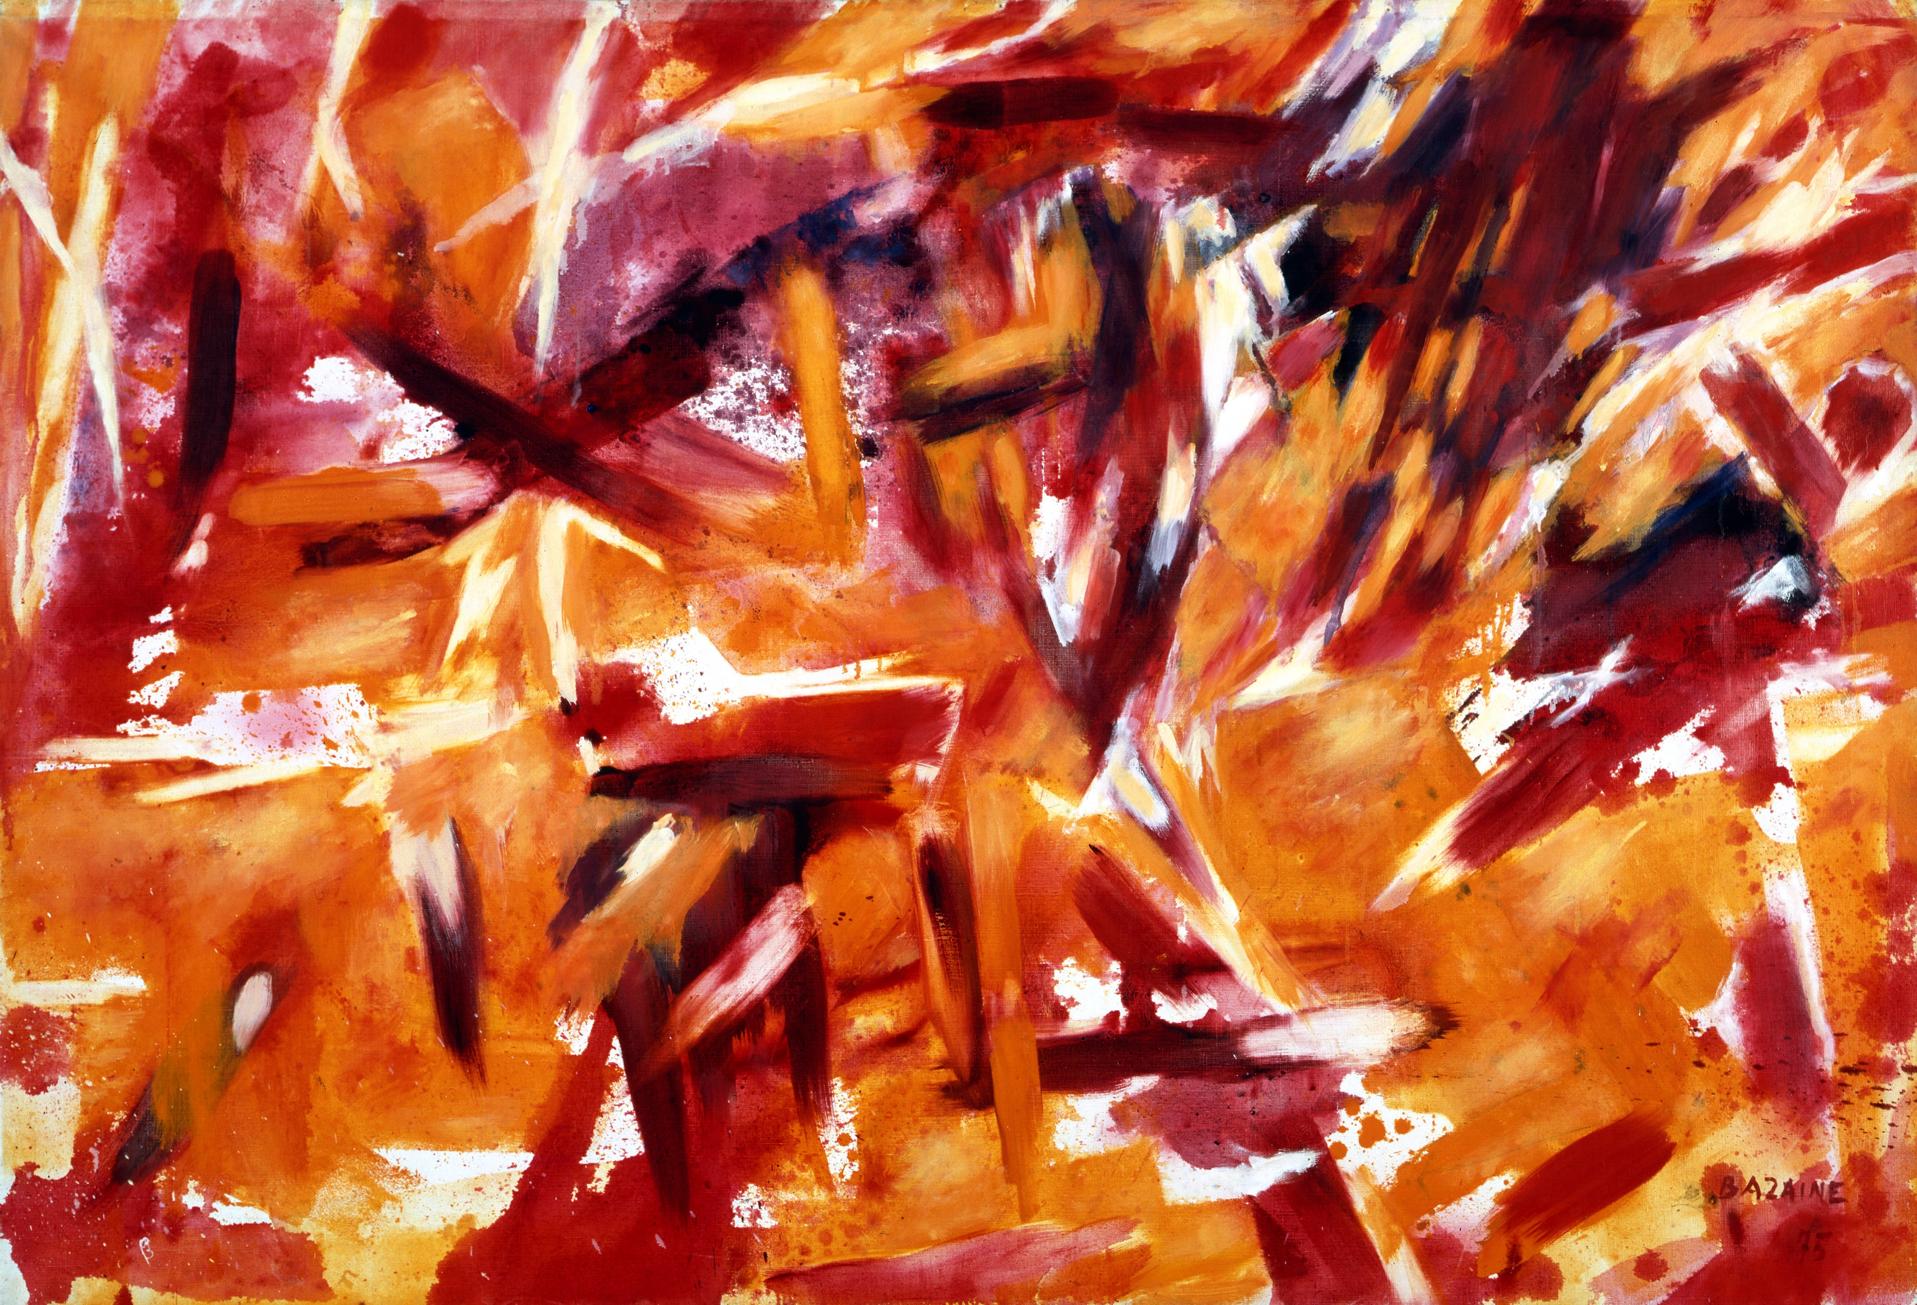
Jean Bazaine 1904-2001

Slide 27
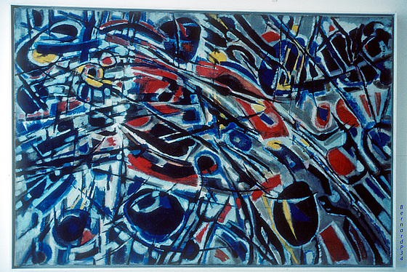
Strom a nebe 1950

Slide 28
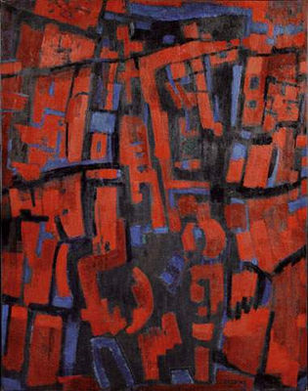
Stromy a planiny 1947

Slide 29
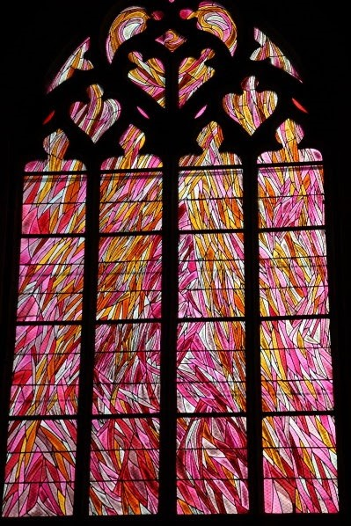
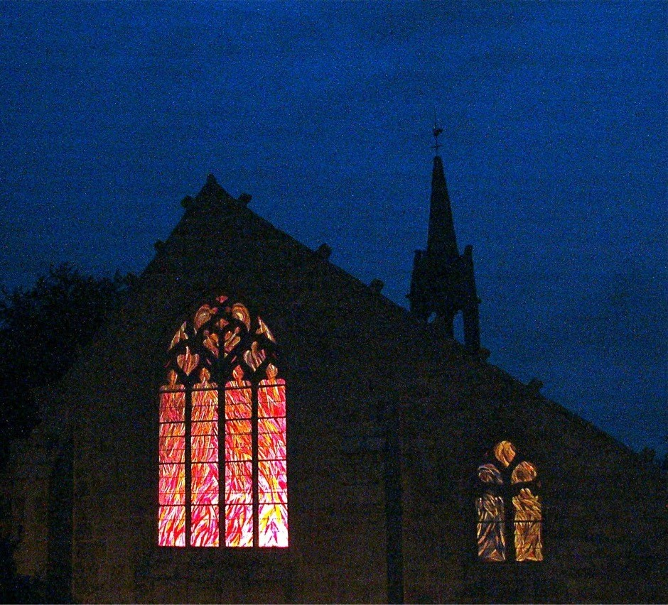

Slide 30
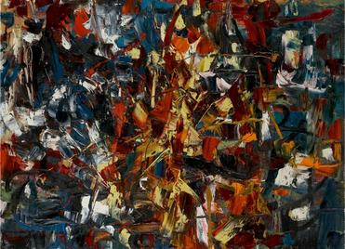
Jean-Paul Riopelle 1923-2002
Bez názvu 1948

Slide 31
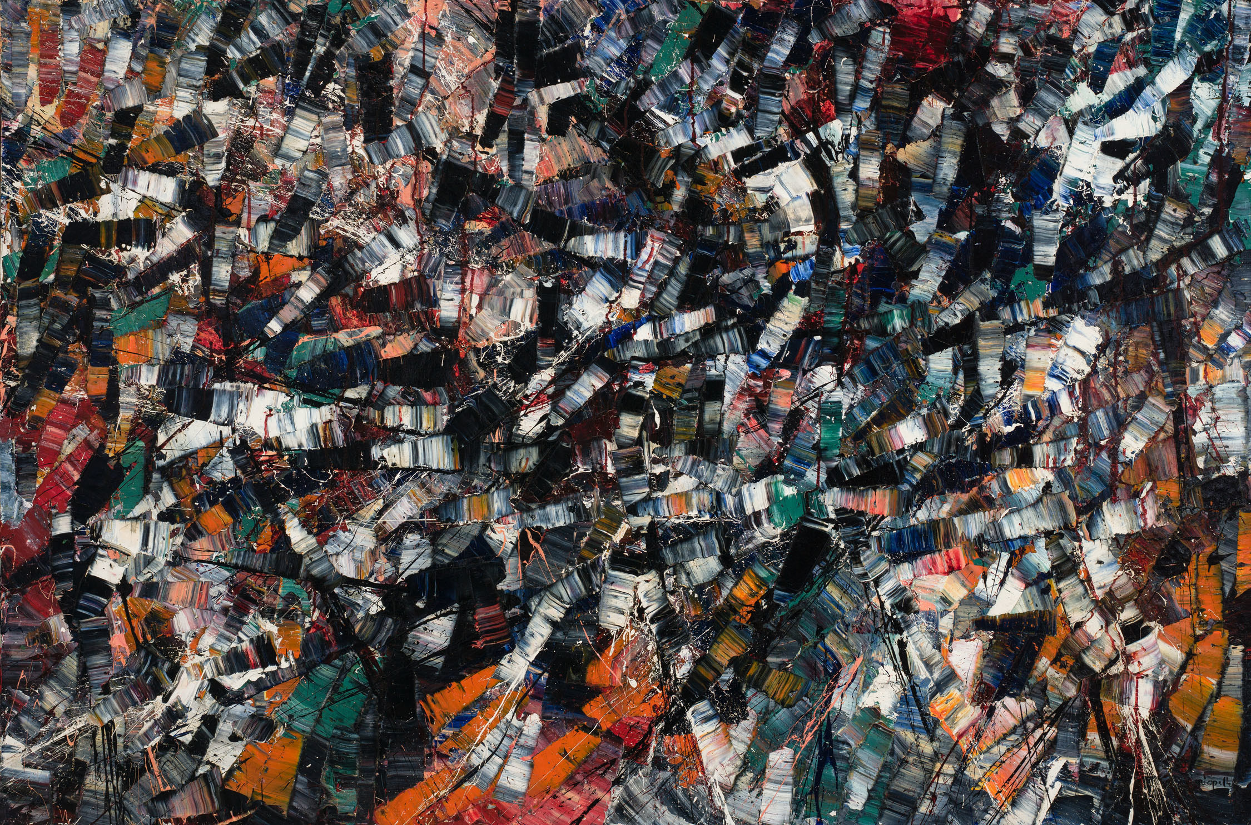
Karneval 1953

Slide 32
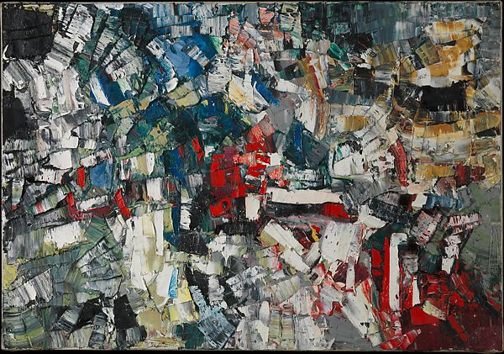
Bez názvu 1957

Slide 33
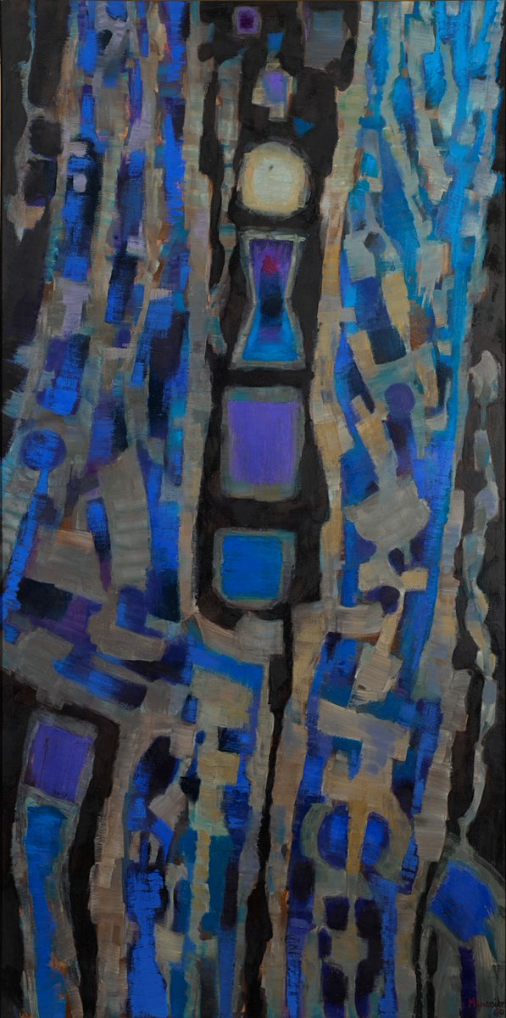
Alfred Manessier 1911-1993
Offrande du soir or Litanies, 1960

Slide 34
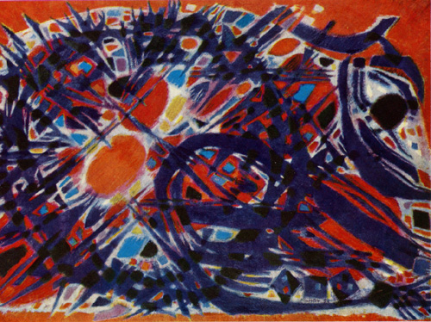
Trnová koruna 1954

Slide 35
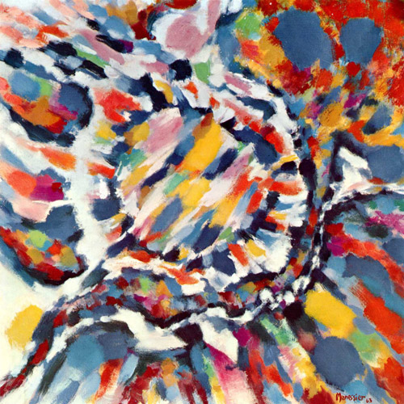
Míza 1963

Slide 36
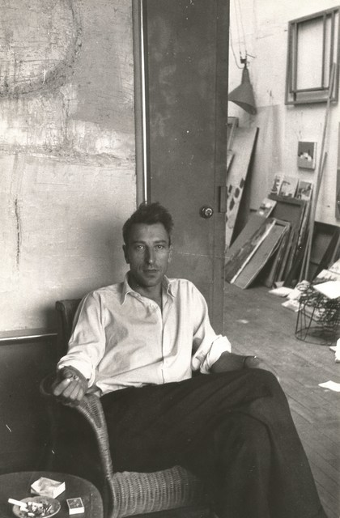
Nicolas de Staël 1914-1955

Slide 37
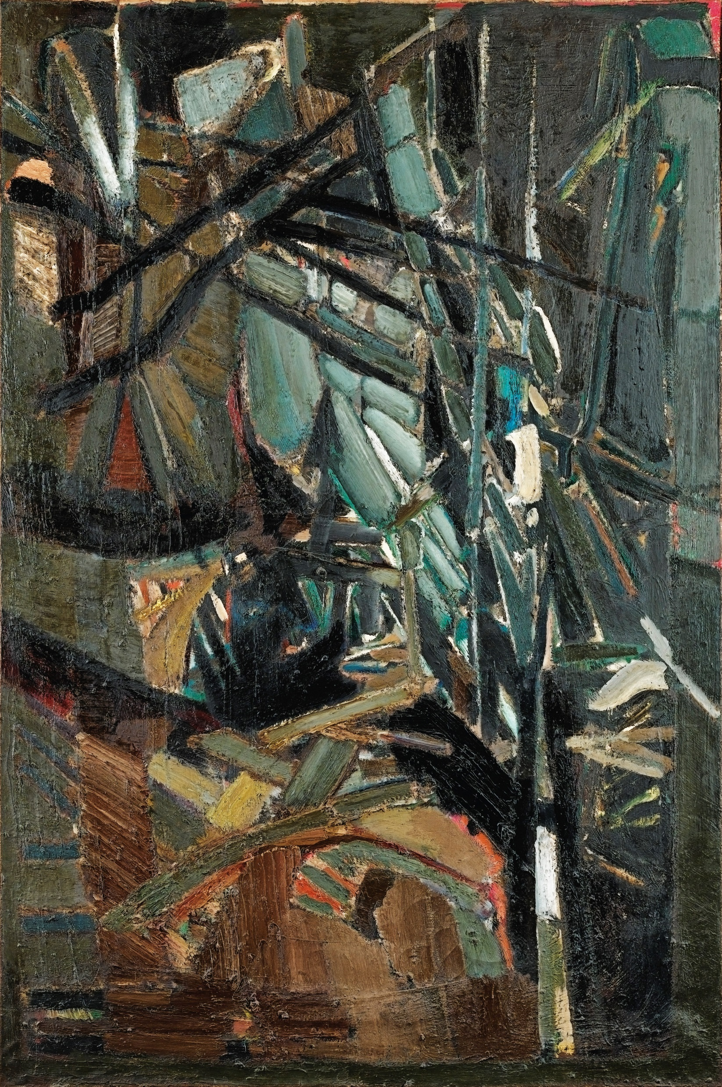
Abstraktní kompozice 1947

Slide 38
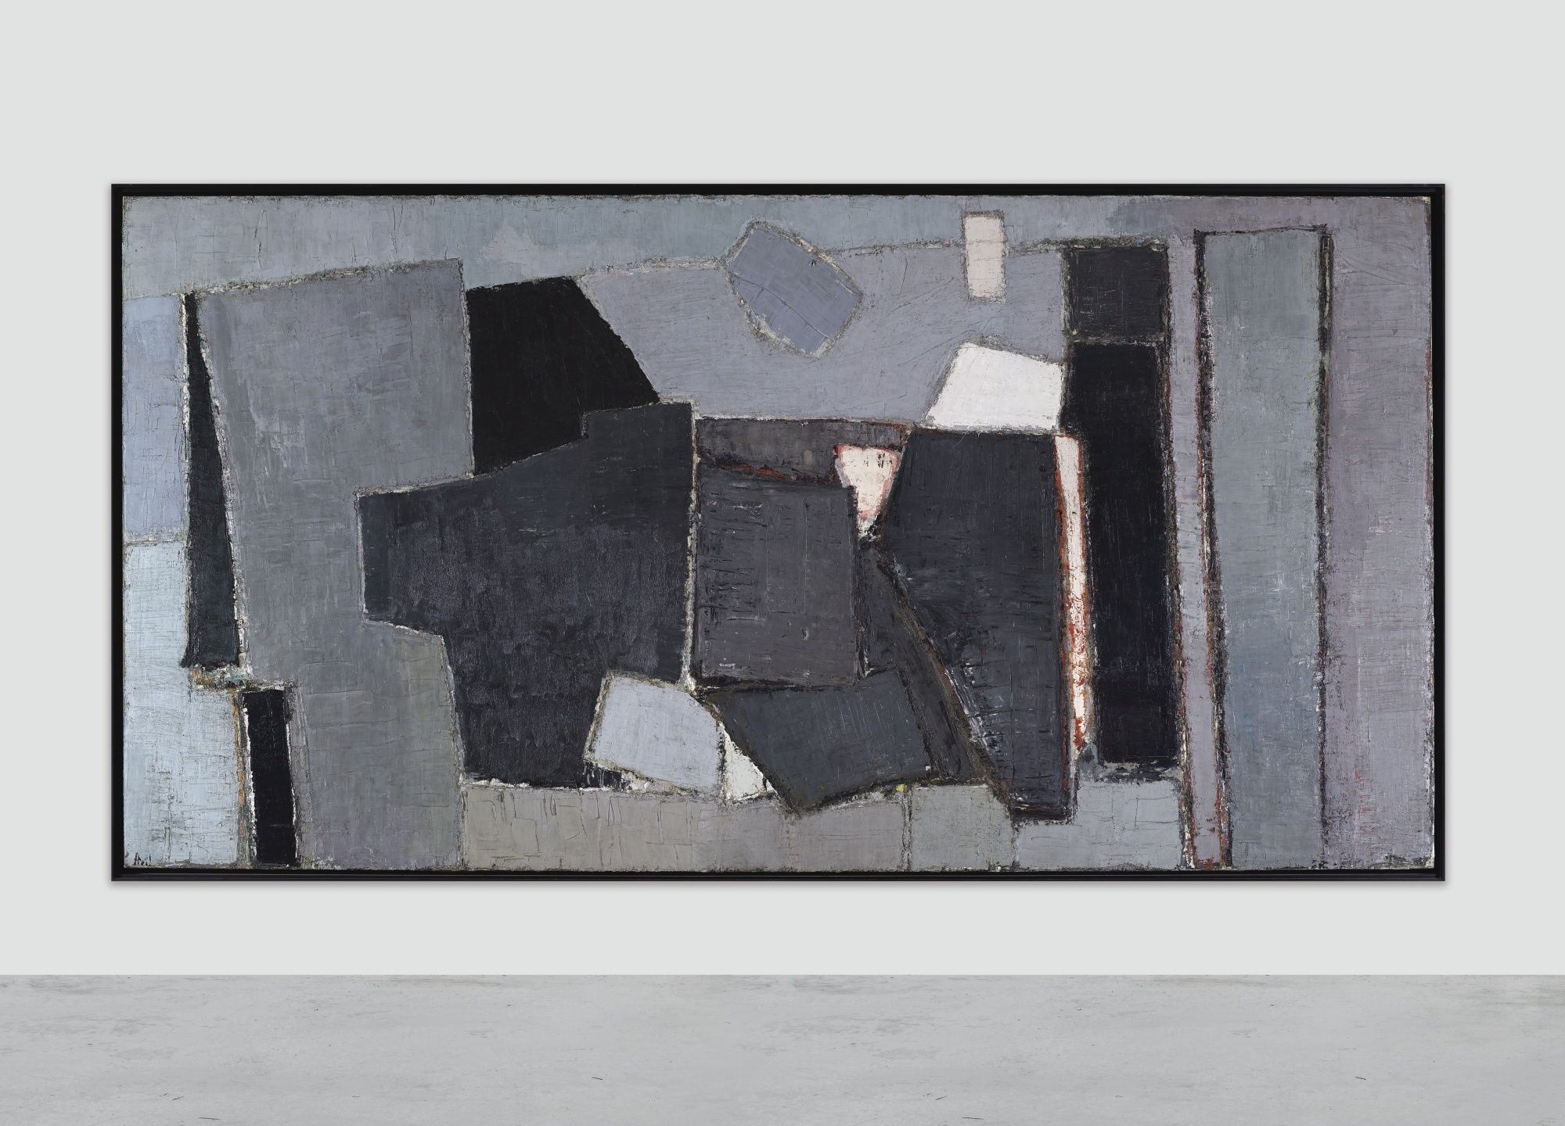
Kompozice 1950

Slide 39
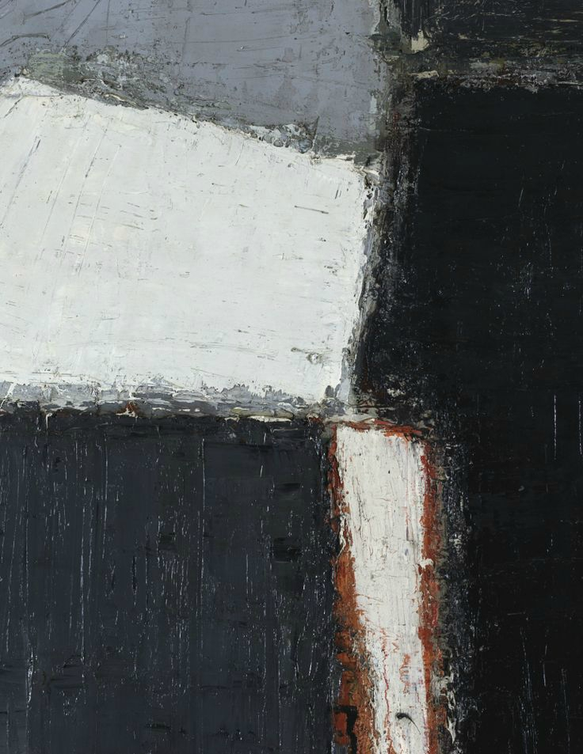
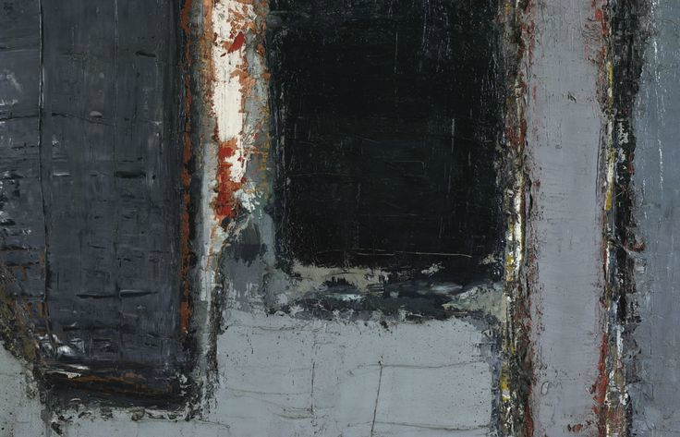

Slide 40
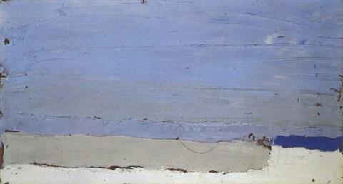
Vilerville 1952

Slide 41
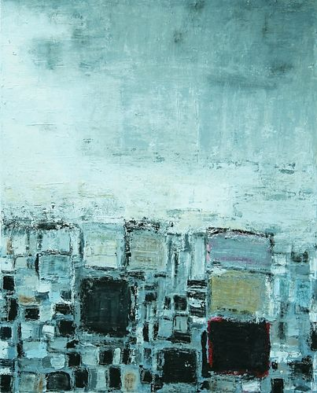
Střechy 1952

Slide 42
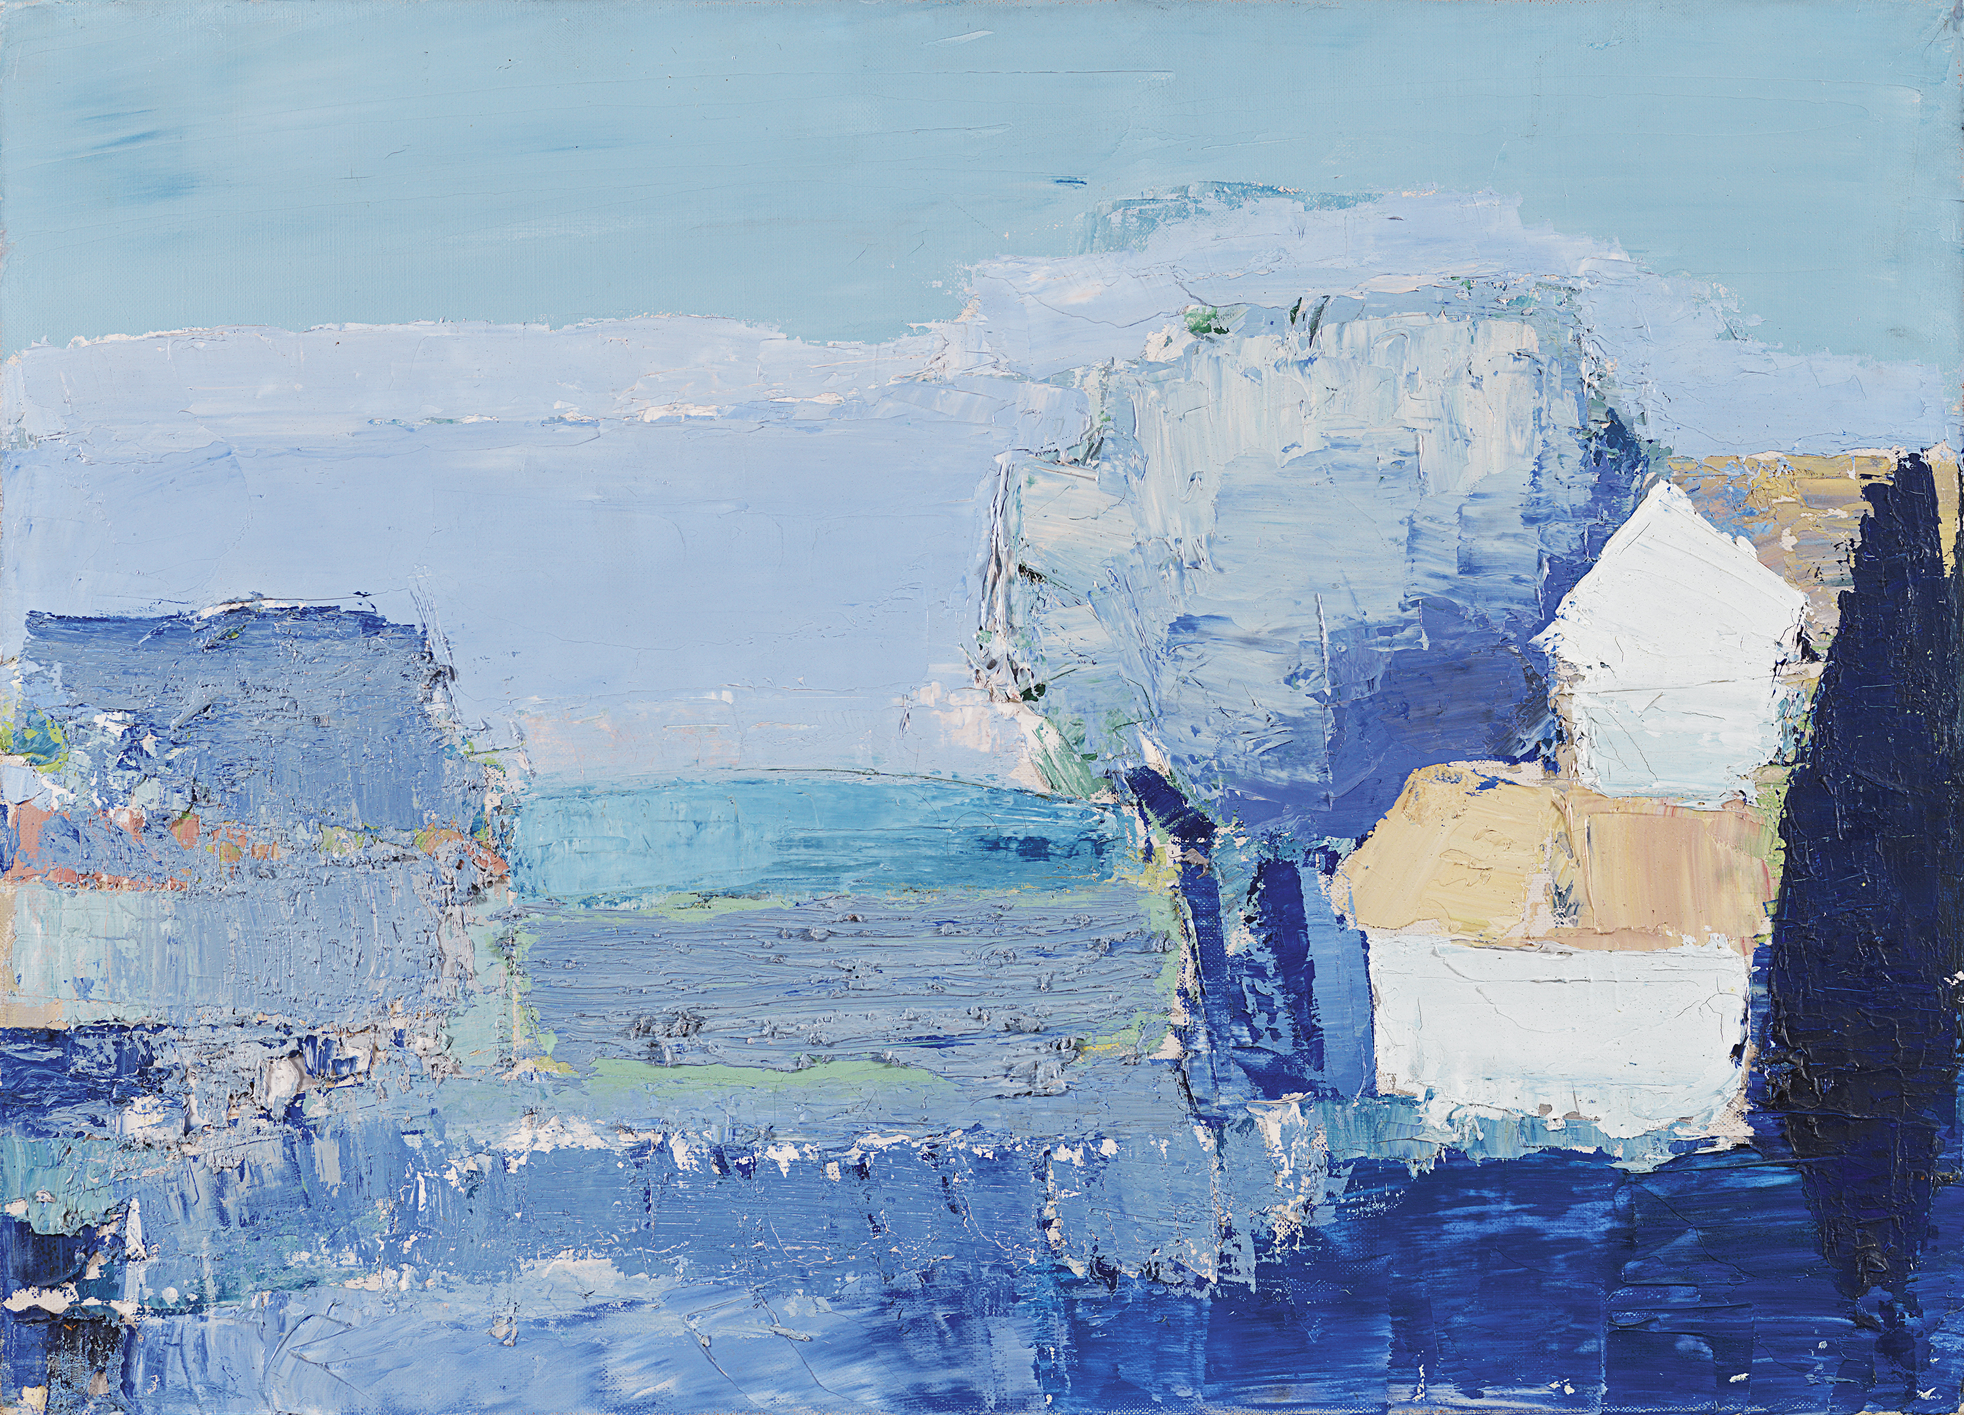
Středomořská krajina 1953

Slide 43
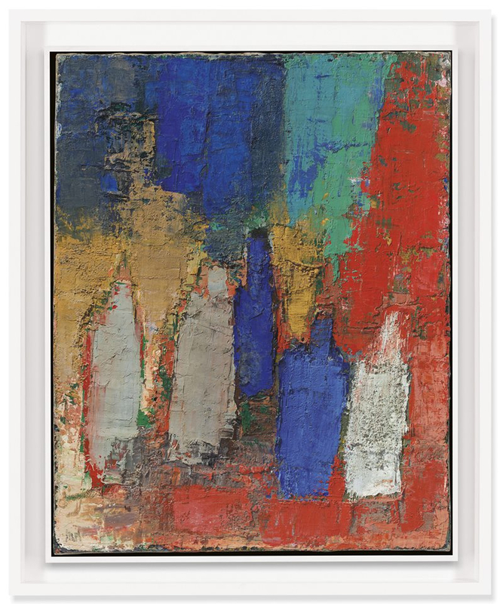
Lahve 1952

Slide 44
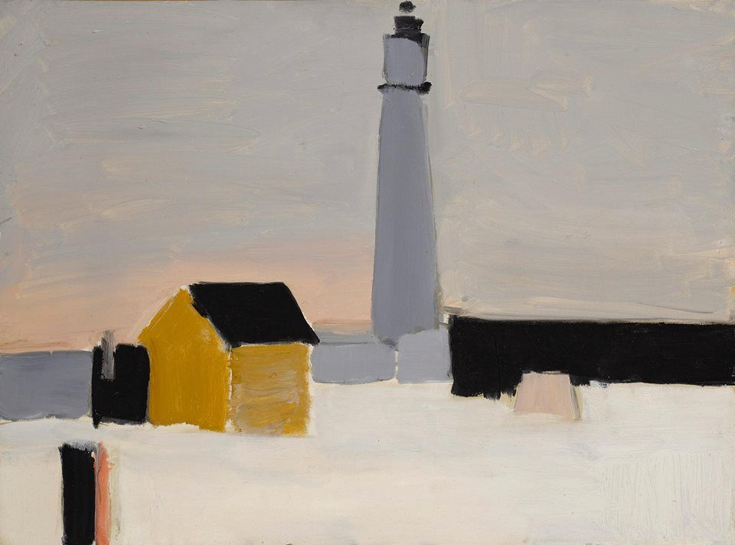
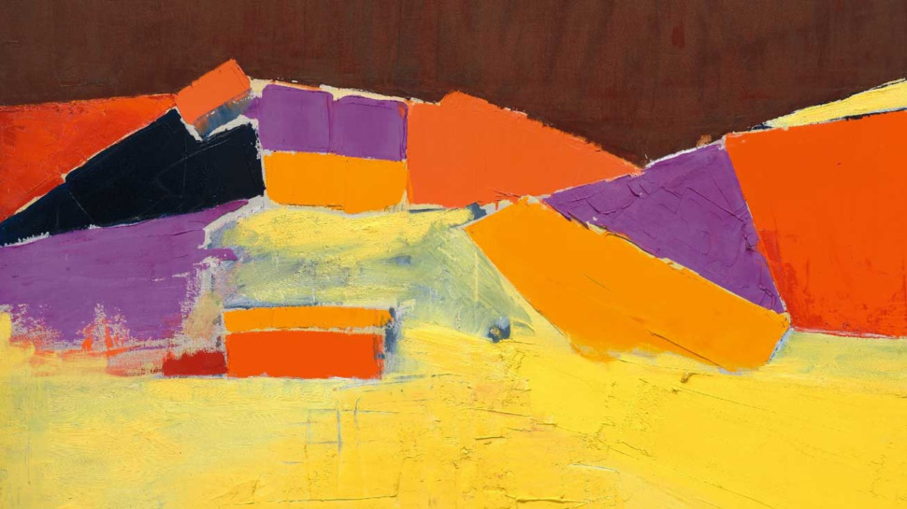
Antibes 1954 Agrigento 1954

Slide 45

Fotbalisté 1952

Slide 46

Zao wou-ki 1921-2013

Slide 47

Juin-Octobre 1985

Slide 48

n 3.12.67 we see the influence of Chinese ink painters and the typical Chinese split composition representing the sky and the earth, but we also see the painterly qualities of a Jackson Pollock or Franz Kline. Wou-Ki never titled his works as he felt this would influence the viewer with pre-conceptions, so whether this is a study of mist, wind, or the elemental properties of the earth, the matter and voids of the universe, it is up to the viewer to decide, but we do see a fusion of Chinese and Western art and a boldness of application and colour.

Slide 49

Pierre Soulages 1919-

Slide 50

Peinture 33x46cm, 1959

Slide 51

Peinture 200x162cm, 1960

Slide 52

Peinture 125x202cm, 1958

Slide 53

Peinture 195x130cm, 1957

Slide 54


Outrenoir 1970 -

Slide 55


Peinture 202x143, 2019

Slide 56

Alberto Burri 1915-1995

Slide 57

Sacco – Composizione 1953

Slide 58

Sacco 1954

Slide 59


Red Plastic 1962

Slide 60

Emilio Vedova 1919-2006

Slide 61

Tensione N 4 V, 1959

Slide 62



Slide 63


Slide 64
Americká lyrická abstrakce

Slide 65

Jules Olitski

Slide 66

Larry Poons

Slide 67
Český informel

Slide 68

Vladimír Boudník 1924-1968

Slide 69

Strukturální grafika XXI 1963

Slide 70


Slide 71

Robert Piesen 1921-1977

Slide 72

Magma 1961

Slide 73

Gehinnom 1963

Slide 74

Pavla Mautnerová 1919 -
Bez názvu 1961

Slide 75

Jan Koblasa 1932-2017
Co je dole je i nahoře

