Slide 1
Abstraktní expresionismus
Akční malba

Slide 2
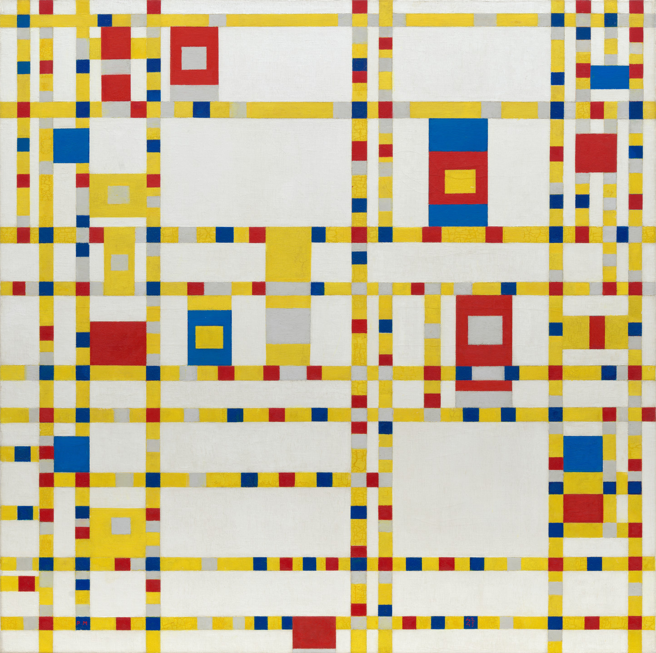
Broadway Boogie woogie, 1942-43

Slide 3
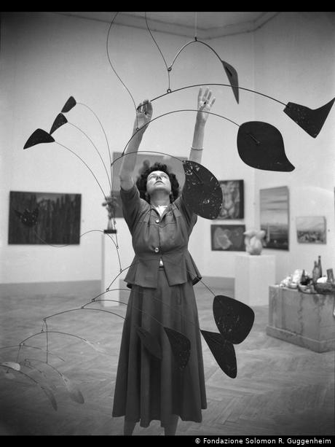
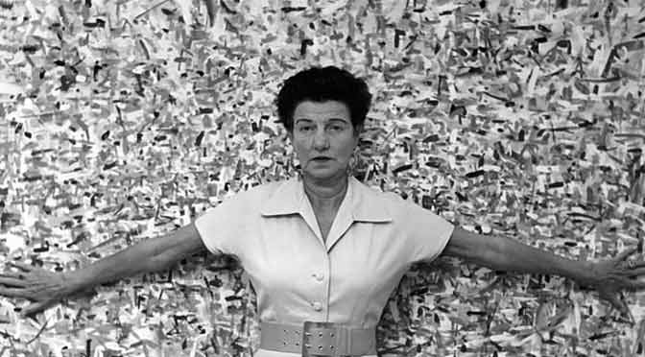
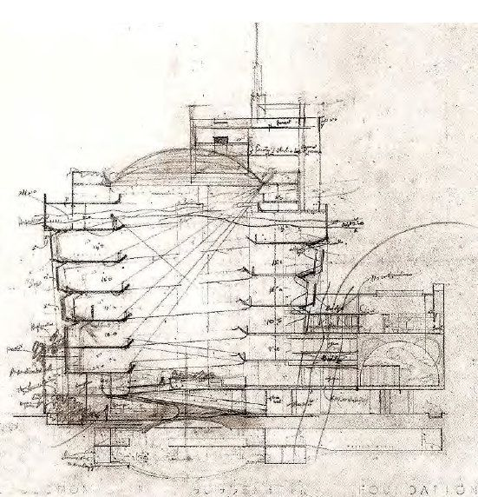
Peggy Guggenheim

Slide 4
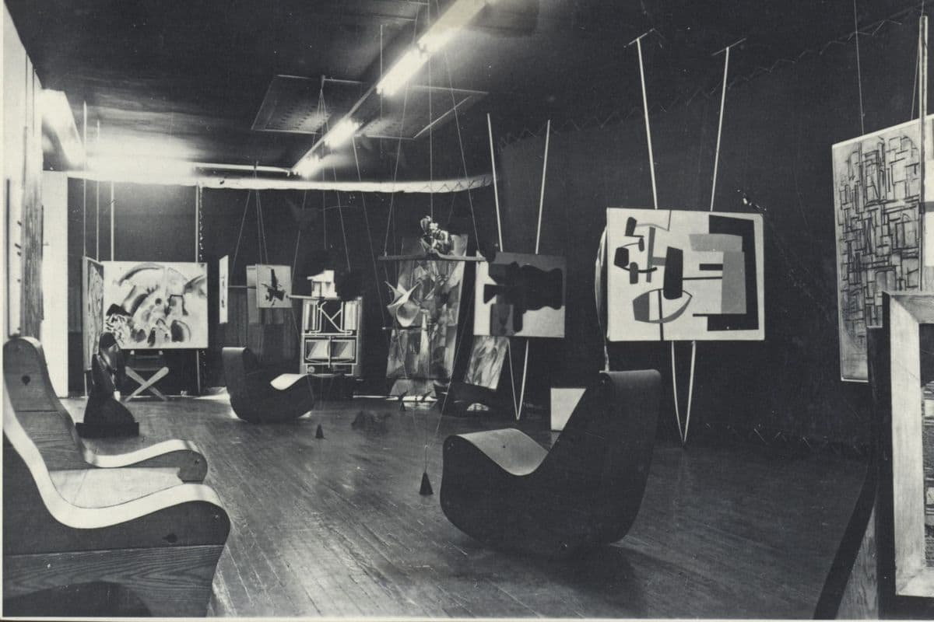
Art of this century gallery, 1942 -

Slide 5
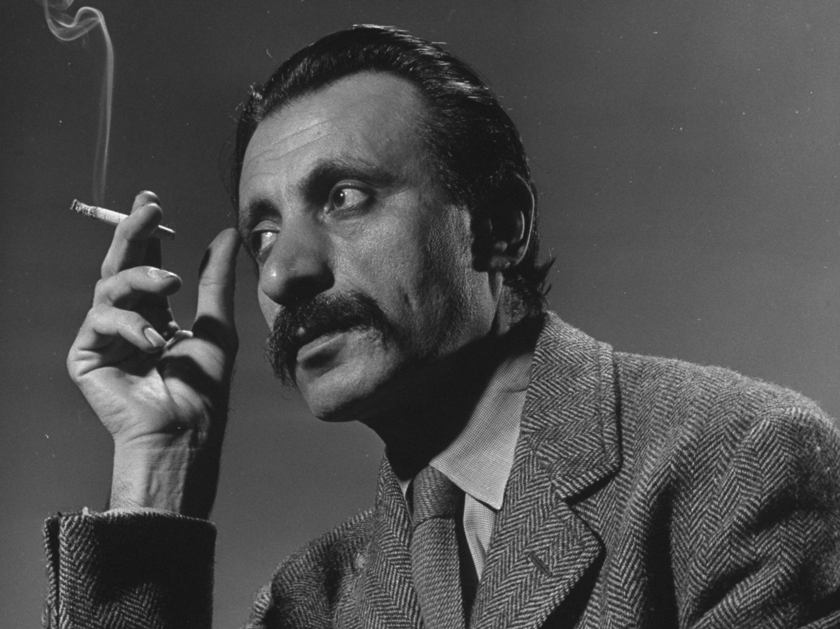
Arshille Gorky 1904-1948

Slide 6
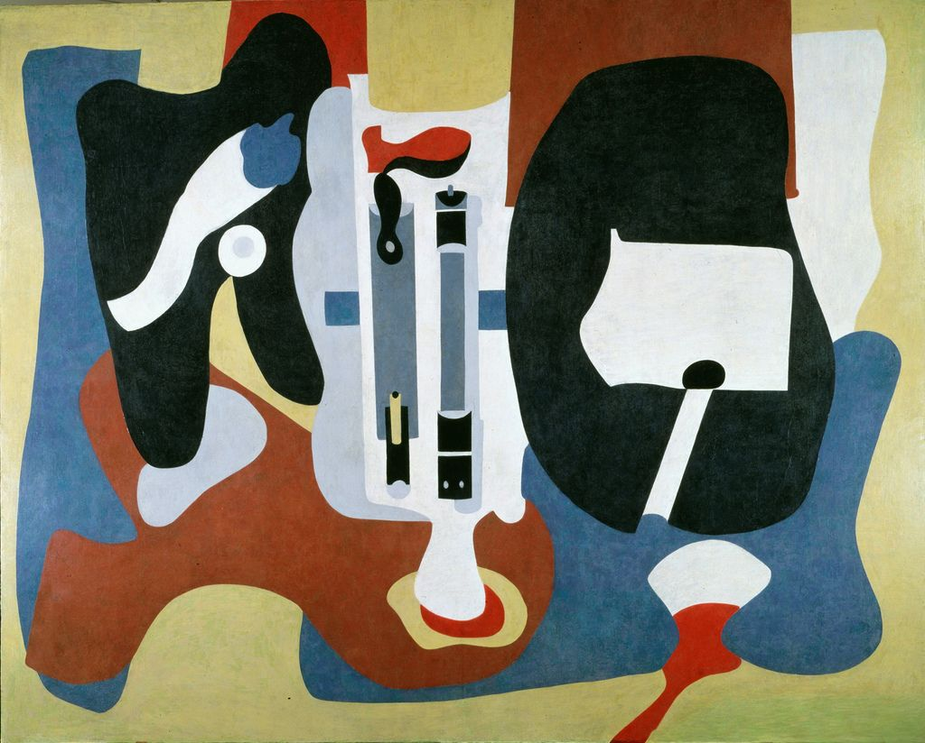
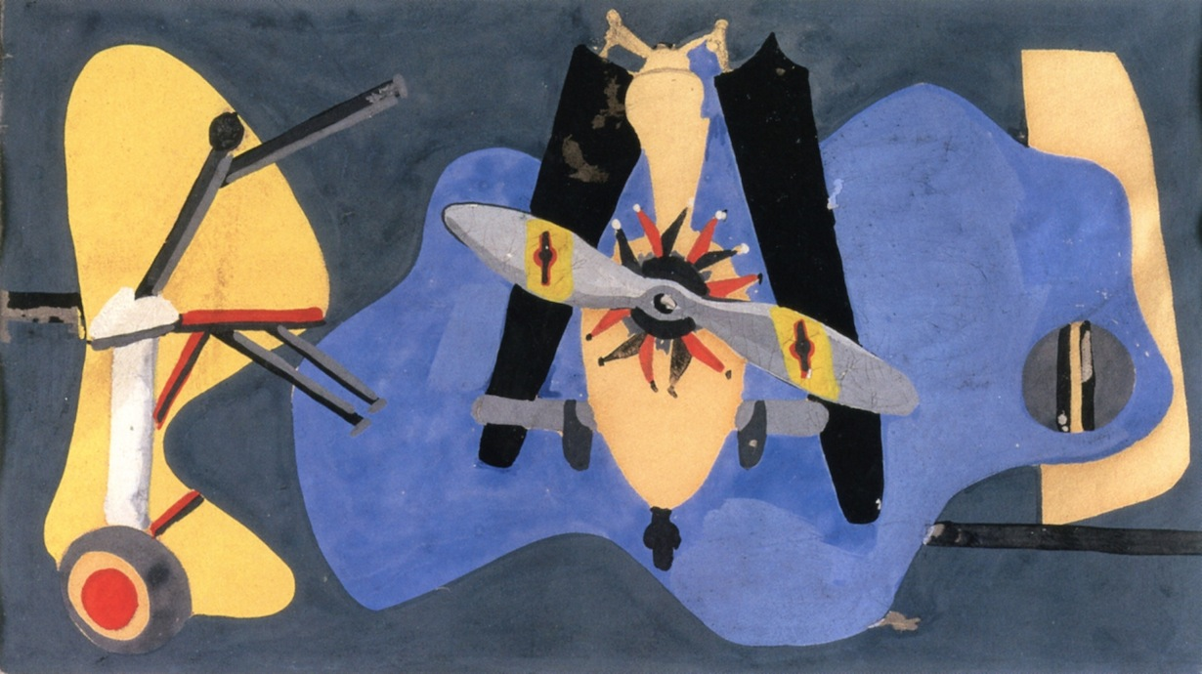
Study for Mechanics of Flying mural, 1936

Slide 7
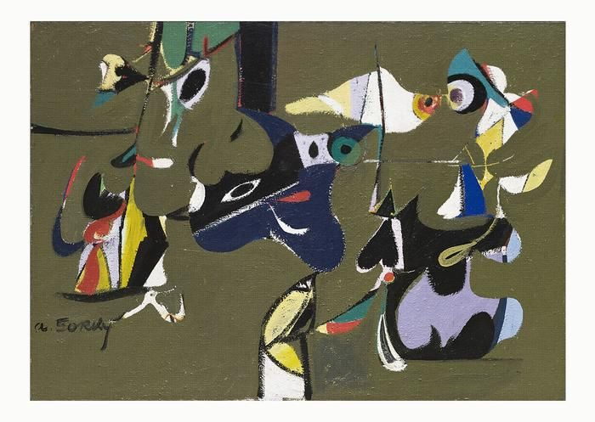
Garden of Sochi 1941

Slide 8
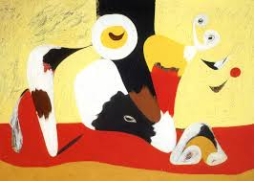
Mojave 1941

Slide 9
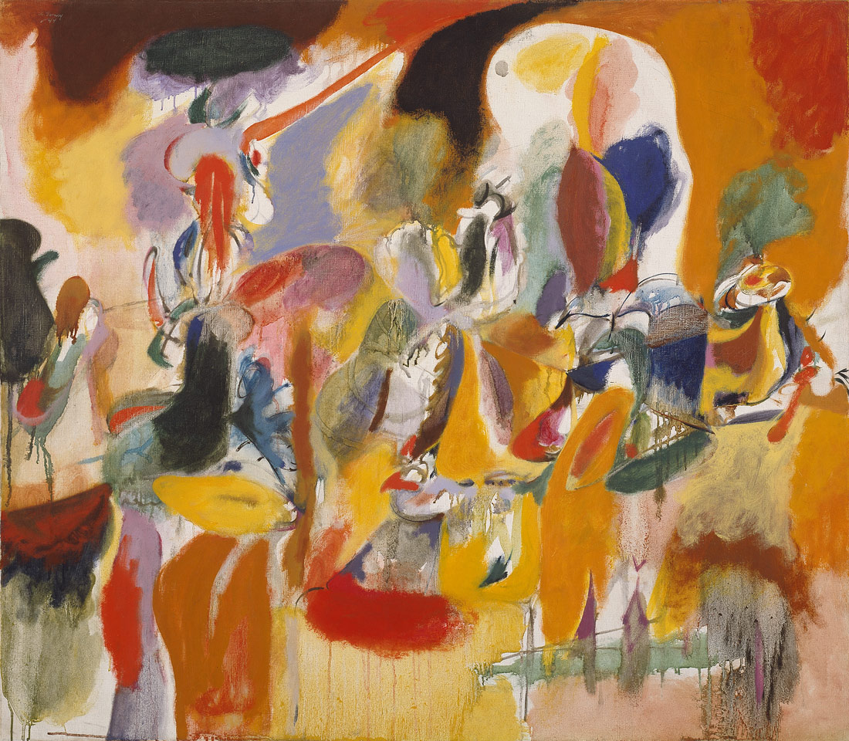
Water of Flowery Mill 1944

Slide 10
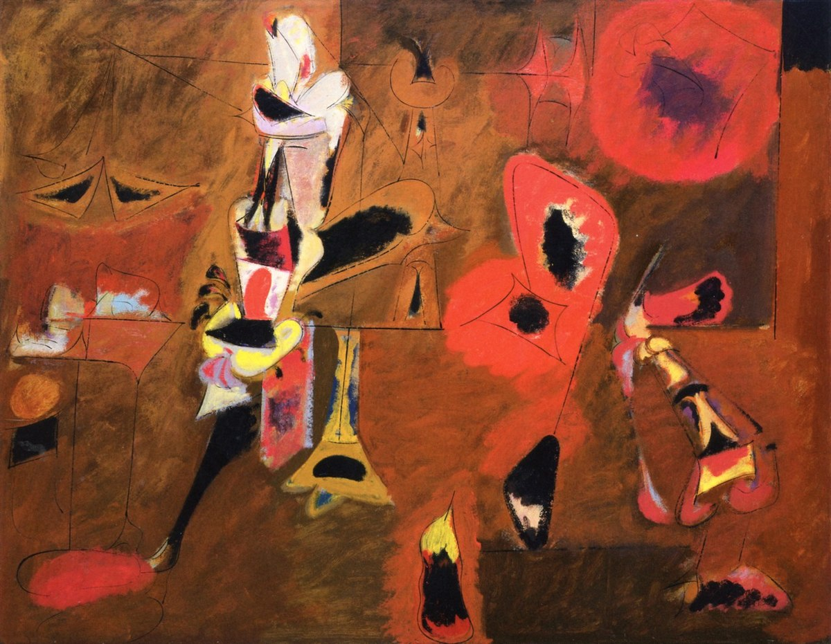
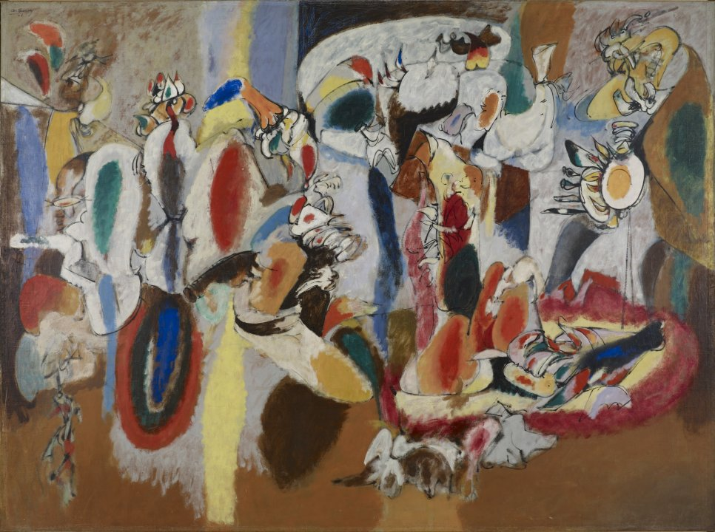
The Liver Is the Cock´s Comb 1944 Agonie 1947

Slide 11
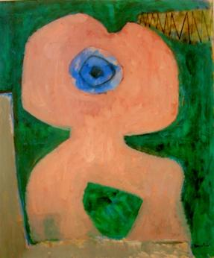
William Baziotes 1912-63
Cyclops 1947

Slide 12
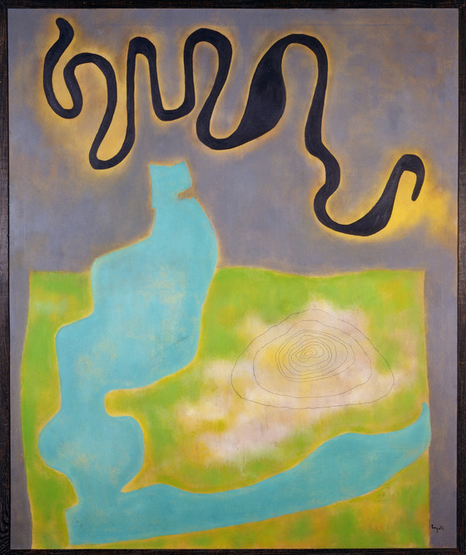
Congo 1954

Slide 13
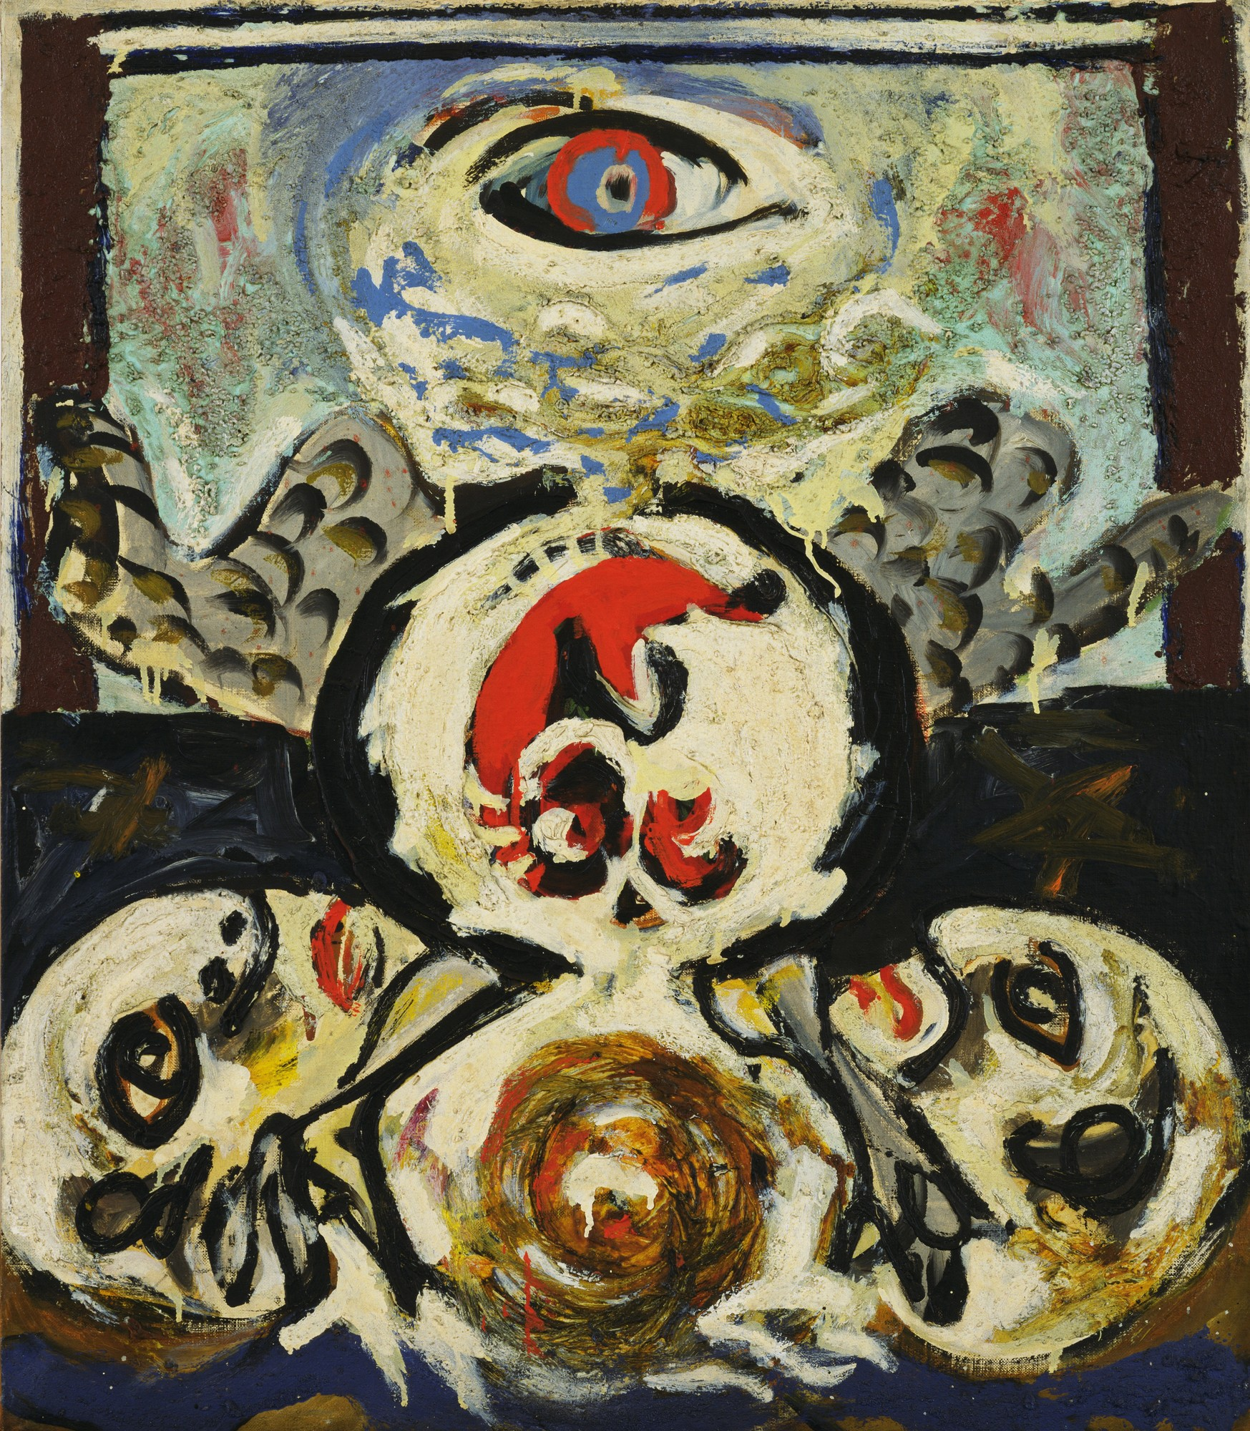
Jackson Pollock
Bird 1938-41

Slide 14
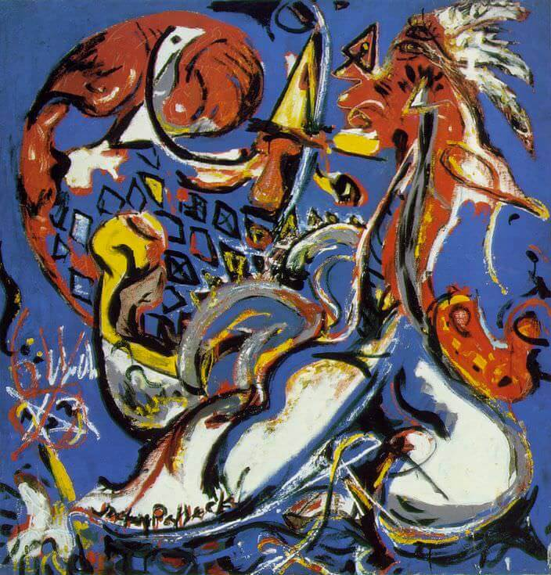
Moon Woman Cuts the Circle1942

Slide 15
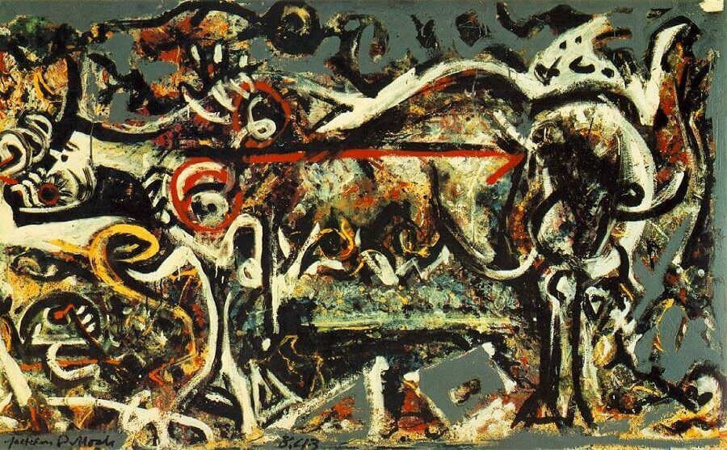
She wolf 1943

Slide 16
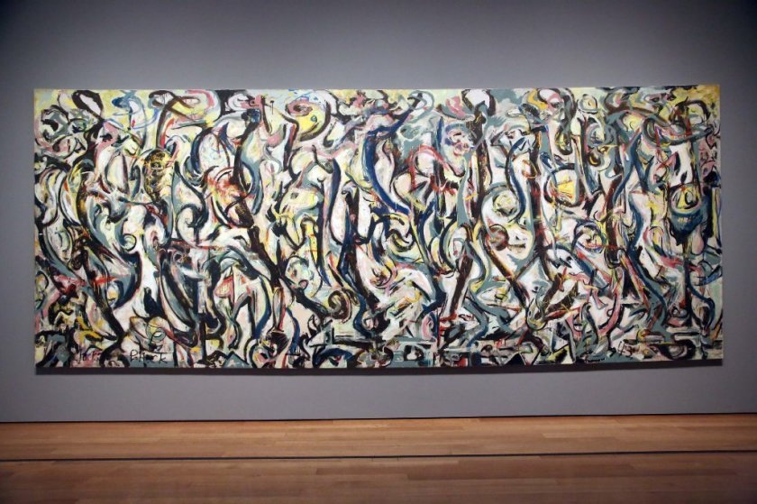
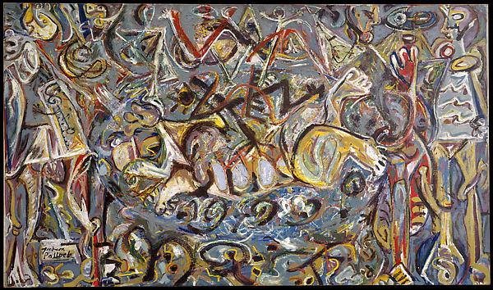
Jackson Pollock 1912-1956
Mural 1943 Pasiphae 1943

Slide 17
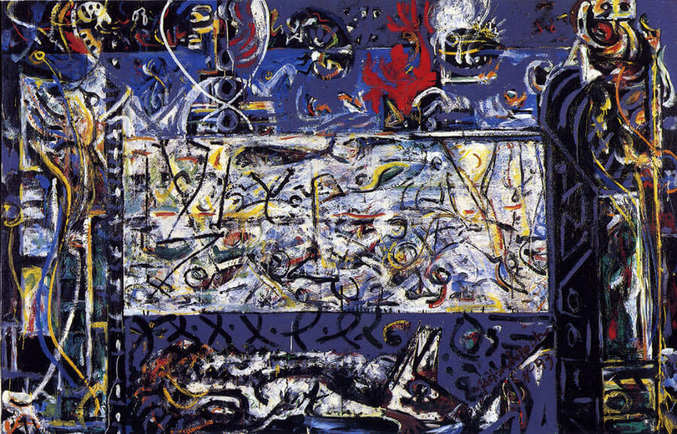
Guardian of the secret 1943

Slide 18
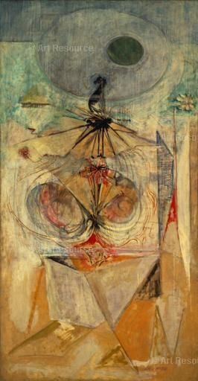
Mark Rothko
Tiresias 1944

Slide 19
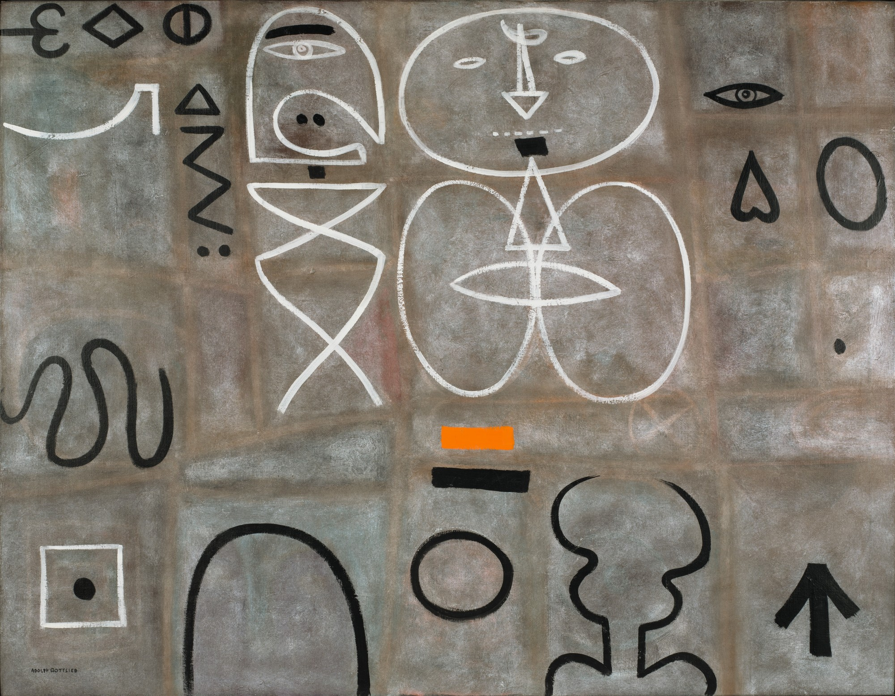
Adolf Gottlieb
Man looking at woman 1949

Slide 20
Abstract expressionism 1950 -
Action painting
(gestural abstraction)
Jackson Pollock
Franz Kline
Philip Guston
Willem de Kooning
---------------------------
Hans Hoffmann
Robert Motherwell
Adolf Gottlieb
Chromatic abstraction
(color- field painting)
Barnett Newman
Clyfford Still
Mark Rothko
Ad Reinhardt

Slide 21
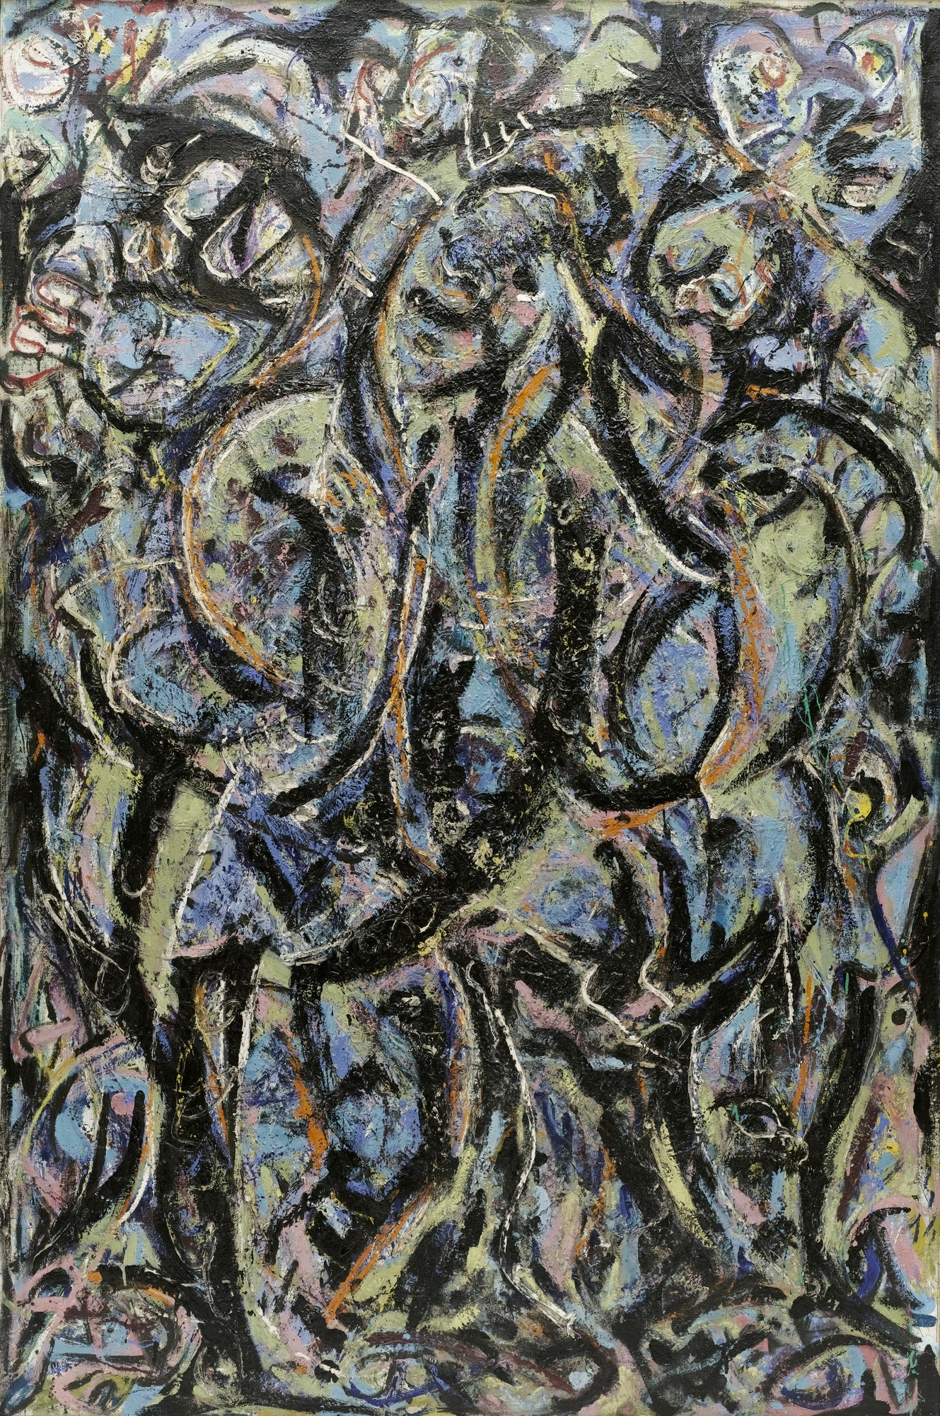
Gothic 1944

Slide 22
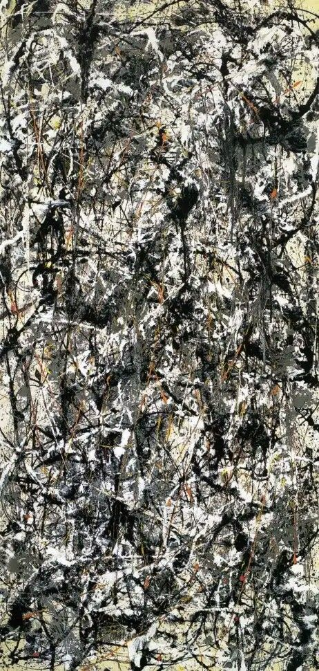
Cathedral 1947

Slide 23
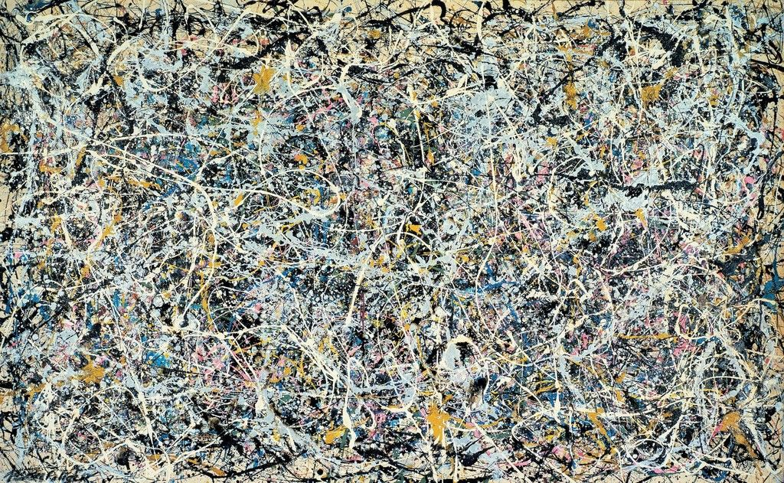
Number 1, 1949

Slide 24
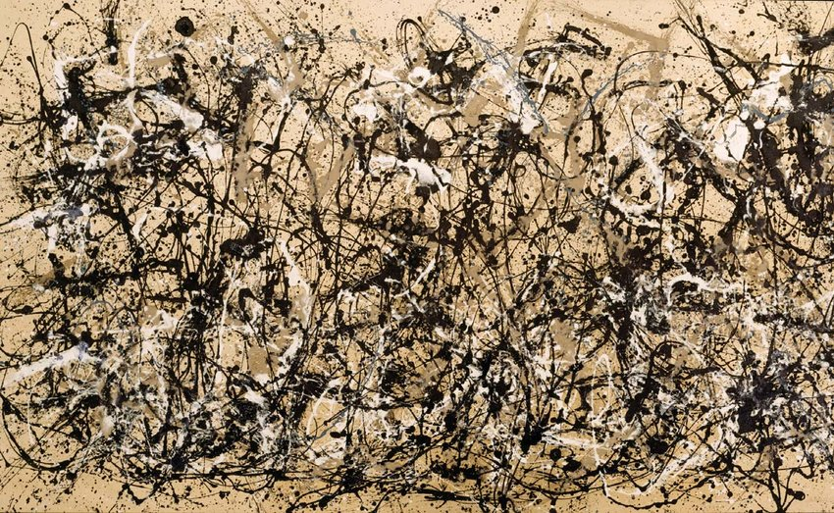
Autumn Rhytm 1950

Slide 25
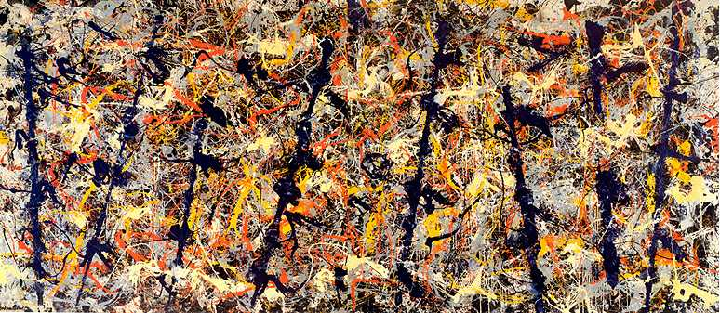
Blue poles 1952

Slide 26
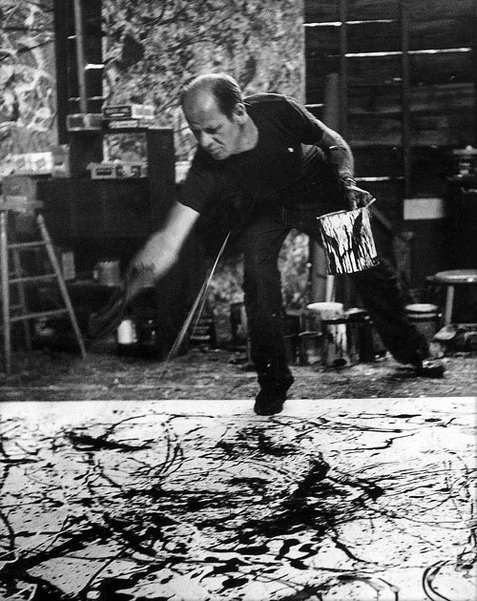
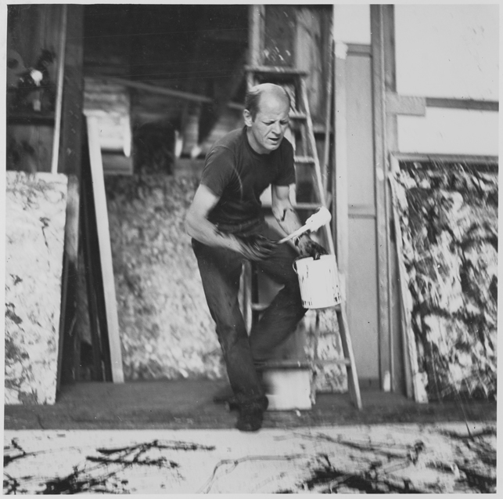
https://www.sfmoma.org/watch/jackson-pollock-paintings-have-a-life-of-their-own/

Slide 27
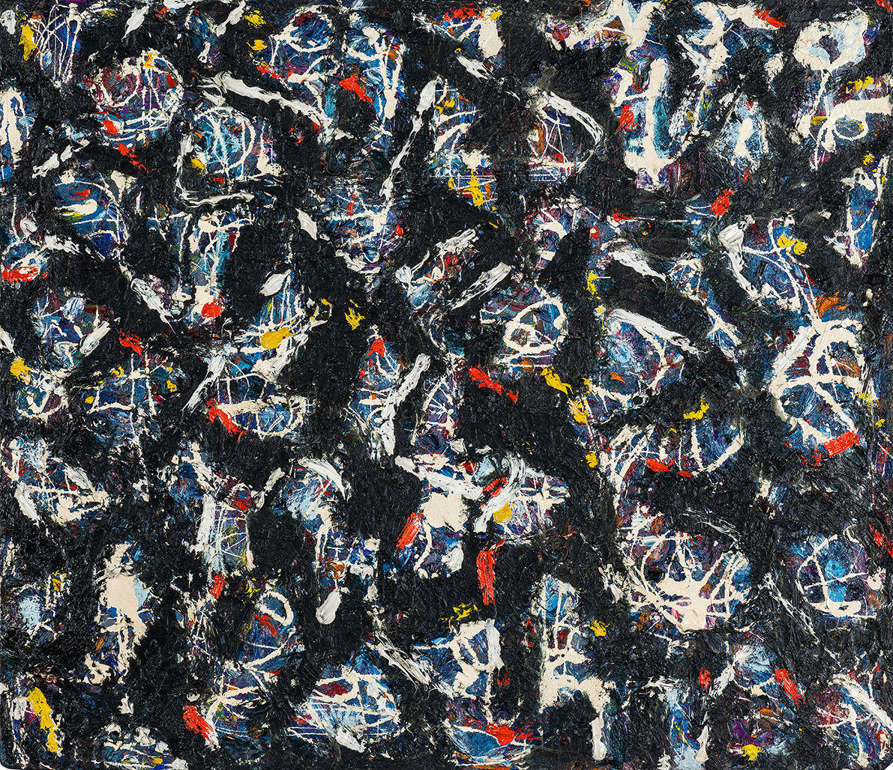
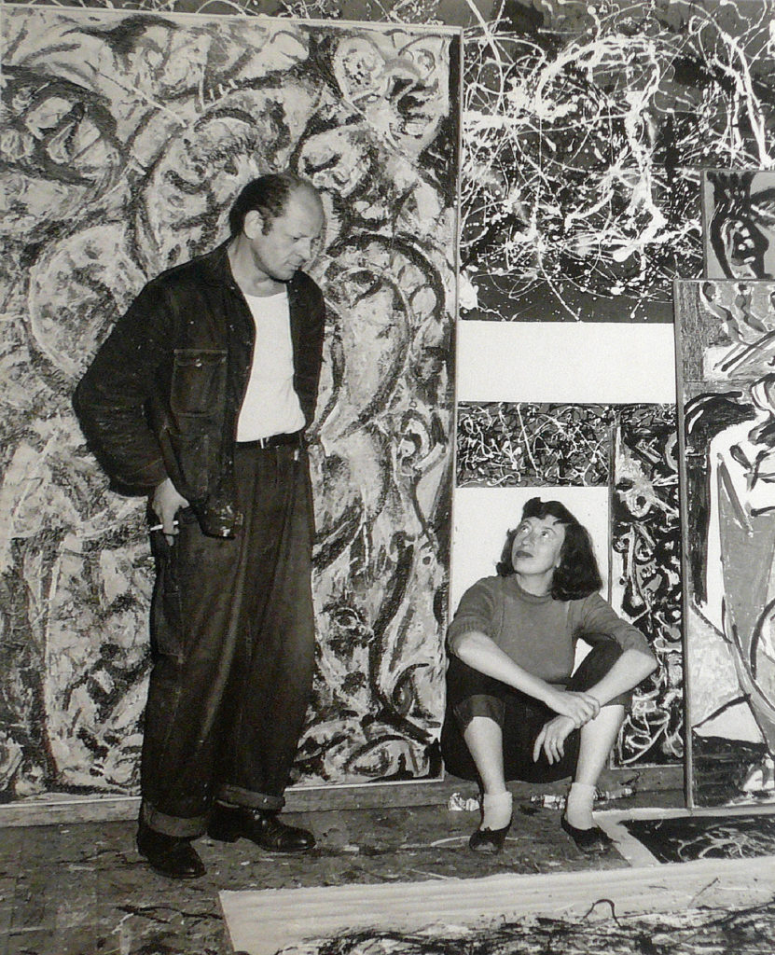
Lee Krasner 1908-1984
Abstract no. 2 1946-47

Slide 28
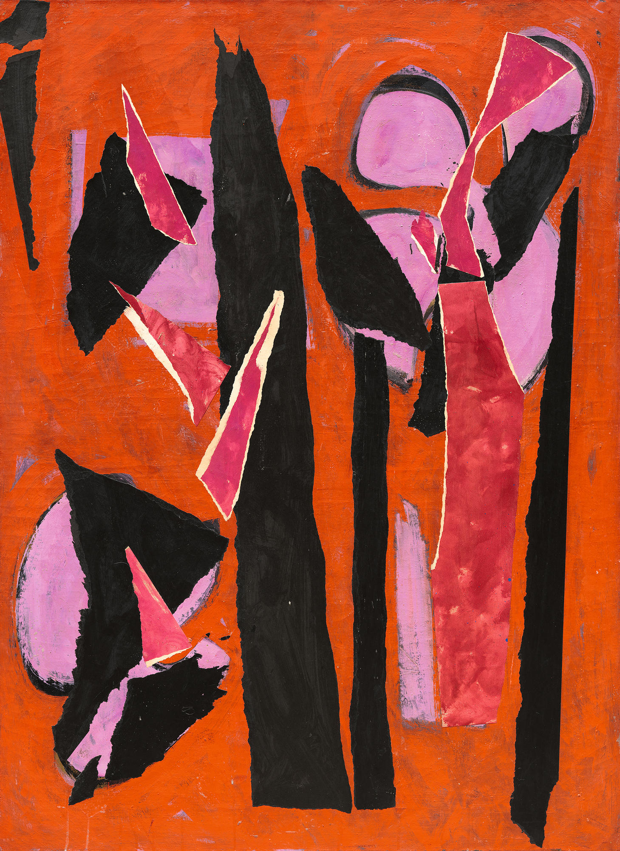
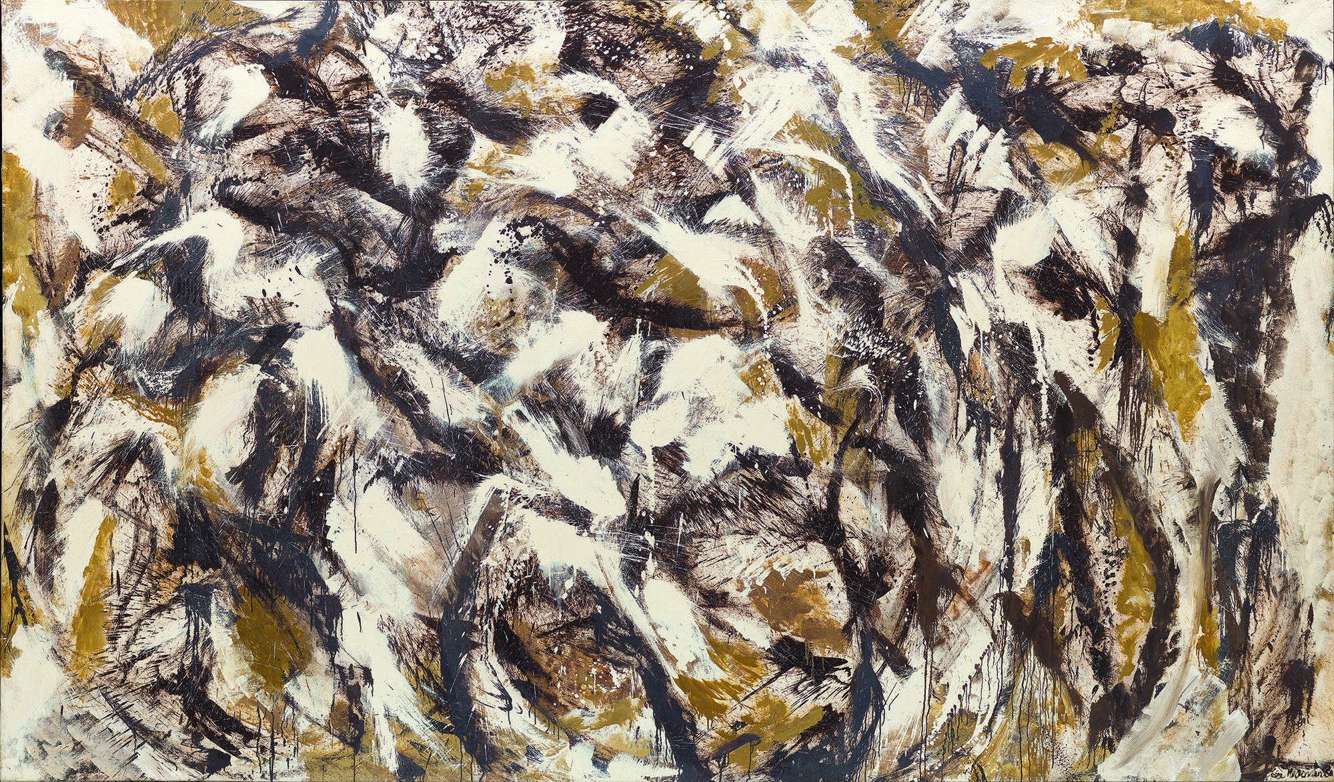
Desert Moon 1955 Polar stampede 1960

Slide 29
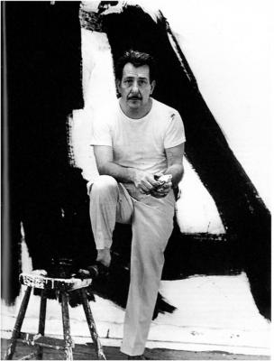
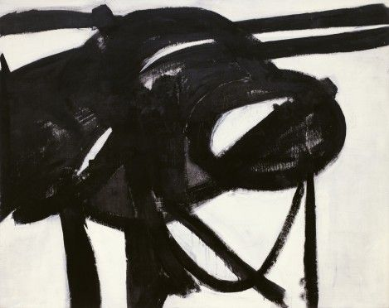
Franz Kline 1910-1962
Chief 1950

Slide 30
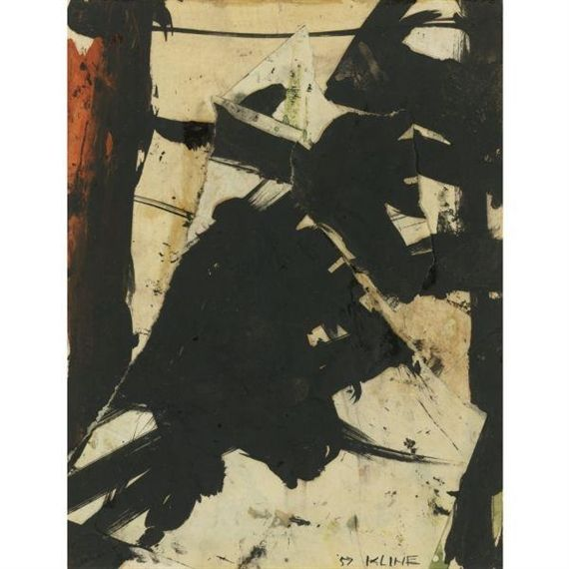
Untitled 1957

Slide 31
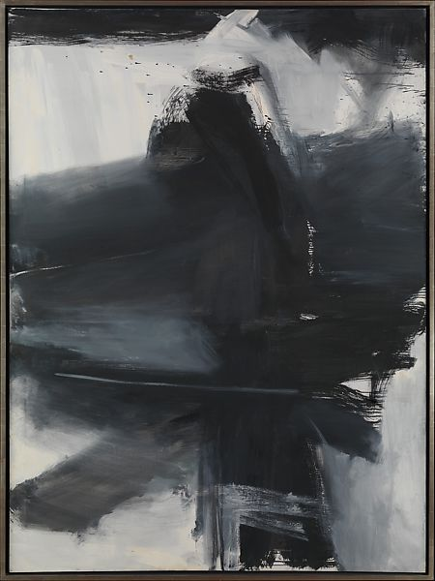
Black, white, grey 1959

Slide 32
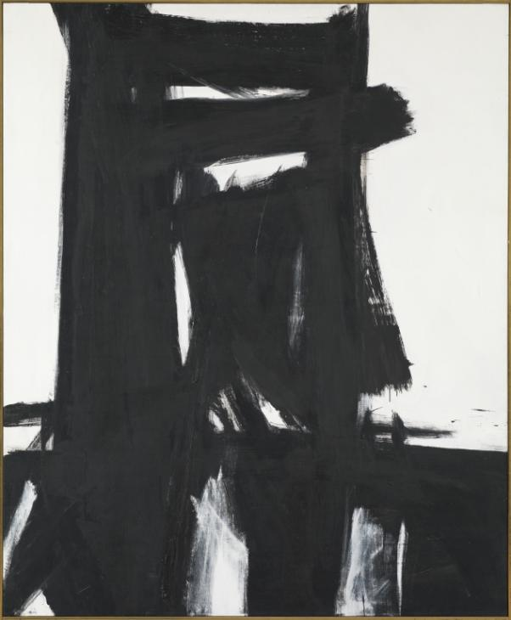

Slide 33
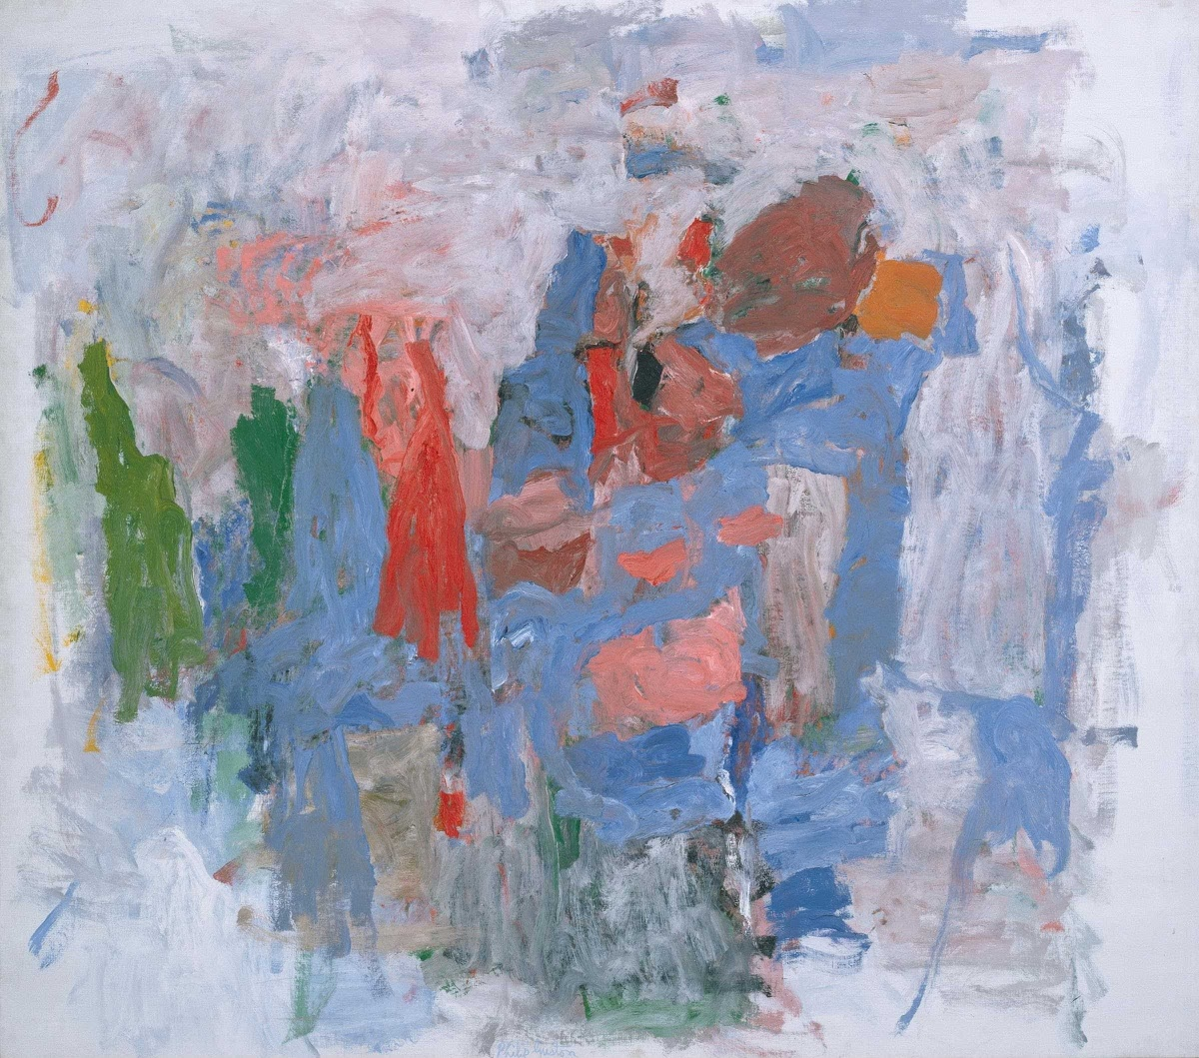
Philip Guston 1913-80
Passage 1957

Slide 34
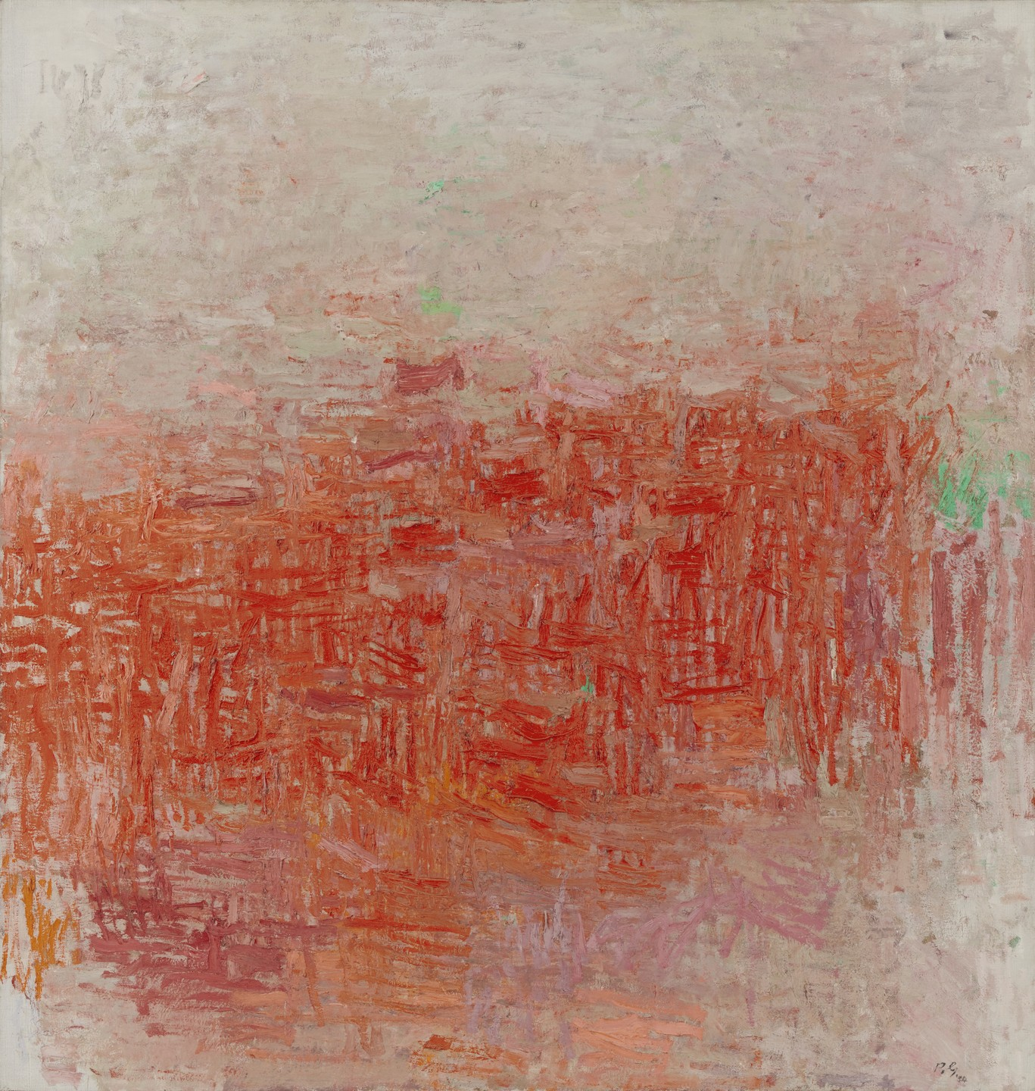
Painting 1954

Slide 35
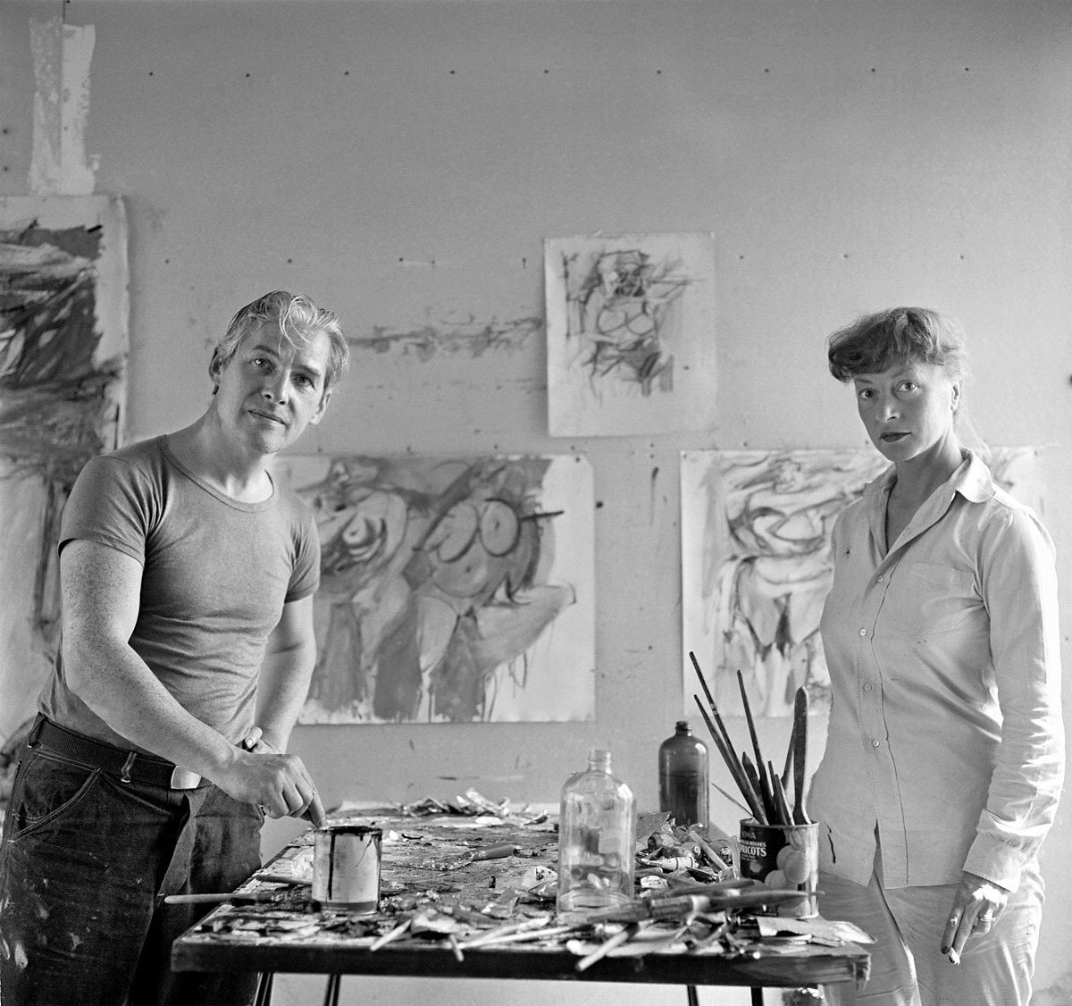
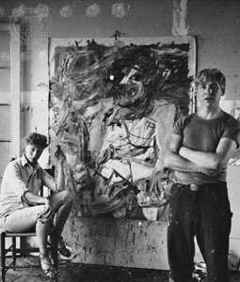
Willem de Kooning 1904-1997

Slide 36
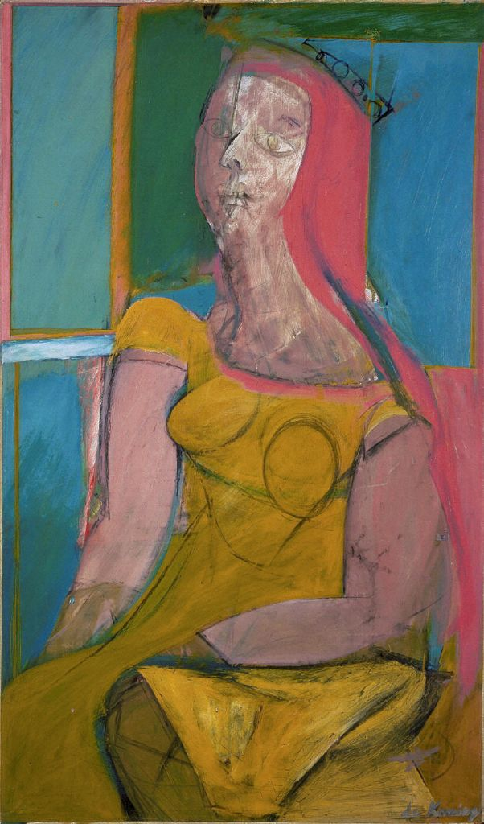
Queen of Hearts 1943-46

Slide 37
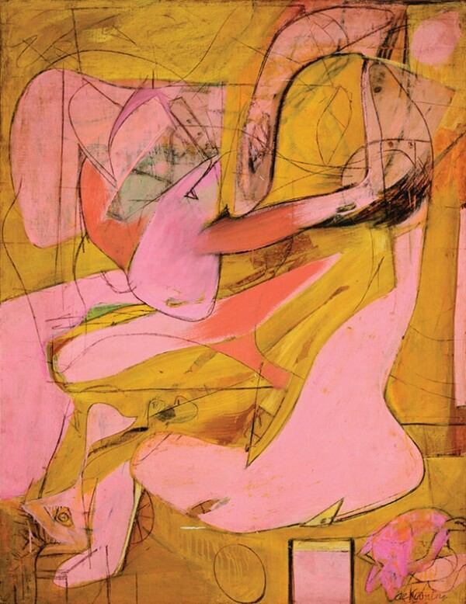
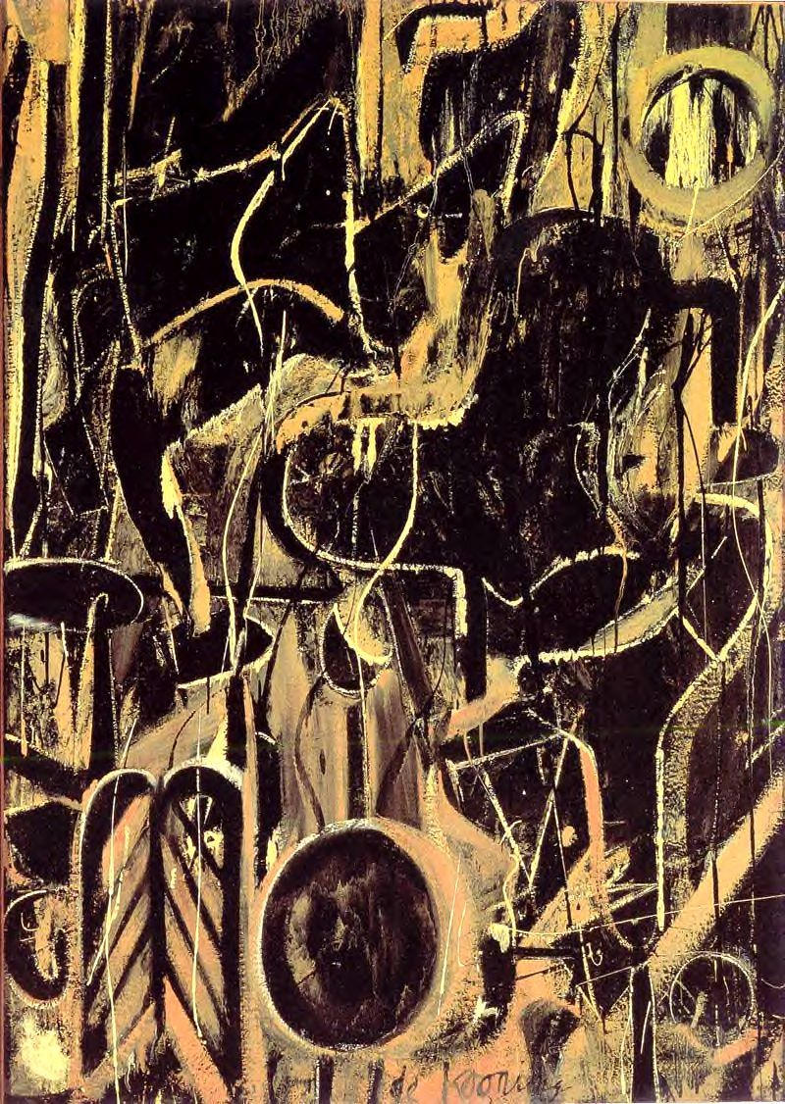
Pink Angels 1947 Light in August 1947

Slide 38
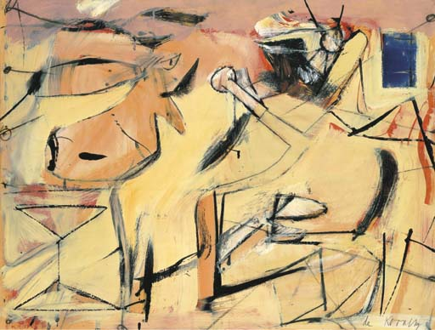
Sailcloth 1949

Slide 39
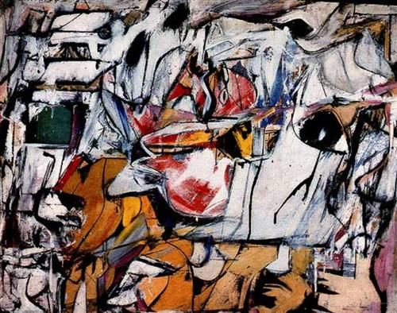
Asheville 1949

Slide 40
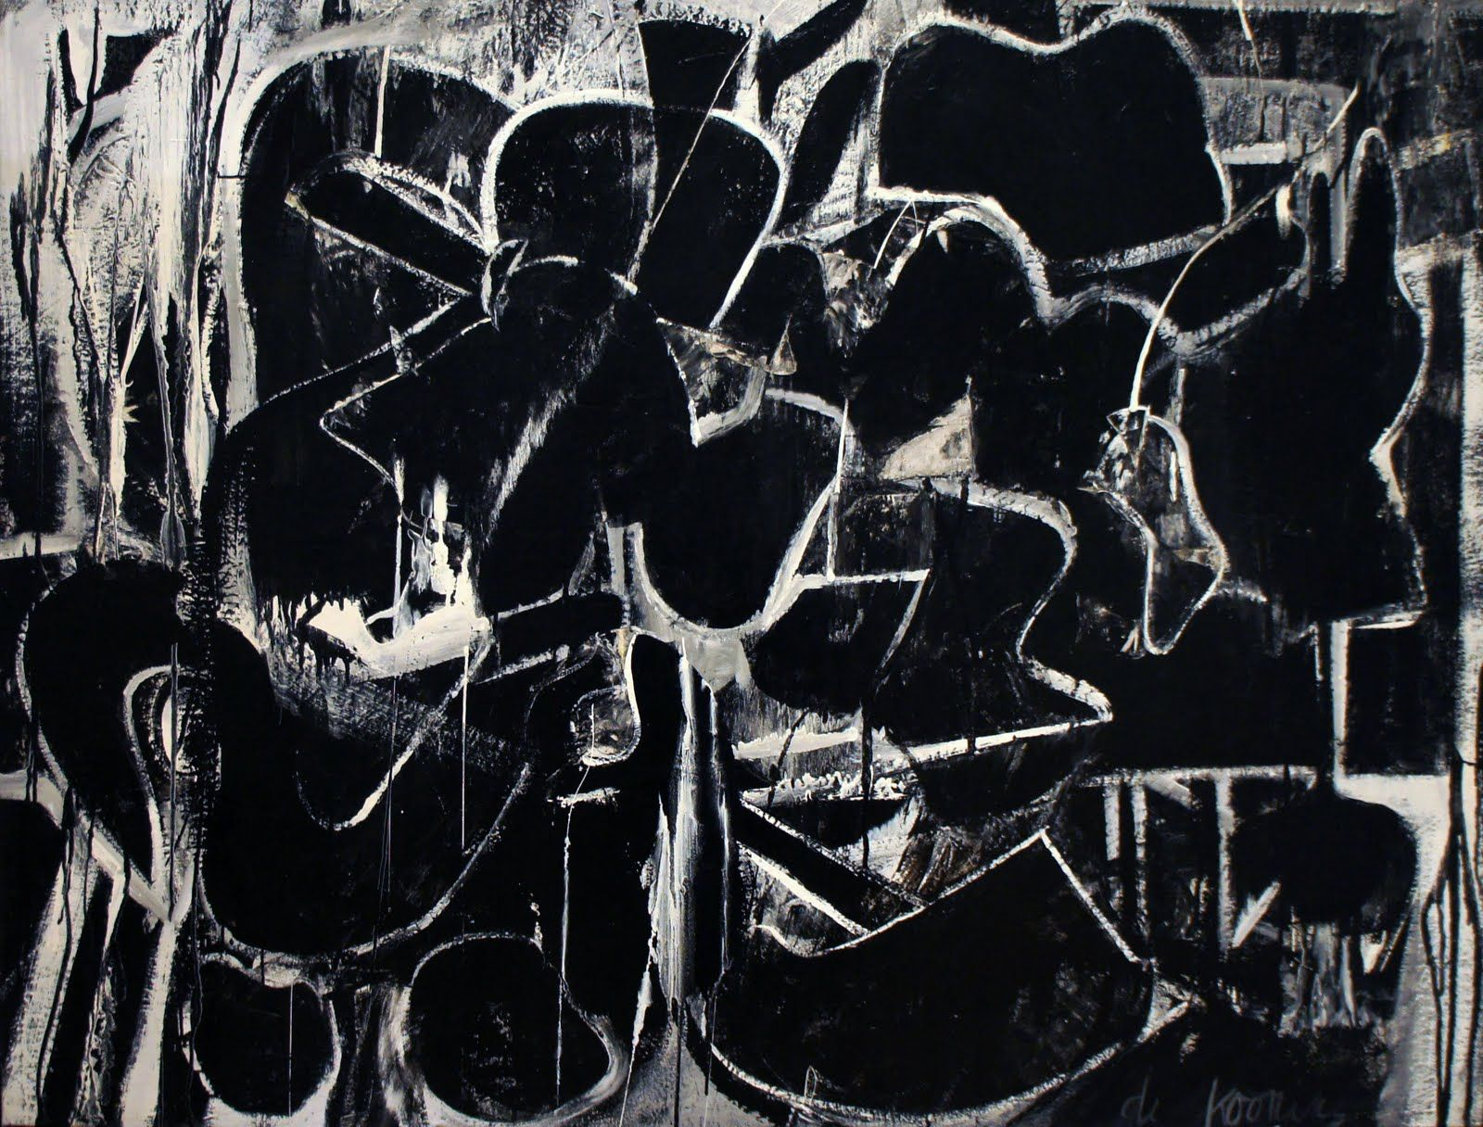
Night Square1950

Slide 41
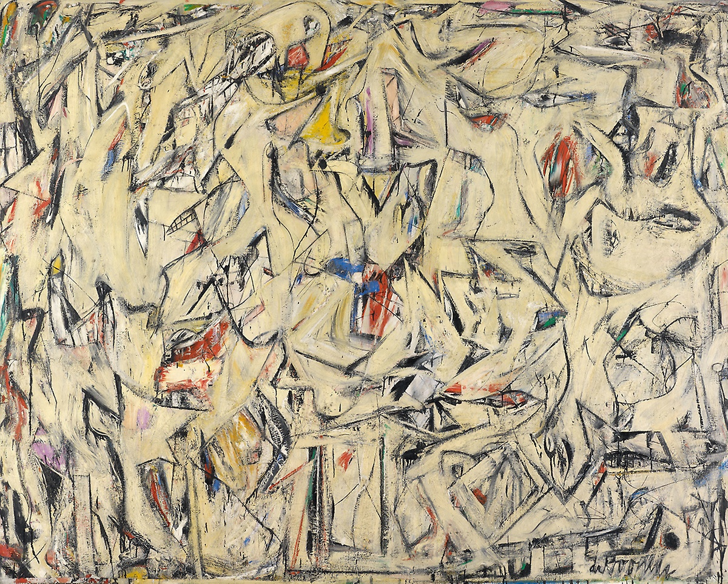
Excavation 1950

Slide 42

Woman 1, 1950

Slide 43

Easter Monday 1958

Slide 44


Late works 1980-1985

Slide 45


Slide 46

Hans Hofmann 1880-1966
The Window 1950

Slide 47

Veluti in Speculum 1962

Slide 48


Robert Motherwell 1915-1991
Pancho Villa, Dead and Alive 1943

Slide 49

Western air 1946

Slide 50

At five in the afternoon 1949

Slide 51

Irish elegy, 1965

Slide 52


Adolf Gottlieb 1903-1974
The Alchemist 1945

Slide 53

Blast I 1957

Slide 54

Irene Pereira, Unfolding Spring

