Slide 1
Abstraktní malířství v USA
Color-field painting

Slide 2
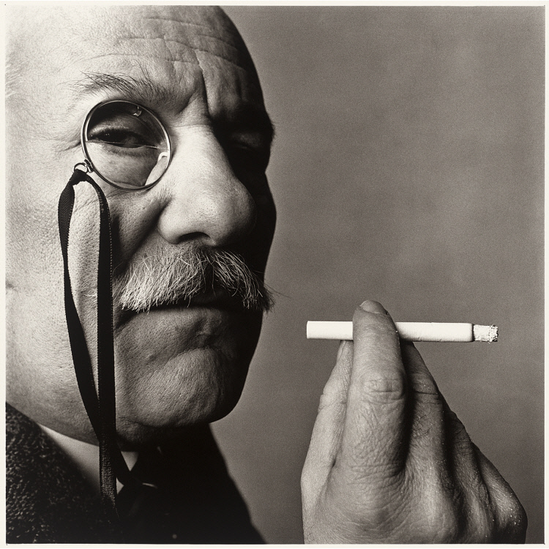
Barnett Newman 1905-1970

Slide 3
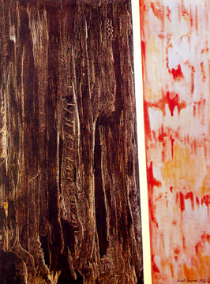
Command 1946

Slide 4
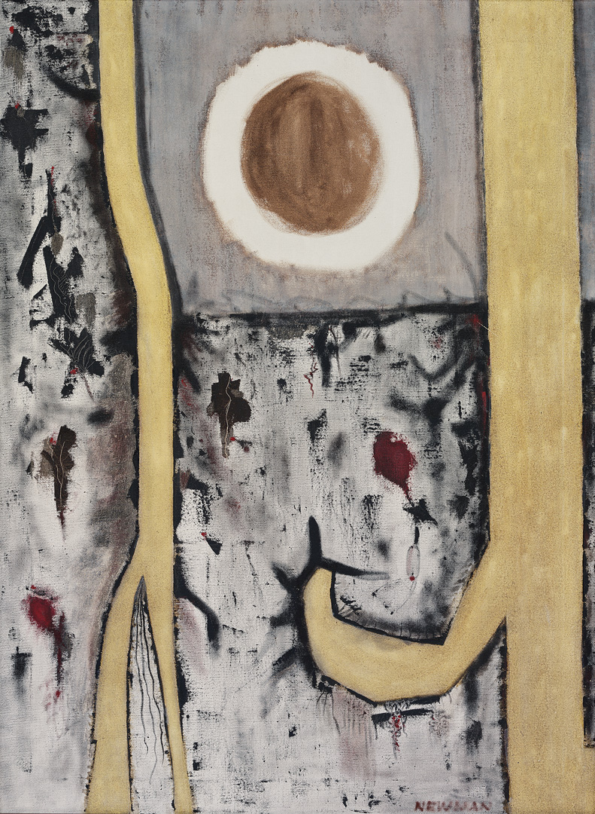
Genetic moment I 1947

Slide 5
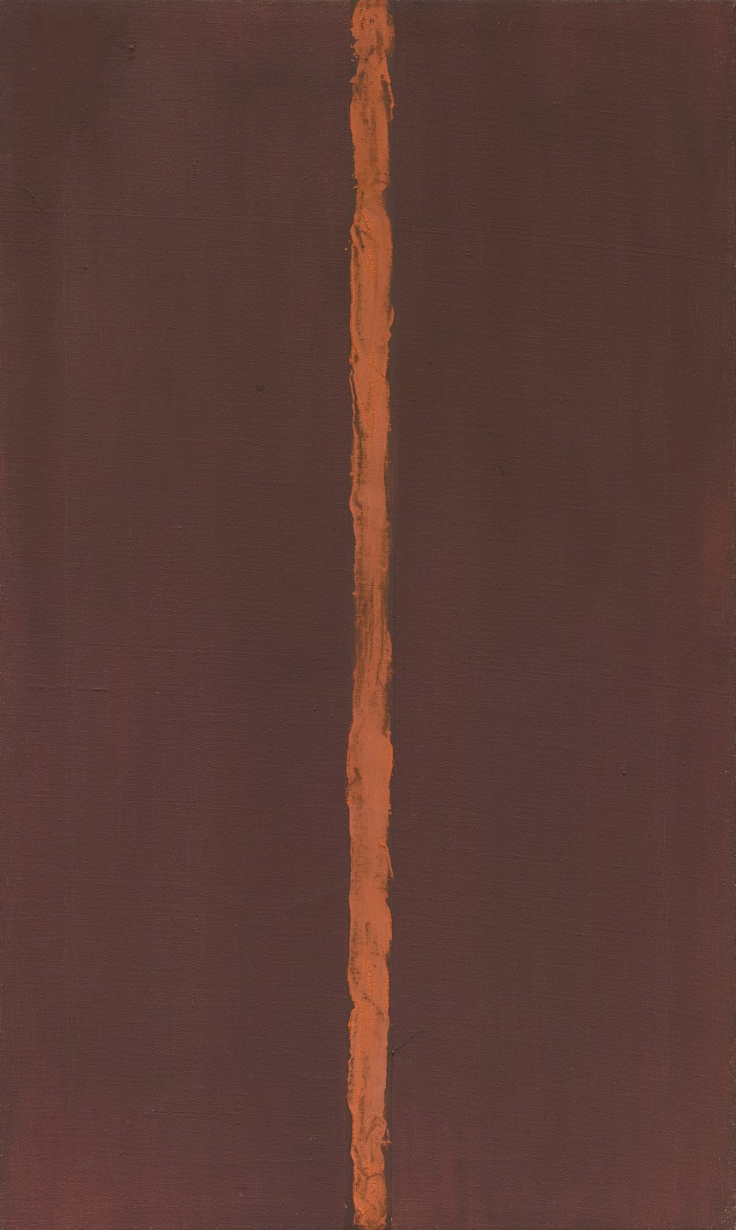
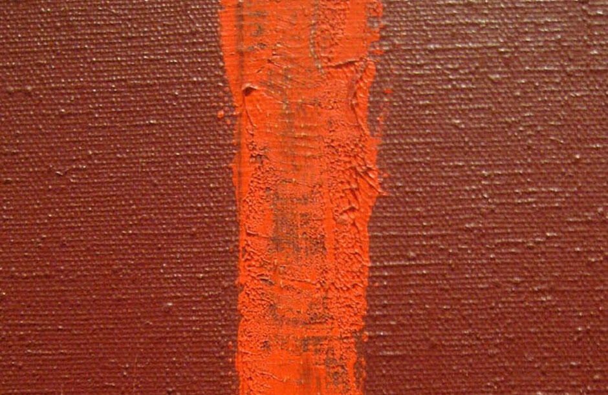
Onement 1, 1948

Slide 6
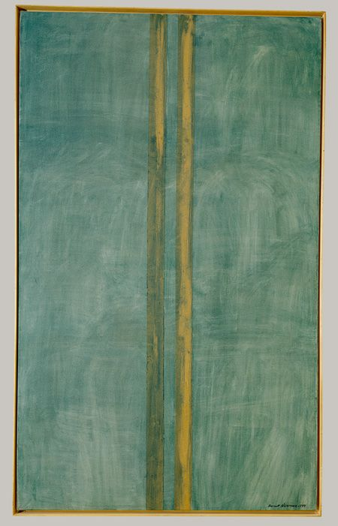
Concord 1949

Slide 7
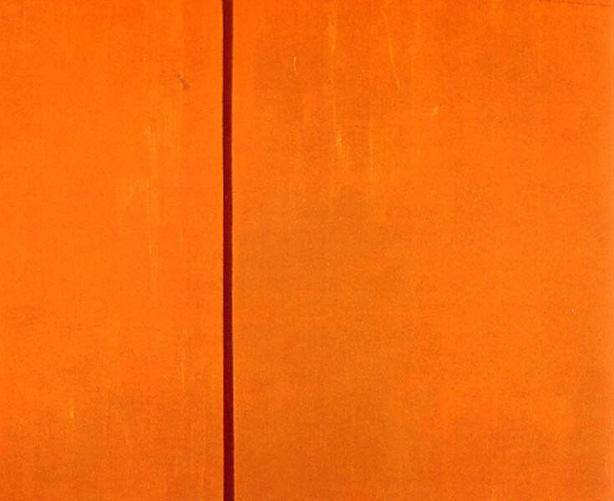
Tundra 1950

Slide 8
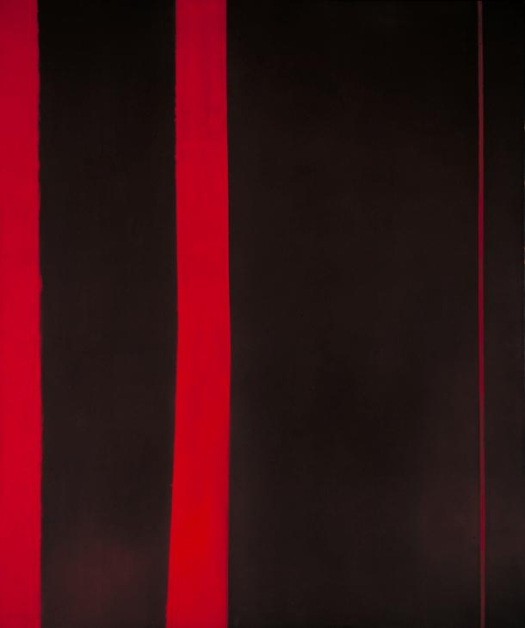
Adam 1952

Slide 9
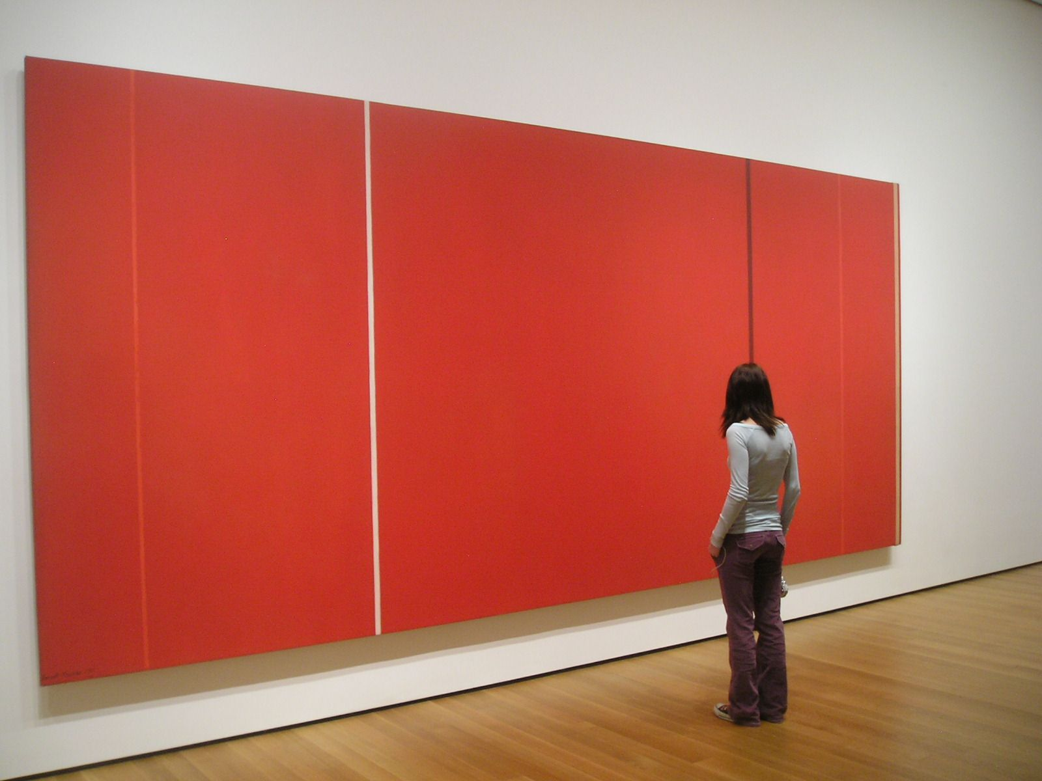
Vir Heroicus Sublimis 1950-51

Slide 10
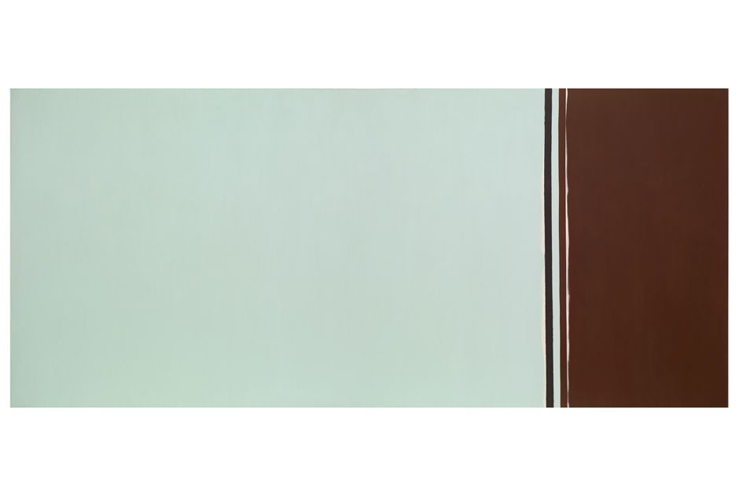
Uriel 1955

Slide 11
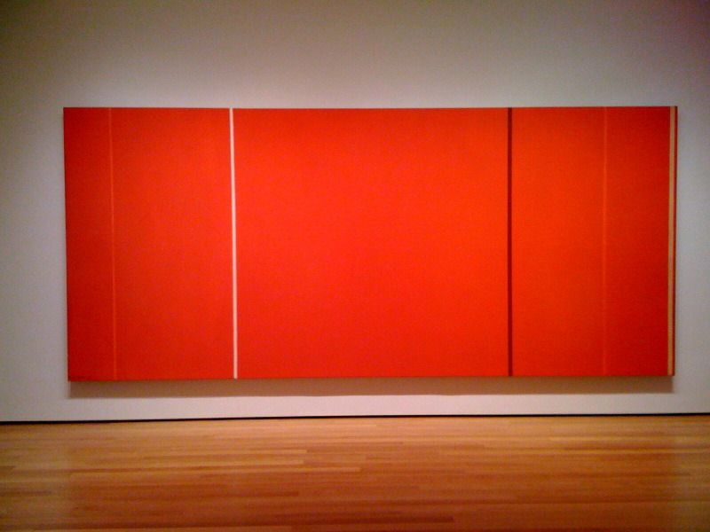
Anna´s Light 1968

Slide 12
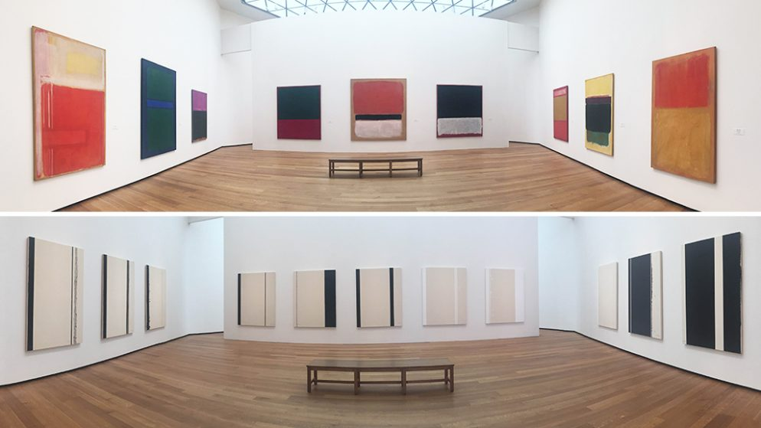
Stations of the Cross 1965-70

Slide 13
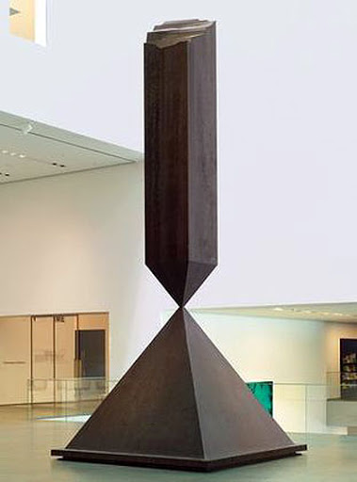
Broken obelisk 1963-67

Slide 14
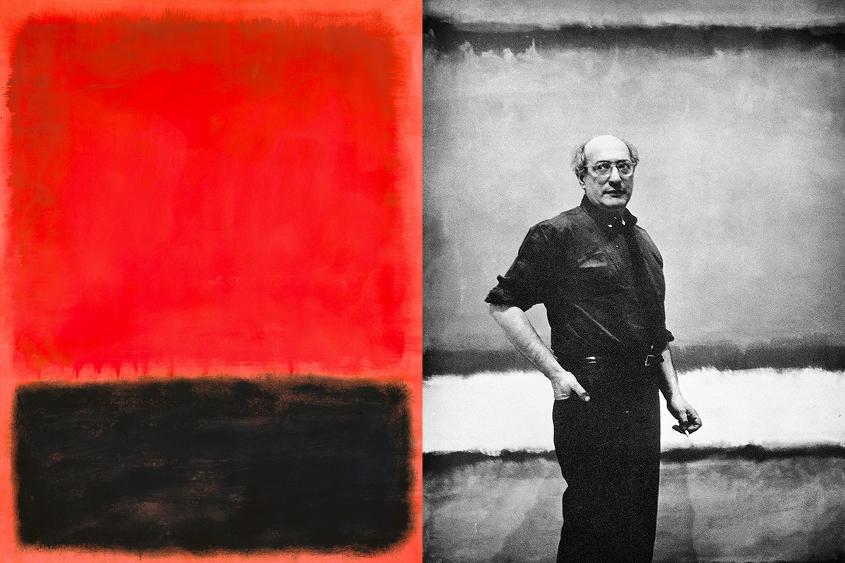
Mark Rothko 1903-1970

Slide 15
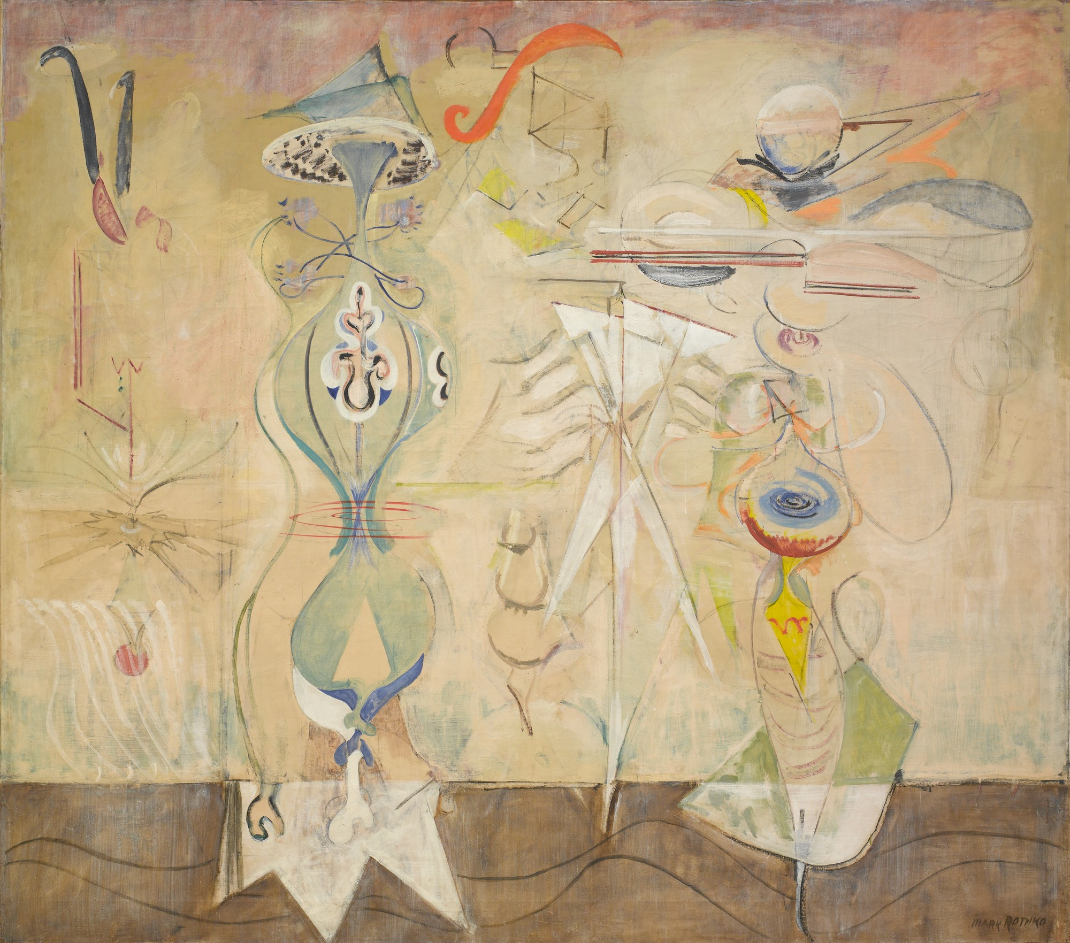
Slow Swirl at the Edge of the Sea 1944

Slide 16
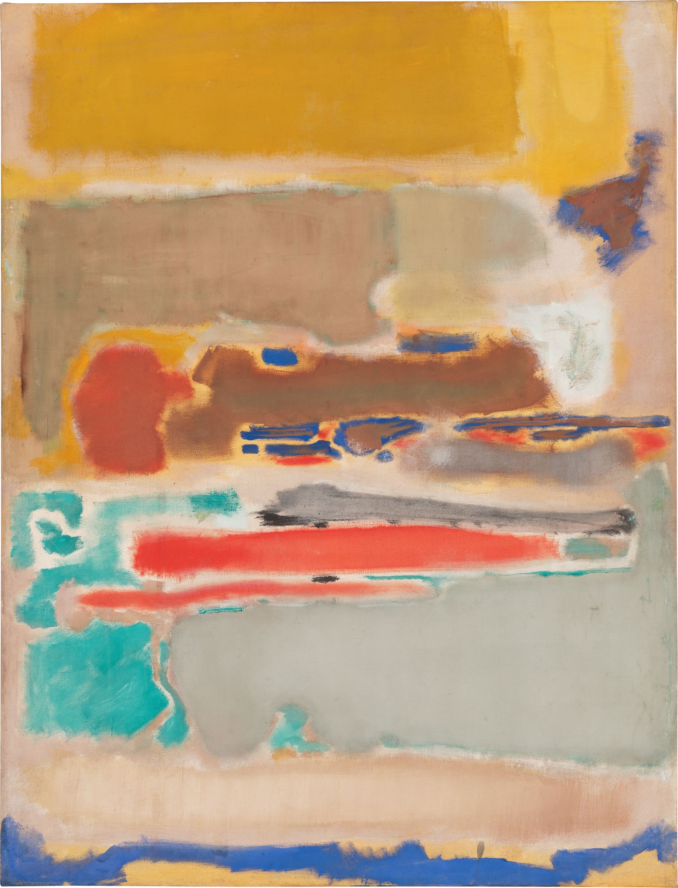
Multiform 1947

Slide 17
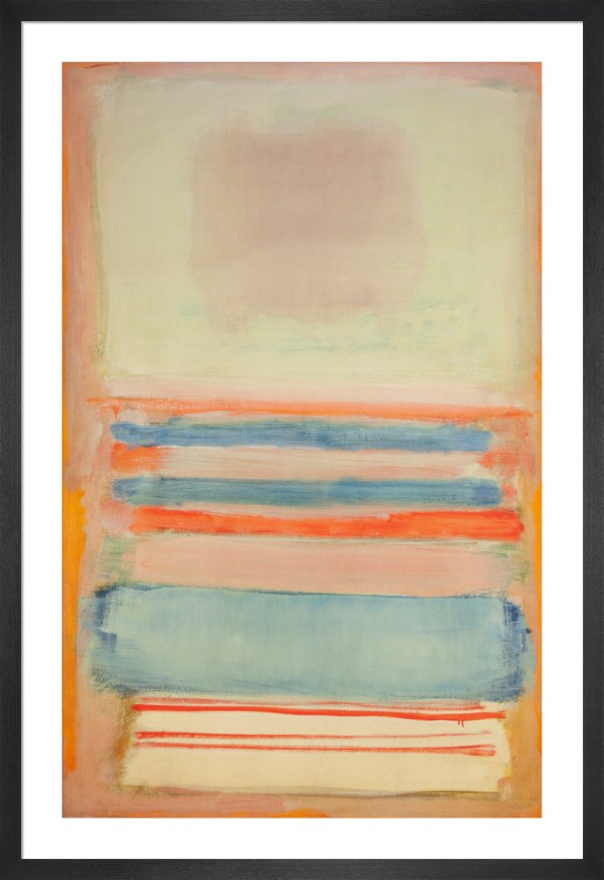
No 11, 1949

Slide 18
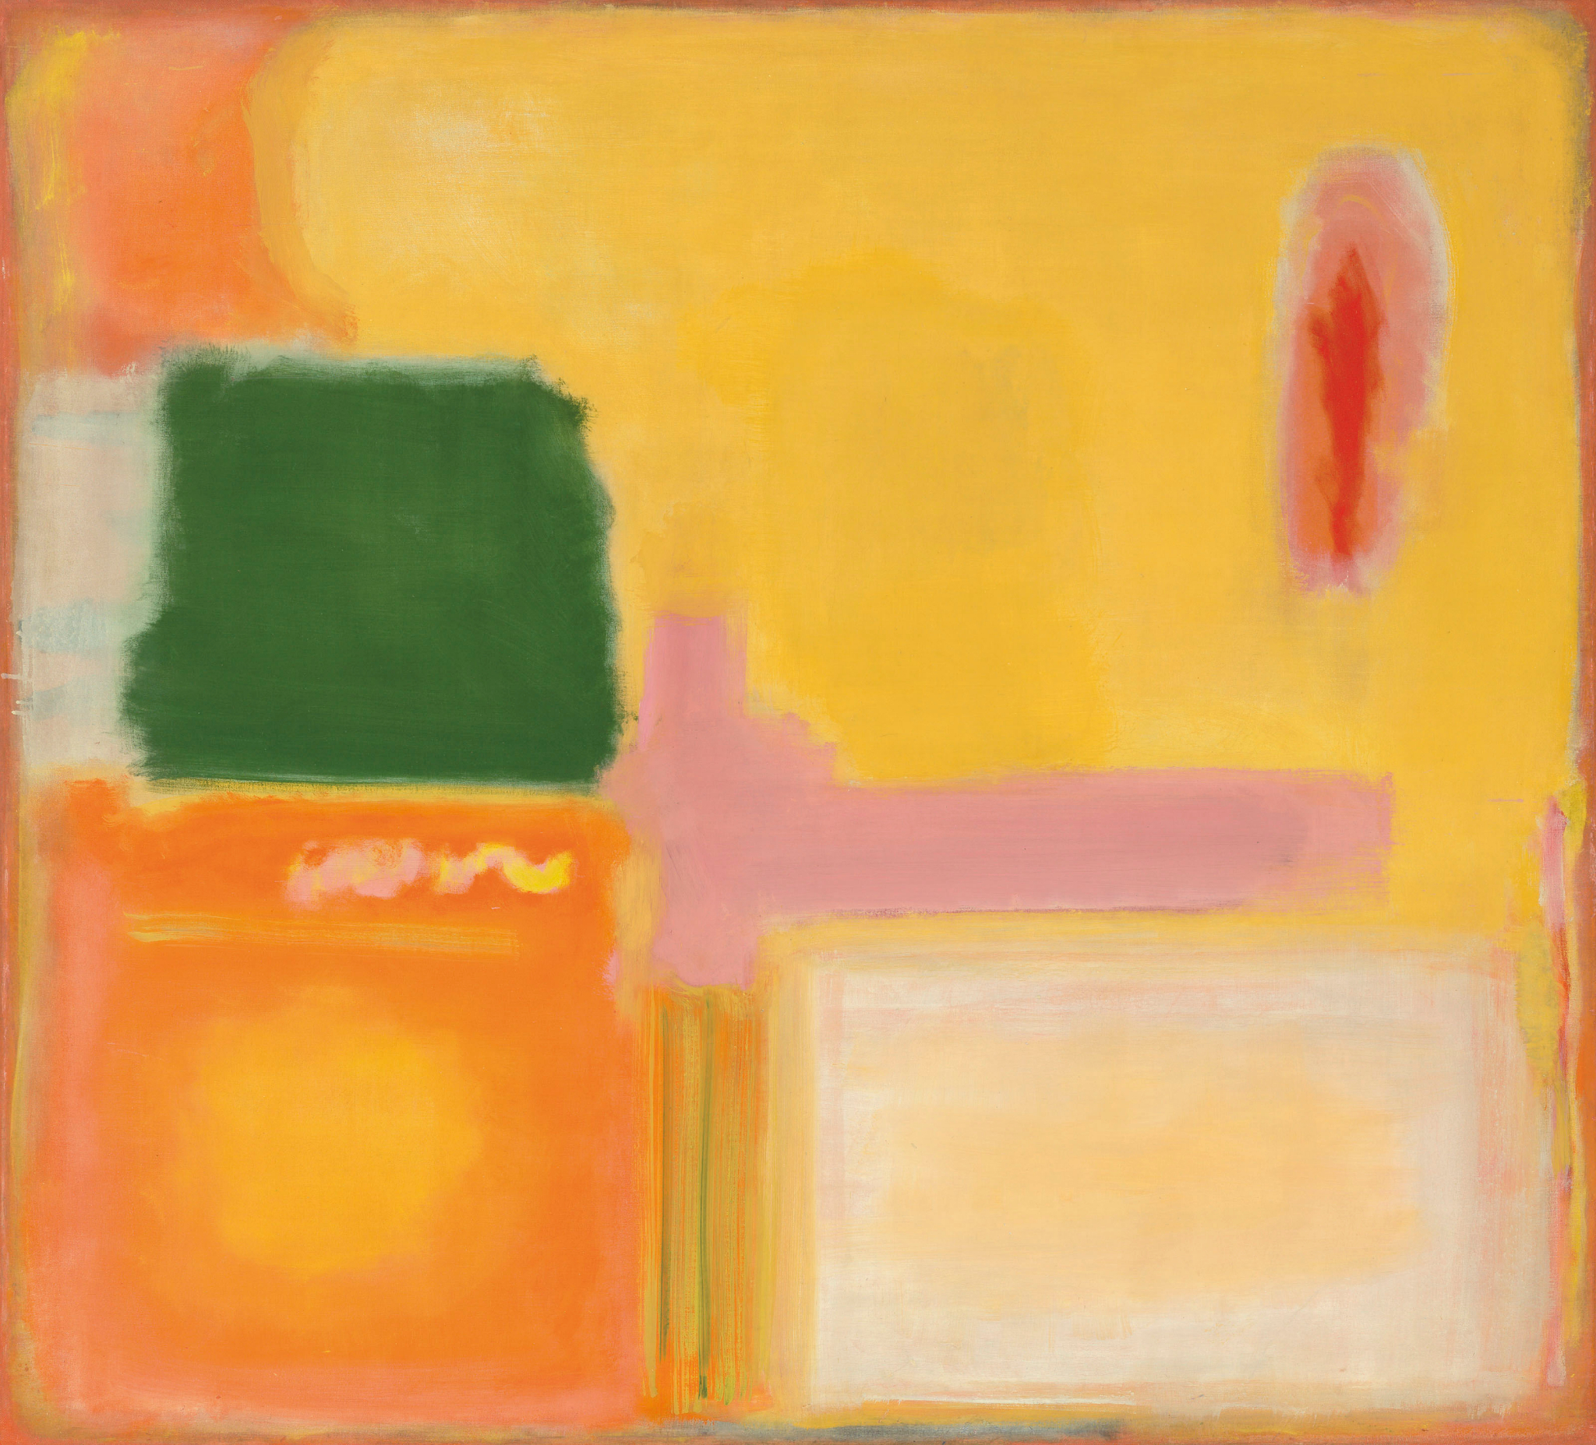
No 16, 1949

Slide 19
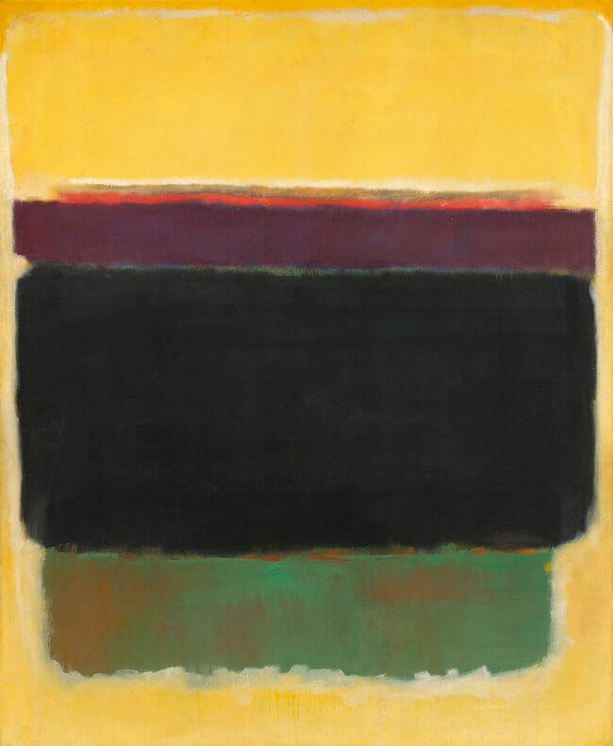
Untitled 1949

Slide 20
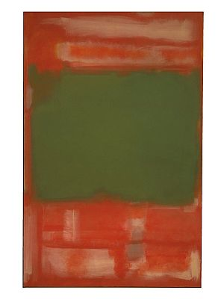
No. 24, 1949

Slide 21
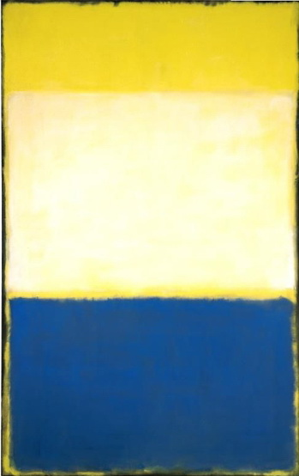
No. 6 (Yellow, White, Blue Over Yellow on Gray) 1954

Slide 22
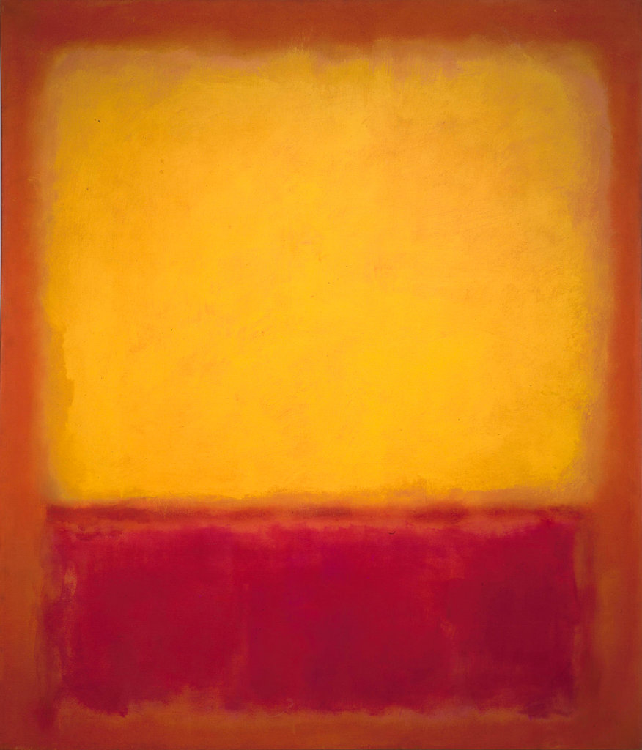
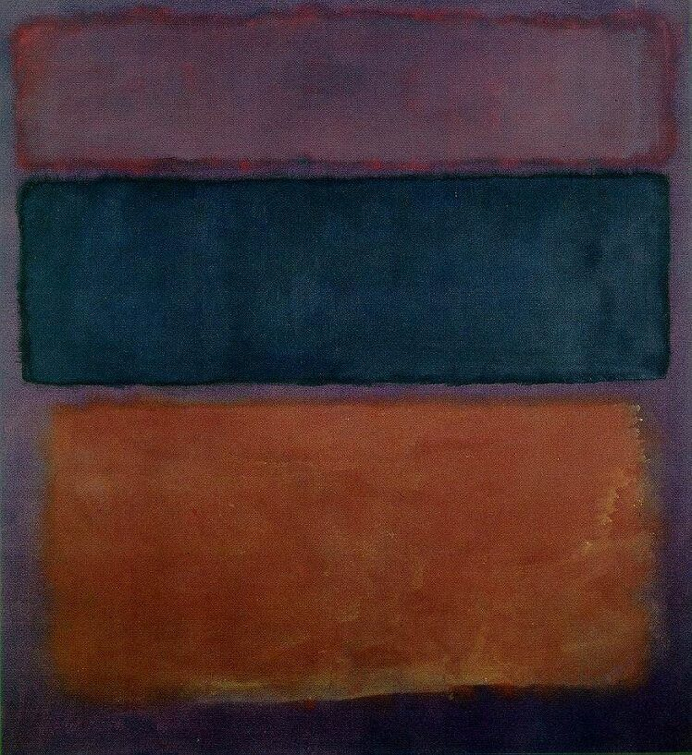

Slide 23
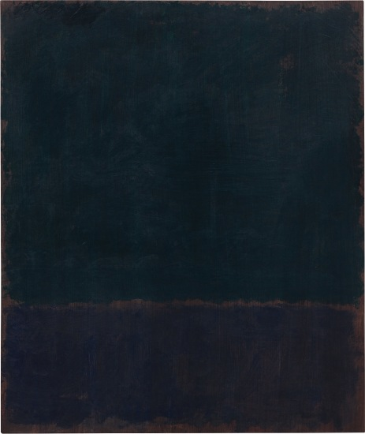
Black blue painting 1968

Slide 24
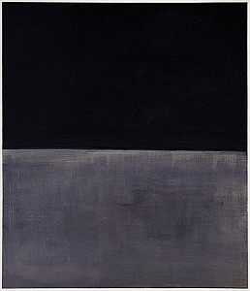
Black on grey 1970

Slide 25
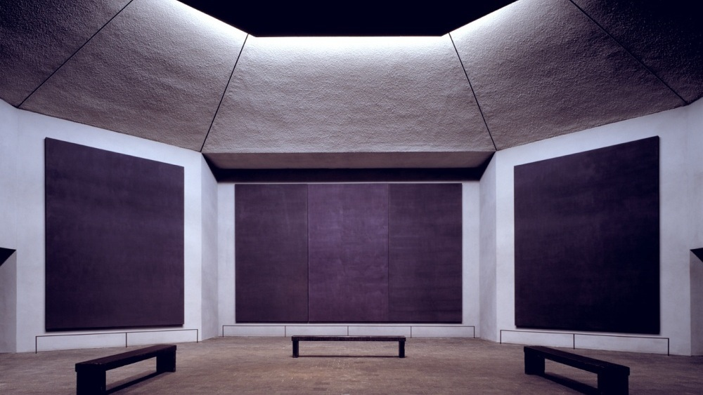

Slide 26
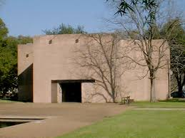
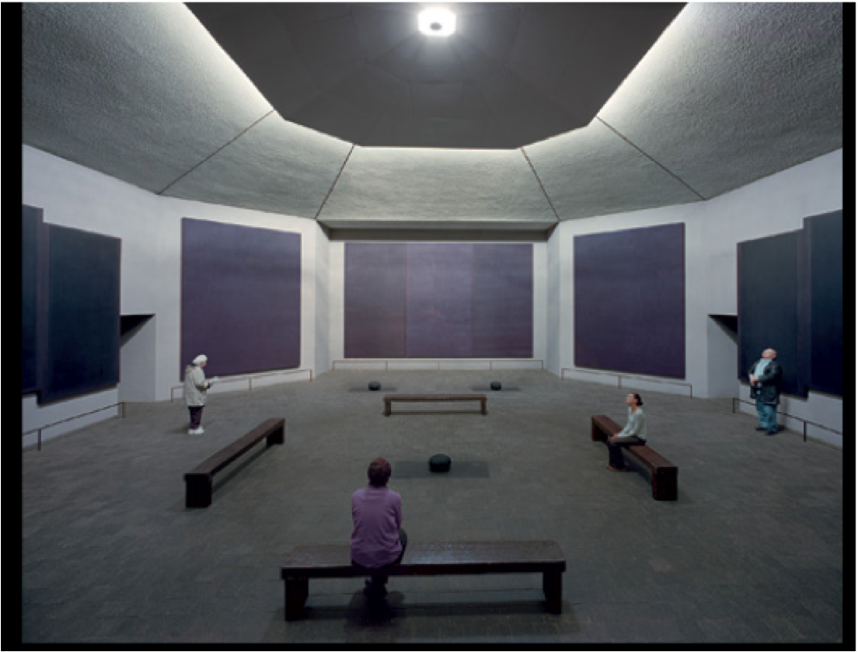
Rothko´s Chapel, Houston 1971

Slide 27
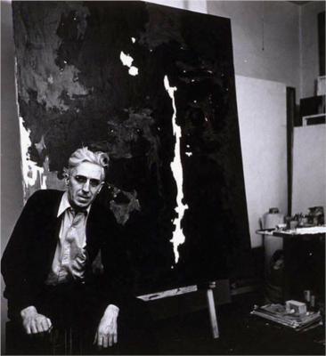
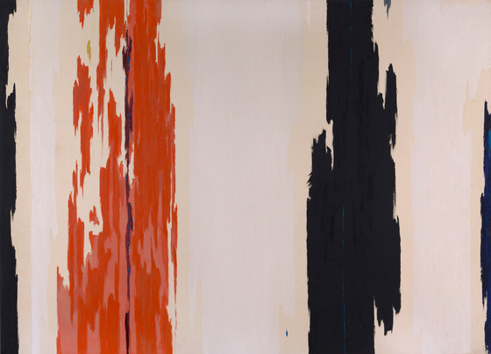
Clyfford Still 1904-80
PH 143

Slide 28
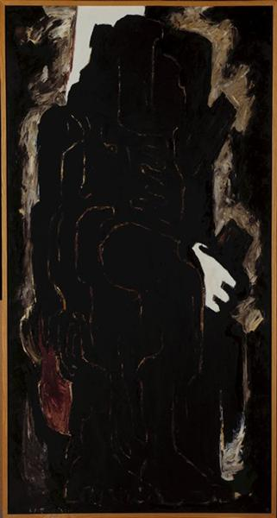
1936-37 no. 2 1937

Slide 29
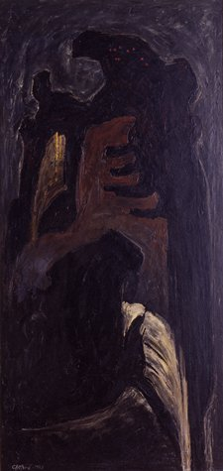
1943-J, 1943

Slide 30
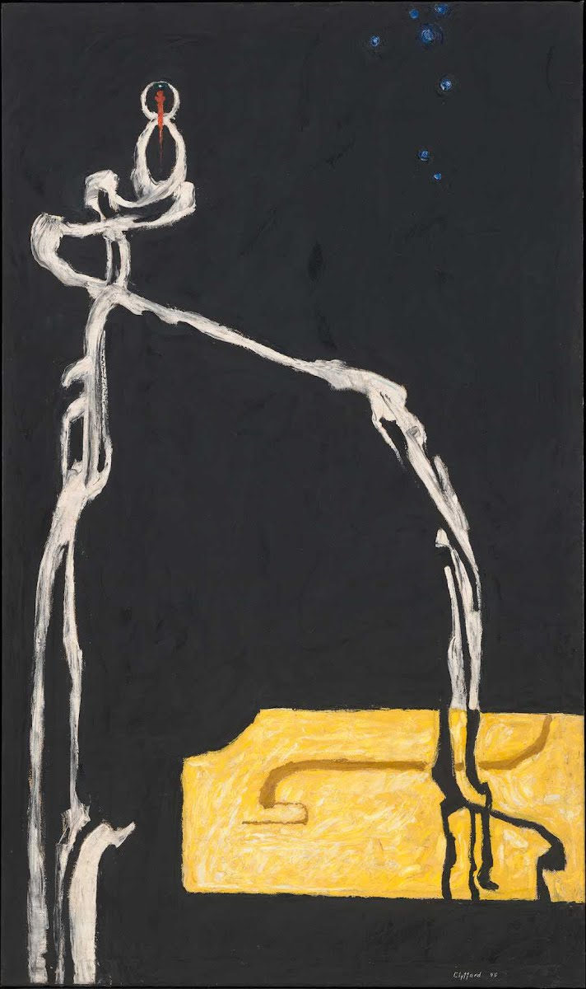
PH-233 (Self portrait), 1946

Slide 31
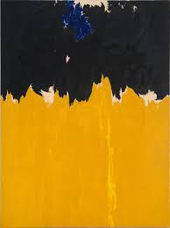
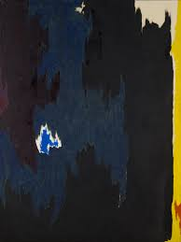
Ph 950, 1950 Ph 252, 1955

Slide 32
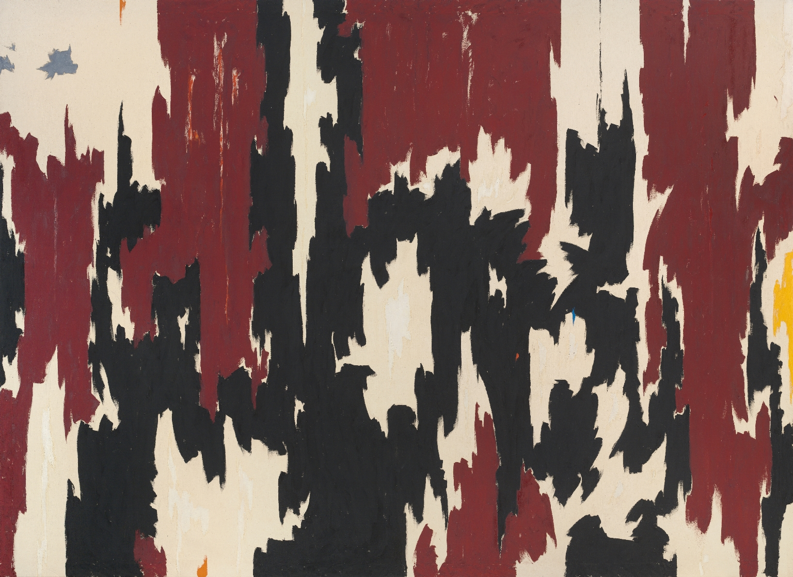
Ph 401, 1957

Slide 33
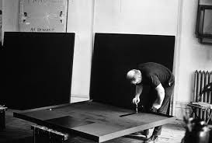
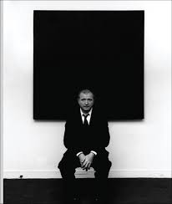
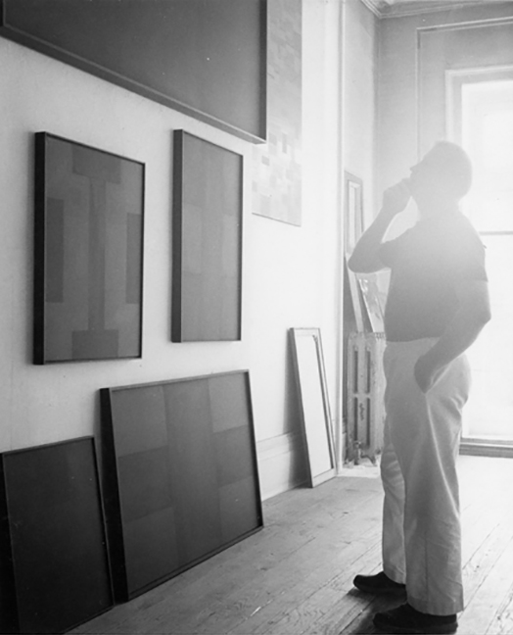
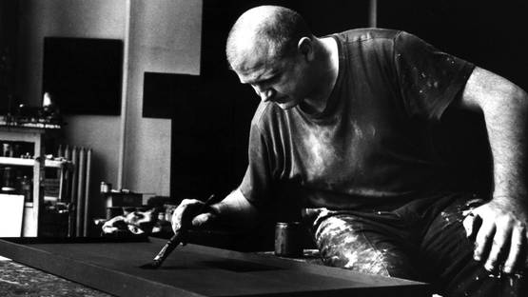
Ad Reinhardt 1913 - 1967

Slide 34
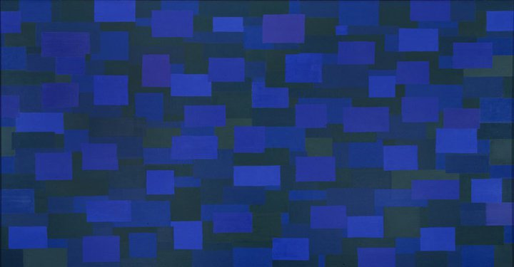
Number 88 (Blue), 1950

Slide 35
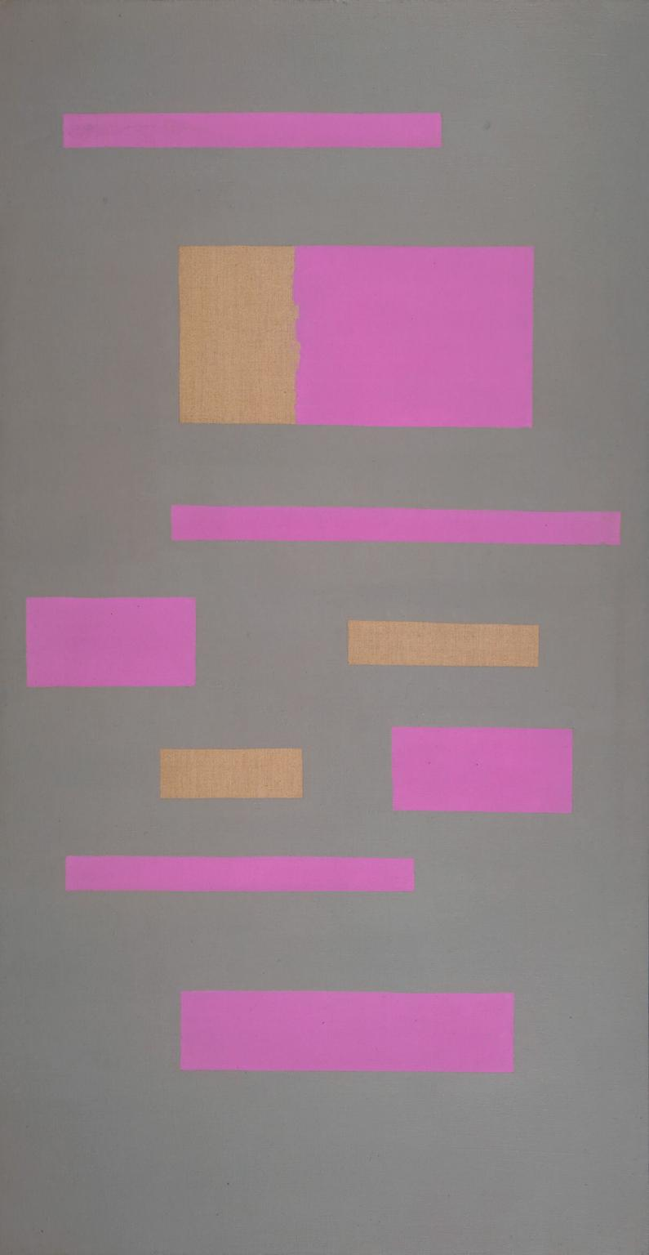
Abstract painting 1952

Slide 36
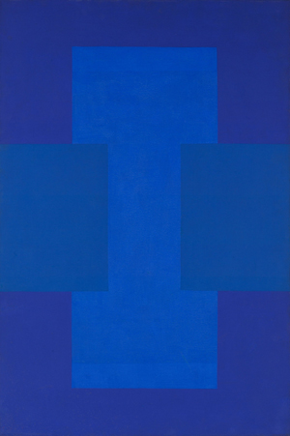
Blue-purple painting 1952

Slide 37
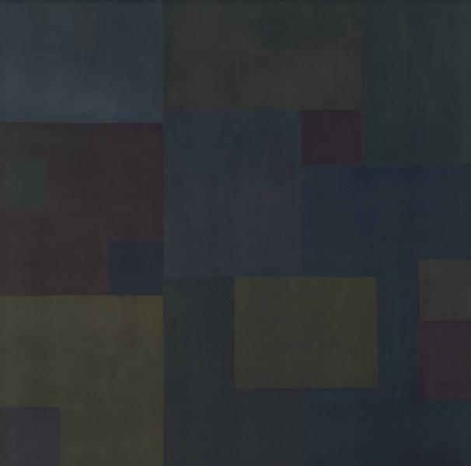
No. 17, 1953

Slide 38
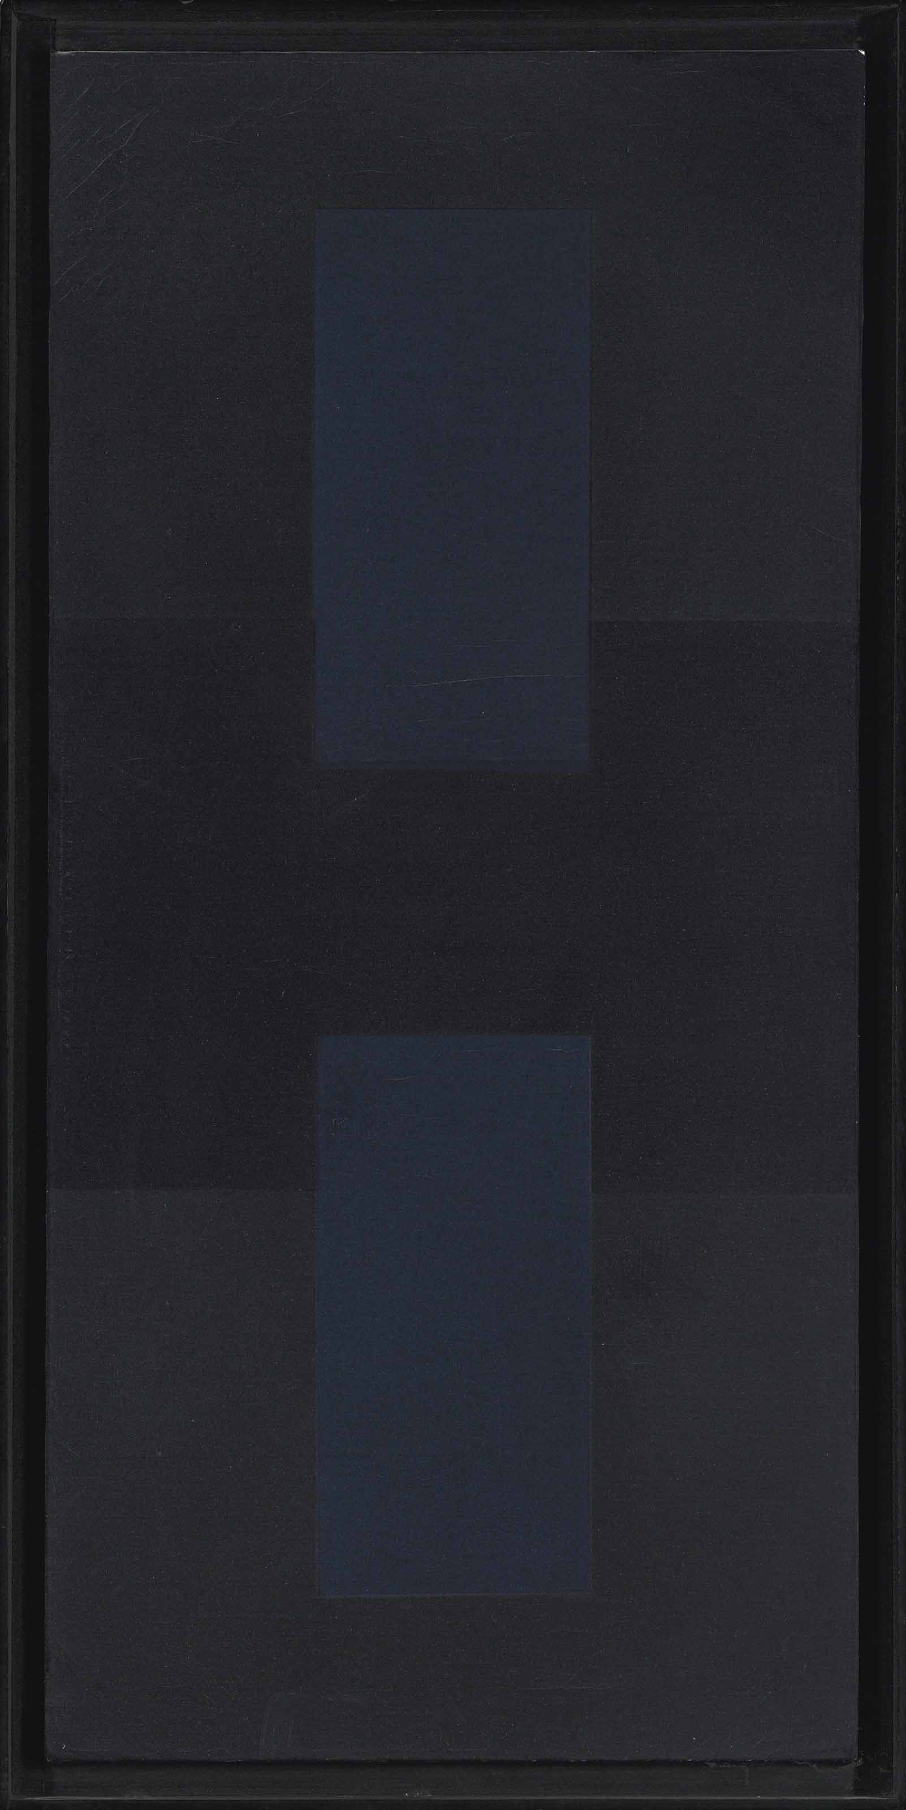
Painting 1959

Slide 39
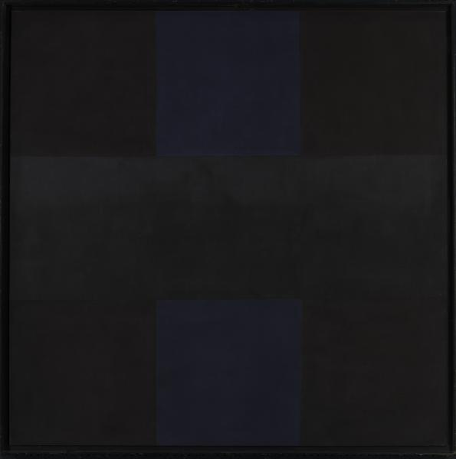
Abstract painting no. 4, 1961

Slide 40

Abstract painting no. 5, 1962

Slide 41
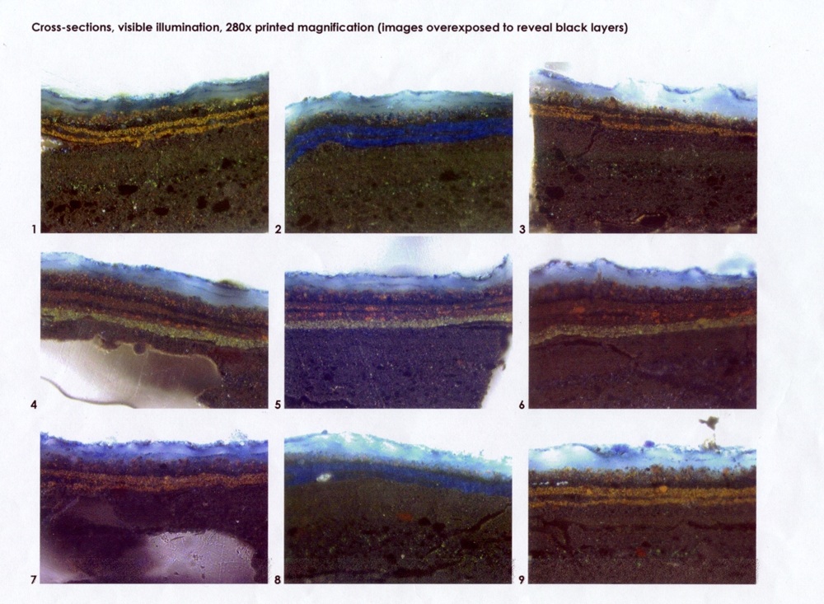
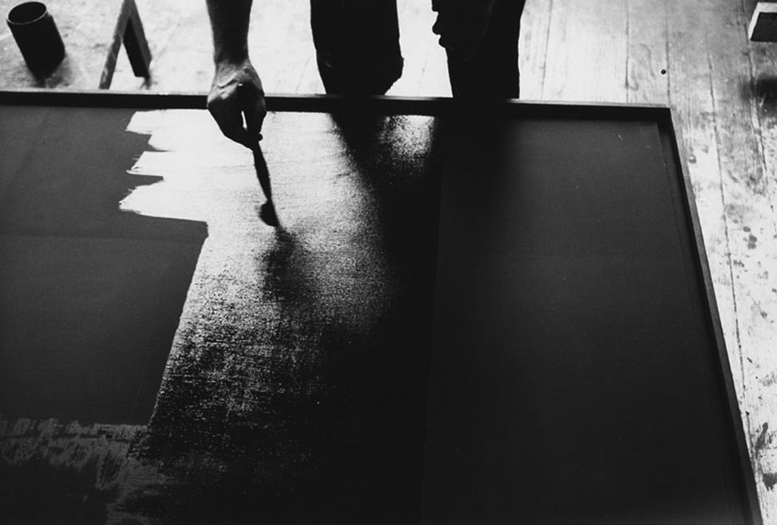

Slide 42


