Slide 1
Vienna and Beyond: Art and Architecture in Austria-Hungary
1873-1918
23 April 2020 - Essay Writing

Slide 2
What is an essay?
“A short piece of writing on a particular subject.”
It is a formal, original text
with a clear sense of argument
Supported by evidence, facts
Expressed logically

Slide 3
Main Topics
General structure/outline of an essay
Introduction
Main Argumentation – divided into clear distinctsections
Conclusion
Bibliography
Illustrations (if relevant)
Notes:
We try to keep it simple with this lecture, as it is pretty difficult to assess this from a far, especially what you already know. Please feel free to ask us, if you need any advise or help with the writing. We will focus on how to deal with research, and building a proper argument in this lesson. The parts mostly consist of the introduction, a research report, how to outline the argument, some visual analysis and the historical/cultural context. The second part of the lecture will focus on some tips regarding the use of the English language. The third part sums up the assessment criteria, we shall use for your essays. After the session you should have a better understanding, what we are looking for in regards to the basic criterias/standards.
You can find many of these brief guides to essay writing in art history, simply by googling it. They all serve different purposes, of course, and have their merits, but you have to browse through them to find the advice you need. A good short summary is the one from Stanford:
https://art.stanford.edu/sites/art/files/a_brief_guide_0.pdf

Slide 4
Introduction
Introduce the topic briefly, by a short thematic opening, either related to the artists life, through a related object, by a historical event, by the cultural atmosphere of the period etc.
Point out a certain problem / questions, related to one of the topics of the course.
Name and explain the more important voices in research / or the general state of the research; What are the most important books / essays, for primary and secondary sources? What is the most influential thesis in that specific field of research?
Provide a short summary of the points you intend to make in the essay, and also indicate what your aim is. This helps the reader know what to expect – and it is like providing them with a map so they can make their way through your essay
Notes:
This one is pretty obvious, it all comes down to how you are able to introduce your thesis briefly and sharpely, while also providing a short overview of the main academic debates

Slide 5
What sources do I use?
Choose:
Periodicals – scholarly, academic, both printed and online
Books – monographs, edited collections
Book reviews
Dissertations
Always ask, how reliable the source is:
E.g. popular books, such as The Da Vinci Code
Wikipedia entries
Websites

Slide 6
What is an argument?
An argument is a flow of reasons. It is a case presented in a logical stream, where ideas run together to support one another.
Arguments are ideas that begin with a proposition, gather reinforcement and head toward a conclusion.
As a writer you need to articulate your views in a clear and logical fashion and be able to convince others of your position.

Slide 7
Forming an argument
If you are writing an analysis that compares and contrasts multiple arguments, do not merely describe one work, then the neaxt work, then the final work. This style—known as “block-by-block”—often leads to a lot of description but not a lot of analysis.
Instead, structure your paper in what is known as the “point-by-point” method. In this method, you identify points of comparison and contrast and allow those points to be the main ideas.
Notes:
It is often easier to just sort everything by artists/countries/years, but after you did the brainstorming and reading, 2-3 major topics should come to your mind, which form the argumentation, and then you can sort the selected artworks within those categories.

Slide 8
Conclusion
Simply put, repeat the things stated in the introduction, but do not only repeat your arguments.
Now, offer some kind of commentary about your argument. In other words: having been presented with various points of view / arguments: where does that leave us? Where do we stand?
Do you have a point of view based on what you have read / the arguments you have presented? The Conclusion is where you put this.

Slide 9
Referencing – why?
gives appropriate recognition to the original authors or researchers whose ideas, words and research have been used
gives strength to your ideas by using well documented research that supports an argument
avoids plagiarism and the subsequent university disciplinary action
enables a reader to locate the sources of your information
provides evidence of your wide reading.

Slide 10
Referencing and footnotes: Use the usual system of citation in the department, or any other of the more common international styles – but the most important thing is – once you have chosen on, stay consistent with the style!
Stanford, A BRIEF GUIDE TO WRITING IN ART HISTORY
iv. Footnotes. Citation
An editor at an important journal once explained: by simply reading the footnotes, he could determine which essays to publish and which to reject. While this may seem like choosing a lover based on a big toe, it’s not as peculiar as it sounds. The footnotes document research you have quoted, paraphrased or summarized in the body of your essay as well as any ideas you’ve borrowed and expressed in the essay. A reader might look at your footnotes, then, and find the answer to these questions: Has this writer read the most important critics on the topic? Has the writer engaged relevant theoretical perspectives? Has the writer relied on scholarly research as compared to internet searches? Has the writer balanced primary and secondary materials?
Your footnotes reveal, in this way, what kind of researcher you are: perfunctory, multilingual, creative, interdisciplinary, reliable... By asking these questions of your own footnotes, you stand to improve both your footnotes and your essay.
Note: You can also use the space of a footnote to provide your reader with salient additional research, as well as anecdotal or other observations that enhance the reader’s understanding of the subject--even as such asides remain ancillary to the essay’s structure. (For proper citation, refer to the detailed instructions in the Library Guide. Art Historians use the style established by the Chicago Manual of Style.)

Slide 11
Bibliography
The essay ends with a list of the primary and secondary sources
List at least 10 relevant secondary sources!
Separate the primary sources from the rest
Only list items, you made use of in the text
Images
Add a fully annotated list of your images at the end of the essay (if relevant)

Slide 12
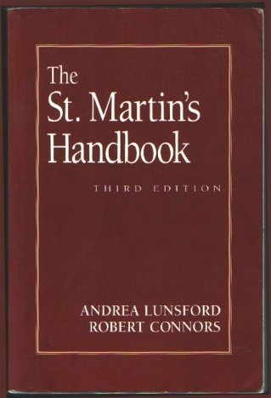
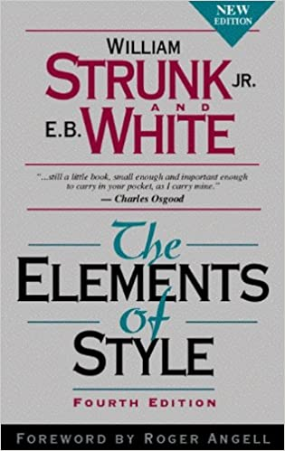
English Language
Use one or two good writing guides, and see, if you can find material that helps you improve
Look up words via Merriam Webster, English is often reliant on specific phrases and/or the use of certain verbs
Use premade collections of art historical phrases, you can google them
Try to find word lists and expand your vocabulary a bit.
Find a friend for proofreading
Notes:
This one is pretty tricky, since your experience with English writing might differ widely. And there is no easy way to improve, you just have to write (and read) more. Style guides often provide loads of additional information, and you will struggle to find the useful ones, but both handbooks mentioned above are pretty useful. Try to look up as many phrase and words on Merriam Webster as you can (while writing). Find someone for proofreading!

Slide 13
What is academic language?
Informal Language | Academic Language
repetition of words | variety of words, more sophisticated vocabulary
sentences start with “and” and “but” | sentences start with transition words, such as “however,” “moreover,” and “in addition”
use of slang: “guy,” “cool,” and “awesome” | No slang

Slide 14
Before you submit
A checklist:
Have I understood the essay question and the requirements?
Have I expressed a clear argument and/or opinion?
Have I used appropriate evidence to support this argument or opinion?
Does my introduction clearly state the topic and how it will be dealt with?
Does my conclusion refer back to the topic and state my findings based on the evidence provided?
Are all my references complete and correct according to the appropriate style?
And finally, if you’re not sure about something, ASK!

