Slide 1
T 3: Silent Cinema

Slide 2
Phases of Silent Cinema
1886 - 1904: Early Cinema
1904 - 1917: Transitional Period
Since 1917: Classical Hollywood Cinema
PD Mag. Dr. Claus Tieber

Slide 3
Modes of Production
1896 – 1907 „Cameraman“ System
1907 – 1909 Director System
1909 – 1914 Director Unit System
1914 – 1931 Central Producer System
PD Mag. Dr. Claus Tieber

Slide 4
Edwin S. Porter
Jack and the Beanstalk (June 1902)
Life of an American Fireman (Nov. 1902 - Jan. 1903)
PD Mag. Dr. Claus Tieber

Slide 5
Length
50 feet
1900: 250 - 400 feet
1903: 300 - 600 feet
1905: 800 - 1000 feet
1000 feet = 300 meter = one reel
PD Mag. Dr. Claus Tieber

Slide 6
Biograph
Wallace McCutcheon
Frank Marion
PD Mag. Dr. Claus Tieber

Slide 7
Uncle Tom‘s Cabin
1903
Porter
First intertitles (in film)
PD Mag. Dr. Claus Tieber

Slide 8
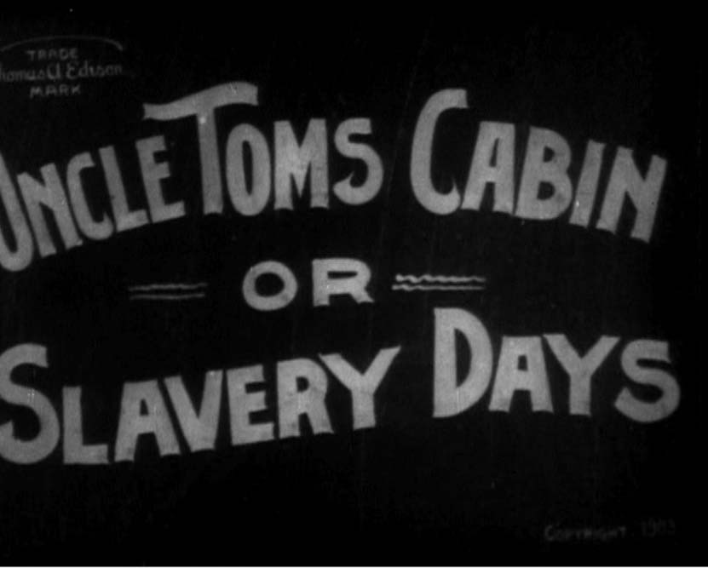
PD Mag. Dr. Claus Tieber

Slide 9
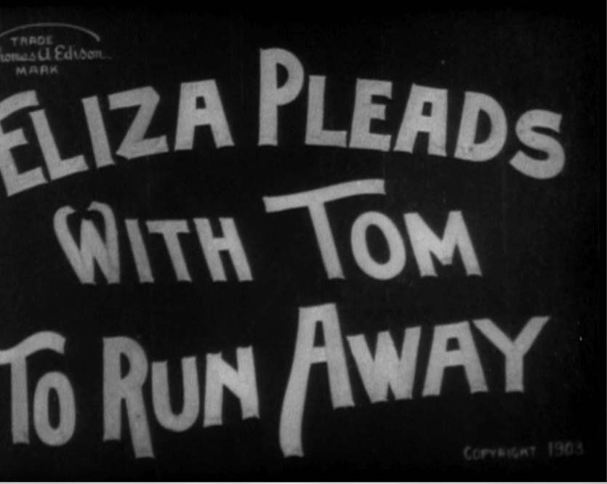
PD Mag. Dr. Claus Tieber

Slide 10
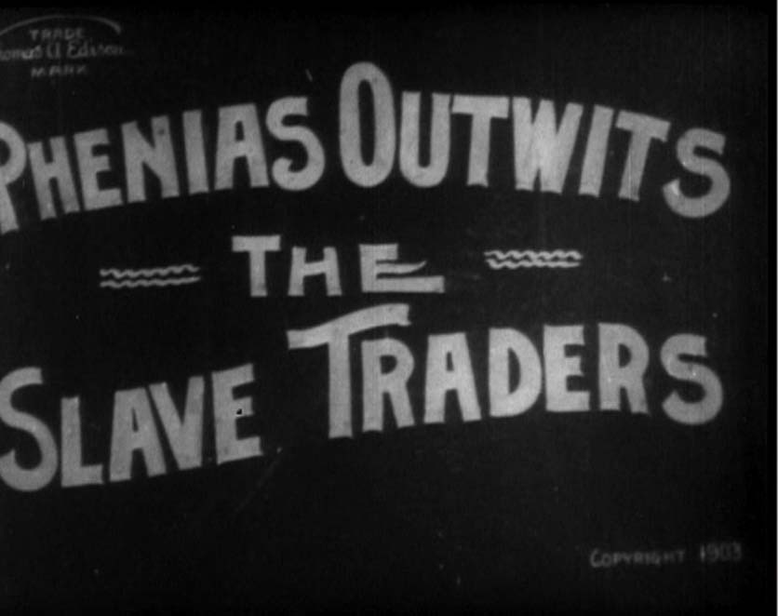
PD Mag. Dr. Claus Tieber

Slide 11
Screenplay Formats
before 1886: oral
1896 – 1904: other media (newspapers, photo stories, etc.)
1904 – 1912: Theater, Scenario
Seit 1912: Continuity Script
PD Mag. Dr. Claus Tieber

Slide 12
Terms
Scenario
Photoplay
Continuity script
Master scene script
PD Mag. Dr. Claus Tieber

Slide 13
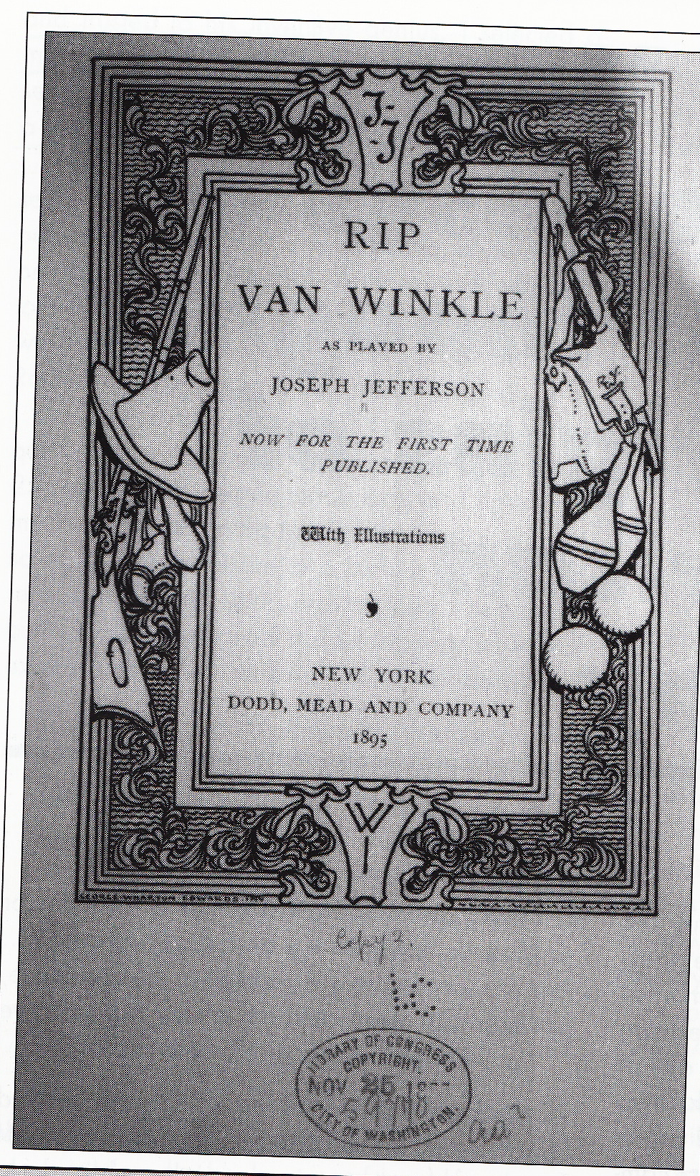
Rip Van Winkle
Thomas Jefferson 1896
PD Mag. Dr. Claus Tieber

Slide 14
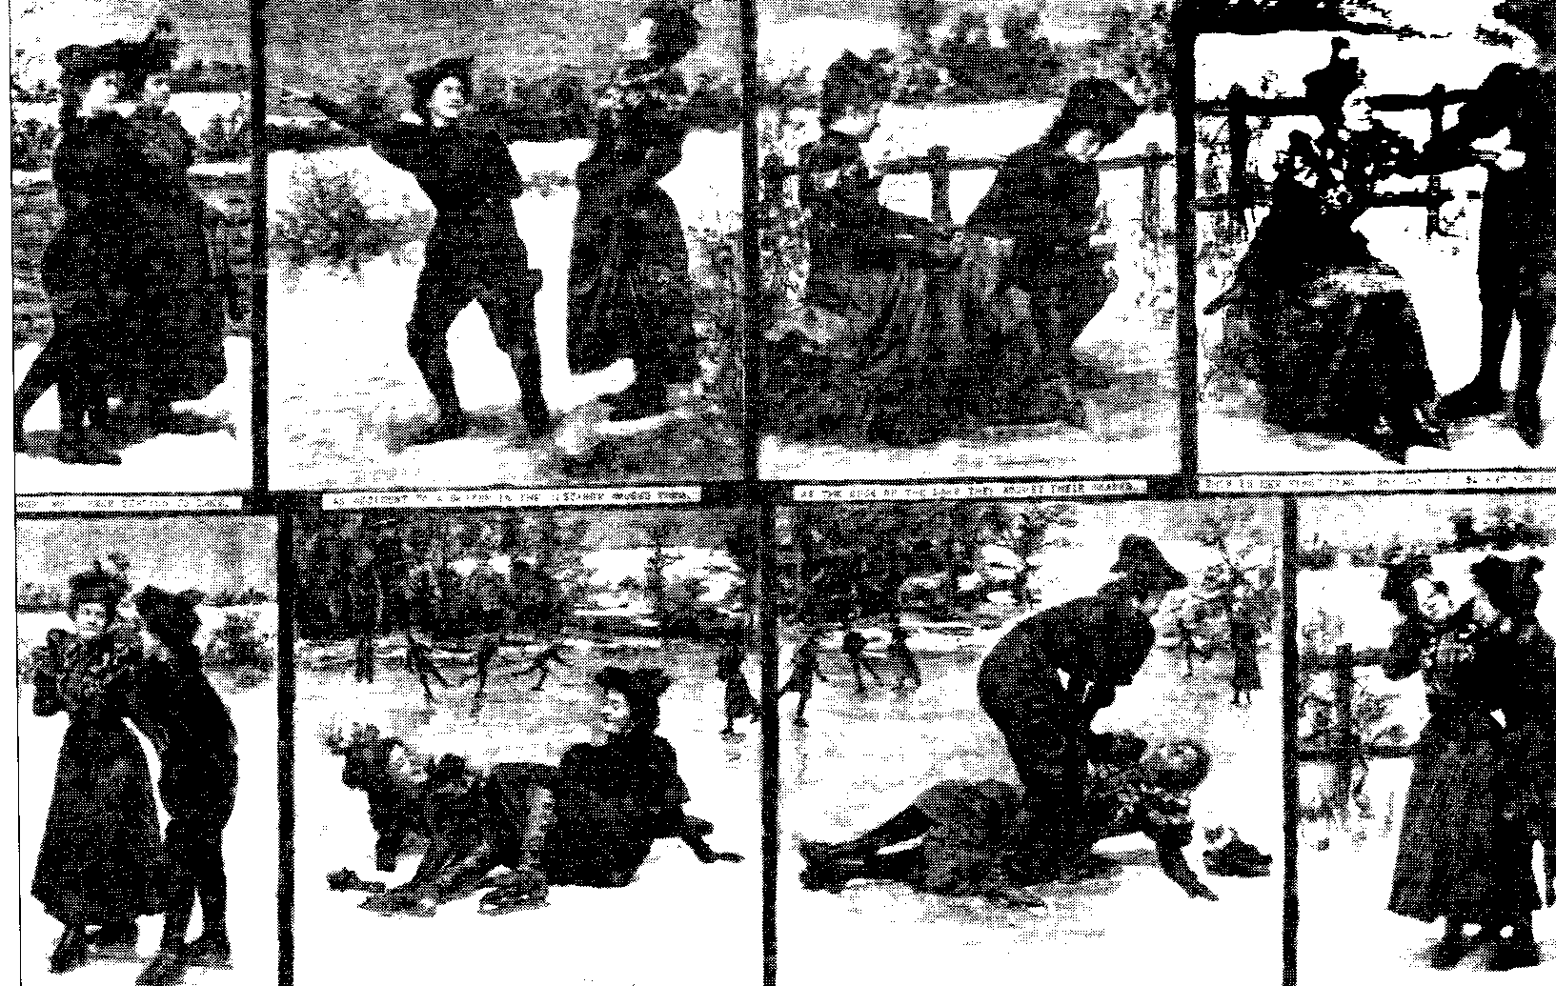
Notes:
UT: an accident to a skater in the distance amuses them, at the edge of the lake they adjust their skates, this is their first time, she can‘t be blamed for unlesbar

Slide 15
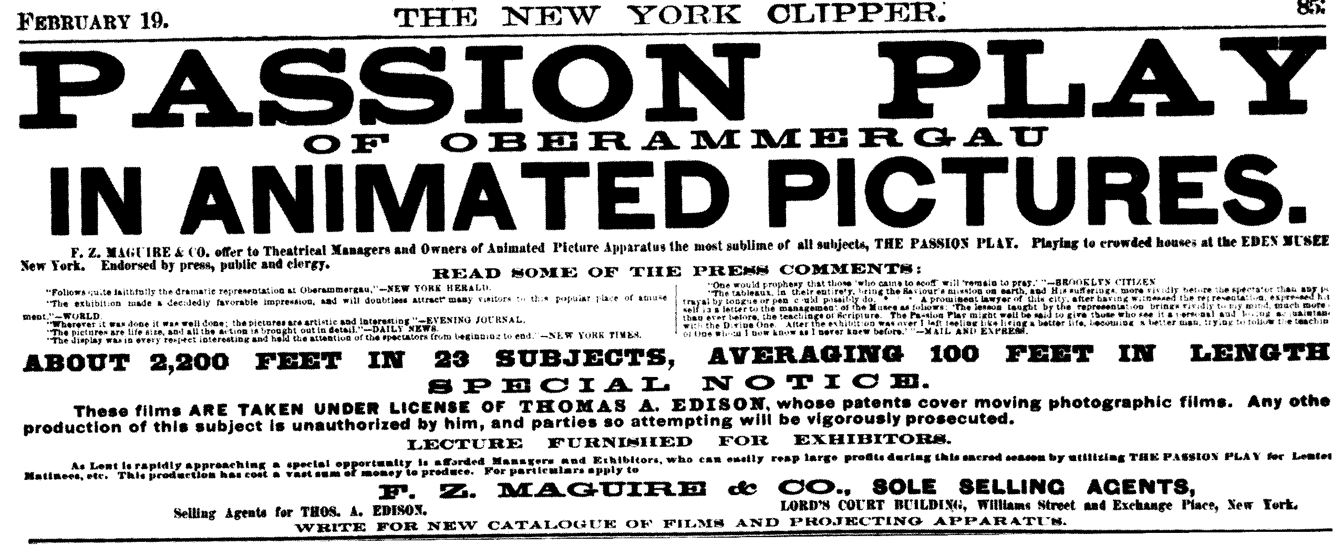
PD Mag. Dr. Claus Tieber

Slide 16
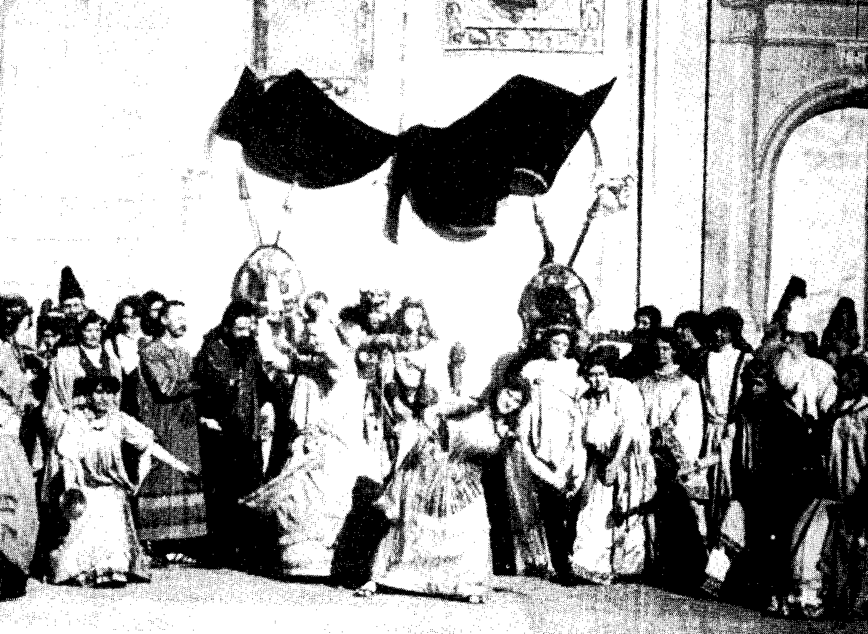
The Passion Play of Oberammergau
Notes:
Salome Dance before Herod

Slide 17
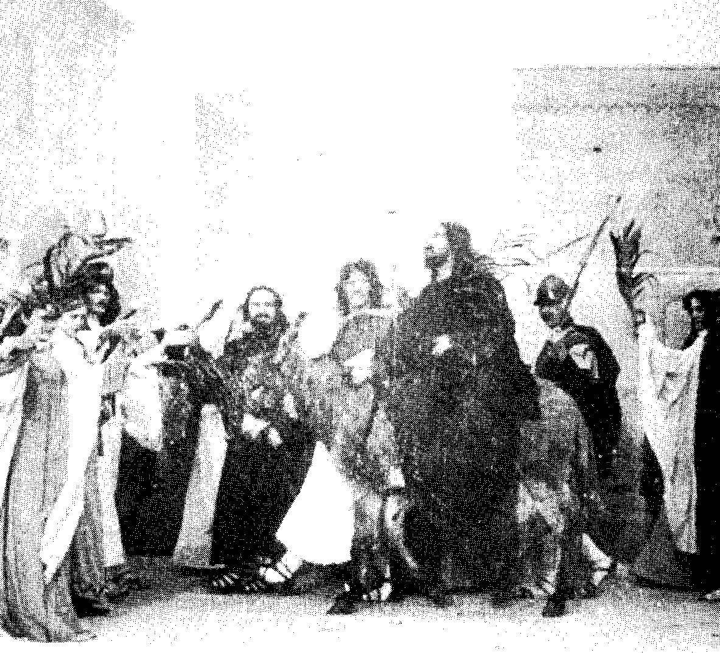
The Passion Play of Oberammergau
PD Mag. Dr. Claus Tieber
Notes:
The Messiah‘s Entry into Jerusalem

Slide 18
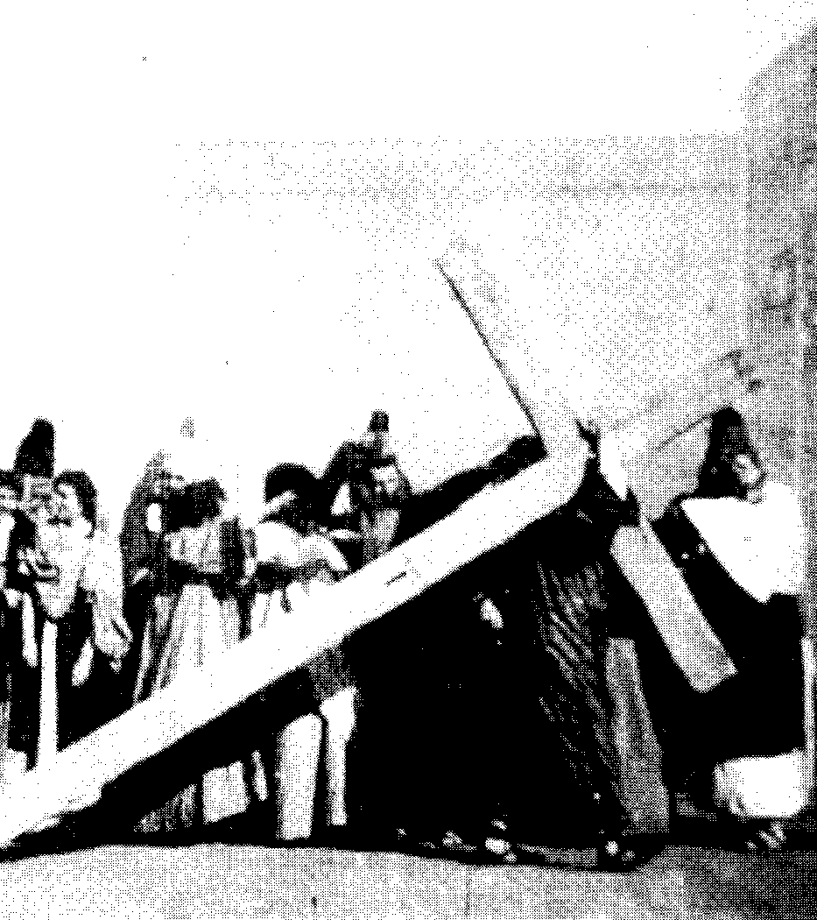
The Passion Play of Oberammergau
Notes:
Carrying the Cross

Slide 19
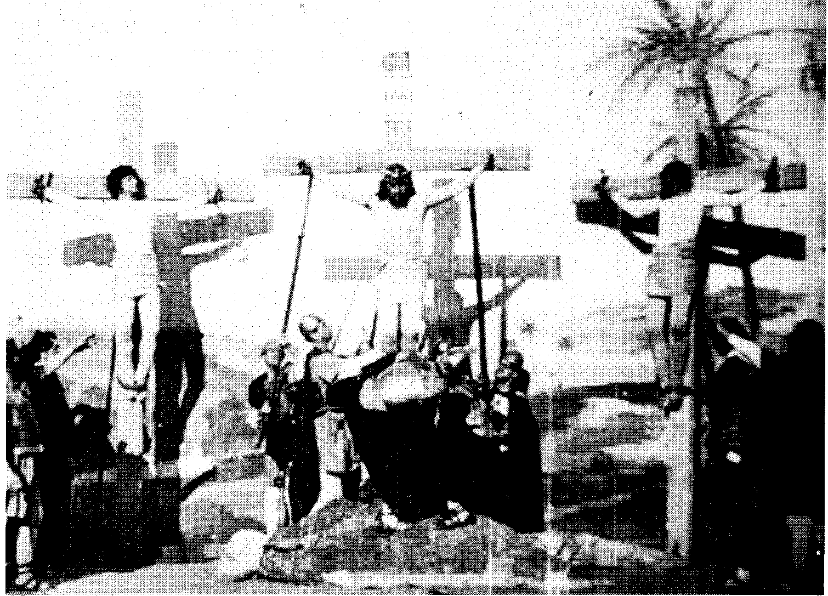
The Passion Play of Oberammergau
PD Mag. Dr. Claus Tieber
Notes:
The Crucifixion

Slide 20
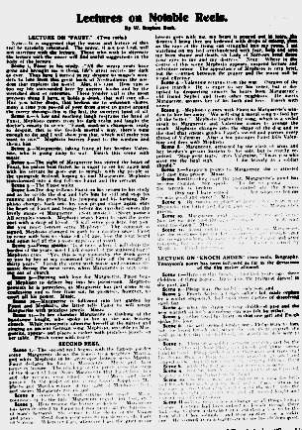
Narrator/Lecturer
PD Mag. Dr. Claus Tieber
Notes:
Lecture on „Enoch Arden“: Scene 1: Here on the beach, a hundred years ago, three children of three houses, Annie Lee, the prettiest damsel in the port, and Scene 2 Philip Rayl, the millers only son, and Scene 3 Enoch Arden, a rough sailor‘s lad, made orphan by a winter shipwreck, had build their castles of dissolving sand, but Scene 4 when the dawn of rosy childhood past and the new warmth of life‘s ascending sun was felt by either. Scene 5t either fixed his heart on that one girl and Enoch spoke his love.

Slide 21
Ben Hur (1907)
Kalem Company
Gene Gauntier
Lew Wallace
PD Mag. Dr. Claus Tieber

Slide 22
Gene Gauntier
PD Mag. Dr. Claus Tieber

Slide 23
Central Producer System
When I had my theatrical company (...) I never told a director ‚Go and put on a play’ and trusted to his inventive genius. I selected a manuscript I liked, and he followed it. And I didn’t see any reason why the same course shouldn’t be a success in the motion picture game.
Lloyd Thanhouser
PD Mag. Dr. Claus Tieber

Slide 24
Scenario Script
the plot of action that is no more than a synopsis of the scenes is being replaced by the full script.
Eapes Winthrop Sargent
PD Mag. Dr. Claus Tieber

Slide 25
D. W. Griffith
PD Mag. Dr. Claus Tieber

Slide 26
Mack Sennett
PD Mag. Dr. Claus Tieber

Slide 27
Frank Capra
Here’s the way we slave: Two men work up a story line, then all the others pitch in on gags. Sennett holds story conferences up here or down in his office. Sometimes he takes us to the projection room to see the rushes. You can scribble out your own ideas, but no scripts for the directors. You tell them the story and they shoot from memory. Got it?
PD Mag. Dr. Claus Tieber

Slide 28
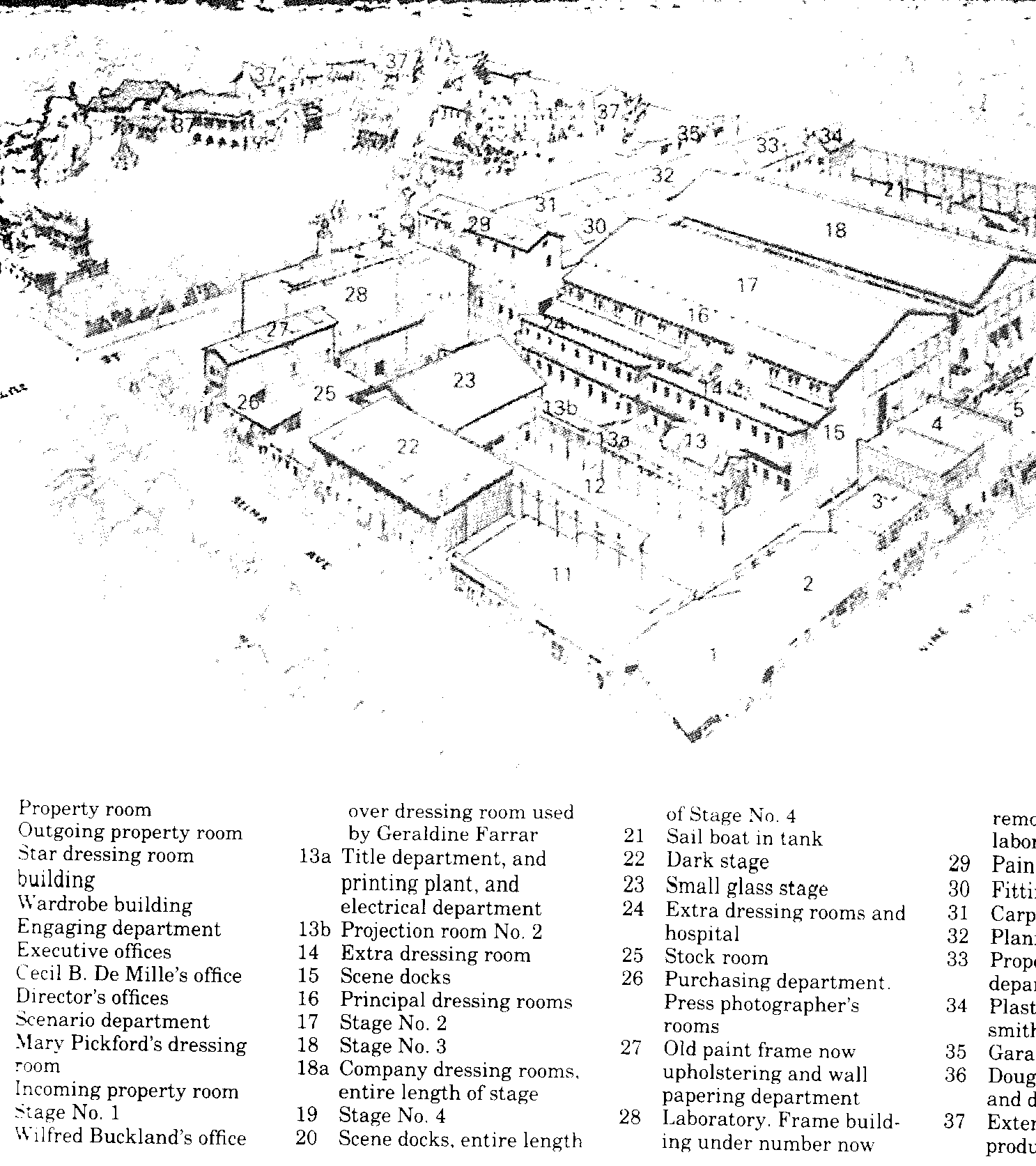
The Lasky studio 1918
Notes:
Scenario department 9 (rechts oben)

Slide 29
Thomas H. Ince
PD Mag. Dr. Claus Tieber

Slide 30
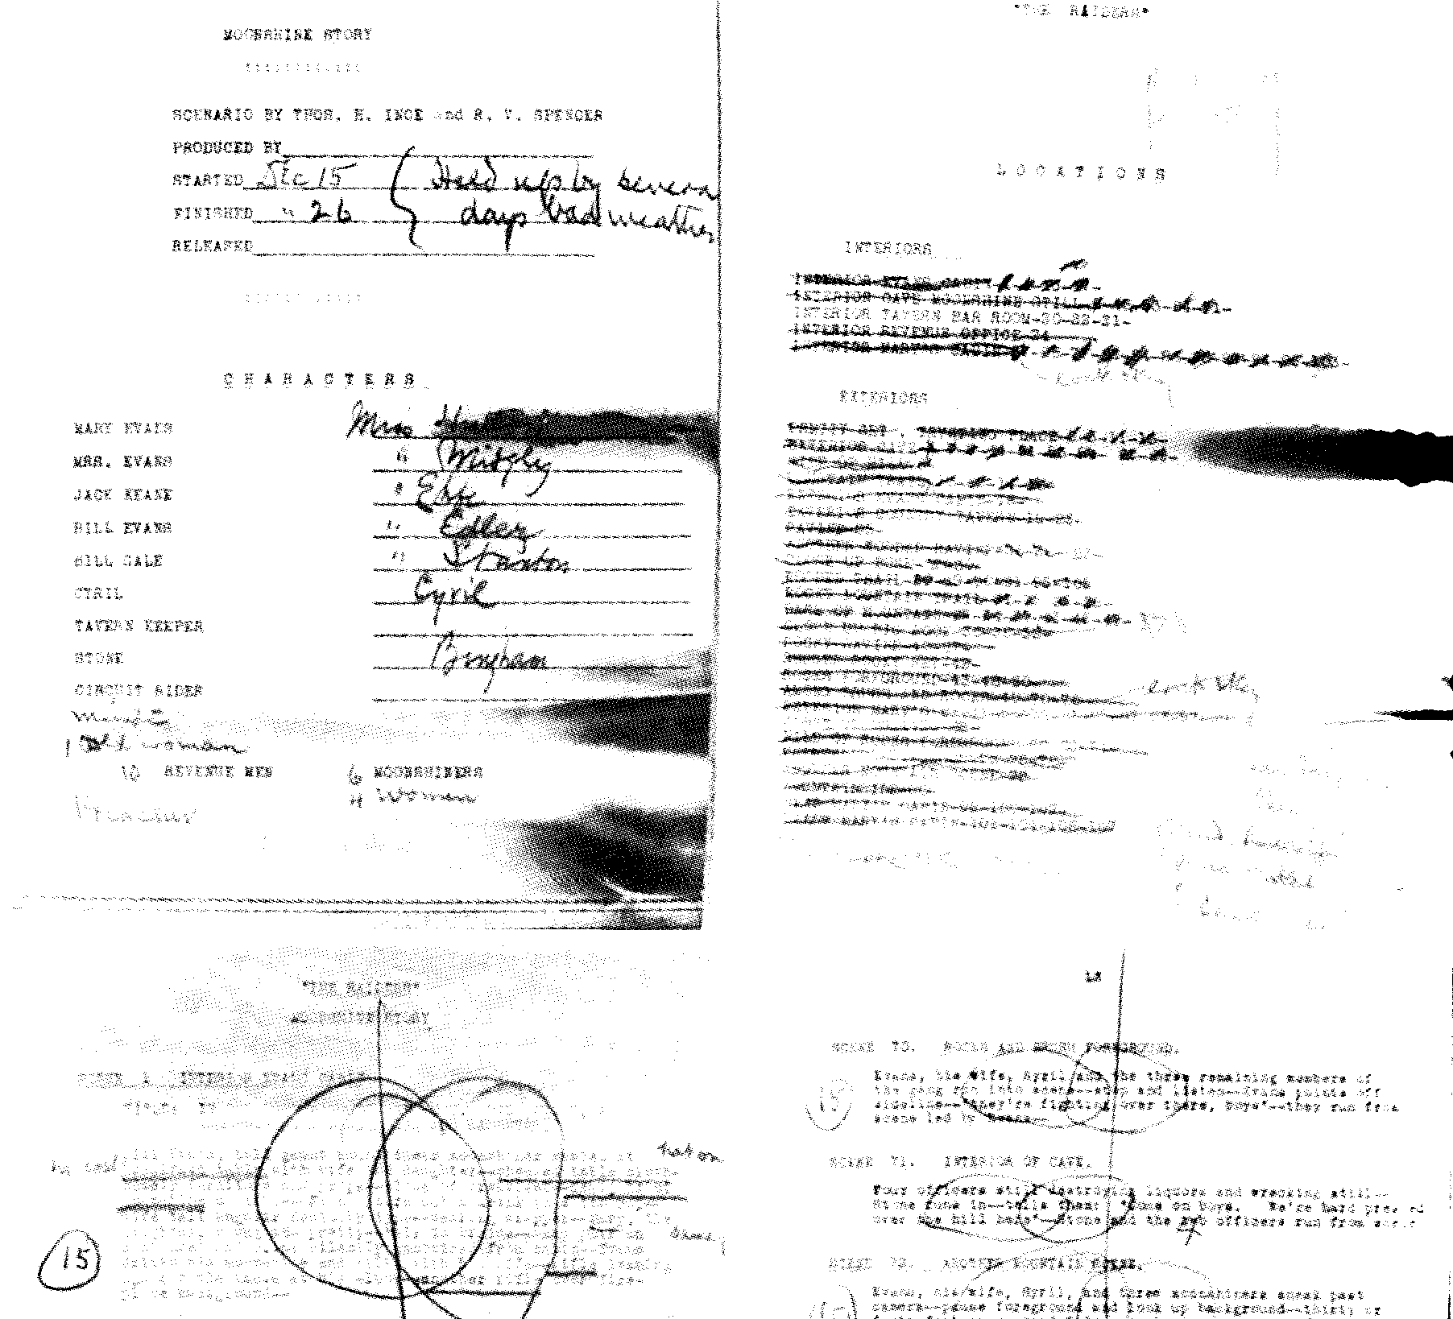
Continuity Script
Notes:
One of the earliest scripts available in the Aitken Brothers papers is for The Raiders, shot in 1913, under the direction of Jan Hunt for Thomas Ince

Slide 31
Ince‘s Authors
C. Gardner Sullivan
Monte Katterjohn
J.G. Hawkes
PD Mag. Dr. Claus Tieber

Slide 32
Roy McCardell

Slide 33
McCardell‘s Photo-Stories
Notes:
1896, Little Willie and the Chorus Girls, Showing how a Youthful Clerk, with Three per Week and Sporty Ideas, is Reveived and finally Sent Home, a Wiser Man
UT: unlesbar, He is having a good time; Inviting him to supper, Upon refusing, his good time ends

Slide 34
Frank E. Woods
PD Mag. Dr. Claus Tieber

Slide 35
Photoplay 1914
Biograph wanted
„problem stories in which effective contrast is made between the rich and the poor.“
PD Mag. Dr. Claus Tieber

Slide 36
The American Film Manufacturing Company
…can now use Eastern and Western drama, melodrama, and comedy drama. All sorts of comedy subjects and an occasional costume play are purchased.

Slide 37
The Bison Film Company
… recently, acquired the services of the Miller Brothers 101 Ranch Company of Indians and cowboys and is in the market for high class western and cowboy scenarios.

Slide 38
The Eclair Company
… on the other hand did not want westerns, while Edison was more interested in ‚the particular plot than the classification.

Slide 39
Kalem
… at this point wanted material that could be done in Southern California, and suggested writers keep in mind the personalities of their top stars, Alice Joyce and Carlyle Blackwell. Kalem did allow as how ‚an occasional railroad subject might be considered.’ Kinemacolor Company of America, in an early attempt at making color films, wanted ‚open air scenes as far as possible,’ while Majestic wanted ‚rural comedies or dramas of life on the farm.’

Slide 40
The Meliès Film Company
… was also looking for stories with Southern California settings, and were even more specific about their requirements: ‚The stories must not require military scenes or anything of a spectacular order. There may be a number of riders used in the picture, incidentally, up to the number of fifteen.’

Slide 41
A Group of Photo-playwrights
PD Mag. Dr. Claus Tieber
Notes:
1914, Roy McCardell, Bannister Merwin, Richard Harding Davis, Harold MacGrath, Epes Winthrop Sargent, Emmet Campbell Hall, J. Berg Esenwein, Marc Edmund Jones

Slide 42
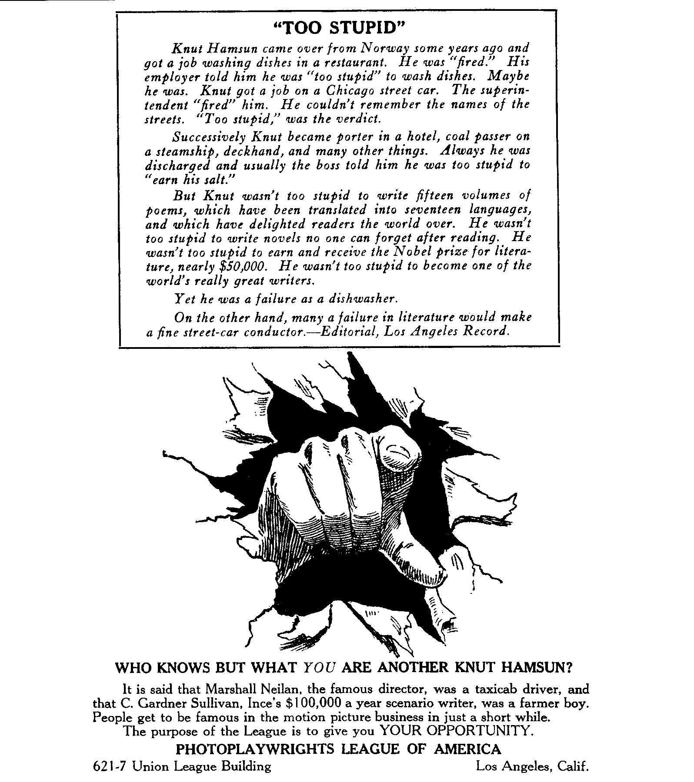
Scenario Fever
PD Mag. Dr. Claus Tieber

Slide 43
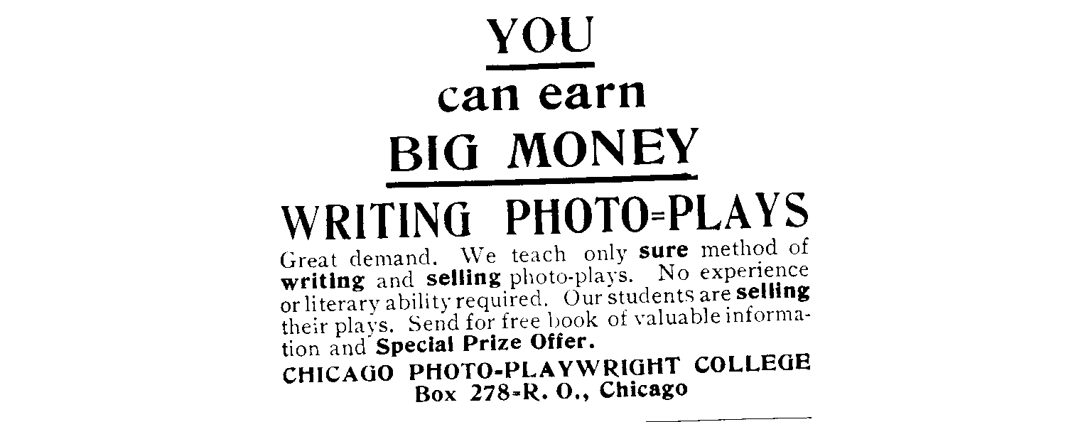
Scenario Fever
PD Mag. Dr. Claus Tieber

Slide 44
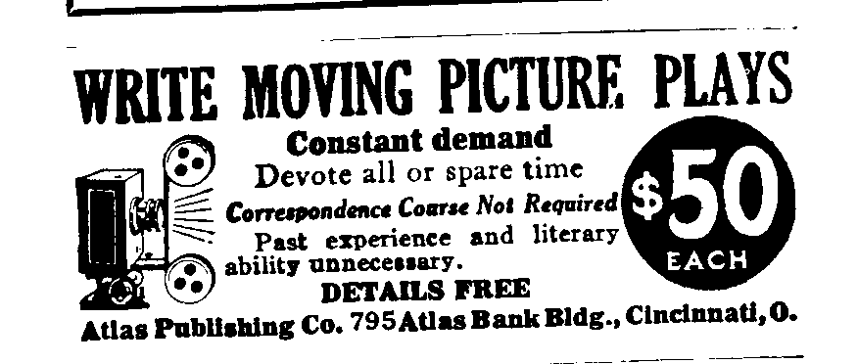
Scenario Fever
Notes:
Motion Picture Magazine January 1915

Slide 45
Professions
Story Editor
Reader/ Story Analyst
Continuity Clerk/ Script Girl
PD Mag. Dr. Claus Tieber

Slide 46
John Emerson and Anita Loos

Slide 47
Anita Loos

Slide 48
June Mathis

Slide 49
June Mathis - Valentino
PD Mag. Dr. Claus Tieber

Slide 50
Jeanie Macpherson
PD Mag. Dr. Claus Tieber

Slide 51
Mary Pickford Frances Marion
PD Mag. Dr. Claus Tieber

Slide 52
Frances Marion
Poor Little Rich Girl (1917)
Stella Maris (1918)
Pollyanna (1920)
The Love Light (1921)
Stella Dallas (1925)
The Scarlett Letter (1926)
The Wind (1928)
Anna Christie (1930)
The Big House (1930)
Min and Bill (1931)
The Champ (1931)
PD Mag. Dr. Claus Tieber

Slide 53
Daddy Long Legs (1919)

Slide 54
The Love Light (1921)

Slide 55
Star Image: Themes and Variations
Little Mary
Mary Pickford

Slide 56
Mary Pickford
The trade press published articles as early as 1910, noting that her fans called her “Little Mary.” By 1912, illustrated magazines, such as McClure’s, as well as newspapers, spread the word of her high salary. (Abel 520)

Slide 57
United Artists

Slide 58
Stella Maris (1918)

Slide 59
Little Lord Fauntleroy (1921)

Slide 60
Daily Talks
life,
Movies
how to get into the movie business
morals

Slide 61
Frances Marion
Parents - children relations
rich - poor, melodramatic vs. classical narration
female characters
Marion - Pickford
PD Mag. Dr. Claus Tieber

Slide 62
Mack Sennett
The more money we spent on the script, on writing the story, the less money it cost us to shoot the pictures when we put the actors to work. I thought that over and made motions to get all the work possible out of my writers.
PD Mag. Dr. Claus Tieber

Slide 63
Goldwyn, Eminent Authors
The great trouble with the usual author is that he approaches the camera with some fixed literary ideal and he cannot compromise with the motion picture viewpoint.
PD Mag. Dr. Claus Tieber

Slide 64
Cont.
This attitude brought many writers whom I had assembled into almost immediate conflict with our scenario department, and I was constantly being called upon to hear the tale of woe regarding some title that had been changed or some awfully important situation which had either been left out entirely or else altered in such a way as to ruin the literary conception.

Slide 65
Payment
1909: 10 $
1914: 50 - 100 $
1000 - 2500 /weel
10.000 - 25.000 $ original story
PD Mag. Dr. Claus Tieber

Slide 66
Intertitles

Slide 67
Intertitles
PD Mag. Dr. Claus Tieber
Notes:
Illustrated title cards, Ince studio 1922

Slide 68
Transition to Sound
Central Producer and Producer Unit System
Master Scene Script
Dialogue Continuity
economic crisis
PD Mag. Dr. Claus Tieber

