Slide 1
L 6: Conclusions

Slide 2
Music in Screenplays
Two column format
Film musical
Musical numbers
Diegetic songs
Extra-diegetic music

Slide 3
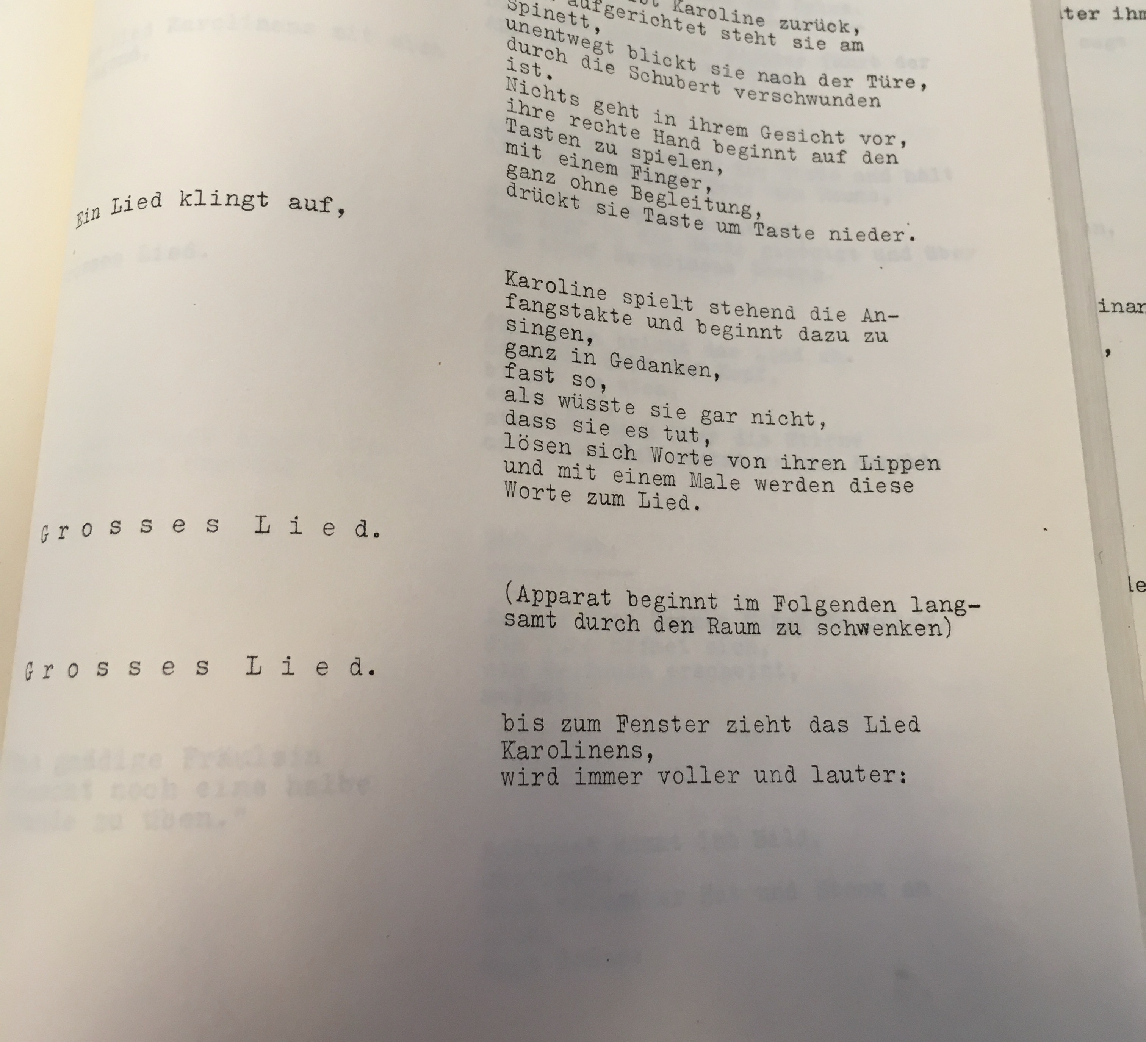
Two Column Screenplay

Slide 4
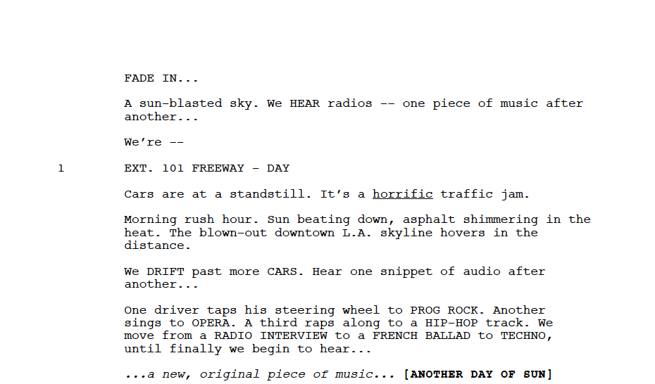
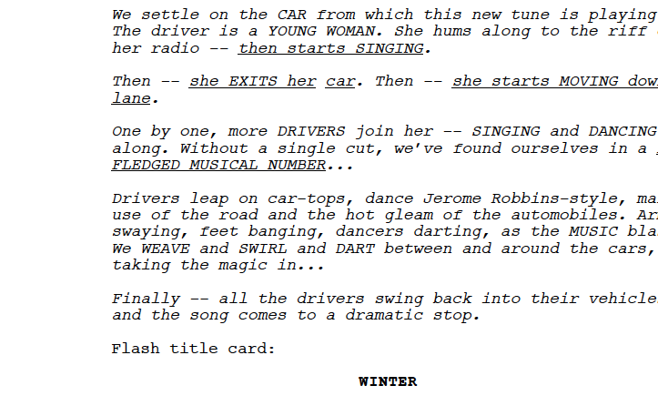
La La Land (USA 2016)
Director & Screenwriter:
Damien Chazelle

Slide 5
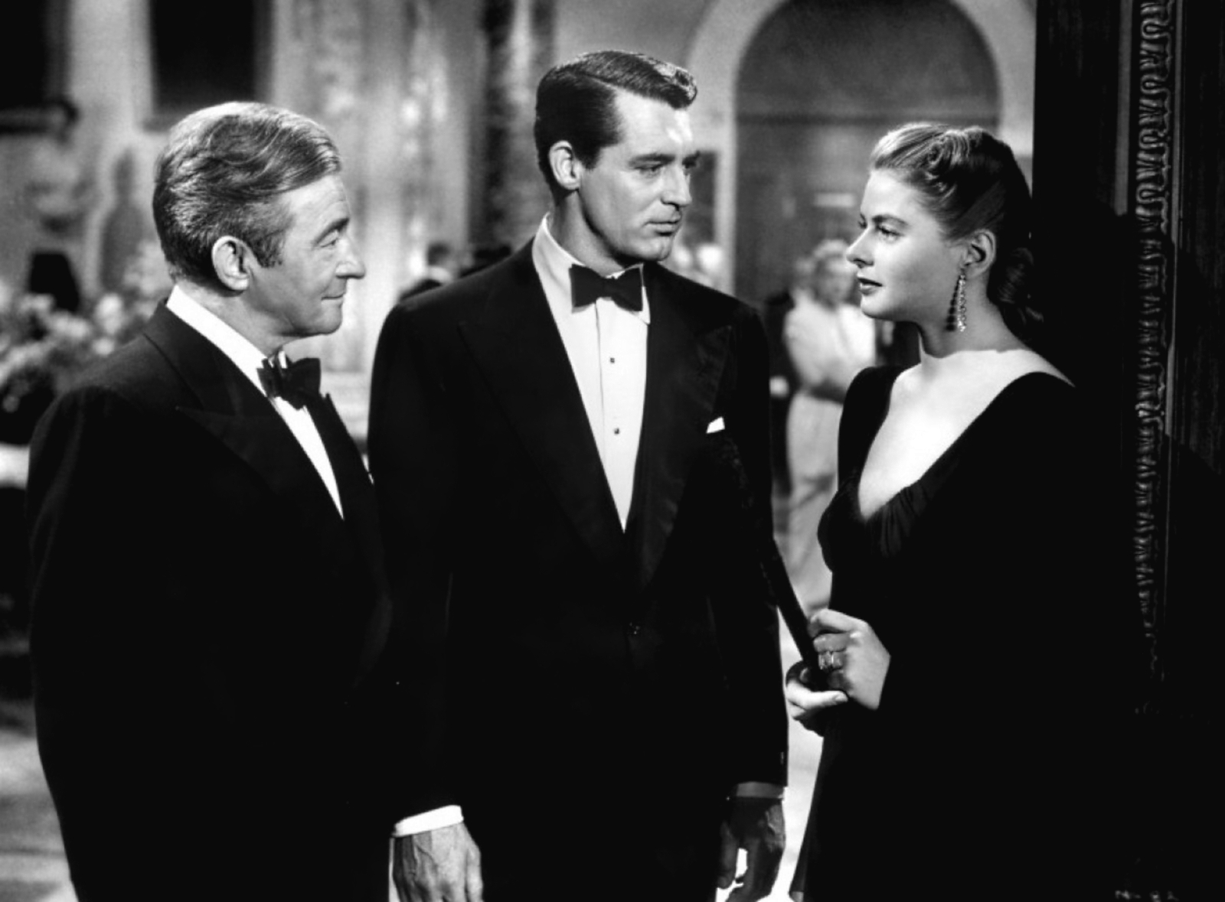
The Case of Notorious

Slide 6
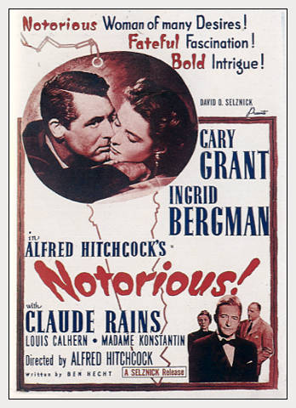
Notorious (1946)
Producer: David O.Selznick
Screenwriter: Ben Hecht
Director: Alfred Hitchcock

Slide 7
Second Treatment Feb. 10th, 1945
We’ve arranged for her to meet Sebastian at the President’s palace tomorrow at three o’clock. Mr. Beardsley is handling that. Thereafter, you’ll be her contact, Devlin.

Slide 8
Dialogue Treatment, April 16th, 1945
PICRA
This is more like opera than politics, gentlemen. (...)
PICRA
But what if this Sebastian ignores her?
BEARDSLEY
He won’t ignore Miss Huberman–I guarantee that.

Slide 9
Temporary Screenplay, May 9th, 1945
BEARDSLEY
I can assure you, Dr. Picra, that the girl we have brought down is perfect for the job – from every point of view.
PICRA
But it is so theatrical an enterprise. Sending out a young lady to win the love of a Nazi underground leader – to become his sweetheart – and betrayer. That is more like opera than politics, gentlemen.
BEARDSLEY
Granted, it’s theatrical. But so is the thing we’re up against. There’s no better way of getting at it quickly and thoroughly than sending a woman after this fellow Sebastian. He’s the head of the whole Nazi business down there and directing their work.

Slide 10
PICRA
(quietly)
I know – I know. Despite all this – it still does not sound entirely reasonable to me. A young lady flinging herself at a Nazi underground leader. Surely this man Sebastian has enough sense in his evil head to become a little suspicious at this lovely stranger assaulting him.
PRESCOTT
You are quite right, Excellency. We selected Miss Huberman, however, because she is not a stranger to Sebastian. Our information is that he was very much in love with her four years ago. He saw a lot of her – and her father at the time.
(...)
PICRA
This is very interesting – and makes the enterprise a little more reasonable.”

Slide 11
Temporary Screenplay, June 11th, 1945
DR. PICRA
But it is so theatrical an enterprise. Sending out a young lady to win the love of a German propaganda chief – to become his sweetheart – and betray him. That is more like opera than politics, gentlemen. Why not simply take him into custody?

Slide 12
Final Script, Sept. 18th, 1945
PICRA
I do not question the girl. Such is not my objection. I simply question why you don’t take the German chief into custody.

Slide 13
PRESCOTT
That’s the beauty of the situation, Excellency. Miss Huberman, according to our information, knew Sebastian four years ago.

Slide 14
PRESCOTT
Sebastian was very much in love with her then – he saw her very often.
PICRA
I see, I see, this in formation makes the enterprise more plausible.

Slide 15
Film (Aug. 15th, 1946)
PRESCOTT
Miss Huberman was chosen not only because her father gives her an ideal background, but because Sebastian knows her.
This is news for Devlin.
PRESCOTT
Oh yes, he was once in love with her.
DEVLIN
Oh, I didn’t know that.

Slide 16
cont.
PRESCOTT
I don’t see why we’re arguing about petty things like this. We’ve got important work to do.

Slide 17
Problems - Solution
Alicia's character: she is more or less a prostitute
the relationship between Alicia and Devlin: he loves her, but must convince her to sleep with another man
the Nazi conspiracy is never specified

Slide 18
Melodrama

Slide 19
Linda Williams
Melodrama is the fundamental mode of popular American moving pictures. It is not a specific genre like the western or horror film; it is not a „deviation“ of the classical realist narrative; it cannot be located primarily in woman’s films, „weepies“, or family melodramas – though it includes them. Rather melodrama is a peculiar democratic and American form that seeks dramatic revelation of moral and emotional truths through a dialectic of pathos and action. It is the foundation of the classical Holly- wood movie.101

Slide 20
Peter Brooks
Melodramatic structure moves from the presentation of virtue-as-inno-cence to the introduction of menace or obstacle, which places virtue in a situation of extreme peril. For the greater part of the play, evil appears to reign triumphant, controlling the structure of events, dictating the moral coordinates of reality.115

Slide 21
Characteristics of Melodrama
Manichaean Worldview
Good and bad
Characters as representants: types, not individuals
Passive protagonists, trying to keep their virtue
Dual Focus Narrations

Slide 22
Coincidence, Deus ex machina
Action, spectacle and pathos
Self-conscious and self-reflexive mode of representation
Explicit moral(istic) message

Slide 23
Models and Films
Devdas
Little Miss Sunshine
Die Hard
Equilibrium
Fairytale
Semantic fields/dualism
Hero’s Journey
3 Act Structure, Plot Points, goal-driven
Melodrama

Slide 24
Changes and Challenges Today
Globalization
Streaming
Digitalization
Transmedia storytelling
storyboarding

Slide 25
Open points
Topics
Questions

