Slide 1
Manuals & Narratology
Introduction into Screenwriting Studies

Slide 2
Manuals
Manuals
Before Hollywood (1910s)
After the Studio System (since 1970s)

Slide 3
Narratology
Narrative structure
Modes of narration
Transmedial vs. Media specific

Slide 4
Patterns, Structures, Paradigms
Are there similar patterns, principles, structures to be found in
Every narration
Every film
Classical films
How have they developed and changed over time?

Slide 5
Narratology
Vladimir Propp
Tzvetan Todorov
Jurij
Lotman

Slide 6
Lotman: The Structure of the Artistic Text
Semantic fields, dualism
Border
Hero-agent

Slide 7
Vladimir Propp
https://www.youtube.com/watch?v=V5RyV-s0yhU&list=PLxfoIafGz08wcNUNkCQohk5z7I0eB4_rM
Morphology of the Folktale

Slide 8
Propp: Characters
Hero
Princess
Villain
Dispatcher
Helper
Donor
False hero

Slide 9
Propp: 31 Functions
Story structure: specific combination of functions
Rules of the genre
Adaptable to classical film?

Slide 10
Tzetan Todorov
https://www.youtube.com/watch?v=f7AfnJd55PI

Slide 11
Todorov: Equilibrium

Slide 12
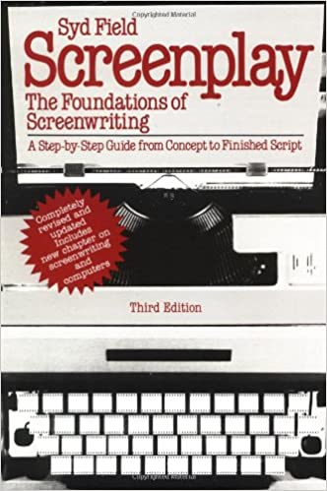
Syd Field
1935 – 2013
USC
Screenplay 1979

Slide 13
Three-Act Structure

Slide 14
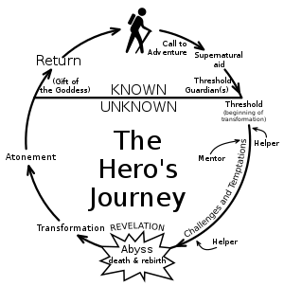
Joseph Campbell & Christopher Vogler: Hero’s Journey
12 stages

Slide 15
Rick Altman: Theory of Narration
Single Focus
Dual Focus
Multiple Focus

