Slide 1
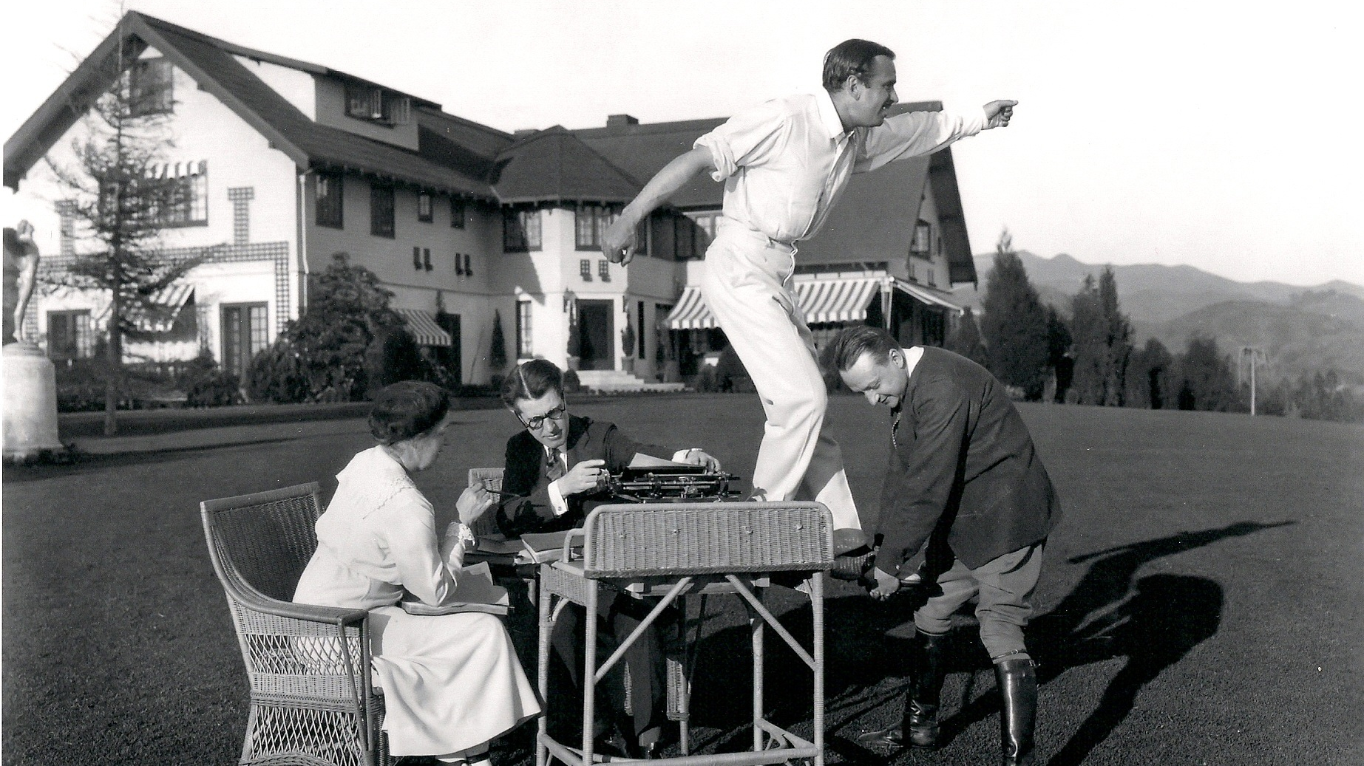
Introduction into Screenwriting Studies
Claus Tieber

Slide 2
Timetable
Lesson 1 (L1) Tuesday 10. 11.
14:00 - 15:50
L2 - Tuesday 10. 11.
16:00 - 17:50
L3 - Wednesday 11. 11.
10:00 - 11:50
L4 - Wednesday 11. 11.
12:00 - 13:50
L5 - Thursday 12. 11.
16:00 - 17:50
L6 - Thursday 12. 11.
18:00 - 19:50
PD Mag. Dr. Claus Tieber

Slide 3
Contents
Screenwriting Studies: Definition, History, Theory and Methods
Screenplay: Formats and History
Modes of Production and Development
Working Conditions and Unionization
The Case of Hollywood: Studio System, Blacklisting etc

Slide 4
Aims
Film historiography
A new field in film and media studies
New approaches
History and presence
Archival material

Slide 5
Your Expectations

Slide 6
Grading

Slide 7
Ontology of the Screenplay
Literary value
Intermedial status
blueprint
document

Slide 8
Screenplay: Definitions
The script of a movie, including acting instructions and scene directions.
Oxford Dictionaries
Notes:
Koebner, Thomas (Hg.): Reclams Sachlexikon des Films. Stuttgart: Reclam 2002. S. 133

Slide 9
screenplay: definitions
„The screenplay, which is sometimes known, also, as the scenario or film script, resembles the blueprint of the architect. It is the verbal design of the finished film.“
Notes:
zitiert nach Auiler, Dan: Hitchcock’s Notebooks. An Authorized and Illustrated Look Inside the Creative Mind of Alfred Hitchcock. New York: Harper Collins 2001 (paperback ed.) S. 21

Slide 10
Screenplay: Definitions
The basic art of the motion picture is the screenplay; it is fundamental; without it there is nothing.
Raymond Chandler
a factory friendly document
David Thomson

Slide 11
screenplay: Definitions
A screenplay is the agreement of a group of filmmakers (SIWG) about what to shoot.

Slide 12
Screenwriting Studies
Narratology
Production Culture
Film History, Authorship
Practice Based Research

Slide 13
Text - Reception
Barthes:
Readerly
audience can easily uncover the text’s pre-determined meaning
Writerly
requiring interpretive effort
Fiske:
Producerly
popular and easy to read
different readers can easily read them in different ways

Slide 14
Screen Idea
Screen Idea
Screen Idea Working Group

Slide 15
Screen Idea Work Group (SIWG)
A flexibly constructed group organized around the development and production of a screen idea
All those who have some direct connection with the development of the screen idea
Ian Macdonald
PD Mag. Dr. Claus Tieber
Notes:
Ian Mcdonald

Slide 16
Screenwriting Studies
Screenplay as text
modular text (Price)
Literature „in flux“ (Sternberg)
„Object Problem“ (Maras)

Slide 17
Auteur-Theory
Stephen Crofts:
1. „ Author as expressive individual“
Notes:
Crofts, Stephen: Authorship and Hollywood. In: Wide Angle 573. 1983. S. 17

Slide 18
2. Author as constructed from film or films“
2.1. as thematic or stylistic properties impressionistically and unproblematically read off from film to film
2.2. a set of structures identifiable within a body of films by the same author
2.3. as a subject position within the film

Slide 19
3. Author as social and sexual subject

Slide 20
4. Author as author-name, as function of the circulation of the film or films

Slide 21
History of Screenwriting Studies
Claudia Sternberg: Written to be Read: the Screenplay as Text
Janet Staiger: Blueprints for Feature Films: Hollywood‘s Continuity Scripts

Slide 22
Pauline Kael: Citizen Kane Book
Richard Corliss: Talking Pictures

Slide 23
History
Tom Stempel: Framework

Slide 24
SRN
Screenwriting Research Network
Journal of Screenwriting
Palgrave Studies in Screenwriting

Slide 25
Manuals
1910s
1970s until now
Universality of narrative structures?

Slide 26
Screenwriting as process
Screen Idea
Production Culture

Slide 27
Doxa
Nobody knows anything?
Knowledge, believe, paradigms and conventions
Discourses about screenwriting

Slide 28
The Screenplay: Elements and Formats,

Slide 29
Master Scene Script
You just write: ‚master scene,’, ‚cut to,’ or ‚close shot’ – which is very easy, just mix it up. The master shots and the individual shots were all shot the same way.“
Julius Epstein
PD Mag. Dr. Claus Tieber

Slide 30
Scene Headings/Slug-lines
Indicate setting and time, whether a scene is to be shot on an interior (INT.) or exterior (EXT.) set, the specific scripted location in all CAPS, and whether it takes place during the DAY or NIGHT (e.g. INT. ROOM – DAY).

Slide 31
Action
Generally reports on character actions but also contains scene descriptions, technical comments, and other relevant story details.

Slide 32
Transitions
Include each passage from one scene to another, always typed in CAPS (e.g. CUT TO:, DISSOLVE TO:, FADE OUT.). Because “cut to” is the default transition, it is generally omitted in contemporary screenplays.

Slide 33
Dialogue
Character Headings – Typed in CAPS and indicate the speaker of a line.
Parenthetical Directions – Used primarily to modify the delivery of dialogue.
Dialogue – All the spoken lines in the script.

Slide 34
Literary Comment
illustrates the non-filmable imagery or emotional truth of a scene or character (e.g. “A tall scarecrow-of-a-man walks his long-haired dog down a dark street, the way a guard might walk his prisoner down the green mile.” Literary Comment in italics.)

Slide 35
Technical Comment
offers instructions for the film crew and is usually capitalized (e.g. “CRANE UP to reveal a tall scarecrow-of-a-man walking his long-haired dog down a dark street. CLOSE on the dog. Somewhere a train blows its WHISTLE.” Technical Comment in italics.)

Slide 36
Speech
consists of dialogue cues within the scene text (e.g. “A man walks his dog. Somewhere a train blows its WHISTLE, startling the animal, and the man tells his dog to heel.” Speech in italics.)

Slide 37
The Apartment
INT. NINETEENTH FLOOR
Acres of gray steel desks, gray steel filing cabinets, and steel-gray faces under indirect light. One wall is lined with glass-enclosed cubicles for the supervisory personnel. It is all very neat, antiseptic, impersonal. The only human touch is supplied by a bank of IBM machines, clacking away cheerfully in the background.

Slide 38
