Slide 1
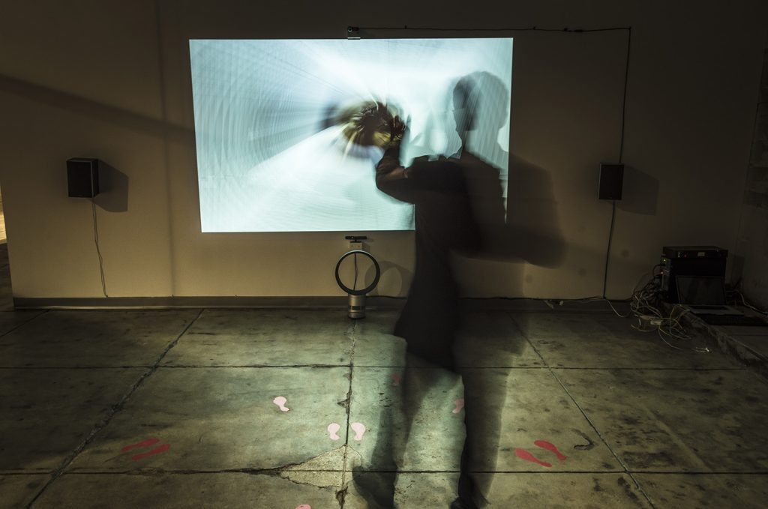
Telematické umění

Slide 2
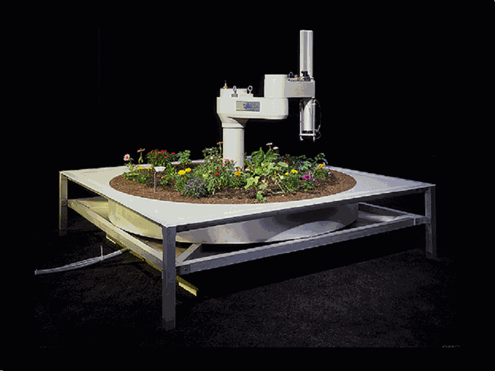
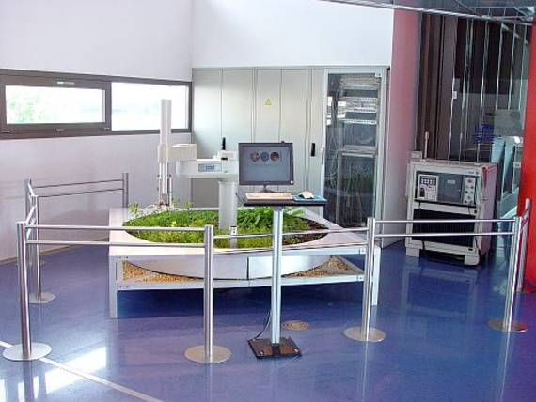
Ken Goldberg – Telegarden (1995-2004)
https://vimeo.com/328144991
https://www.youtube.com/watch?v=gbyy5vSg8w8

Slide 3
Paul Sermon –Telematic Dreaming (1992)
https://vimeo.com/44862244
https://vimeo.com/234630558

Slide 4
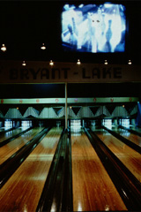
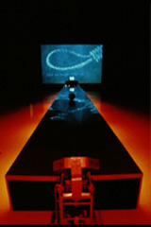
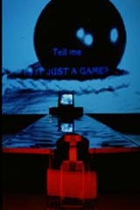
Shu Lea Cheang - Bowling Alley (1995)
http://bowlingalley.walkerart.org/

Slide 5
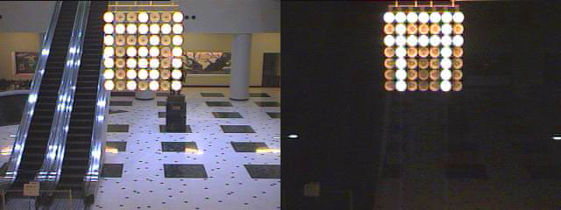
Masaki Fujihata - Light on the Net (1996)
https://www.youtube.com/watch?v=4Lj_VtfZa5E

Slide 6
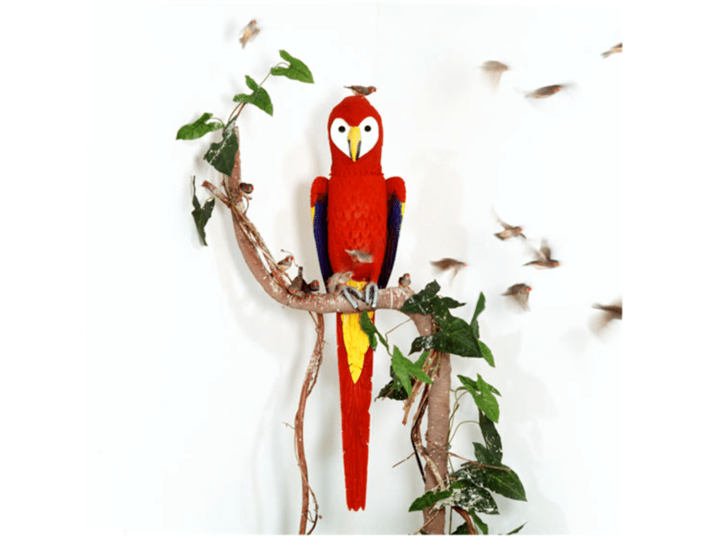
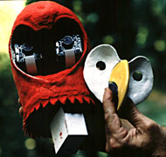
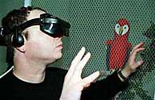
Eduardo Kac - Rara Avis (1996)
www.ekac.org/
https://vimeo.com/320071630

Slide 7
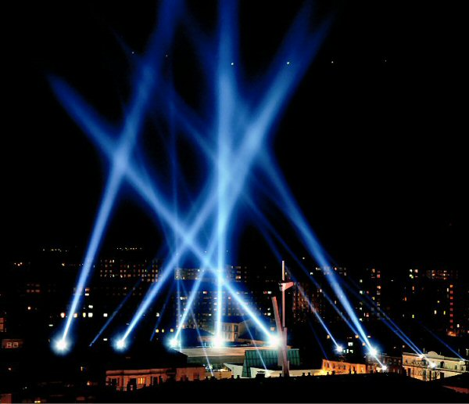
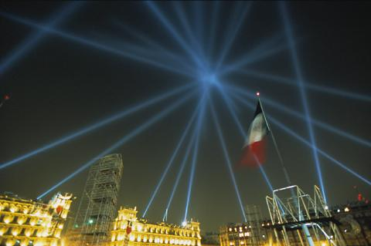
Rafael Lozano-Hemmer - Vectorial Elevation (1999 – 2000)
https://vimeo.com/33988779
http://www.alzado.net/vancouver/home.html

Slide 8
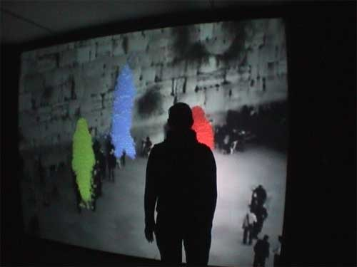
Michael Bielický - Tento rok v Jeruzalémě (2005-2006)
https://vimeo.com/80668118

Slide 9
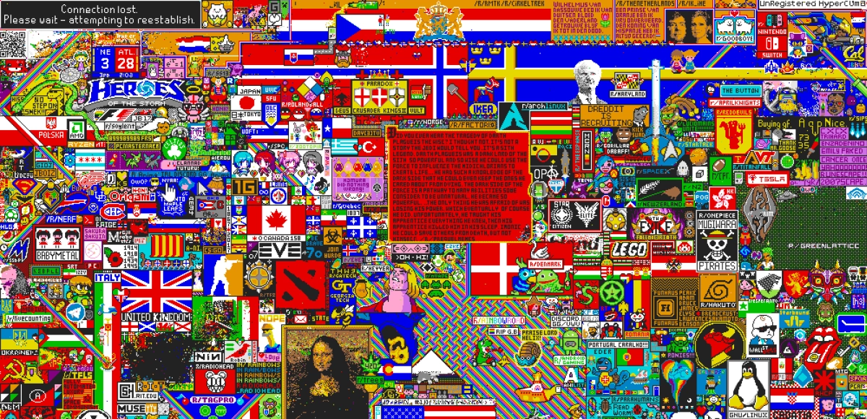
r/Place – Reddit (Josh Wardle) (2017)
https://www.youtube.com/watch?v=XnRCZK3KjUY
https://www.youtube.com/watch?v=ljSnAd6omJ8

