Slide 1
Sémantické aspekty katalogizace IX.
1. 12. 2020
PhDr. Jiří Stodola, PhD.

Slide 2
Cesta k FRBRoo
FRBR – ne pro všechny paměťové instituce
Archivy – popisují sbírky, nepublikované dokumenty (první vyjádření díla) organizací, osob, rodin
FRAD – implementuje archivní standard ISAAR(CPF) (International Standard Archival Authority Record for Corporate Bodies, Persons and Families), popisuje vztahy mezi korporacemi, osobami a rodinami
Archivy neznají více bibliografických identit, neznají dílo jako entitu podléhající autorským právům

Slide 3
CRM
Kombinuje FRBR a CRM (CIDOC Conceptual Reference Model) vytvořený Mezinárodní radou muzeí (CIDOC)
CRM – objektově orientovaný, formální ontologie
FRBR Review Group
FRBR zasazen do rámce CRM
90 tříd – E
148 – vlastností P
Dědičnost vlastností - dědičnost vlastností od nadtřídy k podtřídě znamená, že když položka x je instancí třídy A, tak všechny vlastnosti, které musí platit pro instance kterékoliv z nadtříd k A, musí platit také pro položku x, a všechny nepovinné vlastnosti, které mohou platit pro instance kterékoliv nadtřídyA, mohou platit také pro položku x."

Slide 4
FRBRoo
Muzea zpracovávají mnohem větší množství typů objektů než knihovny
FRBRoo to respektuje, pracuje s třídami a vlastnostmi
Formální ontologie zachycující a reprezentující základní sémantiku bibliografických informací
Integruje bibliografickou a muzeologickou informaci
Interinstitucionální konceptuální model (některé knihovny uchovávají muzejní objekty a muzea zase knihovní)
Interpretace a alternativa vůči FRBRer

Slide 5
FRBRer a FRBRoo
Atributy a vztahy se transformovaly ve vlastnosti
FRBRer – entity statické, přehlíží vznik díla, FRBRoo dynamické, snaží se do modelu zakomponovat procesy, složitá cesta k fyzické jednotce
Obohacení CRM o bibliografický kontext

Slide 6
Názvosloví
F + číslo – identifikátor entity
R + číslo + (B) – identifikátor vlastnosti, B znamená, že postupujeme od oboru hodnot k definičnímu oboru
V CRM E (entita, třída) a P (property), pokud jsou třídy Meta-CRM použity ve FRBRoo mají označení CLP, pokud přímo z CRM, tak E a P
Ontologie: FRBRer – endurantismus, FRBRoo - perdurantismus

Slide 7
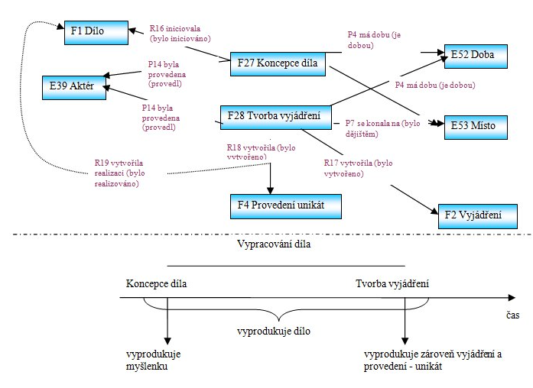

Slide 9
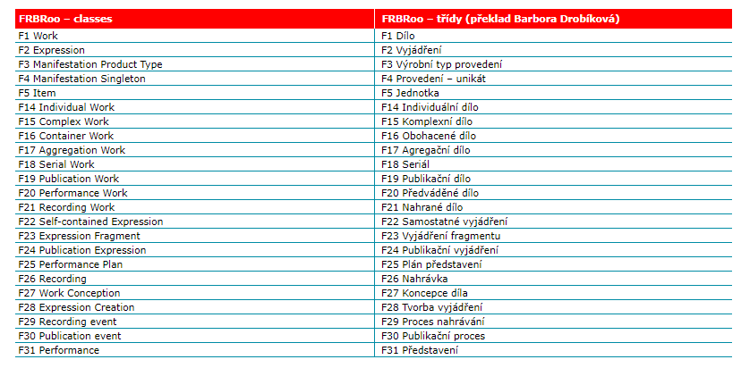

Slide 11
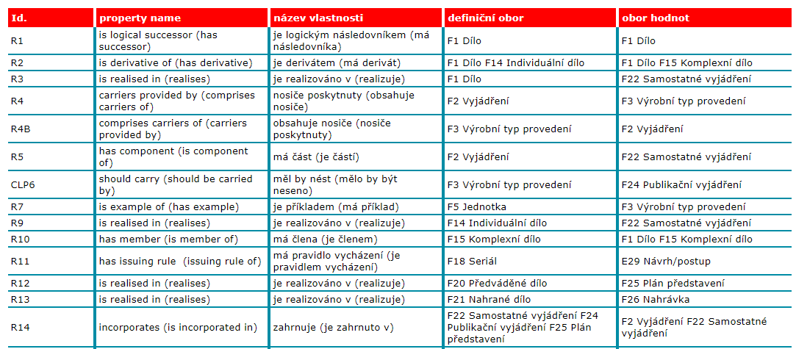

Slide 13
FRAD – symboly

Slide 14
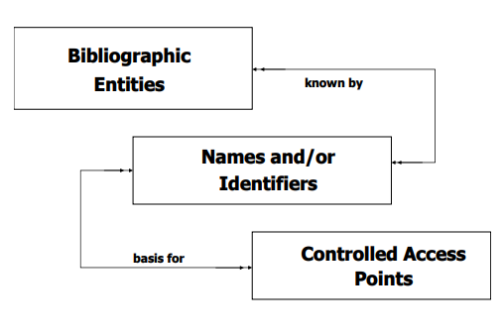
FRAD – základní model

Slide 16
Name I
A character, word, or group of words and/or characters by which an entity is known. [FRBR, modified]
Includes names by which persons, families, and corporate bodies are known. Includes titles by which works, expressions, and manifestations are known.
Includes names and terms by which concepts, objects, events, and places are known.
Includes real names, pseudonyms, religious names, initials, and separate letters, numerals, or symbols.
Includes forenames (or given names), matronymics, patronymics, family names (or surnames), dynastic names, etc.
Includes given names of sovereigns, popes, etc., with associated roman numerals.
Includes names of families, clans, dynasties, houses of nobility, etc.
Includes names representing the successive holders of a title in houses of nobility, etc., viewed collectively (e.g., Dukes of Norfolk).
Includes names used by a corporate body at various periods in its history.
Includes names of associations, institutions, business firms, not-forprofit enterprises, etc.

Slide 17
Name II
Includes names of governments, government agencies, projects, programmes, government officials, delegations, legislative bodies, armed forces, etc.
Includes names of religious bodies, local churches, etc., religious councils, religious officials, provinces, dioceses, synods, etc., papal diplomatic missions, etc.
Includes names of conferences, congresses, meetings, etc.
Includes names of exhibitions, athletic contests, expeditions, fairs, festivals, etc. Includes names of subordinate and related bodies.
Includes numbers that form an integral part of the name of a corporate body or event.
Includes trade names. Includes titles of content, parts of content, compilations of content, etc.
Includes titles by which a work has become known.

Slide 18
Name III
Includes the title proper of the original manifestation of a work.
Includes titles by which a work is identified in reference sources. Includes titles under which a work has been published.
Includes titles by which manifestations of an expression have become known.
Includes the title proper of the original manifestation of an expression.
Includes titles by which manifestations of an expression are identified in reference sources.
Includes titles under which manifestations of an expression have been published.
Includes the title proper of the original edition of a manifestation.
Includes titles by which a manifestation is identified in reference sources.
Includes variant titles appearing on or in a manifestation.
Includes names and terms for events, objects, concepts, and places.

Slide 19
Identifier I
A number, code, word, phrase, logo, device, etc., that is associated with an entity, and serves to differentiate that entity from other entities within the domain in which the identifier is assigned. An identifier can consist of an identifier string (i.e., a sequence of numeric and/or alphabetic characters assigned to an entity to serve as a unique identifier within the domain to which the identifier is assigned) and a prefix and/or suffix (a character or set of characters (numeric and/or alphabetic) appearing before or after an identifier string).

Slide 20
Identifier II
Includes identifiers such as social insurance numbers assigned by a government authority. Includes personal identifiers assigned by other registration authorities.
Includes business registration numbers, registration numbers for charitable organizations, etc., assigned by a government authority.
Includes corporate body identifiers assigned by other registration authorities (e.g., ISBN publisher’s prefix). Includes standard identifiers assigned by registration authorities identifying content (e.g., ISRC, ISWC, ISAN).
Includes standard identifiers assigned by registration authorities identifying manifestations (e.g., ISBN, ISSN).
Includes thematic index numbers assigned to a musical work by the publisher, or a musicologist.
Includes catalogue raisonné numbers. Includes identifiers for items assigned by repositories (e.g., shelf number).
Includes classification numbers referencing specific entities (e.g., a classification number assigned to a particular painting).
Includes registered trademarks.

Slide 21
Controlled Access Point
A name, term, code, etc., under which a bibliographic or authority record or reference will be found. [GARR, modified]
Includes access points designated as authorized (or preferred) forms 15 of names (i.e., authorized access points) as well as those designated as variant forms of name (i.e., variant access points).
Includes access points based on personal, family, and corporate names.
Includes access points based on titles (i.e., names) for works, expressions, manifestations, and items.
Includes access points consisting of a combination of two access points, as in the case of a creator/title access point for a work which consists of an authorized access point for the name of the creator combined with an authorized access point for the name (i.e., the title) of the work.
Includes access points based on names and terms for events, objects, concepts, and places.
Includes access points based on identifiers, such as standard numbers, classification indicia.

Slide 22
Rules
A set of instructions relating to the formulation and/or recording of controlled access points (authorized forms, variant forms or references, etc.).
Includes cataloguing rules and interpretations of those rules.
Includes coding conventions.

Slide 23
Agency
An organization responsible for creating or modifying a controlled access point. The agency is responsible for application and interpretation of the rules it creates and/or uses. The agency may also be responsible for the creation and maintenance of identifiers within its domain.
Includes libraries, national bibliographic agencies, bibliographic utilities, consortia, museums, archives, rights management organizations, etc.

Slide 24
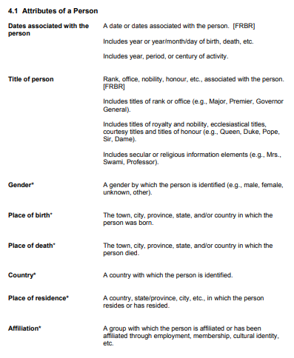
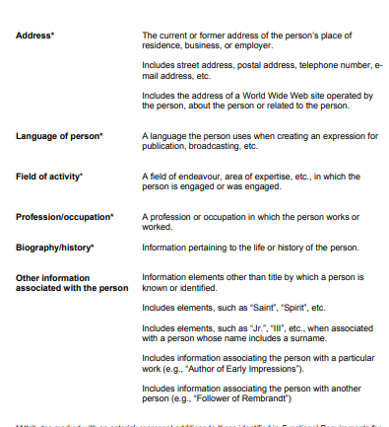

Slide 25
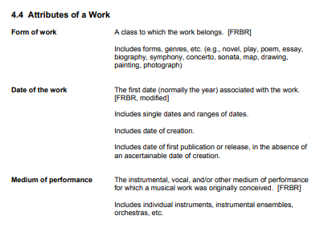
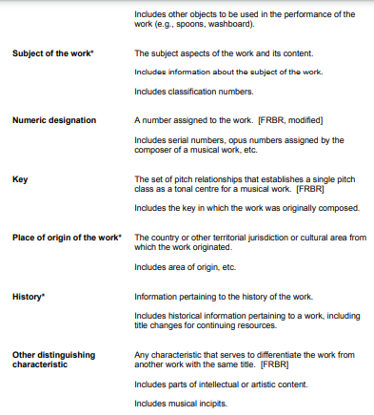

Slide 26
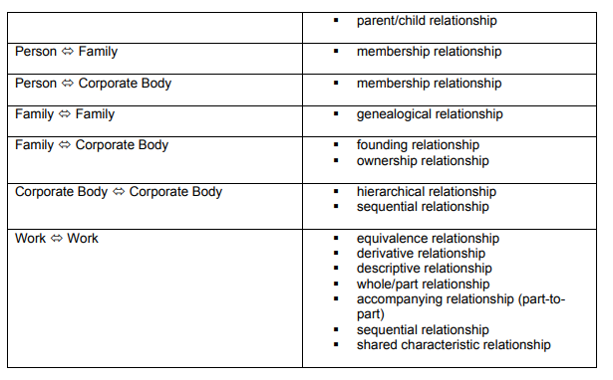

Slide 27
