Slide 1

The Celts and their languages 3
Brittonic languages: Welsh, Cornish and Breton
Lucie Vinšová
Masarykova univerzita 2017

Slide 2
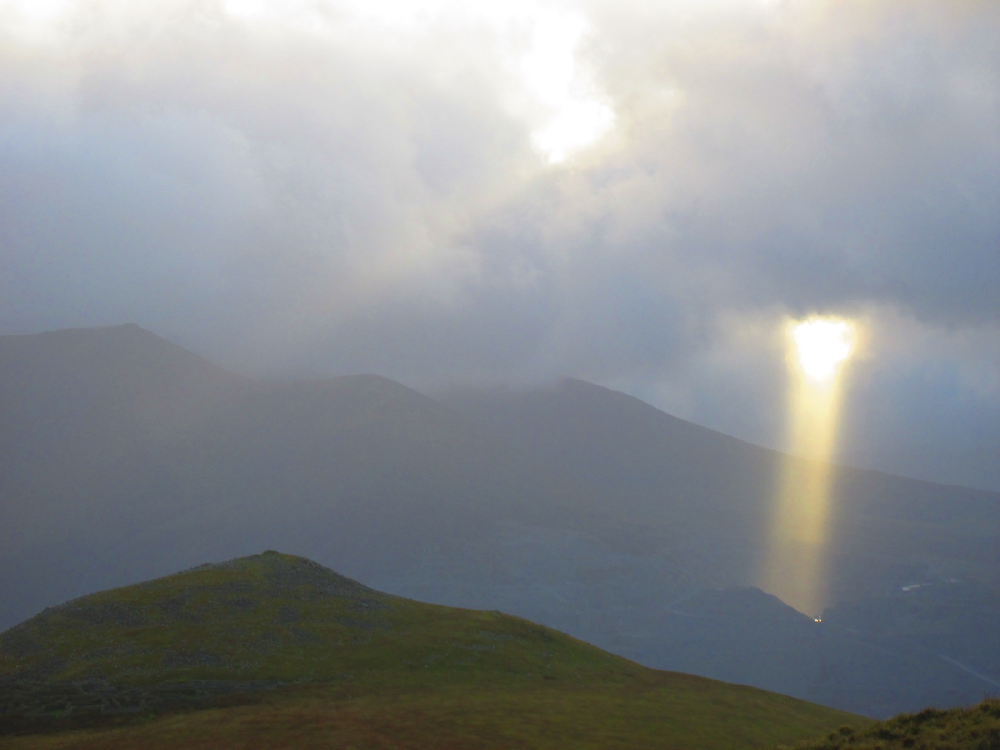
Brittonic (also Brythonic or British Celtic)
Brittonic was the Celtic language of the Celtic inhabitants of Britain before the Roman conquest (AD 43). At its greatest extent, to judge by the geographical distribution of place-names and river names, British Celtic was spoken throughout Britain except for the part of Scotland north of the Firth of Clyde and the Firth of Forth.
(Fortson, Indo-European Linguistics, 2010, p. 328)
The first evidence about the existence of Britain was given by a Greek geographer and explorer Pytheas of Massalia, who around 325 BC managed to organize a successful voyage to north Europe. Back then the name of the island was Prettan…a (later with b-), which we find in W. Prydein "Britain" (*kʷritanī, Prydyn “the Picts“ (*kʷritenī), all from the IE. root *kʷer- “to do", comp. OIr. cruth, W. pryd “appearance" (Schmidt 1993, 68).
The home name for Britain was Albion: Albion ipsi [Britanniae insulae] nomen fuit; OIr. Albu, possible to connect to W elfydd “world”, which reflects Celtic *albiĎdn-. Etymological connection to L. albus “white, light”, analogical to SL"světlý; svět" – “bright, world”(Hamp, ZCP 45, 1992, 87-88). Ad. Václav Blažek, Keltské Jazyky

Slide 3
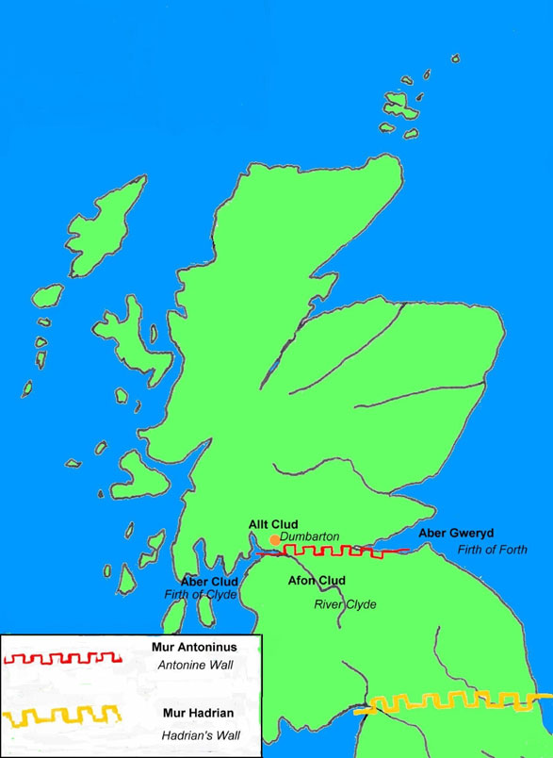

Slide 4
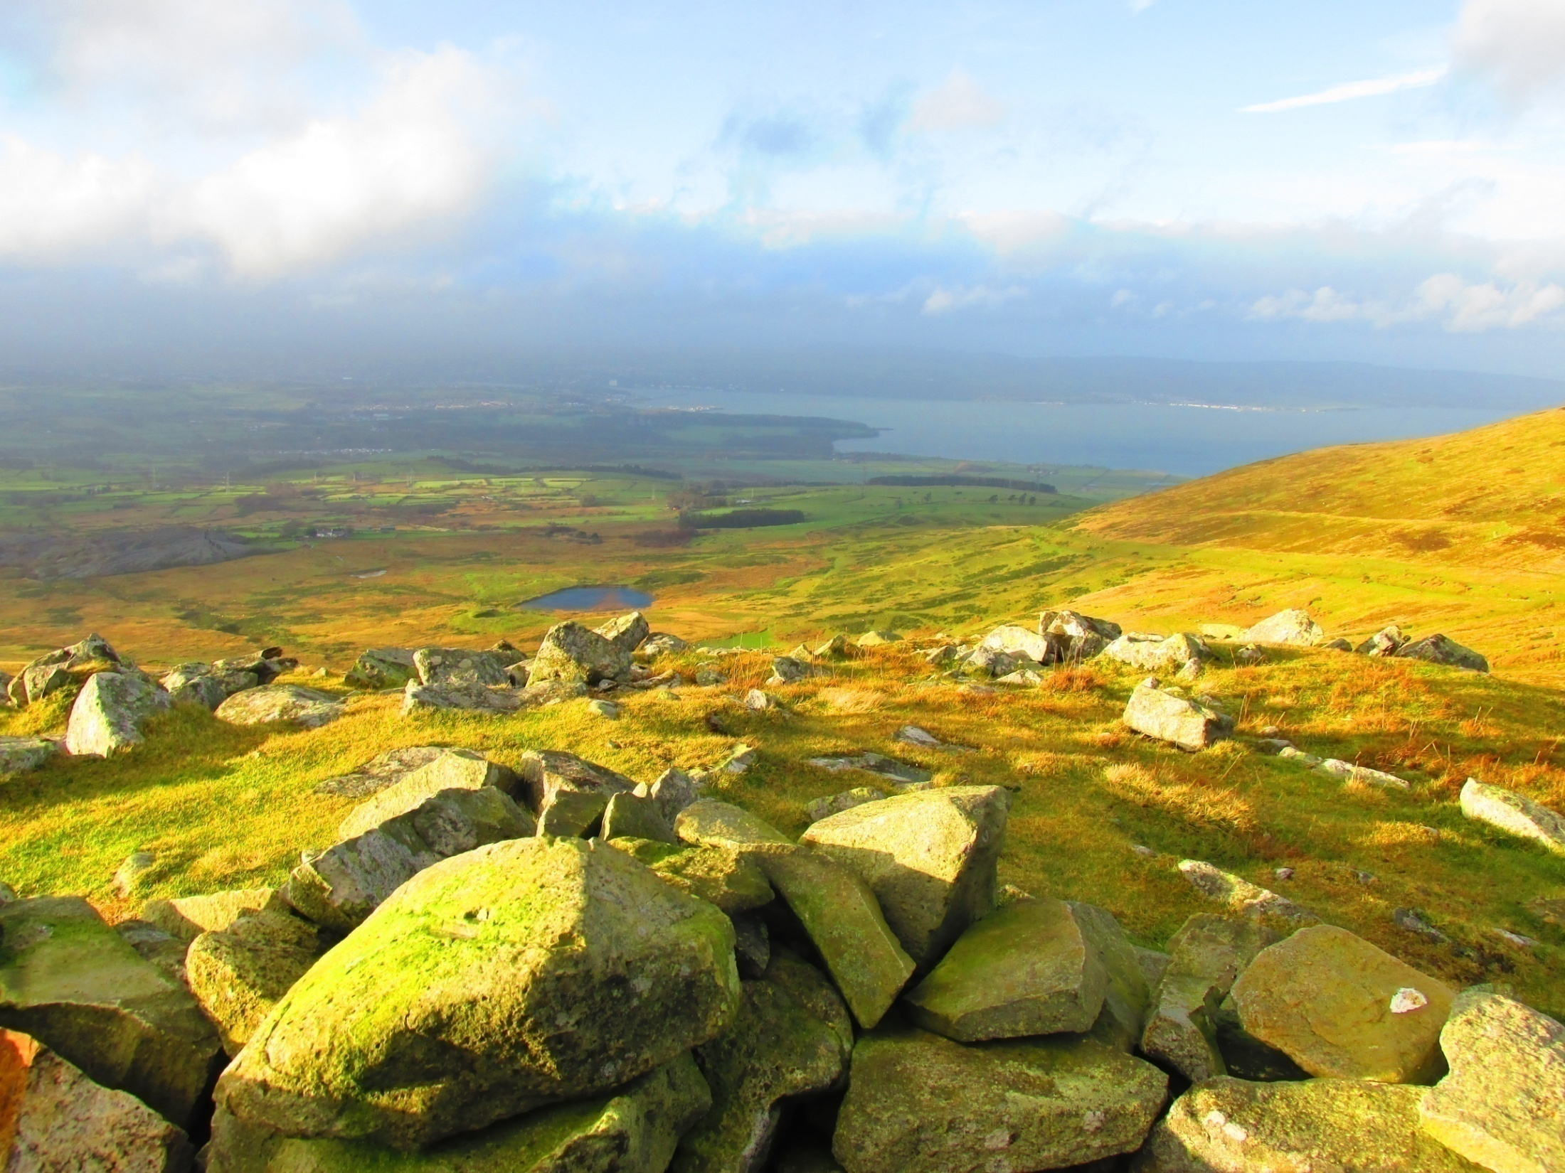
The Picts and their language
The north-east part of today`s Scotland was inhabited by the Picts. Their language might belong, according to the newest research, into the group of the Brittonic languages. However, not enough texts have been found to definitely support this theory.
The name Picti was first mentioned in the year AD 297 by Eumenius, an ancient Roman speaker and writer, in his ode to emperor Constantius. By the name Picti he calls the tribes which are the enemies of the British (next to the Irish). From yet another ode to the same emperor, written in the first decade of the 4th century by an unknown writer, the Picts are identified with Caledonians: “the forests and marshes of the Caledonians and other Picts…” Lat. word pictus, pl. pictí means “painted”. And indicates the habit of the Picts to paint or tattoo their skin. (Ceasar aleady described them in this way)
However, other etymological explanation looks at the parallels between the MIr. cicht “wood-carver", W. pith, Bret. piz “attentive, watchful, careful"< *k~iktu- (Stokes, Holder, aj.).
Transl. Václav Blažek, Keltské Jazyky

Slide 5
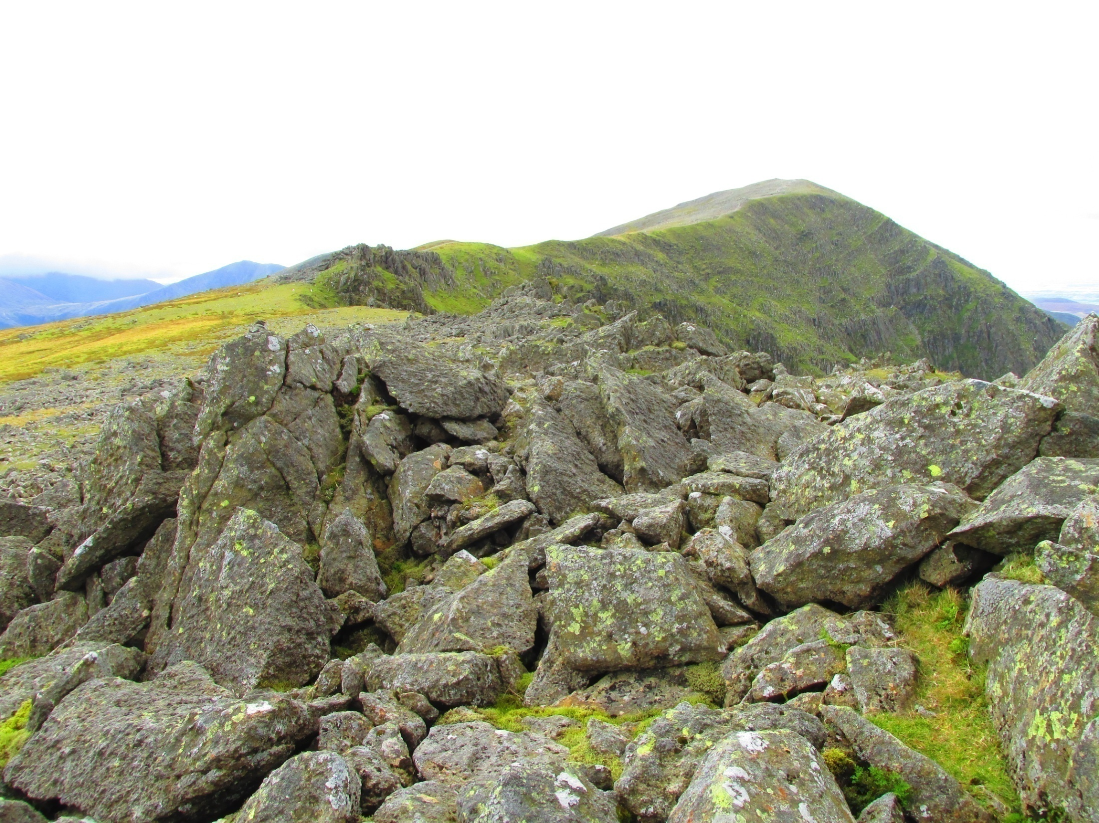
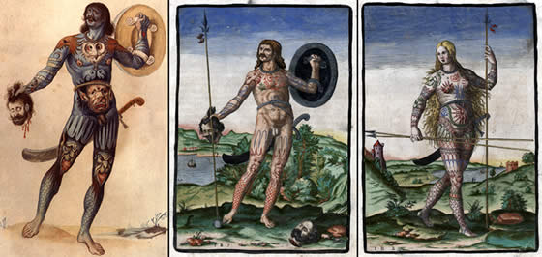

Slide 6
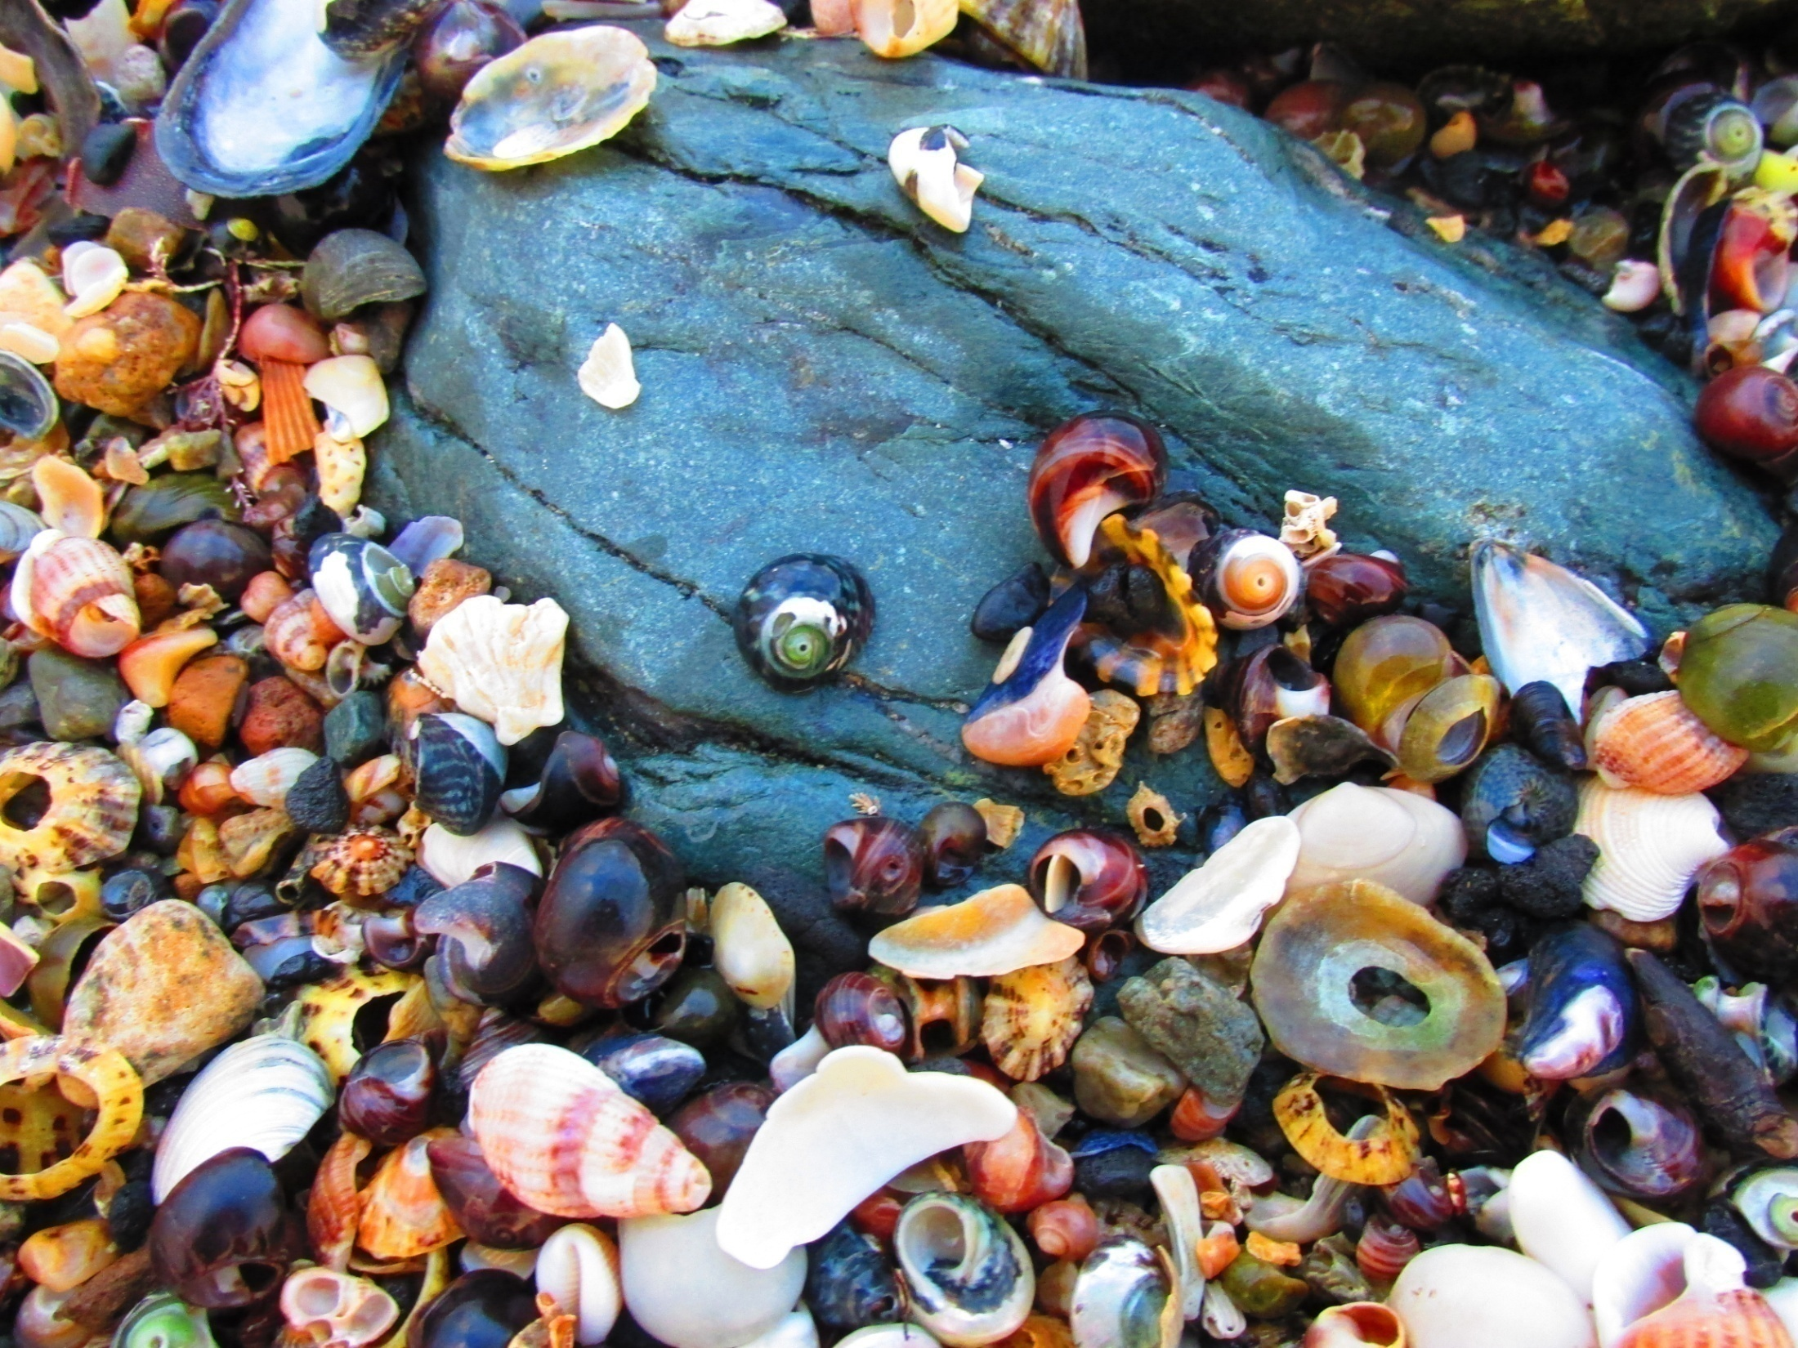
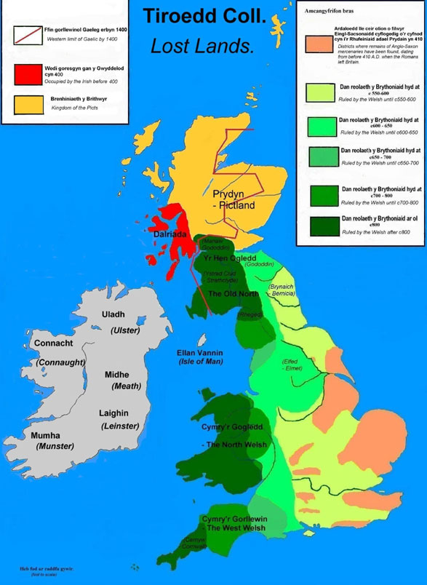

Slide 7

The defining phonological characteristic of Brittonic compared with Goidelic is the change of the common Celtic labiovelar *kʷ to p.
Ex: W. pump „five“ ˂ proto- celt. *kʷenkʷe, OIr. cóic. It is for this reason that Brittonic is often called P-Celtic.
Also characteristic of Brittonic is the change of initial *ṷ to gw, as in W. gwr (OW. guir) „ man“ and gwyn „white“ ˂ṷindos.
(Ad. Fortson, Indo-European Linguistics, 2010, p. 328)

Slide 8
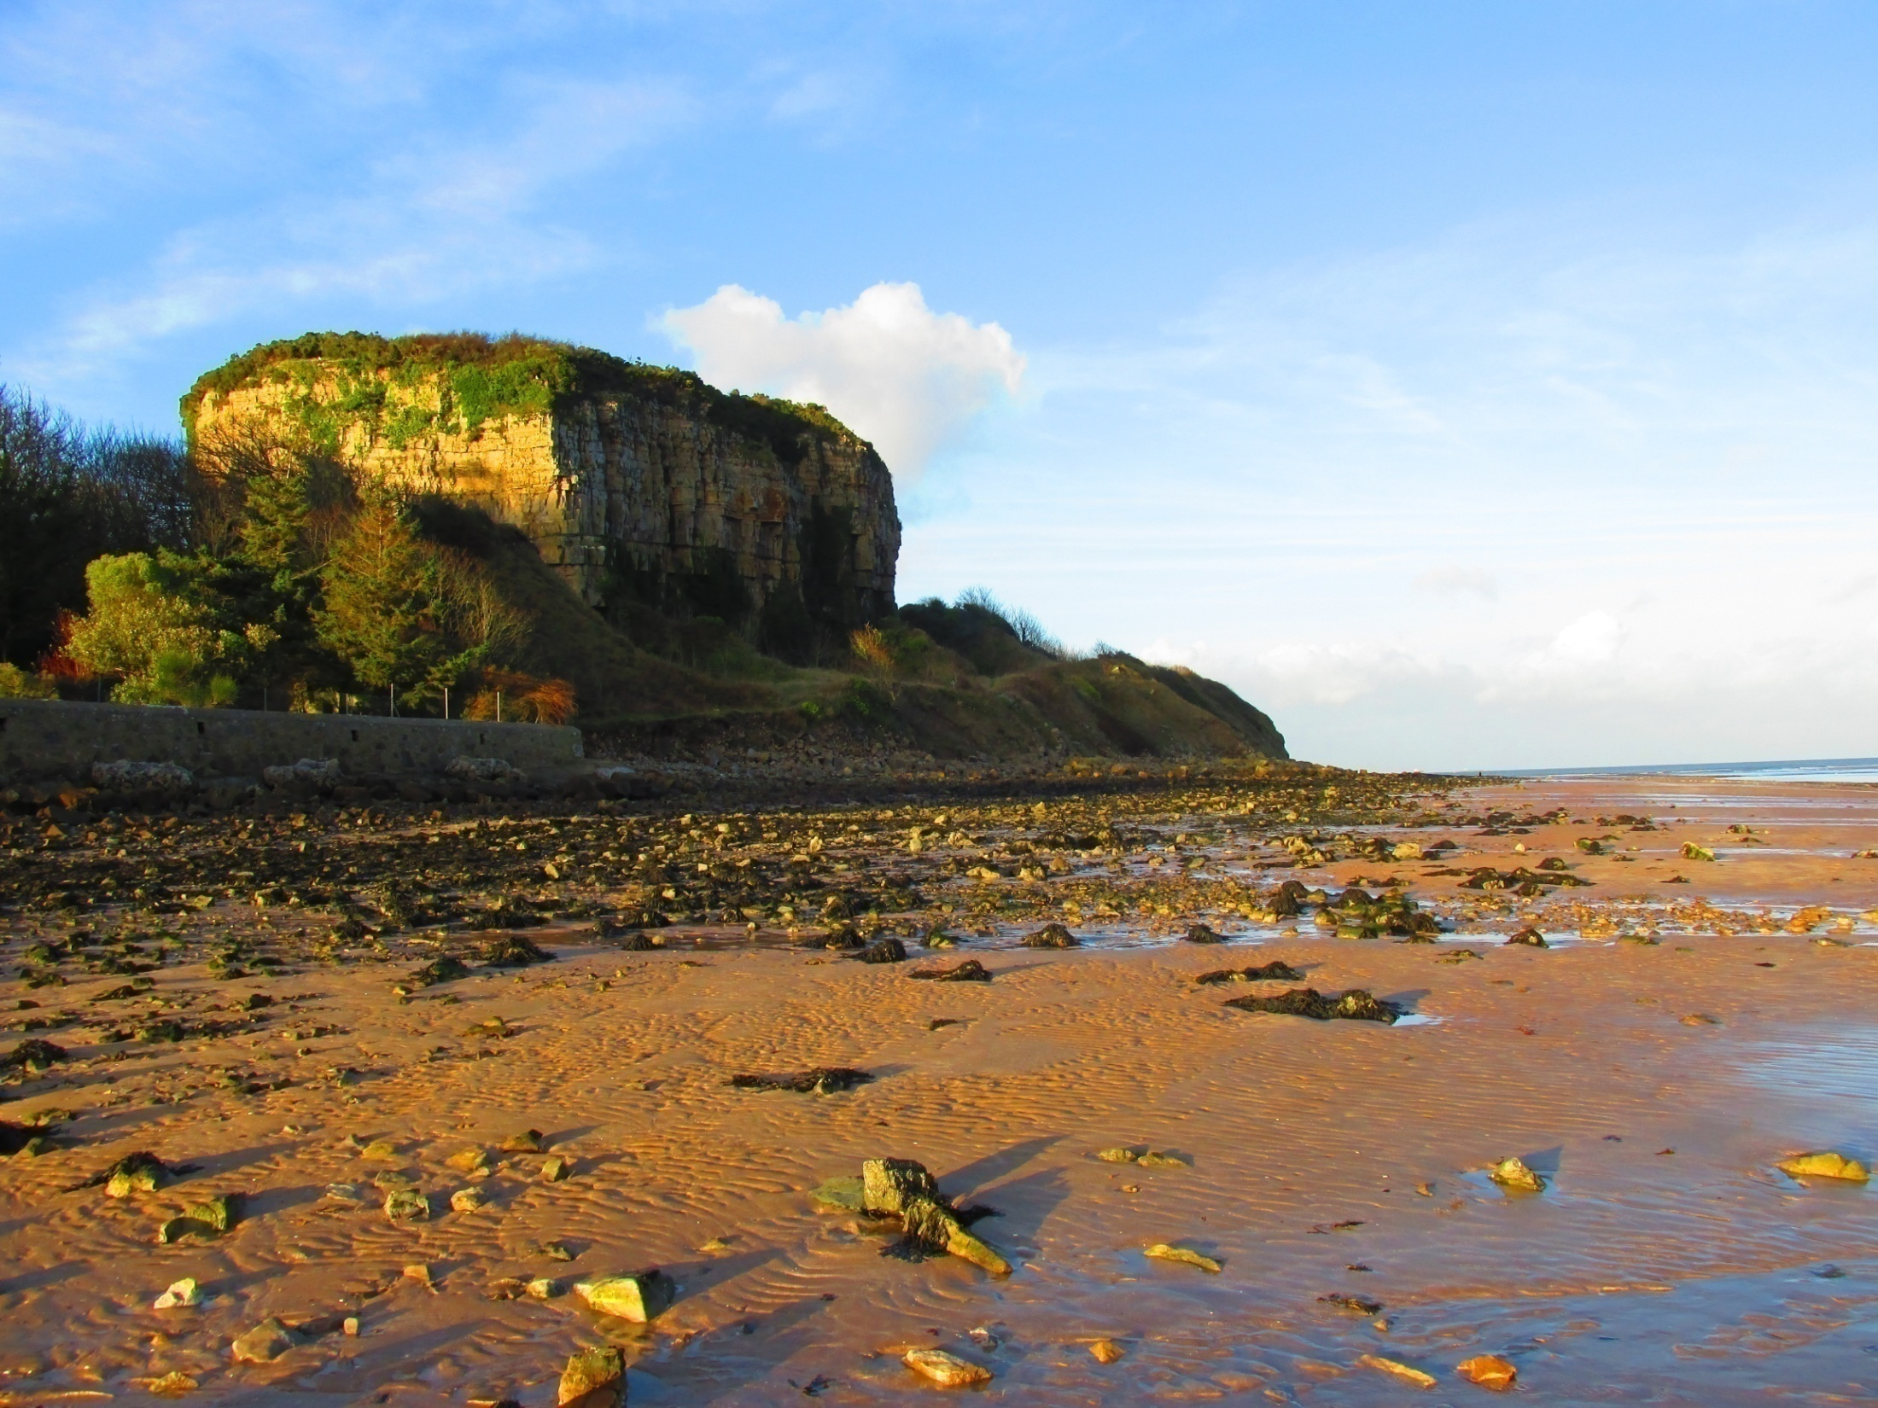
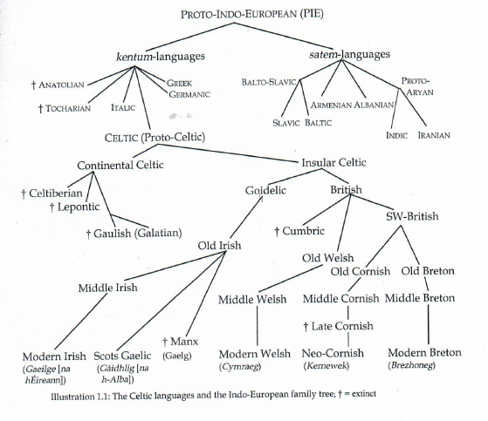

Slide 9
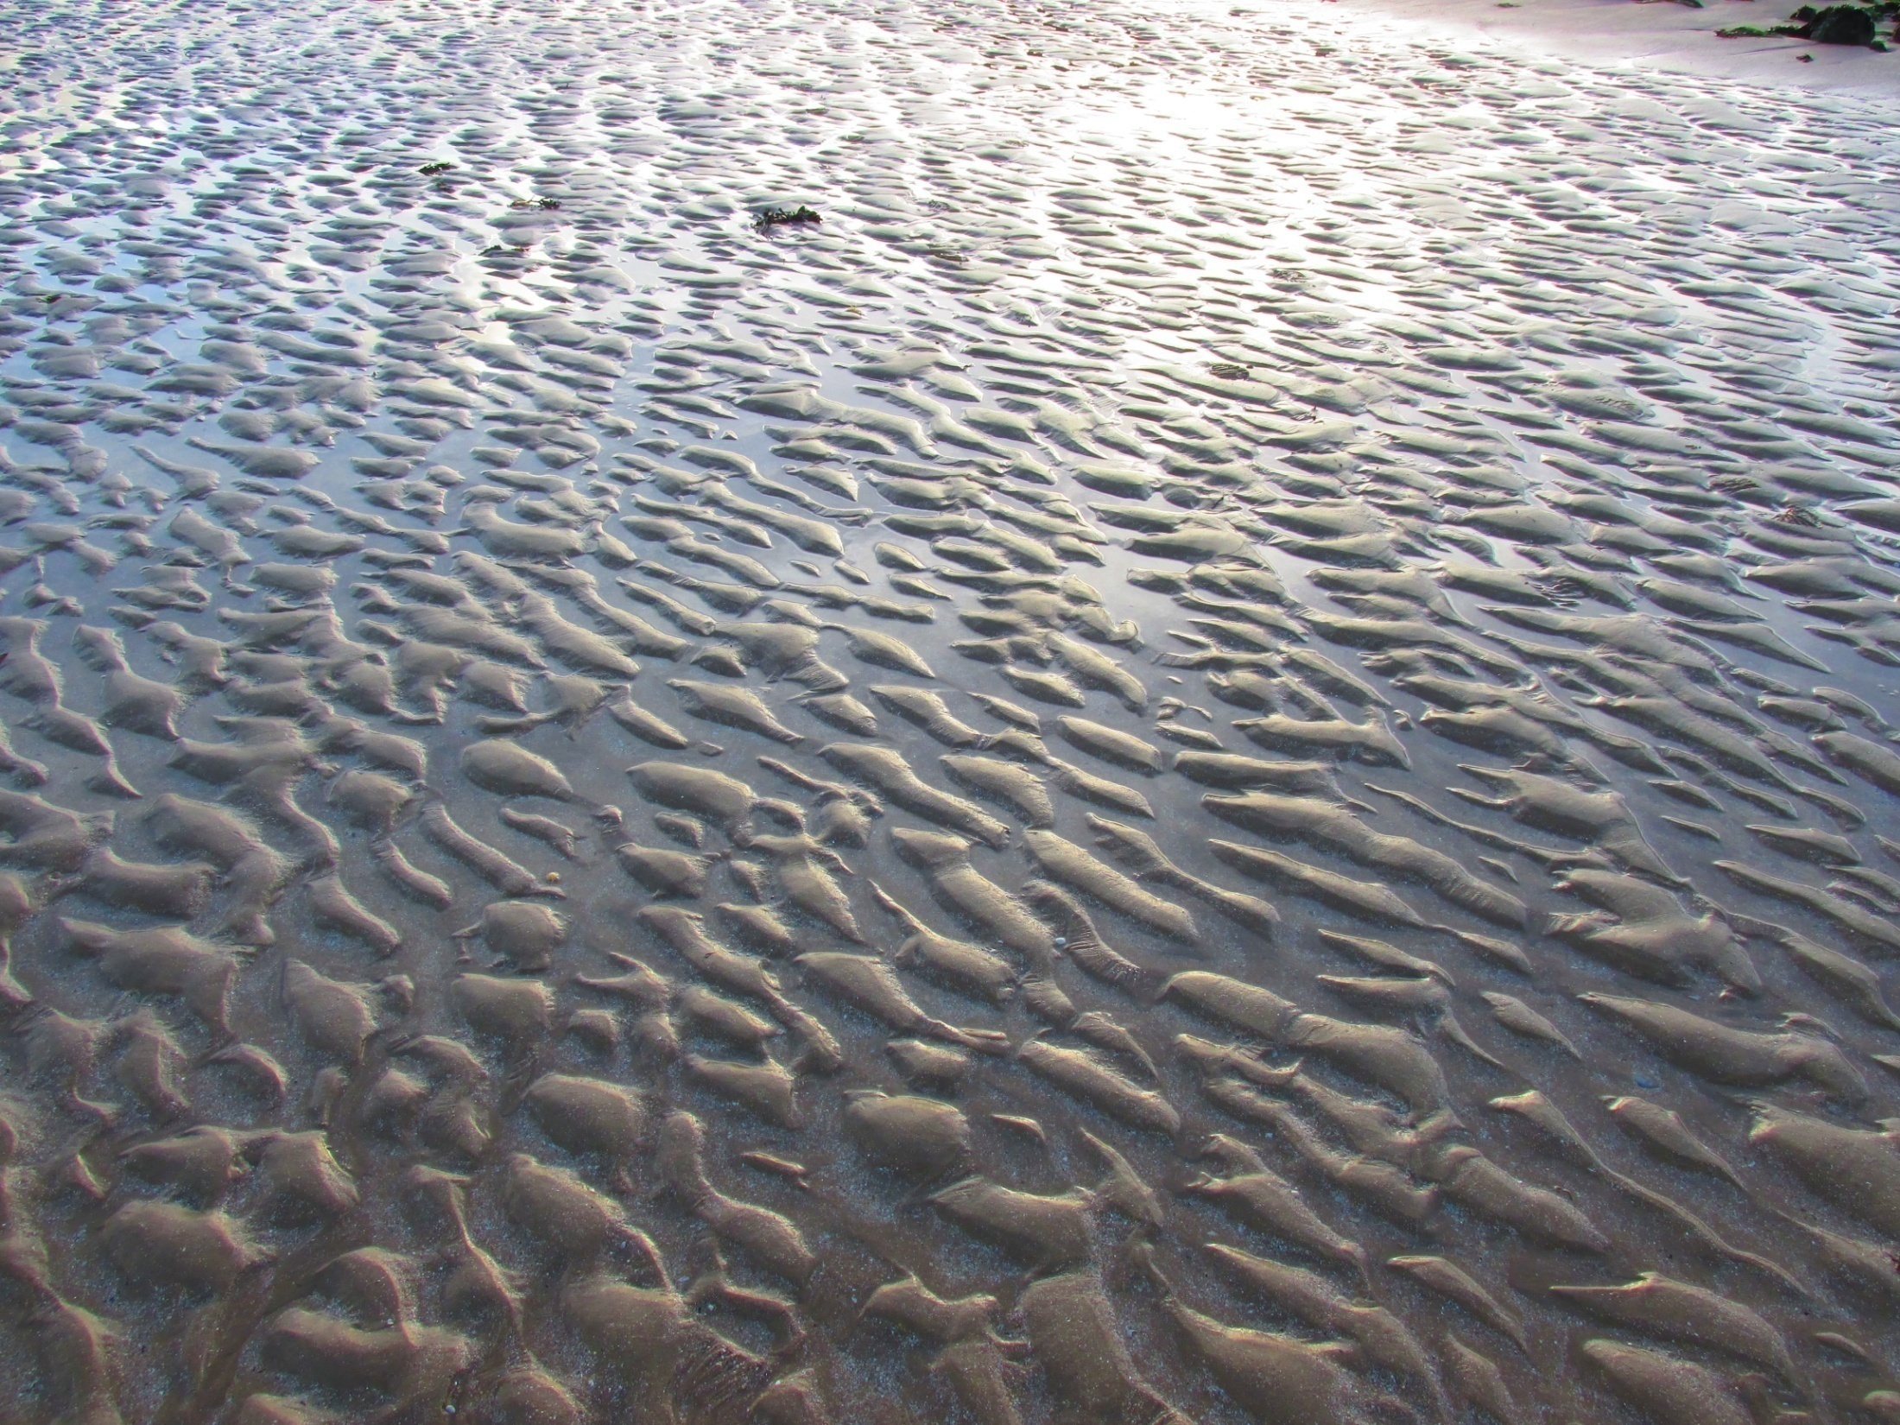
Cornish (Cornwall)
Cornish is most closely related to Breton. It was spoken by the Celtic inhabitants of southwest England who remained after their neighbours migrated to Brittany in the sixth and seventh centuries, when the Anglo-Saxons spread over south England and cut the Cornish people from their Welsh neighbours. The Anglo-Saxon migration also caused some of the Cornish communities to move to Armorica, which was then by the Celtic new inhabitants, named as Bretagne)
(Transl ad. Václav Blažek, Keltské Jazyky and taken from Fortson, Indo-European Linguistics, 2010, p. 334 )
Old Cornish: first texts- religious glosses (anotations) from the 9th cent. and in the year 1100 the longest Cornish text of this period- Vocabularium Cornicum „ Cornish Vocabulary“.
Middle Cornish: 14. and 15. cent. – around 10 000 preserved lines, mostly translated from English, from so called miracle plays- religious theatre pieces.
Late Cornish: dated until the death of the last native speaker (1777), Dolly Pentraeth. Today, revival of the Cornish languages is supported- Neo-Cornish (Kernewek). Thanks to this, Cornish is again actively used by a few people in the region.

Slide 10
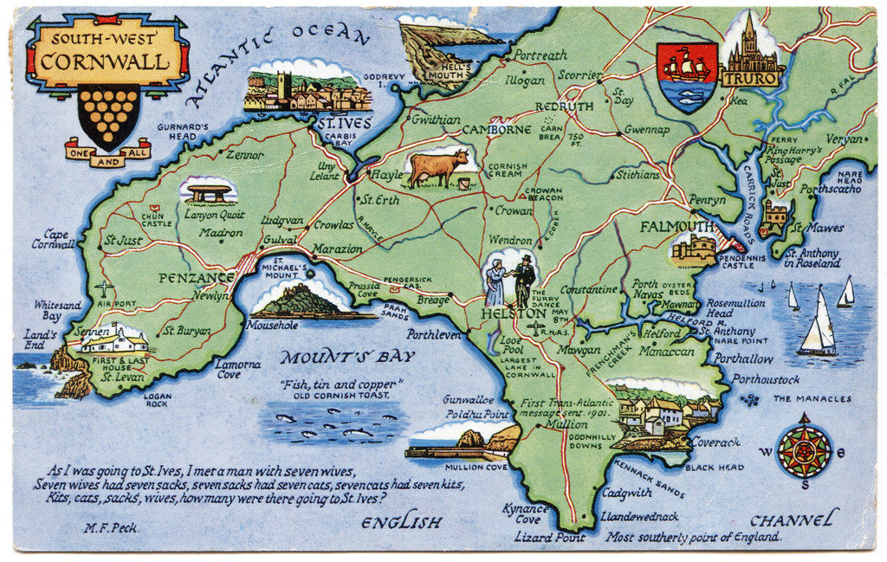
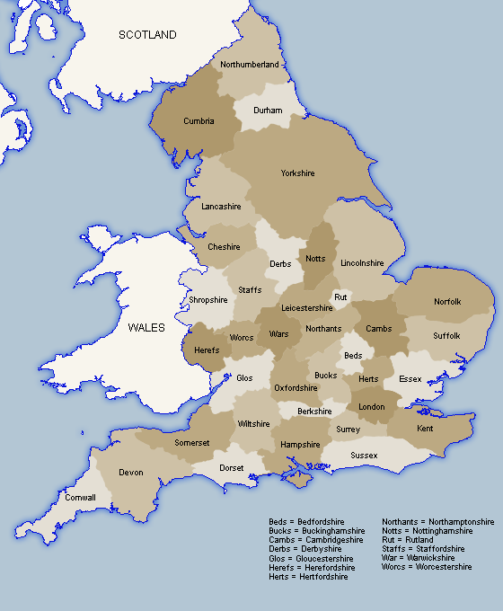

Slide 11
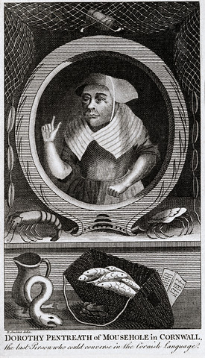
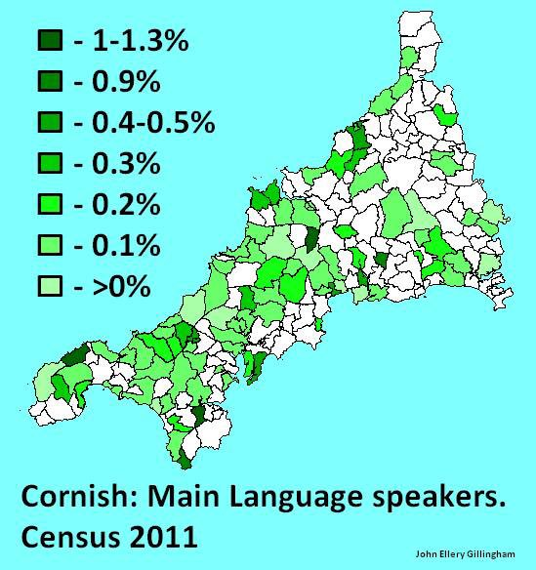

Slide 12
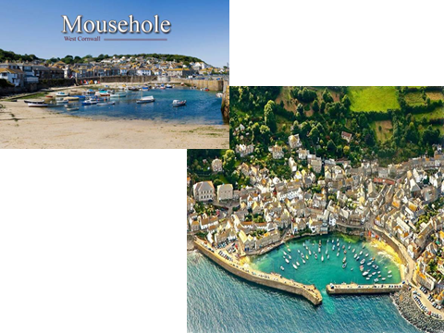

Slide 13
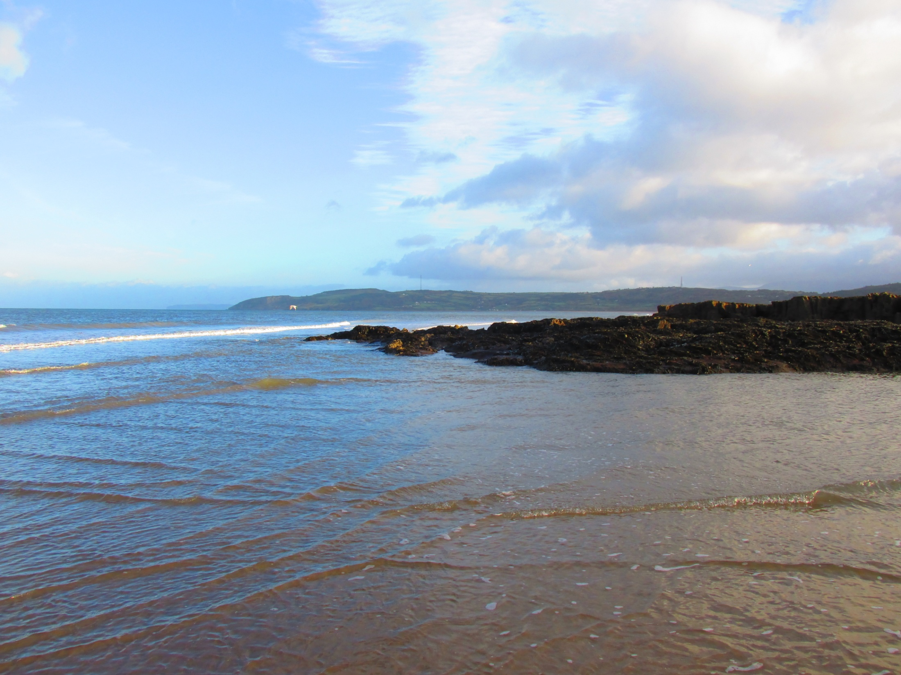
Breton language
The peninsula Armorica (Gaulish for “place by the sea” , started to be called Bretagne after the colonization of the British Celts coming from southeast England in between the 5th and 7th centuries (thanks to the immigration of Anglo-Saxon tribes to Britain). The name Brez(h)oneg. Today E. Brittany, F. Bretagne clearly signifies the Celtic origin of the name.
Ad. Václav Blažek, Keltské Jazyk
Old Breton: the language flourished the most in the 9th century. Most of the texts are religious in nature.
Middle Breton: (12-17 cent.) The area in which Breton was spoken shrank by almost one half. Most of the preserved texts are translations of religious texts from Latin and French. In the 12. cent., Breton was ceased to be used by the gentry which caused its continuous decline.
Modern Breton: 1659 – the first book of Breton grammar and dictionary was published. Modern Breton is composed of the most diverse dialects of any modern Celtic language. Nowadays, only the western part of the area is Breton-speaking (Basse Bretagne) and even here it is restricted to the countryside. Two-fifths of the ordinary vocabulary is of French origin. Today, it is estimated that 200 000 people use Breton on daily basis. (taken from Fortson, Indo-European Linguistics, 2010, p. 332

Slide 14
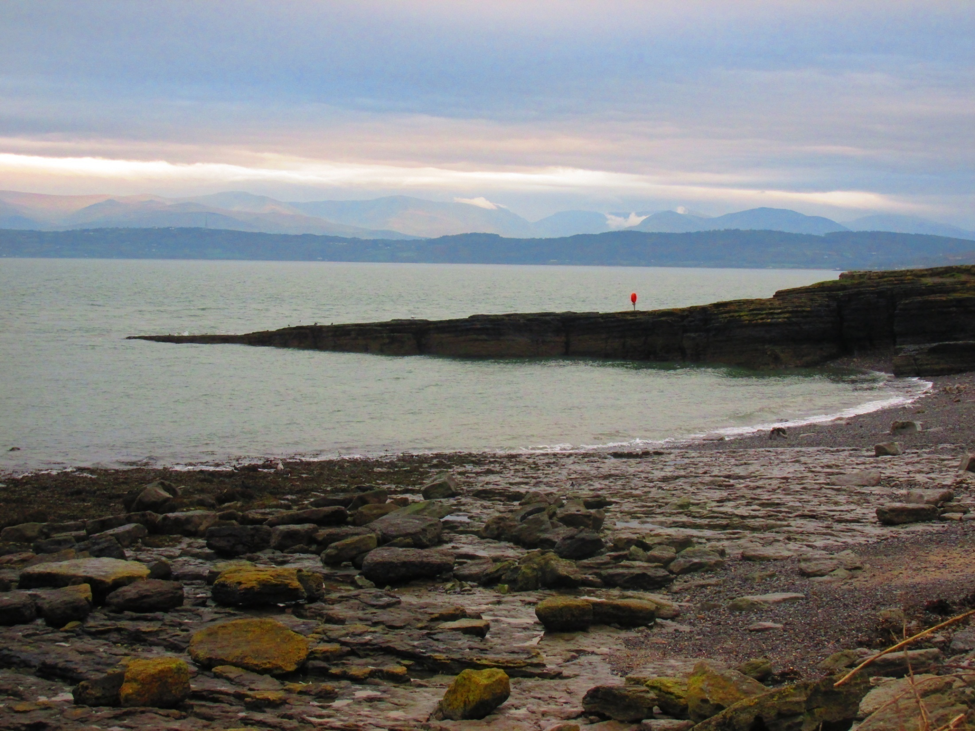
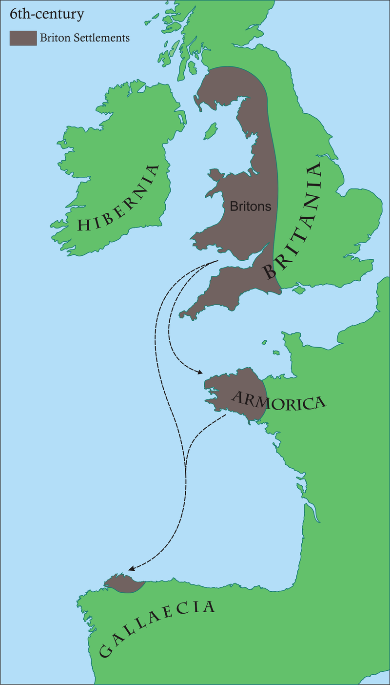
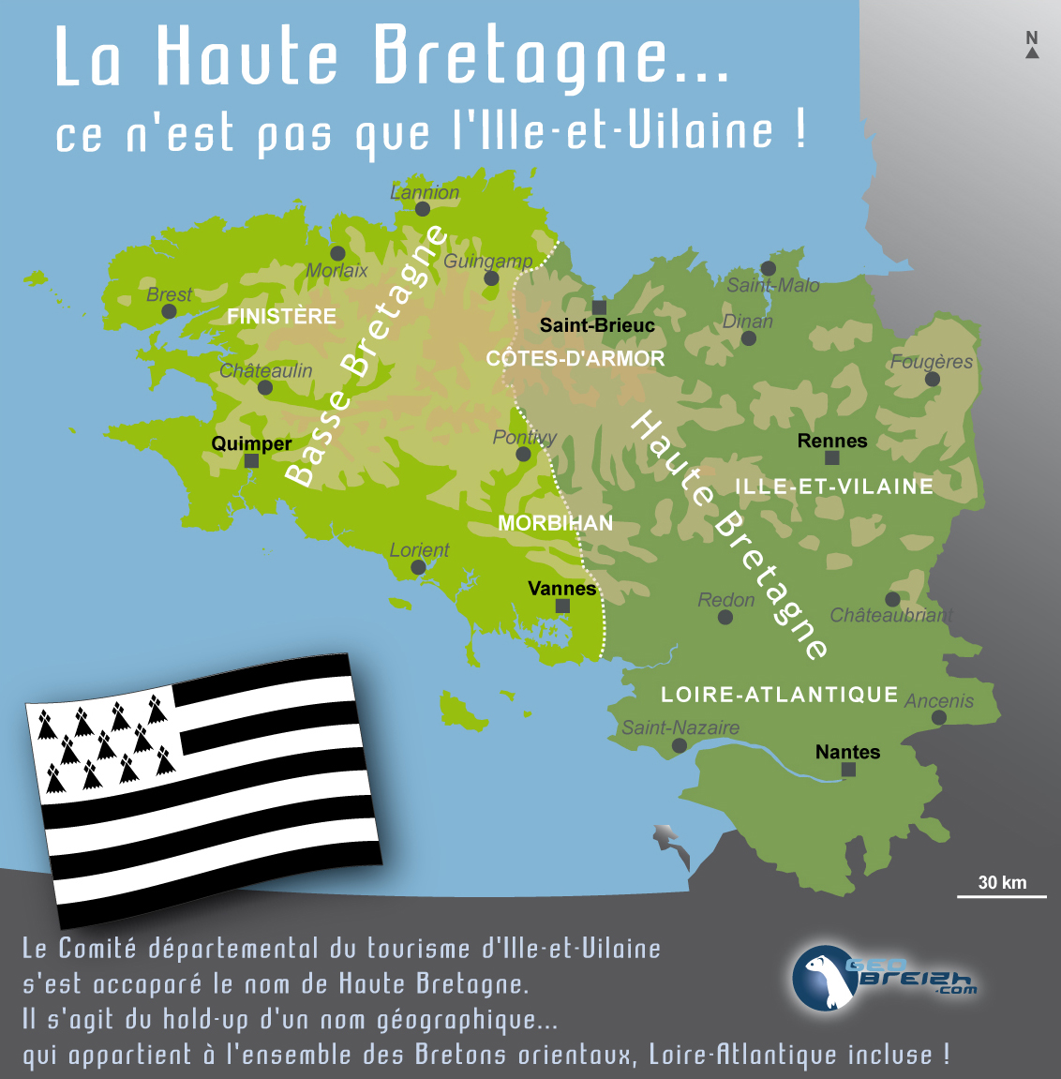

Slide 15

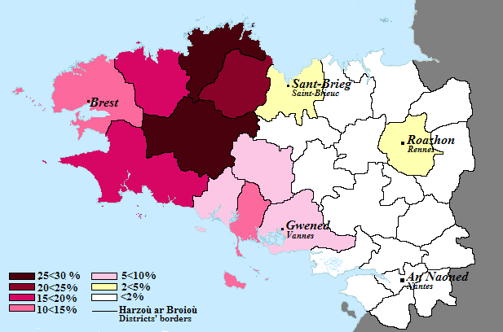

Slide 16
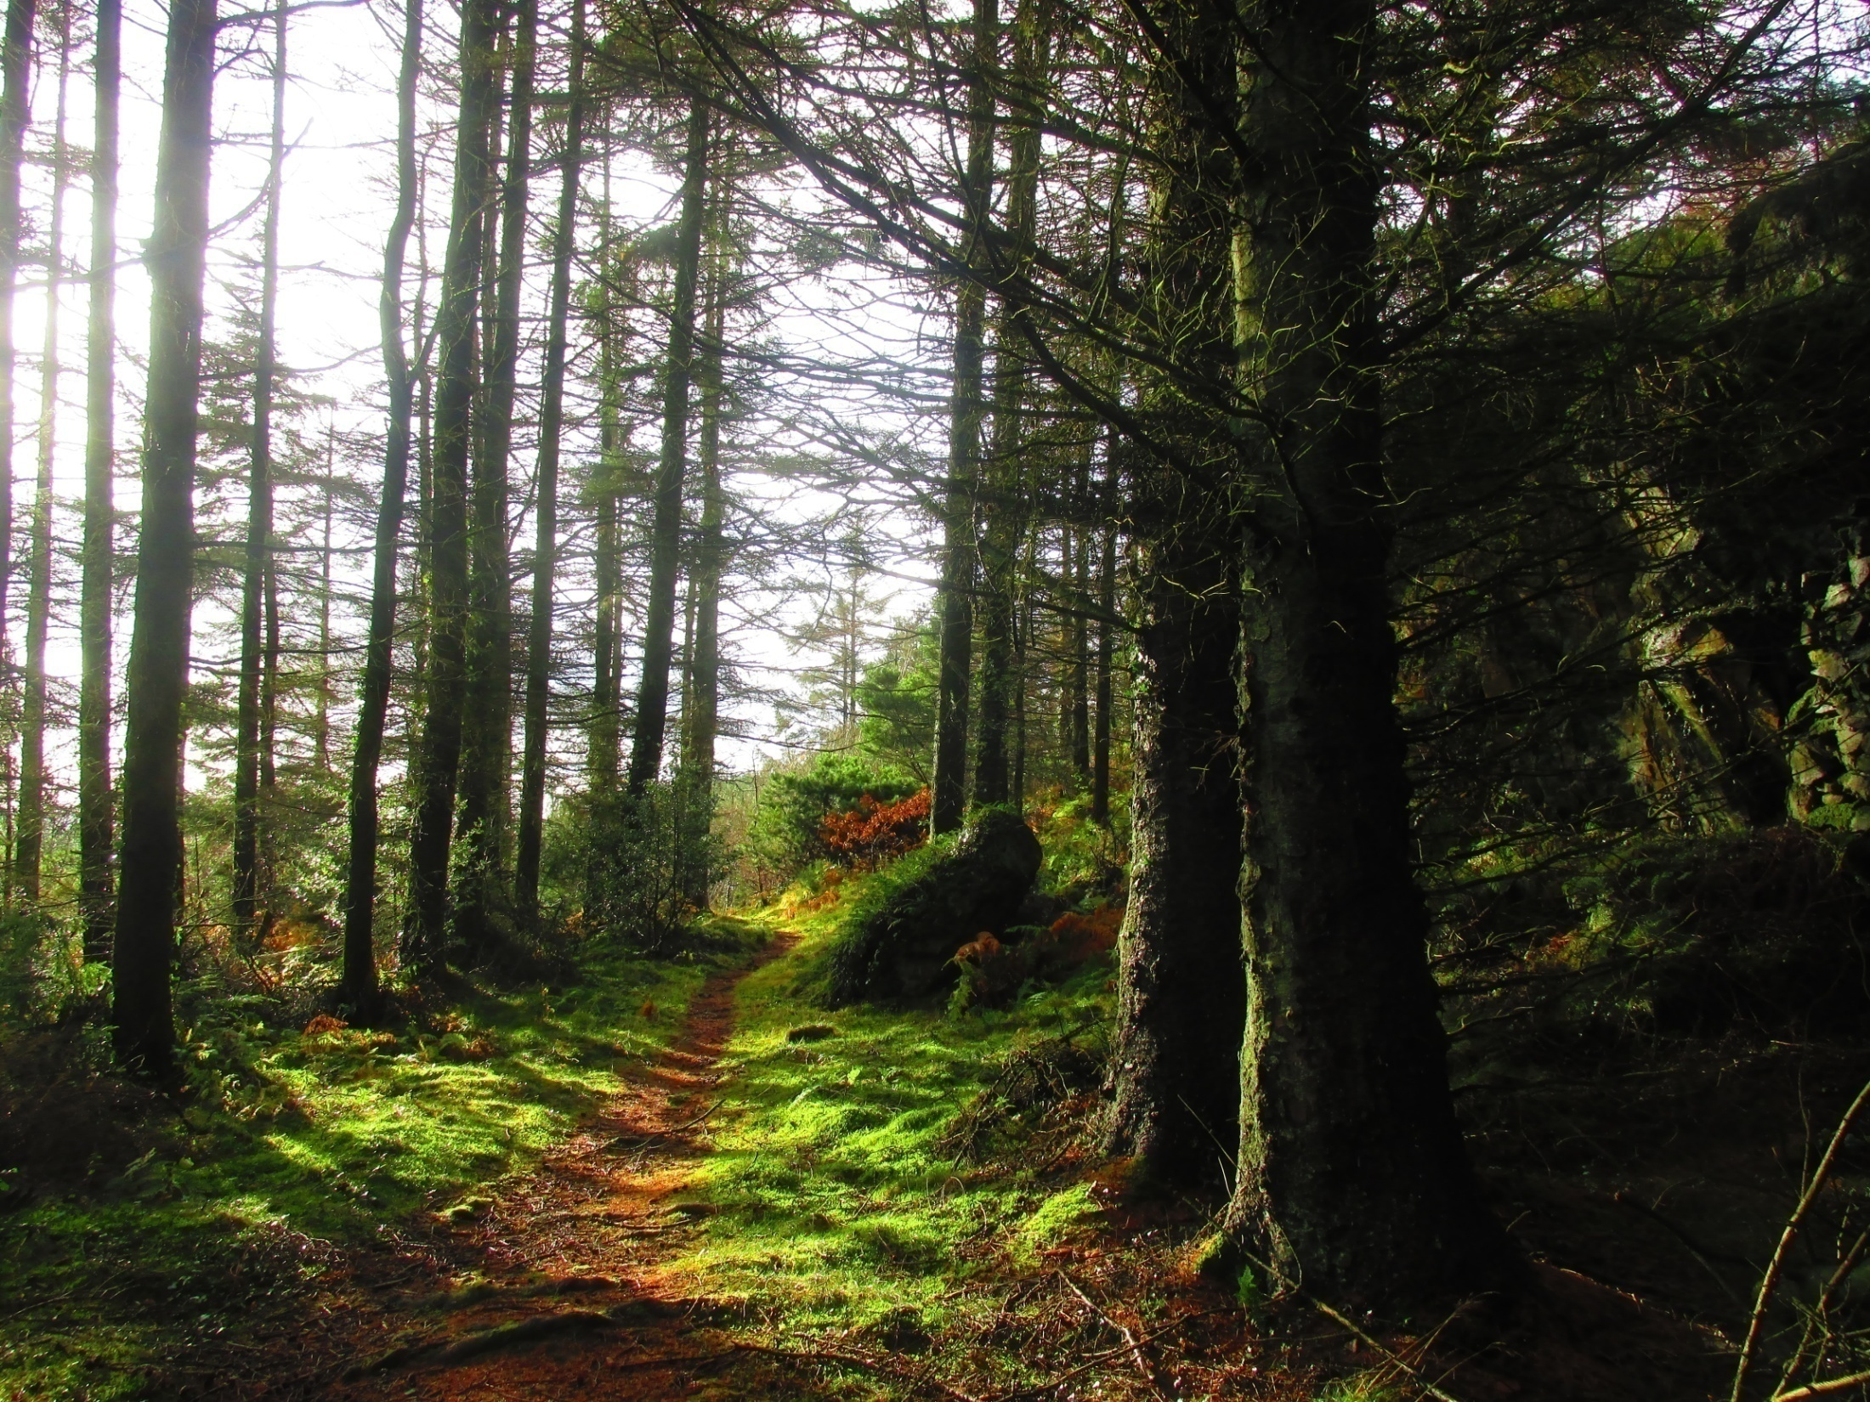
Welsh
The Welsh call themselves as Cymro, this name reflects Bret. *kom-brogos,-is “from the same land", comp. W. bro, OIr. mruig “land" .
Ad. Václav Blažek, Keltské Jazyk
The English term Welsh comes from the Anglo-Saxon name for the Celtic tribes- „wealas“ which means „foreigners“ (4. – 5. cent.). In that time, the British Celtic population was hardly linguistically differentiated. In the 6. and 7. cent., the areas inhabited by the Celts significantly shrank thanks to the Anglo-Saxon colonization.
Old Welsh: (8-12. cent.) followed the period of so called „primitive Welsh”. No literature from this period is preserved (the pieces of two important poets- Taliesin and Aneirin from the 6. cent. survived in later 12. – 13. cent. versions, of course modernized). From this period we only have short Welsh and Latin texts concerning a lawsuit.
Middle Welsh: (12-14. cent.) – the Welsh language flourished. This period offers copious literature of medieval romances and legends. The most famous masterpiece is Mabinogi – a collection of romances.

Slide 17
Modern Welsh: the beginning of this era is marked by the translation of the Bible in the year 1588 (by the bishop of Llandaff, William Morgan). This translation became the literary standard of the Welsh language for many next generations and it is very likely that without it, the Welsh language would have been long extinct. Since the beginning of the 15. cent., the higher strata of society were becoming Anglicized, and Welsh was completely banned from the use as an official administrative language in the mid. 15. cent. This didn`t change until the year 1967).
In the year 1993 by so called. Welsh Language Act, the Welsh language was made equal with English in all spheres of public life (law, education, administration, health care).
The Welsh is spoken mostly in counties Gwynedd and Ynys Môn. It is estimated that about 500 000 people use the Welsh language on daily basis.
Partly taken from Fortson, Indo-European linguistics, 2010, p. 329-331

Slide 18
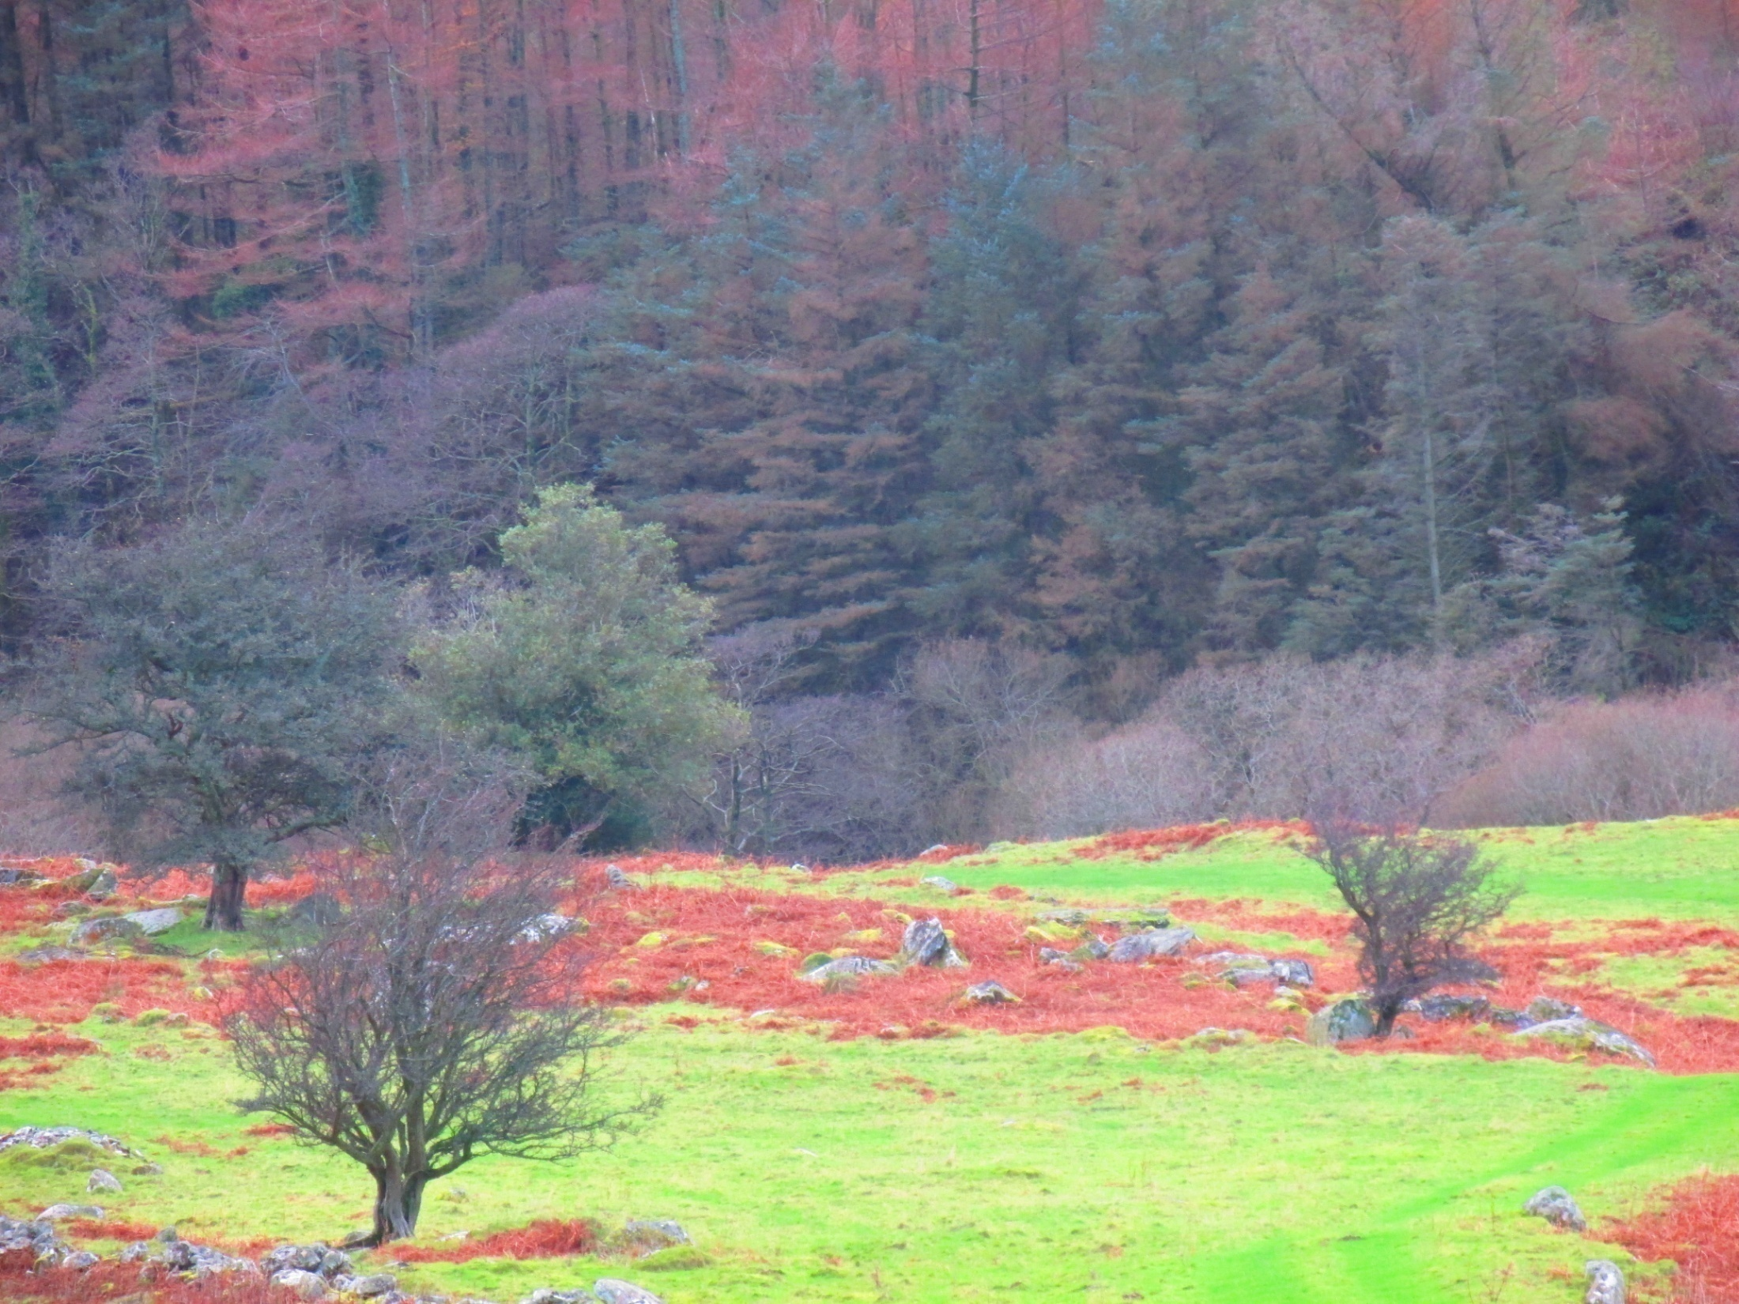
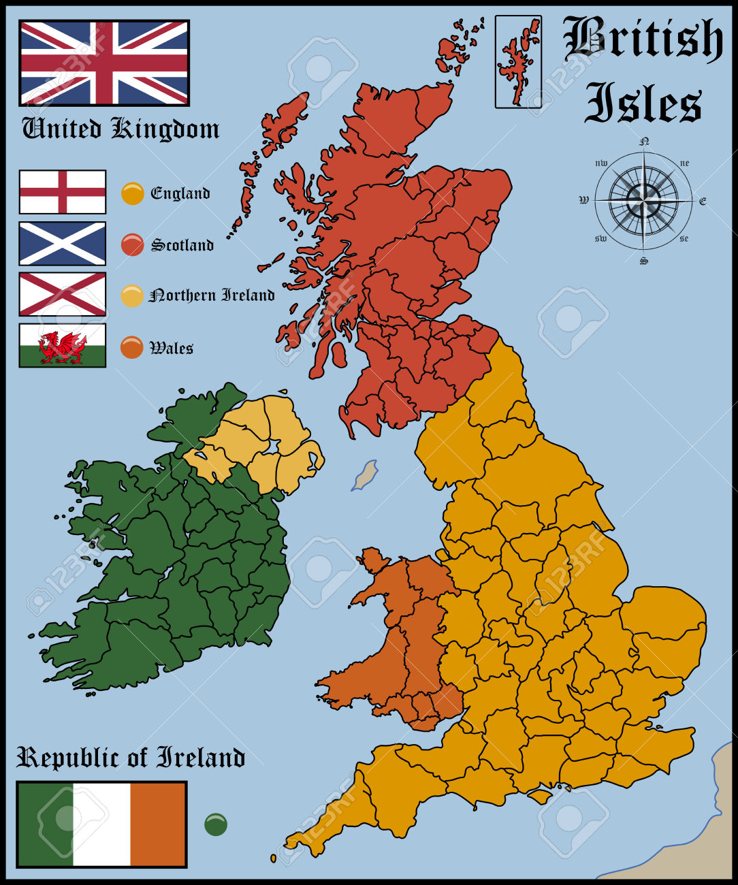
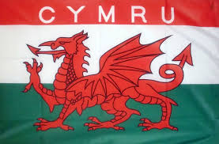

Slide 19
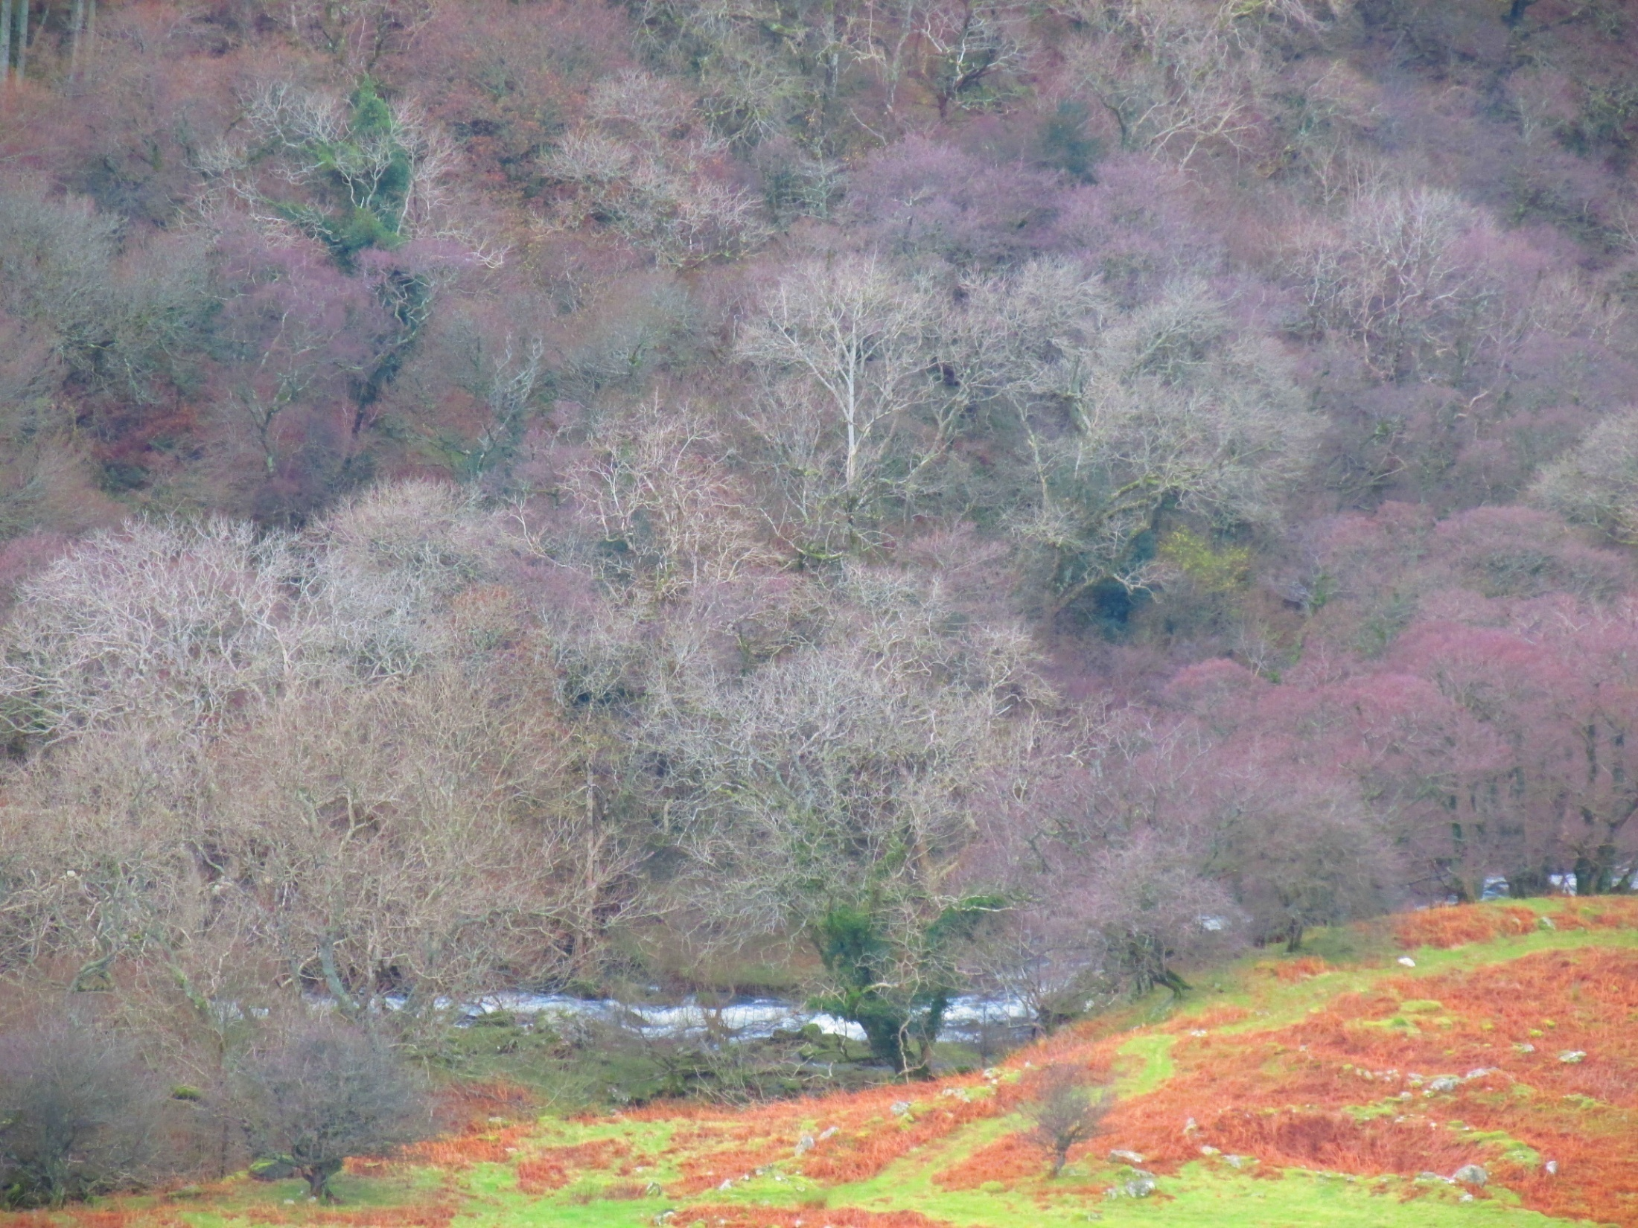
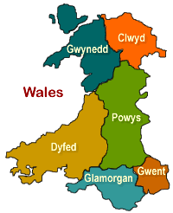
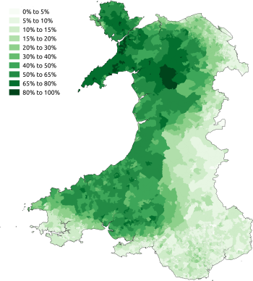
Procentuální zastoupení velšsky mluvící populace na území Walesu.

Slide 20
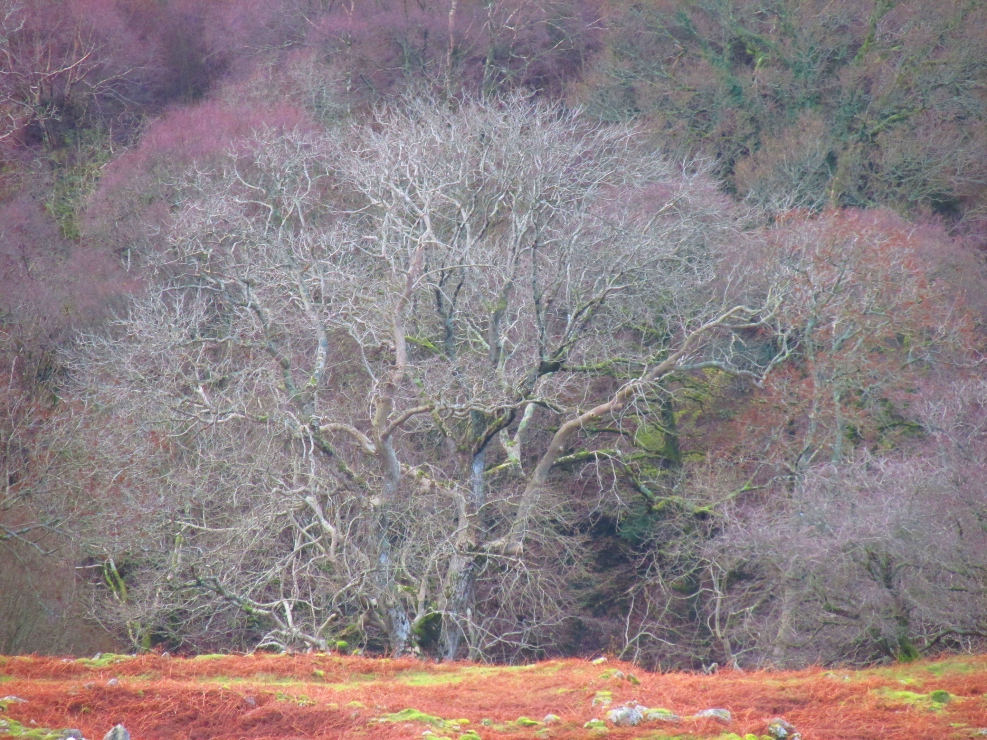
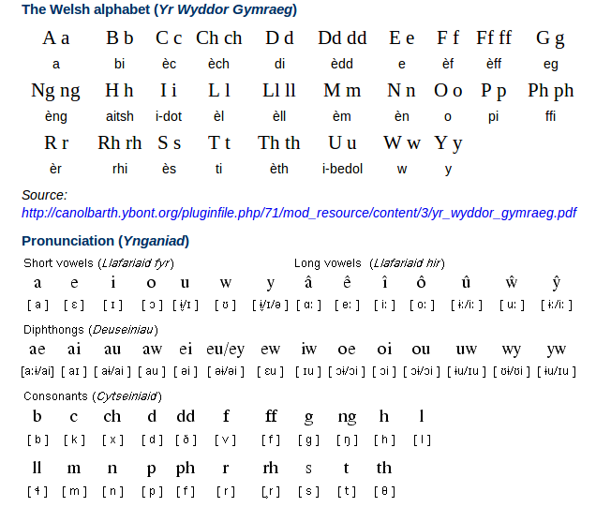

Slide 21
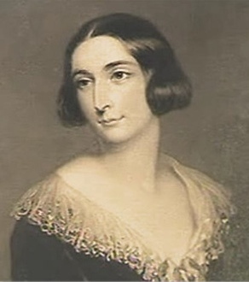
Mabinogi
From 1833 to 1849, Lady Charlotte Guest (1812-1895)- the only daughter of the 9th Earl of Lindsey and wife of the Welsh industrialist Sir Josian John Guest, published her translation of the medieval Welsh prose tales she called The Mabinogion. There are two collections of these tales, one in the White Book of Rhydderch, and the other in the Red Book of Hergest. The White Book is the older manuscript, dating from around 1325, but the only complete text is found in the Red Book, of around 1400. The Red Book is a massive compilation of poetry and prose which includes the text more properly referred to as “The Mabinogi” ; that is, the Four Branches. The error in the name came about as a result of the misunderstanding of the formulae which open and close the tales of Pwyll, Branwen, Math, and Manawydan.

Slide 22
Four Branches of the Mabinogi
The Four Branches of the Mabinogi (Pedair Cainc y Mabinogi) are the most clearly mythological stories contained in the Mabinogion collection.
Pwyll Pendefig Dyfed(Pwyll, Prince of Dyfed) tells of Pryderi's parents and his birth, loss and recovery.
Branwen ferch Llŷr (Branwen, daughter of Llŷr) is mostly about Branwen's marriage to the King of Ireland. Pryderi appears but does not play a major part.
Manawydan fab Llŷr (Manawydan, son of Llŷr) has Pryderi return home with Manawydan, brother of Branwen, and describes the misfortunes that follow them there.
Math fab Mathonwy (Math, son of Mathonwy) is mostly about the eponymous Math and Gwydion who come into conflict with Pryderi.
Native tales
Beginning of "The Dream of Macsen Wledig"
Also included in Lady Guest's compilation are five stories from Welsh tradition and legend:
Breuddwyd Macsen Wledig(The Dream of Macsen Wledig)
Lludd a Llefelys (Lludd and Llefelys)
Culhwch ac Olwen(Culhwch and Olwen)
Breuddwyd Rhonabwy (The Dream of Rhonabwy)
Hanes Taliesin (The Tale of Taliesin)

Slide 23
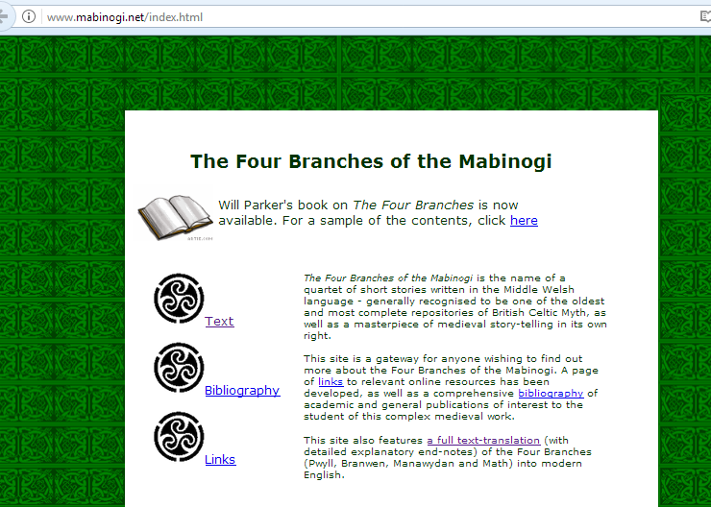

Slide 24
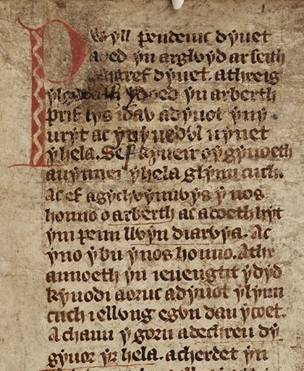
Pwyll Pendeuic Dyuet
a oed yn arglwyd ar seith
cantref Dyuet. A threig
ylgweith yd oed yn Arberth,
prif lys idaw, a dyout yn y
uryt ac yn y uedwl uynet
y hela. Sef kyueir o’y gyuoeth
a uynnei y hela, Glynn Cuch.
Ac ef a gychwynnwys y nos
honno o Arbert, ac a doeth hyt
ym Penn Llwyn Diarwaya; ac
yno y bu y nos honno. A thr
annoeth, yn ieuengtit y dyd,
kyodi a oruc a dyuot y Llyn
Cuch I ellwyng e gwn dan y coet.
A chanu y gorn a dechreu dy
gyuor yr hela ...

Slide 25
Pwyll Prince of Dyved, was lord of the seven Cantrevs of Dyved; and once upon a time he was at Narberth his chief palace, and he was minded to go and hunt, and the part of his dominions in which it pleased him to hunt was Glyn Cuch. So he set forth from Narberth that night, and went as far as Llwyn Diarwyd. And that night he tarried there, and early on the morrow he rose and came to Glyn Cuch, when he let loose the dogs in the wood and sounded the horn, and began the chase.
Lady Charlotte Guest, from the translation done 1838-1849
Pwyll, prince of Dyfed, was lord over the seven cantrefs of Dyfed. Once upon a time he was at Arberth, one of his chief courts, and it came into his head and his heart to go hunting. The part of his realm he wanted to hunt was Glyn Cuch. He set out that night from Arberth, and came as far as Pen Llwyn Diarwya, and stayed there that night. And early the next day he got up, and came to Glyn Cuch to unleash his dogs in the forest. And he blew his horn, and began to muster the hunt...
Sioned Davies, from the 2007 Oxford World’s Classics translation

Slide 26
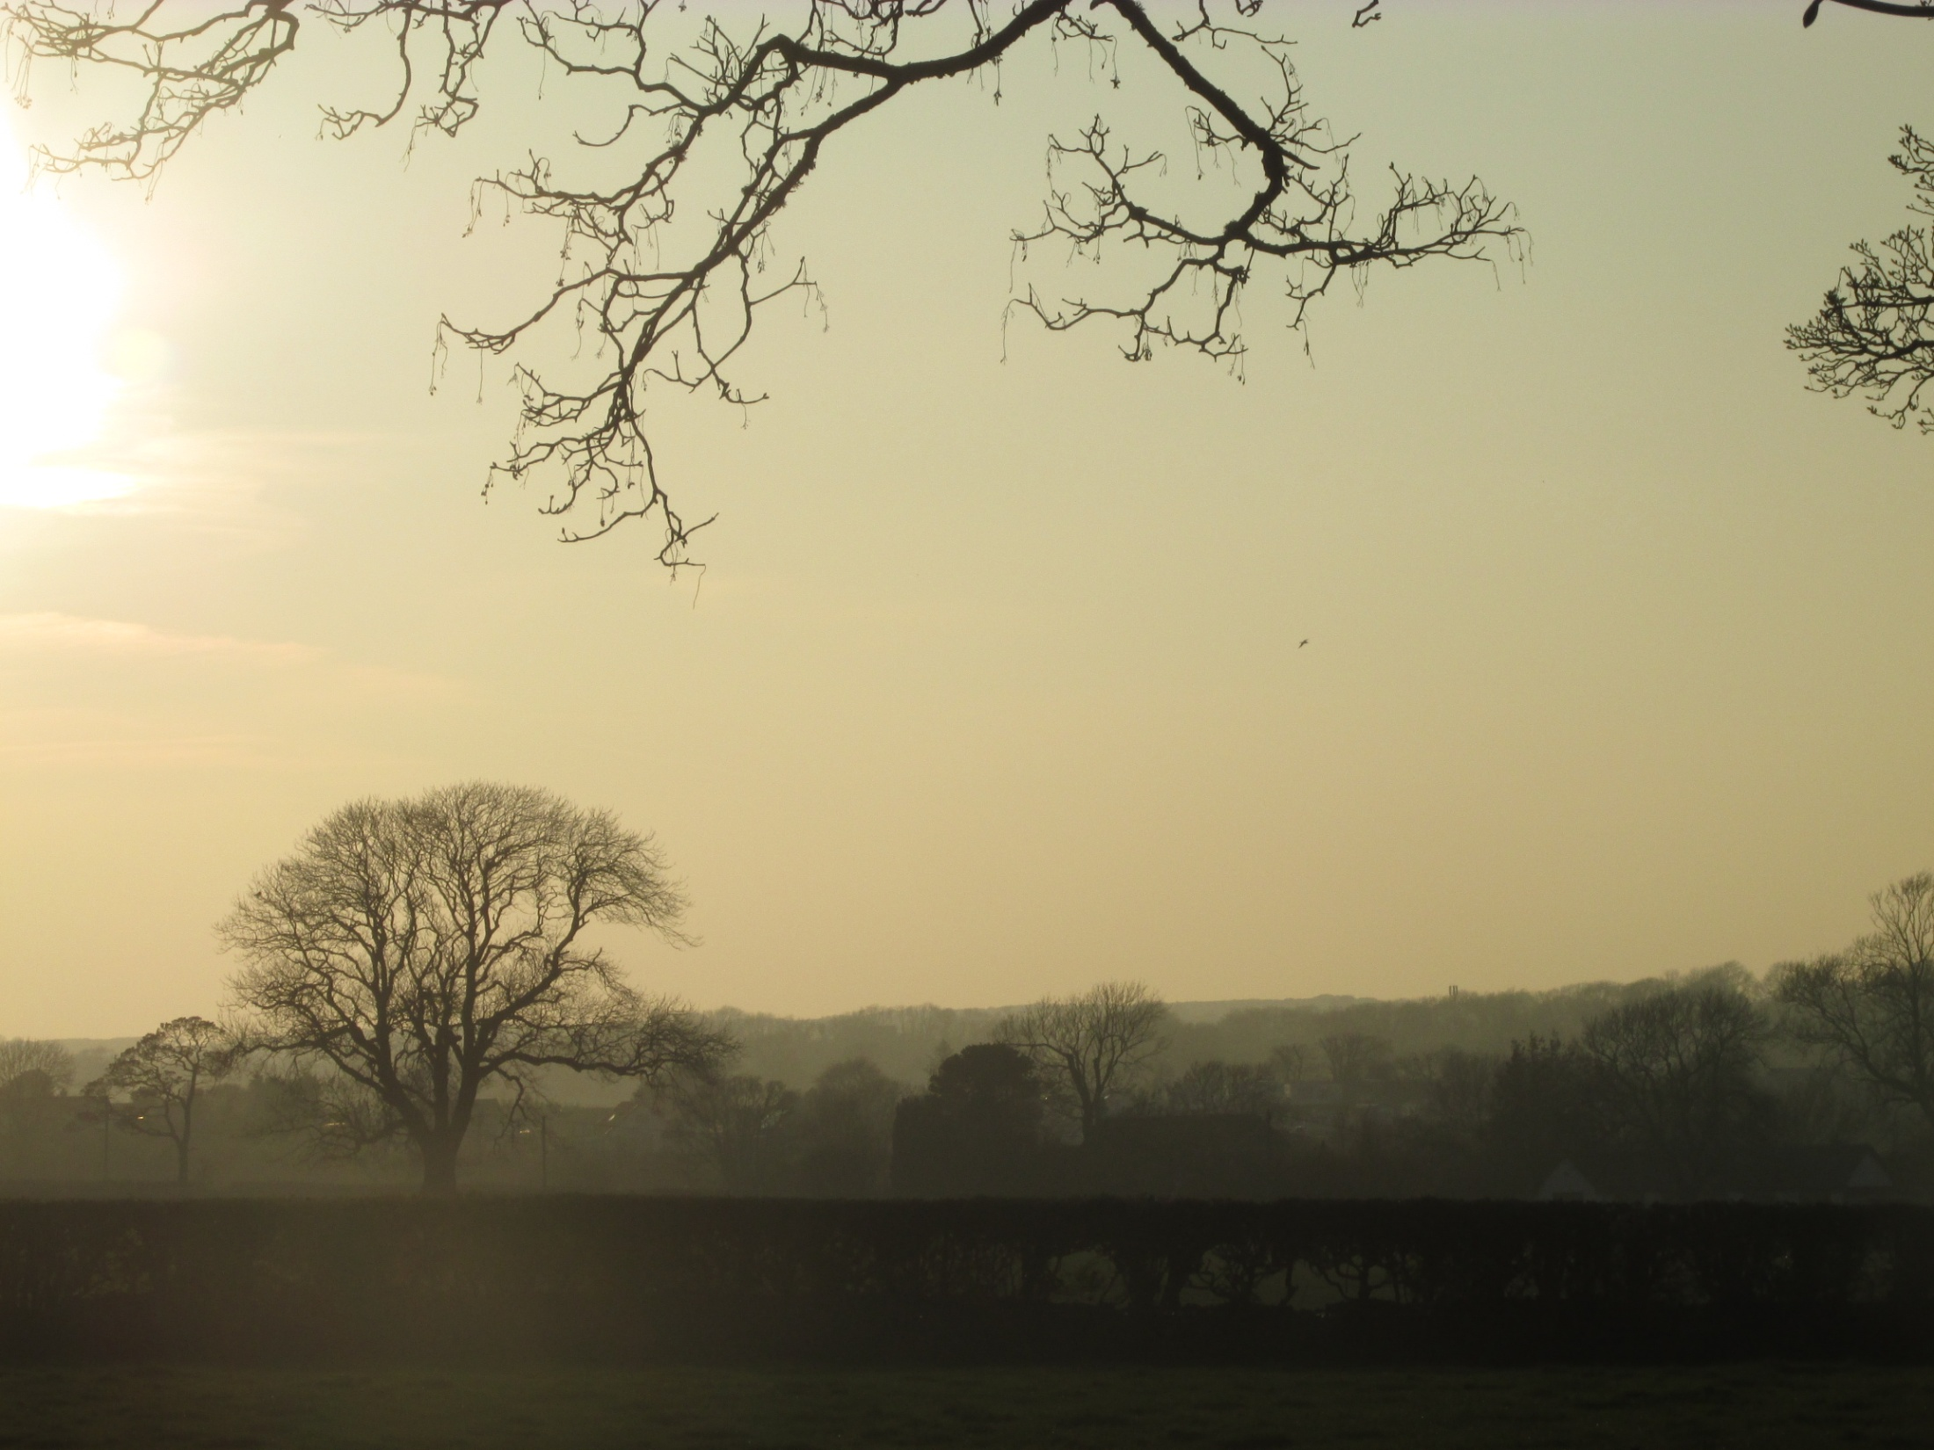
Dafydd ap Gwilym from Ceredigion
(14th century)
One of the leading Welsh poets and one of the greatest poet in Europe in the Middle Ages.
1789 Pughe published a superb edition of Dafydd`s poems (coaxed by Iolo into including some forgeries for the genuine work)
Works on landscape, religious motifs, courtly love, taverns etc.
He popularised the metre known as the cywydd and used it for praise.
Cywydd consists of a series of seven-syllable lines in rhyming couplets, with lines written in cynghanedd.
Cynghanedd means “harmony” and is the basic concept of sound-arrangement within one line, using stress, alliteration and rhyme:
All consonants surrounding the main stressed vowel before the caesura must be repeated after it in the same order. However, the final consonants of the final words of each half of the line must be different, as must the main stressed vowel of each half. For example:
clawdd i ddal / cal ddwy ddwylaw “hedge; fence to reach/ with two hands”

