Slide 1
The Celts and their Languages 5
Goidelic languages and History of Irish
Lucie Vinšová
Masarykova univerzita 2017

Slide 2
Goidelic languages
The Irish called themselves in the old Irish language as Goídel, hence the name. The most common etymological explanation says that this name was originally a brythonic borrowing and came from OW Gwyddel “Irish” (related to MW gwyd “wild”).
OIr word goídelc referred to the “Irish language”. In the classical modern Irish had this name developed into Gaoidhealg, which has been simplified into Gaeilge. (and this is by the way where the Eng. Gaelic originated from.
Transl. Václav Blažek, Keltské Jazyky
The Goidelic languages include:
Irish
Scottish Gaelic
Manx

Slide 3
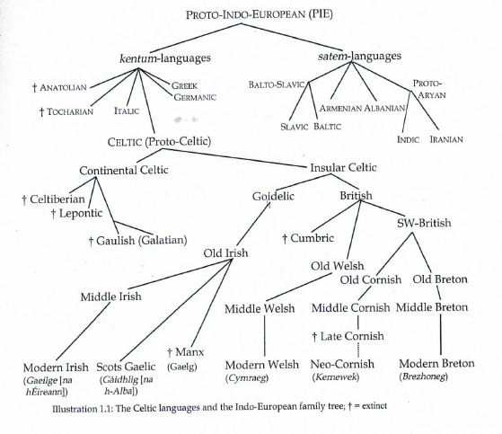

Slide 4
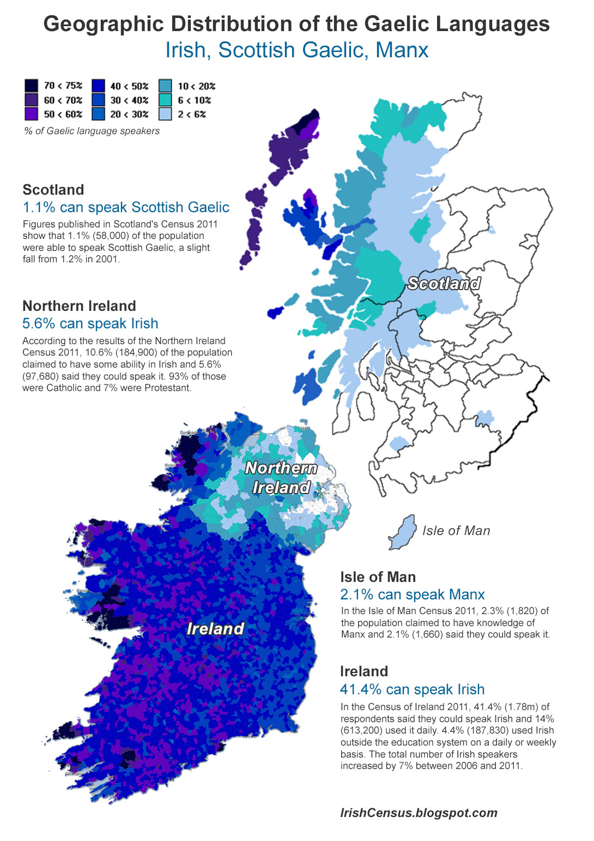

Slide 5
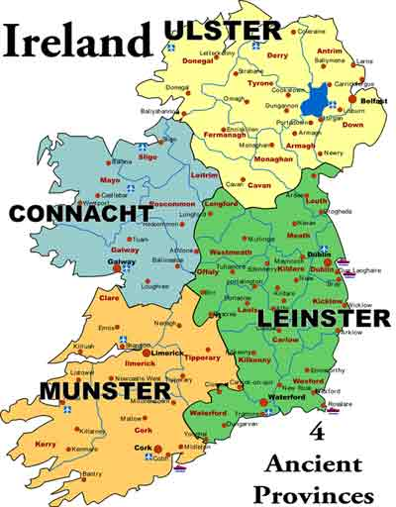

Slide 6
History of Irish
The proper name of Ireland is Ériu (W Iwerydd).
The oldest documented words of Goidelic origin are found in Ptolemy`s Geography (around 150 AD), where in the description of Ireland, he mentioned more than 30 place and tribal names.
Proto-Goidelic
Prehistoric ancestor of Irish, spoken in Ireland at least at the beginning of the Christian era, if not earlier.
Primitive Irish (Ogam Irish)
The earliest preserved Irish is found in about 300 stone inscriptions written in Ogam (Ogham) script. The origin of the Ogam script is unknown and most of the inscriptions come from southern Ireland and date back between the fourth and seventh centuries AD. They are usually short burial inscriptions.
In medieval manuscript tradition names for Ogam letters have come down to us. Often tree names are used for the names of the individual letters, but many of the identifications are dubious. Also not all original phonological values of the Ogam letters are absolutely clear.

Slide 7
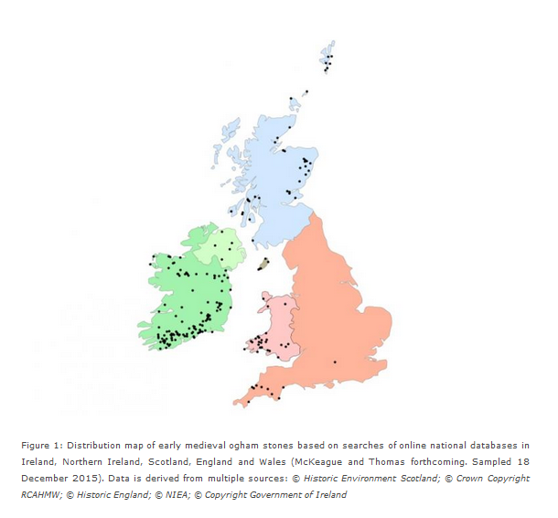

Slide 8
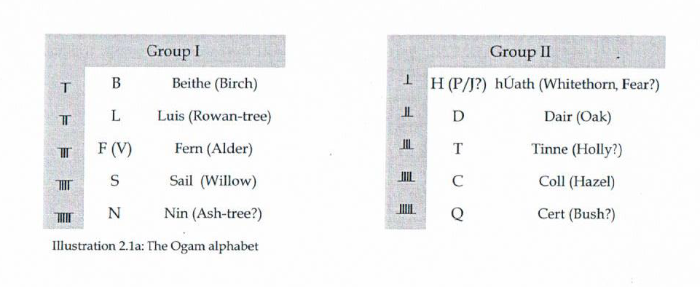
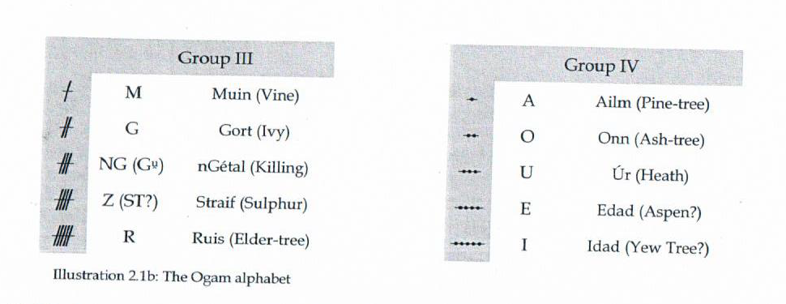

Slide 9
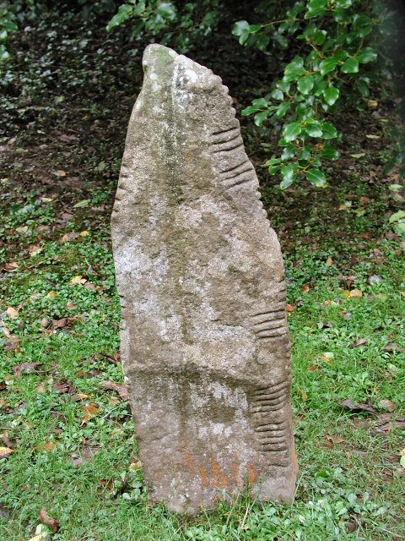
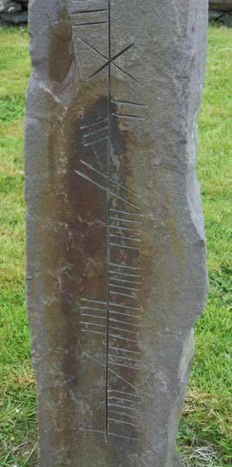

Slide 10
In the fifth century, Ireland converted to Christianity and this resulted in the introduction of the Roman alphabet. In the following two centuries, the Irish language changed radically and started resembling the Irish we know from the most popular medieval Irish literature.
Old Irish
Approximately from the seventh to the mid-900s.
Religious manuscripts brought to the Continent (Milan, Turin, Wűrzburg) by Irish missionaries in the eighth and ninth centuries represent our only contemporary documentation of the Old Irish classical period (commentaries on the psalms). They survived on the Continent for nobody understood them and they were not worn out from continuous use and recopied with modernized spellings.
Many texts that have survived were copied into much later manuscripts.
Old Irish possesses an extremely high number of phonemes in comparison to other European languages (esp. consonants). 18 letters are thus used to express 66 sounds, which means that on average every letter has more than 3 sound meanings.

Slide 11
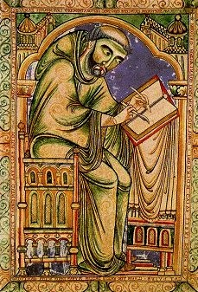
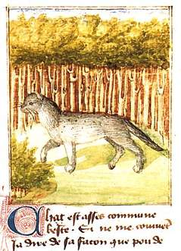
In modern Irish, the number of phonemes was reduced to 52. This is dealt with by introducing broad and slender consonants (palatalization).
Example: Old Irish poem The Scholar and his Cat
A poem about a monk and his cat (Pangur Bán) found in a manuscript in the monastery of St. Paul in Lavanttal in Austria (written around the 9th century).

Slide 12
Middle Irish
10-13th century
There were a lot of far-reaching changes in the morphological system of the language - simplification of verb conjugations.
Reduction of phonemes.
By the end of the 13th century, the language was effectively as it is today.
Modern Irish
The modern Irish period begins with the codification of a normative form of the language by bards and other literary elite in the 13th century. In the early 1600s, however, different regional varieties appeared (Munster, Connacht and Ulster) - they exist until these days.
During the 17th century, Ireland received an English speaking ruling class and the status of the Irish language quickly deteriorated and became a language of the rural poor. During the potato famine (1845-1849) much of the Irish speaking population died and about a million and a half migrated into America.
Today, more people learn Irish as L2, but the future of the Irish speaking community, Gaeltacht, remains uncertain.
From Fortson, Indo-European Linguistics, 2010, and David Stifter, Old Irish for beginners, 2006.

Slide 13
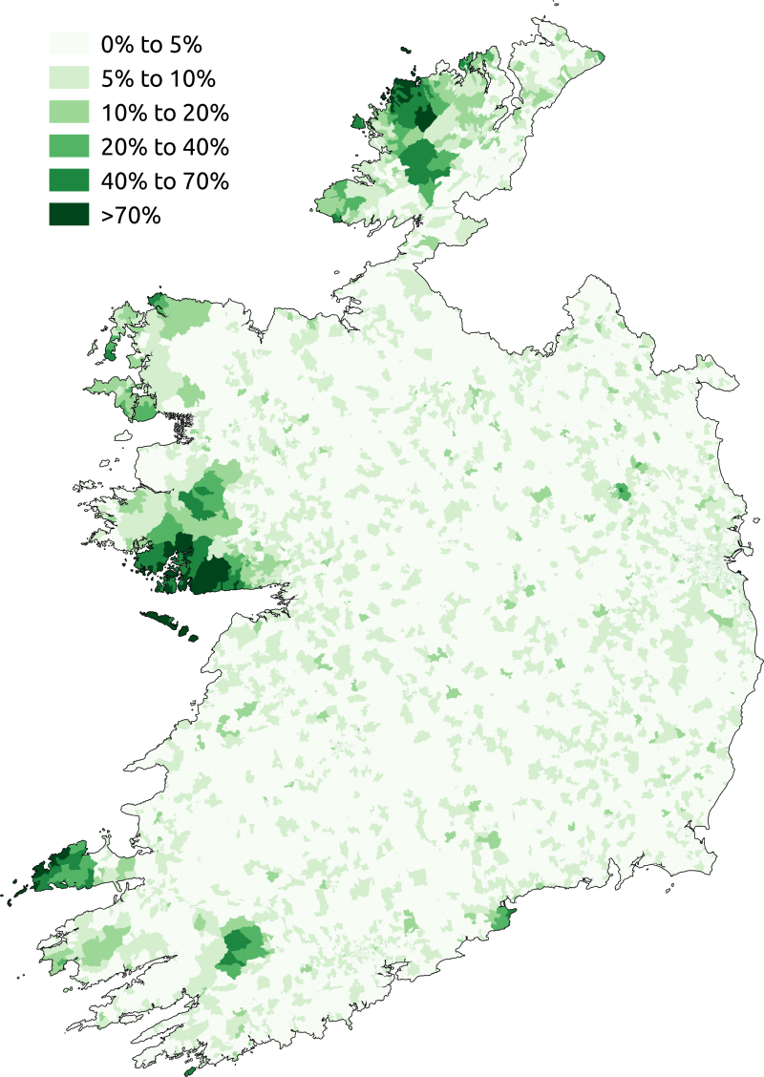
The percentage of respondents who said they spoke Irish daily outside the education system in the 2011 census in the State.

Slide 14
Medieval Irish literature
This literature represents the most extensive and best preserved texts of all the branches of Celtic mythology.
There are four main cycles:
Mythological Cycle (the mythological beginning of Ireland, Metrical Dindshenchas, The Dream of Aengus and others).
Ulster Cycle (set in the 1st century and takes place in Ulster and Connacht- group of heroic tales of warriors, the central piece is Táin Bó Cúailnge „The Cattle Raid of Cooley“ .
Fenian Cycle (deeds of Irish heroes, set probably in the 3rd century).
Historical Cycle (bards used to record the history and the genealogy of the kings they served- the resulting stories became the Historical Cycle).

Slide 15
Scottish Gaelic and Manx
Scottish Gaelic
Beginning around the late fourth century, immigrants from Ireland colonized what is now Scotland, establishing a colony called Dál Ríata, named after a town in northeast Ireland. The Scottish Dál Ríata became the centre of a kingdom and in the 7th century, the connection was severed.
The Gaelic inhabitants expanded inland and the Scottish territory grew. However, English language gradually began to replace Scottish Gaelic, which is today confined to the Outer Hebrides, the Island of Skye, Tiree and Islay.
In the 2011 census, 57 000 people, about 1.1% of Scottish population reported as able to speak Gaelic. Scottish Gaelic is not an official language of the UK. Apart from Scotland, Scottish Gaelic is spoken by about 7000 people in Canada (especially in Nova Scotia and Prince Edward Island).

Slide 16
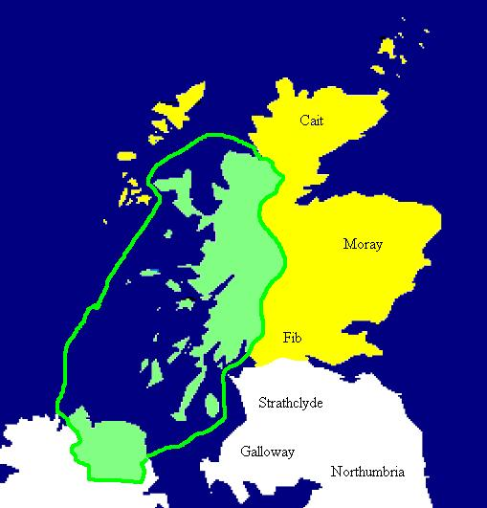
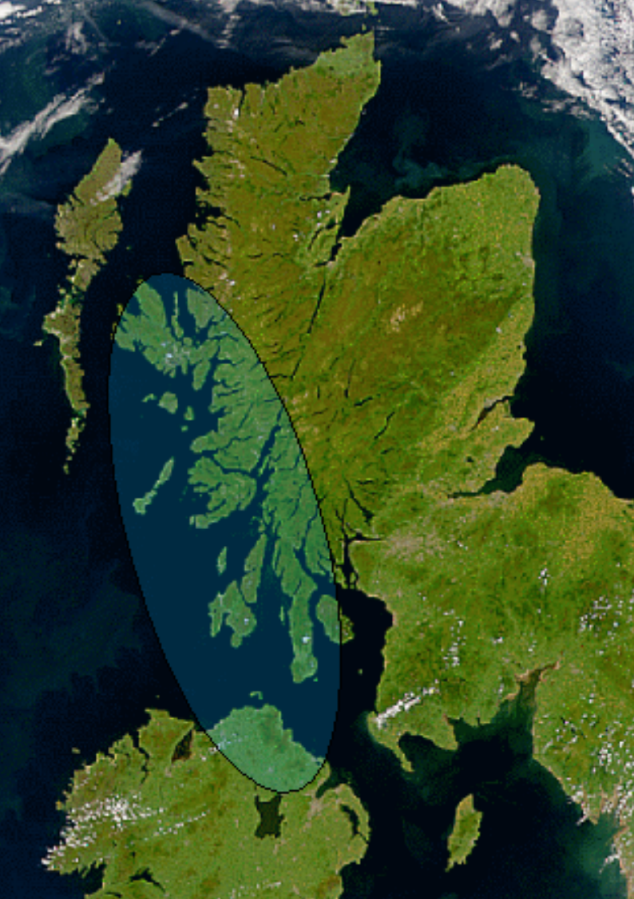
Map of Dál Riata at its height, c. 580–600. Pictish regions are marked in yellow.

Slide 17
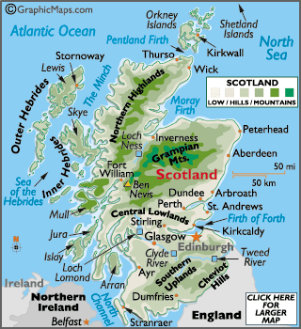
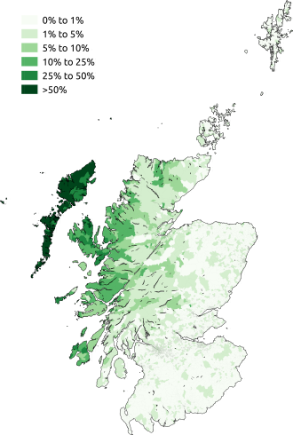
Geographic distribution of Gaelic speakers in Scotland in 2011.

Slide 18
The same group of Irish colonists also settled on the Isle of Man (4-5th centuries). The Manx language is called Gaelg or Gailck. The name of the Island of Man is originally Old Norse Manninsk (pronounced Man-en) and is named after the Irish god of the sea Manannán mac Lir (Mac Lir means “son of the sea”)
Manx is the name given to the form of Goidelic language that developed on the island following the Irish colonization. Written Manx begins with a 17th century translation of a prayer. Most of the published literature is of religious nature.
The Manx orthography is unlike the Irish or Scottish Gaelic one (both related to the orthography of Early Modern Irish).
Manx uses the English alphabet, except for x and z, and digraphs and trigraphs are often used. The orthography was developed by people who were unaware of traditional Gaelic orthography, as they had learned literacy in Welsh and English. The last native speaker of Manx died at the age of ninety-seven: Ned Maddrell in 1974.
From Fortson, Indo-European Linguistics, 2010.

Slide 19
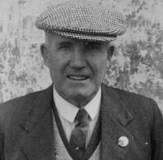
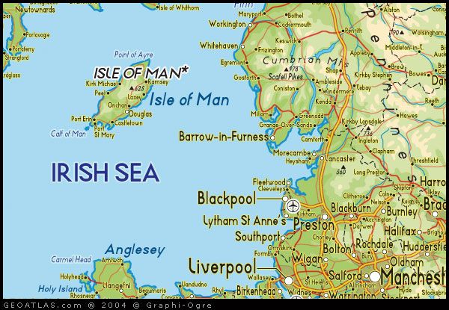
Nedd Maddrell- last native speaker of Manx

Slide 20
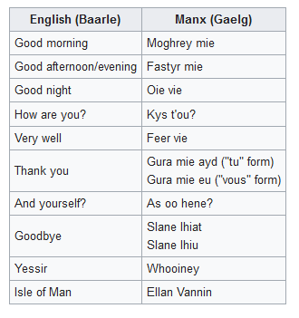

Slide 21
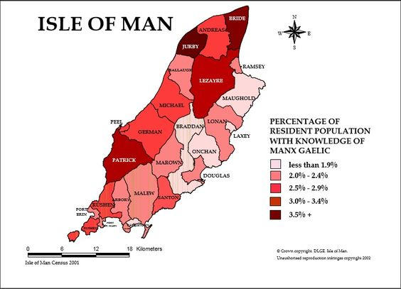

Slide 22
