Slide 1
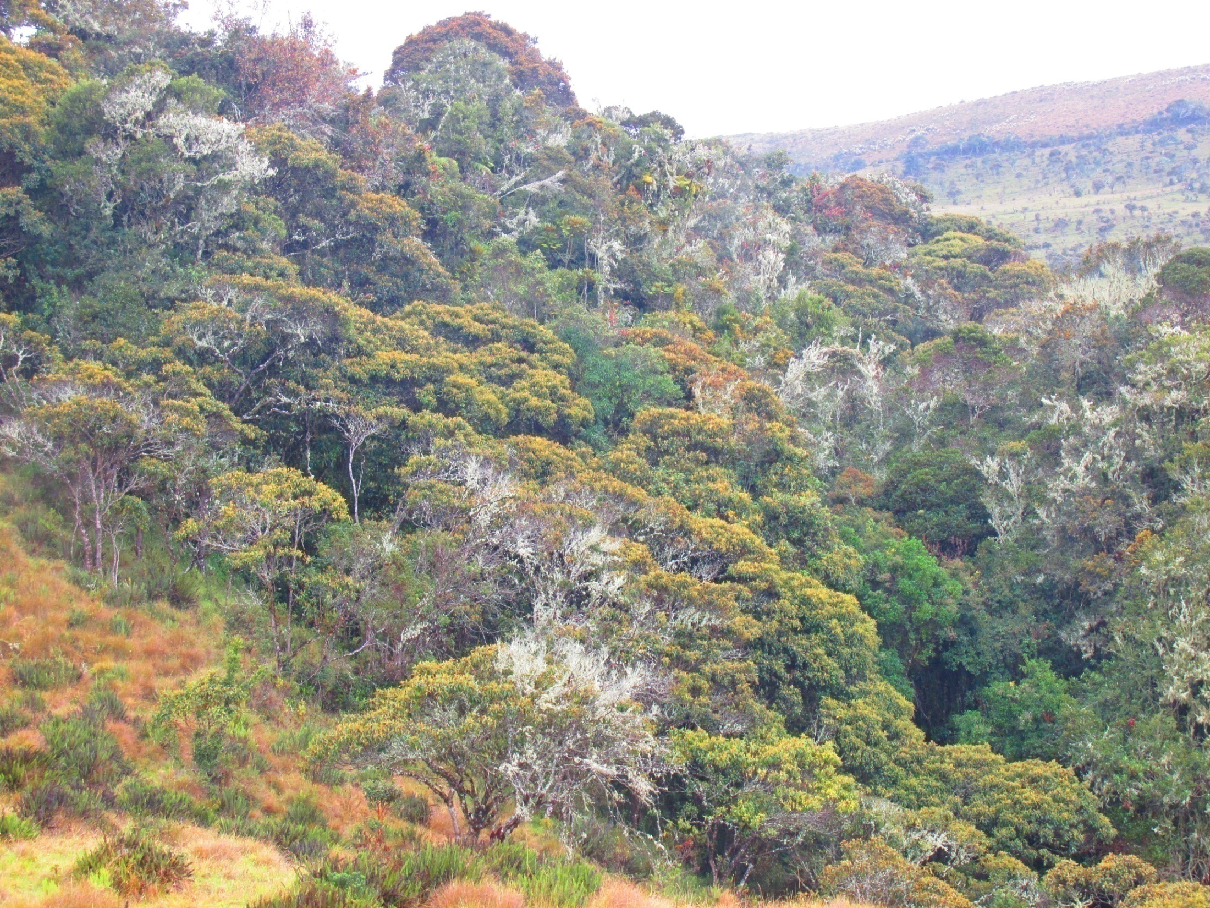
Journey to KansrӨ
(the Underworld of Misak tribe in the south of Colombia)
Lucie Vinsova
Masaryk University Brno

Slide 2

Time unfolds in a spiral. Misaks say that Time is actually a snail shell, srurrapu, which is constantly on the move. Only from our perspective, it moves backwards, so the past is in front of us and the future behind.

Slide 3
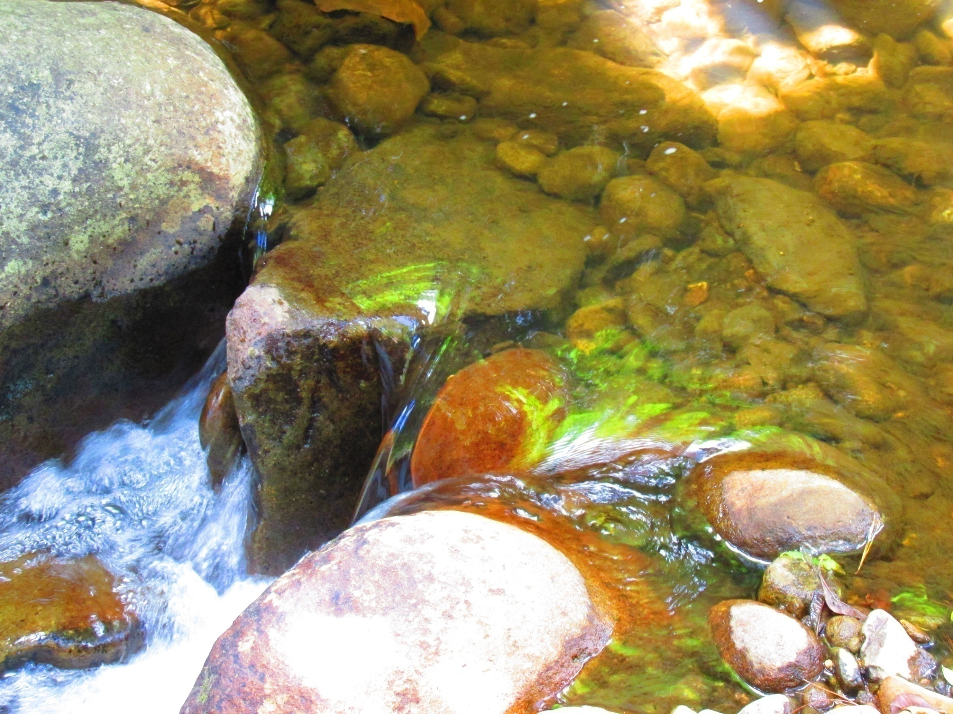
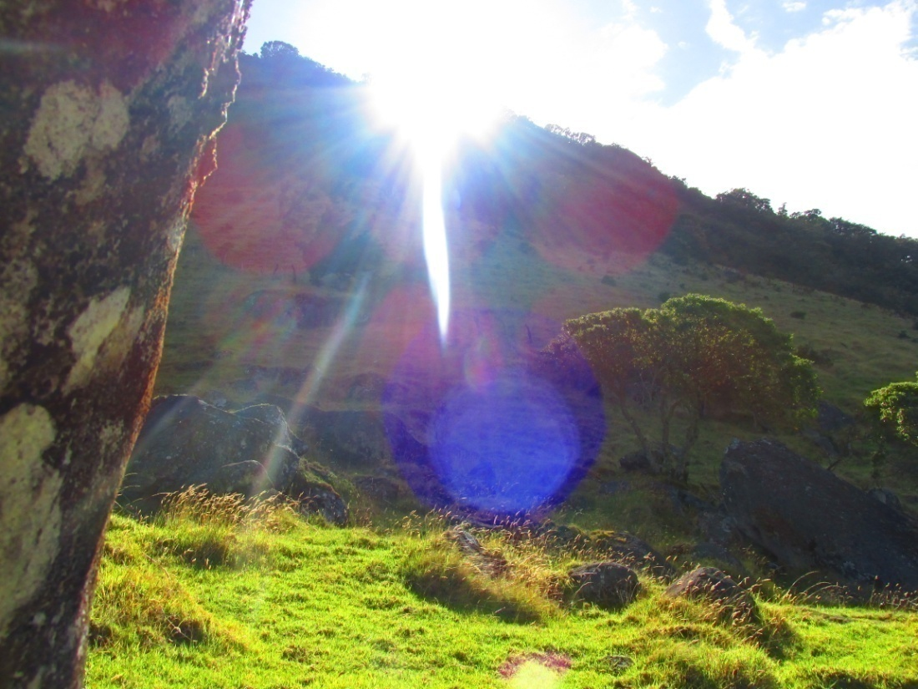
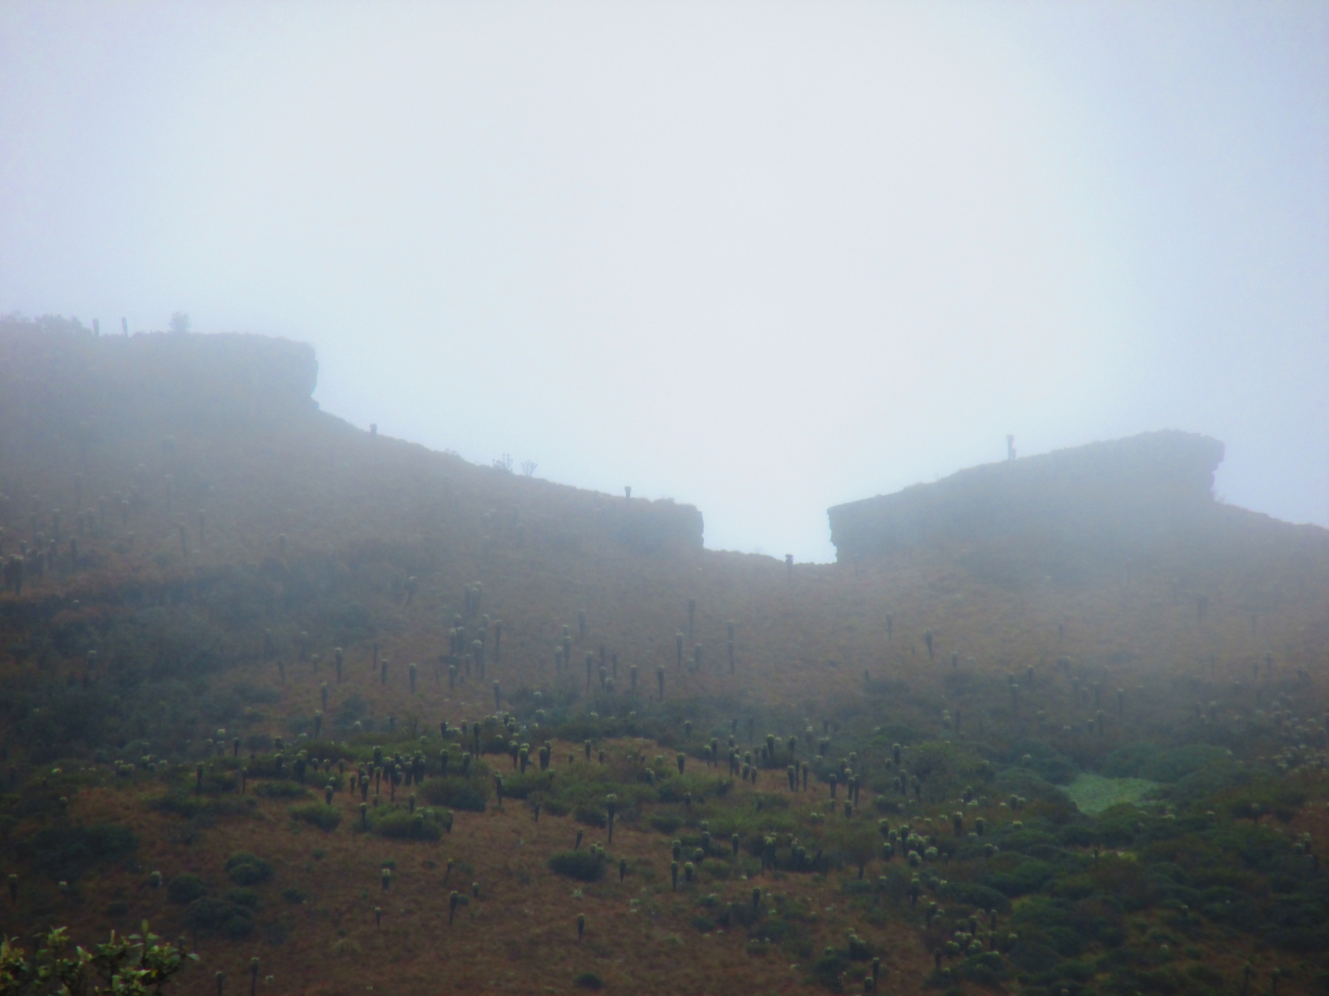
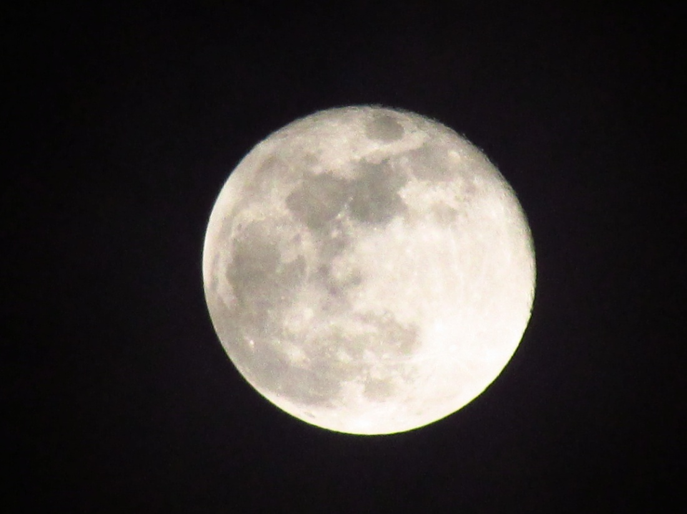
KansrӨ, the Realm of the Dead, is said to be located in páramos, the Andean mountain highland plains. It is believed that the spirits actually reside there and that is why páramos are considered sacred places. This together with the arrow of time means that the Misaks can “see” their ancestors, those who “walk before them”.
“... Thus those who have already passed through this world, opened the path and showed us which way to walk. And so the Misaks of today walk in the footprints of their great tatas, sages, whose work thus hasn`t yet been completed... “
(Luis Guillermo Vasco Uribe, Hijos del Aroiris y del Agua)
In the same manner, when one`s life spiral comes to the end, the soul of the deceased splits into two. One part is the Moon, dark spirit, yon musik, which wants to stay where it used to live…
…While the other one is the Sun, light spirit, posr musik, which departs for Kanre, eventually dissolves in the Great Spirit (which is divided into three great spirits of three basic elements: air, water and earth) and is eventually reborn.

Slide 4
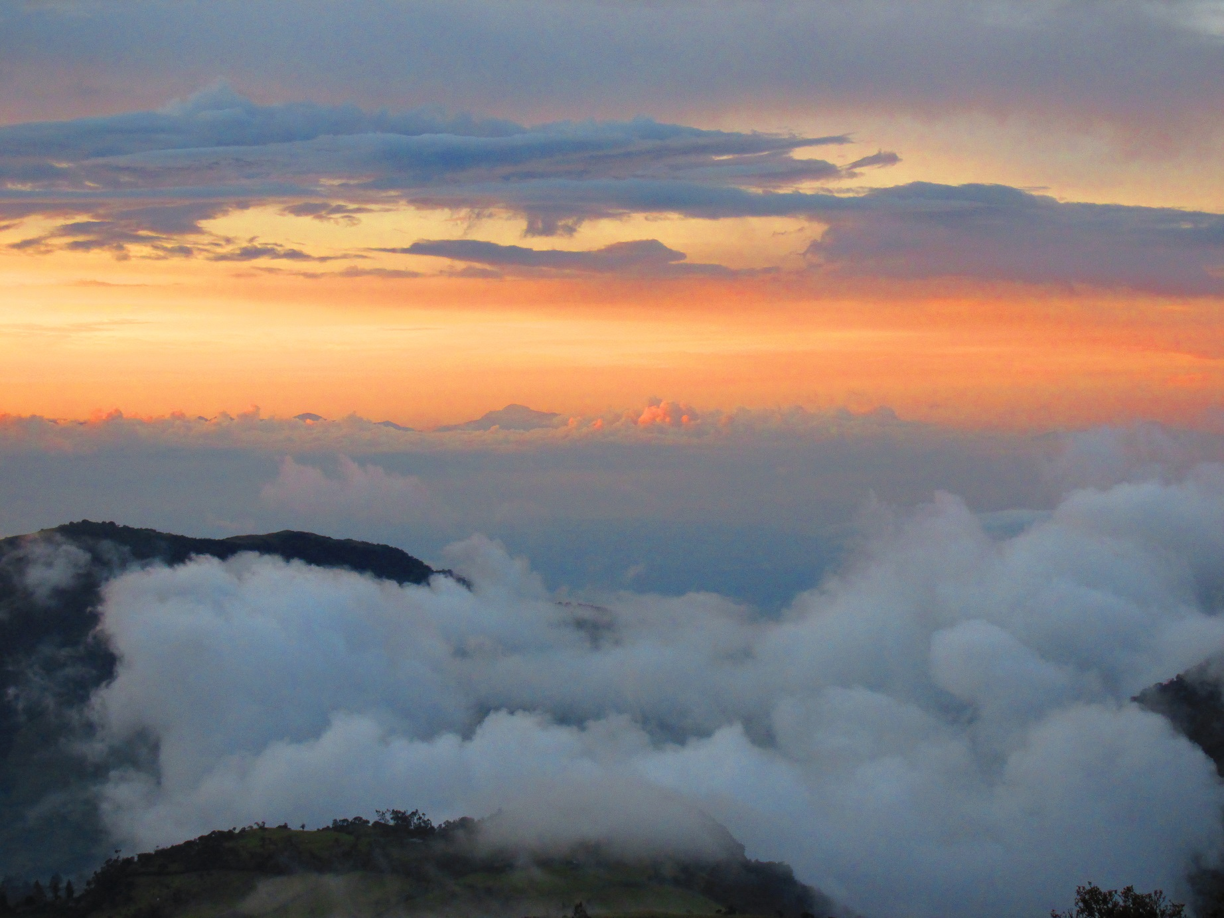
There are three underworld beasts and one demonic spirit that come when somebody is dying. These four make sure that the spirit of the deceased leaves the dead body…

Slide 5

They are:
YemwasrӨ (an eagle), Kuawera (a demonic dog) and Kuskunku (an owl). The fourth is Kuanmusik (a spirit of a dead person).
Kuanmusik persuades the spirit (the dark part of the spirit) of the newly deceased person to leave the body and then whistles to the demonic beasts to pursue the escaping spirit to the páramos. There they attack the spirit and start biting off its flesh and pecking at its bones.
This was connected to the practice of burying the dead after the bruises caused by these demonic animals have appeared on their skin. This custom has now been replaced and the deceased is buried as soon as possible).

Slide 6
Nowadays, Christian funeral customs have merged with the original tribal ones.
Funeral now includes a mass held in Silvia or Las Delicias (towns in Cauca), a funeral procession, the burial itself and cleansing ceremonies.
The deceased is dressed in “western clothes” , for there is a common belief that western clothes don`t burn in Hell. The Misak clothes is burnt with other things of personal possession.
The mourning period of nine days is followed by cleansing ceremonies performed by the local mӨrӨbik, shaman.
During those nine days, neighbours and family relatives help the family of the deceased. They bring them food and drink, for the household of the dead person is contaminated by papӨ
(strong contamination of cold essence which attracts illnesses, evil and malicious spirits), and so cooking is prohibited until the arrival of the shaman who performs the purification rituals.

Slide 7
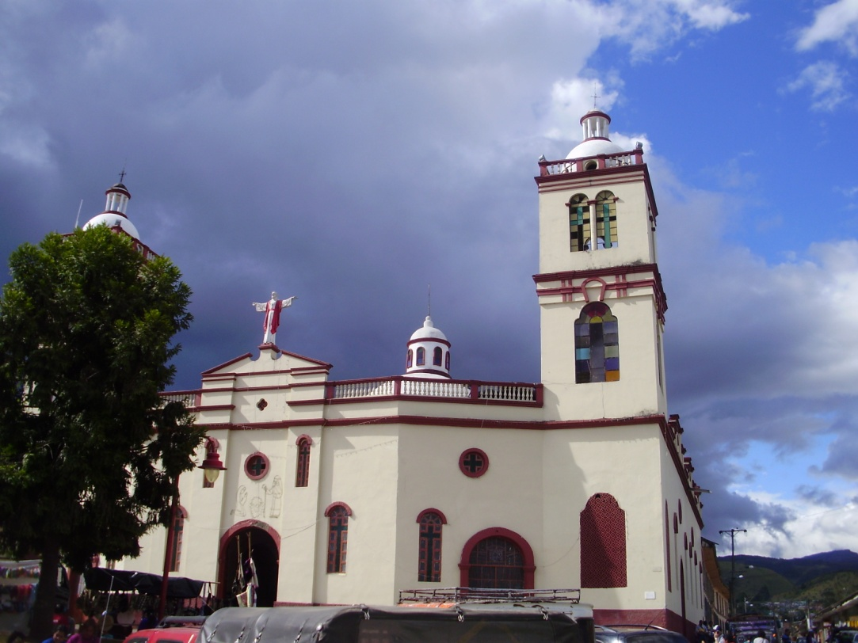
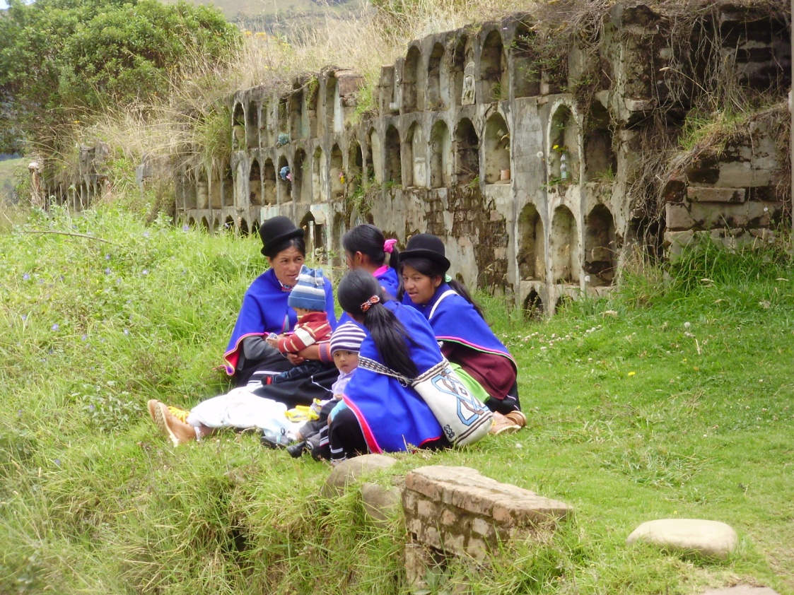
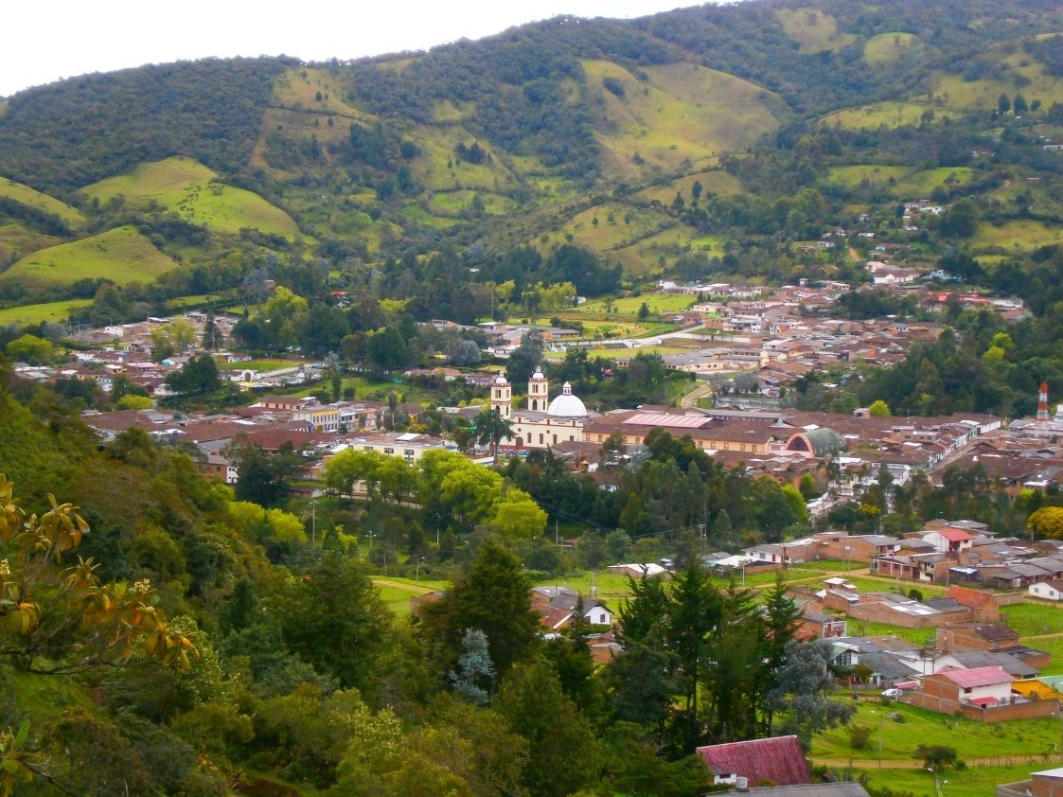
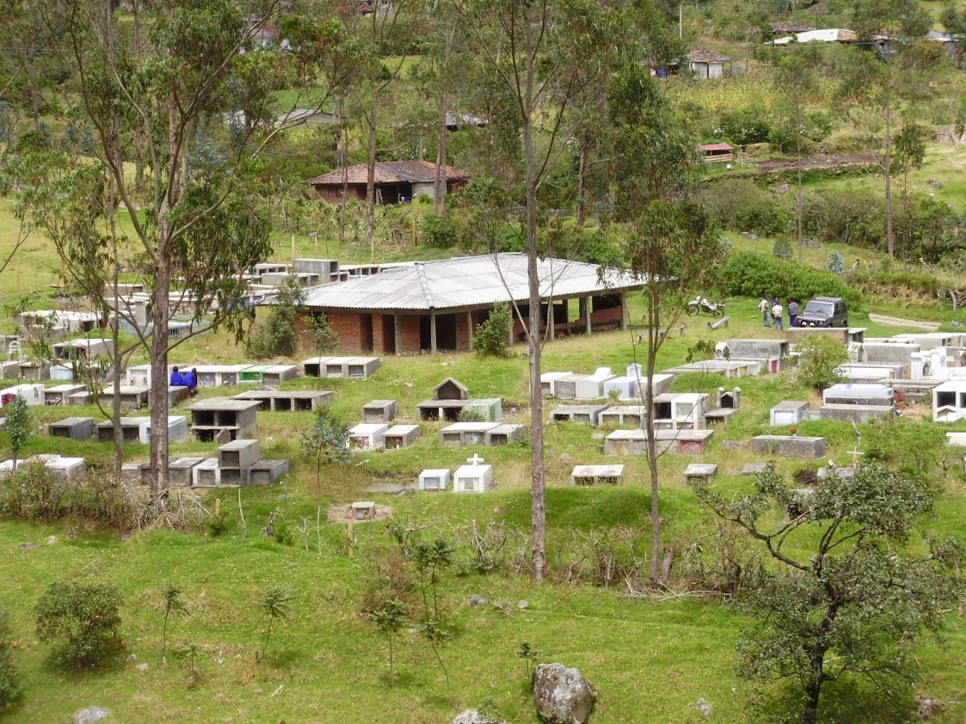

Slide 8
Shaman, mӨrӨbik, arrives 9 days after the death to perform the purification ceremonies.
The yem mӨsik, “dark spirit” doesn`t want to leave its home and clutches to its formal material possessions. That is why most of the personal possessions, and especially the Misak clothes of the deceased are instantaneously taken outside the house to be burnt.

Slide 9
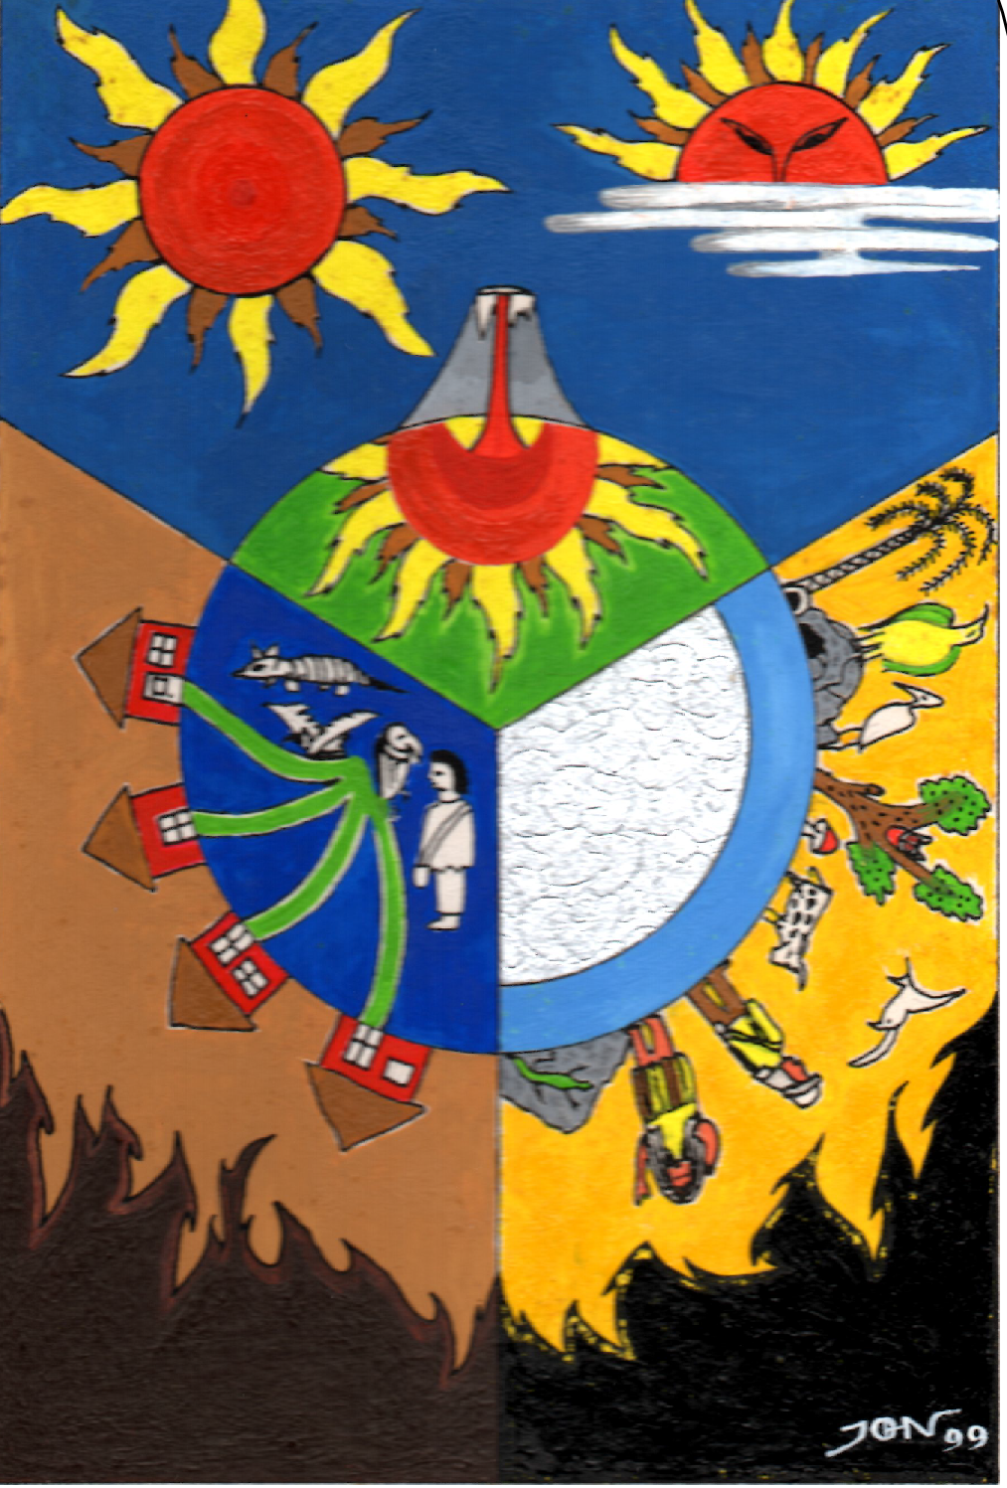
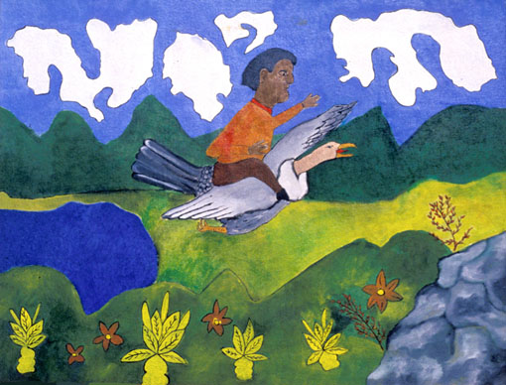
Picture by taita Juan Bautista Ussa Ulluné.
The importance of a shaman: his access to the four spheres of existence and his connection to certain powerful animals.
Picture by Jhon Ferney López Muñoz

Slide 10
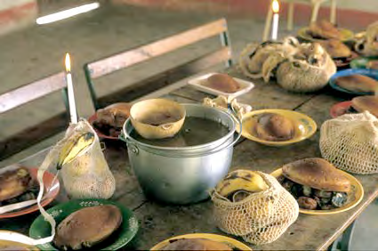
Festival of Offerings
Originally, this festival was celebrated with the first rainfall after the dry season and thus marked the beginning of the new agricultural year, which used to be usually at the end of September or throughout the first half of October.
Today, this festival has merged with the All Saints Day, on the first of November. On this day, people prepare food and drink for the spirits of their deceased (in here they specify that it is the Sun spirit, pӨsr mӨsik, which returns).
Offerings consists of prepared and raw food placed in ceremonial jigras (woven bags). For drink, spirits can choose from coffee, hot chocolate, hot sugar cane water or specially made chicha (fermented corn drink). The offerings differ in case the deceased was a child. (Compare Andean cultures, esp. Cochabamba, Bolivia)
Today, the offerings are usually performed in community centres and at schools.

Slide 11
In the cosmology of the south-west Cauca tribes, spirits of the deceased ancestors are believed to stay with their descendants and influence the life of the present community forever. This is explained in several ways:
When the spirits come for the offering ceremony each year, they cry. Their tears are the raindrops of the first rain in the farming season. And so the tears of the ancestors themselves water the seeds of the coming crop providing food for their descendants.
KansrӨ is a real place in our very world. It is situated in the sacred places of the páramos, high in the mountains. Moreover, people can`t really cease to exist, they just leave for KansrӨ, from where they return every year.
The time current moves in a spiral, and from our point of view backwards, that is why we can always see our ancestors, follow their example and ask them for advice. Moreover, their work is not yet completed for they are attached to the filament of life to the centre of the origin, they are just moving in time, but are still present in this world.

Slide 12
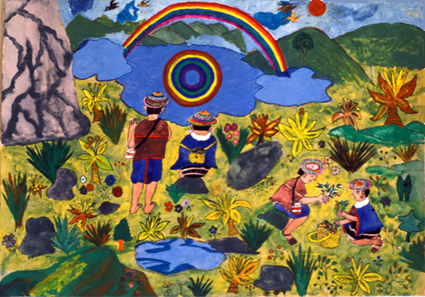
Picture by taita Juan Bautista Ussa Ulluné

Slide 13
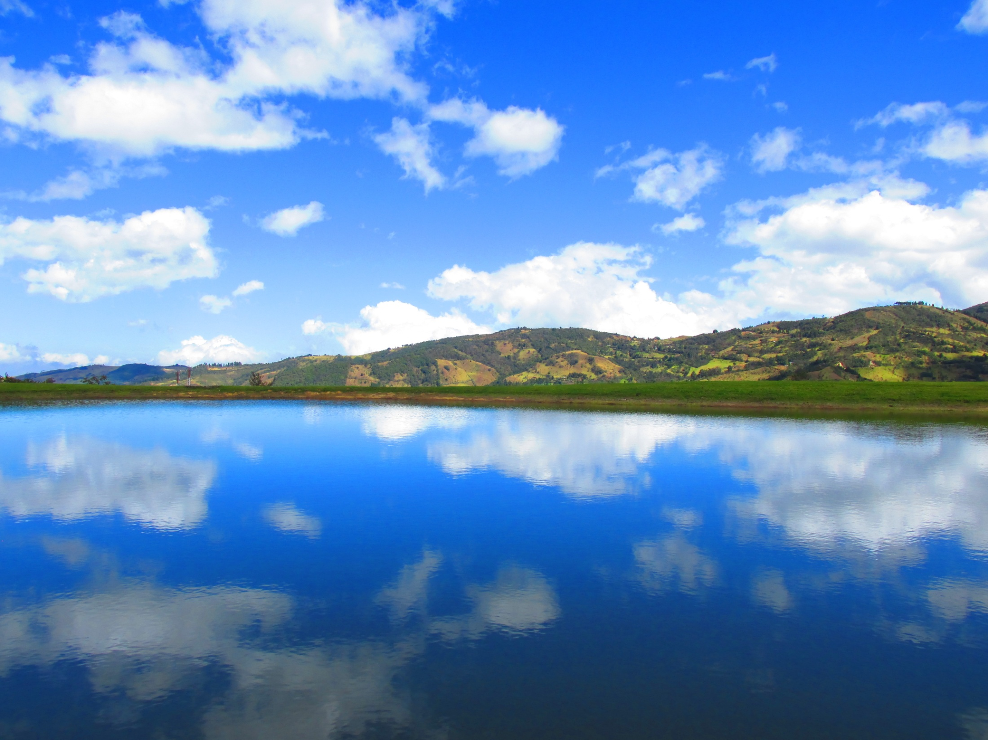
Thank you

Slide 14
Materials:
Abelino Aranda, Luis Guillermo Vasco Uribe, Hijos del Aroiris y del Agua, 2015,
Universidad Nacional de Colombia, Colombia.
Hugo Portela Guarín, El Pensamiento de las Aguas de las Montañas (Coconucos, Guambianos, Paeces, Yanaconas), 2000, Universidad del Cauca, Popayán, Colombia.
Judy Branks and Juan Bautista Sánchez, The Drama of Life (A Study of Life Cycle Customs Among the Guambiano Colombia, South America), 1978, 2011, SIL International, USA.
Walter Krickeberg, Mitos y Leyendas de los Aztecas, Incas, Mayas y Muiscas, 1971, México.
Tulio Rojas Curieux, Adonías Perdomo Dizú, Martha Helena Corrales Carvajal, Una Mirada al Habla Nasa Yuwe de Novirao, 2009, Universidad del Cauca, Colombia.
Mario García Isaza, Gramática Páez, 1996, Prefectura Apostólica de Tierradentro, Belalcázar, Cauca, Colombia.
Lilia Triviño, Bárbara Muelas y equipo colaborador, Gramática Pedagógica de la Lengua Namtrik para Maestros Misak, 2011, Universidad del Cauca, Cali, Colombia.

Slide 15
Gregorio Alberto Yalanda Muelas, Relación entre la Música Tradicional y el Ciclo de Vida de los Misak, 2013, Observatorio del Patrimonio Cultural y Arqueológico OPCA.
Grupo Linguistico de Guambía, Wabia MisaabirӨ, 1986, Popayán, Colombia.
Beatriz Vasquez de Ruiz, Lenguas Aborigenes de Colombia, Descripciones 2, La predicacion en Guambiano, 1988, Universidad de los Andes, Bogotá.
David Lorente Fernández, El «frío» y el «calor» en el sistema médico nahua de la Sierra de Texcoco. Una aproximación. Revista Española de Antropología Americana. 2012, vol. 42, núm. 1, 243-266.
Víctor Bascopé Caero, El Sentido de la Muerte em la Cosmovisión Andina: El Caso de los Valles Andinos de Cochabamba, 2000, Cochabamba, Bolivia.
Léxico de la Lengua Namtrik de Totoró, Comunidad del Resguardo Indígena de Totoró.
Primera edición. 2009. Totoró. Colombia. Lilia Triviño Garzón, Algunas particularidades de los verbos de posición en la lengua guambiana, 2004-2005, Universidad del Cauca.

Slide 16
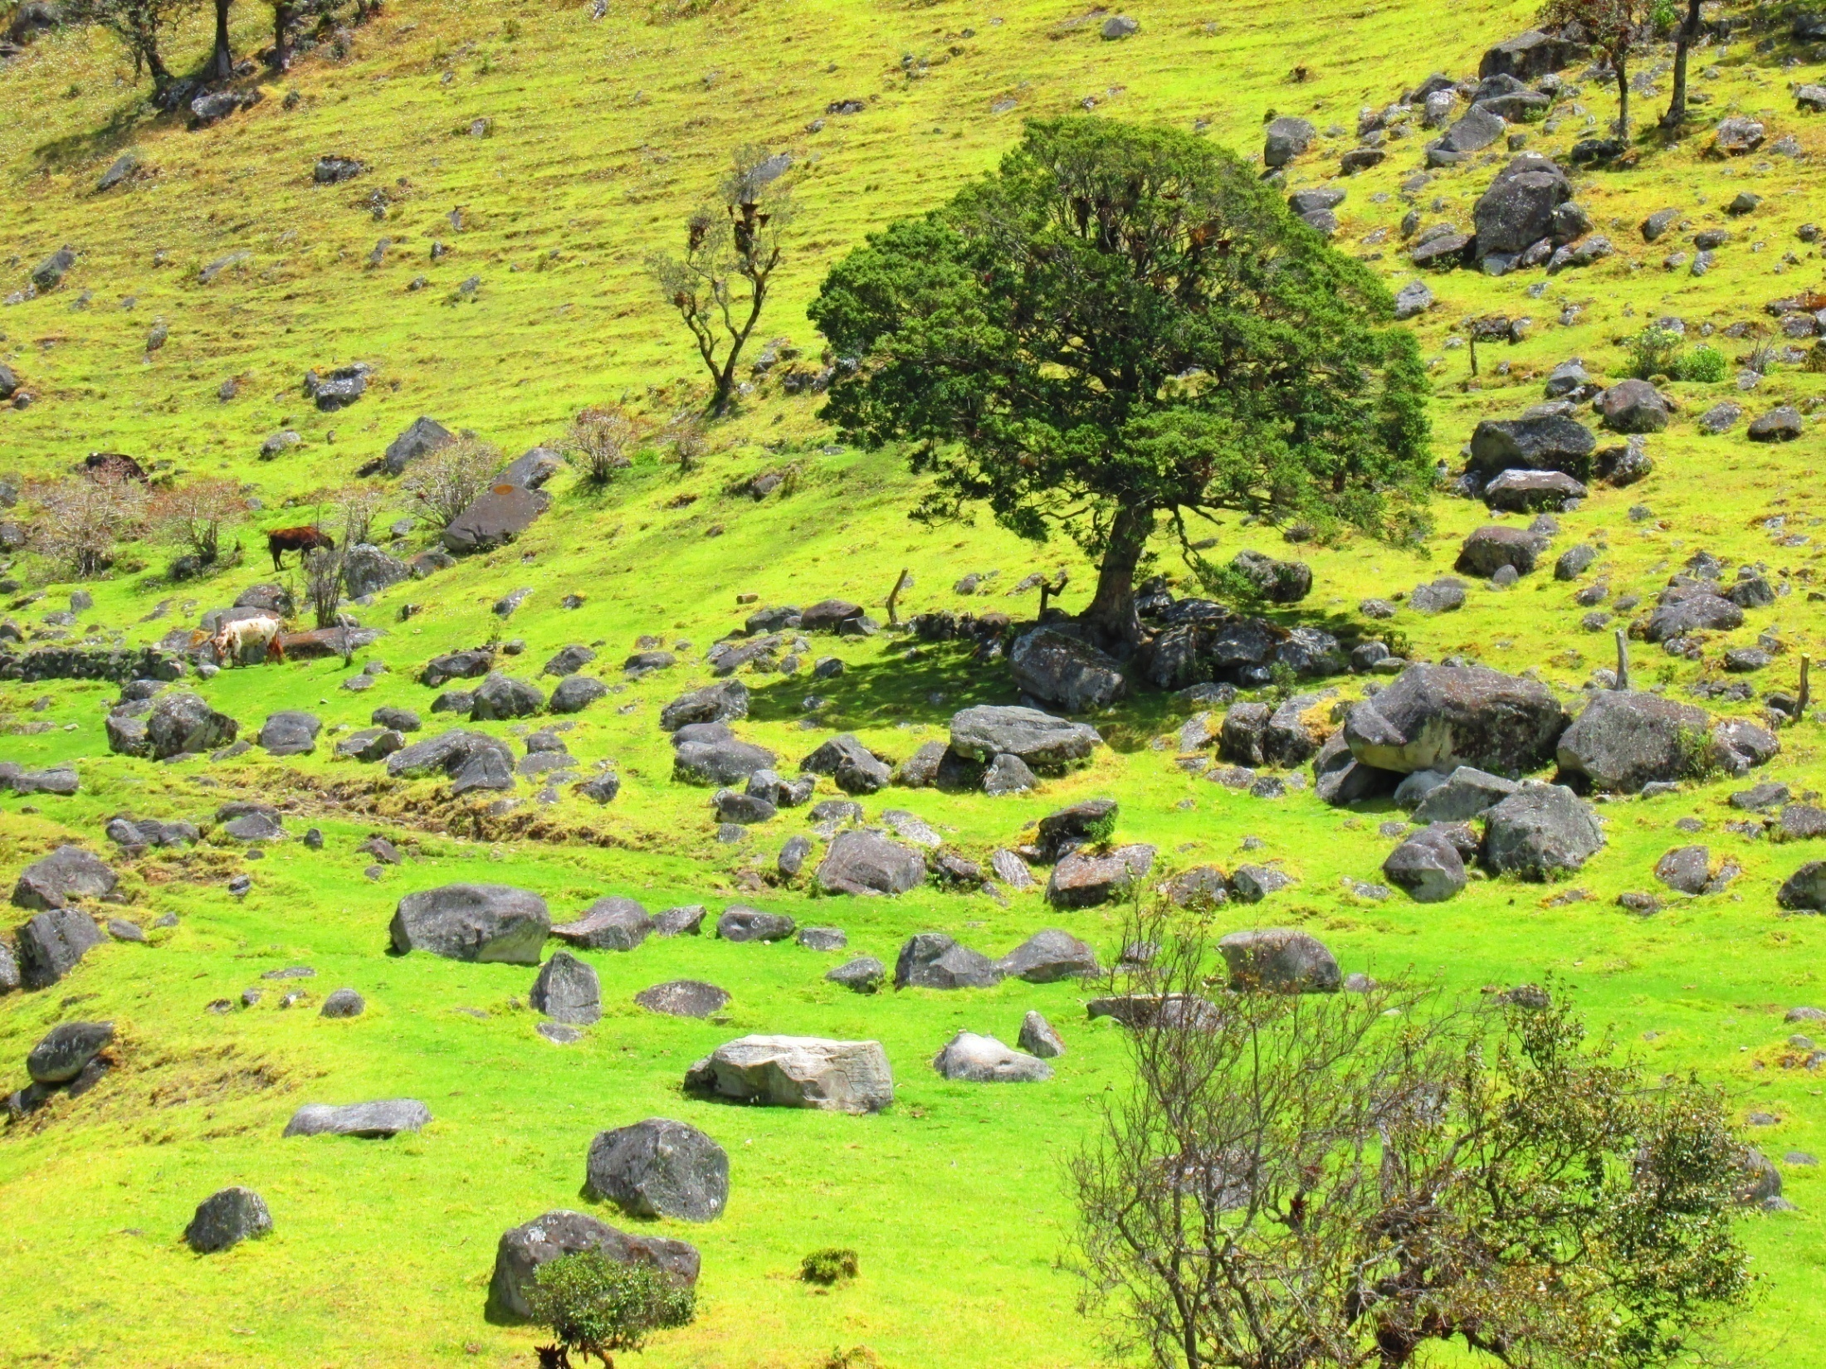
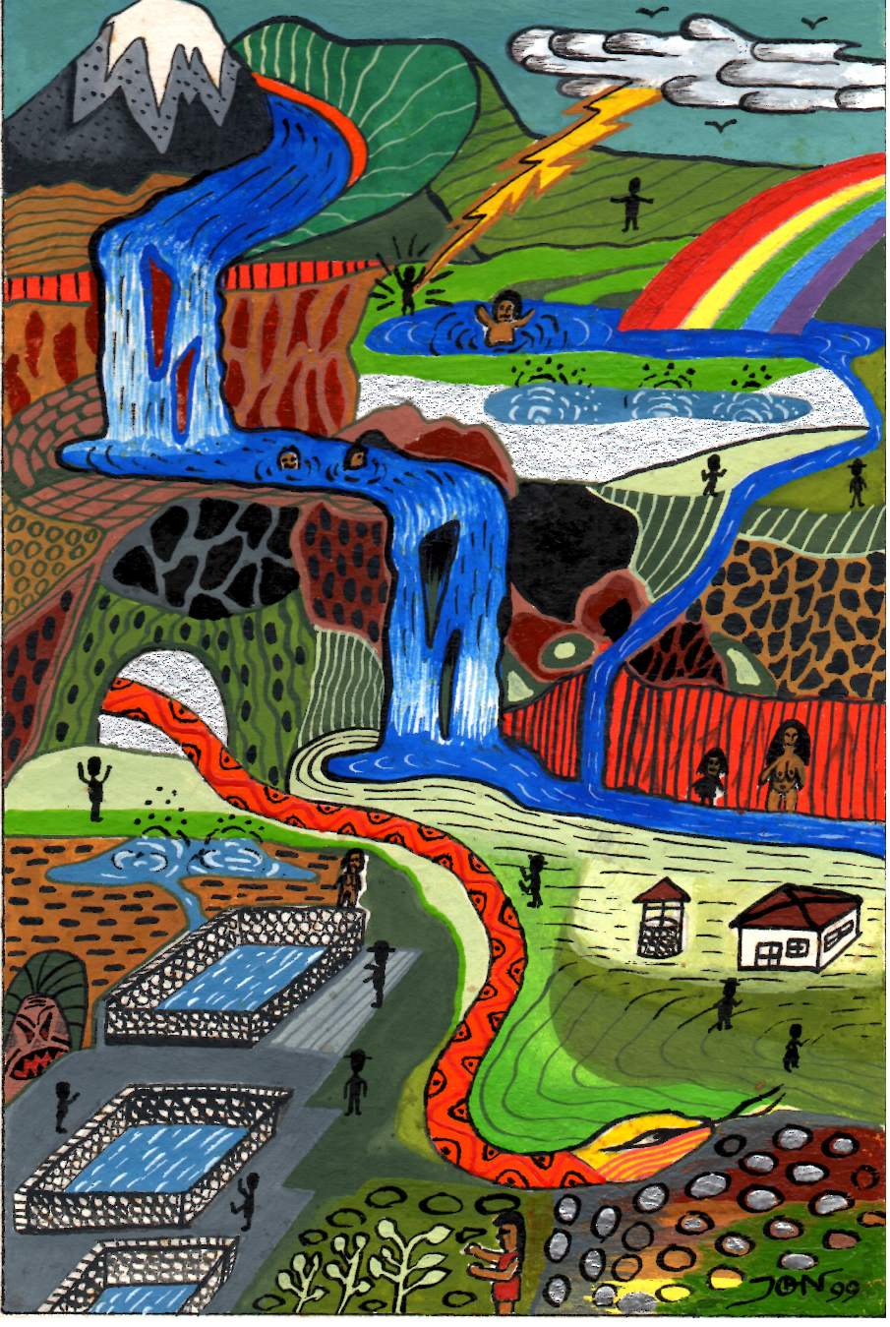
In case you want more…

