Slide 1
Reading Colombian Myths
(Misak and other Cauca tribes and their cosmology)
Lucie Vinsova
Masaryk University Brno

Slide 2
Reading Colombian Myths
Lesson plan:
1. Introduction: Cauca tribes- geography and general information, landscape, language, community.
Creation myths: How from One many were born, Four houses of the existence, the story of Tay (the Sun), the story of Water and Earth, the role of a shaman.
2. The Principles of existence: The arrow of time and the way it`s reflected in Namtrik language, life cycle, the Dualistic forces of nature (hot and cold, left and right), pieces of traditional clothing and their place in Misak cosmology.
3. Children of water: Water cycle, creatures of water, rainbow myth (the story of the rainbow serpent), venturing into páramos and the dangers of “contamination”.
4. Birth: Myths and beliefs connected to the event of birth, the importance of placenta, myths of the arrival of prodigies and chieftains, contamination forces and malevolent spirits (connected to birth).

Slide 3
5. Adulthood: The organization of household, the way Misaks tell time, principles and symbolism of agriculture, mixed crop philosophy, community work events.
6. Death: The myths, beliefs and customs connected to death, departure for the other world, the ceremony of offerings and cleansing rituals.
7. The water cycle, water myths and how it corresponds with the cycle of human life. Contemporary ecological treats to paramos.
8. Misak language (Namtrik): examples of syntax and morphology.
9. Nasa language, connections between native languages and nature, how human body and territory corresponds.
Kogi- introduction and comparison with the studied tribes. Kogi mythology and people as the keepers of the universe.
The twisted language of metaphors in selected Peruvian tribes. The role of shaman and animal metamorphoses.

Slide 4
Subject requirements:
Approximately 60% attendance
Preparation for lessons
A short contribution- cca 20 minutes on an agreed topic

Slide 5
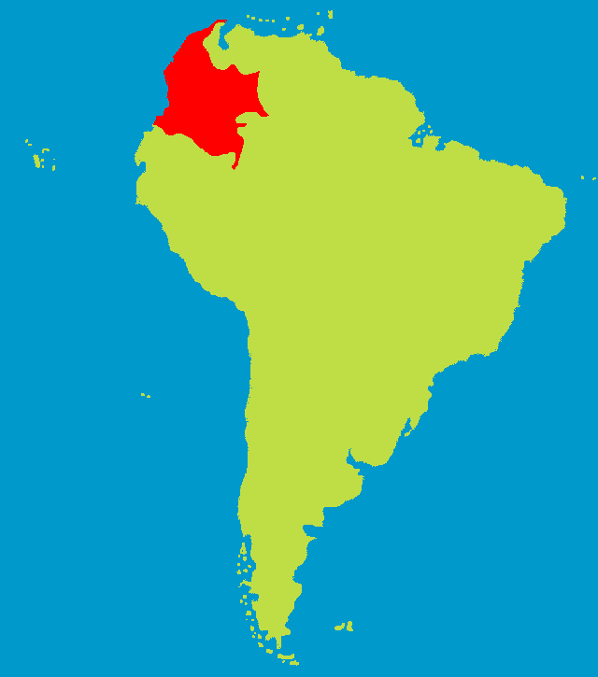
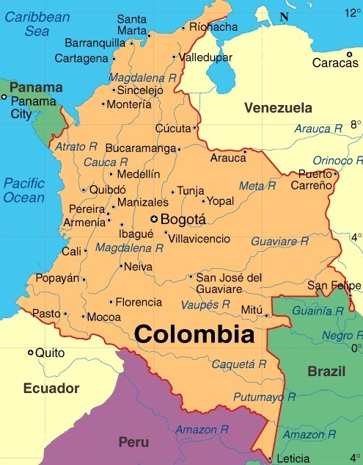
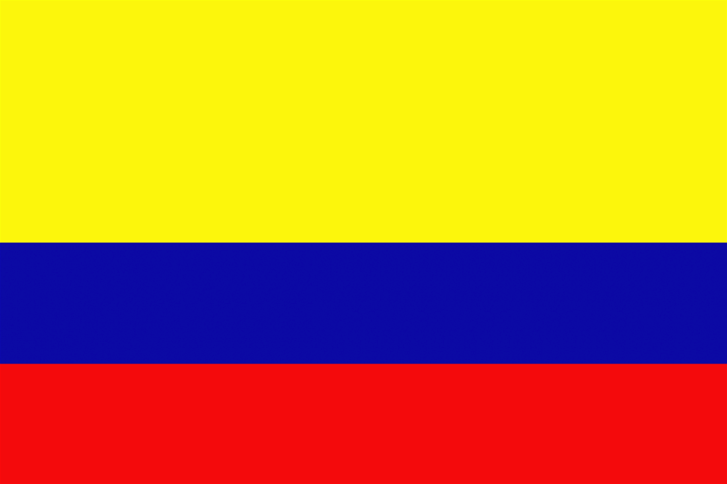
Colombia
Capital: Bogotá
Population: nearly 50 million
Languages: Spanish and at least
68 other recognized ethnic languages

Slide 6
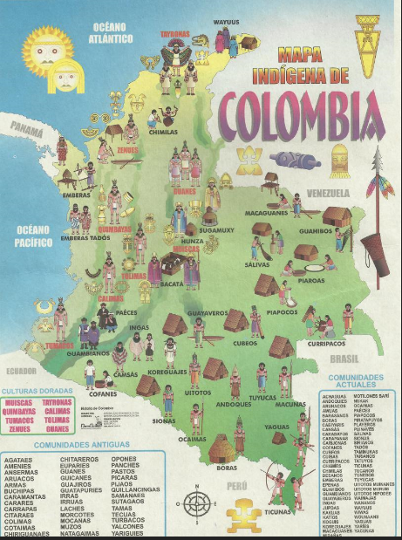

Slide 7
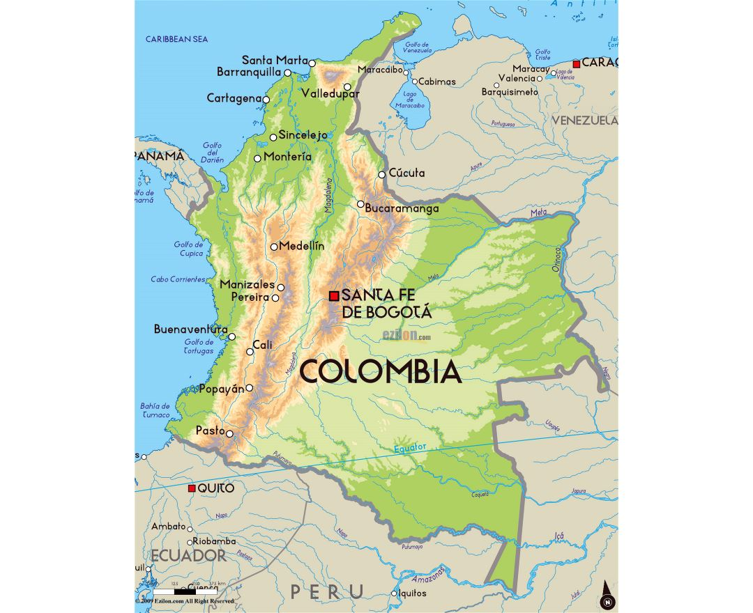
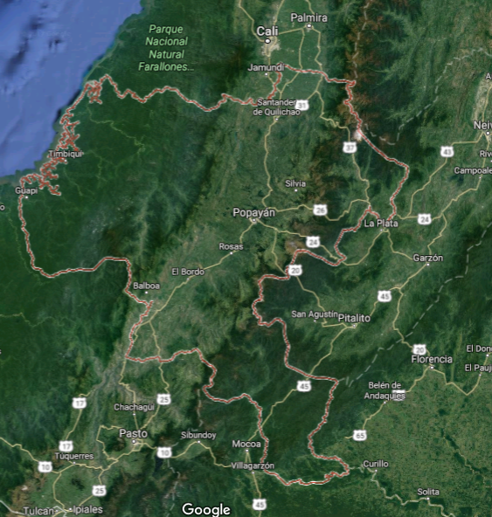
Departamento: Cauca
Capital: Popayán
High percentage of indigenous population (about 20%)

Slide 8
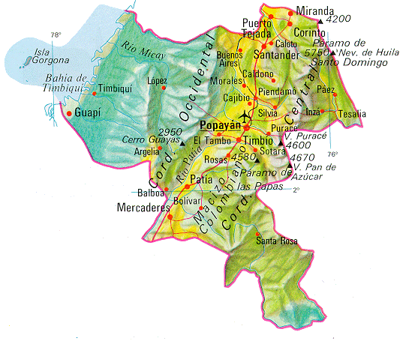
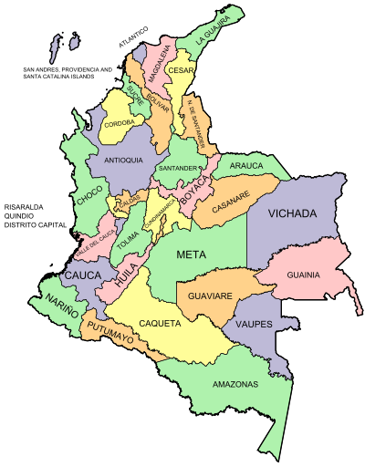
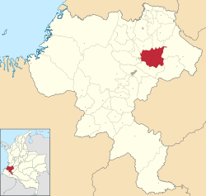
MISAK (GUAMBIANOS)
Population: 21.000 (2005 est)
In depart. Cauca cca 19.000

Slide 9
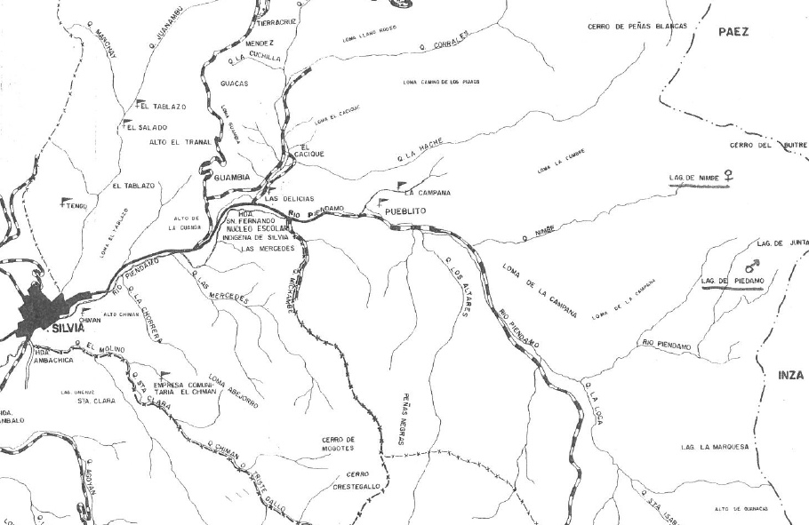
Municipio Silvia:
Population about 32 000 people
Average altitude: 2 800 m.

Slide 10
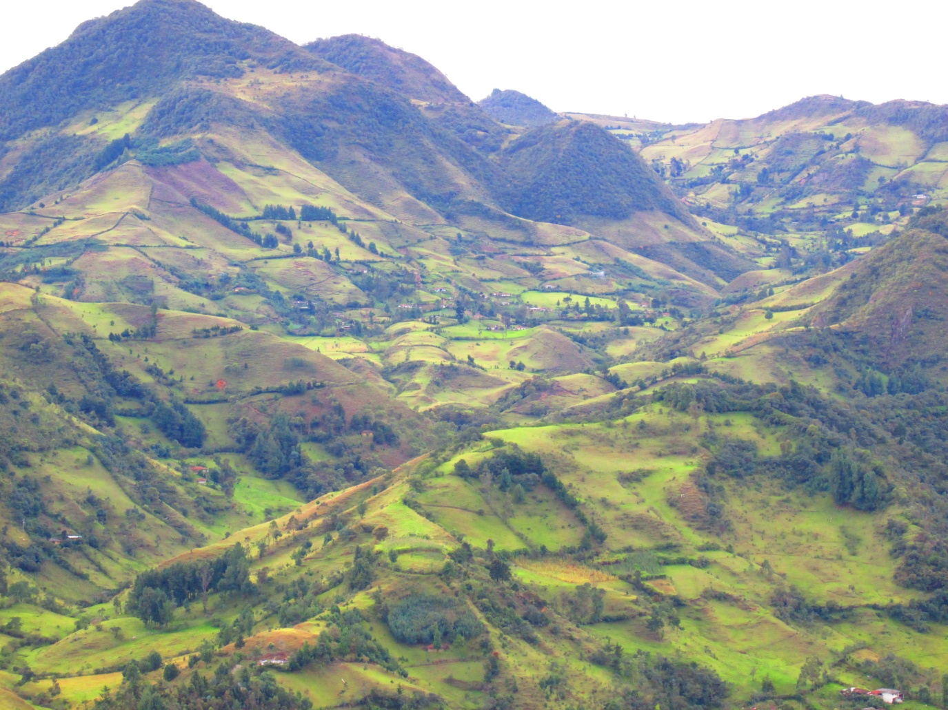
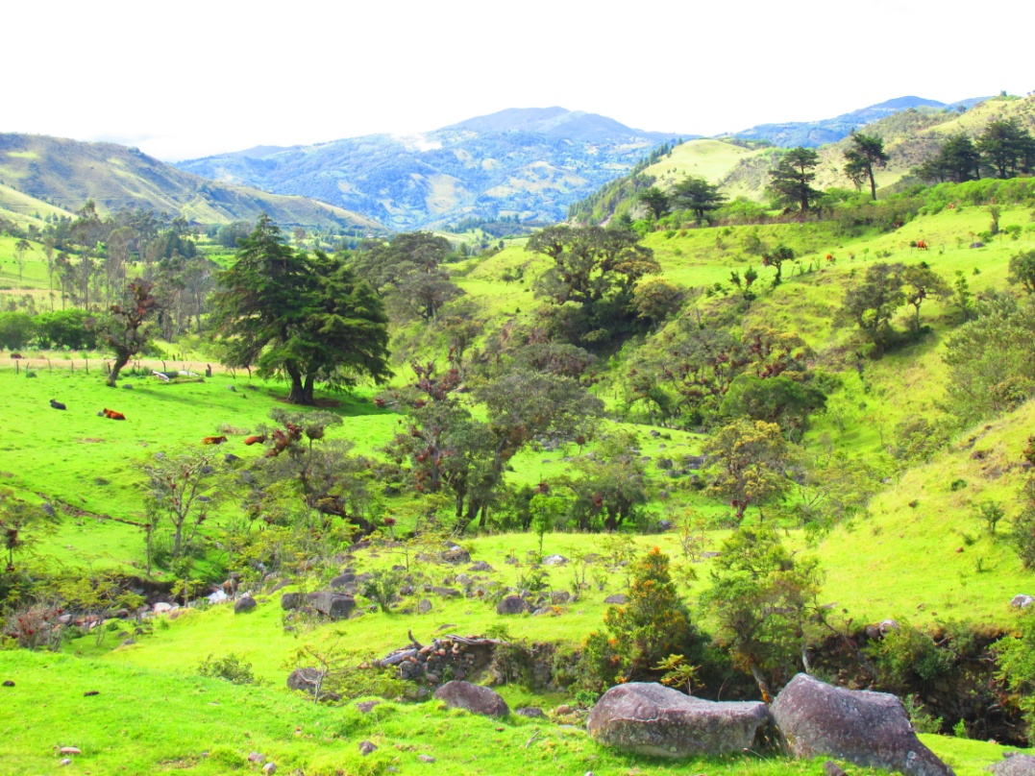
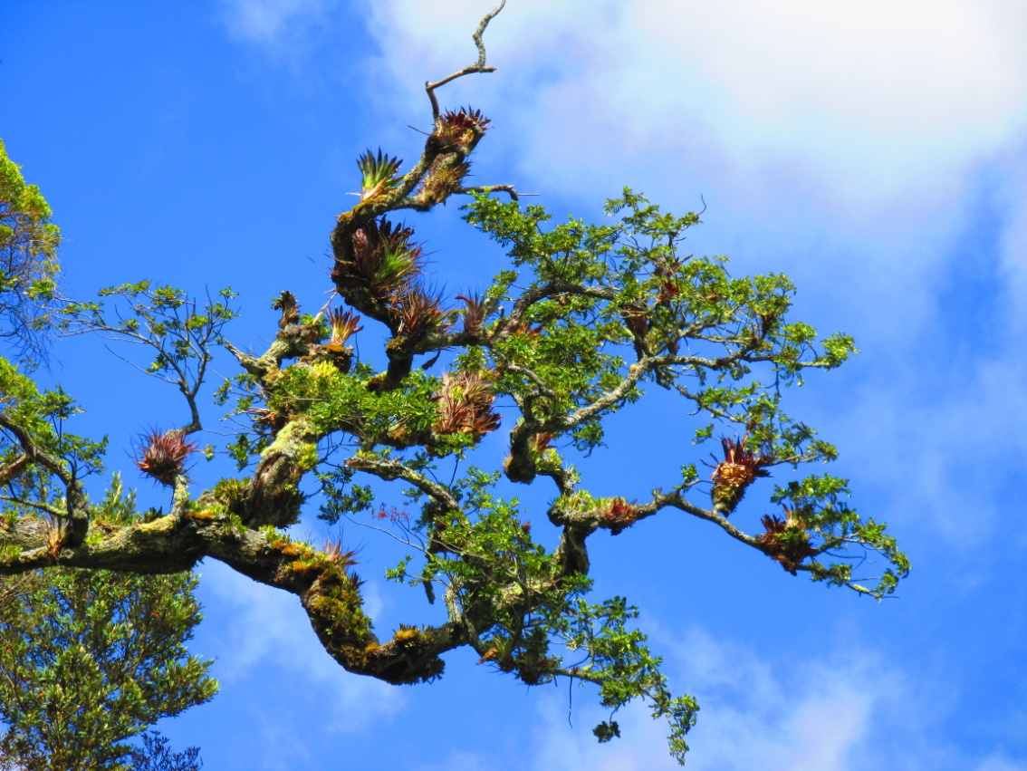
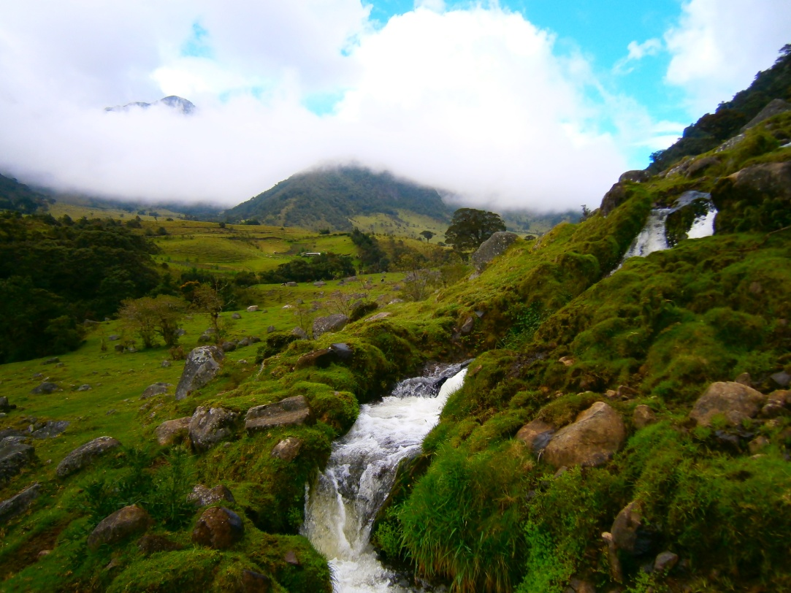
Typical countryside

Slide 11
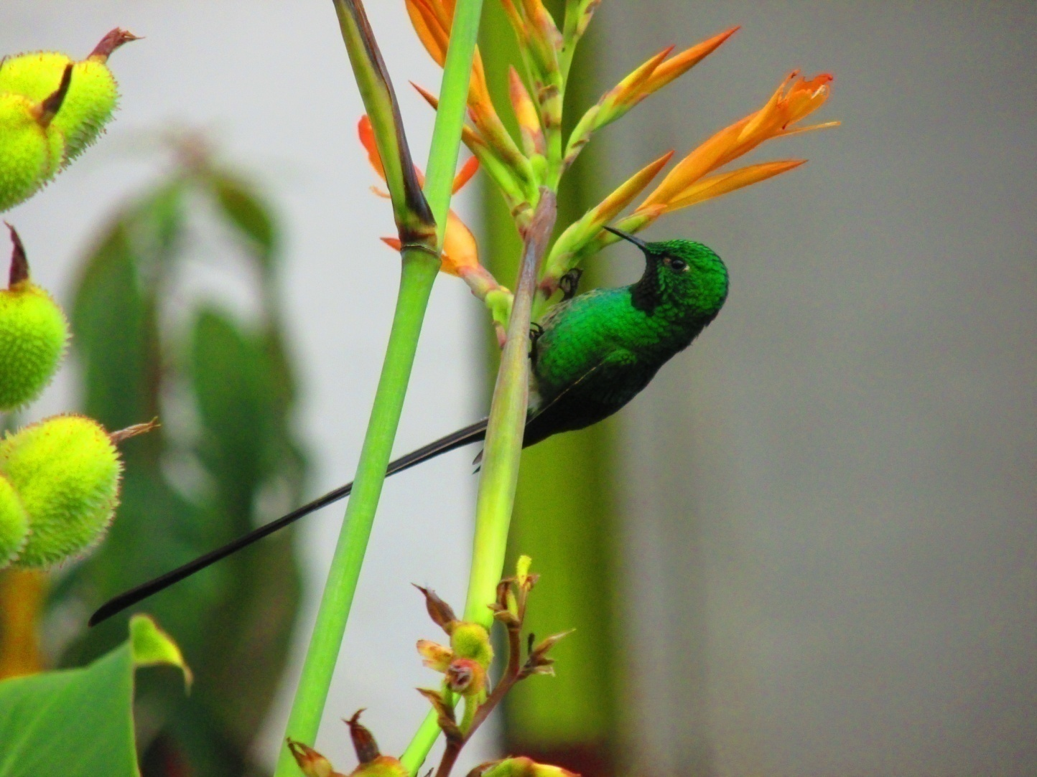
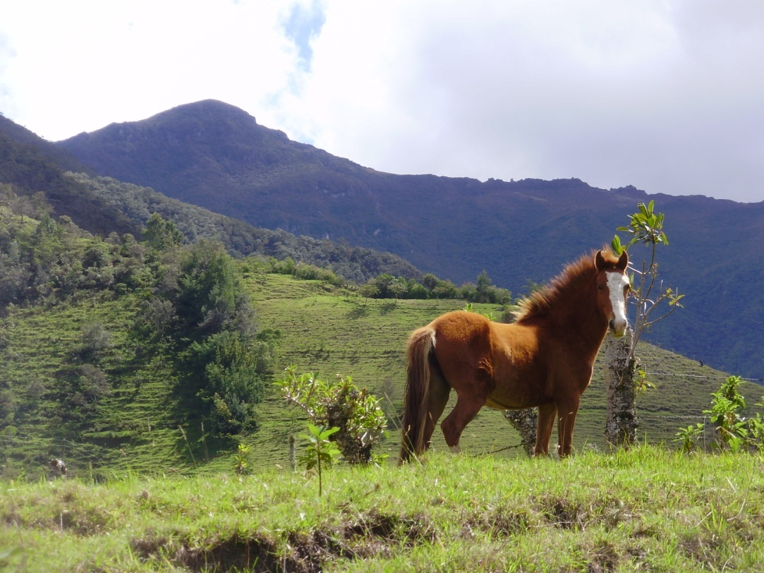
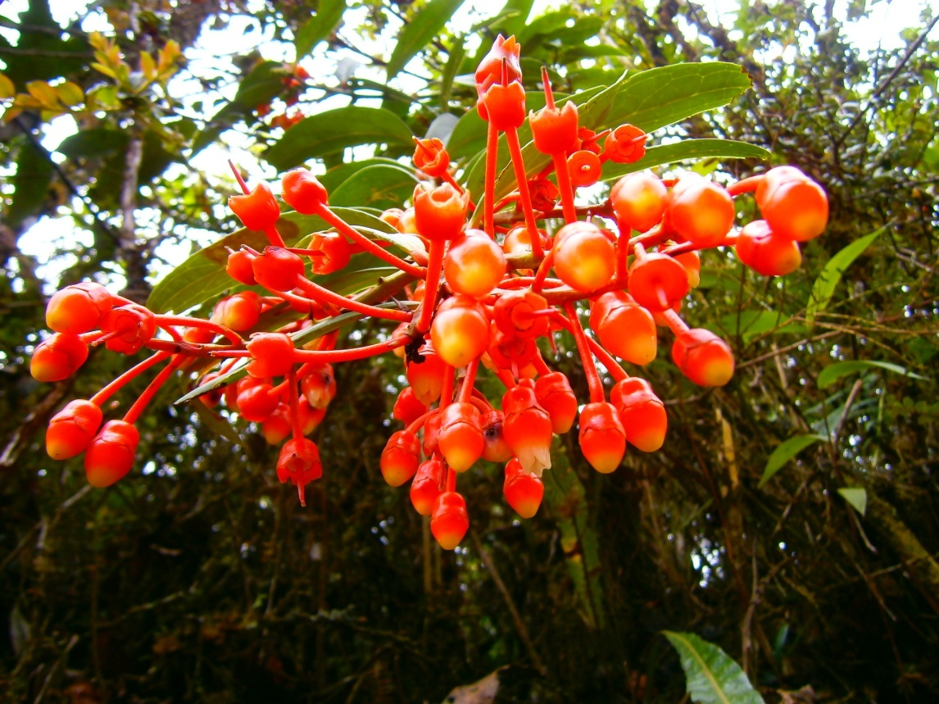
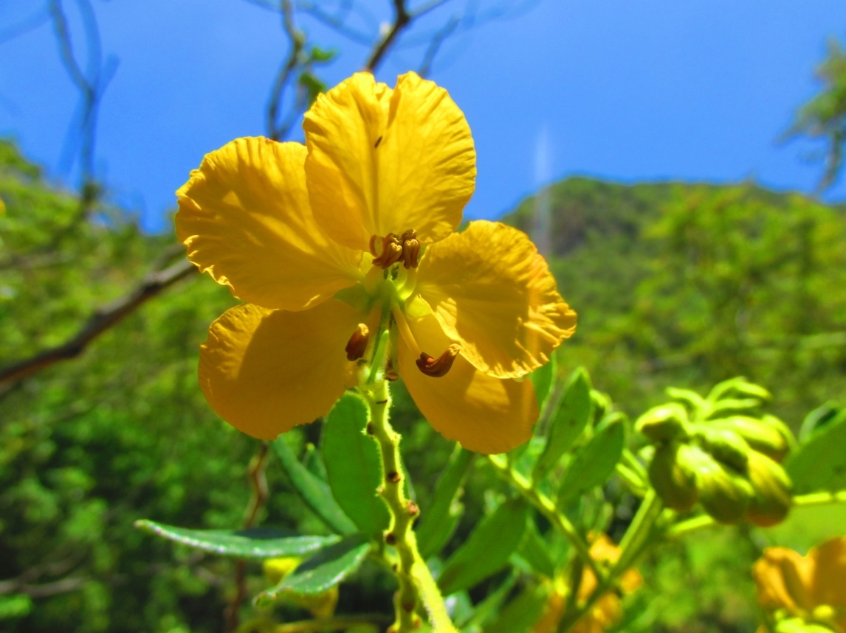
…its animals and plants

Slide 12
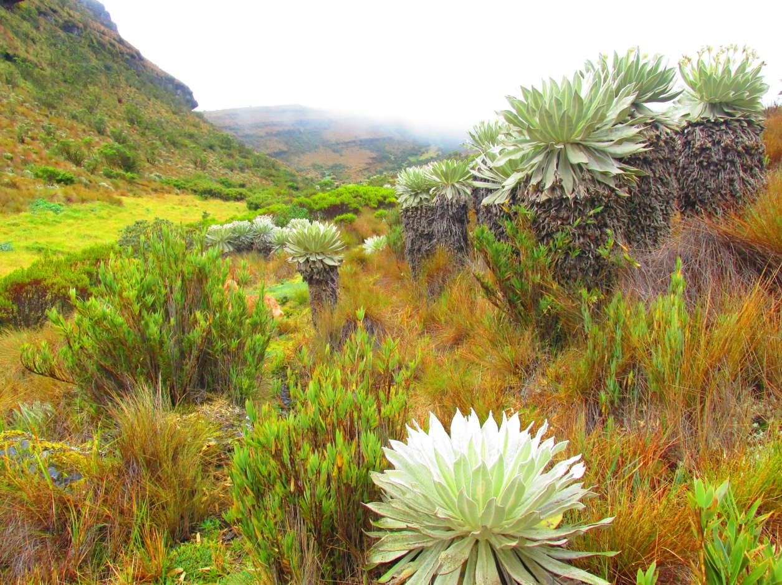
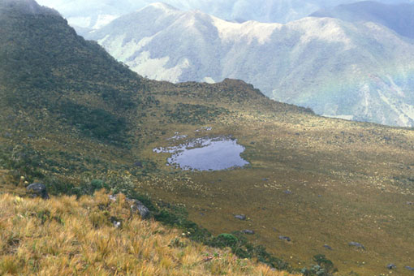
Páramos:
Alpine tundra ecosystems.
Altitudes vary from 3000–4800 m. Areas of marshes, high-mountain plains and lakes.
High rainfall and big temperature differences.
Local tribes connect the area of páramos with KansrӨ, the realm of the dead.

Slide 13
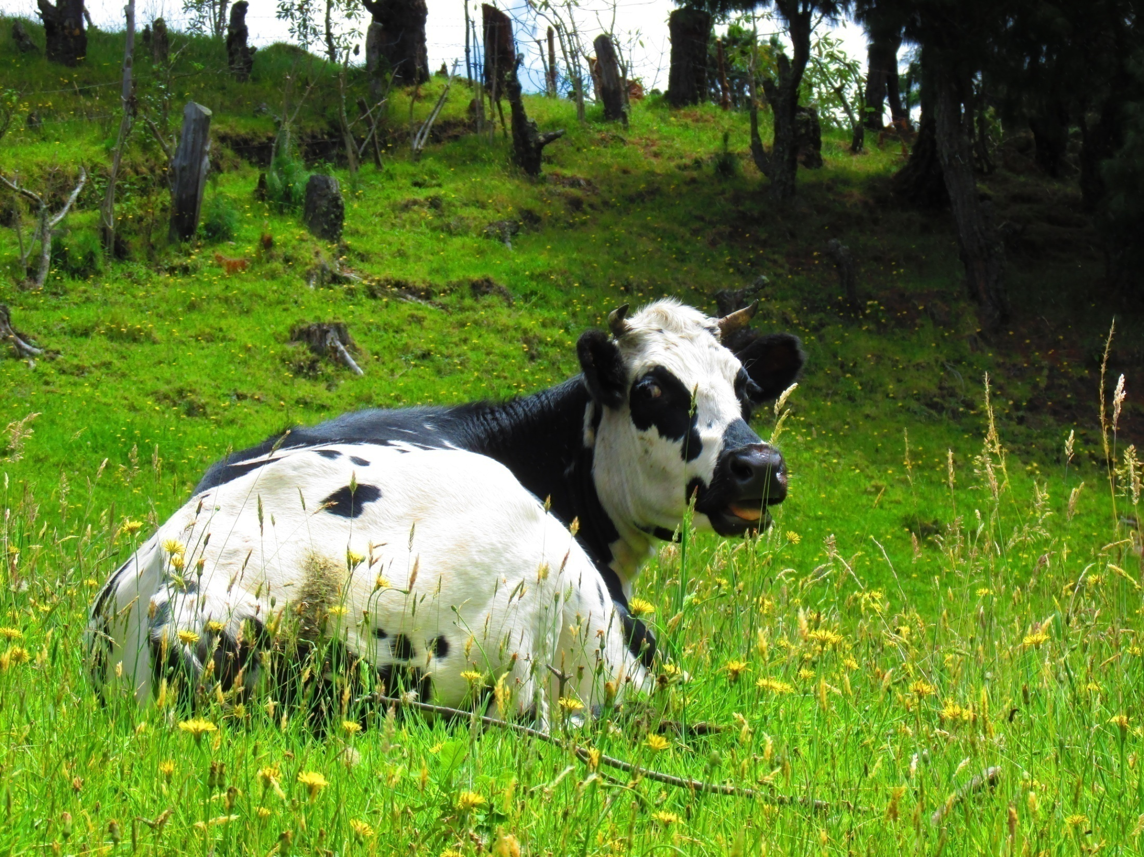
… and verdant lowlands…

Slide 14
Tribes in North East Cauca (“Mother of forests”):
Misak (Guambianos)- language namuy wam (“our language”) or namtrik, population about 20 000 people. They call themselves piurek “children of water”.
Nasa (Paeces)- language nasa yuwe- isolated language, population about 180 000 people.
Coconuco – about 6000 people living in the National Natural Park Puracé .
The languages are of so called Barbacoan family spoken in Colombia and Ecuador.
Probably distantly related to Chibcha languages.

Slide 15
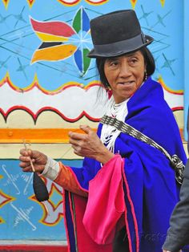
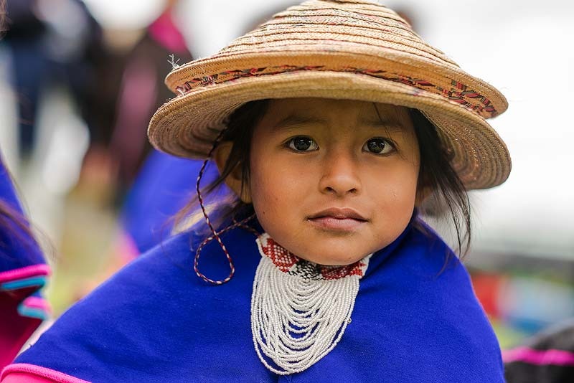
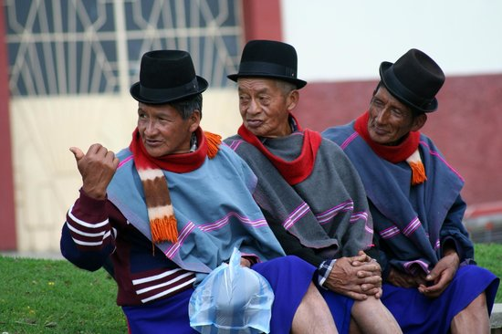
People of the Misak tribe

Slide 16
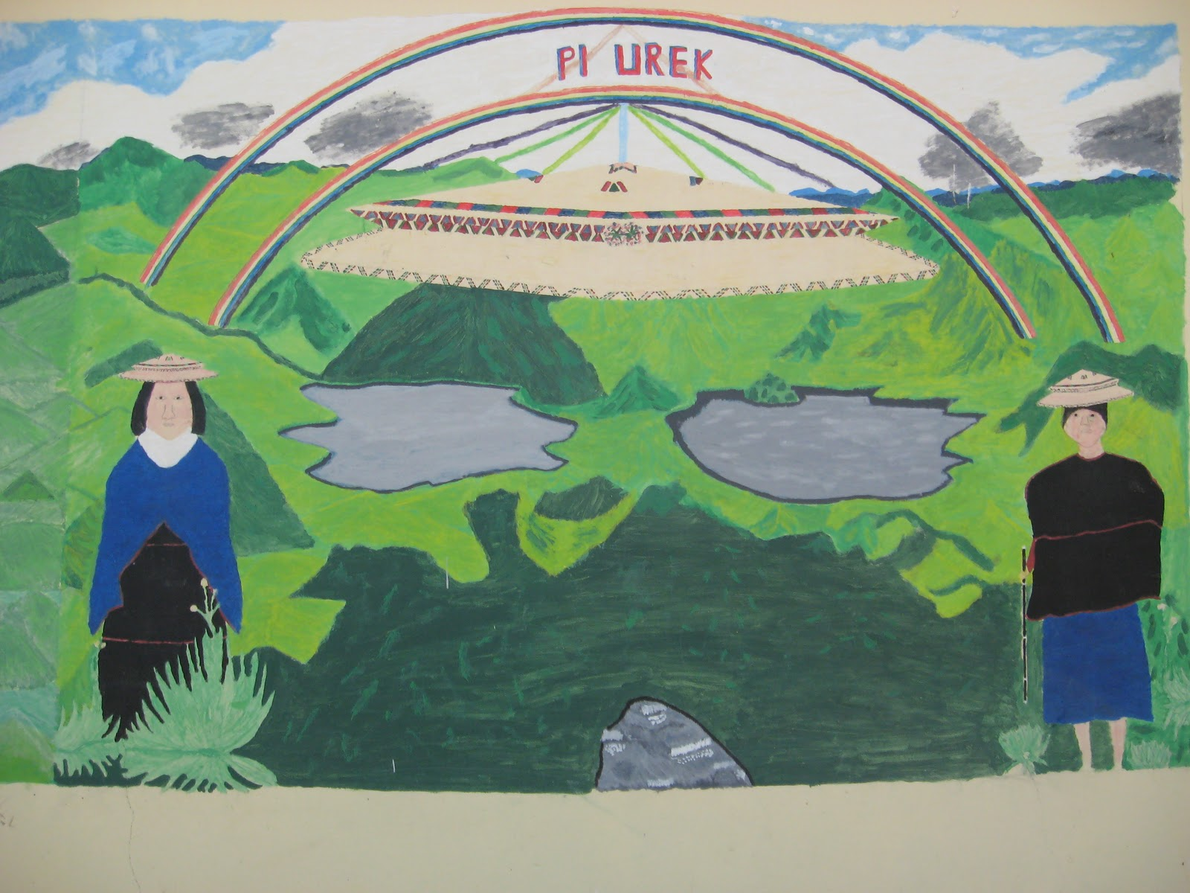
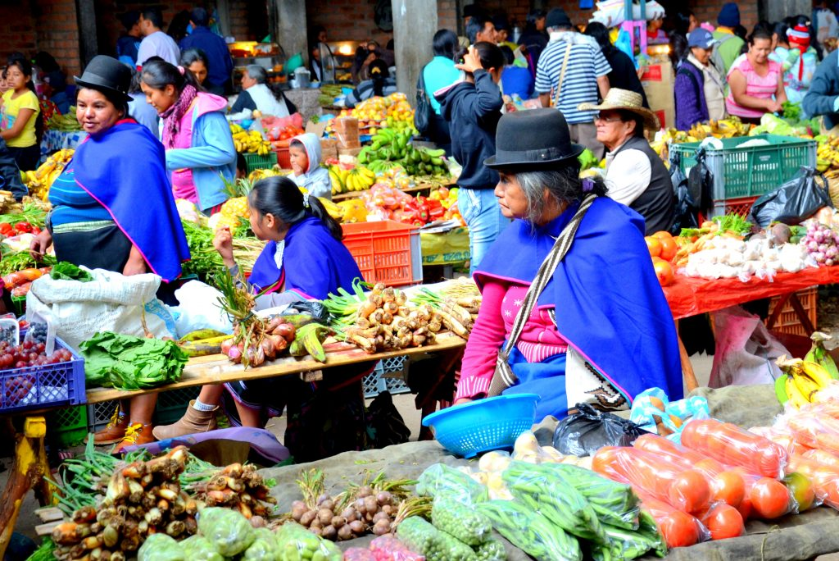
Misak call themselves Pi Urek “children of water”

Slide 17
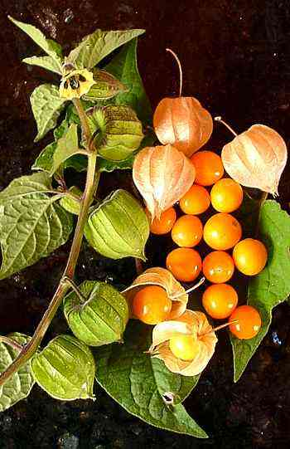
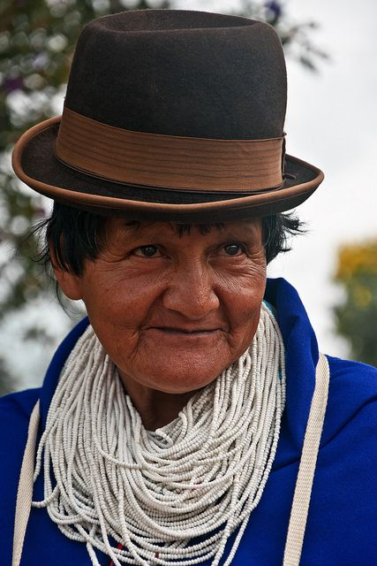
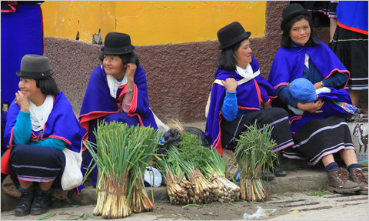
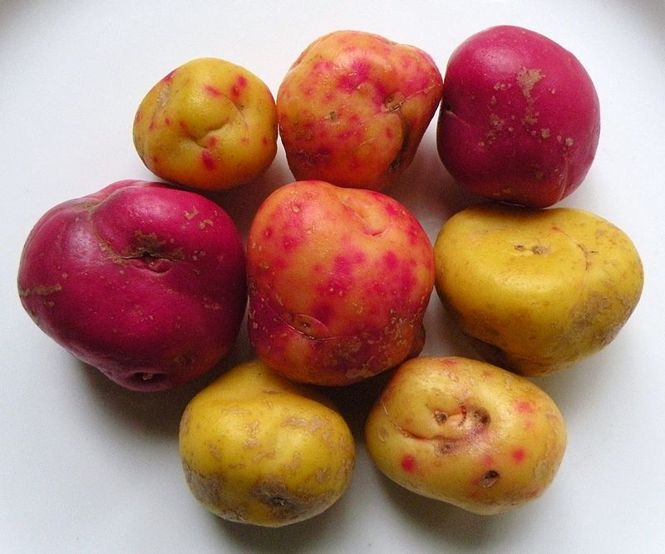
Misaks economy is based on agriculture, farming, cattle raising, and trout farms. They mostly produce coffee, maize, cassava, physalis, potatoes, olluco (ullucus), beans, onion and cabbage .

Slide 18
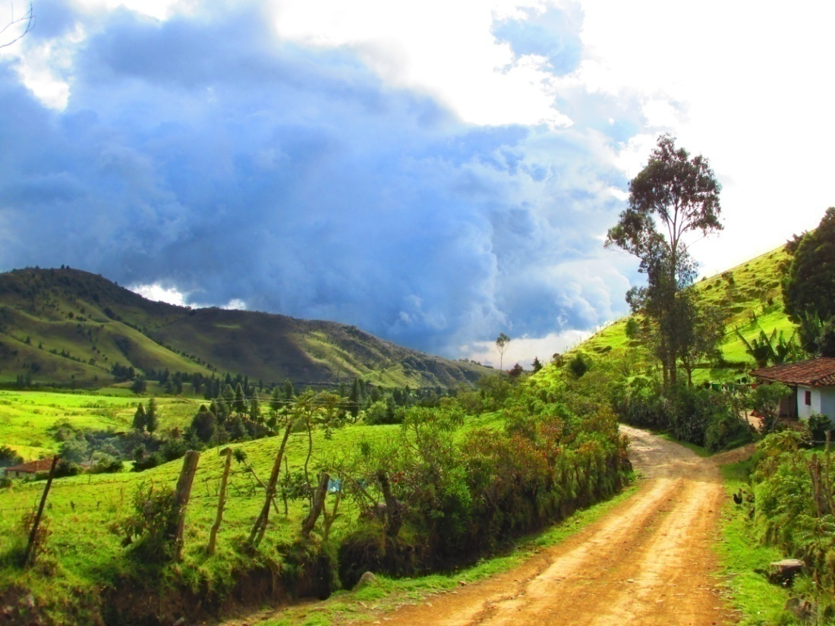
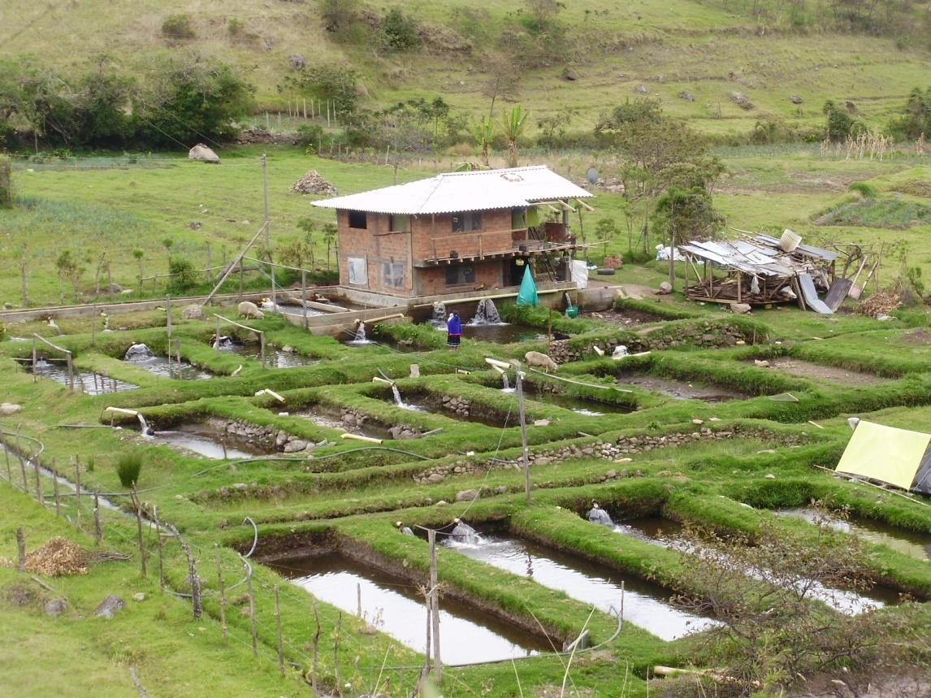
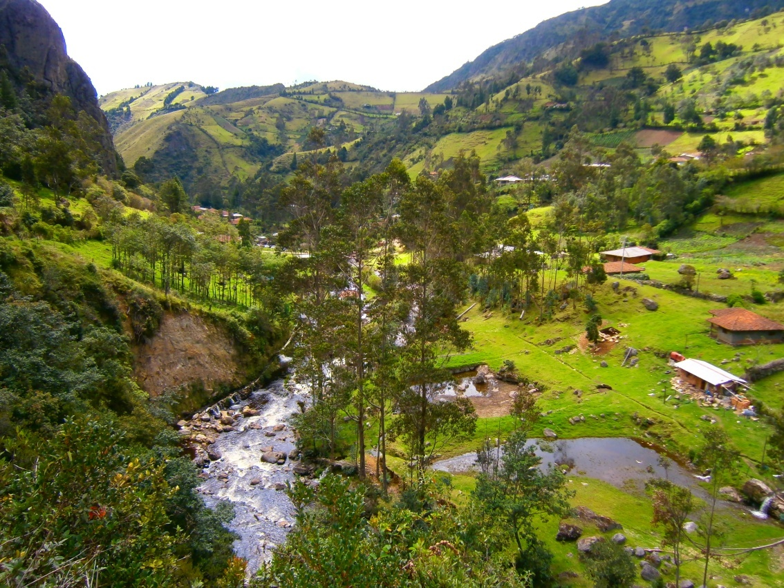
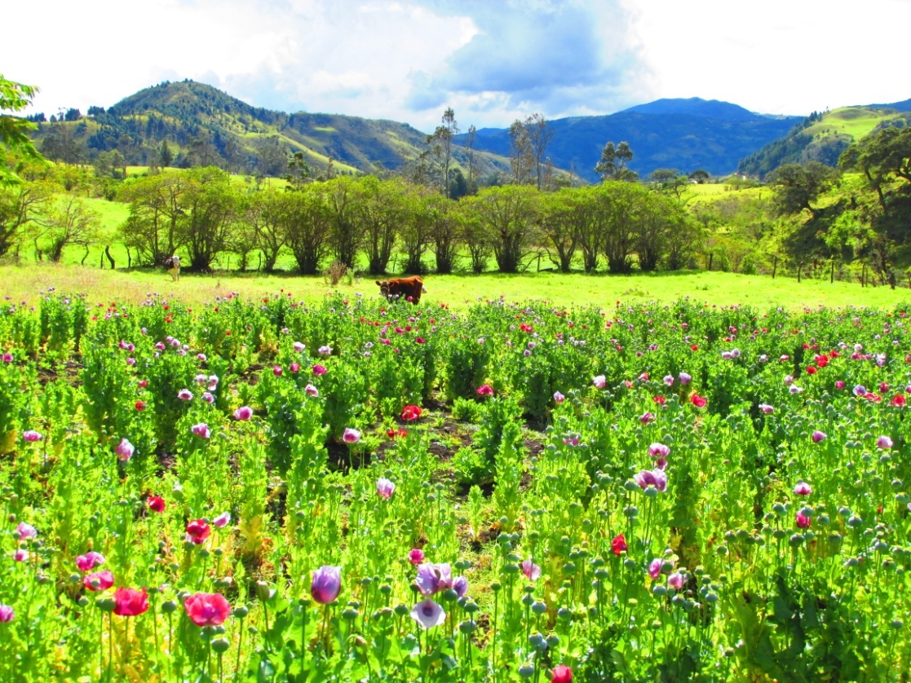

Slide 19
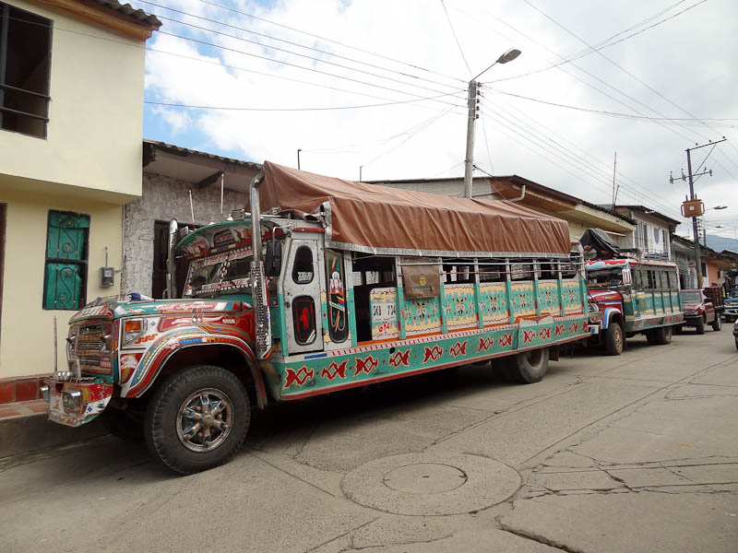
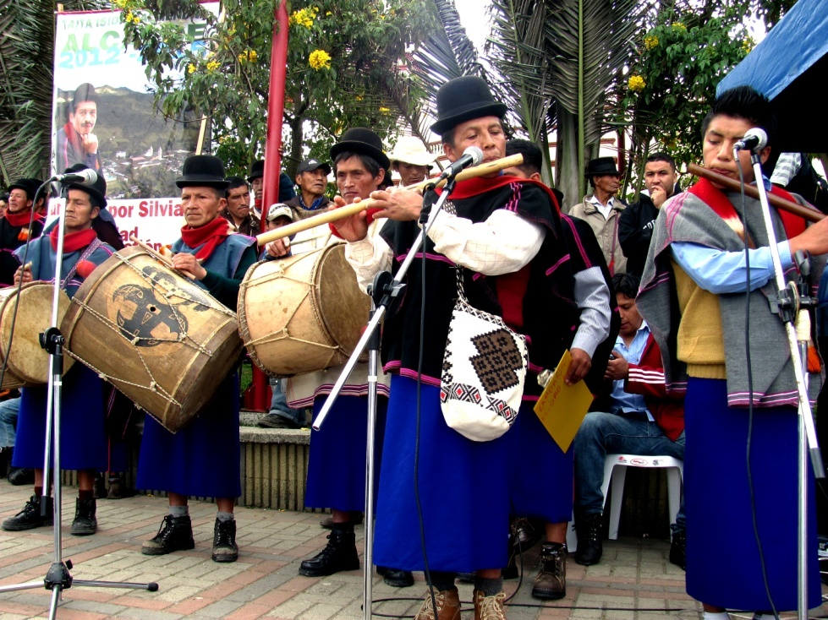

Slide 20
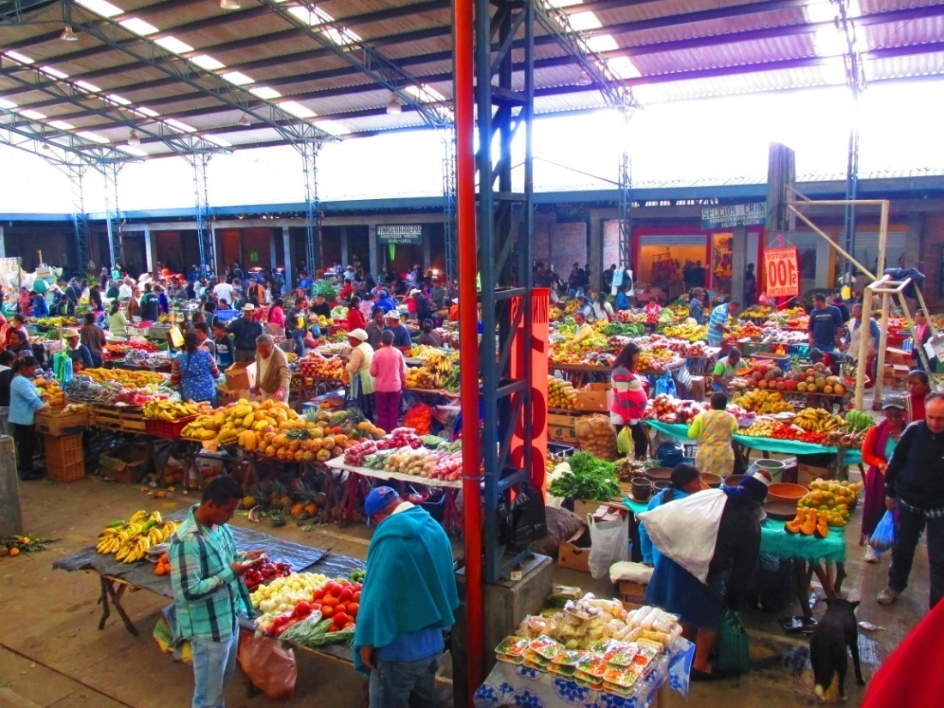
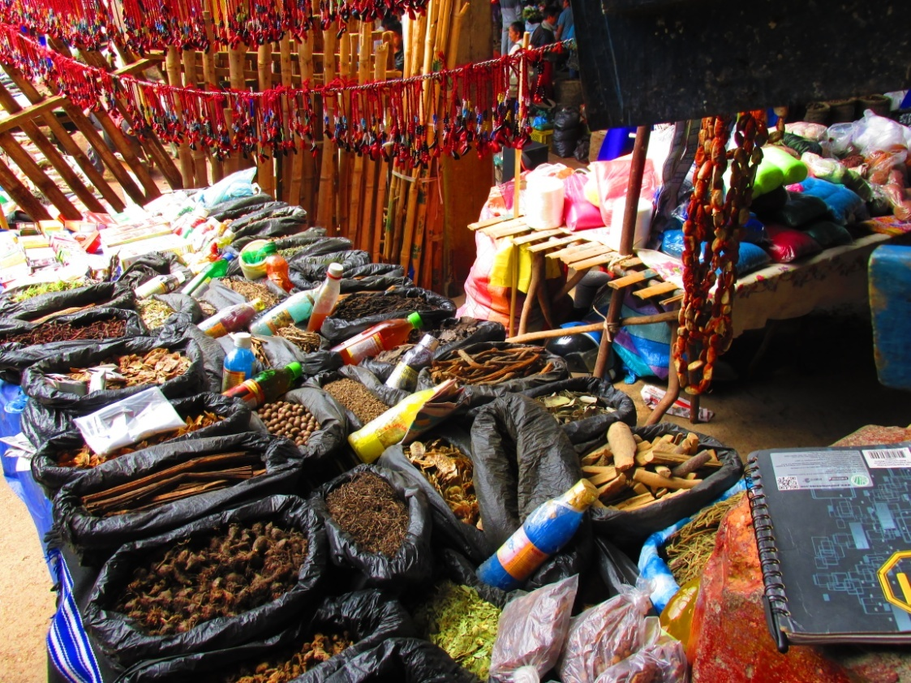
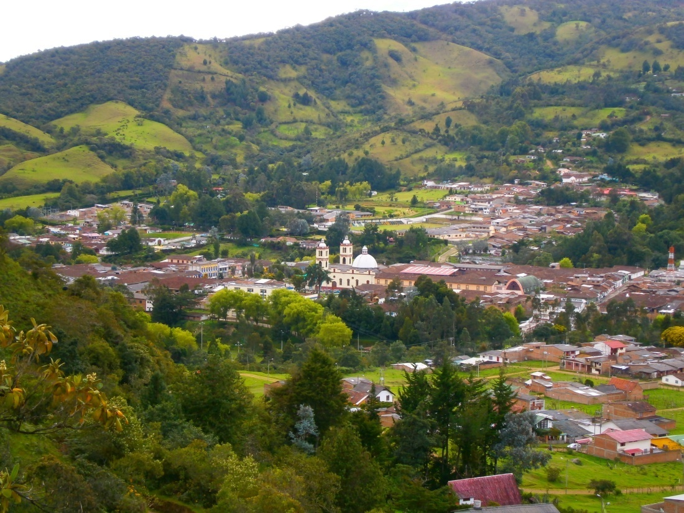
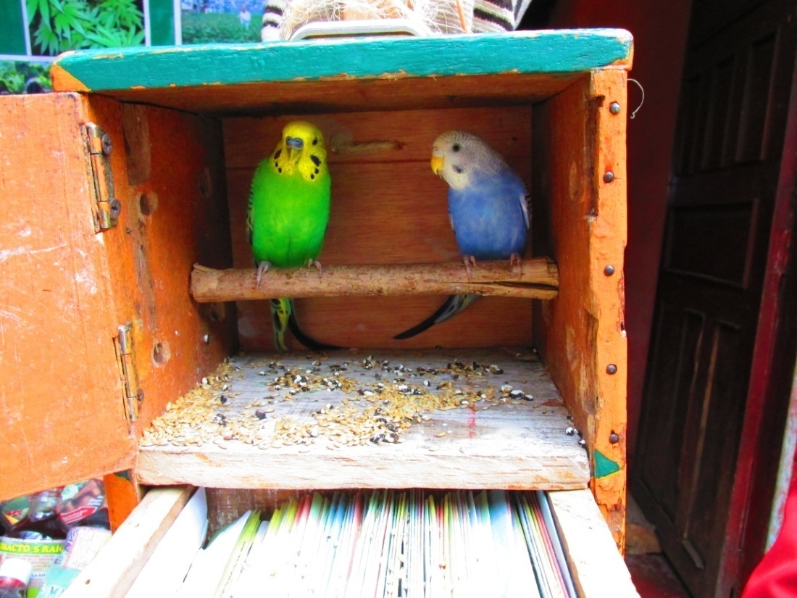

Slide 21
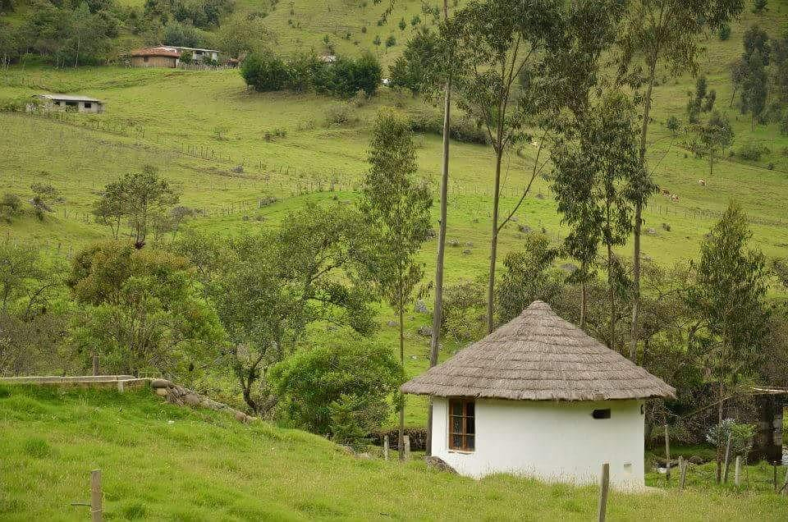
Traditional house should have a round shape.

Slide 22
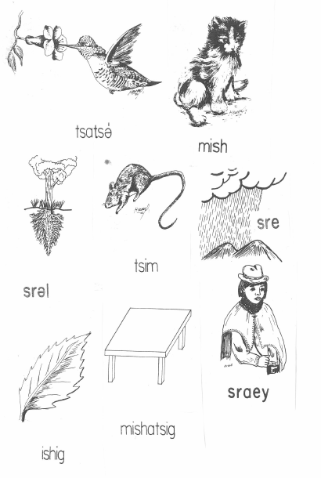
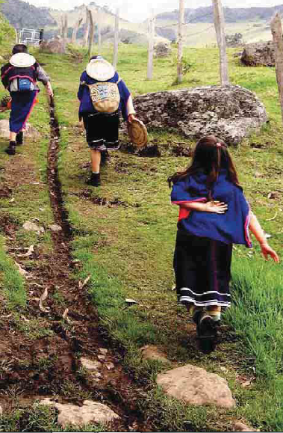
Example from children`s textbook.
How do you say a cat in namuy wam (Namtrik)?

Slide 23
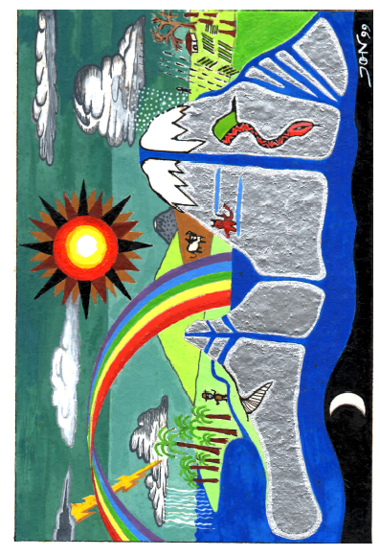
We will study their cosmology from texts and pictures
The way they see the
world, its creation, and the
way life and time unfold…

Slide 24
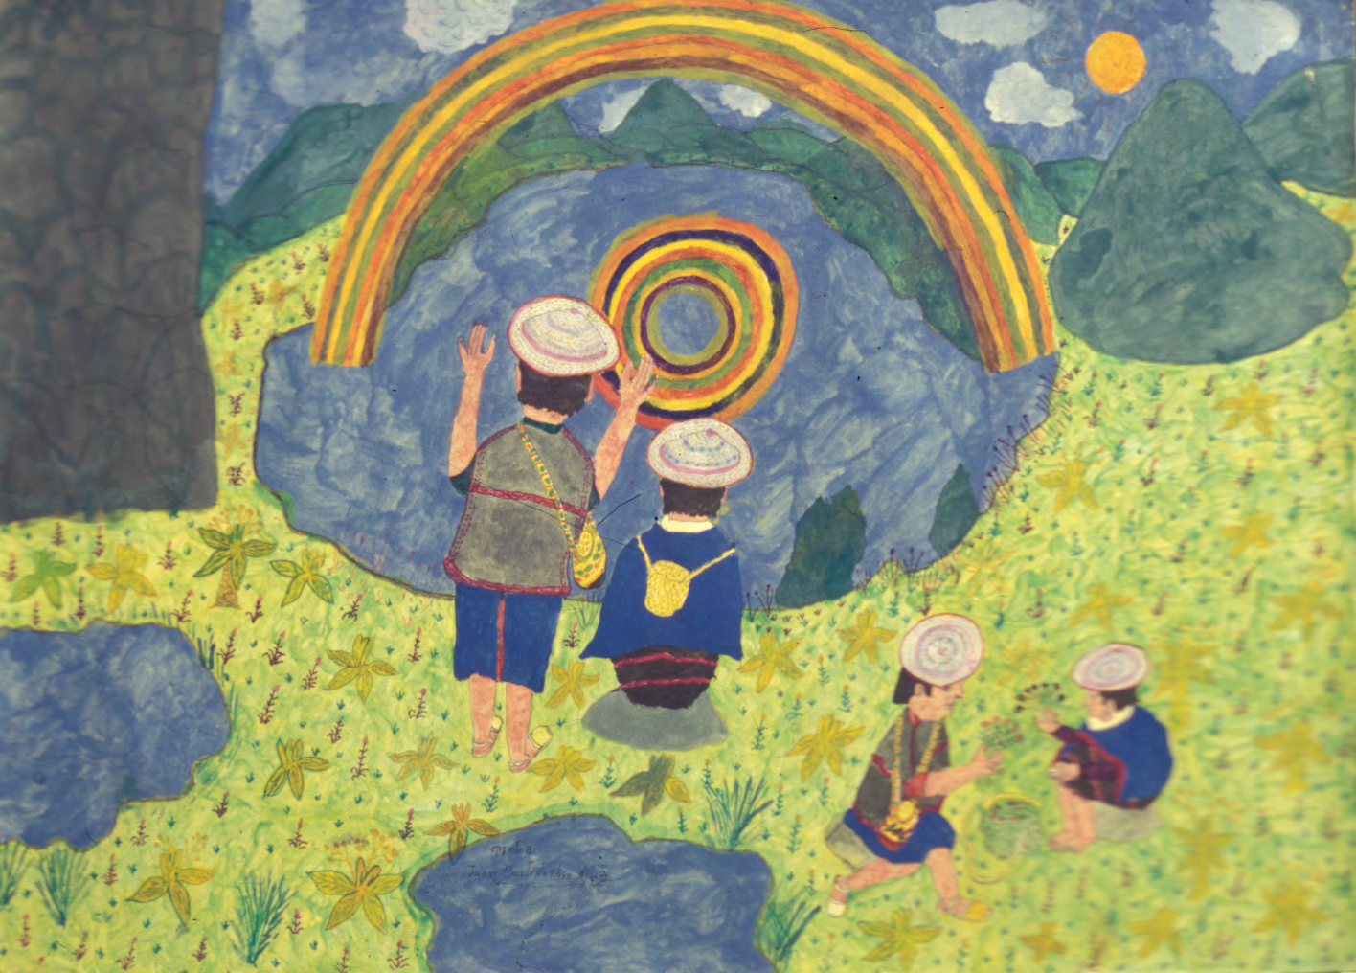
Picture by taita Juan Bautista Ussa Ulluné
Let`s start our journey into their spiritual world…

Slide 25
Materials:
Abelino Aranda, Luis Guillermo Vasco Uribe, Hijos del Aroiris y del Agua, 2015,
Universidad Nacional de Colombia, Colombia.
Hugo Portela Guarín, El Pensamiento de las Aguas de las Montañas (Coconucos, Guambianos, Paeces, Yanaconas), 2000, Universidad del Cauca, Popayán, Colombia.
Judy Branks and Juan Bautista Sánchez, The Drama of Life (A Study of Life Cycle Customs Among the Guambiano Colombia, South America), 1978, 2011, SIL International, USA.
Walter Krickeberg, Mitos y Leyendas de los Aztecas, Incas, Mayas y Muiscas, 1971, México.
Tulio Rojas Curieux, Adonías Perdomo Dizú, Martha Helena Corrales Carvajal, Una Mirada al Habla Nasa Yuwe de Novirao, 2009, Universidad del Cauca, Colombia.
Mario García Isaza, Gramática Páez, 1996, Prefectura Apostólica de Tierradentro, Belalcázar, Cauca, Colombia.
Lilia Triviño, Bárbara Muelas y equipo colaborador, Gramática Pedagógica de la Lengua Namtrik para Maestros Misak, 2011, Universidad del Cauca, Cali, Colombia.

Slide 26
Gregorio Alberto Yalanda Muelas, Relación entre la Música Tradicional y el Ciclo de Vida de los Misak, 2013, Observatorio del Patrimonio Cultural y Arqueológico OPCA.
Grupo Linguistico de Guambía, Wabia MisaabirӨ, 1986, Popayán, Colombia.
Beatriz Vasquez de Ruiz, Lenguas Aborigenes de Colombia, Descripciones 2, La predicacion en Guambiano, 1988, Universidad de los Andes, Bogotá.
David Lorente Fernández, El «frío» y el «calor» en el sistema médico nahua de la Sierra de Texcoco. Una aproximación. Revista Española de Antropología Americana. 2012, vol. 42, núm. 1, 243-266.
Víctor Bascopé Caero, El Sentido de la Muerte em la Cosmovisión Andina: El Caso de los Valles Andinos de Cochabamba, 2000, Cochabamba, Bolivia.
Léxico de la Lengua Namtrik de Totoró, Comunidad del Resguardo Indígena de Totoró.
Primera edición. 2009. Totoró. Colombia. Lilia Triviño Garzón, Algunas particularidades de los verbos de posición en la lengua guambiana, 2004-2005, Universidad del Cauca.

Slide 27
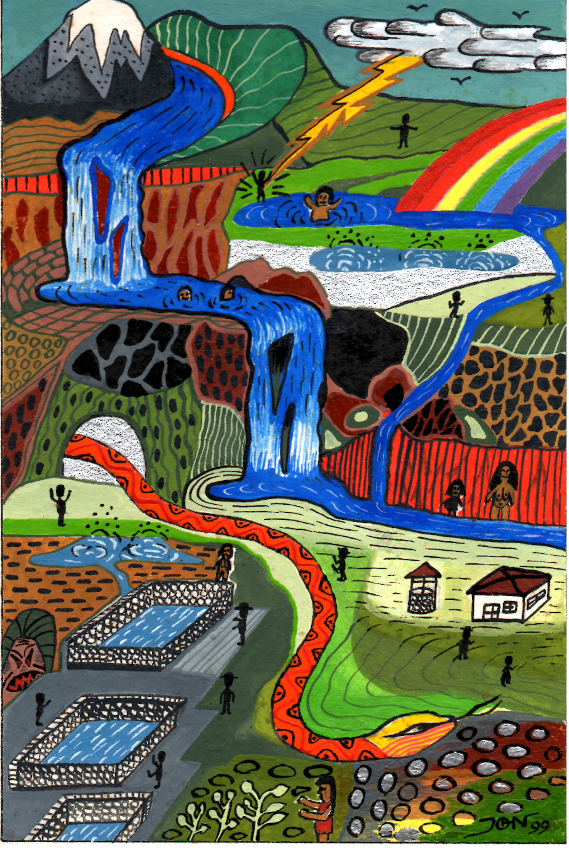
In case you want more…

