Slide 1
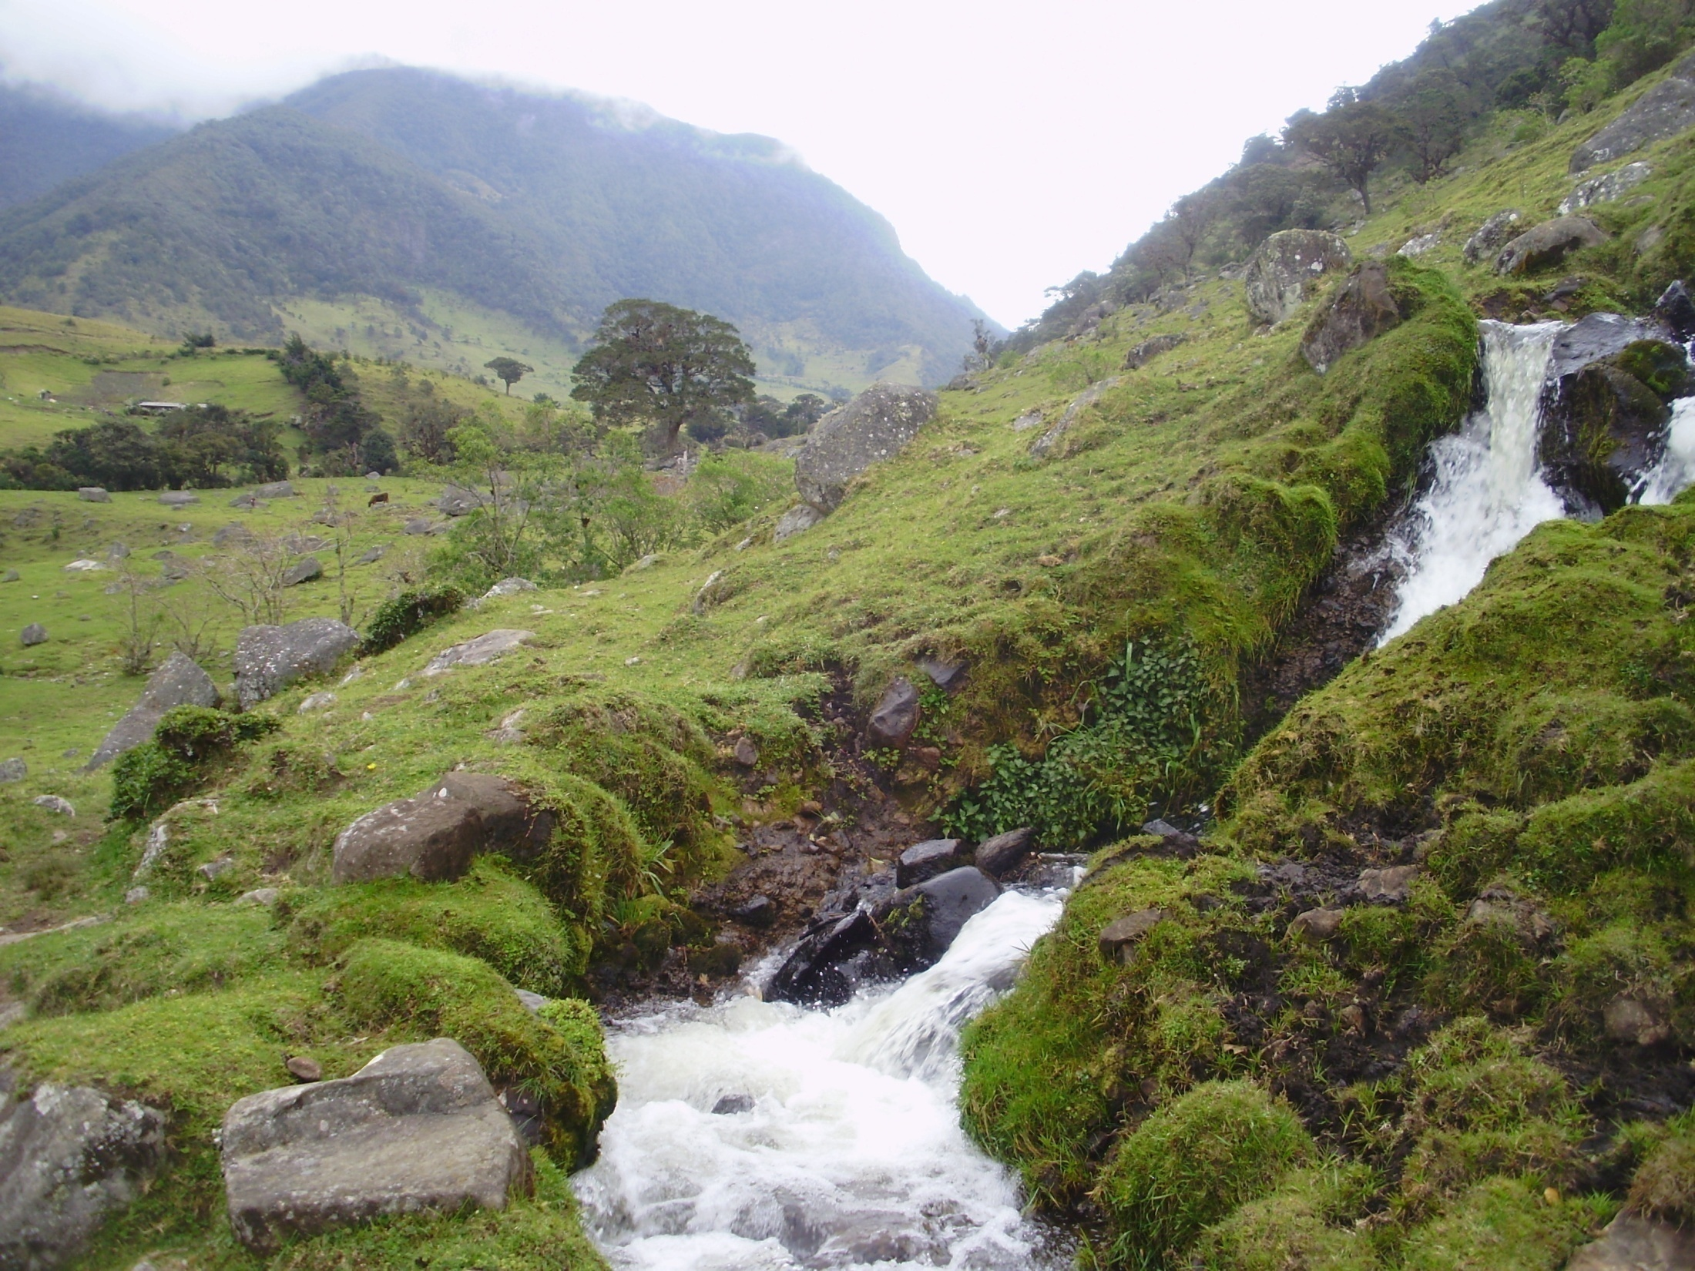
Children of Water: water cycle, creatures of water and the story of Rainbow Serpent
Lucie Vinsova, Masaryk University Brno

Slide 2
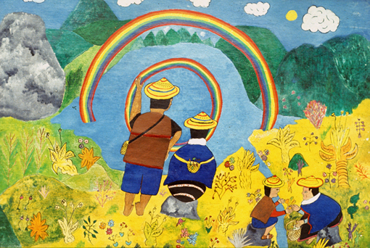
Misaks call themselves Pi Urek: Children of water

Slide 3
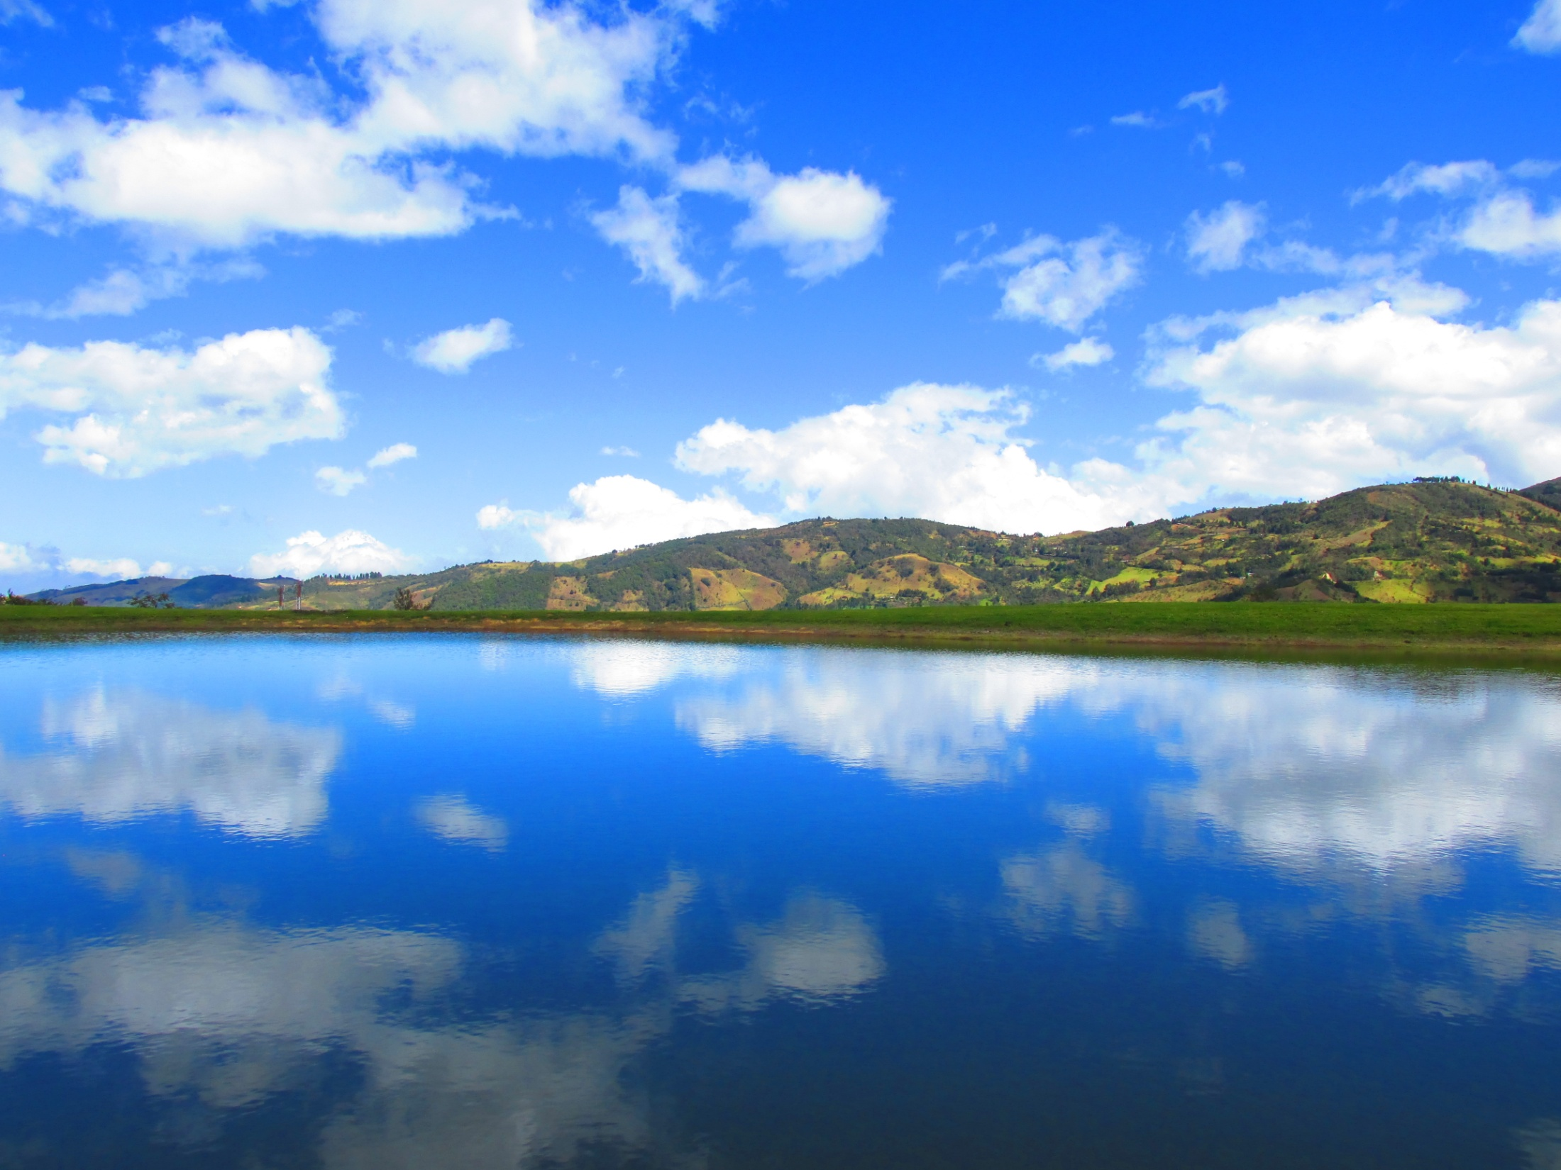
“La historia guambiana es una historia de agua. Nace muy alto de los páramos y de Pishimisak y baja hasta llegar al valle.”
“…Nosotros existimos por el agua… que ella, si se va, vuelve a estar con nosotros… ella es eterna y quiere que existamos”

Slide 4
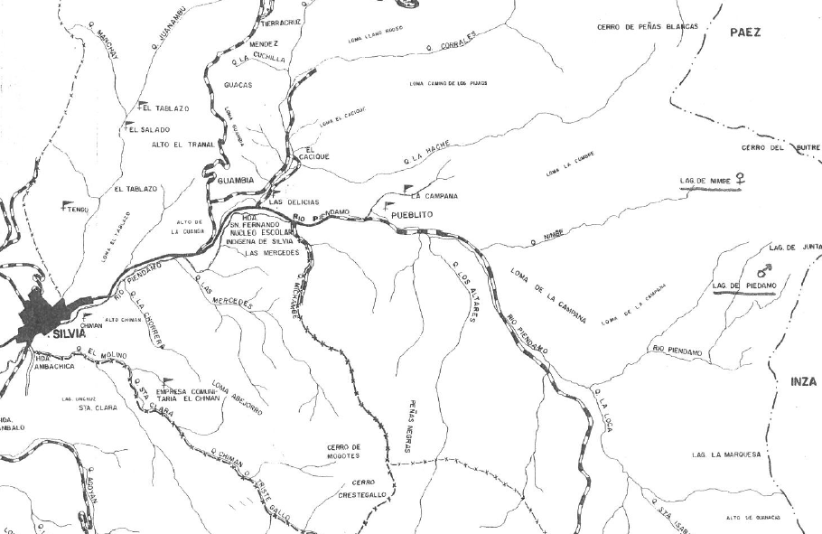

Slide 5

Misaks believe that they are the original inhabitants of Cauca (identifying the legendary Pishau as their direct ancestors).
At the beginning , there was the land and two great lakes- Nupisu (the female lake where the river Piendamó flows from) and Nupirrapu (a male lake).
Water isn`t good or bad, but results in things that might be good or bad.
The tribes of Cauca knows about the full water cycle and uses its parts in their mythology.
Sometimes the water in the inner world bursts into the surface of our world and brings prodigies- important chieftains and teachers of the tribes. They say this water smelt like blood and compare it to the blood that accompanies childbirth.

Slide 7
Papθ
It literary means “contamination” and is most commonly associated with menstruation blood and its colour. It also refers at certain times to the colour of water in the river Piendamo.
Papθ is present in death and birth and menstruation period. There are many restrictions for women while they have their periods (they can`t take parts in so called refrescos, can`t enter sacred places and some of the restrictions must be observed also by the members of her family).
This is not because there would be anything bad about menstruation itself, but they say that this Papθ is of a very hot essence and it is balanced in the body of the woman by a very cold essence, which would interfere with the balance that the ritual of refresco wants to establish. Paramos and scared places have the very same essence and that is why they can be harmful and cause misbalance (illness) in these cases.
Papθ can be cleansed by a shaman. Also bathing and certain herbs are said to have cleansing properties.
Papθ attracts many malevolent spirits and their manifestations like duendes, sierpi, trero and can make the attacks of the arco iris very severe.

Slide 8
In this way, human body (health), the environment (sacred places, lakes, paramos), kansrθ (the realm of the dead) and the universe are all based on the same principle of the equilibrium between the cold and the hot.
For Nasas (Paez) this contamination is called ptanz and represents a common threat to people and the environment alike.

Slide 9
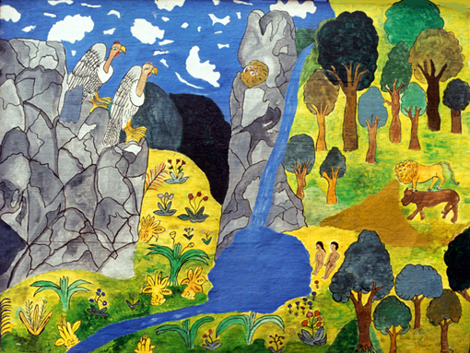
Pishimisak
Pi: water
Pishi: cold
Misak: person
Pishimisak: the great original spirit which inhabits the area of the páramos and sacred lakes.
Its essence is half male and half female (in some versions Kallim (the male spirit of rain and mama Chuminga, the female principle, in other versions it is mama Dominga living on the left side and taita Ciro living on the right side).
The forms of Pishimisak (storm, thunder, old man), its role in the initiation of a new shaman, its house: La casa de maíz, the owner of all the resources, the guardian of the mountains etc.

Slide 10
Creatures strongly attracted to el papθ
Duende
A manifestation of Pishimisak (sometimes only a spirit which lives in the paramos), connected to the element of water and the rainbow. Usually mischievous and playful (throws twigs and stones at people, plays the flute), but can be also dangerous (causes illnesses to small children, seduces young women when they go to the mountains etc).
Sierpi
Also lives in the marshes and swamps. It usually looks like an ul Nam. “snake”, but can take upon itself a form of a young woman or a young man (depends who it wants to seduce). It impregnates women with its children and causes illnesses to men. Sierpi is also in charge of some medicinal and poisonous plants.
Trero
A creature which looks like a huge brown moth with eyes on its wings. It comes at night into a household where somebody has recently died.

Slide 11
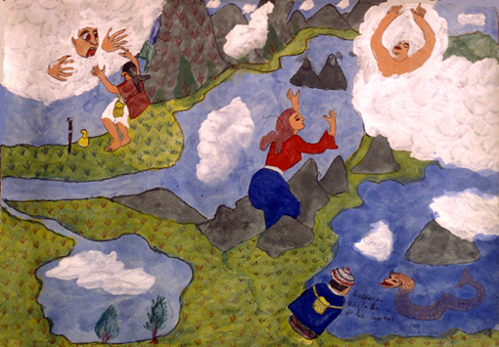

Slide 12
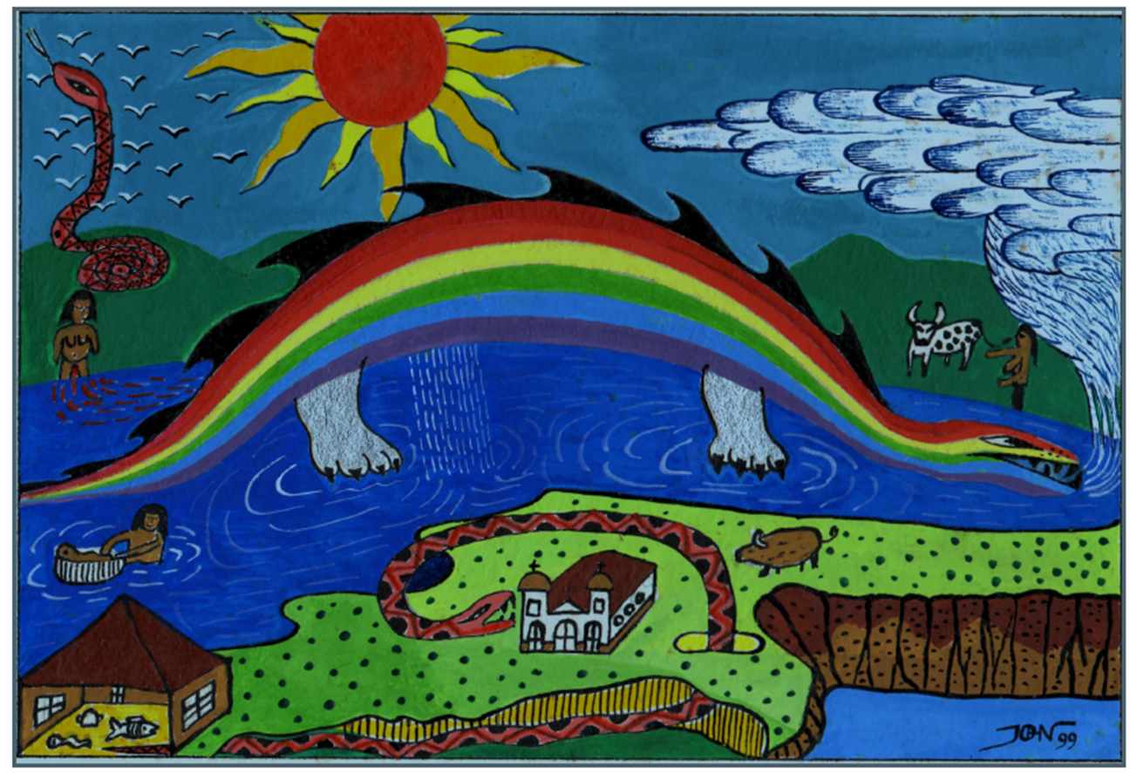
ARCOIRIS KƏSRƏMPƏTƏ (Nam. “aroiris”) (Nam. Kəsrəm “páramo”, pətə “circle”)
Rainbow forms a whole circle with its other half underneath the ground. It was born of water and is one of the original páramo spirits. It can be dangerous to people, cause illnesses and miscarriages. There is a male and a female rainbow.

Slide 13
TYPES OF WATER AND WOMEN`S FERTILITY
There are two main types of water - still (lakes, underground lakes) and running (streams and rivers). They are directly linked to the women`s cycle and fertility.
Lakes- represent the still waters which support a growing life. They are sacred sites where ancestors and the most powerful spirits dwell (the Thunder and the Rainbow). For the Kogi, the lakes are the “wombs of the Mother”.
Streams and rivers are the running waters which represent the birth (exceptional chieftains) or menstruation (river Piendamó). Running water has different colours and textures which depend on the time of the day and the season. For Kogi, running water (and gold) also represents the Earth`s menstrual blood. Water is the symbol of Life and Death (ad Misaks).
Daily routines (especially in the case of women) are observed in accordance of these beliefs.

Slide 14
WATER CYCLE AND CONNECTED RITUALS
“… Water is life. It is born in the springs and flows down in rivers towards the sea. And it comes back, only not in the same rivers, but in the air, in clouds… then it falls again as rain. The water which is good and bad falls down again…”
Sources of water (springs and lakes)- páramos where water comes from is a “sacred land” and only shamans have access to certain sites (Kogi, Misak). Lakes and springs are linked to the birth of all living beings and special prodigies. There are many rituals connected to sacred lakes- cleansing rituals, summoning the rain, initiation of shamans, etc.
Rivers and streams (Kogi) rivers and streams are veins of the world. The water currents running down the rivers are seen as a baby which is being carried by the river down into the valley and it`s laughing.
The river Piendamó represents the axis of the world (territory). In the same way, in each person, the axis goes through the centre of the body. This is used in healing rituals (Nasa and Misak). Rivers are of an unpredictable nature (it is important to observe their colours and sounds).

Slide 15
Sea is seem as a crucial stage in the water cycle. (Kogi) the Mother was at the beginning identified with the ocean. The salty sea water is the amniotic fluid of the Earth.
Sea shells play an important role in Misak and Kogi rituals (Misak and Nasa - ritual of connecting the waters of the female Lake with the sea water brought in a seashell to summon seasonal rains- we can observe a similar ritual in the Kogi communities for keeping the world in balance).
Coming back of the same water in forms of clouds and rain- important are colours and the types of rain as well as the direction it is coming from (signs for events connected to agriculture and to the general well-being of the community).

Slide 16
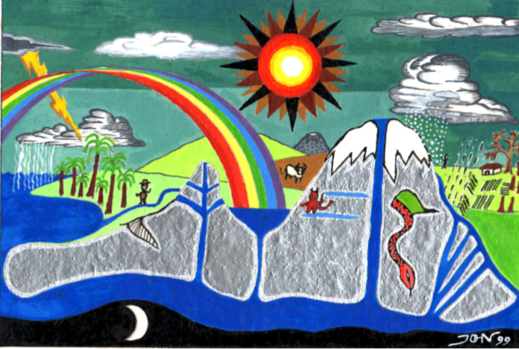
Water in all parts
Author: Jhon Ferney López Muñoz

Slide 17
