Slide 1
Poruchy autistického spektra
Katarína Kemková

Slide 2
Semináre každý týždeň
80% účasť na seminároch + 2 veľké domáce úlohy + malé domáce úlohy Pri online výučbe je účasť hodnotená na základe odovzdávania odpovedníkov do stanovených termínov (8 odpovedníkov aby ste boli pripustení ku kolokviu), ktoré sa budú venovať témam z prednášky a úlohám.
Záverečné kolokvium

Slide 3
Veľká úloha I
Esej na ľubovoľnú tému súvisiacu s PAS
1000 slov +/- 100
Termín odovzdania 13.12. 2020

Slide 4
Veľká úloha II
skupinová práca
téma “Zlepšenie života ľudí s PAS”
tabuľka skupín
poster + prezentácia (20 min.)
16.12.

Slide 5
Sylabus
základné poznatky o autizme
autistická triáda
senzorické abnormality a jazyk
vznik, komorbidita a poznatky z neurovied
diagnostika
teórie autizmu
intervencia
práca s kazuistikami
skupinové projekty

Slide 6
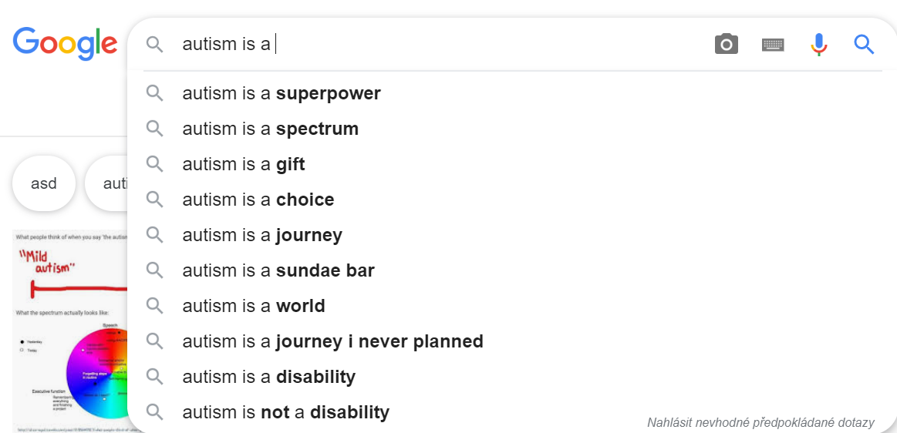
Čo je autizmus?...

Slide 7
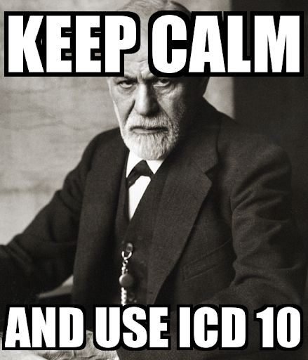
DSM-5 vs MKN-10 vs ICD-11

Slide 8
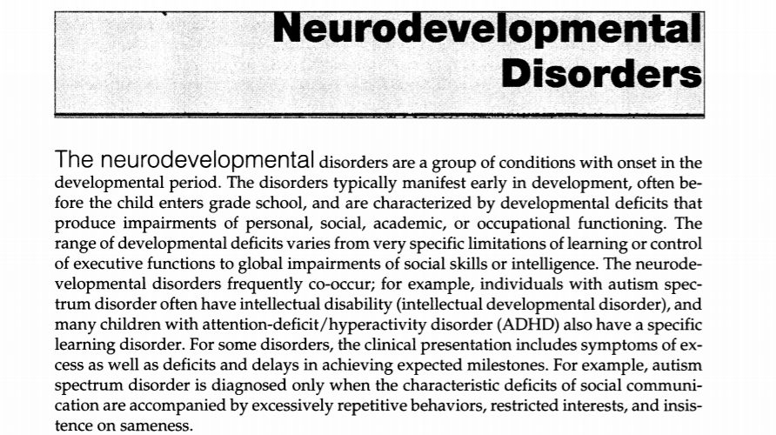

Slide 9
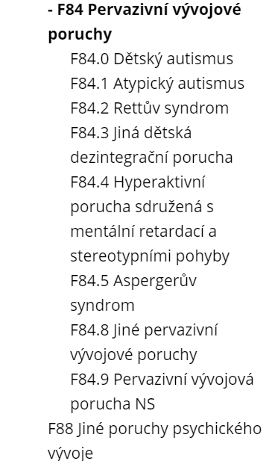
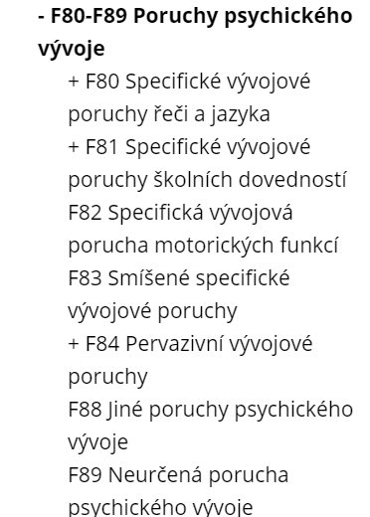
MKN-10

Slide 10
Definícia - DSM-5

Slide 11
MKN-10

Slide 12
ICD-11 - 6A02

Slide 13
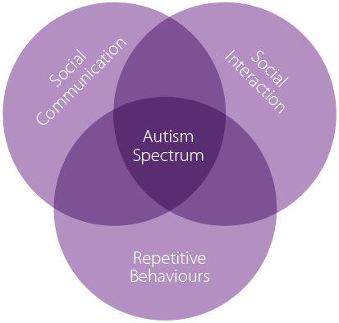

Slide 14
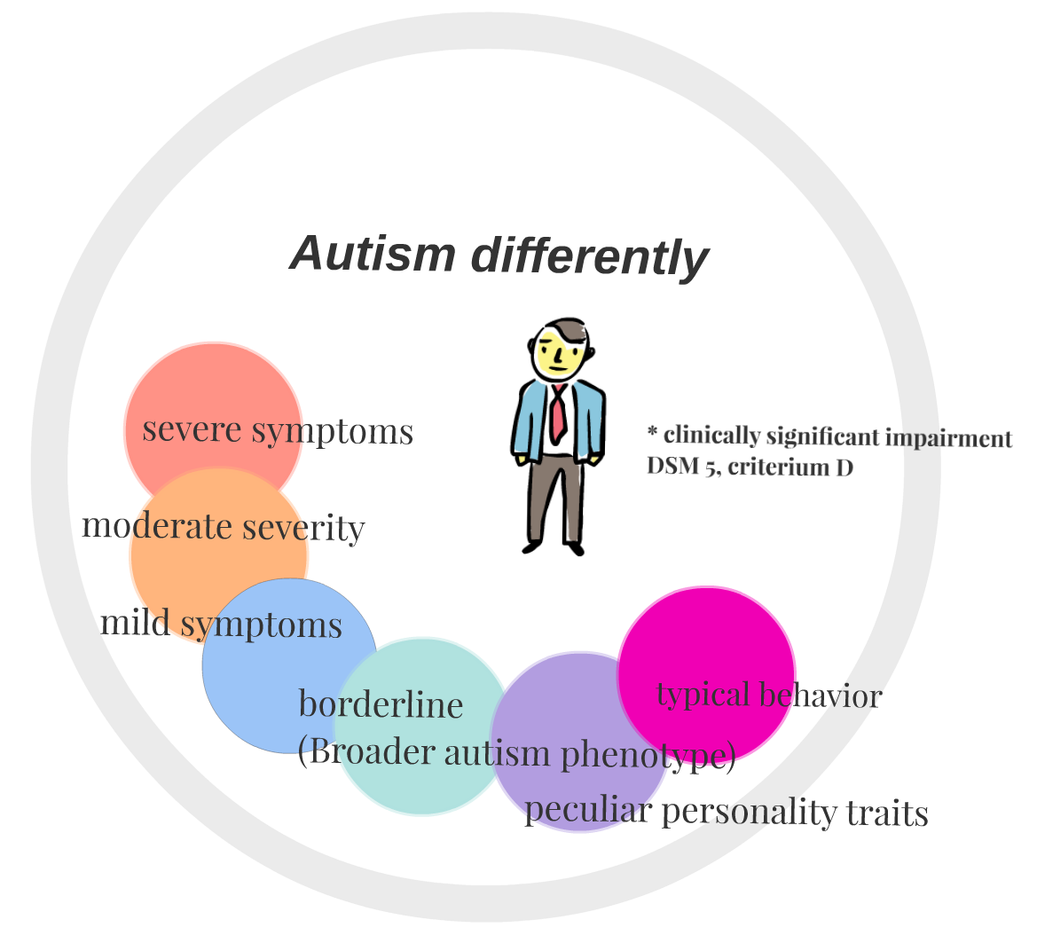

Slide 15
Štatistiky...
USA Rok 2000 - 1 zo 150
USA teraz - 1 z 54
Celosvetovo - 1 zo 160
ČR +1500 až 2000 detí ročne
chlapci 4x častejšie ako dievčatá

Slide 16
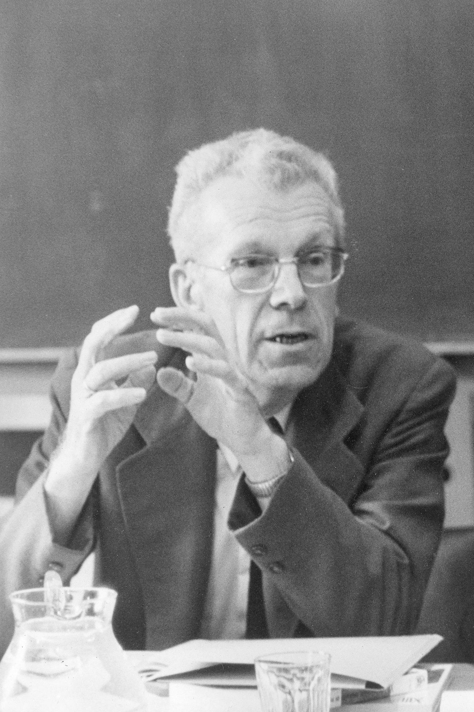
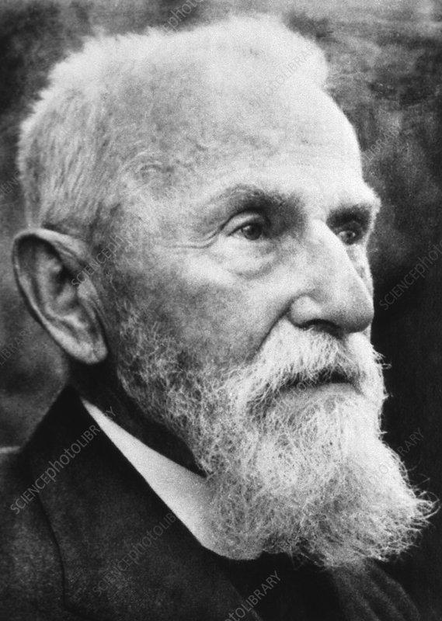
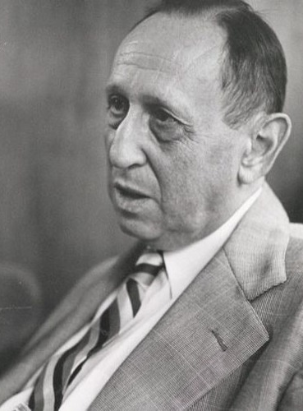
Eugene Bleuler Hans Asperger Leo Kanner

Slide 17
Leo Kanner
“Every child, every adult, everybody wants what I call the three As: affection, acceptance and approval. If the child has that, regardless of his IQ or anything else, he will be all right.”
“disorder of the mother–child relationship”
“extreme autistic aloneness”

Slide 18
“In his key 1943 paper, Kanner considered five features to be diagnostic: a profound lack of affective contact with other people; an anxiously obsessive desire for the preservation of sameness in the child’s routines and environment; a fascination with objects, which are handled with skill in fine motor movements; mutism or a kind of language that does not seem intended for interpersonal communication; good cognitive potential shown in feats of memory or skills on performance tests”

Slide 19
Hans Asperger
“Autistic psychopathy”
“It helped to be a little autistic if you wanted to do things well.”
“While the schizophrenic patient seems to show progressive loss of contact, the children we are discussing lack contact from the start.”
“We claim—not on theoretical grounds but from the experience of dealing with many children—that this boy’s positive and negative features are two naturally necessary, connected aspects of what is really a homogenously laid-out personality. We can also express this as follows: the difficulties which this boy experiences with himself, as well as with his relationship to the world, are the price he has to pay for his special gifts.”

Slide 20
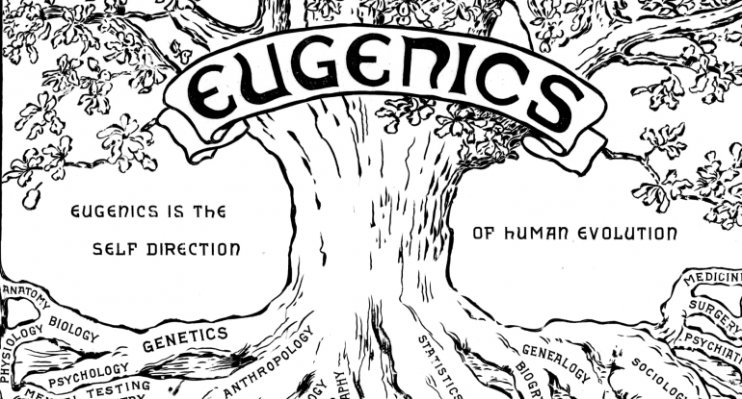
60.te roky
Bruno Bettelheim 1967 - The empty fortress: Infantile autism and the birth of self

Slide 21
60.te roky
In defense of mothers
National Autistic Society (UK)

Slide 22
Zdroje obrázkov:
https://cdn.clipart.email/e63024c7af7ff074dfa1f5a2a57d19ef_things-you-should-know-vol-5-how-to-change-a-tire_299-256.png
https://i1.sndcdn.com/artworks-000255451784-fsm3zi-t500x500.jpg
https://static01.nyt.com/images/2018/04/20/world/europe/20asperger/20asperger-superJumbo.jpg
https://i.pinimg.com/originals/49/54/d4/4954d41f6100ca6264e8a8fb20c5e3f7.jpg
https://img.universitystudent.org/1/4/3149/when-youre-the-only-one-contributing-to-a-group-project-meme.jpg
https://lh3.googleusercontent.com/proxy/dXVAO9OcNZLi0qnwvg-6AomPuqs7XNsRx4XqNupyauqMGx2XwF1OkocQtIgAoaxZrDN8itoRnPbPMpWRBYZlM66gmFHEzY4vjqWP-sGY2qsvs-9wWYuimveb9RT2
https://www.clinical-partners.co.uk/images/autism/triad-of-impairment.png
https://media.sciencephoto.com/image/h4020600/800wm
https://indianfolk.com/wp-content/uploads/2019/02/p2eugenics-copy.sized-770x415x225x239x1831x987.png
https://node2.sdccdn.com/images/savings/logo/4639159.png?width=225&height=150
https://lh3.googleusercontent.com/proxy/n-pS5E--3T5-Wfj1av3vjymA0V6bp0Avjt-vTny9T6s92PdZbjku1gfx1_th37jzNcLywjO_7UKJU6Bl4eY_qA
https://www.autismsociety-nc.org/wp-content/uploads/1in54-3.jpg

