Slide 1
Neurotic, stress-related and somatoform disorders
Mgr. Lucie Stroupková
Clinical Psychology
Department of Psychology, Faculty of Arts, Masaryk University

Slide 2
Neurotic, stress-related and somatoform disorders
ICD-10: F40-F48
Main symptoms: anxiety, fear, concerns, vegetative symptoms
The symptoms are not caused by real/objective danger
One of the most common mental disorders
Might interefre with everyday life
Due to the stigmatization often visiting physician at first

Slide 3
Anxiety x fear
Anxiety: Unpleasant emotional condition, cause of which is unknown for the person; readiness for potentional danger; without any specific subject
Fear: emotional and physiological reaction associated with a particular trigger/subject/danger

Slide 4
Anxiety manifestation
Physiological component:
Muscular tension or pain
Shorten breath, hyperventilation
Heatache, stomachache
shaking
Pain on chest
Armour
Swallowing problems
Vegetative hyperactivity: sweating, tachycardia, cold hands and legs, frequent urination, constipation or diarrhoea, nauzea
Psychological component:
Sense of danger, tension and fear
Concerns
Catastrophic thoughts
Traumatic memories
Sleeplessness or sleepiness
Irritability
Alertness, vigility
Anticipation anxiety

Slide 5
Epidemiology
Prevalence:
China – lifelong prevalence 4,8 %
USA – lifelong prevalence 31 %
Estimated global prevalence – 7,3 %
Agoraphobia: 8,8 %
Social phobia: 10,1 %
Specific phobias: 22,7 %
Panic disorder: 7,9 %
Generalised anxiety disorder: 8,9 %
Obsessive compulsive disorder: 2,9 %
Post-trauamtic stress disorder 7,7 %

Slide 6
Etiology
Multifactorial and intra-individualy variable
Psychoanalytic view: unsolved conflict, a role of temperament and personality, a role of attachement (secure, avoidant, anxious, disorganized)
Cognitive-behavioral view: conditioning (PTSD, phobias, panic disorder, agoraphobia), observational learning
Cognitive view: Subjective perception of the trigger
Biological view: extraggerated physiological reaction
Genetic and neurohumoral impact
Life experience
Stress and stressful events

Slide 7
Neurotic, stress-related and somatoform disorders
F40 Phobic anxiety disorders
F41 Other anxiety disorders
F42 Obsessive-compulsive disorder
F43 Reaction to severe stress, and adjustment disorders
F44 Dissociative (conversion) disorders
F45 Somatoform disorders
F48 Other neurotic disorders

Slide 8
F40 Phobic anxiety disorders
Anxiety or fear reaction is evoked only, or predominantly, by certain well-defined situations or objects (external to the individual) which are not currently objectively dangerous.
F0.0 Agoraphobia
Fears related to open spaces, crowds, placed where it might be difficult to escape inmediately
Fears of leaving home, entering shops, public places, travelling alone in buses or planes
Often terryfiing thoughtsof collapsing and being left without help
Tendency to avoid trigger places -> staying at home, shopping only with a relative
Possibility of panic reaction or extensive anxiety in the trigger situation

Slide 9
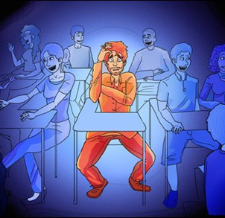
F40 Phobic anxiety disorders
F40.1 Social phobias
Onften starts at adolescence
Fear of being in the centre of attention of relatively small groups (compared to agoraphobia), fear of veing judged by the others
-> Avoidance of social situations, social isolation
Might be restricted to particular situations e.g. Public speaking, eating in public, tallking to people with opposite sex
Often associated with low self-esteen or fear of criticism

Slide 10
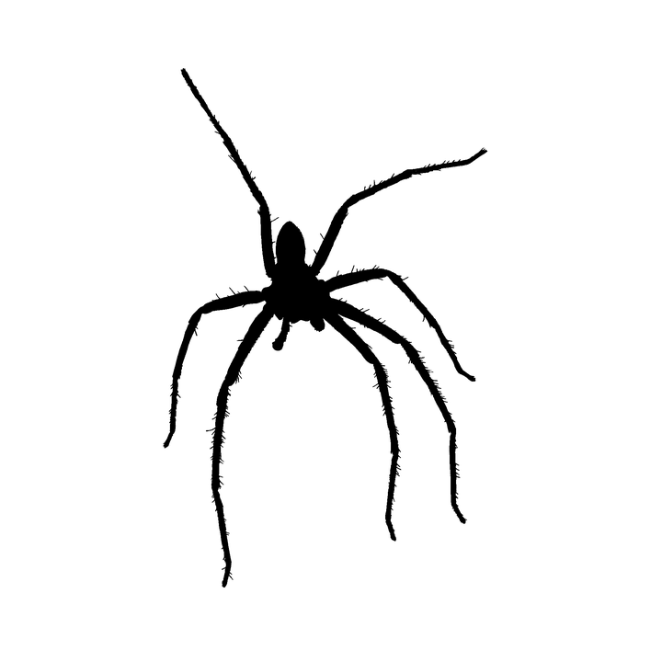
F40 Phobic anxiety disorders
F40.2 Specific phobias
Restricted to highly specific objects or situations
Specific animals, heights, thunder, flying, darkness, closed spaces, public toilets, specific food, diseases, medical procedures, …
Contact with the triger might evoke a panic reaction

Slide 11
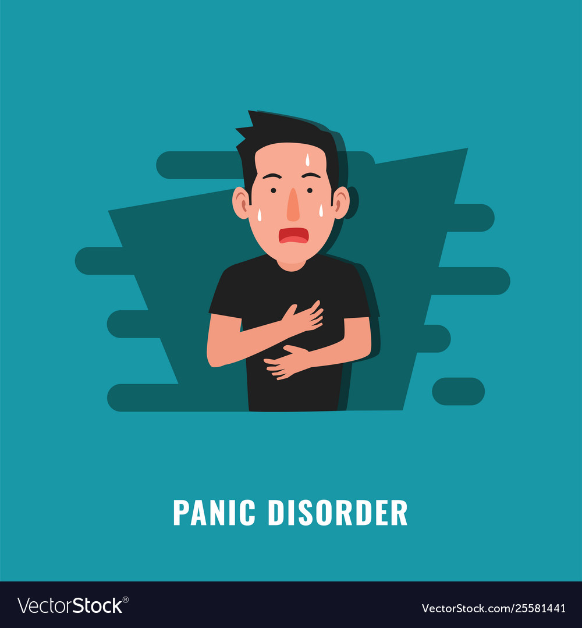
F41 Other anxiety disorders
Manifestations of anxiety which are not restricted to particular environmental situations.
F41.0 Panic disorder
- Recurrent attacks of severe anxiety – so called panic attacks
Panic attack:
-sudden onset of palpitations, chest pain, choking sensations, dizziness, and feelings of unreality
- Fear of dying, losing control, or going mad
- might last for minutes, sometimes longer, frequency is variable

Slide 12
Panic circle

Slide 13
„Panic“ <- god Pan

Slide 14
Managing panic attacks
Breathing – exhallation longer than inhalation
– breathe in – hold - breathe out
Racionalization - Education + ensurance that it is just a panic attack – scientific thinking
Attention - Focus the attention to any pleasant activity, on a subject
Relaxation . Mindfullnes, relaxation techniques, grounding techniques, muscles relaxation techniques
Light exercise, walk
Imagination - something good, safe place
Benzodiazepines

Slide 15
Practical exercise

Slide 16
Mobile phone apps
First help?

Slide 17
F41 Other anxiety disorders
F41.1 Generalized anxiety disorder
- anxiety is generalized and persistent
- feelings of nervousness, trembling, muscular tension, sweating, lightheadedness, palpitations, dizziness, and epigastric discomfort are common
- fears that the sufferer or a relative will shortly become ill or have an accident are common

Slide 18
F41 Other anxiety disorders
F41.2 Mixed anxiety and depressive disordes
- symptoms of anxiety and depression are present but neither is severe enough to justify a separate diagnosis

Slide 19
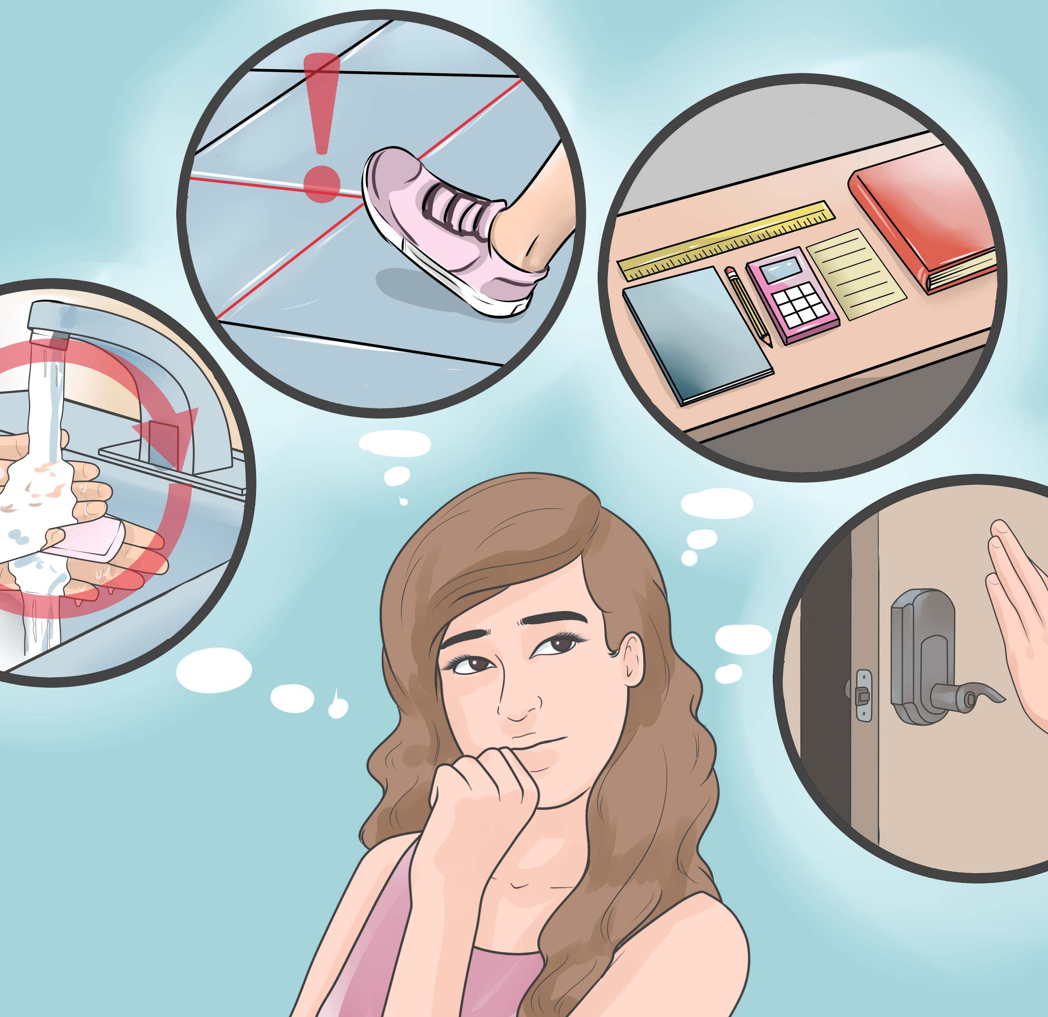
F42 Obsessive-compulsive disorder
Obsessional thoughts + compulsive acts
Obsessional thoughts are ideas, images or impulses that enter the individual's mind again and again in a stereotyped form
Compulsive acts or rituals are stereotyped behaviours that are repeated again and again.
Fear that if the compulsive act is not performed, the sufferer or their relatives die, get ill, hurt, …
Washing hands, cleaning, counting, checking the gass, locking, clapping, tapping, switching off the light jumping over the lines, …

Slide 20
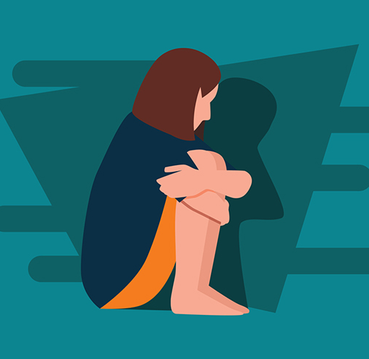
F43 Reaction to severe stress, and adjustment disorders
F43.0 Acute stress reaction
- reaction to an exeptional severe physical or mental stressor (threat to the security of physical integrity of the individual or the relatives, e.g. natural catastrophe, accident, battle, criminal assault, rape)
- lasts days or hours, usually appears whithin minutes after the trigger
- feelings of daze, disorientation, forwarded to the trigger situation, signs of panic anxiety, agitation, over-aktivity, might be amnesia

Slide 21
How to help someone in the accute stress reaction?
Acute acute stress reaction – directive approach, lead the person out of the danger
Panic symptomes – guided breathing, eye contact, tactile contact
Follow up symptomes – be present, attenging, assurance of being there for the person
Forbidden phrases: „It is good“ „It is going to be god, better.“ „You can handle it.“

Slide 22
F43 Reaction to severe stress, and adjustment disorders
F43.1. Post-trauamtic stress disorder
Delayed or protracted response to stressful event or situation of exceptionally threatening or catastrophic nature (nature disadters, witnessing violent death of others, being victime of torture, terrorism, rape,…)
Symptoms: flashbacks, dreams about the event, emotional blunding, deatachment from other people, anhedonia, avoidance of activities and situations reminiscent of the trauma

Slide 23
Treatment
Therapy:
CBT, psychodinamic approaches – anxiety diorders
Hummanistic approaches, CBT – PTSD
Medication: antidepressants, anxiolytics

Slide 24
F44 Dissociative (conversion) disorders
Partial or complete loss of the normal integration between memories and the past, awareness of identity,
Immediate sensations and control of bodily movements.
F44.0 Dissociative amnesia
- Memory loss of important events which is not due to the organic mental disorder
- usually after traumatic or highly stressfull events
F44.1 Dissociative fugue
- all the features of dissociative amnesia + journey away from home of workplace,
in some cases a new identity may be assumed
- usually one of few days, occasionally longer
- places emocionally important, known
F44.2 Dissociative stupor
- stupor without any soamtic cause
- absence of voluntary movement
- minutes to days
And other dissociative disorders of movements, behaviour and cognitive functions

Slide 25
F45 Somatoform disorders
Repeated rpesentation of physical symptoms, persisting requests for medical investigations in spite of repeated negative findings
F45.0 Somatization disorder
- multiple, recurrent and frequently changing physical symptoms, which are present for several years
- long and complicated medacal history before the aptient visits psychiatrist or psychologist
- symptoms usually referred to any part of the body, often gastrointestinal sensations, abnormal skin sensations, sexual and menstrual complaints, chest or breathing problems

Slide 26
F45 Somatoform disorders
45.2 Hypochondrical disorder
- persistant preoccupation with the possibility of having one or more serious and progressive physical disorders and persistant somatic complaints
- normal sensations are interpreted by patient as abnormal and distressing
- when a possibility of particular physical disorder is rejected, the attention is usually moved to another potentional diagnosis

Slide 27
F45 Somatoform disorders
F45.3 Somatoform autonomic dysfunction
- symptoms are presented by the patient as if they were due to a physical disorder of a system or organ that is largely or completely under autonomic innervation and control, i.e. the cardiovascular, gastrointestinal, or respiratory system.
- e.g. Sweating, aches and pains, palpitations, flushing, tremor
- often associated with mental stress

Slide 28
F45 Somatoform disorders
F48.0 Neurastenia
- increased fatique after mental effort or coping with daily tasks, empahis on feelings of bodily or physical weakness and exhaustion after only minimal effort, muscular aches, pain, sleep disturbtion, hypersomnia,

Slide 29
Thank you for the attention ☺

Slide 30
References:
Carlbrig, P. (2004). Panic! Its prevalence, diagnostics and treatment via the internet. [doctoral dissertation thesis, University of Uppsala] https://www.researchgate.net/publication/224881366_Panic_Its_prevalence_diagnosis_and_treatment_via_the_internet
Legg, T. J. (2018, December 7). 11 ways to stop a panic attack. Healthline. https://www.healthline.com/health/how-to-stop-a-panic-attack
Nosková, E., Stopková, P., & Šebela, A. (2017). Aktuální trendy v terapeutickém přístupu v úzkostných poruchách. Psychiatrie pro praxi, 18(3), 106-113.
Práško, J. (2012). Úzkostné poruchy: Klasifikace, diagnostika a léčba. Portál.
Scheinbaum, S. (2012). How to give clients the skills to stop panic attacks. Jessica Kingsley Publishers.
World Health Organization. (1992). The ICD-10 classification of mental and behavioural disorders: Clinical descriptions and diagnostic guidelines. World Health Organization

